Slide 2
Renal Module 2nd Year MBBS(Skill Lab) Histology of the Urinary Bladder
Presenter: DR . Sadia Baqir
(APWMO ) Date: - -25

Slide 4
Professor Umar Model of Integrated Lecture

Slide 5
Learning Objectives
At the end of this session, students should be able to:
Focus & Identify the histological slide of the urinary bladder.
Illustrate the microscopic picture of the urinary bladder.
List two points of identification of the urinary bladder.
Correlate clinical(Vertical integration).
Read research articles related to the topic.

Slide 6
Skill Lab Assessment
4-The muscularis layer of the urinary bladder is also called:
A. Submucosa B. Detrusor muscle C. Lamina propria D. Muscularis mucosae E. Adventitia
.5-What type of connective tissue is primarily found in the lamina propria of the bladder?
A. Dense regular connective tissue B. Reticular connective tissue C. Dense irregular connective tissue D. Adipose tissue E. Cartilage
6-In a contracted bladder, how does the urothelium appear?
A. Flattened and squamous-like B. Thinner than usual C. Folded with rounded surface cells D. Single-layered cuboidal E. Smooth and continuous
1- The epithelium lining the urinary bladder is best described as:
A. Simple squamous B. Stratified squamous non-keratinized C. Stratified cuboidal D. Transitional (urothelium) E. Pseudostratified columnar
2-The superficial cells of the urothelium are known as:
A. Columnar cells B. Dome cells C. Umbrella cells D. Brush cells E. Squamous cells
3. Which feature allows the bladder epithelium to resist toxicity from urine?
A. Absence of tight junctions B. Thin basement membrane C. Presence of mucous glands D. Specialized plasma membrane of umbrella cells E. Keratinization

Slide 7
Skill Lab Assessment
.Which of the following is NOT true about umbrella cells?
A. They contain specialized plaques in their membrane B. They are multinucleated C. They can change shape with bladder distention D. They help form a permeability barrier E. They are the most superficial cells of the urothelium
8. The urothelium can resist stretching because of:
A. Collagen fibers in lamina propria B. The elasticity of umbrella cells C. Long microvilli D. Intercalated discs E. Fibrocartilage
9. The urinary bladder lacks which of the following layers seen in other parts of the GI tract?
A. Lamina propria B. Submucosa C. Mucosa D. Muscularis externa E. Serosa/adventitia
10. What type of muscle tissue is found in the detrusor muscle?
A. Skeletal muscle B. Cardiac muscle C. Smooth muscle D. Mixed skeletal and cardiac E. Myoepithelial cells

Slide 8
Skill Lab Assessment key
1- The epithelium lining the urinary bladder is best described as:
A. Simple squamous B. Stratified squamous non-keratinized C. Stratified cuboidal D. Transitional (urothelium) E. Pseudostratified columnar
2-The superficial cells of the urothelium are known as:
A. Columnar cells B. Dome cells C. Umbrella cells D. Brush cells E. Squamous cells
3. Which feature allows the bladder epithelium to resist toxicity from urine?
A. Absence of tight junctions B. Thin basement membrane C. Presence of mucous glands D. Specialized plasma membrane of umbrella cells E. Keratinization
4-The muscularis layer of the urinary bladder is also called:
A. Submucosa B. Detrusor muscle C. Lamina propria D. Muscularis mucosae E. Adventitia
.5-What type of connective tissue is primarily found in the lamina propria of the bladder?
A. Dense regular connective tissue B. Reticular connective tissue C. Dense irregular connective tissue D. Adipose tissue E. Cartilage
6-In a contracted bladder, how does the urothelium appear?
A. Flattened and squamous-like B. Thinner than usual C. Folded with rounded surface cells D. Single-layered cuboidal E. Smooth and continuous

Slide 9
Skill Lab Assessment key
7.Which of the following is NOT true about umbrella cells?
A. They contain specialized plaques in their membrane B. They are multinucleated C. They can change shape with bladder distention D. They help form a permeability barrier E. They are the most superficial cells of the urothelium
8. The urothelium can resist stretching because of:
A. Collagen fibers in lamina propria B. The elasticity of umbrella cells C. Long microvilli D. Intercalated discs E. Fibrocartilage
9. The urinary bladder lacks which of the following layers seen in other parts of the GI tract?
A. Lamina propria B. Submucosa C. Mucosa D. Muscularis externa E. Serosa/adventitia
10. What type of muscle tissue is found in the detrusor muscle?
A. Skeletal muscle B. Cardiac muscle C. Smooth muscle D. Mixed skeletal and cardiac E. Myoepithelial cells

Slide 10
Interactive Session
Patient: Sara M., a 24-year-old female Complaint: "Burning sensation when I pee and lower abdominal pain for two days." History: No prior UTIs. Recently began using a new brand of intimate wash. No fever. Physical Exam: Suprapubic tenderness. No costovertebral angle tenderness.
Urinalysis:
Positive for leukocyte esterase and nitrites
Presence of white blood cells and bacteria
No casts
Diagnosis: Acute uncomplicated cystitis (likely E. coli)

Slide 11
Gross Anatomy of the Urinary Bladder

Slide 12
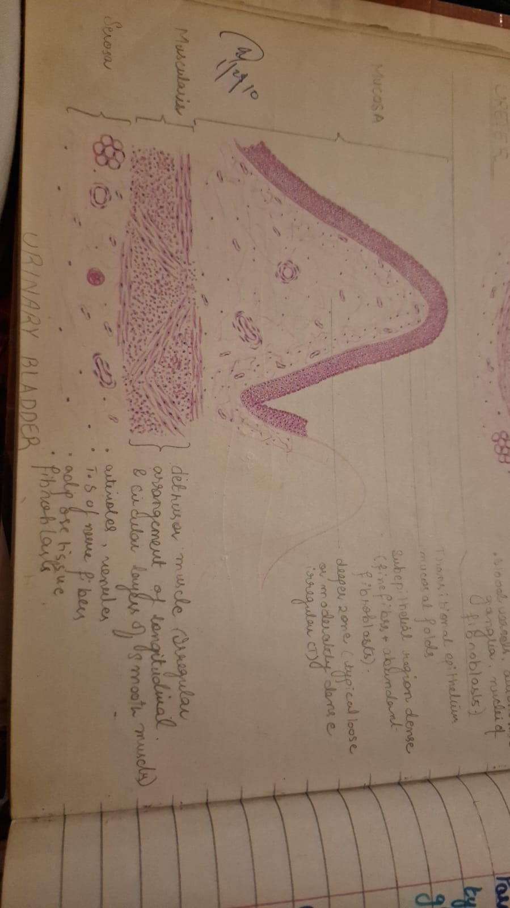
Urinary bladder
Core Knowledge

Slide 13
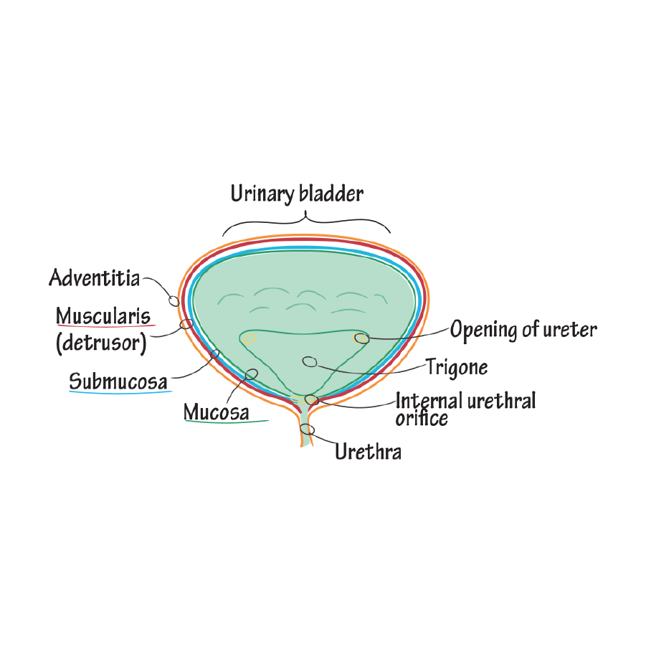
Identification Points of Urinary bladder
Transitional epithelium.
Smooth muscle bundles.

Slide 14
Vertical Integration
Clinical Correlates
Interstitial Cystitis (IC/BPS): Self-Care Treatment

Slide 15
Interactive session
The urinary bladder is lined by transitional epithelium (urothelium), which:
Has 3 layers: basal (cuboidal), intermediate (polygonal), and superficial cells (umbrella cells)
Is specialized to stretch and resist toxicity from urine
Has an underlying lamina propria and detrusor muscle (smooth muscle layers)
In acute cystitis:
The urothelium may appear intact but is often infiltrated by neutrophils
Lamina propria shows vascular congestion and dense inflammatory infiltrate (mostly neutrophils)
In severe cases, the umbrella cells may slough off, exposing the basal layers
You might see edema and ulceration

Slide 16
The protective role of the urothelium (especially umbrella cells) is crucial in resisting infection.
Short female urethra and potential irritants (e.g., harsh soaps, new hygiene products) can predispose to infection.
The detrusor muscle is often normal unless there's chronic inflammation or obstruction.
Mnemonic: "FIRE U" – features of acute cystitis histology
F – Fibrin/debris in lumen
I – Infiltration by neutrophils
R – Reactive hyperplasia of urothelium
E – Edema in lamina propria
U – Umbrella cells exfoliated

Slide 17
Spiral Integration
Research Article
Investigating the epidemiology of community-onset lower urinary tract infections
Aryee, Anna Maria Amanuah; (2022) Investigating the epidemiology of community-onset lower urinary tract infections. Doctoral thesis (Ph.D), UCL (University College London).
Abstract
The rise of antibiotic resistance (ABR), the ability of bacteria to resist the activity of antibiotics, is a threat to patient care. In the UK, there has been a consistent increase in the numbers and proportions of antibiotic resistant infections. Strong evidence exists of a link between antibiotic prescribing and ABR, and interventions have focused on improved and reduced antibiotic prescribing. Urinary tract infection (UTI) is the commonest bacterial community-onset infection, and improved prescribing is an important focus for reducing ABR. In chapter one I give an overview of ABR in England. I provide a background to the clinical presentation, spectrum of disease and microbiological diagnosis of UTI, and set out the rationale for the thesis. In chapter two I describe the data sources used for the studies presented in chapters 3, 4 and 6. In chapter three I present a retrospective cohort study using linked primary care, secondary care and microbiology data investigating the risk factors for hospitalisation (urinary infection-related and all-cause) following consultation for community-onset lower UTI (COLUTI) in primary care. In chapter four I present a retrospective cohort study using linked primary care, secondary care and microbiology data from patients treated for cultureconfirmed COLUTI. I investigate the effect of discordant antibiotic treatment (treatment to which the urine culture organism was resistant) on urinary infection-related hospital admission and reconsultation in primary care. In chapter five I present a systematic review of the risk factors for communityonset Escherichia coli bloodstream infection. In chapter six I present a retrospective cohort study of patients admitted to hospital with community-onset Gram-negative bloodstream infection, examining the effect of discordant empirical antibiotic therapy on in-hospital death and ICU admission. In chapter seven I summarise my research findings, discuss the limitations of the thesis, highlight the practice and policy implications and suggest future research priorities.

Slide 18
Learning Resources
Junqueira’s Basic Histology 13th Edition,
Histology, A Text and Atlas by Michael H. Ross 7th Edition
DiFiore's Atlas of Histology with Functional Correlations, 11th Edition, Google images

Slide 19
THANK YOU

