Slide 2
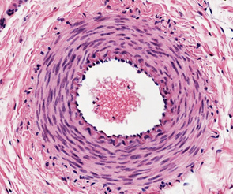
CVS (LGIS) Capillaries
Presenter:
Dr. Mohtasham Hina

Slide 3
Vision; The Dream/Tomorrow
Motto
To impart evidence based research oriented medical education
To provide best possible patient care
To inculcate the values of mutual respect and ethical practice of medicine
Wisdom
Truth
Service

Slide 4
Professor Umar Model of Integrated Lecture

Slide 5
Learning Objectives
At the end of lecture 1st year students should be able to
Describe the general histological structure of capillaries
Tabulate histological differences between capillaries
Correlate clinical aspects
Read a research article
Use digital library
Discuss classification of capillaries

Slide 6
Interactive Session
Vertical Integration
Intercellular junctions of post-capillary venules are the loosest among all microvasculature. During inflammatory conditions, these sites lead to edema due to this reason

Slide 7
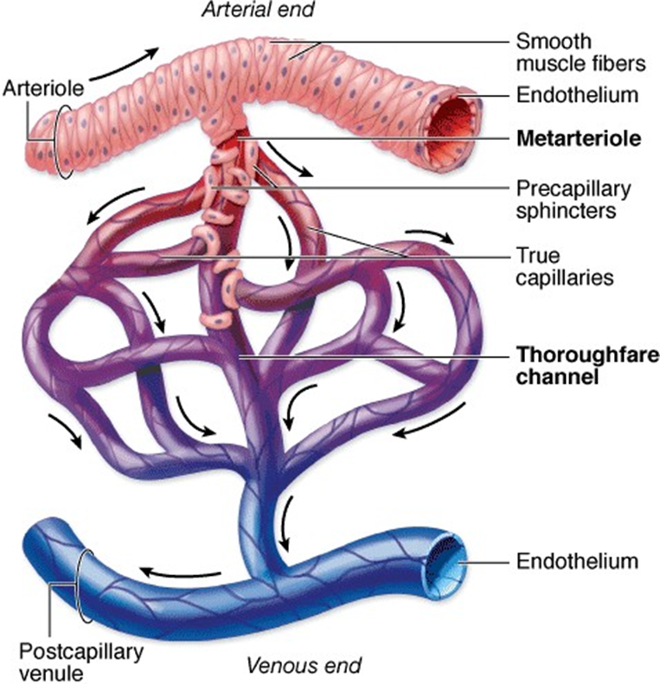
Capillary Bed
Core Concept

Slide 8
Capillaries
Core Concept
5-10 nm
Continuous capillaries
Fenestrated capillaries
Discontinuous capillaries

Slide 9
Capillaries
Core Concept

Slide 10
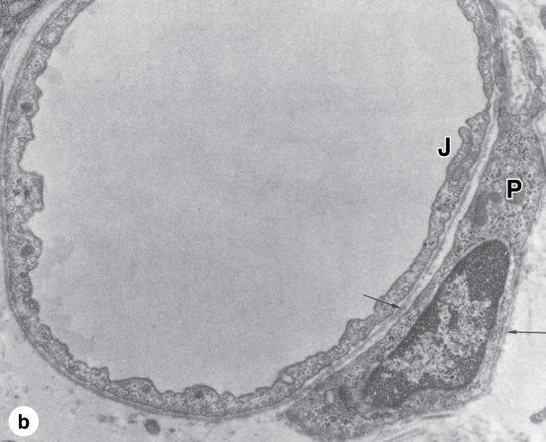
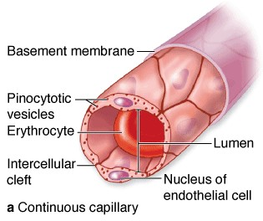
Continuous Capillaries
Core Concept
Tight junctions
No space between intercellular clefts
Continous basal lamina
Numerous pinocytotic vesicles
Pericytes
Skin, kidney, muscles, brain

Slide 11
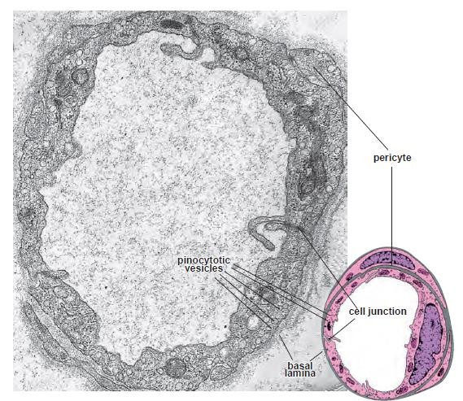
Continuous Capillaries
Core Concept

Slide 12
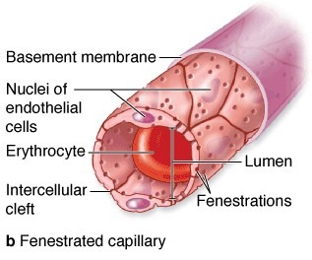
Fenestrated Capillaries
Core Concept
More extensive cellular exchange of materials
Small circular fenestrations
Diaphragm covering the fenestrations (proteoglycans, lack lipid bilayer)
Continous basal lamina
Intestine, choroid
plexus, endocrine glands

Slide 13
Fenestrated Capillaries
Core Concept

Slide 14
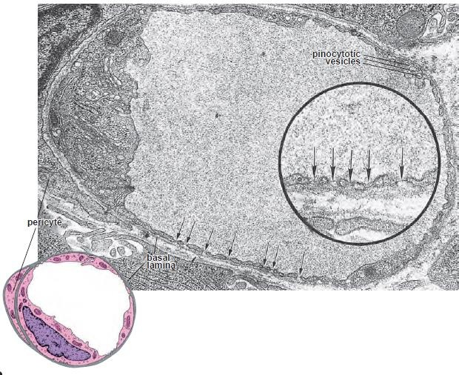
Capillaries
Core Concept

Slide 15
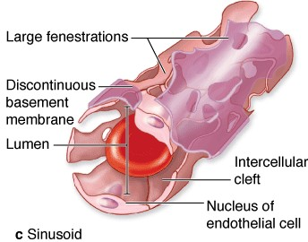
Discontinuous Capillaries
Core Concept
Sinusoids
Irregular shape diameter 30-40nm
Maximal exchange of macromolecules
Large fenestrations
No diaphragm
Discontinuous basal lamina
Liver, spleen, bone marrow

Slide 16
Capillaries
Vertical Integration

Slide 17
Vertical Integration
Family Medicine
Intercellular junctions of post-capillary venules are the loosest among all microvasculature. During inflammatory conditions, these sites lead to edema due to this reason

Slide 18
Vertical Integration
Bio Ethics

Slide 19
Research article
Spiral Integration
Research
Capillary cell-type specialization in the alveolus
https://www.nature.com/articles/s41586-020-2822-7
we use single-cell analysis to elucidate the cell types, development, renewal and evolution of the alveolar capillary endothelium. We show that alveolar capillaries are mosaics; similar to the epithelium that lines the alveolus, the alveolar endothelium is made up of two intermingled cell types, with complex ‘Swiss-cheese’-like morphologies and distinct functions. The first cell type, which we term the ‘aerocyte’, is specialized for gas exchange and the trafficking of leukocytes, and is unique to the lung. The other cell type, termed gCap (‘general’ capillary), is specialized to regulate vasomotor tone, and functions as a stem/progenitor cell in capillary homeostasis and repair. The discovery of cell type specialization in alveolar capillaries transforms our understanding of the structure, function, regulation and maintenance of the air–blood barrier and gas exchange in health, disease and evolution.

Slide 20
How To Access Digital Library
Go to the website of HEC National Digital Library.
On Home Page, click on the INSTITUTES.
A page will appear showing the universities from Public and Private Sector and other Institutes which have access to HEC National Digital Library HNDL.
Select your desired Institute.
5. A page will appear showing the resources of the institution
6. Journals and Researches will appear
7. You can find a Journal by clicking on JOURNALS AND DATABASE and enter a keyword to search for your desired journal.

Slide 21
Learning Resources
Junqueira’s Basic Histology 12th Edition, Chapter 11
Histology , A text and Atlas by Michael H.Ross 6th Edition, Chapter 13
Google scholar

Slide 22
