Slide 3
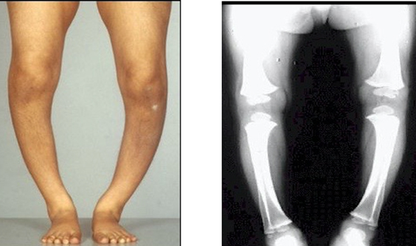
RICKETS AND OSTEOMALACIA
Dr. Muhammad Umer
MBBS, FCPS (MED) Senior Registrar MU1
Holy Family Hospital RWP

Slide 4
DEFINITION
CORE CONCEPT
Osteomalacia is defective mineralization of newly formed bone matrix or osteoid.
Rickets is defective mineralization at the epiphyseal growth plate and is found in association with osteomalacia in children.

Slide 5
ETIOLOGY
CORE CONCEPT
Many factors can result in defective mineralization of the osteoid.
For normal mineralization, adequate levels of vitamin D, calcium and phosphate, adequate activity of alkaline phosphatase, a normal PH at the osteoid surface and normal osteoid composition are all necessary.
The most common cause of osteomalacia is hypophosphataemia due to hyperparathyroidism secondary to vitamin D deficiency.

Slide 6
CORE CONCEPT
The most common cause of vitamin D deficiency worldwide is dietary deficiency.
Bread, milk and cereals in high- income countries are now fortified with vitamin D.
Vitamin D is produced in the skin through the action of sunlight on 7- dehydrocholesterol .
Lack of sun exposure can lead to vitamin D deficiency, especially in individuals living in temperate regions who keep large parts of the skin covered throughout the year.

Slide 7
CORE CONCEPT
Vitamin D is a fat- soluble vitamin, so gastrointestinal disease can result in malabsorption.
Gastrectomy, various forms of bariatric surgery, cystic fibrosis, coeliac disease, Crohn’s disease and primary biliary cirrhosis are well- recognized causes.
Due to the intimate involvement of the kidney in phosphate balance, a number of causes of osteomalacia are mediated by the kidney .
Primary renal phosphate wasting occurs in tumour- induced osteomalacia, multiple myeloma and Fanconi’s syndrome.
Proximal (type 2) renal tubular acidosis can cause osteomalacia due to both renal phosphate wasting and abnormal osteoid pH secondary to metabolic acidosis.

Slide 8
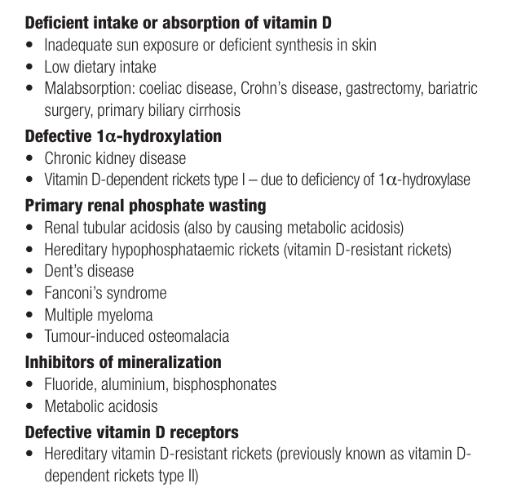
CAUSES OF RICKETS/OSTEOMALACIA
CORE CONCEPT

Slide 9
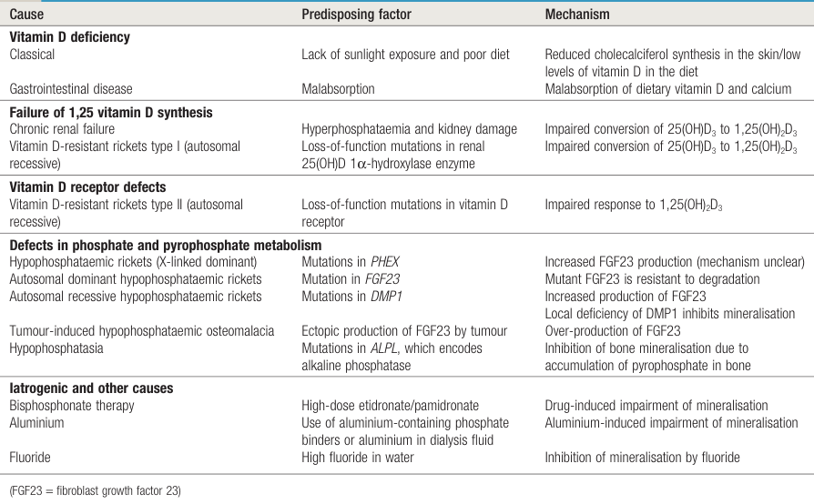
CAUSES OF RICKETS/OSTEOMALACIA
CORE CONCEPT

Slide 10
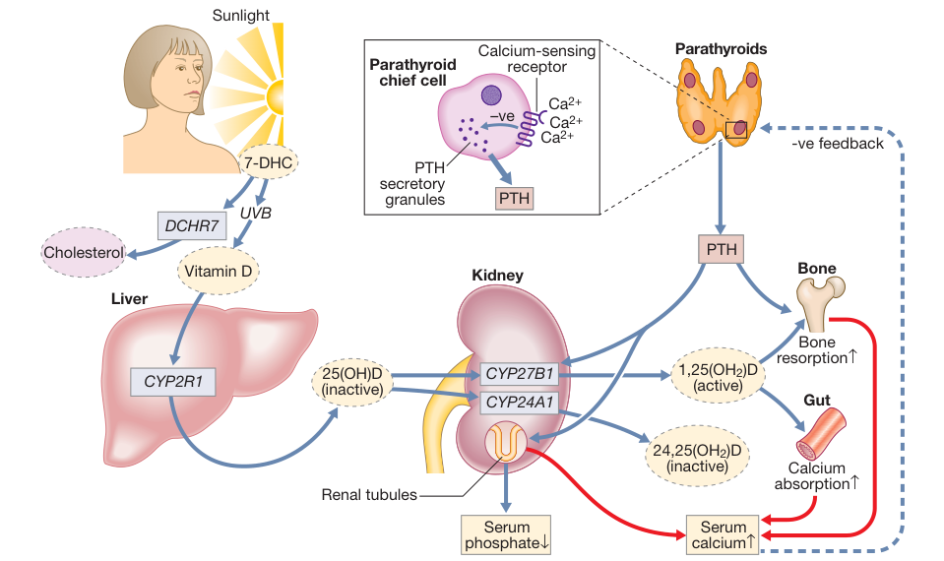
VITAMIN D METABOLISM
HORIZONTAL/ SPIRAL INTEGRATION

Slide 11
CLINICAL FEATURES
VERTICAL INTEGRATION
Osteomalacia may be asymptomatic and identified incidentally on routine investigations following a fragility fracture.
When symptomatic, it characteristically causes muscle weakness and widespread bone pain.
Muscle weakness is due to a multifactorial proximal myopathy.
It results in a characteristic waddling gait with difficulty climbing stairs and getting out of a chair.

Slide 12
VERTICAL INTEGRATION
At birth, neonatal rickets may present as craniotabes (a thin, deformed skull).
In the first few years of life, there may be widened epiphyses at the wrists and beading at the costochondral junctions, producing the ‘rickety rosary’, or a groove in the rib cage (Harrison’s sulcus).
In older children, lower limb deformities are seen.
A myopathy may also occur.
Hypocalcaemic tetany may occur in severe cases.

Slide 13
INVESTIGATIONS
VERTICAL INTEGRATION
Serum alkaline phosphatase is elevated in 90% of cases.
Low serum calcium, low phosphate and elevated PTH are each present in approximately half of the cases.
Serum 25-hydroxyvitamin D3 is low, usually less than 25 nmol/L(10 ng/mL).
Serum FGF- 23 is elevated in many people with tumour- induced osteomalacia and in hypophosphataemic rickets.

Slide 14
VERTICAL INTEGRATION
Plain radiographs demonstrate decreased bone mineralization.
The characteristic finding in osteomalacia is Looser’s pseudofractures.
These are narrow radiolucent lines with sclerotic borders running perpendicular to the cortex.
They can be found at any site but are most commonly seen in the femur and pelvis.
Tetracycline- labelled bone biopsy is the gold standard diagnostic test. This is not practical in most clinical settings and is used mainly in research studies.

Slide 15
RICKETS AND OSTEOMALACIA
VERTICAL INTEGRATION
XRAY FINDINGS: RICKETS Thickening and widening of epiphyses, Cupping of metaphysis, Wide metaphysis ,Bowing of diaphysis, Blurred trabeculae.

Slide 16
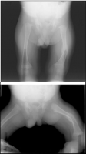
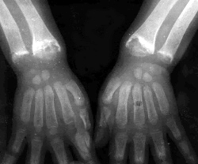
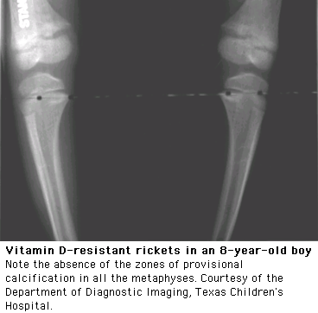

Slide 17
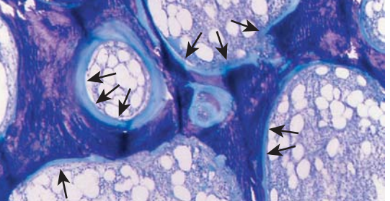
SPIRAL/HORIZONTAL INTEGRATION
Photomicrograph of bone biopsy from an osteomalacic patient showing thick osteoid seams (stained light blue, arrows) that cover almost all of the bone surface. Calcified bone is stained dark blue.

Slide 18
MANAGEMENT
VERTICAL INTEGRATION
Vitamin D replacement is the cornerstone of treatment.
Treatment involves two stages:
An initial loading stage to replenish body stores of vitamin D, and a subsequent maintenance phase to avoid repeat deficiency .
All patients should also receive supplementary calcium of 1000–1200 mg/day.
In nutritional deficiency, recommended initial replacement is with vitamin D 50,000 units per week orally.
The initial replacement dose should be continued for6–8 weeks.

Slide 19
VERTICAL INTEGRATION
Vitamin D is also available as an intramuscular injection;
two doses of 300,000 units are usually enough to replenish body stores.
Adequacy of vitamin D replacement should be confirmed by repeat measuring of vitamin D levels.
This should be followed by maintenance supplementation with 800–1000 units of vitamin D per day.
Doses for children are lower and are age- dependent.

Slide 20
VERTICAL INTEGRATION
People with gastrointestinal disease and vitamin D deficiency due to malabsorption need higher doses of 10,000–50,000 units per day of vitamin D.
Tumour-induced osteomalacia is best treated by removal of the causative neoplasm, which is usually occult and frequently benign. This leads to rapid resolution of symptoms.

Slide 21
SPIRAL INTEGRATION

Slide 22
FURTHER READING
Elder CJ, Bishop NJ. Rickets. Lancet 2014; 383:1665–1676.
Pearce SH, Cheetham TD. Diagnosis and management of vitamin D deficiency. BMJ 2010; 340:b5664.

Slide 23
POLYARTHRITIS

Slide 24
Arthritis vs Arthralgia
CORE CONCEPT
Joint pain
Inflammatory
Swelling
Redness
Tenderness
Limitation of range of motion
Stiffness
Joint pain
Non inflammatory
Pain without swelling, redness

Slide 25
CORE CONCEPT
Monoarthritis: is defined as the involvement single joint.
Oligoarthritis: is defined as the involvement of 2-4 joints or joint groups (the wrist has many joints but counts as a single site).
Polyarthritis: is defined as the involvement of five or more joints or joint groups.

Slide 26
CAUSES
CORE CONCEPT
Monoarthritis | Oligoarthritis | Polyarthritis
Septic arthritis | Reactive arthritis | Rheumatic arthritis
Trauma | Psoriatic arthritis | Psoriatic arthritis
Gout | Ankylosing spondylitis | Systemic lupus erythromatosis
Pseudogout | Enteropathic arthritis | Mixed connective tissue disease
Osteoarthritis | Gonococcal arthritis | Chronic tophaceous gout
TB | Rheumatic fever
Malignancy | Juvenile inflammatory arthritis

Slide 30
TOOLS FOR EVALUATION OF JOINT PAIN
CORE CONCEPT
INCLUDES:
HISTORY
EXAMINATION
LAB TESTS/INVESTIGATIONS

Slide 31
CLINICAL ASSESSMENT
VERTICAL INTEGRATION
The hallmarks of inflammatory arthritis are early-morning stiffness and worsening of symptoms with inactivity, along with synovial swelling and tenderness on examination.
The pattern of involvement can be helpful in reaching a diagnosis .
Clinical features in other systems can be helpful.
RA is characterized by symmetrical involvement of the small joints of the hands (metacarpophalangeal (MCP) and PIP joints) and feet, wrists, ankles and knees.

Slide 32
VERTICAL INTEGRATION
PsA is strongly associated with enthesitis. In PsA there may be involvement of the proximal and distal interphalangeal (PIP and DIP) joints.
Asymmetry, lower limb predominance, enthesitis and greater involvement of large joints are characteristic of the SpAs.
Inflammatory OA can appear similar to small-joint PsA in the pattern of joint involvement.
SLE can be associated with polyarthritis but more usually causes polyarthralgia and tenosynovitis, mainly of distal limb joints/tendons.

Slide 33
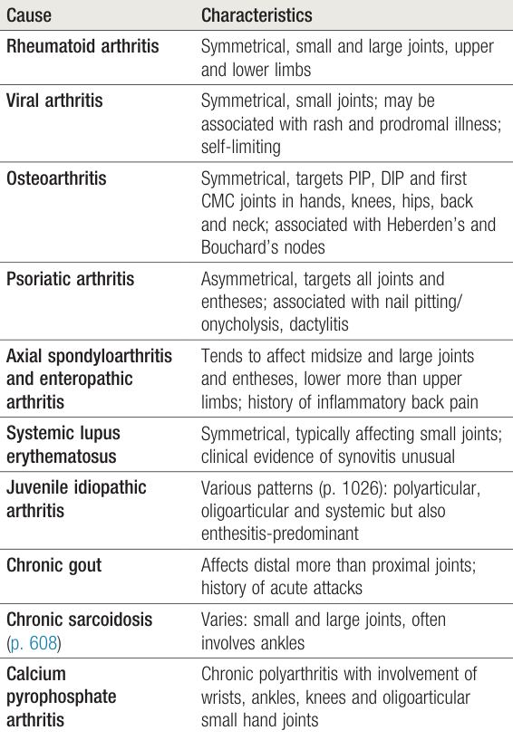

Slide 34
INVESTIGATIONS
VERTICAL INTEGRATION
Blood samples should be taken for routine hematology, bio-chemistry, ESR, CRP, viral serology.
Immunological screen, including ANA, RF and ACPA.
Ultrasound examination or MRI may be required to confirm the presence of synovitis, if this is not obvious clinically.

Slide 35
MANAGEMENT
VERTICAL INTEGRATION
Treatment with non-steroidal anti-inflammatory drugs (NSAIDs) and analgesics will help.
Systemic glucocorticoids can be considered if symptoms are very severe or having a great functional impact.
Early immunotherapy (DMARDs) is required in RA and in some cases of PsA.
An early accurate and specific diagnosis is very important.

Slide 36
LONGITUDINAL INTEGRATION

Slide 37
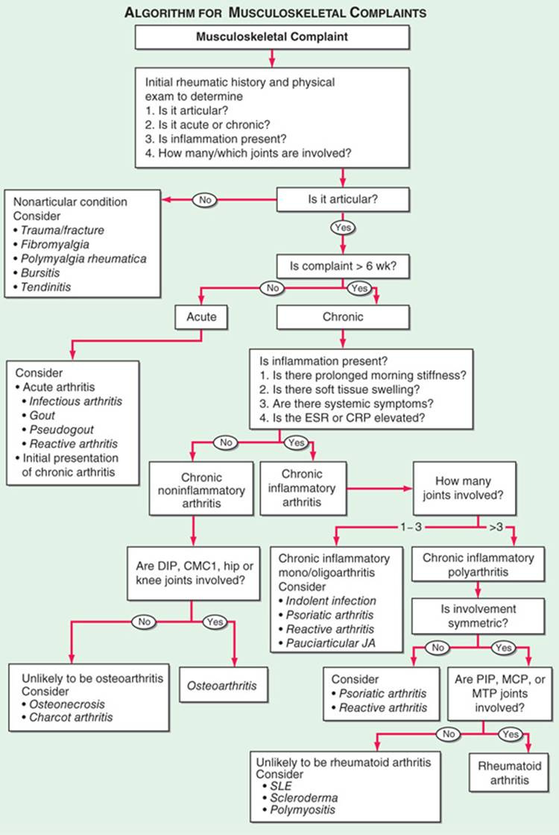
VERTICAL INTEGRATION

Slide 38
