Slide 2
Blood & Immunity Module(LGIS) LYMPH NODE
Presenter:
Dr. Mohtasham Hina

Slide 3
Vision; The Dream/Tomorrow
Motto
To impart evidence based research oriented medical education
To provide best possible patient care
To inculcate the values of mutual respect and ethical practice of medicine
Wisdom
Truth
Service

Slide 4
Professor Umar Model of Integrated Lecture

Slide 5
Learning Objectives
At the end of lecture 1st year students should be able to
Classify lymphoid tissue
Discuss the histological features of lymph node
Enlist functions of lymph node
Describe filtration through lymph node
Discuss importance of high endothelial venule
correlate clinical aspects
To understand bio-physiological aspect of skin
Read a research article
Use digital library

Slide 6
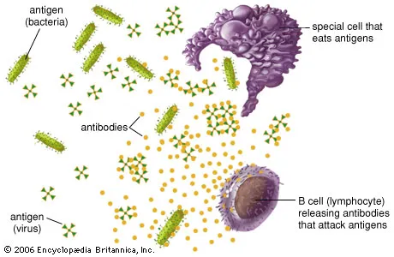
Immune System
Core Concept
Antigens:
A molecule that is recognized by cells of the immune system is called an antigen and typically elicits an immune response.
Antibody:
a glycoprotein of the immunoglobulin family that interacts specifically with an antigenic determinant (epitope)

Slide 7
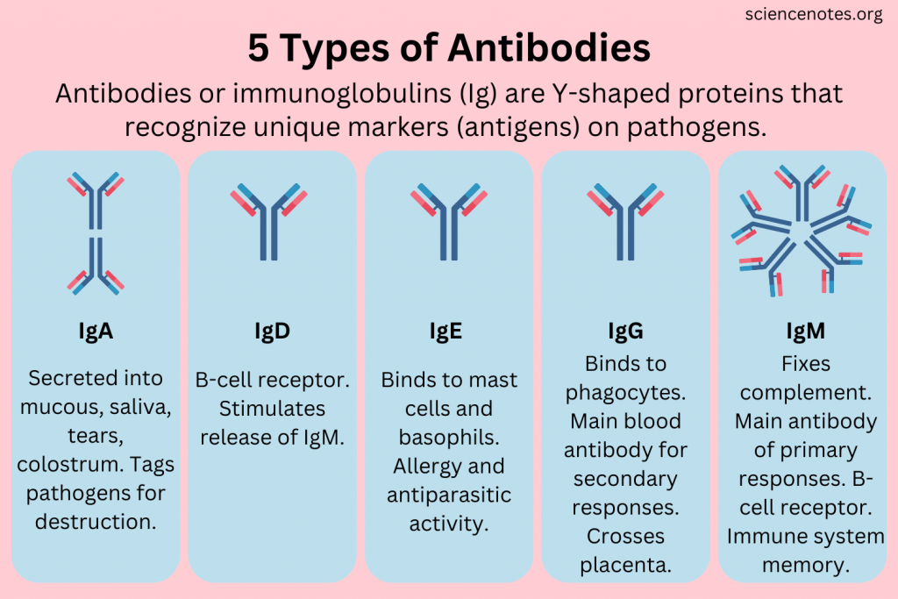
Horizontal Integration

Slide 8
Classes of Antibodies
Core Concept
IgG:
is the most abundant class representing 75% to 85% of the immunoglobulin in blood. Production increases during immune responses following infections, etc. Highly soluble
Stable (half-life >3 weeks)
Crosses the placental barrier into the fetal circulation. (This confers passive immunity against certain infections until the newborn’s own adaptive immune system is acquired)

Slide 9
Classes of Antibodies
Core Concept
IgA:
Present in almost all exocrine secretions.
Produced by plasma cells in mucosae of the digestive, respiratory, and reproductive tracts. Another protein bound to this immunoglobulin, the secretory component, is released by the epithelial cells
Present in milk, saliva, tears, and mucus coating the mucosae in which it is made

Slide 10
Classes of Antibodies
Core Concept
IgM:
constitutes 5% to 10% of blood immunoglobulin IgM is mainly produced in an initial response to an antigen.
IgE:
much less abundant in the circulation and exists bound to receptors on the surface of mast cells and basophils.
Increases in allergic reactions

Slide 11
Classes of Antibodies
Core Concept
IgD:
The least abundant immunoglobulin in plasma.
Bound to the surface of B lymphocytes where they act as antigen receptors in triggering B-cell activation.

Slide 12
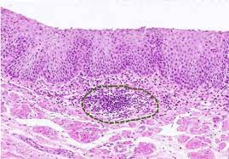
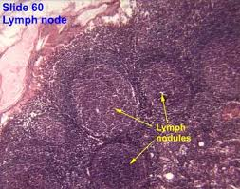
Lymphoid Tissue
Core Concept
Nodular
Diffuse

Slide 13
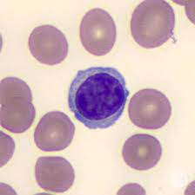
Nodular Lymphoid Tissue
Core Concept

Slide 14
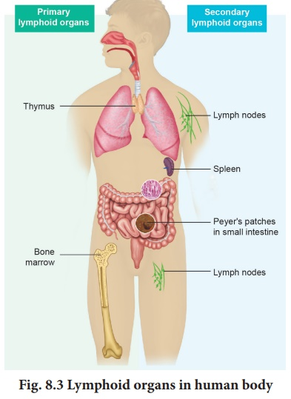
Core Concept

Slide 15
Lymphoid Organs
Core Concept
Lymph node
Tonsils
Thymus
Spleen
Gut associated lymphoid tissue (GALT)
Mucosa associated lymphoid tissue (MALT)

Slide 16
Lymph Node
Core Concept

Slide 17
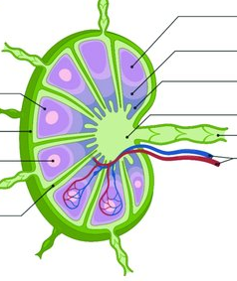
Panoramic view of lymph node
Core Concept

Slide 18
Cells Of Reticular Meshwork
Core Concept
Reticular cells
Dendritic cells
Follicular dendritic cells
Macrophages

Slide 19
Follicular Dendritic cell
Core Concept

Slide 20
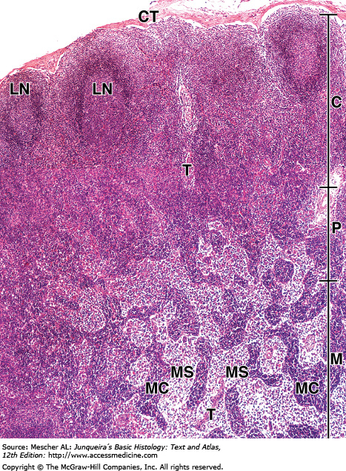
Lymph Node
Core Concept

Slide 21
Lymphatic nodule
Core Concept

Slide 22
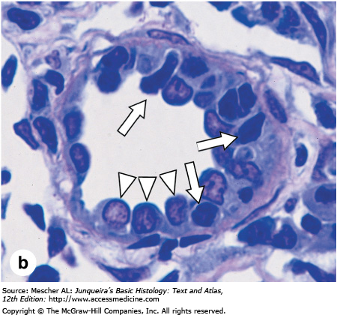
Paracortex

Slide 23
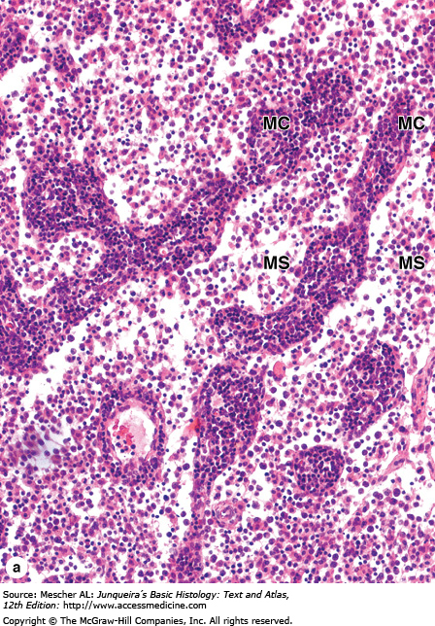
Medulla
Core Concept

Slide 24
Circulation Of Lymphocytes
Core Concept

Slide 25
Circulation of lymph
Core Concept

Slide 26
Lymphadenopathy
Family Medicine
Spiral Integration
A 15 years old boy presented with history of fever and sore throat. Now he noticed a painless swelling in the cervical region that gradually increased. General physical examination was unremarkable except a small, painless lump in right side of neck. Doctor made a diagnosis of lymphadenopathy due to recent viral infection

Slide 27
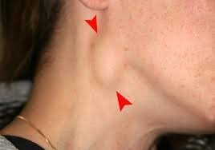
Lymphadenopathy
Family Medicine
Spiral Integration
Observation and Reassurance
Symptomatic Treatment:
pain and fever control
Adequate hydration
Rest
Monitoring
Avoid unnecessary antibiotics

Slide 28
Cancer Cell Metastasis (sentinel L.N.)
Family Medicine
Vertical Integration

Slide 29
Breaking Bad News
Spiral Integration
Bio Ethics
SPIKES Protocol
1. Setting up the Interview:
Environment: Choose a private, quiet place where you won’t be interrupted.
People: Ensure the patient has the option to have a family member or friend present.
Time: Allocate sufficient time for the conversation.
2. Assessing the Patient’s Perception:
Understanding: Start by asking the patient what they already know about their condition.
Clarify Misconceptions: Correct any misunderstandings gently.
3. Obtaining the Patient’s Invitation:
Permission: Ask the patient if they are ready to hear the details about their diagnosis.

Slide 30
Breaking Bad News
Bio Ethics
Spiral Integration
4. Giving Knowledge and Information:
Clear Language: Use simple, non-technical language.
Small Chunks: Provide information in manageable pieces.
Check Understanding: Frequently check if the patient understands what you are saying.
5. Addressing the Patient’s Emotions with Empathetic Responses:
Acknowledge Feelings: Recognize and validate the patient’s emotions.
Support: Offer emotional support and reassure them that they are not alone.
6. Summarizing and Strategizing:
Recap: Summarize the main points of the discussion.
Next Steps: Discuss the next steps in their care plan and provide resources for additional support

Slide 31
Progression of Metastasis through Lymphatic System
Research
Spiral Integration
https://pubmed.ncbi.nlm.nih.gov/?term=Lei%20Pj%5BAuthor%5D
Lymph nodes are the most common sites of metastasis in cancer patients. Nodal disease status provides great prognostic power, but how lymph node metastases should be treated is under debate. Thus, it is important to understand the mechanisms by which lymph node metastases progress and how they can be targeted to provide therapeutic benefits. In this review, we focus on delineating the process of cancer cell migration to and through lymphatic vessels, survival in draining lymph nodes and further spread to other distant organs. In addition, emerging molecular targets and potential strategies to inhibit lymph node metastasis are discussed.

Slide 32
How To Access Digital Library
Go to the website of HEC National Digital Library.
On Home Page, click on the INSTITUTES.
A page will appear showing the universities from Public and Private Sector and other Institutes which have access to HEC National Digital Library HNDL.
Select your desired Institute.
5. A page will appear showing the resources of the institution
6. Journals and Researches will appear
7. You can find a Journal by clicking on JOURNALS AND DATABASE and enter a keyword to search for your desired journal.

Slide 33
Learning Resources
Junqueira’s Basic Histology 12th Edition, Chapter 14
Histology , A text and Atlas by Michael H.Ross 6th Edition, Chapter 14
Google scholar
Progression of Metastasis through Lymphatic System
https://pubmed.ncbi.nlm.nih.gov/?term=Zhou%20H%5BAuthor%5D

