Slide 2
Reproduction Module 2nd Year MBBS(Skill Lab) Histology of Ovary , Uterus, & uterine Tubes
Presenter: DR . Sadia Baqir
(APWMO ) Date: - -25

Slide 4
Professor Umar Model of Integrated Lecture

Slide 5
Learning Objectives
At the end of this session, students should be able to:
Focus & Identify the histological slide of ovary, uterus, & uterine tubes.
Illustrate the microscopic picture of ovary, uterus, & uterine tubes.
List two points of identification ofovary, uterus, & uterine tubes.
Correlate clinical(Vertical integration).
Read research articles related to the topic.

Slide 6
Skill lab Assessment
1 Which of the following cells are responsible for estrogen production in the ovarian follicle? A. Theca interna cells B. Granulosa cells C. Theca externa cells D. Germ cells E. Corpus albicans cells
2. The corpus luteum is primarily formed from which of the following? A. Oogonia B. Theca externa C. Granulosa and theca interna cells D. Atretic follicle E. Zona pellucida
3. Which structure surrounds the oocyte in a developing follicle and serves as a barrier to sperm? A. Tunica albuginea B. Zona pellucida C. Antrum D. Corona radiata E. Cumulus oophorus
4. The outermost layer of the ovary is made up of which of the following? A. Germinal epithelium B. Zona pellucida C. Theca interna D. Corpus luteum E. Medulla
.5. Which layer of the uterus undergoes cyclic changes during the menstrual cycle? A. Myometrium B. Perimetrium C. Stratum functionalis of endometrium D. Stratum basalis of endometrium E. Cervical epithelium
6. . The myometrium of the uterus is primarily composed of which tissue type? A. Dense connective tissue B. Stratified squamous epithelium C. Elastic cartilage D. Smooth muscle E. Pseudostratified columnar epithelium

Slide 7
Skill lab Assessment key
4. The outermost layer of the ovary is made up of which of the following? A. Germinal epithelium B. Zona pellucida C. Theca interna D. Corpus luteum E. Medulla
.5. Which layer of the uterus undergoes cyclic changes during the menstrual cycle? A. Myometrium B. Perimetrium C. Stratum functionalis of endometrium D. Stratum basalis of endometrium E. Cervical epithelium
6. . The myometrium of the uterus is primarily composed of which tissue type? A. Dense connective tissue B. Stratified squamous epithelium C. Elastic cartilage D. Smooth muscle E. Pseudostratified columnar epithelium
1. Which of the following cells are responsible for estrogen production in the ovarian follicle? A. Theca interna cells B. Granulosa cells C. Theca externa cells D. Germ cells E. Corpus albicans cells
2. The corpus luteum is primarily formed from which of the following? A. Oogonia B. Theca externa C. Granulosa and theca interna cells D. Atretic follicle E. Zona pellucida
3. Which structure surrounds the oocyte in a developing follicle and serves as a barrier to sperm? A. Tunica albuginea B. Zona pellucida C. Antrum D. Corona radiata E. Cumulus oophorus

Slide 8
Skill lab Assessment
7. The endometrial glands are best described as: A. Straight tubular and non-secretory B. Simple tubular and secretory C. Coiled acinar and keratinized D. Stratified and serous E. Compound branched and non-secretory
8. During the secretory phase, the endometrium is characterized by: A. Thin lining and mitotic activity B. Shedding of surface epithelium C. Reduced glandular activity D. Highly coiled glands and stromal edema E. Predominantly straight glands with no secretion
9.Which of the following cell types in the uterine tube is primarily responsible for moving the oocyte toward the uterus? A. Peg cells B. Ciliated columnar epithelial cells C. Goblet cells D. Smooth muscle cells of the serosa E. Cuboidal mesothelial cells
10. The mucosa of the uterine tube is best described as: A. Smooth and lined with stratified squamous epithelium B. Flat with non-ciliated columnar cells C. Highly folded with ciliated and secretory columnar cells D. Lined with pseudostratified cuboidal epithelium E. Containing keratinized villi

Slide 9
Skill lab Assessment key
9.Which of the following cell types in the uterine tube is primarily responsible for moving the oocyte toward the uterus? A. Peg cells B. Ciliated columnar epithelial cells C. Goblet cells D. Smooth muscle cells of the serosa E. Cuboidal mesothelial cells
10. The mucosa of the uterine tube is best described as: A. Smooth and lined with stratified squamous epithelium B. Flat with non-ciliated columnar cells C. Highly folded with ciliated and secretory columnar cells D. Lined with pseudostratified cuboidal epithelium E. Containing keratinized villi
.7.The endometrial glands are best described as: A. Straight tubular and non-secretory B. Simple tubular and secretory C. Coiled acinar and keratinized D. Stratified and serous E. Compound branched and non-secretory
8. During the secretory phase, the endometrium is characterized by: A. Thin lining and mitotic activity B. Shedding of surface epithelium C. Reduced glandular activity D. Highly coiled glands and stromal edema E. Predominantly straight glands with no secretion

Slide 10
Interactive Session
In a 25-year-old woman presenting with irregular menstruation, hirsutism, and infertility.
Transvaginal ultrasound reveals enlarged ovaries with multiple subcapsular cystic follicles. . ovarian biopsy shows multiple peripheral cystic follicles with thickened theca interna. Histologically, the stroma appears hyperplastic, and normal corpus luteum formation is absent.
what can be cause?

Slide 11
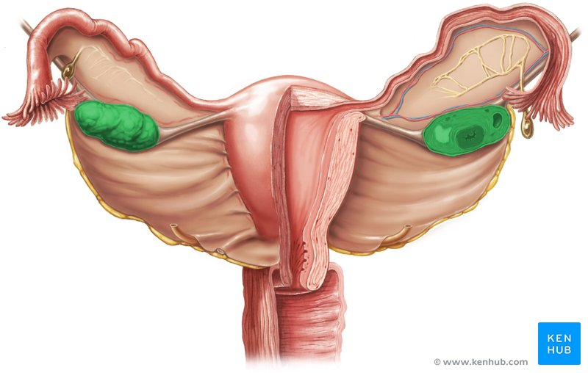
Gross Features of ovary
Core Knowledge

Slide 12
Core Knowledge
Histology of Ovary

Slide 13
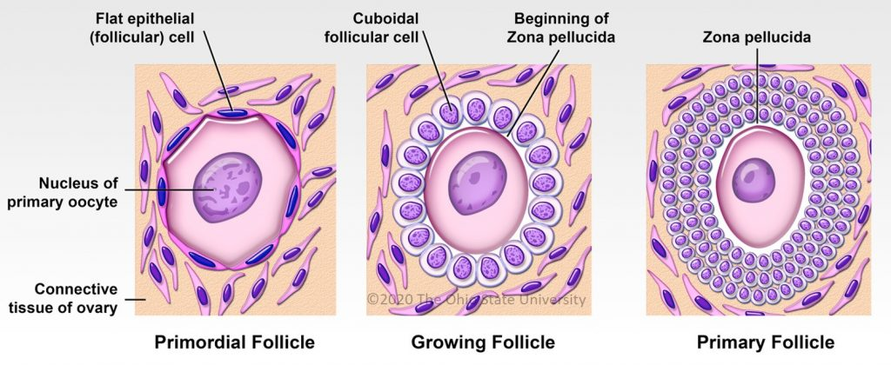

Slide 14
Identification Points of Ovary
Cuboidal surface germinal epithelium
Cortex
Thin fibrous sub-germinal dense stroma is Tunica albuginea
In cortex of mature ovary are embedded parenchymatous ovarian follicle in various developmental stages
Medulla
1. Loose fibro-elastic CT with blood vessels and nerves

Slide 15
Gross Anatomy of Uterine tube
Core Knowledge

Slide 16
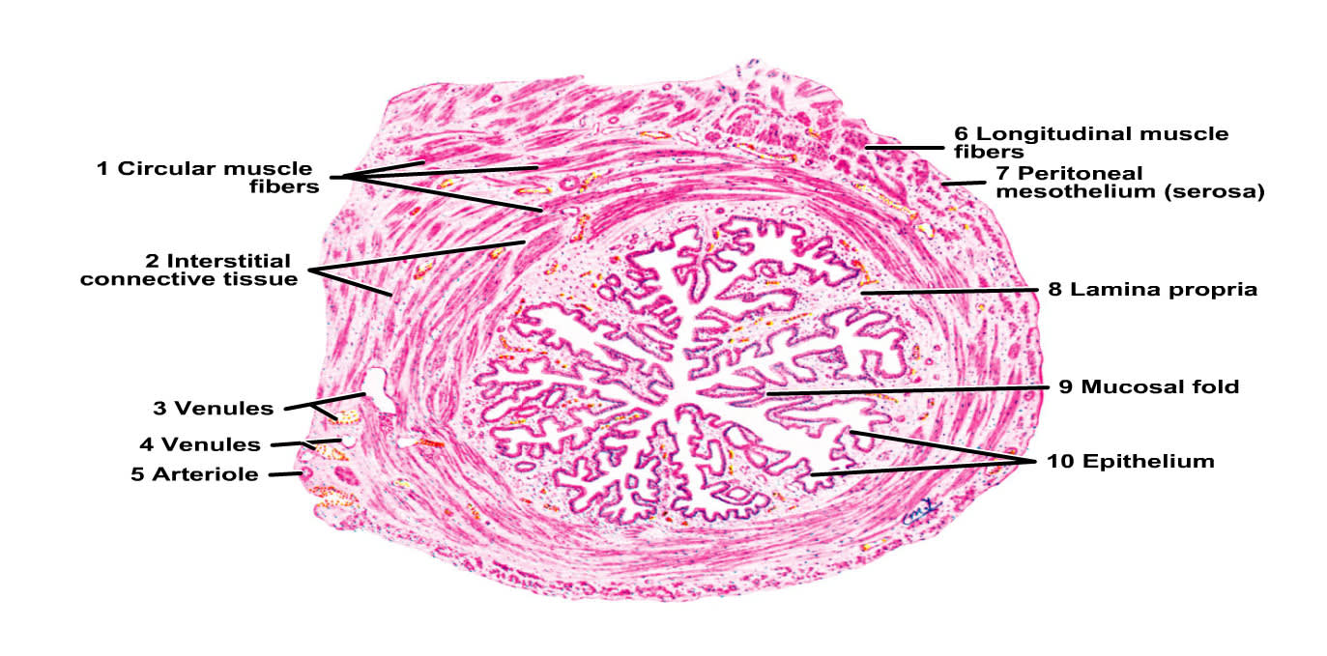
Uterine Tube (Fallopian end)

Slide 17
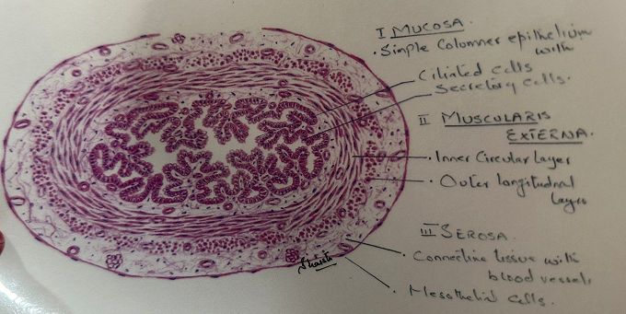

Slide 18
Points of identification (Uterine tube)
. Mucosa :-
Lumen is irregular due to mucosal folds
Epithelium is columnar ciliated/ non-ciliated
Basement membrane incomplete
Lamina propria consists of loose CT
2. Muscularis:-
Inner circular SM
Outer longitudinal SM
3. Serosa:-
Simple squamous epithelium

Slide 19
Gross anatomy of the Uterus

Slide 20
Histology of uterus

Slide 21
Endometrium ( Secretory phase)
Endometrium ( proliferative phase Phase)
Endometrium ( Menstrual Phase)

Slide 22
Points of identification of The Uterus
Inner layer/ mucosa/ Endometrium:- (Stratum functionalis 2/3rd– Stratum basalis)
Simple columnar epithelium (ciliated/ non-ciliated)
Lamina propria long simple tubular glands & branching decidual cells( fibroblasts)
2. Muscularis/ Myometrium:- Thickest coat
a. Innermost is longitudinal SM
b. Circular/ Spiral SM
c. Circular/ Spiral SM
d. Outermost is longitudinal SM
3. Perimetrium:-
Single layer of mesothelial cells supporte by thin CT

Slide 23
Vertical Integration
Clinical Correlates

Slide 24
Interactive session
Despite a normal-appearing transvaginal ultrasound, endometrial biopsy and hormonal workup raise suspicion for anovulation.
Histology reveals hyperplastic ovarian stroma and thickened theca interna, supporting a diagnosis of Polycystic Ovarian Syndrome.
These findings of PCOS are often linked to hormonal imbalance and anovulation.

Slide 25
Spiral Integration
Research Article
Changes in individual polycystic ovary syndrome phenotypical characteristics over time: a long-term follow-up study
Fertility and Sterility, Volume 117, Issue 5, May 2022, Pages 1059-1066
Jolanda van Keizerswaard, Alexandra L.P. Dietz de Loos, Yvonne V. Louwers, Joop S.E. Laven
objective
To assess the effects of aging on the features of polycystic ovary syndrome (PCOS).
Design Cohort study.
Setting a Tertiary care center.
Patient(s)
Women with PCOS, diagnosed according to the 2003 Rotterdam criteria, who visited our outpatient clinic repeatedly.
Intervention(s)
Comparisons were made between the first visit and consecutive visits.
Main Outcome Measure(s)
Change in PCOS phenotype groups in terms of clinical and endocrine characteristics.
Result(s)
A total of 596 women visited the outpatient clinic repeatedly. An estimated change per 5-year age showed a decrease in the prevalence of phenotype A and an increase in the prevalence of not having PCOS. The serum levels of testosterone, androstenedione, and dehydroepiandrosterone sulfate as well as the free androgen index decreased significantly. Clinical characteristics showed an increase in terms of body mass index and waist circumference, whereas plasma glucose levels, insulin levels, and insulin resistance did not change significantly.
Conclusion(s)
The prevalence of PCOS phenotype groups changes over time. There is an important age effect that indicates a more regular menstrual cycle, decrease in the serum androgen levels, and improvement in polycystic ovarian morphology when aging occurs in women with PCOS.
Cambios en las características del fenotipo individual del síndrome de ovario poliquístico a lo largo del tiempo: un estudio de seguimiento a largo plazo.

Slide 26
Learning Resources
Junqueira’s Basic Histology 13th Edition.
Histology, A Text and Atlas by Michael H. Ross, 7th Edition,
DiFiore's Atlas of Histology with Functional Correlations, 11th Edition,
Google images

Slide 27
THANK YOU

