Slide 2
Renal Module 2nd Year MBBS(Skill Lab) Histology of Kidney
Presenter: DR . Sadia Baqir
(APWMO ) Date: 24-2-25

Slide 4
Professor Umar Model of Integrated Lecture

Slide 5
Learning Objectives
At the end of this session, students should be able to:
Focus & Identify the histological slide of the Kidney.
Illustrate the microscopic picture of the Kidney.
List two points of identification of the kidney.
Correlate clinical(Vertical integration).
Read research articles related to the topic.

Slide 6
Skill Lab Assessment
1-Which part of the nephron is typically NOT found in the kidney cortex? A. Proximal convoluted tubule B. Distal convoluted tubule C. Loop of Henle (thin segment) D. Glomerulus E. Bowman's capsule 2- What is the main function of the juxtamedullary nephron? A. Reabsorption of glucose B. Secretion of hydrogen ions C. Concentration of urine D. Filtration of blood E. Activation of vitamin D 3- What distinguishes the proximal convoluted tubule (PCT) from the distal convoluted tubule (DCT) histologically? A. PCT has a wider lumen B. PCT has more mitochondria C. PCT has a brush border (microvilli) D. DCT has cuboidal epithelium E. DCT is surrounded by podocytes
4-Which hormone increases water permeability in the collecting ducts of the kidney? A. Aldosterone B. Antidiuretic hormone (ADH) C. Renin D. Atrial natriuretic peptide (ANP) E. Erythropoietin
5-Which cells form the visceral layer of Bowman’s capsule? A. Endothelial cells B. Podocytes C. Mesangial cells D. Juxtaglomerular cells E. Macula densa
6-What type of endothelium is found in glomerular capillaries? A. Simple squamous B. Fenestrated endothelium C. Stratified squamous D. Continuous endothelium E. Sinusoidal endothelium

Slide 7
Skill Lab Assessment key
1-Which part of the nephron is typically NOT found in the kidney cortex? A. Proximal convoluted tubule B. Distal convoluted tubule C. Loop of Henle (thin segment) D. Glomerulus E. Bowman's capsule 2- What is the main function of the juxtamedullary nephron? A. Reabsorption of glucose B. Secretion of hydrogen ions C. Concentration of urine D. Filtration of blood E. Activation of vitamin D 3- What distinguishes the proximal convoluted tubule (PCT) from the distal convoluted tubule (DCT) histologically? A. PCT has a wider lumen B. PCT has more mitochondria C. PCT has brush border (microvilli) D. DCT has cuboidal epithelium E. DCT is surrounded by podocytes
4-Which hormone increases water permeability in the collecting ducts of the kidney? A. Aldosterone B. Antidiuretic hormone (ADH) C. Renin D. Atrial natriuretic peptide (ANP) E. Erythropoietin
5-Which cells form the visceral layer of Bowman’s capsule? A. Endothelial cells B. Podocytes C. Mesangial cells D. Juxtaglomerular cells E. Macula densa
6-What type of endothelium is found in glomerular capillaries? A. Simple squamous B. Fenestrated endothelium C. Stratified squamous D. Continuous endothelium E. Sinusoidal endothelium

Slide 8
Skill Lab Assessment
7-Which of the following is NOT a component of the juxtaglomerular apparatus (JGA)? A. Macula densa B. Juxtaglomerular cells C. Mesangial cells D. Podocytes E. Lacis cells (extraglomerular mesangial cells) 8-Vasa recta are found primarily in which region of the kidney? A. Renal cortex B. Renal capsule C. Renal hilum D. Renal pelvis E. Renal medulla
9-Which of the following is true regarding diabetes insipidus? A. Caused by excess ADH B. Leads to glucose in urine C. Causes water retention D. Results from lack of ADH action E. Treated with insulin
10. Which of the following best describes transitional epithelium? A. Single layer of cuboidal cells B. Multilayered with ability to stretch C. Ciliated columnar cells D. Squamous keratinized cells E. Found only in the urethra

Slide 9
Skill Lab Assessment key
7-Which of the following is NOT a component of the juxtaglomerular apparatus (JGA)? A. Macula densa B. Juxtaglomerular cells C. Mesangial cells D. Podocytes E. Lacis cells (extraglomerular mesangial cells) 8-Vasa recta are found primarily in which region of the kidney? A. Renal cortex B. Renal capsule C. Renal hilum D. Renal pelvis E. Renal medulla
9-Which of the following is true regarding diabetes insipidus? A. Caused by excess ADH B. Leads to glucose in urine C. Causes water retention D. Results from lack of ADH action E. Treated with insulin
10. Which of the following best describes transitional epithelium? A. Single layer of cuboidal cells B. Multilayered with ability to stretch C. Ciliated columnar cells D. Squamous keratinized cells E. Found only in the urethra

Slide 10
Interactive Session
A 12-year-old boy presents with hematuria and periorbital edema two weeks after a streptococcal throat infection. A renal biopsy shows hypercellular glomeruli with neutrophilic infiltration and immune complex deposition. Which histological finding is most characteristic of post-streptococcal glomerulonephritis

Slide 12
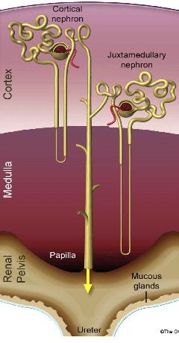
Biophysiological aspects of the kidney.

Slide 13
The shape and cross-sectional structure of the different parts of the tubules differ, according to their functions
1- Proximal convoluted tubule- a simple, tall cuboidal epithelium with a brush border (microvilli).
2- Loop of Henle,
This has a thick descending portion (pars recta), a thin descending portion, a thin ascending portion, and a thick ascending portion.The lumen is made up of simple squamous epithelium.
3- Distal convoluted tubule.
These tubules are less numerous than the PCT.
The epithelial cells are cuboidal, with very few microvilli.
The cells stain more palely than those of the PCT.
4-Collecting tubules are not part of the nephron.
The epithelium of these tubules consists of cuboidal or columnar cells. They empty into
5- collecting ducts that are easy to recognise, because they have large lumens, with pale staining columnar epithelium.

Slide 14
Glomerulus

Slide 17
Core Knowledge
Histology of Kidney

Slide 18
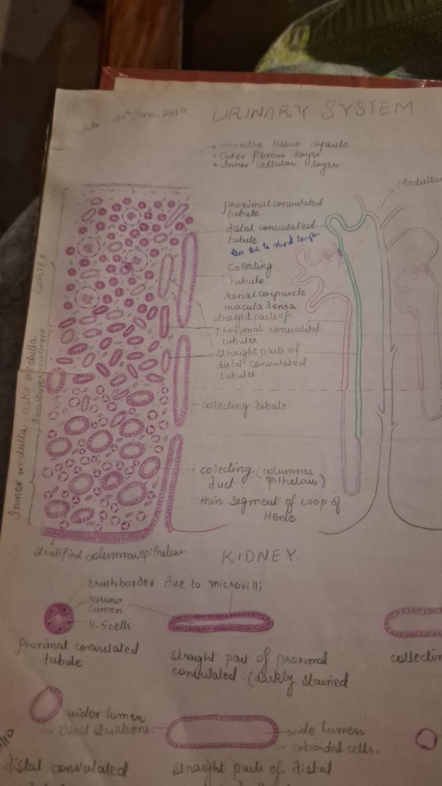
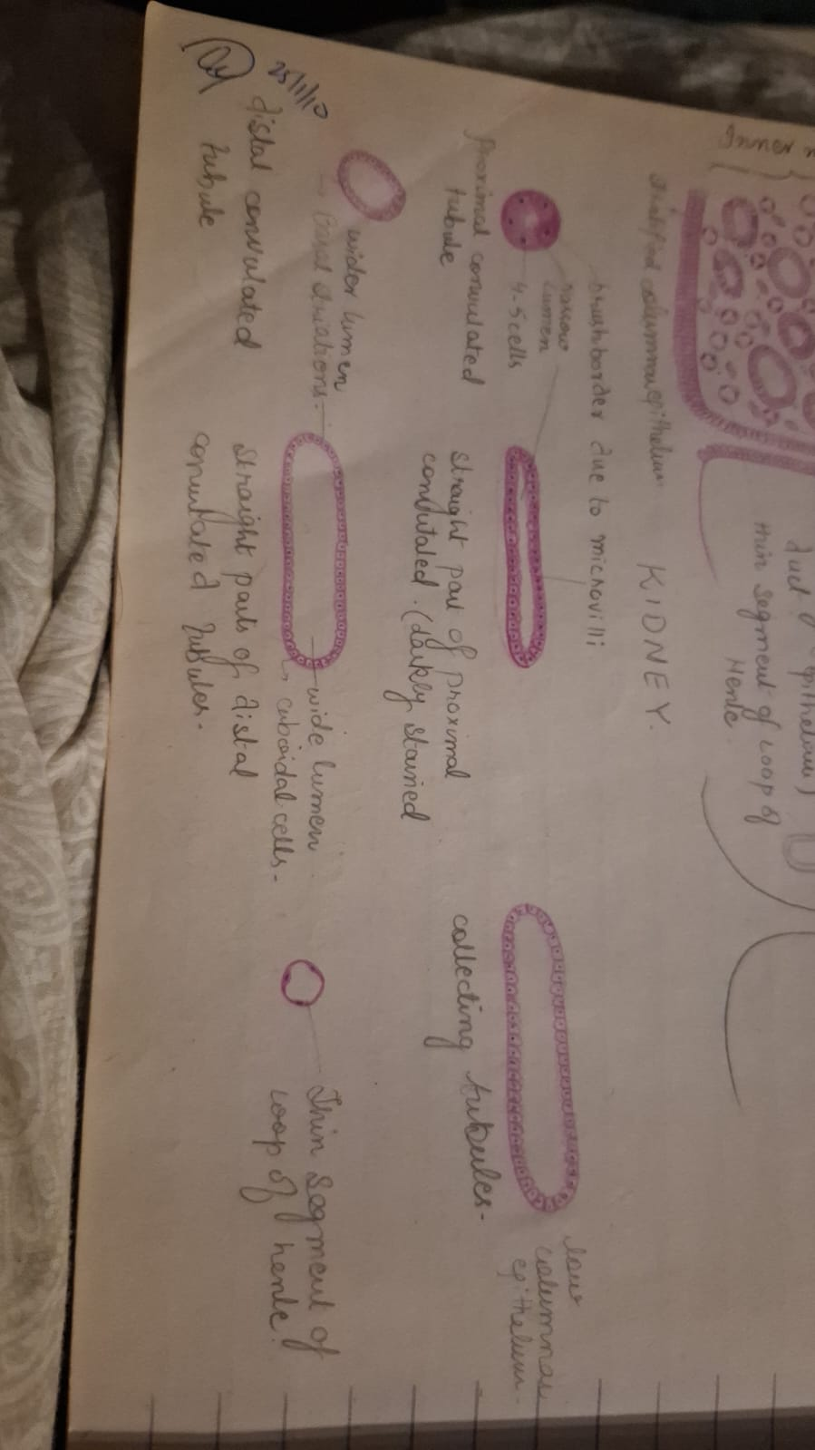
Histology of the Kidney
Core Knowledge

Slide 19
Identification Points of Kidney.
Cortex contains:
glomeruli,
conulated tubules
and medullary rays.
Medulla contains :
renal pyramid,
loop of henele
and collecting tubule.

Slide 20
Vertical Integration
Clinical Correlates
Glomerulonephritis
Degenerative changes observed in podocytes and the glomerular basement membrane.
It affects the filtration process of the kidney
Occurs in diabetic patients having uncontrolled blood sugar .
More proteins are released into urine leading to kidney failure.

Slide 21
Interactive session
The most characteristic histological finding is "hypercellular glomeruli
due to proliferation of mesangial and endothelial cells, along with neutrophilic infiltration."
In post-streptococcal glomerulonephritis, light microscopy typically shows
enlarged, hypercellular glomeruli,
and immunofluorescence often reveals granular ("starry sky") deposits of IgG, IgM, and C3 along the basement membrane and mesangium.

Slide 22
CTGF in kidney fibrosis and glomerulonephritis Review Open access Published: 06 August 2018 Volume 38, article number 14, (2018) Cite this article
Spiral Integration
Research Article
Abstract
Background
Glomerulonephritis, which causes inflammation in glomeruli, is a common cause of end-stage renal failure. Severe and prolonged inflammation can damage glomeruli and lead to kidney fibrosis. Connective tissue growth factor (CTGF) is a member of the CCN matricellular protein family, consisting of four domains, that regulates the signaling of other growth factors and promotes kidney fibrosis.
Main body of the abstract
CTGF can simultaneously interact with several factors with its four domains. The microenvironment differs depending on the types of cells and tissues and differentiation stages of these cells. The diverse biological actions of CTGF on various types of cells and tissues depend on this difference in microenvironment. In the kidney, CTGF is expressed at low levels in normal condition and its expression is upregulated by kidney fibrosis. CTGF expression is known to be upregulated in the extra-capillary and mesangial lesions of glomerulonephritis in human kidney biopsy samples. In addition to involvement in fibrosis, CTGF modulates the expression of inflammatory mediators, including cytokines and chemokines, through distinct signaling pathways, in various cell systems. In anti-glomerular basement membrane (GBM) glomerulonephritis, systemic CTGF knockout (Rosa-CTGF cKO) mice exhibit 50% reduction of proteinuria and decreased crescent formation and mesangial expansion compared with control mice. In addition to fibrotic markers, the glomerular mRNA expression of Ccl2 is increased in the control mice with anti-GBM glomerulonephritis, and this increase is reduced in Rosa-CTGF cKO mice with nephritis. Accumulation of MAC2-positive cells in glomeruli is also reduced in Rosa-CTGF cKO mice. These results suggest that CTGF may be required for the upregulation of Ccl2 expression not only in anti-GBM glomerulonephritis but also in other types of glomerulonephritis, such as IgA nephropathy; CTGF expression and accumulation of macrophages in the mesangial area have been documented in these glomerular diseases. CTGF induces the expression of inflammatory mediators and promotes cell adhesion.
Short conclusion
CTGF plays an important role in the development of glomerulonephritis by inducing the inflammatory process. CTGF is a potentiate target for the treatment of glomerulonephritis.

Slide 23
Learning Resources
Junqueira’s Basic Histology 13th Edition, Chapter 15, pages 292-295
Histology , A text and Atlas by Michael H.Ross 7th Edition, Chapter 16, pages 529-533
DiFiore's Atlas of Histology with Functional Correlations 11th Edition, Chapter 11, pages 239-243
Google images

Slide 24
THANK YOU

