Slide 1


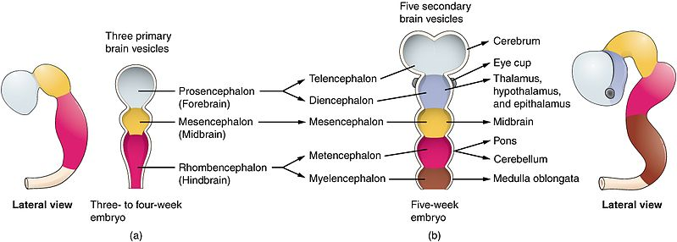
Central Nervous System Module - I
2nd Year MBBS(LGIS)
Early Development of Central Nervous System
Presenter: Prof. Dr. Ifra Saeed Date: 00-00-25

Slide 2
Prof. Umar’s Model of Teaching Strategy
Self Directed Learning Assessment Program
Objectives :To cultivate critical thinking, analytical reasoning, and problem-solving competencies.
To instill a culture of self-directed learning, fostering lifelong learning habits and autonomy.
First Ten Minutes
How to Assess?
Ten randomly selected students will be evaluated within the first 10 minutes of the lecture through 10 multiple-choice questions (MCQs) based on the PowerPoint presentation shared on Students Official WhatsApp group, one day before the teaching session.
The number of MCQs from the components of the lecture will follow the guidelines outlined in the Prof. Umar model of Integrated Lecture.
Component of LGIS | Core Knowledge | Horizontal Integration | Vertical Integration | Spiral Integration
No of MCQs | 6-7 | 1-2 | 1 | 1

Slide 3
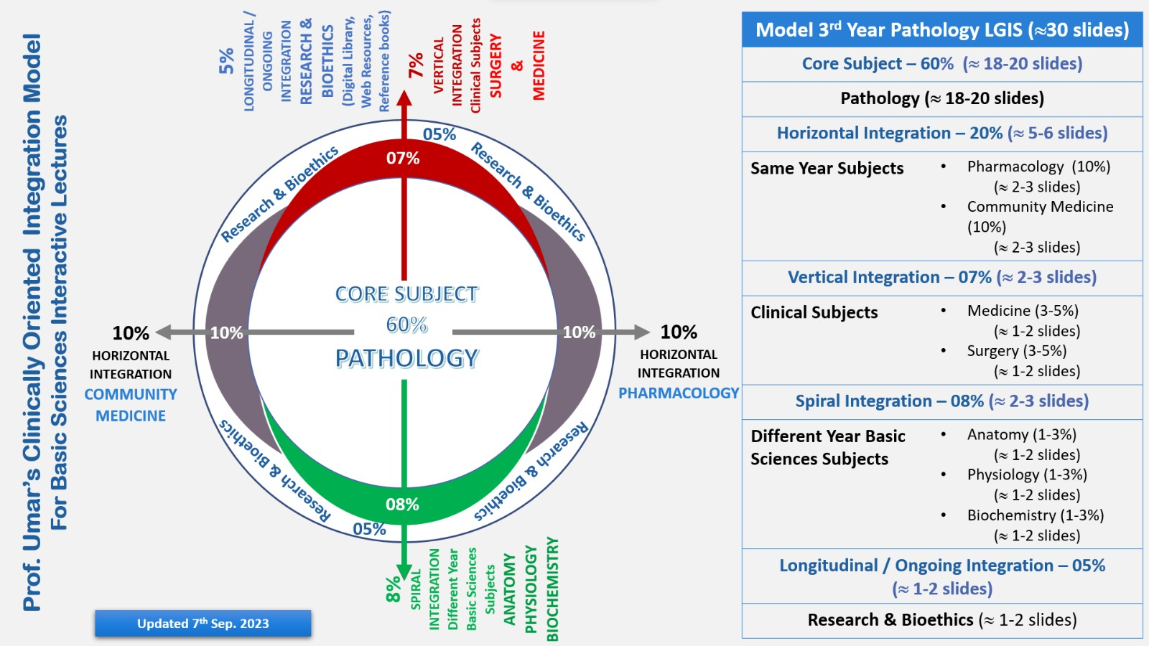
Professor Umar Model of Integrated Lecture

Slide 4
Learning Objectives
At the end of the session, student will be able to
Describe Early development of CNS
Discuss process of neurulation
Discuss congenital abnormalities
Integrate physiological and biochemical aspects with development of CNS
Approach towards patient of spina bifida
Correlate and build core knowledge on the basis of latest research
Role of artificial intelligence
Bioethics related to patients of spina bifida

Slide 5
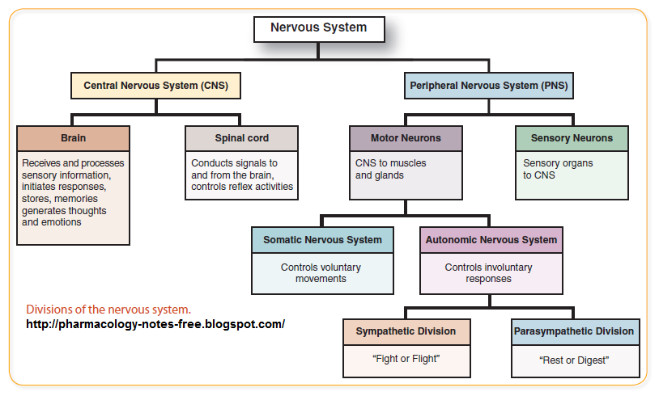
Central Nervous System
Core Concept

Slide 6
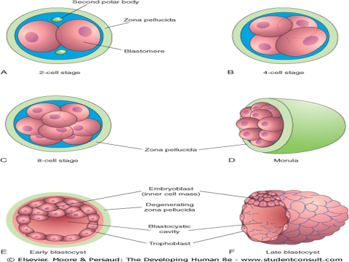
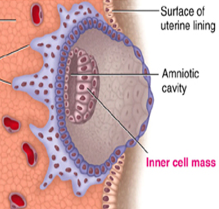

Early Development

Slide 7
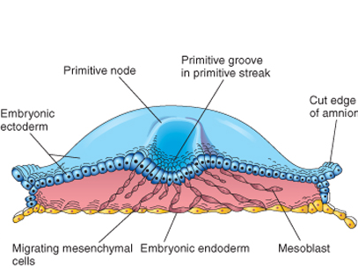
Gastrulation and Formation of Three Germ Layers

Slide 8
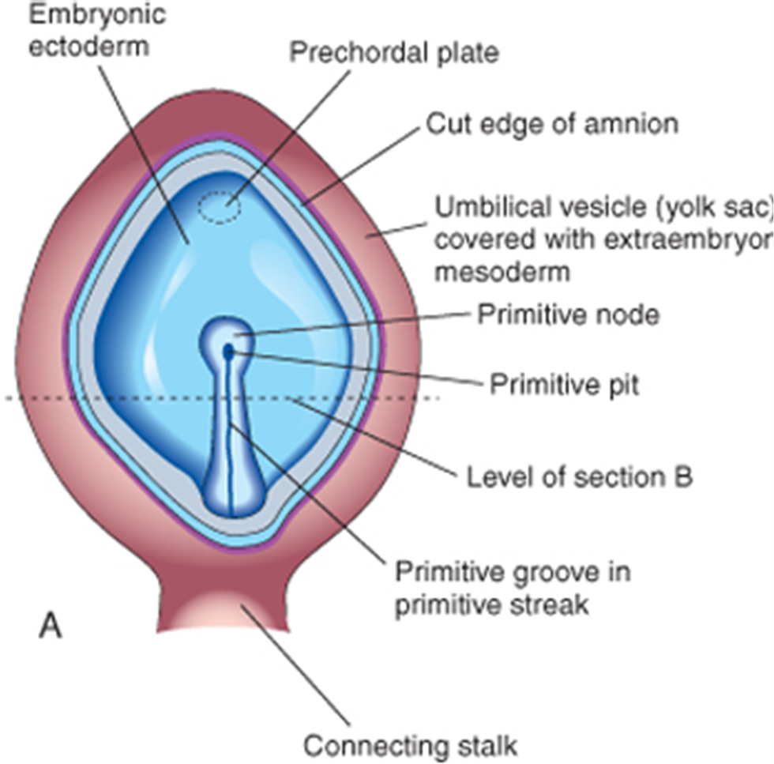
Early development of CNS
At the beginning of the third week, an opacity formed by a thickened linear band of epiblast-the primitive streak-appears caudally in the median plane of the dorsal aspect of the embryonic disc
As the streak elongates by addition of cells to its caudal end, its cranial end proliferates to form a primitive node

Slide 9
Primitive Streak
The primitive streak results from the proliferation and movement of cells of the epiblast to the median plane of the embryonic disc.

Slide 10
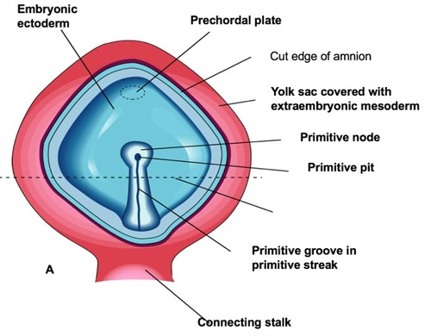
Primitive Groove
A narrow groove-primitive groove-develops in the primitive streak that is continuous with a small depression in the primitive node-the primitive pit.
The primitive groove and pit result from the invagination (inward movement) of epiblastic cells.

Slide 11
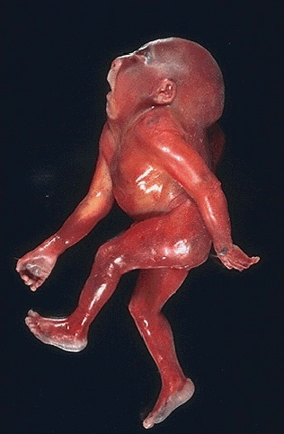
Iniencephaly
Iniencephaly is a rare neural tube defect that results in extreme bending of the head to the spine.
The diagnosis can usually be made on antenatal ultrasound scanning, but if not will undoubtedly be made immediately after birth because the head is bent backwards and the face looks upwards. Usually the neck is absent. The skin of the face connects directly to the chest and the scalp connects to the upper back. The infant will usually not survive more than a few hours.

Slide 12
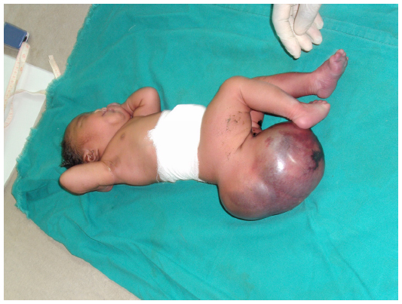
Fate Of Primitive Streak
Primitive streak actively form the mesoderm by the ingression of cells until the early part of 4th week thereafter production of mesoderm slows down.
Primitive streak diminishes in size and become insignificant structure in sacrococcygeal region and disappear by the end of fourth week
Sacrococcygeal teratoma: incidence is 1 in 35000
80% are females

Slide 13

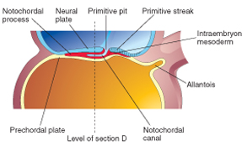
Formation Of Notochord
Some mesenchymal cells that have ingressed through the streak and, as a consequence, acquired mesodermal cell fates migrate cranially from the primitive node and pit, forming a median cellular cord, the notochordal process

Slide 14
Formation of notochordal canal
Extent of notochordal process(from prechordal plate to pit)
Significance of prechordal plate
By the middle of the third month three sites without mesoderm

Slide 15
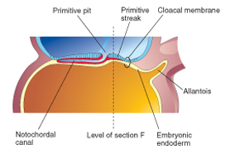
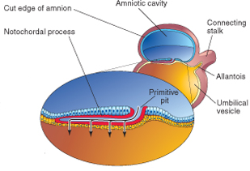
The floor of the notochordal process fuses with the underlying embryonic endoderm
The fused layers gradually undergo degeneration, resulting in the formation of openings in the floor of the notochordal process, which brings the notochordal canal into communication with the umbilical vesicle

Slide 16
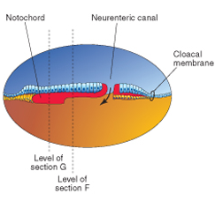
Neuroenteric Canal

Slide 17
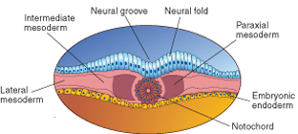
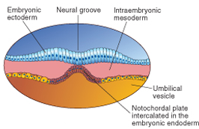
The openings rapidly become confluent and the floor of the notochordal canal disappears; the remains of the notochordal process form a flattened, grooved notochordal plate
Beginning at the cranial end of the embryo, the notochordal cells proliferate and the notochordal plate infolds to form the notochord

Slide 19
The Notochord :
Defines the primordial longitudinal axis of the embryo and gives it some rigidity
Provides signals that are necessary for the development of axial musculoskeletal structures and the central nervous system
Contributes to the intervertebral discs
Remnants forms the chordomas

Slide 20
Neurulation ( Formation Of Neural Tube)
The processes involved in the formation of neural plate, neural folds and closure of folds to form neural tube constitute neurulation.
These process are completed by the end of fourth week when closure of caudal neuropore occurs

Slide 21
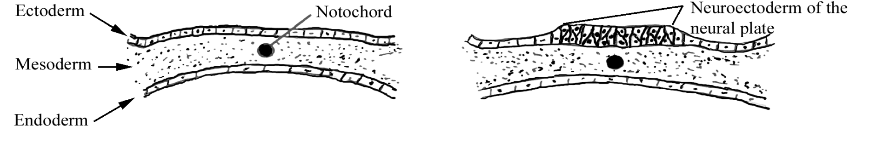
Neurulation
Induction of the neuroectoderm
Organized by the notochord
Creation of a neural plate
Position of neural plate
Extension of neural plate

Slide 22
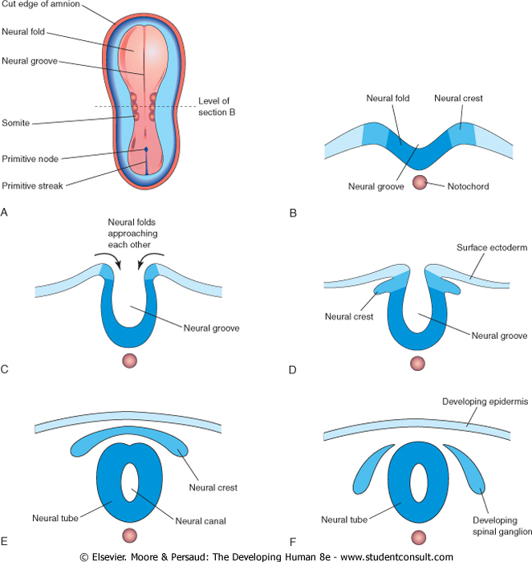
Neural Tube Formation

Slide 23
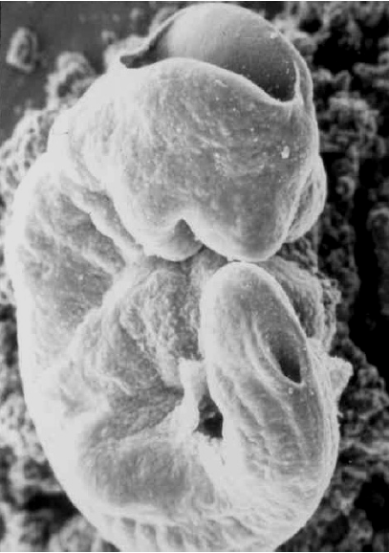
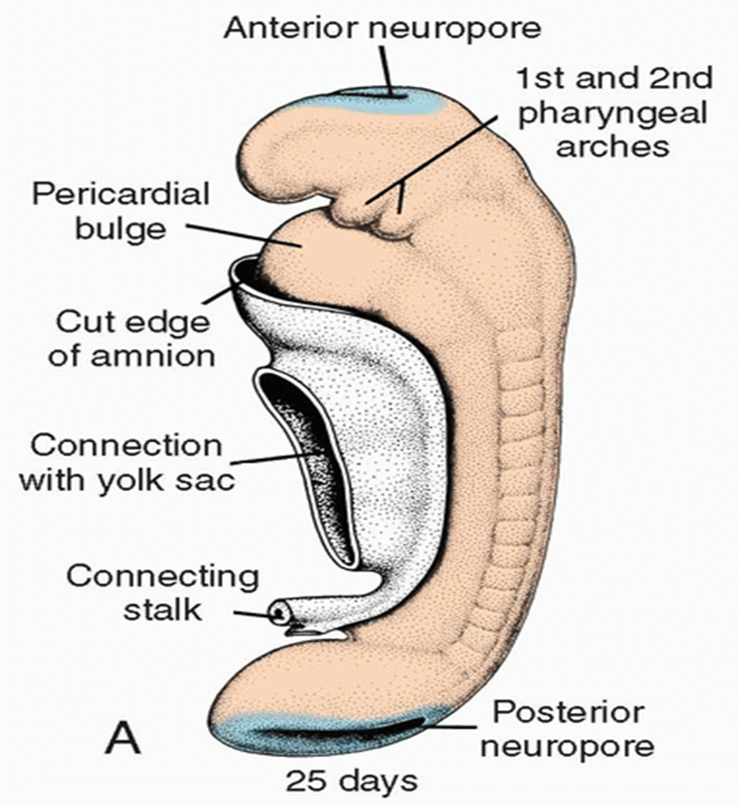
Closure of Neural Tube
Day 25 Rostral neuropore closes
Day 25 + 2 Caudal neuropore closes

Slide 24

Neural crest formation
As the neural folds fuses to form the neural tube, some ectodermal cells lying inside the margins of neural fold loose attachments to the neighboring cells
The neural crest cells form a flattened irregular mass neural crest between neural tube and overlying ectoderm.
Neural crest soon divide into right and left parts
Migration of NCC

Slide 25

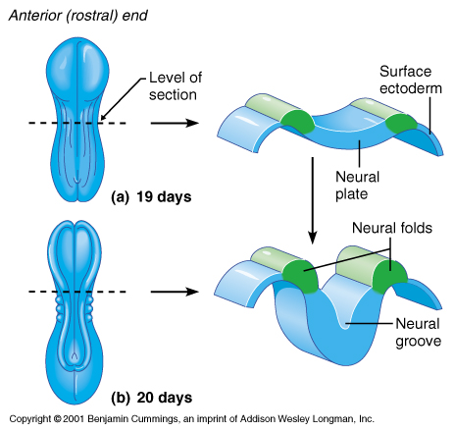

Slide 26
Neural Crest Cells give rise to
Sensory ganglion of spinal and cranial nerves
Dorsal root ganglion
Neurolemma sheaths of nerves
Ganglion of autonomic nervous system
Contribute to the formation of leptomeninges
Pigment cells
Suprarenal medulla
Connective tissue components in head
Ganglion of cranial nerves V, VII, IX and X
Smooth muscles of the blood vessels of forebrain and face

Slide 27
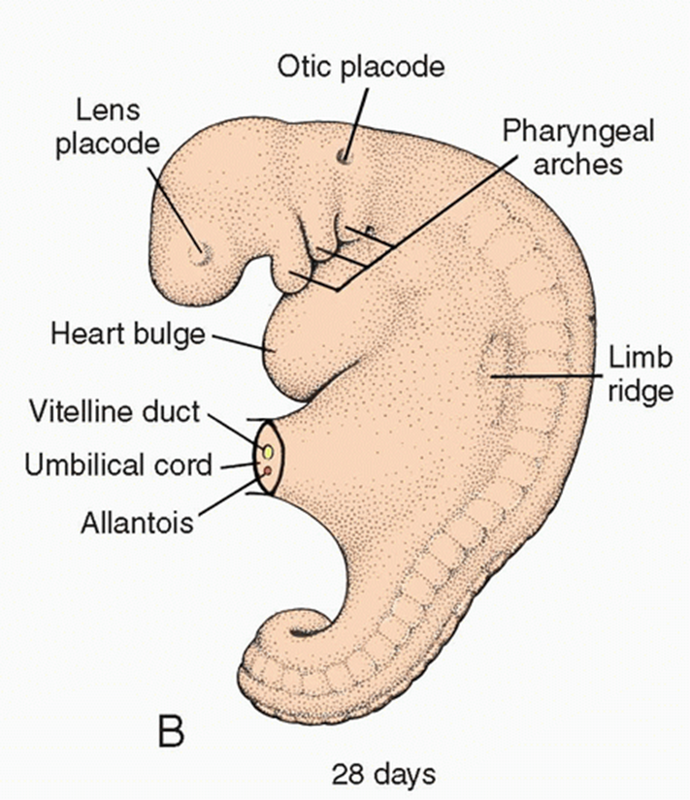
Lens Placodes/ Otic Placodes
By the time the neural tube is closed, two bilateral ectodermal thickenings the lens placodes and otic placodes become visible in the cephalic region of the embryo.
During further development, the otic placodes invaginate and form the otic vesicles,
At approximately the same time, the lens placodes appear. These placodes also invaginate and, during the fifth week, form the lenses of the eyes

Slide 28
Neural Tube Defects
There are two types of NTDs: open, which are more common, and closed.
Open NTDs occur when the brain and/or spinal cord are exposed at birth through a defect in the skull or vertebrae (back bones). Examples of open NTDs are anencephaly, encephaloceles, hydranencephaly, iniencepaly, schizencephaly, and spina bifida.
Closed NTDs occur when the spinal defect is covered by skin. Common examples of closed NTDs are lipomyelomeningocele, lipomeningocele
Vertical Integration

Slide 29
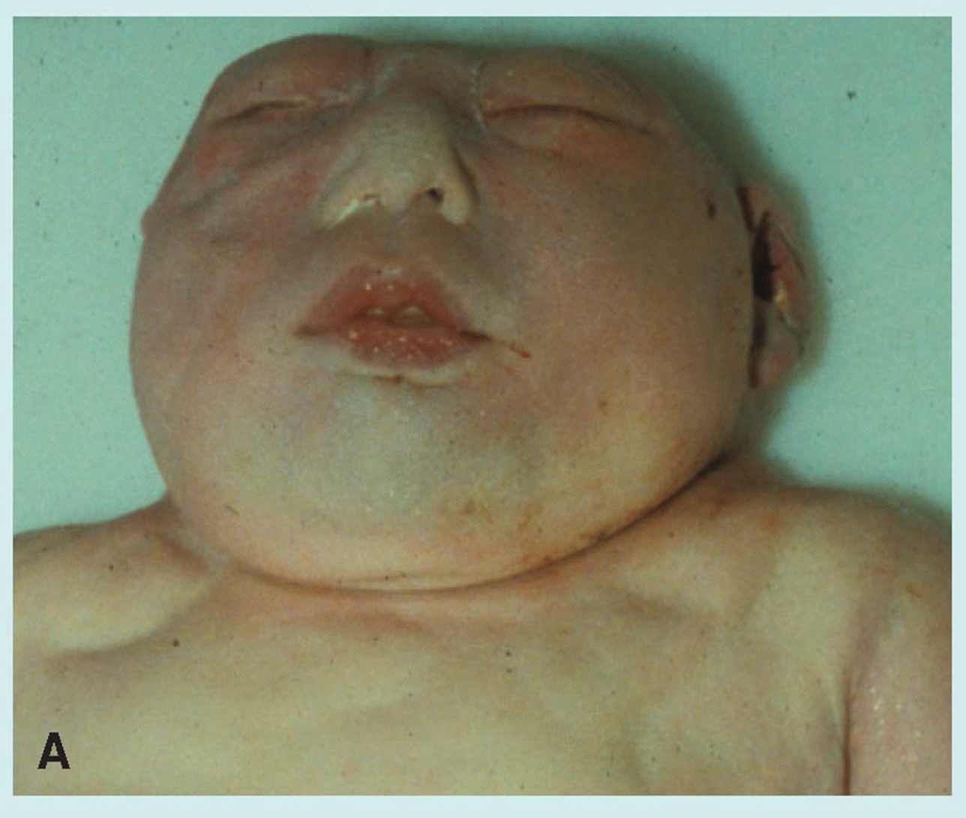

Anencephaly
is a neural tube defect that occurs when the head end of the neural tube fails to close, usually during the 23rd and 26th days of pregnancy, resulting in an absence of a major portion of the brain and skull.
without the main part of the forebrain—the largest part of the cerebrum—and are usually blind, deaf and unconscious.
infant will never gain consciousness. Infants are either stillborn or usually die within a few hours or days after birth.

Slide 30
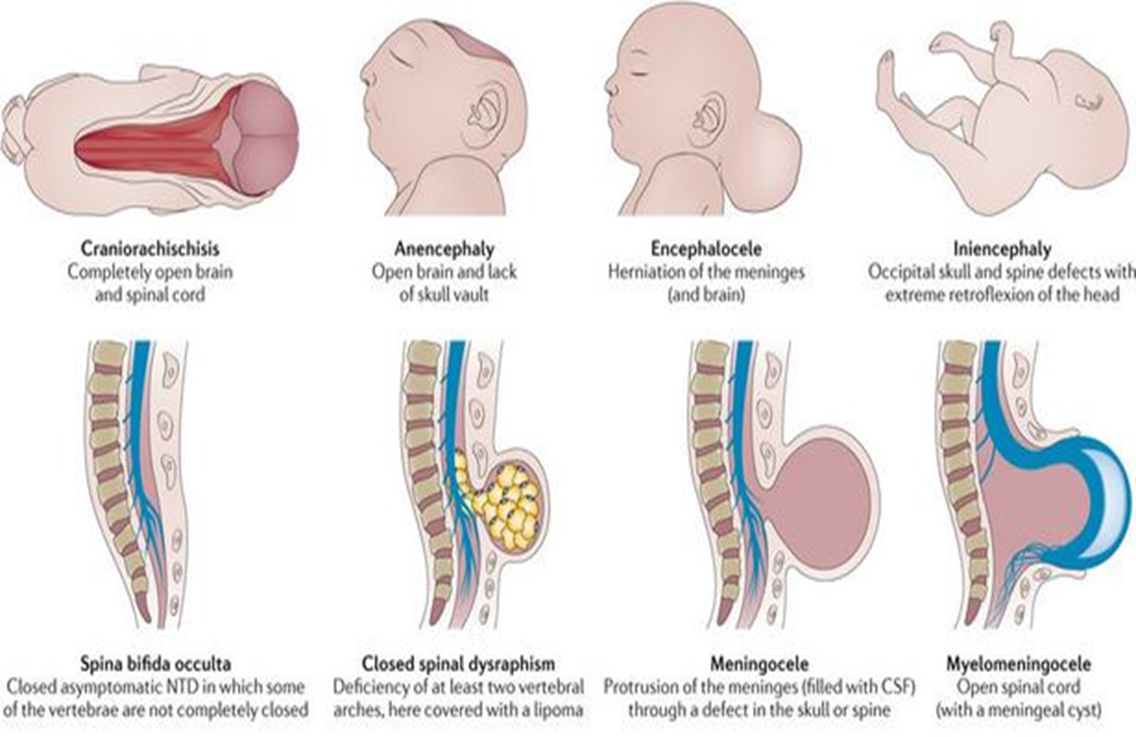
Encephaloceles
are characterized by protrusions of the brain through the skull that are sac-like and covered with membrane. They can be a groove down the middle of the upper part of the skull, between the forehead and nose, or the back of the skull. Encephaloceles are often obvious and diagnosed immediately. Sometimes small encephaloceles in the nasal and forehead are undetected.

Slide 31
Iniencephaly
Iniencephaly is a rare neural tube defect that results in extreme bending of the head to the spine.
The diagnosis can usually be made on antenatal ultrasound scanning, but if not will undoubtedly be made immediately after birth because the head is bent backwards and the face looks upwards. Usually the neck is absent. The skin of the face connects directly to the chest and the scalp connects to the upper back. The infant will usually not survive more than a few hours.

Slide 32
Anencephaly
Anencephaly is a significant developmental disorder of the central nervous system with substantial deformation of the brain and cranial vault.
Despite the lack of knowledge regarding the etiology and pathogenesis of anencephaly, it is believed that a number of environmental and dietary variables contribute to the disorder.
Folate deficiency is a significant nutritional risk factor that has been linked to the development of the disease.
Maternal serum alpha-fetoprotein (MSAFP) testing can detect the great majority of anencephaly patients during the second pregnant trimester. 2-dimensional prenatal ultrasonography which has advanced over time, has supplanted the screening approach of maternal serum alpha-fetoprotein values. Anencephaly is incompatible with life. Preventive care is the most crucial component of this condition’s management. Recommending supplements of folic acid for females who are able to conceive is the simplest strategy to lower the prevalence of anencephaly.
Reference: Almufadhal MH, Mohammed ZQ. Anencephaly. InCongenital Brain Malformations: Clinical and Surgical Aspects 2024 May 22 (pp. 35-40). Cham: Springer Nature Switzerland.
Family Medicine

Slide 33
A global update on the status of prevention of folic acid-preventable spina bifida and anencephaly in year 2022
Volume116, Issue5 May 2024 https://doi.org/10.1002/bdr2.2343
Study showed that only a quarter of all FAP SBA cases were averted through mandatory folic acid fortification in the year 2022; many countries are not implementing the policy, resulting in a large proportion of FAP SBA cases that can be prevented. Fortification will help countries with achieving 2030 Sustainable Development Goals on neonatal- and under-five mortality, disability, stillbirths, and elective terminations prevention, from FAP SBA. (Folic Acid-Preventable Spina Bifida and Anencephaly)
Research

