Slide 1


Slide 2


Muscloskeletal (MSK 1) Module
1st Year MBBS(LGIS)
Connective Tissue I
Presenter: Dr. Kashif Date: 19-04-25
(APMO)

Slide 3
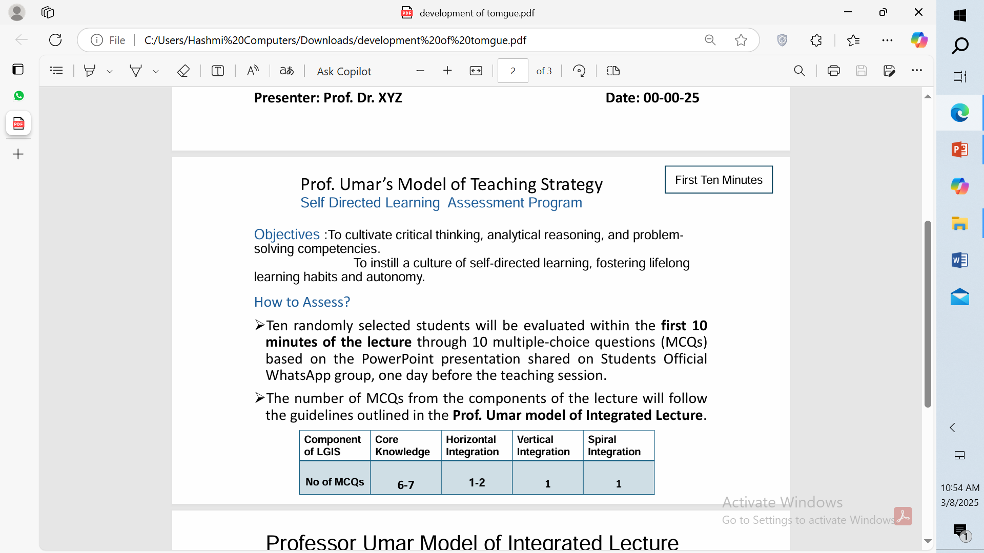

Slide 4
Motto, Vision, Dream
To impart evidence based research oriented medical education
To provide best possible patient care
To inculcate the values of mutual respect and ethical practice of medicine
Wisdom
Truth
Service

Slide 5
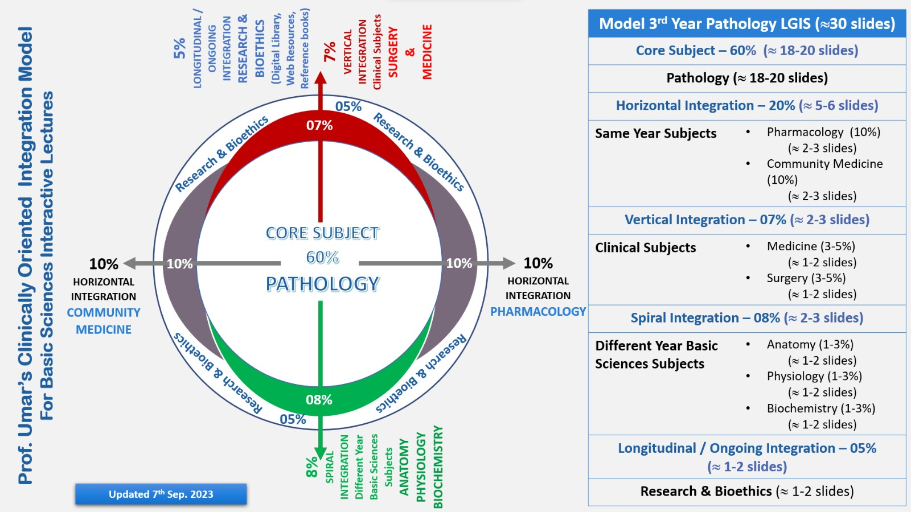
Professor Umar Model of Integrated Lecture

Slide 6
Assessment

Slide 7
1. Cell having a bilobed nucleus and reddish granules in the cytoplasm is
Basophil
Eosinophil
Adipocyte
Neutrophil
fibroblast
2. Variety of connective tissue which provides a delicate supporting framework for many highly cellular organs
Dense regular C.T
Adipose C.T
Mesenchmal C.T
Reticular C.T
Loose areolar C.T

Slide 8
3. Variety of cells are spindle-shaped cells with ovoid or elliptical nuclei and irregular cytoplasmic extensions
Fibroblast
Adipocytes
Neutrophil
Macrophage
Plasma cells
4. Mucoid C.T is found in
Umbilical cord
Skin
Liver
Pancreases
intestine

Slide 9
5. Variety of C.T which Provides both cushioning for organs and energy storage and involved in hormone secretion such as leptin
Mucoid C.T
Reticular C.T
Adipose C.T
Loose areolar C.T
Dense regular C.T

Slide 10
Answers
1. B
2. D
3. A
4. A
5.C

Slide 11
Learning Objectives
Identify mucoid connective tissue under microscope
Illustrate histological structure of mucoid connective tissue
Write two points of identification
Identify reticular and adipose connective tissue under microscope
Illustrate histological structure of reticular and adipose connective tissue
Write two points of identification

Slide 12
Core Knowledge

Slide 13
Core Knowledge
Cells Of Connective Tissue

Slide 14
Core Knowledge
Classification Of Connective Tissue

Slide 15
Core Knowledge

Slide 16
Core Knowledge
Reticular C.T

Slide 17
Core Knowledge
Adipose C.T

Slide 18
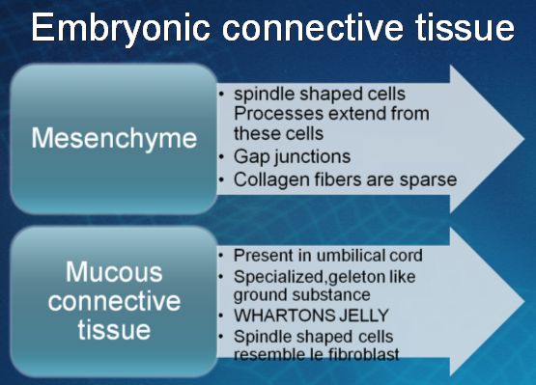
Core Knowledge

Slide 19
Core Knowledge

Slide 20
Vertical Integration

Slide 21
Vertical Integration
Anaphylaxis
Anaphylaxis is an allergic reaction characterized by increased basophils and mast cells, dilated capillaries, and exudates in the loose connective tissue.
Symptoms :: urticaria (hives), pruritus (itching), flushing, shortness of breath, and shock.
MECHANISM>> activation and release of histamine and inflammatory mediators from mast cells and basophils.

Slide 22
How To Access Digital Library
Go to the website of HEC National Digital Library.
On Home Page, click on the INSTITUTES.
A page will appear showing the universities from Public and Private Sector and other Institutes which have access to HEC National Digital Library HNDL.
Select your desired Institute.
A page will appear showing the resources of the institution
Journals and Researches will appear
You can find a Journal by clicking on JOURNALS AND DATABASE and enter a keyword to search for your desired journal.

Slide 23
Research Articles
Impaired Adipogenesis and Dysfunctional Adipose Tissue in Human Hypertrophic Obesity
https://journals.physiology.org/doi/full/10.1152/physrev.00034.2017

Slide 24
Learning Resources
Junqueira's Basic Histology: Text and Atlas,Book by Anthony L. Mescher and L. Carlos Junqueira
d`ifiore’s Atlas Of Histology With Functional Correlations
Manual of Histology-I (General) by Tassaduq Hussain Shiekh
www.google.com for pictures

Slide 25
Thank You

