Slide 2
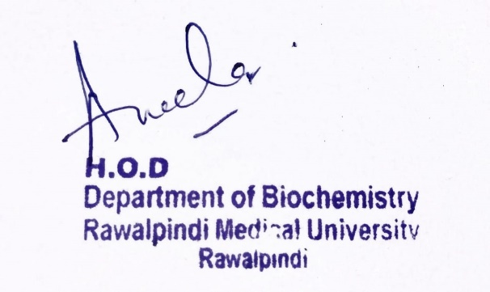
Renal Module 2nd Year MBBS(LGIS) Urea Cycle
Presenter: Dr Uzma Zafar Date: 01-02-25
Deptt of Biochemistry
RMU

Slide 3
Motto, Vision, Dream
To impart evidence based research oriented medical education
To provide best possible patient care
To inculcate the values of mutual respect and ethical practice of medicine
Wisdom
Truth
Service

Slide 4
Professor Umar Model of Integrated Lecture

Slide 5
Learning Objectives
At the end of the lecture, students will be able to:
DISCUSS the Urea cycle
Describe Its reactions and regulation
Elaborate the Deficiencies of the urea cycle

Slide 6
Core Knowledge
Functions of proteins
In Cell Membrane, proteins perform the following functions:
Membrane proteins can allow hydrophilic molecules to pass through the cell membrane.
Some membrane proteins can feature a binding site called receptors. These binding sites are characterized by specific shapes that match the shape of a chemical messenger
Another important function of membrane proteins is the identification and recognition between cells
Enzymes and polypeptide hormones regulate metabolism in the body
Contractile proteins in muscle permit movement
In bone, the protein collagen forms a framework for the deposition of calcium phosphate crystals.
Immunoglobulins fight infectious bacteria and viruses
In the blood stream, proteins like hemoglobin and plasma albumin shuttle molecules

Slide 7
Core Knowledge
UREA CYCLE
Urea is the major disposal form of amino groups derived from amino acids and accounts for 90% of the nitrogen-containing components of urine.
One nitrogen of the urea molecule is supplied by free ammonia and the other nitrogen by aspartate.
The carbon and oxygen of urea are derived from CO2 (as HCO3−). Urea is produced by the liver and then is transported in the blood (blood urea nitrogen) to the kidneys for excretion in the urine.

Slide 8
Core Knowledge
Reactions of the Urea Cycle
Reactions
The first two reactions leading to the synthesis of urea occur in the mitochondrial matrix,
Whereas the remaining cycle enzymes are located in the cytosol

Slide 9
Core Knowledge
Reactions of the Urea Cycle Cont.
1. Carbamoyl phosphate formation: Formation of carbamoyl phosphate by carbamoyl phosphate synthetase I (CPS I) is driven by cleavage of two molecules of ATP.
Ammonia incorporated into carbamoyl phosphate is provided primarily by the oxidative deamination of glutamate by mitochondrial GDH. The nitrogen atom derived from this ammonia becomes one of the nitrogens of urea. CPS I requires N-acetylglutamate (NAG) as a positive allosteric activator
2. Citrulline formation: The carbamoyl portion of carbamoyl phosphate is transferred to
ornithine by ornithine transcarbamylase (OTC) as the phosphate is released as
inorganic phosphate. The reaction product, citrulline, is transported to the cytosol.
Ornithine is regenerated with each turn of the urea cycle, much in the same way that oxaloacetate is regenerated by the reactions of the tricarboxylic acid (TCA) cycle (see p. 120)

Slide 10
Core Knowledge
Reactions of the Urea Cycle Cont.
3. Argininosuccinate formation: Argininosuccinate synthetase combines citrulline with aspartate to form argininosuccinate. Aspartate provides the second nitrogen that is incorporated into urea. The formation of argininosuccinate is driven by the cleavage of ATP to adenosine monophosphate and pyrophosphate. This is the third and final molecule of ATP consumed in the formation of urea.
4. Argininosuccinate cleavage: Argininosuccinate is cleaved by argininosuccinate lyase to yield arginine and fumarate. The arginine serves as the immediate precursor of urea.
The fumarate is hydrated to malate, which can be transported into mitochondria via the malate shuttle, reenter the TCA cycle, and get oxidized to oxaloacetate, which can be used for gluconeogenesis.
Oxaloacetate OAA can be converted to aspartae via transammination entering the urea cycle.

Slide 11
Core Knowledge
Reactions of the Urea Cycle Cont.
5. Arginine cleavage to ornithine and urea: Arginase-I hydrolyzes arginine to ornithine and urea and is virtually exclusive to the liver, such as the kidney, can synthesize arginine from citrulline.
Arginase enzyme is not present in the kidney.
6. Fate of urea: Urea diffuses from the liver and is transported in the blood to the kidneys, where it is filtered and excreted in the urine.
A portion of the urea diffuses from the blood into the intestine and is cleaved to CO2 and ammonia by bacterial urease.
The ammonia is partly lost in the feces and is partly reabsorbed into the blood.
In patients with kidney failure, plasma urea levels are elevated, promoting a greater transfer of urea from blood into the gut.
The intestinal action of urease on this urea becomes a clinically important source of ammonia, contributing to the hyperammonemia often seen in these patients.
Oral administration of antibiotics reduces the number of intestinal bacteria responsible for this ammonia production.

Slide 12
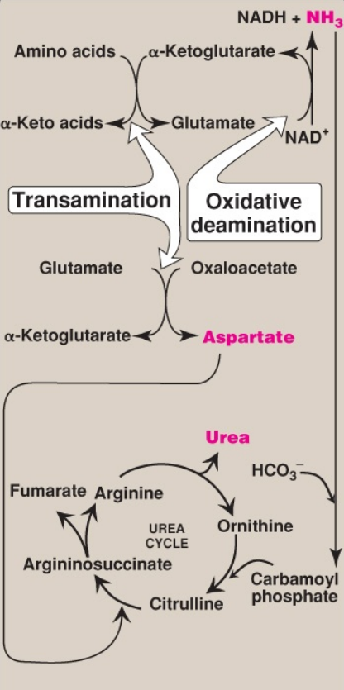
Core Knowledge
Flow of nitrogen from amino acids to urea. Amino groups for urea synthesis are collected in the form of ammonia (NH3 ) and aspartate. NAD(H) = nicotinamide adenine dinucleotide; HCO3 – = bicarbonate.

Slide 13
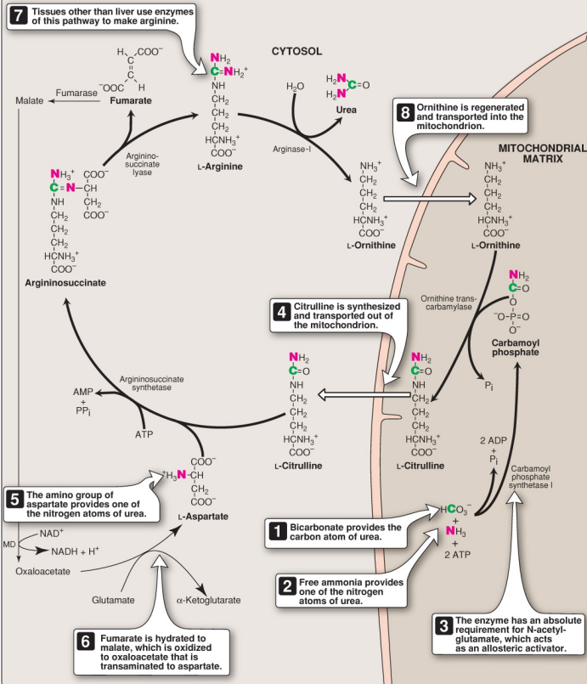
Core Knowledge
Reactions of the urea cycle. (Note: An antiporter transports citrulline and ornithine across the inner
mitochondrial membrane.) ADP = adenosine diphosphate; AMP = adenosine monophosphate; PPi =
pyrophosphate; Pi = inorganic phosphate; NAD(H) = nicotinamide adenine dinucleotide; MD = malate
dehydrogenase.

Slide 14
Core Knowledge
Overall stoichiometry of the Urea Cycle
Aspartate + NH3 + HCO3– + 3ATP + H2O →
urea + fumarate + 2ADP + AMP + 2Pi + Ppi

Slide 15
Core Knowledge
Regulation of the Urea Cycle
NAG is an essential activator for CPS I, the rate-limiting step in the urea cycle. It increases the affinity of CPS I for ATP.
NAG is synthesized from acetyl CoA and glutamate by Nacetylglutamate synthase (NAGS, in a reaction for which arginine is an activator.
The cycle is also regulated by substrate availability (short-termregulation) and enzyme induction (long term).

Slide 16
Core Knowledge
Urea cycle deficiencies
All of the other urea cycle disorders follow an autosomalrecessive inheritance pattern.
In each case, the failure to synthesize urea leads to hyperammonemia during the first weeks following birth.
Combinations of other symptoms common to hyperammonemia (tremors, slurred speech, drowsiness, vomiting cerebral edema, blurred vision, intellectual and developmental disability, and in severe hyperammonemia, even coma and death) can also be seen in different urea cycle deficiencies.
Diagnosis is based upon symptoms, laboratory testing, and genetic testing.
Historically, congenital urea cycle defects have a high morbidity (neurologic manifestations) and mortality

Slide 17
Core Knowledge
Congenital:
Ornithine transcarbamylase deficiency:
OTC deficiency is the most common urea cycle disorder.
Specific laboratory test results include a decrease in reaction and the downstream products citrulline and arginine.
Interestingly, there is also an increase in detectable serum and urinary orotic acid levels. Carbamoyl phosphate, one of the OTC substrates, instead becomes a substrate for pyrimidine biosynthesis, entering into the pathway downstream of the regulatory reaction.
As a result, orotic acid is an overproduced pyrimidine biosynthesis pathway intermediate.

Slide 18
Core Knowledge
Congenital:
b. Argininosuccinate synthetase deficiency:
This deficiency is also referred to as citrullinemia type 1, as there is an accumulation of the substrate for the reaction, citrulline, in blood and urine.
There may be a neonatal acute (classic) form, a milder late-onset form, a form that begins during or after pregnancy, and an asymptomatic form.
In the neonatal acute form, citrulline can be detected as part of newborn screening.
This detection is critical to prevent hyperammonemia and brain damage.
c. Argininosuccinate lyase deficiency:
In argininosuccinate lyase deficiency, there is an accumulation of the substrate for the reaction, argininosuccinate, in the urine, resulting in argininosuccinic aciduria.
This is diagnostic and part of the newborn screening.
In more severe- and late-onset forms of the deficiency, the aciduria may be associated with neurologic abnormalities, developmental delays, and cognitive impairment.

Slide 19
Core Knowledge
Congenital:
d. Arginase-I deficiency:
In arginase-I deficiency, there is an accumulation of the substrate for the reaction, arginine, in the blood and urine, and is often referred to as argininemia or hyperargininemia.
The hyperammonemia seen with arginase deficiency is often less severe because arginine contains two waste nitrogens, and can be excreted in the urine.
As such, patients with this deficiency may appear to be healthy at birth, and have normal development during the first 1 to 3 years.
After this, the first symptoms of arginase deficiency may appear with apparent developmental delays, loss of developmental milestones, and intellectual disability.
Hyperammonemia may be episodic, associated with high-protein meals or periods of stress, such as illness or fasting.

Slide 20
Core Knowledge
Congenital:
e. N-acetylglutamate synthase deficiency:
Like the aginase-I deficiency, a deficiency in NAGS can result in developmental delays and intellectual disability.
Less severe forms maybe episodic later in life, associated with periods of high-protein meals, stress, or fasting.
Carglumic acid is an FDA-approved therapy for NAGS deficiency.
It is a synthetic form of NAG, the positive allosteric activator of carbamoyl phosphate synthetase I.

Slide 21
Core Knowledge
Treatment for hyperammonemia
Treatment for urea cycle enzyme deficiencies involves both limiting protein intake in the diet in the presence of sufficient calories to prevent protein catabolism, and the removal of excess ammonia in the blood.
Patients adhere to a low-protein diet, with minimal protein levels needed to maintain good health.
Drinks with special formulas and/or medical foods can be purchased in which protein levels are tailored to the patient’s needs.
Nitrogen-scavenging medications, including the aromatic acids benzoate and phenylbutyrate, can reduce ammonia levels in the blood.
Benzoate combines with glycine to form hippurate.

Slide 22
Core Knowledge
Core Concept
Treatment for hyperammonemia
Phenylbutyrate is converted to phenylacetate, and combines with glutamine to form phenylacetylglutamine.
Both end products, hippurate and phenylacetylglutamine, are readily excreted in the urine. The combined excretion of glycine and glutamine, and their subsequent biosynthesis, effectively lowers ammonia levels and the potential for hyperammonemia.
During severe hyperammonemia, patients may also require dialysis, intravenous fluids, or other treatments to quickly reduce blood ammonia levels and prevent permanent brain damage.

Slide 23
Horizontal Integration

Slide 24
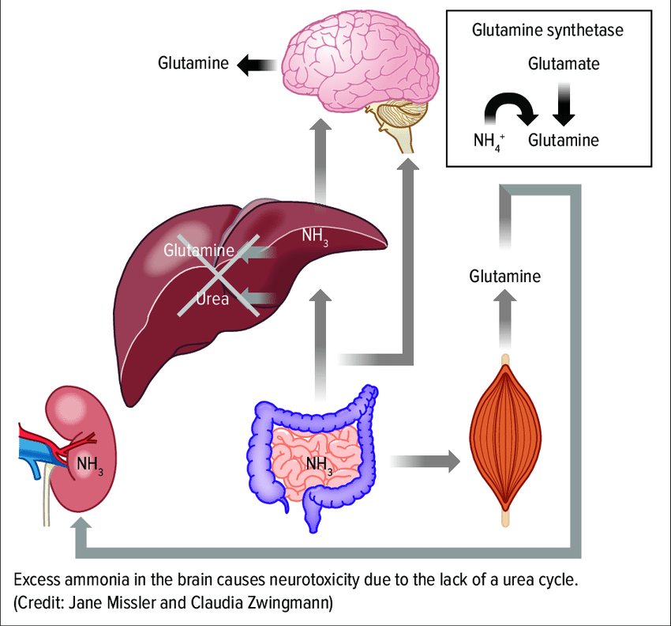
Vertical Integration
Clinical Correlates

Slide 25
Spiral Integration
Family Medicine
Family Medicine plays important role in following manner:
Diagnosis
Education
Dietary Guidance
Monitoring
Refer to Specialists

Slide 26
Spiral Integration
Bioethics
Ethical Considerations
From an ethical standpoint, the scenario raises considerations regarding patient autonomy, informed consent, and confidentiality
The physician must ensure that patient fully understands her diagnosis, treatment options, and potential implications
Discuss the necessity of a healthy lifestyle & treatment plan. This requires clear communication and understanding of risks and benefits.
Additionally, the physician must respect patient’s privacy and confidentiality throughout the diagnostic and treatment process

Slide 27
Spiral Integration
Artificial Intelligence
Role of AI in (The Disease) Management
AI can potentially aid in enhancing diagnostic accuracy and efficiency.
AI-powered decision support systems can also help clinicians in selecting appropriate treatment modalities
AI-driven predictive models may help anticipate the risk of complications of the Disease in susceptible populations

Slide 28
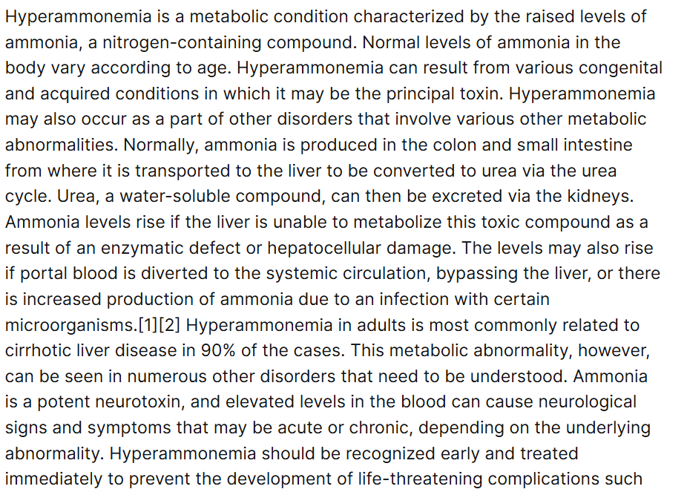
Spiral Integration
Research Article
https://www.researchgate.net/publication/346506005_Hyperammonemia

Slide 29
How To Access Digital Library
Steps to Access HEC Digital Library
Go to the website of HEC National Digital Library
On Home Page, click on the INSTITUTES
A page will appear showing the universities from Public and Private Sector and other Institutes which have access to HEC National Digital Library HNDL
Select your desired Institute
A page will appear showing the resources of the institution
Journals and Researches will appear
You can find a Journal by clicking on JOURNALS AND DATABASE and enter a keyword to search for your desired journal

Slide 30
Learning Resources
Lippincott Illustrated Reviews 8th Edition, Chap , pages -
Harper’s Illustrated Biochemistry 32nd Edition, Chap , pages –
Google images

Slide 31
THANK YOU

