Slide 1
Sclera
Presented By Dr Salman Tariq

Slide 2
Sclera

Slide 3
Learning Objectives
At the end of the lecture ,the students will be able to
Describe anatomy of sclera
Describe classification of the diseases related to sclera
Describe management of diseases related to sclera

Slide 4
Anatomy of sclera
It is also known as the white of the eye.
It is opaque,protective,outer layer of the eyer containing collagen and elastic fibers.
Anteriorly the Sclera forms white of the eyeball and is covered by fascial sheath of eyeball and conjunctiva
The recti muscles are attached to the sclera
The sclera is perforated posteriorly by optic nerve.

Slide 6
Anatomy of sclera
For the purpose of description, the sclera is divided into 3 layers
Episclera
Scleral stroma
Lamina fusca

Slide 8
Episclera
It is the outermost layer
Anteriorly it consists of dense vascular connective tissue, which lies between superficial scleral stroma and Tenon capsule.
Sclera Stroma
It is a dense fibrous tissue with fine elastic fibers
Lamnina Fusca
It is the innermost layer of the sclera It is separated from external surface of the choroid by perchoroidal space.

Slide 9
Diseases of Sclera

Slide 10
Episcleritis
Episcleritis is idiopathic,benign,recurrent and a bilateral condition.
Females are affected more than males.
It causes mild discomfort, and rarely associated with systemic disease.
It is usually self limiting, but since the symptoms are tiresome,anti-inflammatory treatment can be given.
Features peak within 24 hours after which it fades over next few days.

Slide 11
Types of Episcleritis
Simple Episcleritis
Nodular Episcleritis

Slide 12
Simple episcleritis
Symptoms
Discomfort,Grittiness,Photophobia
Signs
Redness May be sectoral or diffuse.
Often it has interpalpebral distribution ,in contrast to scleral disease which starts in upper temporal quadrant.
Treatment
A weak topical steroids are adequate in some cases
Oral NSAIDs are sometimes required for 10 days.

Slide 13
Simple Episcleritis

Slide 14
Nodular Episcleritis
It tends to affect young females but has less acute onset and more prolonged course than simple variety.
Presentation
is with red eyes and is first noted on waking. Over next few days the redness increases in size but remains in same location.
Signs
One or more tender nodule within the interpalpebral fissure
Treatment
It is like episcleritis

Slide 15
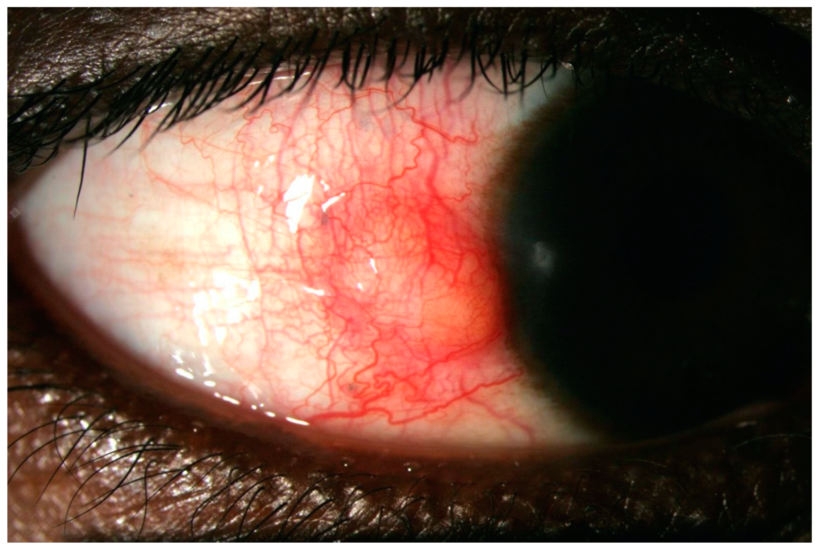
Nodular Episcleritis

Slide 16
Classification of Scleritis

Slide 17
Anterior Non-Necrotizing Scleritis(Nodular)
Symptoms
Pain, followed by redness and tenderness of the globe and appearance of scleral nodule.
Signs
Scleral nodules are located in the interpalpebral area closer to limbus.
They have deeper blue red color than episcleral nodule and are immobile
Installation of 10 percent phynlyepinephrine will construct superficial episcleral vessels but not the deeper scleral vessel.
Treatment
Topical steroids and oral NSAIDs.

Slide 19
Anterior Non-Necrotizing Scleritis (Diffuse )
Symptoms
Diffuse redness progressing to pain that may radiate to face and temple. The discomfort typically wakes the patient in the early hours of morning.
Signs
Vascular congestion and dilatation associated with oedema.
Redness may be generalized or localized to one quadrant.
Conjunctival chemosis and lid swelling

Slide 21
Anterior Necrotizing Scleritis with inflammation
It is a severe form of scleritis.
The condition is bilateral
Symptoms
Gradual onset of pain that radiates to temple ,brow or jaw
Signs
Signs vary according to 3 types of necrotizing disease
a) Vaso occlusive
b) Granuloma formation
c) surgically induced.

Slide 22
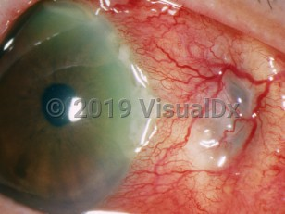
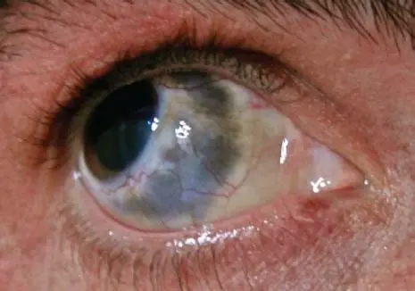

Slide 23
Investigation
ESR
CRP
RA factor
ANA
ANCA

Slide 24
Posterior Scleritis
It is a potentially blinding condition. It is defined as involvement of the sclera posterior to the rectus muscles.
Symptoms
Pain, redness
Signs
Inflammation extending to optic disc
Inflammation of muscles causing myositis Periorbital oedema, chemosis
Raised IOP

Slide 25
B SCAN IN POSTERIOR SCLERITIS

Slide 26
Treatment of Immune mediated Scleritis
Topical steroids
May relieve symptoms and oedema in necrotizing disease.
Systemic NSAIDs
Systemic Steroids :They are used when NSAIDs are in appropriate or inadequate as in necrotizing disease.
Immunomodulatory agents: Should be considered when control is
a) incomplete wit steroids alone
b) Steroid sparing agent
c) to treat underlying disease.

Slide 27
MCQ
A patient came to eye opd with presenting complaints of,redness ,grittiness,photophobia along with discomfort in the right eye over the past few days.On Slit lamp examination there was redness in the interpapebral region.What is diagnosis ?
A ) Nodular Episcleritis
B ) Diffuse Non necrotizing scleritis
C) Nodular non necrotizing scleritis
D ) Anterior Necrotizing scleritis with inflammation.
E) Simple Episcleritis

Slide 28
MCQ
A patient came to eye opd with presenting complaints of pain redness in the right eye for the last few days. The pain was quire severe radiating to face and temple and waking the patient in early hours of morning. The redness was generalized on slit lamp examination . What is the diagnosis ?
A) Nodular scleritis
B) Nodular episcleritis
C) Simple Episcleritis
D ) Diffuse Scleritis
E ) Posterior Scleritis

Slide 29
MCQ
A patient came to eye opd with presenting complaints red eye for the last 2 days. The patient was experiencing discomfort. On slit lamp examination there was a tender red vascular nodule. What is your diagnosis ?
A ) Nodular episcleritis
B ) Diffuse Episcleritis
C ) Diffuse Scleritis
D ) Nodular scleritis
E ) Scleromalcia Perforans

Slide 30
Artificial Intelligence
AI can contribute to scleritis management in several ways:
Diagnostic Assistance: AI algorithms can analyze images of the eye, such as fundus photographs or optical coherence tomography (OCT) scans, to identify characteristic signs of scleritis. By detecting subtle changes or patterns indicative of scleritis, AI systems can assist ophthalmologists in making accurate and timely diagnoses.
Risk Prediction: AI models can analyze various patient data, including medical history, demographics, and clinical findings, to predict the risk of developing scleritis or its complications. This predictive capability can aid in early intervention and personalized treatment planning.
Treatment Optimization: AI can help optimize treatment strategies by analyzing large datasets of patient outcomes and treatment responses. By identifying patterns in treatment efficacy and adverse effects, AI systems can assist clinicians in selecting the most effective and well-tolerated therapies for individual patients.

Slide 31
Research in the treatment of Necrotizing Scleritis
Research in the treatment of necrotizing scleritis focuses on several key areas:
Immunosuppressive Therapy: High-dose systemic corticosteroids are often the first-line treatment to control inflammation. However, due to potential side effects with long-term use, research explores alternative or adjunctive immunosuppressive agents such as methotrexate, cyclophosphamide, azathioprine, mycophenolate mofetil, and biologic agents like tumor necrosis factor (TNF) inhibitors (e.g., infliximab).
Biologic Therapies: Biologic agents targeting specific inflammatory pathways have shown promise in treating necrotizing scleritis, particularly in cases refractory to conventional therapies. These include anti-TNF agents (e.g., infliximab, adalimumab), rituximab (anti-CD20 monoclonal antibody), and tocilizumab (IL-6 receptor antagonist).
Surgical Interventions: In cases of impending or actual scleral perforation, surgical interventions may be necessary to reinforce the sclera and prevent globe rupture. These include scleral patch grafting, amniotic membrane transplantation, and tectonic keratoplasty.
Emerging Therapies: Research continues to explore novel treatment modalities for necrotizing scleritis, including newer biologic agents, targeted immunomodulators, and regenerative medicine approaches such as stem cell therapy.

