Slide 1
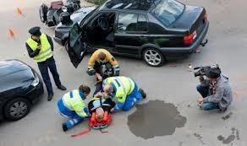
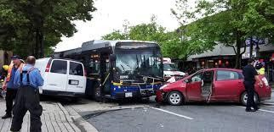
Transportation Injuries
/Accidents (R T A) 337 G
Dr Filza ali & Dr Shahrukh

Slide 2
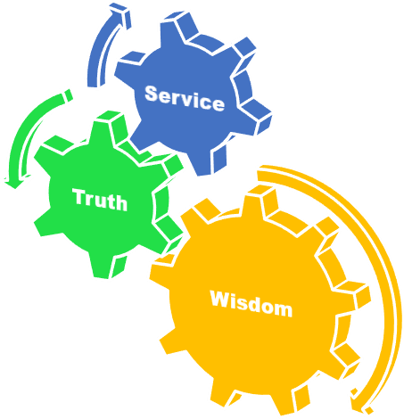
Vision of RMU
The Dream/ Tomorrow
To impart evidence based research oriented medical education
To provide best possible patient care
To inculcate the values of mutual respect and ethical practice of medicine
State the role of medico legal officer in case of receiving burnt dead body.

Slide 3
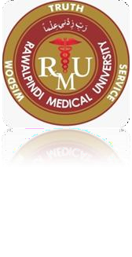
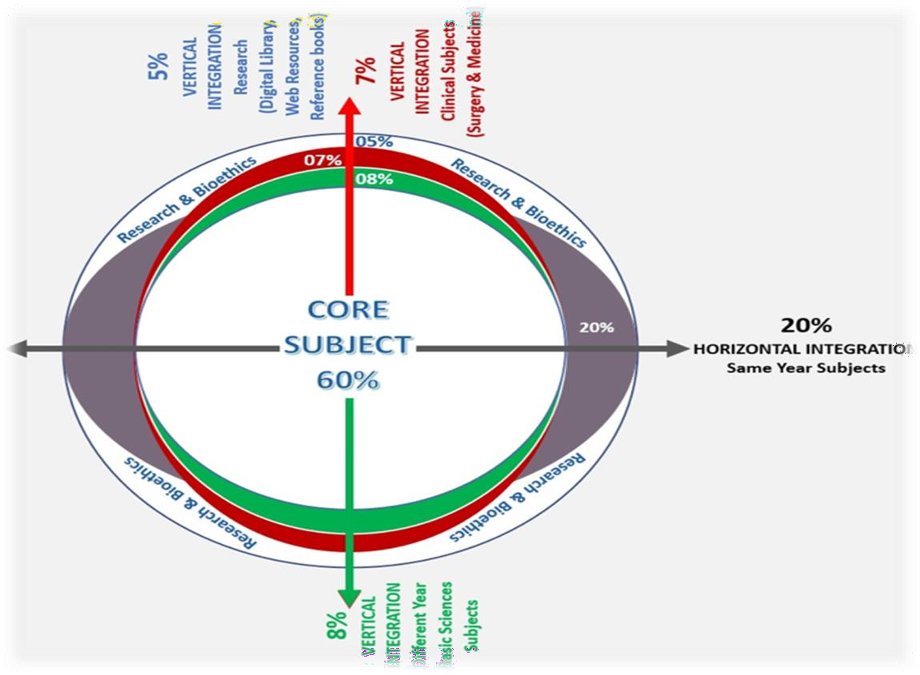
Prof Umar’s LGIS model

Slide 4
SEQUENCE OF LGIS
Learning Objectives
Core concept 70 %
Horizontal integration related to Pathology and Pharmacology 15 %(if applicable)
Relevant clinical concepts and medico legal application of core knowledge / Vertical integration 10%
Research article relevant to the topic 3%
Ethics and family medicine 2%

Slide 5
Learning Objectives
Describe injuries to pedestrian
injuries sustained by occupant of a vehicle.
Define terms like Bird foot injury, waddle’s triad and Dicing injuries.
injuries sustain by motorcyclist

Slide 6
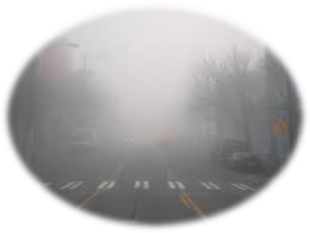
CAUSES OF RTA (ROAD TRAFFIC ACCIDENTS)
Core Concept
MECHANICAL CAUSES
ENVIROMENTAL CAUSES
HUMAN CAUSES

Slide 7
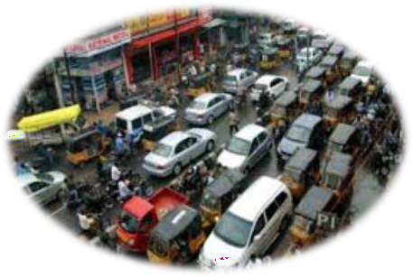
A: MECHANICAL CAUSES
Core Concept
Tyre burst
Breaking of tie-rod
Failure of brakes

Slide 8
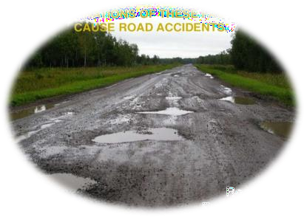
B: ENVIROMENTAL CAUSES
Core Concept
Poor visibility (fog , rain)
Mixed traffic ( slow & fast moving, pedestrians, animals)
Audio visual distractions.
Condition of roads, open holes, gutters, speed breakers etc.

Slide 9
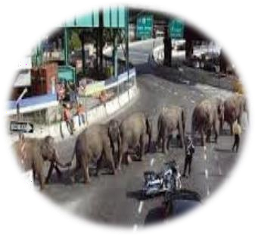
C) HUMAN CAUSES
Core Concept
Age (minimum?, maximum?)
Physical disability (poor vision, hearing loss , loss of vision or limb)
Drugs (alcohol, tranquilizer)
Drugs delay the reaction time. If the level of alcohol is 80mg% or more the driver is charge.
Fatigue
Low driving standard
Motor Vehicle Ordinance 1965

Slide 10
CLASSIFICATION OF RTA
Core Concept
NO. OF VEHICLES INVOLVED
Single
More than one
DIRECTION OF IMPACT
Frontal impact
Lateral impact
Rear impact

Slide 11
3. Extent Of Damage To The Injured
Core Concept
Minor (injuries trivial, victim not hospitalized).
Moderate (injuries serious, victim hospitalized for a week).
Severe(injuries endanger life, victim hospitalized for more than a week).
Fatal (injuries fatal for life, victim dies on the spot or within 30 days of hospitalization).

Slide 12
4. Motive of accident
Core Concept
Crash with out motive ( due to intoxication or any other reason)
Crash with motive ( homicide or to mask it, or suicide)

Slide 13
Road Traffic Injuries
Core Concept
Vehicle occupants
Driver
Front seater Rear seaters
Outsiders
Pedestrians

Slide 14
PEDESTRIAN
Core Concept
PRIMARY IMPACT
SECONDARY IMPACT
SECONDARY INJURIES
waddle’s triad
D) RUN OVER INJURIES

Slide 15
1. Primary impact injuries: caused by the first impact between vehicle and the victim. It depends upon the height of pedestrian (children, adults).
Core Concept
Bumper fracture/Fender fracture: Fracture of tibia and fibula of one or both legs due to impact of bumper. (Height of fracture depends on whether the brakes were applied or not).

Slide 16
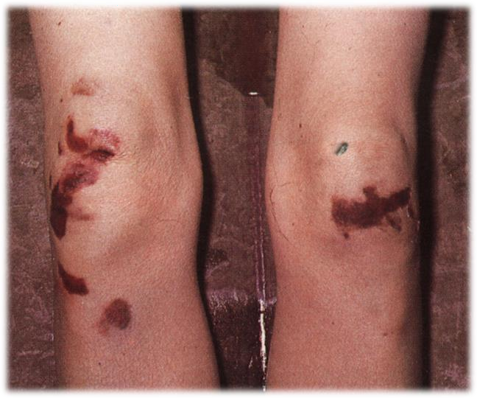
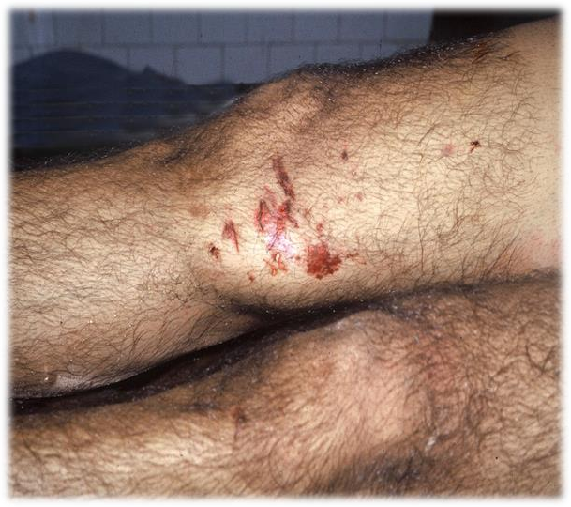
Pedestrian injury
Road traffic accidents
Core Concept
Bumper injuries

Slide 17
Core Concept
2. Secondary Impact Injuries: due to subsequent impact with the same vehicle.
It depends on the point of impact of injury.
If it is at or above the centre of gravity as in children, the victim is directly thrown to the ground.
If it is below the centre of gravity, then victim will lift up to the vehicle.

Slide 18
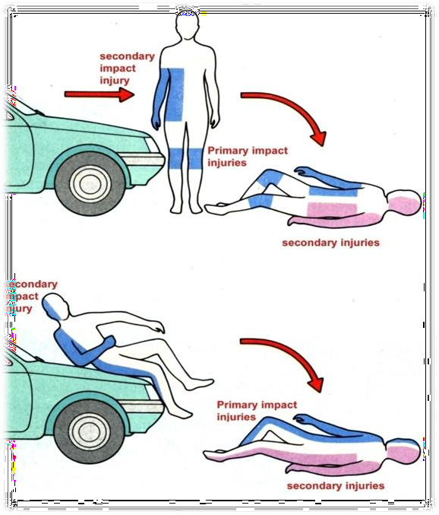
Core Concept
SECONDARY INJURIES:
These injuries are due to the victim falling on the ground. These injuries can be due to:
Fall on the ground or hitting
some other object on ground.
Hit by other vehicles.

Slide 19
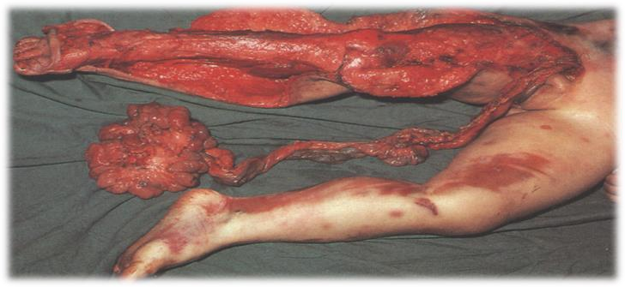
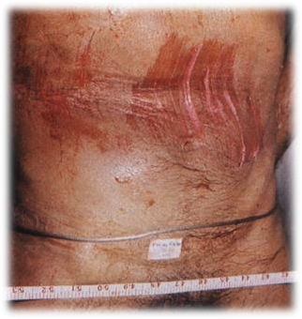
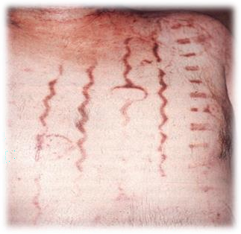
4. RUN OVER INJURIES
Core Concept
Dragging, brush burn
Tyre marks
Degloving, avulsion

Slide 20
Occupant injuries
Core Concept
Driver injuries
Passenger injuries
Depend upon the type of impact:
Front impact crash
Side impact crash
Rear impact crash
Roll-over crash
Other mishaps

Slide 21
1. Front impact crash (Head on collision)
Core Concept
This means that one car strikes another car head-on or it strikes a fixed object.
Vehicle rapidly decelerates and stops. The occupants continue to move and strike against the interior of the vehicle.
The driver may receive different injuries due to steering wheel and dashboard:
Fractures of wrist, arms, legs, pelvis, teeth, jaws, ribs etc.

Slide 22
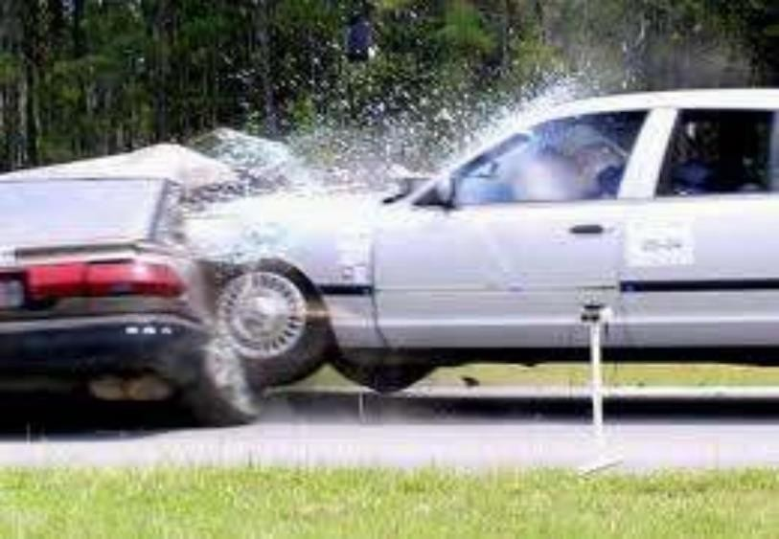
2. Side impact crash (Lateral impact)
Core Concept
When the vehicle is struck on the side by another vehicle or skids sideways into a fixed object.
Cervical spine fractures are common.
Chest and abdominal injuries can occur. Middle of the body is involved

Slide 23
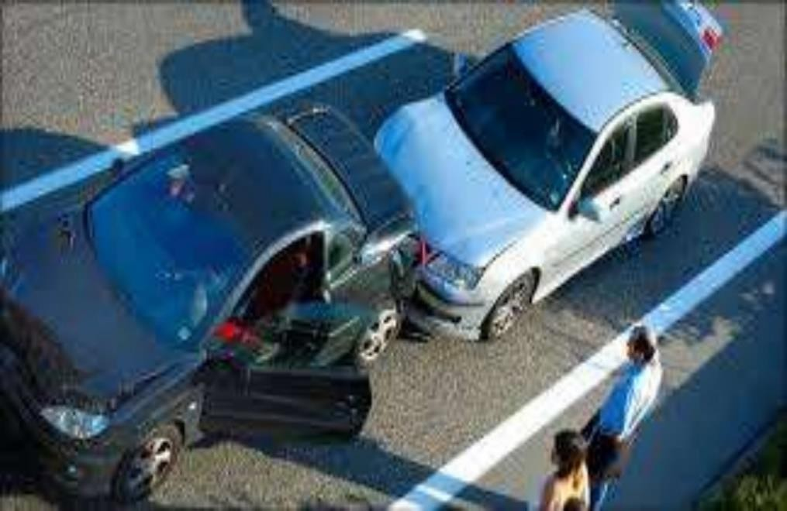
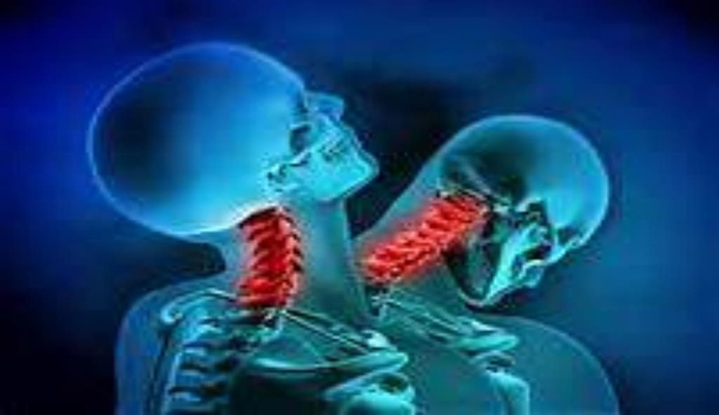
3. Rear impact crash
Core Concept
When a vehicle is struck from back by another vehicle.
Whiplash injury is common(C4-C6). Raised back rest prevents neck injuries.
Lumbar and hip region injuries also seen.

Slide 24
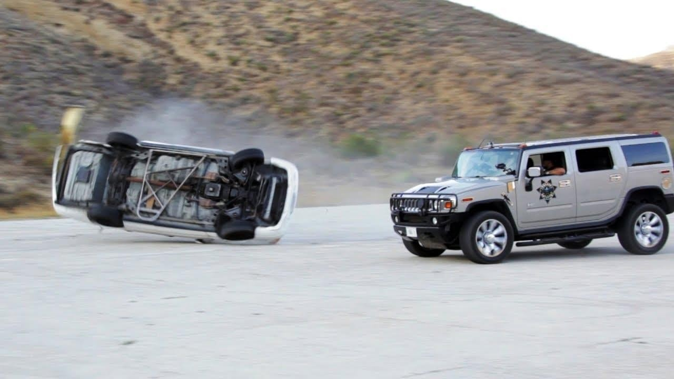
4. Roll-over crash
Core Concept
The occupants receive surprisingly moderate injuries as the vehicle is not brought to a sudden stop.

Slide 25
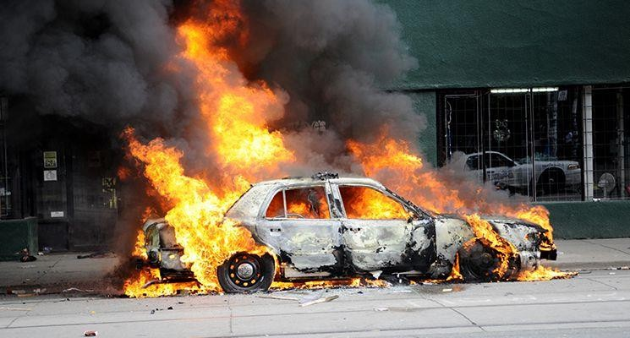
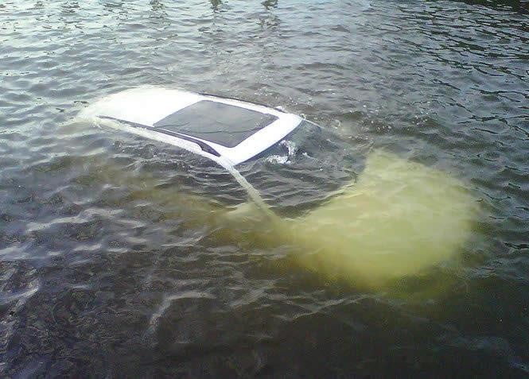
Other mishaps
Core Concept
Ejection
Fire
Submersion.
Ejection:
When a person is thrown out of the vehicle from broken wind screen and from the doors.
Non ejection:
When person remains inside the vehicle.

Slide 26
Typical steering wheel injuries
Core Concept
Occurs only in the driver.
Head and Face:
Fracture teeth, jaw, facial bones and head injuries from wind screen. Coup and contre coup, bird foot injury.
Chest:
Chest of the driver compressed against steering wheel. Multiple rip fractures.
Neck:
Hyper-flexion of thoracic and cervical spine injury.
Hyper extension, whiplash to cervical spine.
Lower limb
Fracture hip, femur, tibia, fibula occurs from force transmitted to leg by applying brakes.
Seat belt:
Seat belt injury. Chest and abdomen compressed
Dead body of the driver can be recognized by typical steering wheel injury.

Slide 27
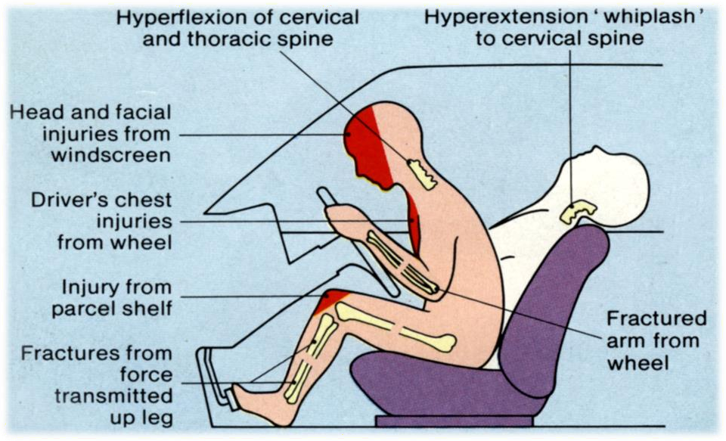
Injuries to driver
Road traffic accidents
Core Concept

Slide 28
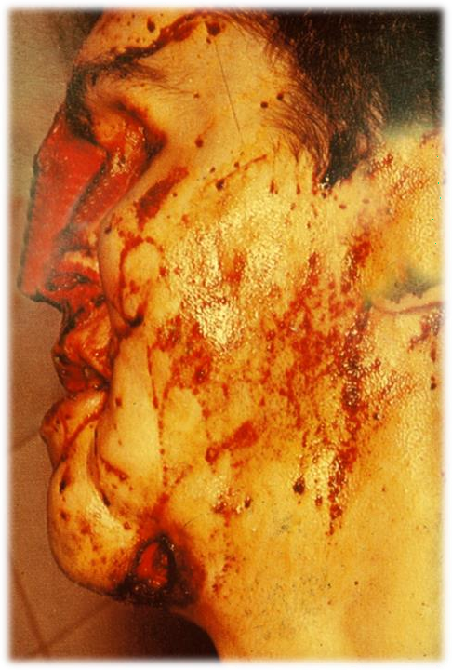
Bird Foot Injuries:
Core Concept
These injuries are abrasions, superficial vertical cuts on the face due to tiny pieces
of wind shield glass.
They are commonly found on face and neck of driver and front seat passengers.
Dice injuries
These are characteristic right angled or
V shaped cuts caused by diced or cubical fragments of glass of a broken side window.

Slide 29
INJURIES TO FRONT SEAT PASSENGER
Core Concept
Striking against wind screen
Head injury, dislocation of cervical spine (whiplash)
Dash board injury
Lacerated wound, contusions, abrasions.
Applying brakes
Fracture of the tibia fibula by transfer of force along the leg, when brakes are applied. It is spontaneous reaction.
Bird foot injury

Slide 30
INJURY TO THE BACK SEAT PASSENGERS
Core Concept
No wind screen, no dash board……. get injuries from door
structure, back of front seat & projecting objects.
REAR IMPACT:
Accelerates the vehicle… injury to neck, lumbar region and hip
region.
LATERAL IMPACT:
Middle parts of body involved main injuries are crush injuries.
EJECTION INJURIES:
Run over or dragging, if door opens.
HITTING AGAINST THE TOP OF VEHICLE:
Head injury, fracture, dislocation of cervical spine.

Slide 31
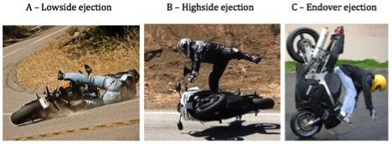
Injuries sustained by motorcyclist
Core Concept
Injuries sustained by motorcyclist are much more serious than car travelers
Inherent instability of two-wheeler
Unprotected and lack of protective gear
Rash and negligent driving
31

Slide 32
Head
Core Concept
Injury sustained to head is common in motorcyclist
Injury to lateral part with fracture of temporo-parietal bone is more common.
basal skull fractures especially hinge type also called as motorcyclist fracture
Impact on face causes fracture of facial skeleton.
Impact on forehead causes sagittal fracture of base of skull
Impact on chin causes mandibular fracture.
32

Slide 33
Seat Belt Injuries
Core Concept
Though seat belts prevent injuries and reduced death rate, however, at times cause injuries
1. Lap-strap type
2. Shoulder diagonal type
3. Diagonal plus lap-strap
4. Shoulder harness
Seat belt injuries may be simple or fatal
Contusion due to seat belt is common and may occur over chest or abdomen
33

Slide 34
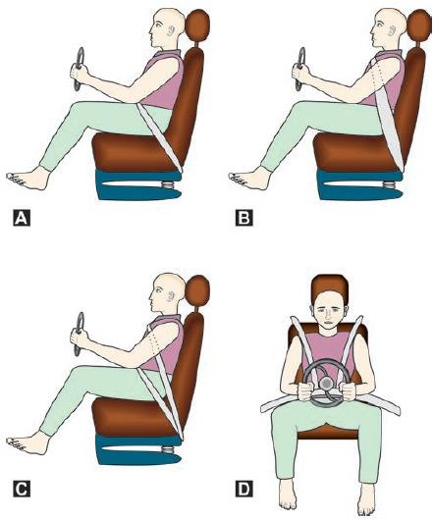
Core Concept
34

Slide 35
RESEARCH
RESEARCH
https://core.ac.uk/download/pdf/228552460.pdf
https://www.researchgate.net/publication/371219757_A_Review_Paper_on_Road_
Traffic_Accidents_RTA_Trends_in_Kathmandu_Valley
https://www.researchgate.net/publication/281361304_AN_EMPIRICAL_STUDY_
OF_ROAD_ACCIDENTS_INFLUENCE_OF_THE_COSTS_OF_LIVING

Slide 36
The 4 basic ethical principles of
ETHICS
Beneficence
Non-Maleficence
Respect for autonomy
Justice
https://www.ncbi.nlm.nih.gov/pmc/articles/PMC2 967260/
BIOMEDICAL ETHICS

Slide 37
FAMILY MEDICINE
FAMILY MEDICINE
Prevention is a responsibility of every family practitioner as he prescribes and counsels in his office. He has a limited role at an accident scene, but here he supports the patient and may assist personnel of ambulance, police or fire services. In the receiving hospital emergency room the priorities of emergency care, investigations and the indications for transfer of the patient to another facility plays important role. If the victim dies, the relatives' mourning is helped by organ donation and the initiative of the family practitioner in these circumstances may help many people.

Slide 38
How to use HEC Digital Library
Go to the website of HEC National Digital Library
http://www.digitallibrary.edu.pk
On Home Page, click on the INSTITUTES.
A page will appear showing the universities from Public and Private Sector and other Institutes which have access to HEC National Digital Library (HNDL).
Select your desired Institute.
A page will appear showing the resources of the institution
Journals and Researches will appear
You can find a Journal by clicking on JOURNALS AND DATABASE and enter a keyword to search for your desired journal

Slide 39
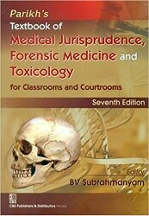
TEXT BOOKS & PRACTICAL NOTEBOOK:
Principles & Practice of Forensic Medicine. by Nasib R. Awan
Parikh’s Textbook of Medical Jurisprudence,
Forensic Medicine & Toxicology.
Practical Manual Of Forensic Medicine
& Toxicology

Slide 40
39

