Slide 1
REGIONAL INJURIES
Dr Filza ali & Dr Shahida

Slide 2
Motto Vision; The Dream/Tomorrow
Wisdom
Truth
Service
To impart evidence based research oriented medical education
To provide best possible patient care
To inculcate the values of mutual respect and ethical practice of medicine

Slide 3
Professor Umar Model of Integrated Lecture
60%
CORE SUBJECT
20%
HORIZONTAL
INTEGRATION
Physiology
biochemistry
8%
VERTICAL INTEGRATION
Pathology
pharmacology
7%
VERTICAL INTEGRATION
Clinical integration
5%
VERTICAL INTEGRATION
Research, professionalism
Ethics
Digital library

Slide 4
SEQUENCE OF LGIS
Learning Objectives
Core concept 70 %
Horizontal integration related to Pathology and Pharmacology 15 %(if applicable)
Relevant clinical concepts and medico legal application of core knowledge / Vertical integration 10%
Research article relevant to the topic 3%
Ethics and family medicine 2%

Slide 5
LEARNING OBJECTIVES
Briefly describe head injury, scalp injury, injury to skull and brain
Classify skull fractures
Explain the method of coup and contrecoup injuries
Describe injury to spine and spinal cord (whiplash injury)
Describe thoraco abdominal injuries especially injury to spleen and liver

Slide 6
Head injuries
Core Concept
Closed head injury: when the dura remains intact.
Open head injury: when the dura is lacerated.
Classification:
Injuries to scalp/muscles
Injuries of Skull
Injuries of brain

Slide 7
Injuries of Scalp
Core Concept
Bruising of scalp
Laceration of scalp
Infections

Slide 8
2. Fractures of skull
Core Concept
The fractures of skull can occur either by direct or indirect violence.
The base of skull is relatively weak part due to its irregular shape and foramina,
therefore it is the most common site of skull fractures.
Outer table is stronger………..than inner table.

Slide 9
Types of fractures of the skull
Core Concept
Fissured fracture.
Sutural fracture
Depressed/signature fracture.
Comminuted fracture.
Pond or indented fracture.
Gutter fracture.
Penetrating fracture.
Elevated fracture.
Spider web fracture or mosaic fracture.

Slide 10
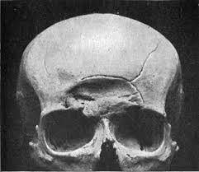
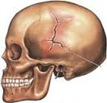
Fissured ( linear), Hairline fracture
Core Concept
This is a linear fracture or crack involving the outer or inner table or both.

Slide 11
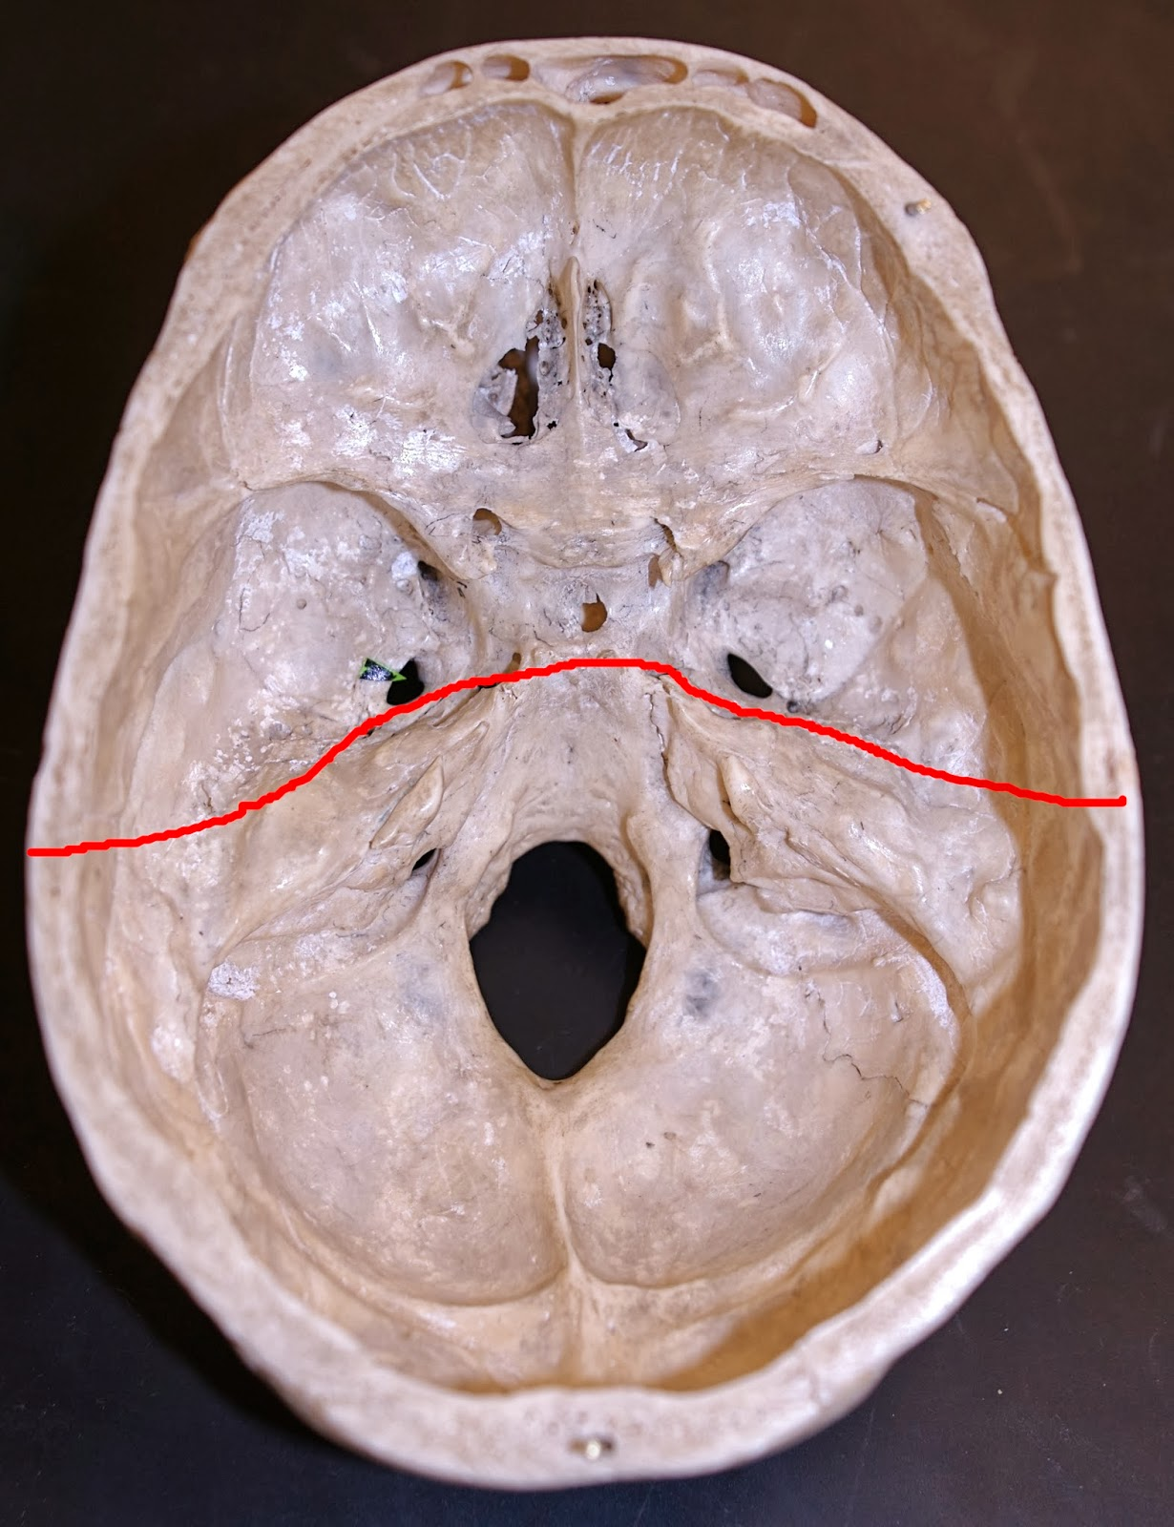
Diastasis or sutural fracture
Core Concept
In children and young adults a linear fracture may pass into a suture line and causes a diastasis or opening of the weaker suture between bones.
The most commonly involved suture is sagittal.
Common in child abuse syndrome.

Slide 12
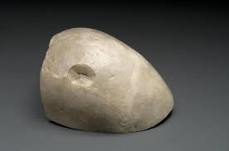
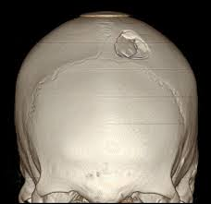
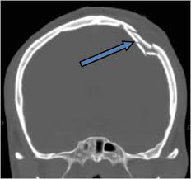
Depressed fracture
Core Concept
This is caused by a heavy weapon with a small striking surface, eg, hammer.
The fracture bone is driven inward and its shape may indicate the type of the weapon, therefore it is also know as SIGNATURE FRACTURE.

Slide 13
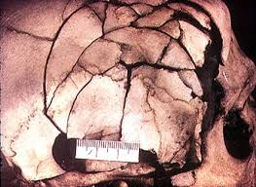
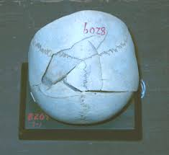
Comminuted fracture
Core Concept
The bone is broken into two or more pieces.

Slide 14
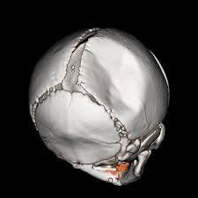
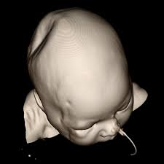
Pond or indented fracture
Core Concept
Pond fracture occur in children due to elasticity of their skull bones.

Slide 15
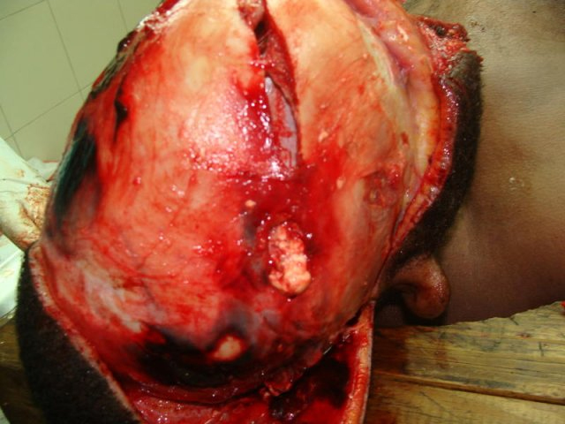
Gutter fracture
Core Concept
When a part of the thickness of skull bone is removed, eg, in glancing bullet wounds.

Slide 16
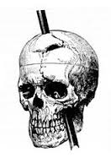
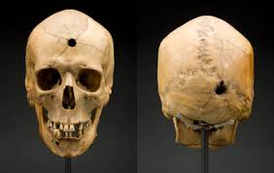
Penetrating fracture
Core Concept
This is clean cut opening due to a penetrating weapon, eg, dagger, rod or bullet.

Slide 17
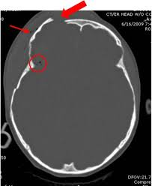
Elevated fracture
Core Concept
Elevation of one end of bone above the surface of skull while the other end may dip down in the cranial cavity.

Slide 18
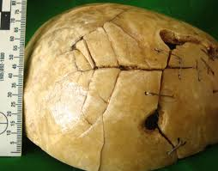
Spider web fracture or mosaic fracture
Core Concept
A comminuted depressed fracture may also have fissure radiating from it forming a spider web.

Slide 19
Fractures of base of skull
Core Concept
Anterior cranial fossa
Middle cranial fossa
Posterior cranial fossa
Around the foramen magnum

Slide 20
Fracture of anterior cranial fossa
Core Concept
CAUSES:
Direct Impact
Heavy Blow On Chin
May result from contre coup injuries.
MENIFESTATIONS:
It manifests by escape of blood & CSF from nose & black eye.

Slide 21
Fracture of posterior cranial fossa
Core Concept
CAUSES:
Direct impact on back of head.
MANIFESTATION:
Escape of blood and CSF in tissue of the back/ neck.

Slide 22
RING FRACTURE (Fracture around foramen magnum)
Core Concept
CAUSES :
It results from fall from height on feet & buttocks.
Sudden violent turn of head on spine.
Severe blow on vertex
Heavy blow directed underneath the occiput or chin.

Slide 23
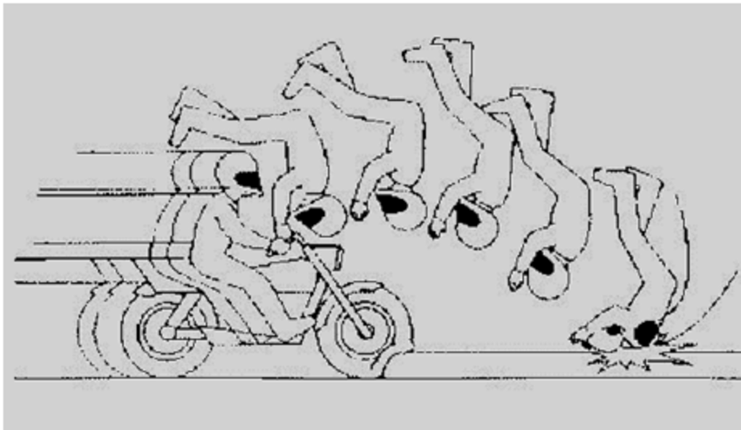
MOTORCYCLISTS FRACTURE
Core Concept
Also called Hinge fracture or Transverse fracture
This is a fracture of the base of the skull that completely splits it , creating a hinge
It frequently occurs with side impacts
NODDING FACE sign

Slide 24
3. INJURY TO THE BRAIN
Core Concept
Extra/epi-dural heamorrhage:
Bleeding above the dura mater, between skull and dura. Cause of this bleed is rupture of middle meningeal artery.
Sub-dural heamorrhage:
Bleeding between dura and arachnoid mater. It is due to injury to cerebral vein.
Sub-arachnoid heamorrhage:
Bleeding between pia mater and arachnoid mater. Caused by injury to cerebral artery.
4. Intra cerebral heamorrhage:
Bleeding within brain
(plz do differences)

Slide 25
BOXER’S HMG/PUNCH DRUNK (Traumatic Encephalopathy, Slug happy, Slug nutty, Goofy)
Core Concept
This occurs mostly in boxers when multiple punches/ jolts are given on the head, chronic micro injuries occur to the brain.
Seen in boxers and he looks like under the influence of alcohol(drunkenness). But actually he has not taken alcohol.
Boxers heamorrhages:
Seen in boxers
Apoplexy
Intracranial heamorrhage from any condition other than trauma e.g. diabetes, hypertension.

Slide 26
COUP AND CONTRECOUP INJURIES
Core Concept
These injuries usually occur in ROAD TRAFFIC ACCIDENTS or FALLS
They are due to moving head being more or less suddenly brought to stop against a large usually stationary object.
These are also called Deceleration /negative acceleration injuries

Slide 27
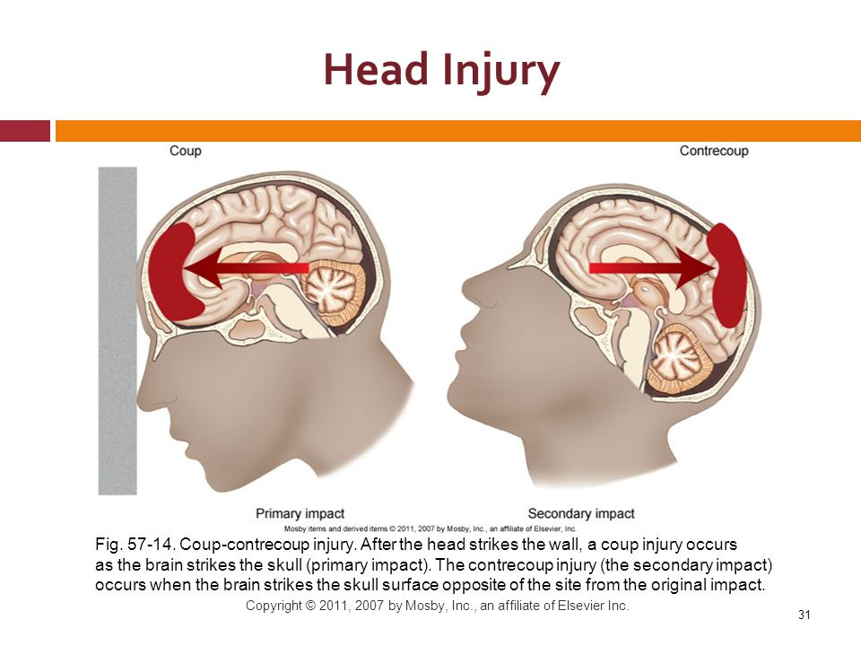
Coup and Contre Coup Injuries
Core Concept

Slide 28
Coup injuries
Core Concept
A coup injury ( coup = blow ) is one which occurs immediately beneath the area of impact. Head is fixed.

Slide 29
Contre coup injury
Core Concept
A contre coup injury ( contre = opposite; coup = blow ) is one which is situated on the opposite side of the area of impact.
Head is free to move.

Slide 30
Requirements for Contre coup injury
Core Concept
Cavity
There should be a cavity for a contre coup injury to occur e.g. cranial, thorax.
Contents of cavity
Injuries occur to the content of the cavity and not to the cavity itself e.g. in cranial cavity injury occurs to the brain.
Opposite to site of impact
Free movement
Without movement contre coup injury cannot occur.

Slide 31
Core Concept
LUCID INTERVAL:
It is a state of consciousness between two states of unconsciousness seen in epi/extra dural hematoma .
Unconsciousness ------- due to concussion
Consciousness ---------- due to recovery
Unconsciousness ------- due to raised intracranial tension due to bleeding

Slide 32
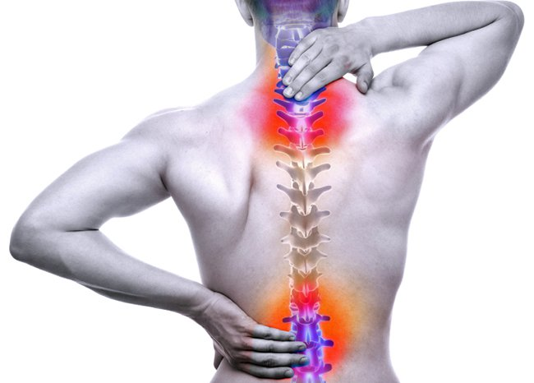
SPINAL CORD INJURIES
Core Concept
INJURIES TO CORD:
Concussion: Just loss of function of spinal cord not anatomical damage.
Compression: Dislocation of vertebrae causes compression.
Pithing: A needle is inserted into the nape of the neck to kill an infant.
Laceration
INJURIES
Railway spine: Concussion of spinal cord in railway accidents is called railway spine. Transient paralysis of arms, hands, bladder, rectum, lower limbs with or without loss of sexual function. Recovery unless cord lacerated.
Whiplash injury/ jack knife injury: Momentary dislocation of cervical spine C4-C6-------contusion-------self reduction

Slide 33
WHIPLASH INJURY
Core Concept
It is an acceleration deceleration mechanism of energy transfer to the neck that may result in bony and soft injuries
Commonly seen in RTA s due to hyperextension of the neck
Sustained by occupants of the front seat in a motor vehicle
AUTOPSY FINDINGS ;
Facet joint, yellow ligament, uncovertebral and disc/ end plate lesions may be seen
An area of hemorrhagic discolouration on the surface or in substance of the cord or subthecal effusions of blood may be found

Slide 34
WHIPLASH INJURY
Core Concept

Slide 35
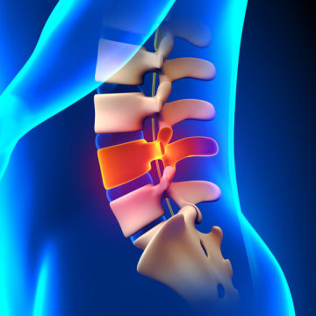
Indications of opening spinal cord during autopsy
Core Concept
Ordinarily spinal cord is not opened in autopsy examination.
It is opened in following conditions.
Local trauma
Negative autopsy
Death from convulsions e.g. tetanus, nux vomica
Battered babies/ wives/ husbands
Most common site of fractures/ dislocation
C4 to C6
T3 to T6
T10 to L3

Slide 36
CHEST INJURIES
Core Concept
Injuries of the chest may be :
NON PENETRATING OR CLOSED
They do not open up any part of the thoracic cavity
Usually caused by blunt force
PENETRATING OR OPEN
If parietal pleura is damaged ,it will produce an open pneumothorax

Slide 37
RIBS
Core Concept
Blunt injury may result in the fracture of the ribs
if compression is front to back……lateral ribs fractures
Back to front compression ……fracture of ribs near the spine
Side to side compression ……fracture of ribs near spine and sternum
Middle ribs from 4th to 8th are usually fractured
Flail chest occurs when at least 3 successive ribs are fractured at 2 points
Fractures of the sternum are not common

Slide 38
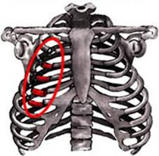
Flail Chest (Collapse of the chest)
Core Concept
It occurs when at least three successive ribs are fractured at two points creating a floating segment of chest wall.
Floating segment is sucked inward during inspiration

Slide 39
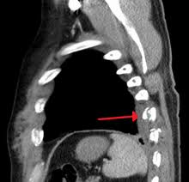
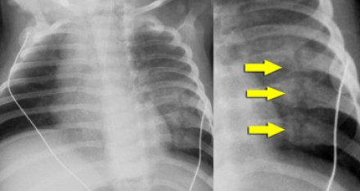
Core Concept
NOBBING FRACTURE
It is seen in child abuse. Child is held in both hands around the thorax. Fingers are kept on spinal cord and thumb on thorax/chest. Child is vigorously shaken. Fractures occur at different points at different times.

Slide 40
SPLEEN
Core Concept
Most common organ to be injured in blunt abdominal trauma
Penetrating wounds are less common but bleeding is more profuse
Spleen may be injured by forces of compression and traction
Compression forces produce lacerations
Traction forces may tear the spleen from its pedicle
Ruptured usually in its concave (visceral surface)
Lacerations are usually transcapsular and may occur at hilar or convex surface
Laceration of the spleen produces rapid and profuse hemorrhage leading to hypotension

Slide 41
LIVER
Core Concept
Second most frequently damaged abdominal organ in blunt trauma
Commonly ruptured by motor accidents,blow, kick or sudden contraction of abdominal muscles
Liver is more susceptible than spleen to penetrating injury.
The right lobe is five times more commonly affected than the left
Convex surface and inferior border are commonly involved
Laceration of the liver produces slow but considerable bleeding over a period of time

Slide 42
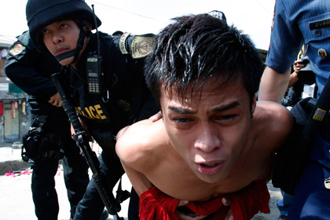
CRUSH SYNDROME
Core Concept
Muscles are crushed as in police torture. Acid metabolites are realized from crushed muscles. -------------- enter circulation------- kidney tries to excrete causing kidney failure.
In such cases both kidneys are sent to the chemical examiner.

Slide 43
The principle of beneficence is the obligation of physician to act for the benefit of the patient and supports a number of moral rules to protect and defend the right of others, prevent harm, remove conditions that will cause harm, help persons with disabilities, and rescue persons in danger. It is worth emphasizing that, the language here is one of positive requirements. The principle calls for not just avoiding harm, but also to benefit patients and to promote their welfare.
Ethics
Vertical integration
Beneficence
TAKE HOME MESSAGE

Slide 44
Related Research Article :
Research
Study of Skull Fracture Pattern in Cases with Head Injury by Blunt Force:
https://pjmhsonline.com/2017/jan_march/pdf/486.pdf

Slide 45
FAMILY MEDICINE
Patients attending an emergency department (ED) are entitled to assume that they will be treated in accordance with the best available evidence. The emergency physician (EP) has a responsibility to expand the fund of knowledge that underpins best evidence by means of clinical studies of new technologies and interventions:
NSAIDs , such as ibuprofen, help decrease swelling, pain, and fever. This medicine is available with or without a doctor's order. NSAIDs can cause stomach bleeding or kidney problems in certain people. If you take blood thinner medicine, always ask if NSAIDs are safe for you.
FAMILY MEDICINE

Slide 46
How To Access Digital Library
Steps to Access HEC Digital Library
Go to the website of HEC National Digital Library.
On Home Page, click on the INSTITUTES.
A page will appear showing the universities from Public and Private Sector and other Institutes which have access to HEC National Digital Library HNDL.
Select your desired Institute.
5. A page will appear showing the resources of the institution
6. Journals and Researches will appear
7. You can find a Journal by clicking on JOURNALS AND DATABASE and enter a keyword to search for your desired journal.

Slide 47
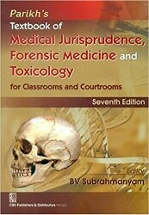
TEXT BOOKS & PRACTICAL NOTEBOOK:
Principles & Practice of Forensic Medicine.
by Nasib R. Awan
Parikh’s Textbook of Medical Jurisprudence,
Forensic Medicine & Toxicology.
Practical Manual Of Forensic Medicine
& Toxicology

Slide 48
THANK YOU

