Slide 1


Slide 2


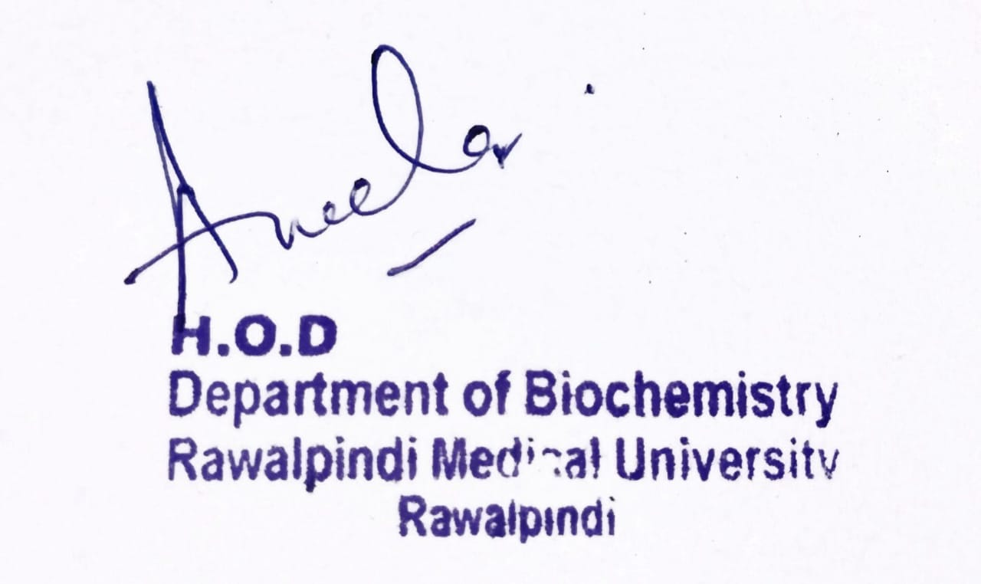
Foundation Module
2nd Year MBBS(LGIS)
Protein Metabolism
Presenter: Dr Uzma Zafar Date: 01-02-25
Deptt of Biochemistry
RMU

Slide 3
Motto, Vision, Dream
To impart evidence based research oriented medical education
To provide best possible patient care
To inculcate the values of mutual respect and ethical practice of medicine
Wisdom
Truth
Service

Slide 4
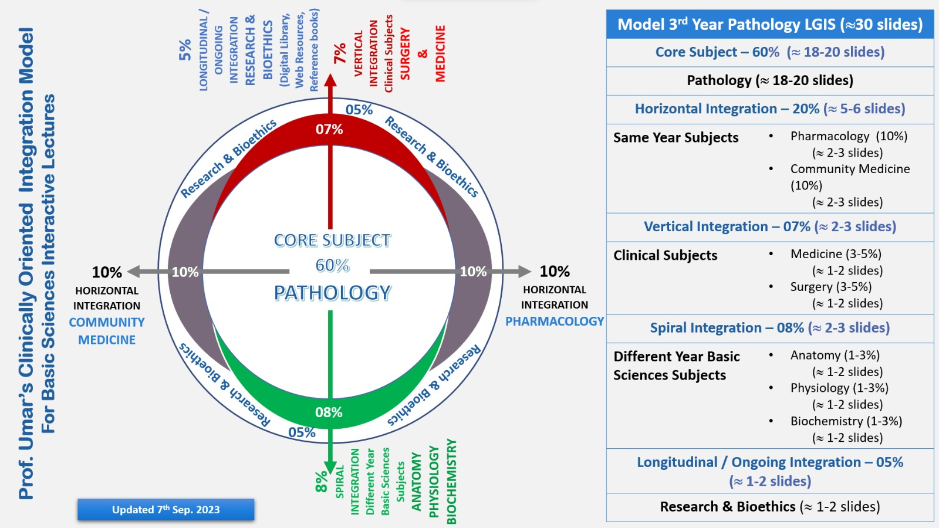
Professor Umar Model of Integrated Lecture

Slide 5
Learning Objectives
At the end of the lecture, students will be able to:
Describe chemical reactions of amino acids
Discuss the metabolism of ammonia
Sources OF ammonia
transport of ammonia
its toxicity and disorders

Slide 6
Core
Knowledge
Introduction to Protein Metabolism:
:
Amino acids are not stored by the body therefore amino acids must be obtained from the diet, synthesized de novo, or produced from the degradation of body protein.
The first phase of catabolism involves the removal of the α-amino groups, forming ammonia and the corresponding α-keto acids, the carbon skeletons of amino acids.
In the second phase of amino acid catabolism, the carbon skeletons of the α-keto acids are converted to common intermediates of energy-producing metabolic pathways.
These compounds can be metabolized to carbon dioxide (CO2 ) and water (H2O), glucose, fatty acids, or ketone bodies.

Slide 7
Core
Knowledge
Biochemical reactions of Amino Acids in the Body
1.Transamination
Amino Acid is deaminated to from a keto acid and NH2 group liberated from amino acid aminates an other keto acid to form another amino acid.
Alanine + α- Ketoglutarate Glutamate + Pyruvate
Oxaloacetate + Glutamate Aspartate + α- Ketoglutarate

Slide 8
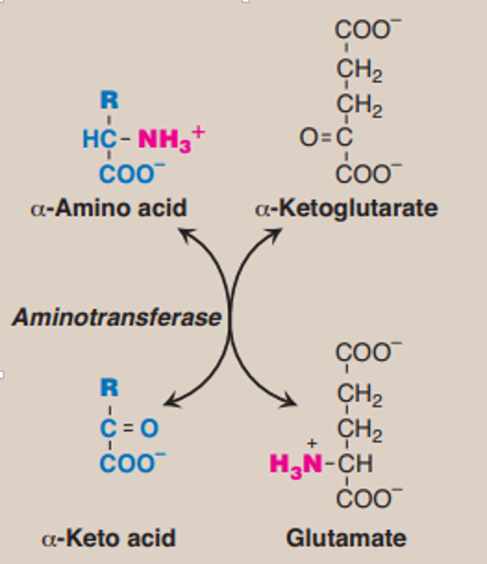
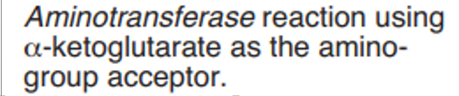
Core
Knowledge

Slide 9
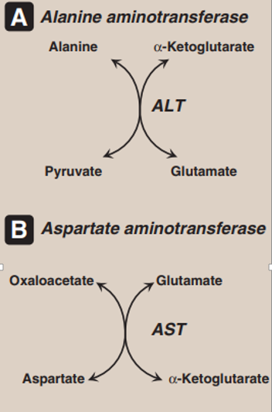

Core
Knowledge

Slide 10
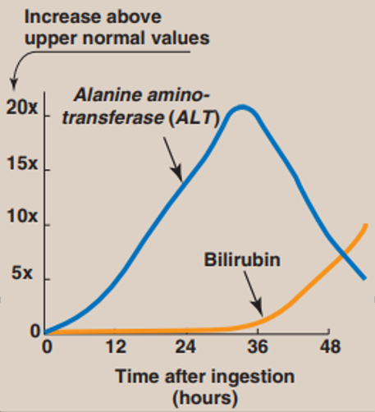
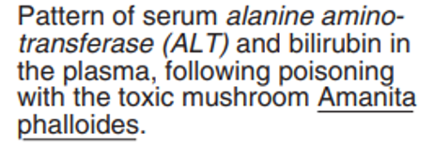
Core
Knowledge

Slide 11
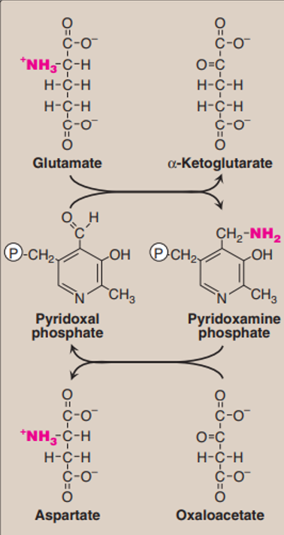
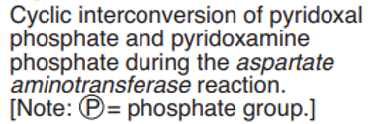
Core
Knowledge

Slide 12
Core
Knowledge
2. Trans methylation
S–Adenosylmethionine act as methyl donor
E.g. In the formation of Adrenaline from Nor–Adrenaline
S–Adenosylmethionine + Nor – Adrenaline Adrenaline + S–Adenosyl homocysteine
Other examples of Trans methylation are:
Formation of Creatine

Slide 13
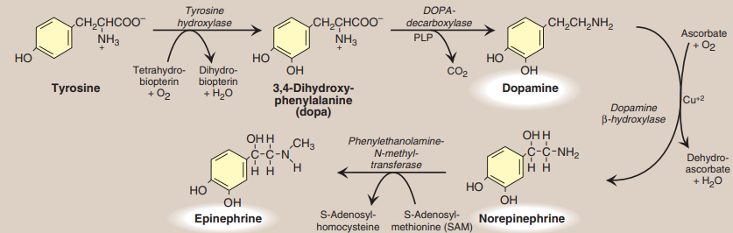
Core
Knowledge
Synthesis of catecholamines. PLP = pyridoxal phosphate

Slide 14
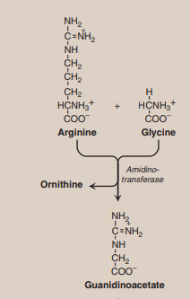
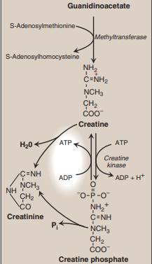
Core
Knowledge
Synthesis of creatine.

Slide 15
Core
Knowledge
3. Deamidation
Glutamine and Asparagine are Amide forms of Glutamic acid and Aspartic acid.
They are hydrolyzed by Glutaminase and Asparaginase to corresponding amino acids.
Ammonia is liberated in these reactions.

Slide 16
Core
Knowledge
3. Deamidation Cont.
(a) Asparagine + H2O Aspartic acid + NH3
(b) Glutamine + H2O Glutamic acid + NH3

Slide 17
Core
Knowledge
4. Deamination
It is removal of NH3 in the free form from an amino acid resulting in the formation of corresponding keto acid
It mainly takes place in Liver
It is of 2 types
(I) Oxidative deamination
(ii) Non oxidative deamination

Slide 18
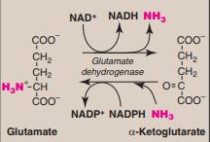
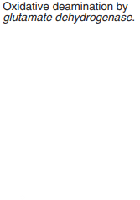
Core
Knowledge
(I) Oxidative Deamination

Slide 19
Core
Knowledge
(I) Oxidative Deamination
Glutamate dehydrogenase:
The amino groups of most amino acids are ultimately funneled to glutamate by means of the transamination with α-ketoglutarate. Glutamate is unique in that it is the only amino acid that undergoes rapid oxidative deamination—a reaction catalyzed by glutamate dehydrogenase.

Slide 20
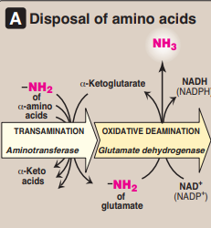
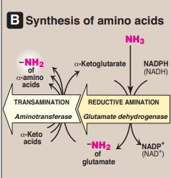
Core
Knowledge
(I) Oxidative Deamination
a. Coenzymes: Glutamate dehydrogenase is unusual in that it can use either NAD+ or NADP+ as a coenzyme NAD+ is used primarily in oxidative deamination (the simultaneous loss of ammonia coupled with the oxidation of the carbon skeleton and NADPH is used in reductive amination.
Combined actions of aminotransferase
and glutamate dehydrogenase reactions.

Slide 21
Core
Knowledge
(I) Oxidative Deamination
b. Direction of reactions: The direction of the reaction depends on the relative concentrations of glutamate, α-keto glutarate, and ammonia, and the ratio of oxidized to reduced co-enzymes
Combined actions of aminotransferase
and glutamate dehydrogenase reactions.

Slide 22
Core
Knowledge
(I) Oxidative Deamination
c. Allosteric regulators: Guanosine triphosphate (GTP) is an allosteric inhibitor of glutamate dehydrogenase, whereas adenosine diphosphate (ADP) is an activator.
Combined actions of aminotransferase
and glutamate dehydrogenase reactions.

Slide 23
Core
Knowledge
2. D-Amino acid oxidase:
D-Amino acid oxidase (DAO) is an FAD-dependent peroxisomal enzyme that catalyzes the oxidative deamination of these amino acid isomers, producing α-keto acids, ammonia, and hydrogen peroxide. The α-keto acids can enter the general pathways of amino acid metabolism, and be reaminated to L-isomers, or catabolized for energy.

Slide 24
Core
Knowledge
2. D-Amino acid oxidase:
In this type of Deamination first there is removal of H2O by Dehydratases resulting in the formation of Imino acid followed by spontaneous Deamination
E.g. Hydoxy amino acids likes Serine and Threonine.

Slide 25
Core
Knowledge
METABOLISM OF AMMONIA
Ammonia is produced by all tissues during the metabolism of a variety of compounds, and it is disposed of by formation of urea in the
Liver However, the level of ammonia in the blood must be kept very low, because even slightly elevated concentrations (hyperammonemia) are toxic to the central nervous system
Sources of ammonia
1. From glutamine
2. From bacterial action in the intestine
3. From amines
4. From purines and pyrimidines

Slide 26
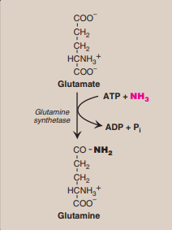
Core
Knowledge
Synthesis of glutamine.

Slide 27
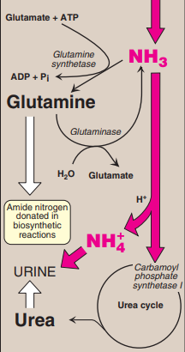
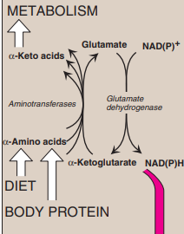
Core
Knowledge
Transport of ammonia in the circulation

Slide 28
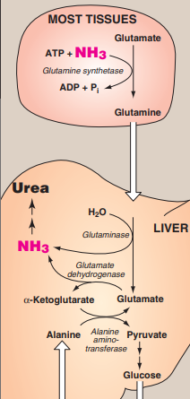
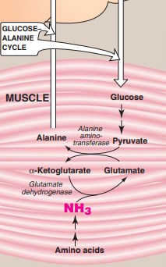
Core
Knowledge
Transport of ammonia from peripheral tissues to the liver.

Slide 29
Core
Knowledge
Hyperammonemia
When liver function is compromised, due either to genetic defects of the urea cycle or liver disease, blood levels can rise above 1,000 μmol/L. Such hyper ammonemia is a medical emergency, because ammonia has a direct neurotoxic effect on the CNS cause the symptoms of ammonia intoxication, which include
tremors, slurring of speech, somnolence, vomiting, cerebral edema,
and blurring of vision. At high concentrations, ammonia can cause
coma and death.

Slide 30
Core
Knowledge
Hyperammonemia
The two major types of hyperammonemia are:
Acquired hyperammonemia:
Liver disease is a common cause of hyperammonemia in adults, and may be due, for example, to viral hepatitis or to hepatotoxins such as alcohol causing Cirrhosis of the liver.
2. Congenital hyperammonemia:
Genetic deficiencies of each of the five enzymes of the urea cycle. Ornithine transcarbamoylase deficiency, which is X-linked, is the most common of these disorders, predominantly affecting males. All of the other urea cycle disorders follow an autosomal recessive inheritance pattern. The failure to synthesize urea leads to hyperammonemia during the first week following birth

Slide 31
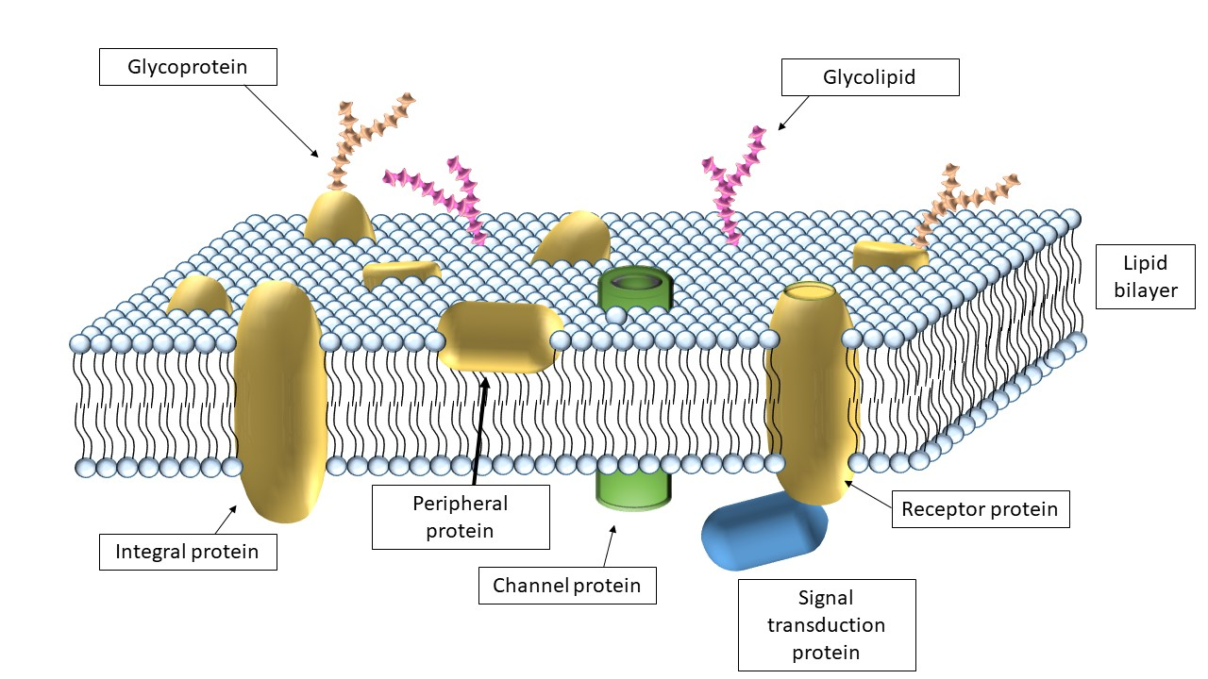
Horizontal Integration

Slide 32
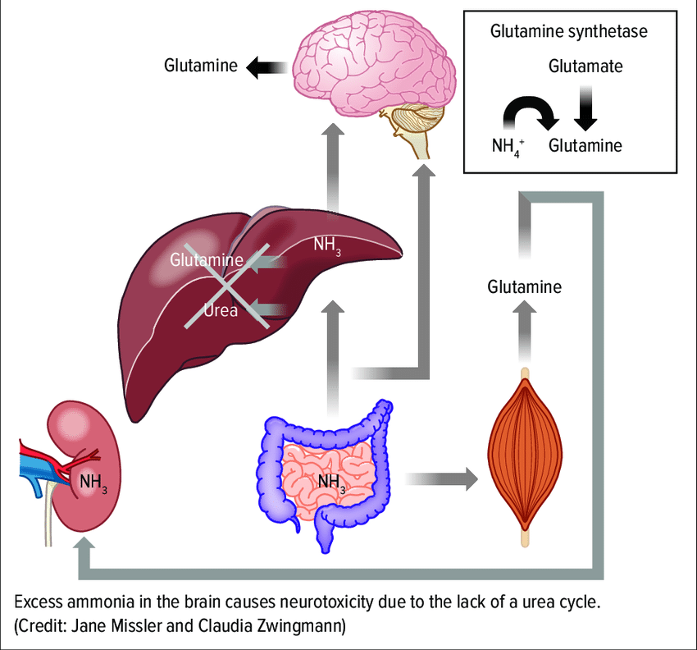
Vertical Integration
Clinical Correlates

Slide 33
Spiral Integration
Family Medicine
Family Medicine plays important role in following manner:
Diagnosis
Education
Dietary Guidance
Monitoring
Refer to Specialists

Slide 34
Spiral Integration
Bioethics
Ethical Considerations
From an ethical standpoint, the scenario raises considerations regarding patient autonomy, informed consent, and confidentiality
The physician must ensure that patient fully understands her diagnosis, treatment options, and potential implications
Discuss the necessity of a healthy lifestyle & treatment plan. This requires clear communication and understanding of risks and benefits.
Additionally, the physician must respect patient’s privacy and confidentiality throughout the diagnostic and treatment process

Slide 35
Spiral Integration
Artificial Intelligence
Role of AI in (The Disease) Management
AI can potentially aid in enhancing diagnostic accuracy and efficiency.
AI-powered decision support systems can also help clinicians in selecting appropriate treatment modalities
AI-driven predictive models may help anticipate the risk of complications of the Disease in susceptible populations

Slide 36

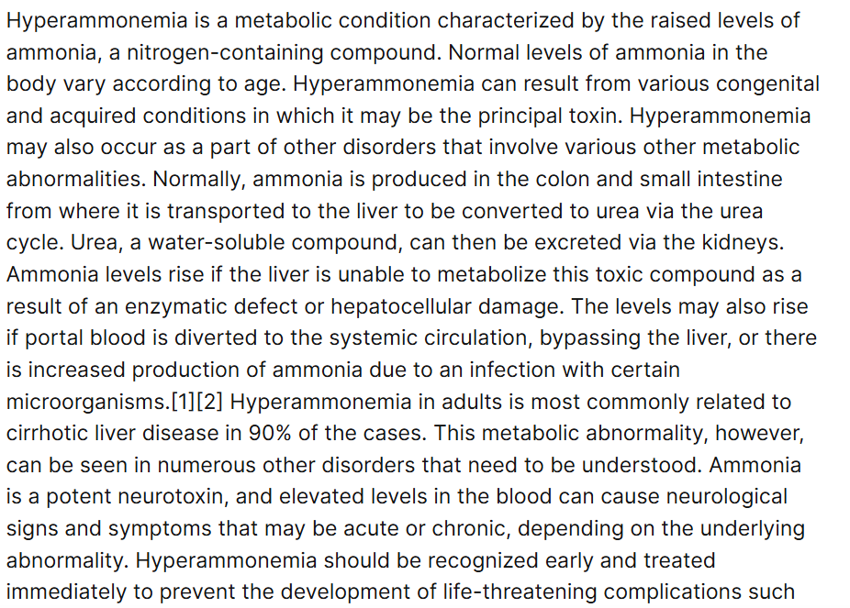
Research Article
https://www.researchgate.net/publication/346506005_Hyperammonemia

Slide 37
How To Access Digital Library
Steps to Access HEC Digital Library
Go to the website of HEC National Digital Library
On Home Page, click on the INSTITUTES
A page will appear showing the universities from Public and Private Sector and other Institutes which have access to HEC National Digital Library HNDL
Select your desired Institute
A page will appear showing the resources of the institution
Journals and Researches will appear
You can find a Journal by clicking on JOURNALS AND DATABASE and enter a keyword to search for your desired journal

Slide 38
Learning Resources
Lippincott Illustrated Reviews 8th Edition, Chap , pages -
Harper’s Illustrated Biochemistry 32nd Edition, Chap , pages –
Google images

Slide 39
THANK YOU

