Slide 1
Adrenal Tumors
Department of surgery
DHQ Teaching Hospital
Rawalpindi

Slide 2
Learning objectives
At the end of lecture , Students should be anle to
1. Describe the surgical anatomy and function of adrenql gland
2. Enumerate the causes of surgically treatable causes of hypertension
3. Classify adrenal tumors
4. Outline the salient feature of common Adrenal tumors

Slide 8
Primary Hyperaldosteronism (Conn’s Syndrome)
Incidence : Among patients with hypertension incidence of PHA is about 2%.
Most frequent cause of PHA is UNILATERAL ADENOCORTICAL ADENOMA.
Clinical features :
Hypertension
Headache
Muscle weakness
Cramps
Intermittent paralysis

Slide 10
DIAGNOSIS
Plasma potassium levels.
Aldosterone to plasma renin activity ratio.
Selective adrenal vein catheterization.
MRI and CT to distuingish unilateral from bilateral disease.

Slide 13
Pheocrhomocytoma
Pheochromocytomas are catecholamine-secreting tumors that arise from chromaffin cells of the adrenal medulla.
Incidence of pheochromocytoma is approximately 0.8 per 100,000 person-years
Catecholamine-secreting tumors are rare neoplasms, probably Occurring in less than 0.2 percent of patients with hypertension.

Slide 14
Familial vs Sporadic Pheochromocytoma
Most catecholamine-secreting tumors are sporadic. However, approximately 40 percent of patients have the disease as part of a familial disorder.
Hereditary (familial) catecholamine-secreting tumors typically present at a younger age than sporadic neoplasms.
There are several familial disorders associated with adrenal pheochromocytoma, all of which have autosomal dominant inheritance:
Von Hippel-Lindau syndrome (10 to 20 percent in VHL syndrome).
Multiple endocrine neoplasia type 2( 50 percent in MEN2)
Neurofibromatosis type 1 (0.1 to 5.7 percent with NF1)

Slide 15
Clinical signs and symptoms
Classic triad — The classic triad of symptoms in patients with a pheochromocytoma consists of episodic headache, sweating,tachycardia.
On rare occasions, patients present with a condition termed pheochromocytoma crisis, or pheochromocytoma multisystem crisis. These individuals may have either hypertension or hypotension, hyperthermia (temperature >40°C), mental status changes, and other organ dysfunction.
Cardiomyopathy – Rarely, pheochromocytoma is associated with cardiomyopathy attributed to catecholamine excess that is similar to stress-induced (takotsubo) cardiomyopathy.

Slide 16
Characteristics
95 percent of catecholamine-secreting tumors are intraadrenal (pheochromocytoma).
Approximately 10 to 15 percent of catecholamine-secreting tumors are extraadrenal and are referred to as catecholamine-secreting paragangliomas.

Slide 17
Diagnosis
Biochemical Assays :-
Low Risk Pateints (24-hour urinary fractionated catecholamines and metanephrines)
High Risk Patients (plasma fractionated metanephrines by high-performance liquid chromatography (HPLC) with electrochemical detection or tandem mass spectroscopy (MS/MS). These techniques have overcome the problems with fluorometric analysis (eg, false-positive results caused by alpha-methyldopa, labetalol, or sotalol, and false-negative results caused by imaging contrast agents).

Slide 21
Radiological investigations
both CT and MRI are quite sensitive (98 to 100 percent) but are only approximately 70 percent specific because of the higher prevalence of adrenal "incidentalomas“.
With CT, no risk of exacerbation of hypertension with low-osmolar contrast,is safe for patients with pheochromocytoma.
MRI, can distinguish pheochromocytoma from other adrenal masses; on T2-weighted images, pheochromocytomas appear hyperintense and other adrenal tumors isointense.

Slide 23
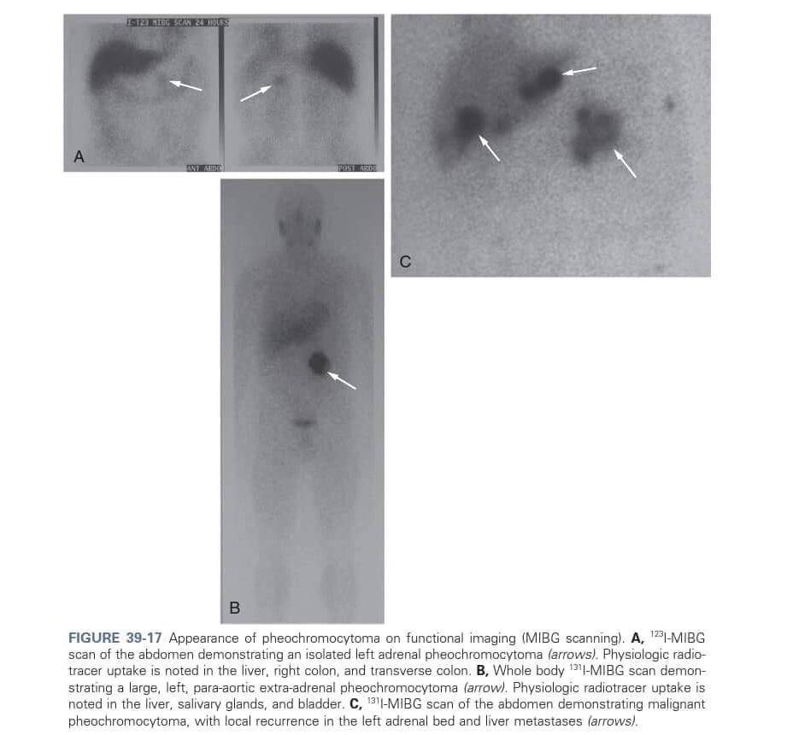
Other radiological investigations
IOBENGUANE I-123 (MIBG)

Slide 24
GENETIC TESTING
Genetic testing should be considered if a patient has one or more of the following:
●Paraganglioma
●Bilateral adrenal pheochromocytoma
●Unilateral adrenal pheochromocytoma and a family history of pheochromocytoma/paraganglioma
●Unilateral adrenal pheochromocytoma onset at a young age (eg, <45 years).

Slide 25
TREATMENT (preop-asessment)
Agents known to provoke a pheochromocytoma paroxysm (eg, beta-adrenergic blocker in absence of alpha-adrenergic blockade, glucagon, histamine, metoclopramide, high-dose corticosteroids) should be avoided.
Preoperative medical therapy is aimed at:
●Controlling hypertension (including preventing a hypertensive crisis during surgery).
●Volume expansion

Slide 26
Pre-op managment
An alpha-adrenergic blocker is given for at least 7 days preoperatively to normalize blood pressure and expand the contracted intravascular space.
Phenoxybenzamine initial dose is 10 mg twice daily, and the dose is increased by 10 to 20 mg in divided doses every two to three days as needed, The final dose is typically between 20 and 100 mg daily.
High sodium diet — On the second or third day of alpha-adrenergic blockade, diet high in sodium content (>5000 mg daily) because of the catecholamine-induced volume contraction and the orthostasis associated with alpha-adrenergic blockade.

Slide 27
Beta-Blockers
beta-adrenergic blockade is initiated, two to three days preoperatively.
beta-adrenergic blocker is administered, it should be used cautiously and at a low dose.
●As an example, a patient may be given 10 mg of propranolol orally every six hours on the first day of beta-adrenergic blockade. Another option is to start with low-dose metoprolol (eg, 12.5 mg twice daily).
●On the second day, the beta-adrenergic blockade (assuming the patient tolerates the drug) is converted to a single, long-acting dose.
●The dose is then increased as necessary to control the tachycardia (goal heart rate is 60 to 80 beats per minute).

Slide 28
Intra-operative managment
Adverse hemodynamic changes are a challenge like intraoperative hypertnesion which can be caused by
A) Stimulation of catecholamine release by anesthesia inducing agents.
B) By direct manipulation of tumor.

Slide 29
Alogrithem for management
Familial pheochromocytoma
MEN 2 (complete bilateral adrenalectomy)
VHL (Cortical sparing bilateral adrenalectomy)
Approx 10% are malignant and 5 year survival rates are less than 50%,most common sites of mets are Axial skeleton,liver,lymph node,lung,kidney.

Slide 33
Complications
Acute hypertensive crisis.
Cardiac Arrythmias.
Post-op hypotension.
Post-op hypoglycemia.

Slide 34
Adrenalectomy techniques
1. Laproscopic Transabdominal Adrenalectomy.
2. Retropeitoneoscopic Adrenalectomy.
3. Open Transabdominal Adrenalectomy.
4. Retroperitoneal Open Adrenalectomy.
5. Partial Adrenalectomy.

Slide 35
Pre-Op Preperation
Prophylactic antibiotics : first generation cephalosporin ie cefazolin is given iv one hour before the surgery.
Venous thromboembolism prophylaxis : DVT prophylaxis is particularly important in patients with Cushing syndrome because they frequently manifest hypercoagulability.
A selective 5-HT3 receptor antagonist, such as ondansetron , is administered preoperatively or intraoperatively to reduce postoperative nausea and vomiting commonly associated with an adrenalectomy.

Slide 40
Intra-operative challenges
Hemodynamic liability – hypertensive crisis (pheochromocytoma)
Adrenal insufficiency : To prevent hypotension due to adrenal insufficiency immediately after a unilateral or bilateral adrenalectomy for patients with Cushing syndrome, intravenous hydrocortisone (50 to 100 mg) is administered upon removal of the adrenal gland. This can be quickly transitioned to oral hydrocortisone when the patient resumes oral intake, usually on the day of surgery.

Slide 41
Intra-operative challenges
Vascular involvement — Open transabdominal approach through an extended right subcostal incision to facilitate immediate access and control of the IVC in the event of an injury or in the clinical setting of vascular involvement. This approach also allows for an en bloc resection of the tumor if it involves the IVC and/or liver.
Tumor capsule rupture —The tumor capsule must remain intact during the resection to prevent spillage of tumor cells. Complete resection frequently requires en bloc excision of surrounding structures, including the perinephric fat envelope, retroperitoneal lymph nodes, IVC, spleen, or pancreas. Such resection is best accomplished through an open approach.

Slide 42
Partial adrenalectomy
Partial adrenalectomy may be a reasonable alternative to complete adrenalectomy for small, potentially benign adrenal lesions and may be preferred for bilateral small lesions.
Partial adrenalectomy has been reported with the laparoscopic transabdominal approachand the retroperitoneoscopic approach .
For lesions <3 cm that are located anteriorly or laterally in the adrenal gland (to preserve the adrenal vein.

Slide 43
Laproscopic Transabdominal Adrenalectomy
Patient positioning — The patient is placed on an inflatable beanbag in the lateral decubitus position, with all bony prominences padded and the area between the iliac crest and 11th rib overlying the kidney exposed. The patient is rotated backward approximately 15°, and the beanbag is inflated to secure this position.
Port and extraction sites — Prior to making any incision for port placement, the skin is infiltrated with a 1% lidocaine and 0.4% bupivacaine (50:50 mixture) solution. The ports should be placed approximately 9 to 12 cm apart, with the most lateral port placed through the flank.

