Slide 1


Slide 2
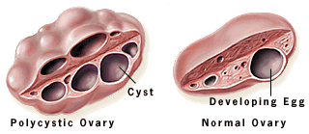
Polycystic Ovarian Syndrome
(PCOS)
Dr. Nighat naheed
Assisstant. Professor
Obstetrics & Gynaecology
Rawalpindi Medical College
Rawalpindi

Slide 3




To impart evidence-based research-oriented medical education.
To provide the best possible patient care.
To inculcate the values of mutual respect and ethical practice of medicine

Slide 4
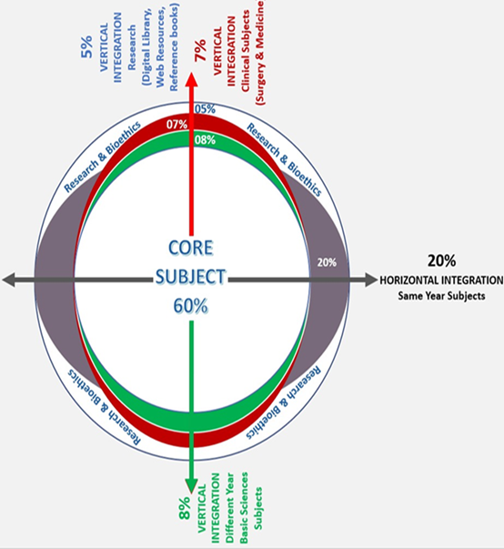
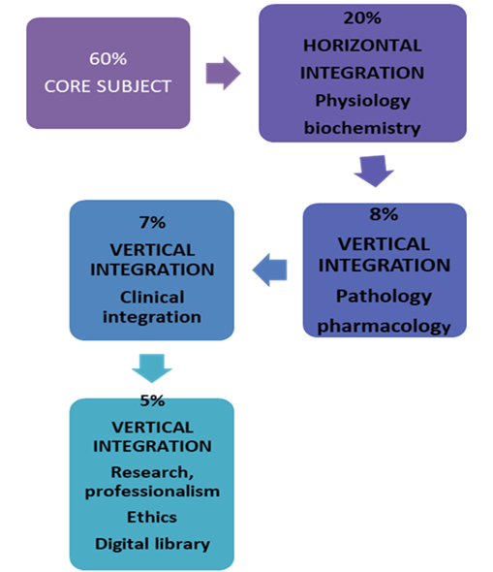


Slide 5
Question 1
When assessing a patient’s serum hormone levels,
what would be consistent with PCOS?
Decreased testosterone and decreased estrogen
Increased testosterone and LH, decreased FSH
Decreased testosterone and decreased prolactin
Decreased LH and Increased FSH
Increased LH and increased FSH
✓

Slide 6
Question 2
Polycystic Ovarian Syndrome (PCOS) confers an increased risk of:
a. Endometrial cancer
b. Ovarian cancer
c. Ovarian cysts
d. Type 2 diabetes mellitus
e. Breast Cancer
✓

Slide 7
Question 3
Which of the following on ultrasound can make the diagnosis of Polycystic Ovarian according to Rotterdam criteria?
a. ≥10 antral follicles per ovary
b. ≥12 antral follicles per ovary
c. ≥20 antral follicles per ovary
d. ≥25 antral follicles per ovary
e. ≥30 antral follicles per ovary
✓

Slide 8
Question 4
What is the first line management of menstrual irregularity in women with PCOS and BMI of 29kg/m2?
COCP
Weight reduction and life style modification
Metformin
Myo-inositol
✓

Slide 9
Question 5
A 22 year old woman with PCOS complaining of excessive facial hair growth. What is the best way to manage her problem?
COCP ( Diane 35)
Clomephine citrate
Metformin
Myo-inositol
Clomephine + metformin
✓

Slide 10
LEARNING OBJECTIVES
By the end of this session students will be able to:
Discuss the pathophysiology of PCO’S.
Explain diagnostic criteria of PCO’S
Describe clinical features of PCO’S
Enlist investigations of patient with PCO’S.
Discuss the management options of PCO’S.

Slide 11

POLYCYSTIC OVARIAN SYNDROME
PCOS is the commonest endocrine disturbance to affect women during their reproductive years
Prevalence in general population
20% – 33%
PREVALENCE IN South Asian : 52%
GENETIC INHERITANCE
24 % of all mothers
33% of all sisters
Rodin et al Clin. Endocrinol. 49, 91, 1998
Adam Balen, “PCOS: diagnosis, prevalence and ethnic differences” Gynecology Forum Volume 18, No. 4, 2013

Slide 12
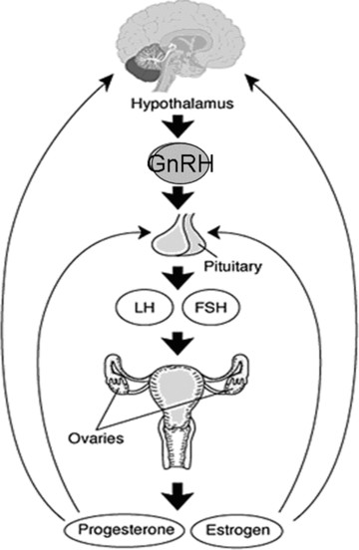
HYPOTHALAMIC PITUITARY OVARIAN AXIS

Slide 13
ETIOLOGY
Lifestyle and inherited risk factors
Hormonal changes exacerbated by obesity
High androgen levels
Insulin resistance
Hirsutism
Acne
Alopecia
Oligo-anovulation menstrual irregularity and subfertility
Metabolic syndrome
Increased CV risk factors
T2DM
Adverse effect on quality of life and mental health
Ref: S.Shorakae et.al., “Polycystic ovary syndrome: a common hormonal condition with major metabolic sequlae that
physicians should know about”, Internal Medicine Journal 44 (2014), Royal Australian College of Physicians, 720-726

Slide 14
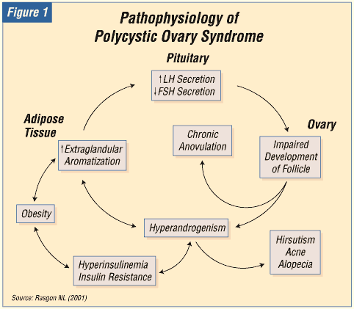
PATHOPHYSIOLOGY

Slide 15

DIAGNOSIS

Slide 16
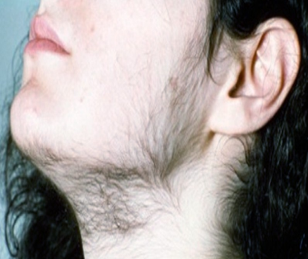


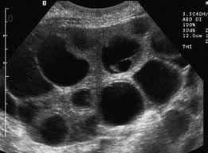
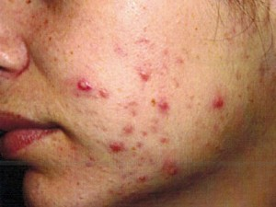
CLINICAL FEATURES
Oligomenorrhea/amenorrhea
Hirsutism
Subfertility
Obesity
Acanthosis nigricans

Slide 17



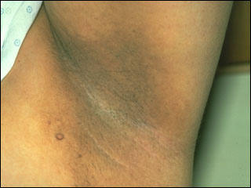
CLINICAL FEATURES
Metabolic syndrome (MetS)
  Obesity (38-60%)
  Diabetes mellitus
  Hypertension
  Dyslipidemias
  Acanthosis nigricans

Slide 18
DIAGNOSTIC CRITERIA
ESHRE/ASRM (Rotterdam, Netherlands)
Rotterdam criteria : 2 of the 3 features required for
diagnosis
anovulation /oligomenorrhoea
Hyperandrogenism (clinical / biochemical)
Polycystic ovaries on ultrasonography
(peripheral distribution of follicles,
≥12 follicles, 2-9 mm and ovarian volume >10 cm³)
ESHRE/ ASRM-sponsored PCOS Workshop Group
Human Reprod. 19, 41, 2004

Slide 19
INVESTIGATIONS
↑ Fasting insulin
↑ Androgens
Reversed FSH/LH ratio
↓ SHBG
↑ Oestradiol
↑ Prolactin

Slide 20
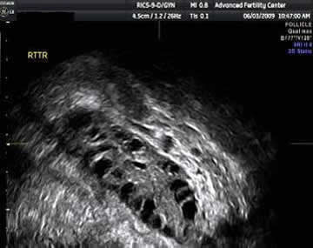
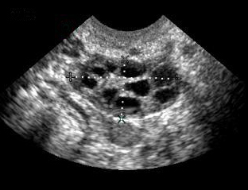
RADIOLOGICAL INVESTIGATIONS
New criteria
Presence of at least one
criterion:
Enlarged ovaries (>10 cm3)
Increased number of follicles
(at least 12 between 2-20 mm
diameter)
It is sufficient that only one ovary
is enlarged

Slide 21

MANAGEMENT

Slide 22
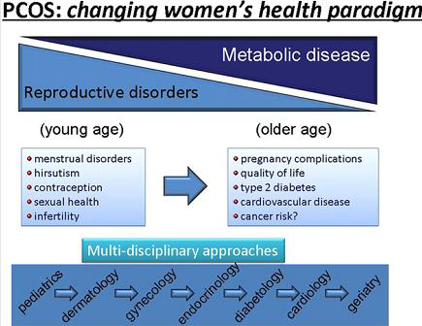
MULTI DISCIPLINARY APPROACH
Fauser, Bart CJM, et al. "Consensus on women’s health aspects of polycystic ovary syndrome (PCOS): the Amsterdam ESHRE/ASRM-
Sponsored 3rd PCOS Consensus Workshop Group." Fertility and Sterility 97.1 (2012): 28-38.

Slide 23
LONG TERM HEALTH RISKS
Ovarian Disease
Metabolic Disease
15 years
Hyperandrogenism
Oligo-anovulation
25 - 40 years
Infertility
Hyperandrogenism
Pregnancy complications
45 years
Hyperandrogenism
Glucose intolerance
55 years
Cardiovascular
Type 2 diabetes
Endometrial CA
Endocrinologist
Gynecologist
Cardiologist
Diabetologist
Gynecologist
Maeliss Peigne, et. al. “Long term health risks of PCOS”, Gynecology Forum Volume 18, No. 4, 2013

Slide 24

LIFE STYLE MODIFICATION

Slide 25
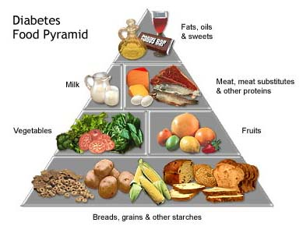

OBESITY
Weight reduction (BMI < 30 kg/m²)
Diet
Exercise
Drugs

Slide 26
MENSTRUAL IRREGULARITY
Without hyperandrogenism
Combined oral contraceptives.
Progesterone
With hyperandrogenism
Cyproterone acetate
Drosperinone

Slide 27
HIRSUTISM
Physical treatment
Medical treatment

Slide 28
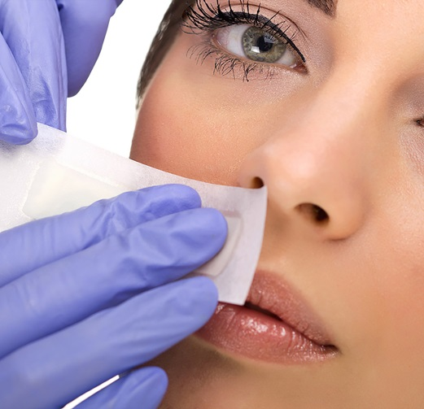

PHYSICAL TREATMENT
Waxing
Electrolysis
Bleaching
Laser
Photothermolysis
Vaneeka cream

Slide 29

MEDICAL TREATMENT
Estrogen/progestogen combination with antiandrogenic properties
Non-steroidal antiandrogens (Spironolactone, Flutamide, Finasteride)
    Alone
    Combined
Insulin sensitizing drugs (Metformin)
    Alone
    Combined

Slide 30
HYPERINSULINAEMIA
METFORMIN
Ameliorates hyperinsulinaemia and
hyperandrogenism
No effect on weight loss
Dose: 850 mg bid / 500 mg tid
Recommended for adolescent PCOS

Slide 31

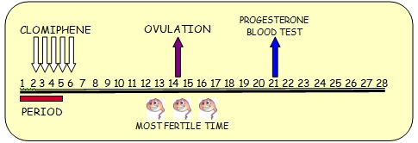
INFERTILITY
Life style modification
Ovulation Induction
Surgical

Slide 32

OVULATION INDUCTION
Antiestrogens (Clomiphene citrate)
Aromatase inhibitors (Letrazole)
Gonadotrophins (hMG, hCG, FSH)

Slide 33
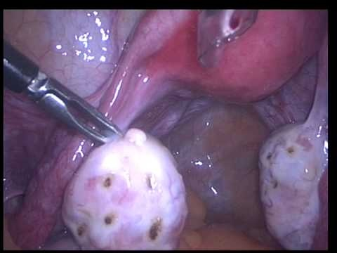
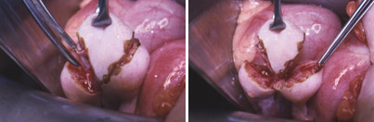
SURGICAL TREATMENT
Ovarian diathermy
Ovarian wedge resection

Slide 34
LONG TERM HEALTH RISKS DUE TO ANOVULATION
Chronic anovulation and prolonged exposure to unopposed estrogen can lead to endometrial hyperplasia and endometrial cancer
Risk of endometrial cancer was 5.3 times higher in women with PCOS and 6.1 times higher in obese women with PCOS
To prevent endometrial hyperplasia, at least four induced withdrawal bleeds per year are recommended
Maeliss Peigne, et. al. “Long term health risks of PCOS”, Gynecology Forum Volume 18, No. 4, 2013

Slide 35

RECENT ADVANCES
Ref: Long term Consequences of Polycystic Ovarian Syndrome, Green Top Guidelines No. 33, 2014 RCOG

Slide 36
ROLE OF VITAMIN D IN PCOS
The prevalence of vitamin D deficiency in women with PCOS is about 67-85% with serum concentrations of 25(OH)D <20 ng/ml³
Low 25(OH)D levels may exacerbate the symptoms of PCOS
There is inverse correlation between Vitamin D levels and metabolic risk factors
Lin & Wu: The role of vitamin D in polycystic ovar y syndrome, Indian J Med Res 142, September 2015, pp 238-240
Sur and Chakravorty, The Relationship between Vitamin D, Insulin Resistance and Infertility in PCOS Women, Gynecology & Obstetrics, 2015

Slide 37
ROLE OF INOSITOL
Myo inositol
D-chiro-inositol
Two inositol Stereoisomers in a plasma ratio of 40:1

Slide 38
BENEFICENCE
The principle of beneficence is the obligation of physician.
To act for the benefit of the patient.
Support a number of moral rules to protect and defend the right of others.
Prevent harm, remove conditions that will cause harm.
Help persons with disabilities, and rescue persons in danger.

Slide 39
BIOMEDICAL ETHICS
Importance of awareness of a healthy lifestyle.

Slide 40

CONCLUSION
PCO syndrome is a COMPLEX clinical entity and should be dealt with according to the problems of the patients

Slide 41

Hope we all have a better tomorrow
Thank You

