Slide 2
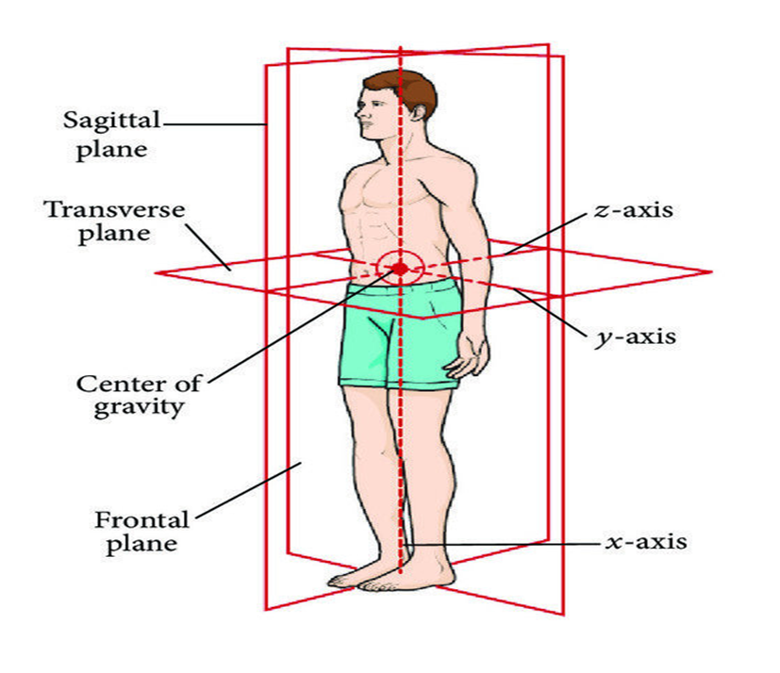
Anatomicomedical Terminologies(Position And Planes)
Foundation Module
1st Year MBBS SGD
February 2025
Dr Zeneara Saqib

Slide 3
Vision; The Dream/Tomorrow
Motto
To impart evidence based research oriented medical education
To provide best possible patient care
To inculcate the values of mutual respect and ethical practice of medicine
Wisdom
Truth
Service

Slide 4
Professor Umar Model of Integrated Lecture

Slide 5
How To Access Digital Library
Go to the website of HEC National Digital Library.
On Home Page, click on the INSTITUTES.
A page will appear showing the universities from Public and Private Sector and other Institutes which have access to HEC National Digital Library HNDL.
Select your desired Institute.
A page will appear showing the resources of the institution
Journals and Researches will appear
You can find a Journal by clicking on JOURNALS AND DATABASE and enter a keyword to search for your desired journal.

Slide 6
Learning Objectives
Describe different anatomical planes of human body and correlate with radiographic sections
Demonstrate anatomical position of human body
Apply the strategic use of artificial intelligence in healthcare
Practice the principles of bioethics
Able to read a relevant research article

Slide 7
Core Concept
No Of Slides………………30

Slide 8
Anatomical Position
In anatomical position the body is erect, the eyes are directed forward and look straight, the upper limbs hang by the side of the body with palms of the hand turned forward and the fingers are pointed straight down, the lower limbs, including the feet, are parallel to one another with feet flat on the floor and toes pointing forwards.

Slide 9
Human Body in Anatomic Position

Slide 10
OTHER POSITIONS OF THE BODY
Core Concept
1. Supine position: the person lies on the back with face
directed upwards.
2. Prone position: the person lies on his belly (abdomen)
with his face directed downwards .

Slide 12
3. Lithotomy position: the person lies supine with buttocks
at the edge of the table. The hips and knees are semiflexed and the thighs are abducted .

Slide 13
Lithotomy Table

Slide 14
ANATOMICAL PLANES OF THE BODY
1. Midsagittal plane (or median plane): It passes lengthwise,
i.e. longitudinally through the sagittal suture (midline) anddivides the body into equal right and left halves.

Slide 16
Three fundamental planes of the human body in anatomical position.

Slide 18
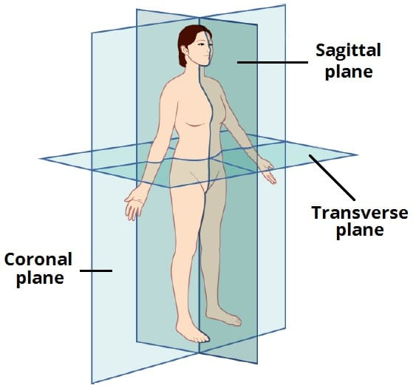
ANATOMICAL PLANES OF THE BODY
2. Sagittal plane: Any plane parallel to midsagittal plane is
termed sagittal plane.

Slide 19
ANATOMICAL PLANES OF THE BODY
3. Coronal ( or frontal) plane: passes longitudinally at right
angles to the median plane and divides the body into
front and back portions..
.

Slide 20
ANATOMICAL PLANES OF THE BODY
4. Transverse /horizontal / crosssectional plane): passes parallel to the horizon (ground) and divides the body at any level into upper
and lower portions. It is perpendicular to the median plane.

Slide 21
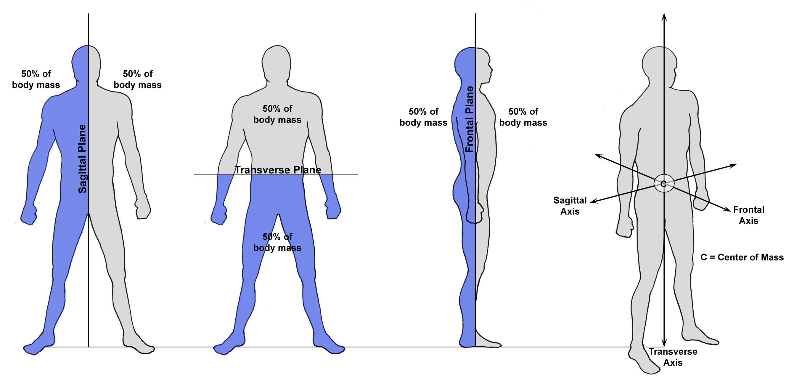
Cardinal Plane
Whenever the plane passes through the center of the body, be
it sagittal, frontal or transverse, it is referred to as cardinal plane because it divides the body into equal parts. The point at which the three cardinal planes intersect each other is the center of gravity

Slide 22
Cardinal Plane

Slide 26
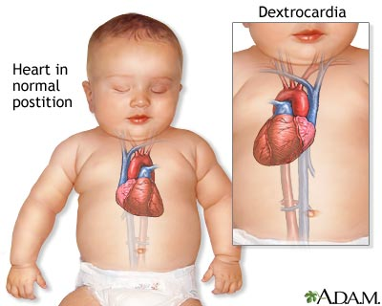
VERTICAL INTEGRATION
DEXTROCARDIA

Slide 27
Assessment
1. Regarding anatomical position, which of the following
statements is not correct:
(a) The body is erect and eyes are directed forward
(b) The upper limbs hang by the side of the body and
palms face anteriorly
( c) The body is in fetal position
(d) The lower limbs and feet are parallel and toes are
directed forward

Slide 28
Assessment
2. The sectional plane that divides the body into anterior
and posterior portions is:
(a) Transverse plane
(b) Sagittal plane
(c) Coronal plane
(d) Oblique plane

Slide 29
Assessment
Which of the following is also called frontal plane:
(a) Midsagittal
(b) Sagittal
(c) Coronal
( d) Transverse

Slide 30
Assessment
Select the correct statement:
(a) In the supine position the person lies on the back
with face directed upwards
(b) In prone position the person lies on his back with
face directed upwards
(c) In prone position the person lies on his belly with
face directed to the left side
(d) In supine position the person lies on this back with
face directed to the right side

Slide 31
Assessment
Which of the following is not a fundamental plane:
(a) Coronal
(b) Transverse
( c) Vertical
(d) Midsagittal

Slide 32
Research article
Anatomical Position:
https://www.ncbi.nlm.nih.gov/books/NBK513320/
This article provides a comprehensive overview of the anatomical position, including its definition and importance in anatomical nomenclature.

Slide 33
REFRENCES
1.Clinically Oriented Anatomy by Keith Moore 9th edition.
2.Cunningham’s Manual of Practical Anatomy by G.J. Romanes, 16th edition, Vol-I, II and III
3.http://www.anatomyzone.com 3D anatomy
https://teachmeanatomy.info
Special thanks for youtube video

Slide 34
Thank You

