Slide 2
MEDICAL ETHICS
Dr FARAN MAQBOOL
ASSISTANT PROFESSOR
MEDICINE DEPARTMENT
RAWALPINDI TEACHING HOSPITAL

Slide 4
Mission, Vision ,Goals
MISSION To impart evidence-based research-oriented health professional education Best possible patient care Mutual respect, ethical practice of healthcare and social accountability. Vision and Values Highly recognized and accredited centre of excellence in Medical Education, using evidence-based training techniques for development of highly competent health professionals, who are lifelong experiential learner and are socially accountable. Goals The Undergraduate Integrated Learning Program is geared to provide you with quality medical education in an environment designed to learn and grow.

Slide 5
Learning objective
Definition and introduction
Types
Moral duty of doctor.
Moral rights of patients
Principles of ethics
Ethical problems
Component of ethics
Criminal negligence

Slide 6
Medical Ethics
CORE CONCEPT
Ethics: Greek word from "ETHIKOS"means Theory of living
Ethics or moral philosophy is the systematic
endeavour to understand moral concepts
and justify moral principles and theories.
Medical etiquette
Refers to the courtesy with which a doctor
should treat his colleagues

Slide 7
DEFINATION
CORE CONCEPT
Science of morality .
The standard of conduct and competence expected of medical professionals
With the study of moral problems raised by practice of medicine .

Slide 8
ETHICS TYPES
CORE CONCEPT
Clinical ethics
Public health ethics
Research ethics

Slide 9
Clinical ethics
CORE CONCEPT
Relationship between doctor and patient

Slide 10
Public health ethics
CORE CONCEPT
Deals with health issues of group of people
Stop smoking in public area

Slide 11
Research ethics
CORE CONCEPT
Deals with issues related with clinical research.
Rights of participants maintained
Conducted safely
no research can be undertaken unless its undergone ethical scrutiny

Slide 12
THE MORAL DUTIES OF THE DOCTOR
CORE CONCEPT
Help, cure
Promote and protect the patient’s health
Confidentiality
Protect the patient’s life
Respect the patient’s autonomy
Protect privacy
Respect the patient’s dignity

Slide 13
The moral rights of the patient
CORE CONCEPT
High quality medical service
Autonomous choice
Decide
Be informed
Privacy
Health education
Dignity

Slide 14
PRINCIPLE OF CLINICAL ETHICS
CORE CONCEPT
RESPECT AND AUTHONOMY
Respect for the person
Respect is significant aspect of the relationship between patients and doctor .
Respect of patient autonomy in choice for seeking advice

Slide 15
Truth telling
CORE CONCEPT
Telling the truth is essential to generate and maintain trust between the doctor and the patient .
Provide the information about nature of illness. Expected outcome and therapeutic alternatives and answers the question honesty .
Truth can be withhold in two condition
If it cause real harm to patient.{patient is depressed and likely do suicide to listen. Breaking the bad news.
If patient do not want to listen the bad news .{wait for patient adjustment }

Slide 16
Informed consent
CORE CONCEPT
Describe the participation of patients in decisions about their health care .
In order to faciliate this .the clinician must provide the patient with an adequate explanation and detail of relevant risk benefits of each possible course of action
Patient will is most imp
If patient lack the decision making capacity.the clinician should act in the best interest of patient

Slide 17
Confidentiality
CORE CONCEPT
Maintaining the trust between doctor and patient
To prevent the unauthorized access to patient record ,disclosure the patient identity and information
Disclosure of information only when patient gives consent and when required by law and needed in court
When share other health professional person, should based on need to know

Slide 18
Doing good
CORE CONCEPT
The health of my patient will be my first consideration .
Patient best interest

Slide 19
Not doing harm
CORE CONCEPT
Patient best interest

Slide 20
justics
CORE CONCEPT
Justice relate primarily to the distribution of medical care and allocation of resources .
Fair delivery of health care
Who need it most
Respect for right of person
Fair share of resources
Respect for merit
Who have financial issues.socially deprived .

Slide 21
CORE CONCEPT
ETHICAL PROBLEMS

Slide 22
A gap or block
CORE CONCEPT
The ideal goal is clear .but there is obstacles to achieve it
Economics
Social
In the belief system of the patient .
To bridge the gap and remove the block
A young boy with Wilson disease having advice liver transplant bt belong to developing country ,economic block

Slide 23
Priority setting
CORE CONCEPT
The right course of action is clear .but prioritization is necessary and the principles to guide that process have to be defined
Last bed allocation decision in intensive care .80 year old with pneumonia,20 year old with advanced lymphoma ,

Slide 24
Moral dilemma
CORE CONCEPT
Accordance with one ethical principle may conflict with another ethical principle
Pt makes the different choice .consider artifial feeding peg[percutaneus endoscopic gartrostomy] .the dr may decide it for patient best interest and patient refuse the procedure .
Solved by good dr patient communication

Slide 25
Resolving conflict
CORE CONCEPT
Conflict of opinion may arise between members team responsible for care of the patient.
Elderly patient having significant co morbidity providing dialysis by renal dr.having divergent views whether this treatment should continued or not
Through discussion ,multidisciplinary team .referral to decision making authority. Director of services.

Slide 26
Components of Medical Ethics
CORE CONCEPT
Physician patients relationship
Physician: physician relationship
Physician : health system relationship
Physician: Society relationship

Slide 27
Public and Community Health
CORE CONCEPT
Enlighten the public concerning quarantine regulations
Measures for the prevention of epidemic and communicable diseases
When an epidemic occurs a physician should not abandon his duty for fear of contracting the disease himself.

Slide 28
Common criminal negligence
CORE CONCEPT
In case of death; doctor can be booked under
section 304 A (rash and negligent act)
Common example of criminal negligence.
􀀹 Amputation or removal of wrong limb or organ
􀀹 Ligation of ducts/ vessels
􀀹 Retaining of objects in surgical site
􀀹 Tight plaster cast leading to gangrene
􀀹 Transfusion or anesthetic mistakes.

Slide 29
Euthanasia
CORE CONCEPT
Active: an active intervention to end life
Passive : deliberately withholding treatment
that might help a patient live longer
Voluntary : euthanasia is performed following a
request from a patient
Doctor assisted suicide : a doctor prescribes
a lethal drug which is self administered by the patient

Slide 30
CORE CONCEPT
WHAT IS YOUR CHOICE MAKES DIFFERENCE ???
•Medicine is about : “Can we?”
•Ethics is about: “Should we?”

Slide 31
An innate desire
CORE CONCEPT
People world over still wish to see the
doctors as trustworthy and honorable

Slide 32
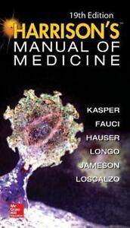
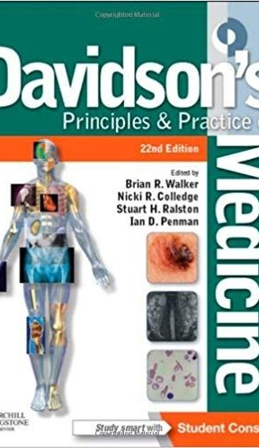
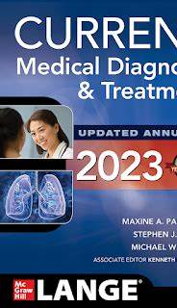
STUDY RESOURCES
VERTICAL INTEGRATION

Slide 33
THANKS

