Slide 2
Dr Arslan Ahmad Assistant Professor Medicine RMU/HFH
LIVER DISORDERS AND THROMBOCYTOPENIA IN PREGNANCY

Slide 3
Mission Statement: To impart evidence based research oriented health professional education in order to provide best possible patient care and inculcate the values of mutual respect, ethical practice of healthcare and social accountability. Vision: Highly recognized and accredited centre of excellence in Medical Education, using evidence-based training techniques for development of highly competent health professionals, who are lifelong experiential learner and are socially accountable. Values: Merit ,Pursuit of Excellence, Integrity ,Diversity & Inclusivity ,Social Impact MOTO: Service Truth Wisdom

Slide 4
SEQUENCE OF LGIS
Learning Objectives
Introduction /Etiology/ Common liver disorders in Pregnancy (Core Concept)
Related Pathophysiology(Horizontal Integration)
Diagnosis and Management of Liver disorders in Pregnancy ( Core Concept)
Complications of liver disorders in Pregnancy(Vertical Integration)
Family Medicine/Research/MDM/Ethics

Slide 5
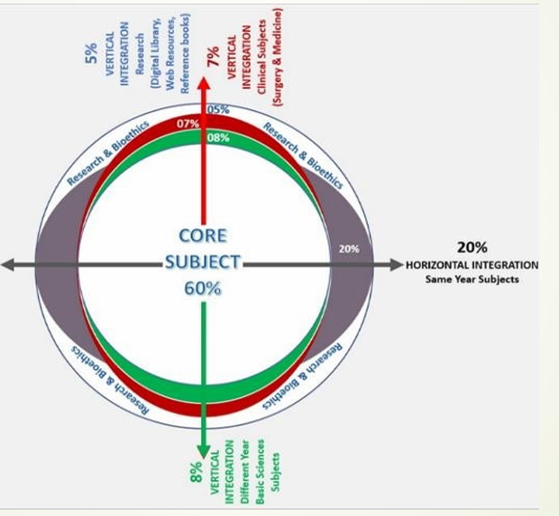
Prof Umer Model of Integrated Lecture

Slide 6
LEARNING OBJECTIVES
CORE CONCEPT
Identify the normal physiological changes in the liver during pregnancy
Identify the risk factors and populations at risk for developing liver disease in pregnancy
Explain the liver diseases that are unique during pregnancy and their management
Identify and workup common liver disorders in pregnancy, including Intrahepatic Cholestasis of Pregnancy (ICP), Acute Fatty Liver of Pregnancy (AFLP), HELLP Syndrome, and viral hepatitis.
Explain the maternal and fetal complications associated with liver disorders in pregnancy
Compare the pharmacological options available for management.
Recognize the importance of early detection, timely intervention, and appropriate delivery planning in improving maternal and fetal outcomes.
Identify public health strategies/MDM for early detection and management in at- risk populations.

Slide 7
INTRODUCTION AND CLINICAL SIGNIFICANCE OF LIVER DISORDERS IN PREGNANCY CORE CONCEPT
Pregnancy induces significant physiological changes in liver function and coagulation.
Some disorders are unique to pregnancy while others are pre-existing conditions exacerbated by it.
The levels of estrogens (estradiol) and progesterone increase progressively during pregnancy.
These sex hormones have effects on hepatic metabolic synthesis and excretory functions.
The phenomenon of hemodilution secondary to the increase in plasma volume decreases the serum protein concentrations.
Liver disease during pregnancy can be very complicated to manage, It is important to identify the underlying etiology as it will direct the proper treatment.

Slide 8
PHYSIOLOGICAL CHANGES DURING PREGNANCY VERTICAL INTEGRATION
During Pregnancy the gross examination of the liver is relatively unchanged
Skin findings such as spider angiomata (vascular spider) and palmer erythema can be seen especially prominent in the latter half of the pregnancy
Serum alkaline phosphate (ALP) increases markedly (up to four times the normal) in the third trimester which results from the increased levels of placental alkaline phosphate
Serum alanine transferase (ALT), aspartate aminotransferase (AST), and total and free bilirubin typically remain within normal limits
Hemodilution results in a decrease in serum albumin which worsens as pregnancy progresses
Total cholesterol, triglyceride, fibrinogen, and ceruloplasmin are few other laboratory findings that are noticeably augmented during pregnancy

Slide 9
PHYSIOLOGICAL CHANGES DURING PREGNANCY VERTICAL INTEGRATION
 | Pregnancy Trimester
Tests | First | Second | Third
Albumin | < | < | <
ALT | = | = | =
AST | = | = | =
Total bilirubin | < | < | <
Alkaline phosphatase | = | = or > | >
GGT | = | < | <
5'-nucleotidase | = | = or > | = or >
Total bile acids (fasting state) | = | = | =
Prothrombin time | = | = | =
= : no or slight changes, > : increase, < : decrease compared to non-pregnant women.

Slide 10
APPROACH TO HEPATOBILIARY DISEASE IN PREGNANCY CORE CONCEPT
A basic workup includes a detailed history, clinical examination and diagnostic workup.
The history should include prior pregnancy and associated liver complications, intravenous drug use, transfusions, the term of pregnancy, and oral contraceptive use.
Patient should be evaluated for clinical findings such as nausea, vomiting, jaundice, generalized pruritus, polyuria, and polydipsia in the absence of diabetes, and abdominal pain
Liver diseases during pregnancy can be classified into three categories:
Those unique to pregnancy Those unrelated to pregnancy
Those preexisting the pregnancy

Slide 11
COMMON LIVER DISORDERS DURING PREGNANCY:
CORE CONCEPT
Those Unique to pregnancy:
Hyperemesis gravidarum
Intrahepatic cholestasis of pregnancy (ICP)
Acute fatty liver of pregnancy (AFLP)
Preeclampsia and HELLP syndrome
Unrelated to pregnancy:
Viral hepatitis
Vascular liver disease
Biliary tract disorders
Preexisting the pregnancy
Cirrhosis
Autoimmune hepatitis
Wilsons Diseases

Slide 12
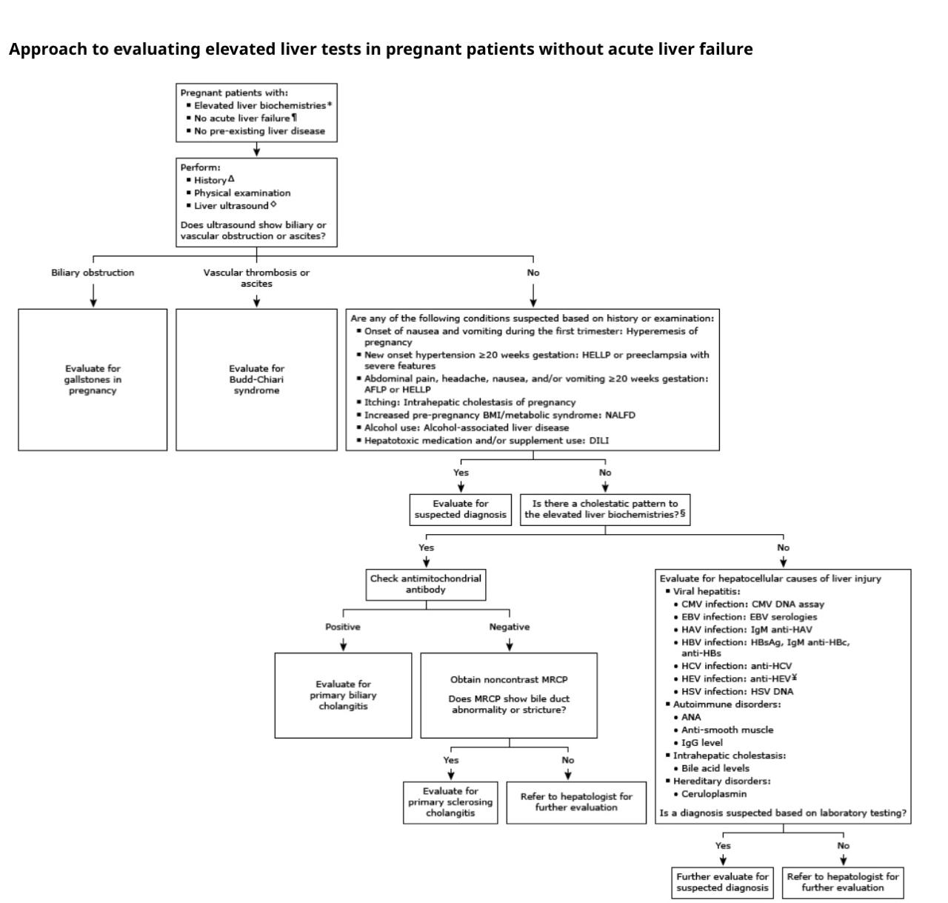
CORE CONCEPT

Slide 13
INDICATIONS OF BASELINE LIVER TESTS
CORE CONCEPT
Obtain baseline liver biochemical and function tests in pregnant patients with any of the following
History of pregnancy-related liver disease in prior pregnancy (eg, intrahepatic cholestasis of pregnancy, preeclampsia, hemolysis, elevated liver enzymes, low platelets (HELLP) syndrome, acute fatty liver)
History of chronic hypertension or gestational hypertension
Risk factors for liver disease (eg, metabolic syndrome, alcohol use disorder)
Viral hepatitis identified on prenatal screening (eg, hepatitis B surface antigen-positive or anti-hepatitis C virus antibody positive)

Slide 14
CORE CONCEPT
Liver tests that are commonly measured include:
Serum aminotransferases: ALT and AST
Alkaline phosphatase
Total bilirubin
Prothrombin time/international normalized ratio
Serum albumin

Slide 15
EVALUATION OF LIVER FAILURE
CORE CONCEPT
Pregnant patients with acute severe liver injury (ie, serum aminotransferases typically more than 10 times the upper limit of normal, hepatic encephalopathy, and coagulopathy) have acute liver failure.
Such patients require urgent consultation with maternal-fetal medicine and hepatology specialists and referral to a liver transplantation center.
The initial evaluation for a pregnant patient with elevated liver biochemistries but without acute liver failure is similar to the evaluation of a nonpregnant patient..
For pregnant patients assessing clinical features and interpreting the liver biochemistries must also take into account the timing of symptom onset and gestational age.

Slide 16
EVALUATION OF LIVER FAILURE
VERTICAL INTEGRATION
Patient history and presentation
Timing of symptom onset – The timing of symptom onset (gestational age) can help guide the evaluation :
Gestational age <20 weeks – Severe nausea and emesis with onset in the first trimester suggests hyperemesis gravidarum.
Gestational age ≥20 weeks – New onset hypertension at ≥20 weeks gestation is concerning for Hemolysis, elevated liver enzymes, low platelets (HELLP) syndrome or preeclampsia with severe features.
Symptoms of nausea, vomiting, headache, and abdominal pain in the third trimester are concerning for acute fatty liver of pregnancy.

Slide 17
VERTICAL INTEGRATION
Risk factors for exposure to potential hepatotoxins (medications, dietary and herbal supplements, alcohol use, illicit substance use)
Risk factors for nonalcohol-associated fatty liver disease (metabolic syndrome, dyslipidemia)
Symptoms and signs of hepatobiliary disease (pruritus, jaundice)
History of liver disease with prior pregnancy: Some pregnancy-related diseases (eg, intrahepatic cholestasis of pregnancy) commonly recur in subsequent pregnancies.

Slide 18
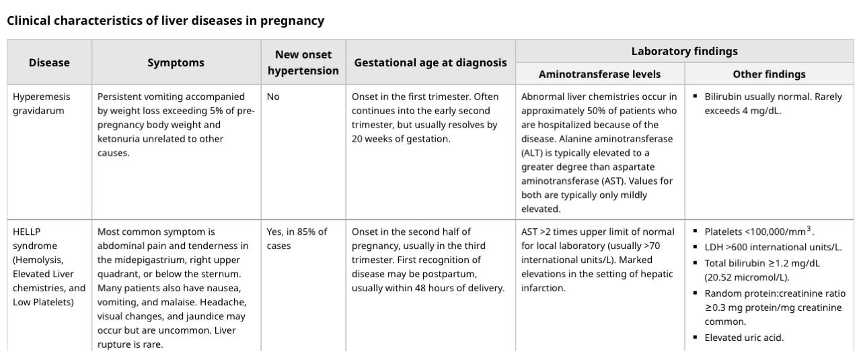
VERTICAL INTEGRATION

Slide 19
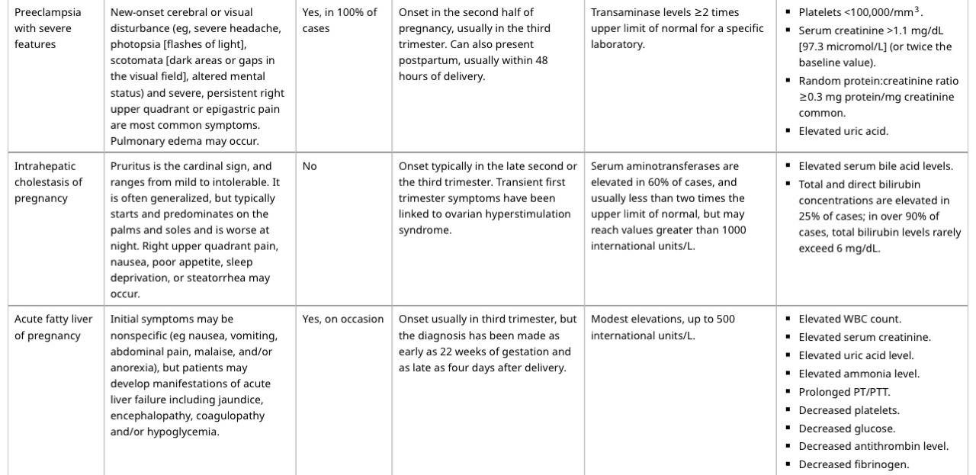

Slide 20
HYPEREMESIS GRAVIDARUM CORE CONCEPT
Adverse pregnancy outcomes:
Increased risk for low birth weight
Preterm birth secondary to maternal low weight gain and undernutrition
Preeclampsia
Placental abruption
Risk factors:
Past history of the disease Hyperthyroidism Psychiatric illness
Molar pregnancy Preexisting diabetes Multiple gestations Multiparity Increased BMI
Treatment of hyperemesis gravidarum consists of nonpharmacologic and pharmacologic interventions
Clinicians should encourage patients to take prenatal vitamins for 1 month before fertilization
Supportive therapy is recommended for abnormal maternal thyroid tests caused by gestational transient thyrotoxicosis or hyperemesis gravidarumIntravenous

Slide 21
MANAGEMENT OF HYPEREMESIS GRAVIDARUM CORE CONCEPT
IV hydration should be administered to patients who are unable to tolerate oral (PO) fluids
Strongly consider correction of ketosis and vitamin deficiency
Include dextrose and vitamins in therapy in cases of prolonged vomiting
Consider administering thiamine before dextrose infusion to prevent Wernicke encephalopathy
For non responder to medical therapy begin enteral tube feeding
Use peripherally inserted central catheters only as a last resort in patients with hyperemesis gravidarum
Early treatment of nausea and vomiting of pregnancy can help control symptoms and prevent more serious complications
Ginger may be used for its beneficial effects in the treatment of nausea and vomiting of pregnancy
Methylprednisolone may be effective in some refractory

Slide 22
ACUTE FATTY LIVER OF PREGNANCY CORE CONCEPT
This life-threatening condition often develops in the second half of pregnancy
Symptoms usually develop over several days to weeks and include nausea, vomiting, anorexia, lethargy, abdominal pain, ascites, and progressive jaundice
Transient polyuria and polydipsia may also occur due to the development of transient diabetes insipidus
Acute renal failure occurs in 50% of patients
50% of patients also have hypertension, proteinuria, and edema suggestive of preeclampsia
Risk factors
Older maternal age Primiparity Multiple gestations
Preeclampsia Male fetus Underweight
Previous history of AFLP
Genetic mutation that affects their mitochondrial fatty acid oxidation pathway
Fetus with a long-chain 3-hydroxyacyl-coenzyme A dehydrogenase (LCHAD) deficiency

Slide 23
MANAGEMENT OF AFLP CORE CONCEPT
Patients with AFLP should be delivered promptly expectant management is not appropriate
All patients with AFLP and their children should undergo molecular testing for LCHAD
In addition to early delivery supportive treatment is an important part of the management of AFLP
Critical care support for patients and fetuses
Monitoring and treatment of hypoglycemia
Management of coagulopathy
Mechanical ventilation for acute respiratory distress syndrome (ARDS)
N-acetylcysteine treatment
Dialysis or plasmapheresis.
Liver transplantation has been explored as a last measure

Slide 24
INTRAHEPATIC CHOLESTASIS OF PREGNANCY CORE CONCEPT
Patients with total bile acid levels of ≥100 mmol/L should be offered delivery at 36-0/7 weeks of gestation
Delivery between 36-0/7 and 39-0/7 weeks of gestation and total bile acid levels of < 100
Delivery between 34 and 36 weeks of gestation with total bile acid levels of ≥100 mmol/L and with any of the following:
Unremitting pruritis
History of stillbirth before 36 weeks of gestation
Evidence of worsening hepatic function
Ursodeoxycholic acid at 10-15 mg/kg divided into two or three daily doses
Management includes symptomatic treatment of the patient as well as close monitoring and possibly early delivery of the fetus.
Complications:
Fetal distress Prematurity Stillbirth

Slide 25
HEMOLYSIS, ELEVATED LIVER ENZYMES, AND LOW PLATELETS SYNDROME CORE CONCEPT
HELLP syndrome should be managed by prompt delivery especially after 34 weeks' gestation
Platelet transfusion to 40,000-50,000 cells/μL should be considered before delivery especially if cesarean section is likely.
If the diagnosis of HELLP syndrome is still in question the patient should be stabilized initially with good blood pressure control.
Intravenous hydralazine or labetalol may be used to maintain the systolic blood pressure below 160 mm Hg and the diastolic blood pressure below 110 mm Hg
Complications:
HELLP syndrome is associated with increased maternal and fetal morbidity and mortality
The risk of maternal death is approximately 1%
Pulmonary edema Acute renal failure DIC Abruptio placenta
Liver hemorrhage Retinal detachment ARDS Stroke

Slide 26
MANAGEMENT OF PREECLAMPSIA CORE KNOWLEDGE
The optimal management of a woman with preeclampsia depends on gestational age and disease severity
Because delivery is the only cure for preeclampsia clinicians must try to minimize maternal risk while maximizing fetal maturity
The primary objective is the safety of the mother and then the delivery of a healthy newborn
Obstetric consultation should be sought early to coordinate transfer to an obstetric floor as appropriate
Patients with preeclampsia without severe features are often induced after 37 weeks' gestation

Slide 27
MANAGEMENT OF PREECLAMPSIA CORE KNOWLEDGE
Before this the immature fetus is treated with expectant management with corticosteroids to accelerate lung maturity in preparation for early delivery
In patients with preeclampsia with severe features induction of delivery should be considered after 34 weeks' gestation
In the emergency setting control of BP and seizures should be priorities

Slide 28
SEIZURE TREATMENT AND PROPHYLAXIS CORE KNOWLEDGE
Active seizures should be treated with intravenous magnesium sulfate as a first-line agent.
A loading dose of 4 g should be given by an infusion pump over 5-10 minutes followed by an infusion of 1 g/h maintained for 24 hours after the last seizure.
Recurrent seizures should be treated with an additional bolus of 2 g or an increase in the infusion rate to 1.5 g or 2 g per hour.
Prophylactic treatment with magnesium sulfate is indicated for all patients with severe preeclampsia.
For eclamptic seizures that are refractory to magnesium sulfate, lorazepam and phenytoin may be used as second-line agents.

Slide 29
COMPLICATIONS OF PREECLAMPSIA
VERTICAL INTEGRATION
Maternal Complications
Neurological
Recurrent seizures (status epilepticus)
Cerebral edema
Intracranial hemorrhage (stroke)
Cortical blindness
Cardiovascular
Hypertensive crisis
Myocardial infarction
Pulmonary edema
Disseminated intravascular coagulation (DIC)
Renal
Acute kidney injury (AKI)
Oliguria or anuria
Proteinuria progression
Hepatic
Liver rupture or hemorrhage
Elevated liver enzymes (HELLP syndrome)
Hematologic
DIC (excessive clotting and bleeding)
Thrombocytopenia

Slide 30
COMPLICATIONS OF PREECLAMPSIA
VERTICAL INTEGRATION
Obstetric Compliactions
Placental abruption
Postpartum hemorrhage (PPH)
Uterine atony
Eclampsia remains a leading cause of maternal mortality globally.
Fetal Complications
Intrauterine Growth Restriction (IUGR)
Preterm Birth
Fetal Distress
Stillbirth or Intrauterine Fetal Demise (IUFD)
Neonatal Hypoxia & Neurodevelopmental Delay

Slide 31
SUBSEQUENT TESTING
VERTICAL INTEGRATION
Determining liver injury pattern
For pregnant patients without a suspected etiology of abnormal liver biochemistries based on initial evaluation, subsequent testing is guided by the predominant pattern of liver injury :
Patients with hepatocellular injury
Acute viral hepatitis
Immunoglobulin M (IgM) anti-hepatitis A virus
Hepatitis B surface antigen (HBsAg), IgM antibody to hepatitis B core antigen, antibody to HBsAg
Anti-hepatitis C virus antibody
Anti-hepatitis E virus (in regions where HEV infection is endemic)
Herpes simplex virus DNA by polymerase chain reaction
Cytomegalovirus DNA assay
Epstein-Barr virus serologies

Slide 32
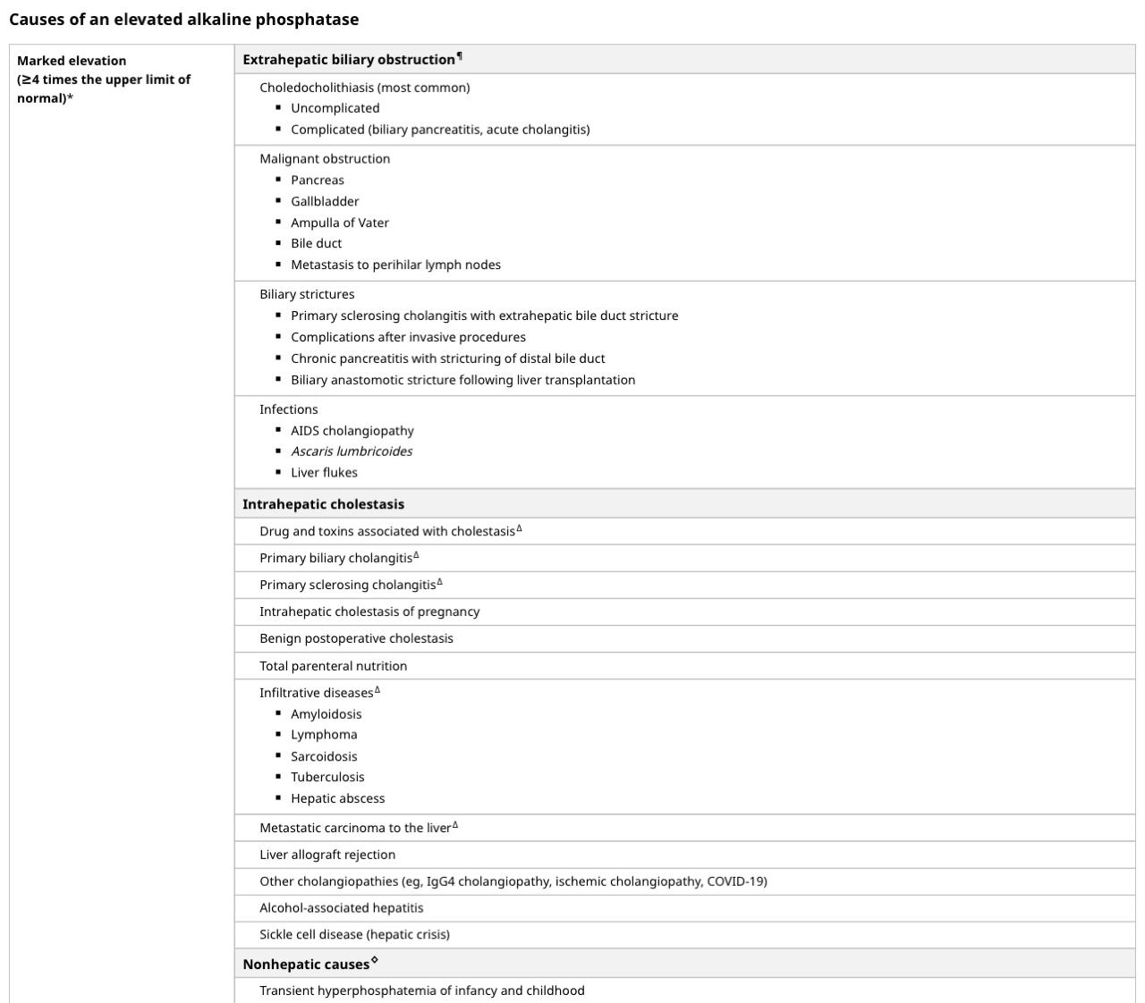
VERTICAL INTEGRATION

Slide 33
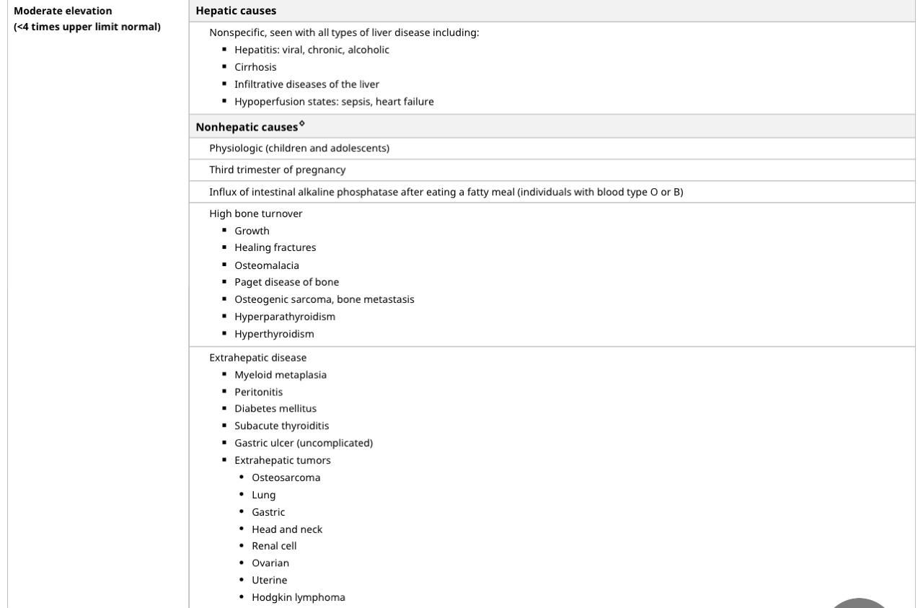
VERTICAL INTEGRATION

Slide 34
Preventive Strategies /Public Health
VERTICAL INTEGRATION
Prevention & Early Identification
Routine liver function tests in high-risk pregnancies
Screening for hepatitis B & C during antenatal visits
Identifying high-risk groups (e.g., history of liver disease, metabolic disorders)
Optimizing Maternal Health
Preconception Counseling
Ensuring access to prenatal care & hepatology services
Advise pregnant women at high risk of pre-eclampsia to take 75 mg to 150 mg of aspirin daily from 12 weeks until the birth of the baby.

Slide 35
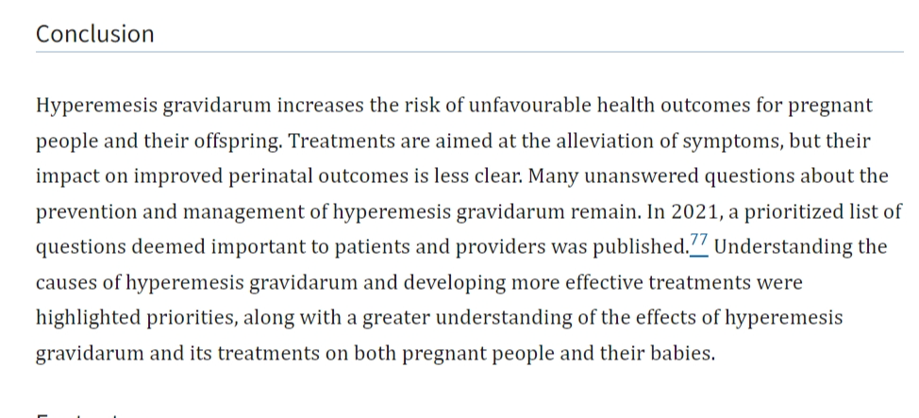
RECENT ADVANCES/RESARCH ARTICLE
Diagnosis and treatment of hyperemesis gravidarum
PMCID: PMC11019608 PMID: 38621783

Slide 36
MULTIDISCIPLINARY APPROACH VERTICAL/HORIZONTAL INTEGRATION
The management of liver disorders in pregnancy requires a vertically integrated, multidisciplinary approach, beginning with an understanding of the underlying pathophysiology ,risk factors, and diagnosis.
Effective management involves collaboration among obstetricians, hepatologist, pediatricians, nutritionists, and internal medicine specialists along with the integration of lifestyle modifications, pharmacological treatment, and obstetric monitoring
Additionally, postpartum follow-up and public health interventions play a crucial role in preventing long-term complications for both the mother and child.

Slide 37
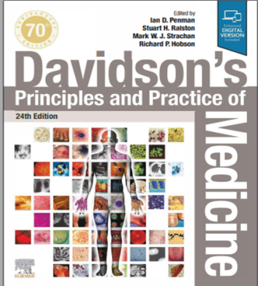
Resources/References
MEDSCAPE
RCOG Guidelines
RCOG GUIDELINES

