Slide 1
OPTIC NERVE

Slide 3
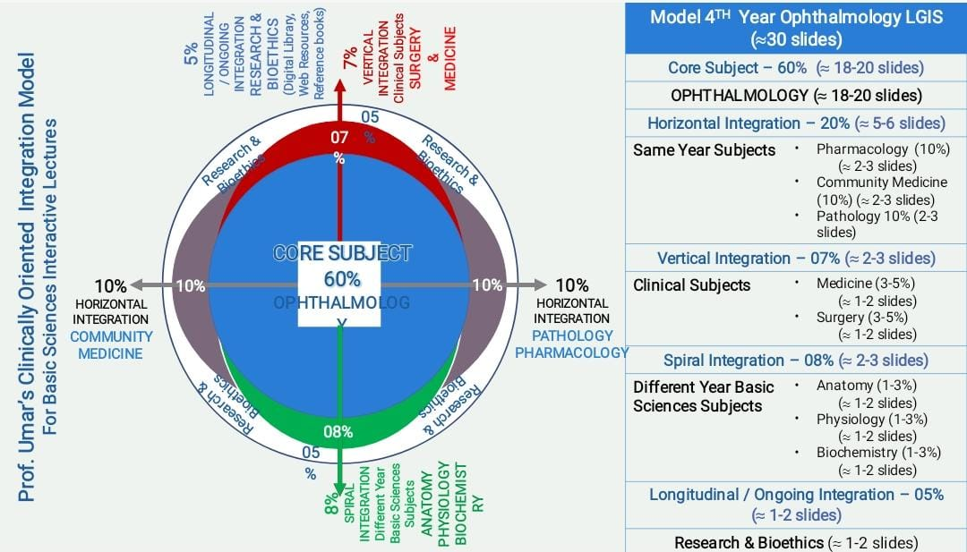
Sequence of Lecture
VERTICAL INTEGRATION
HORIZONTAL INTEGRATION
CORE SUBJECT
EOLA (END OF LECTURE ASSESSMENT)
DIGITAL LIBRARY REFERENCES (RESEARCH, BIOETHICS, ARTIFICIAL INTELLIGENCE.)

Slide 4
Learning Objectives
At the end of this session, student will be able to
Recall anatomy and pathway of Optic nerve
Optic Neuritis and its types
Know the Clinical Features of Optic Neuritis, Papilledema
Discuss the different treatment options

Slide 5
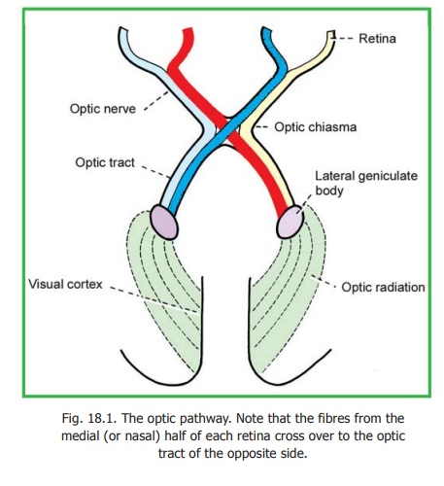
Vertical Integration

Slide 6
Optic Neuritis
Core Subject
Inflammation of optic nerve

Slide 7
TYPES
Core Subject
Optic Neuritis
Acute
Papillitis
Retrobulbar Neuritis
Chronic
Toxic amblyopias
Neuroretinitis

Slide 8
ETIOLOGY
Horizontal Integration
Demyelinating disease
Multiple sclerosis
Neuromyelitis Optica (Devic’s disease)
Para Infections
With or after a viral infection e.g., measles, mumps, rubella or whooping cough
Infection
Viral : Varicella zoster
Bacteria : Syphilis, lyme, Cat scratch fever
Contagious inflammation of
Meninges
Orbit
Sinuses
Intraocular Inflammation
Uveitis
Endophthalmitis

Slide 11
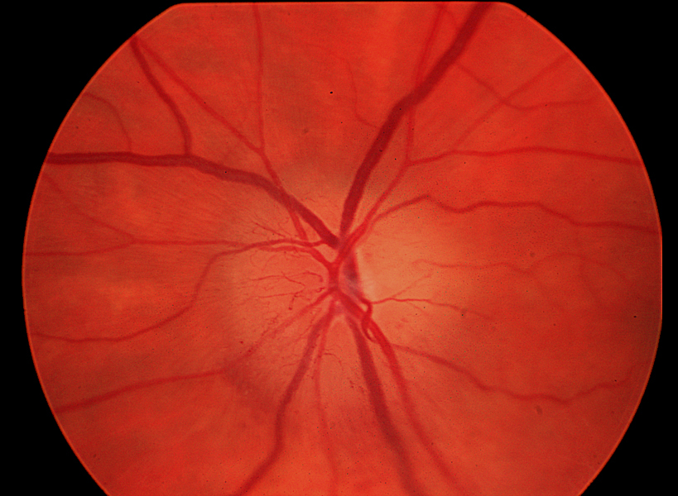
Papillitis
Core Subject
Inflammation of optic nerve head, (hyperaemia and oedema of optic disc)
Inflammation of intraocular portion of optic nerve
More in children

Slide 12
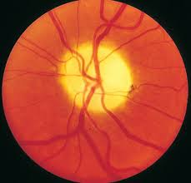
Retrobulbar Neuritis
Core Subject
Inflammation of orbital part of optic nerve, optic disc appears normal
More in adults

Slide 13
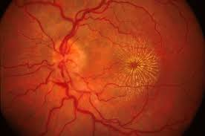
Neuroretinitis
Core Subject
Papillitis with inflammation of retinal fibres

Slide 14
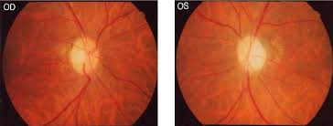
Toxic Neuropathy
Core Subject
Optic nerve fibres damaged by exogenous poisons
MILD TOXIC AGENTS: tobacco, ethyl alcohol; central scotoma due to effect on papillomacular bundle
SEVERE AMBLYOPIA: quinine, arsenic, organic etc; peripheral contraction of visual field or blindness

Slide 15
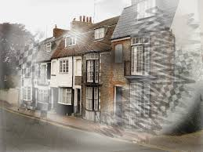
CLINICAL FEATURES
Core Subject
SYMPTOMS:
Acute or subacute visual loss; unilateral but bilateral in viral disease
Pain; on extraocular movements

Slide 16
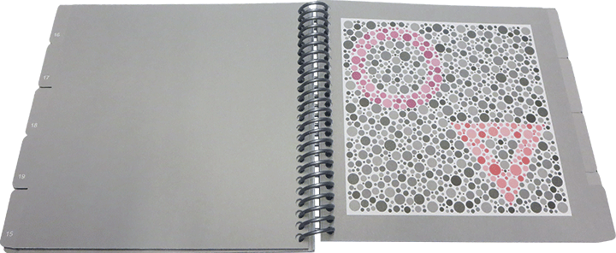
Core Subject
SIGNS
Visual Acuity; reduced from moderate to complete loss of vision
Colour vision; red and green colour
Relative afferent pupillary defect(RAPD); always
Tenderness; of globe ,deep orbital pain, brow pain

Slide 17
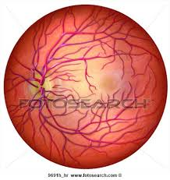
Core Subject
FUNDUS EXAMINATION
In retrobulbar neuritis, fundus appears normal
In papillitis, swollen disc with inflammatory cells in the vitreous
In neuroretinitis, swollen disc with inflammatory cells in the vitreous and macular oedema ( macular star)

Slide 18
Core Subject

Slide 19
INVESTIGATIONS
Core Subject
SYSTEMIC
Blood CP and ESR: variable according to cause
Serological tests: positive according to cause
MRI brain: periventricular plaques in MS
OCULAR
Perimetry: central or centrocaecal scotoma
Visual evoked potential: abnormal

Slide 20
PROGNOSIS
Core Subject
Usually good, visual acuity and colour vision recovers in months

Slide 21
TREATMENT
Vertical Integration
Depends upon cause
Corticosteroid : shorten period of visual loss
Oral prednisolone only CI : higher recurrence rate
Multiple sclerosis:
IV methylprednisolone Na Succinate
IM interferon beta
Vitamin B1, B6, B12 injections

Slide 23
Papilloedema

Slide 24
DEFINITION:
Core Subject
“It is the passive edema of the optic nerve
head secondary to raised intracranial
pressure”.
It is always bilateral.

Slide 25
ETIOLOGY:
Horizontal Integration
Impaired CSF circulation due to obstruction of ventricular system e.g. aqueduct stenosis
Intracranial infection e.g. meningitis
Intracranial hemorrhage
Diffuse cerebral edema
Intracranial space occupying lesion e.g. tumor, abcess
Benign intracranial hypertension (pseudotumor cerebri)
Tumors of spinal cord
contd

Slide 26
Core Subject
Systemic conditions:
malignant hypertension
toxemia of pregnancy
Vitamin A deficiency

Slide 27
PATHOGENESIS
Horizontal Integration
Raised ICP perineural subarachnoid space
CSF under pressure diffuses into optic nerve increased tissue pressure blocks axoplasmic flow in retinal nerve fibers at level of lamina cribrosa accumulation of axoplasm and swelling of optic nerve fibers.
Swollen axons circulatory stasis in the prelaminar region
Venous stasis and dilatation breakdown of optic disc barrier edema, exudates, hemorrhage and cotton wool spots.

Slide 28
CLINICAL FEATURES
Core Subject
1.SYSTEMIC SYMPTOMS:
HEADACHE:
Intensity and site are variable
May occur at any time of day but specifically early morning
Aggravated by coughing, sneezing and straining
Typically relieved by vomiting

Slide 29
Core Subject
NAUSEA AND VOMITING
Vomiting is sudden and often projectile
DETERIORATION OF CONSCIOUSNESS
Slight drowsiness to severe unconsciousness
2.OCULAR SYMPTOMS
Blacking out/graying out recurrent attacks of transient obscuration of vision, unilateral or bilateral, lasting 10-15 sec, precipitated by sudden change of posture
Diplopia due to extraocular muscle palsy

Slide 30
STAGES
Core Subject

Slide 31
OCULAR SIGNS
Core Subject
Visual acuity- normal
Pupil reactions-normal
Opthalmoscopic features:
Disc hyperemic, elevated, blurred margins
Blood vessels obscured as they cross the disc margin, veins are engorged and tortuous
Venous pulsation absent
Venous pulsation ceases when ICP exceeds 200 +/- 25mmhg

Slide 32
Core Subject
Hemorrhages splinter and flame shaped, may be present on or around the disc
Exudates and cotton wool spots may be present around the disc
Macular star incomplete macular star with temporal margin missing
PATON’S lines circumferential retinal folds in the peripapillary region
Central cup is retained but obliterated in the later stage

Slide 33
Core Subject

Slide 34
Core Subject

Slide 35
INVESTIGATIONS
Core Subject
The most imp factor in such a patient is to rule out the space occupying lesion causing raised ICP.
1.EXAMINATION
Blood pressure
Fundus exam to rule out ocular causes
Full neurological exam
Pharyngeal exam

Slide 36
Core Subject
2. LAB INVESTIGATIONS
Blood CP and ESR
Blood sugar
Serology of syphilis
Lumbar puncture for opening pressure and CSF analysis
3. IMAGING
X-ray
MRI
CT-Scan
Magnetic resonance angiography (MRA)

Slide 37
TREATMENT
Core Subject
Treat the underlying cause first
Control of raised ICP:
Diuretics
Repeated lumbar puncture
Ventriculo lumboperitoneal shunt
Pressure on optic nerve can be relieved by optic nerve sheath decompression

Slide 38
DIFF B/W PAPILLITIS AND PAPILLOEDEMA
Core Subject

Slide 39
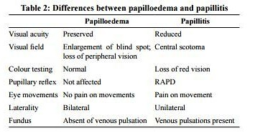
Core Subject

Slide 41
End of Lecture Assessment
A 23 year old female presents to OPD with complaint of sudden decrease in vision in right eye. On examination she has faulty colour vision decrease contrast sensitivity. On examination there is RAPD and disc edema

Slide 42
Case Scenario
A 40 year old male presents to OPD with complaints of headache. On examination his vision is 6/6 in both eyes. On examination there is bilateral disc edema.

Slide 44
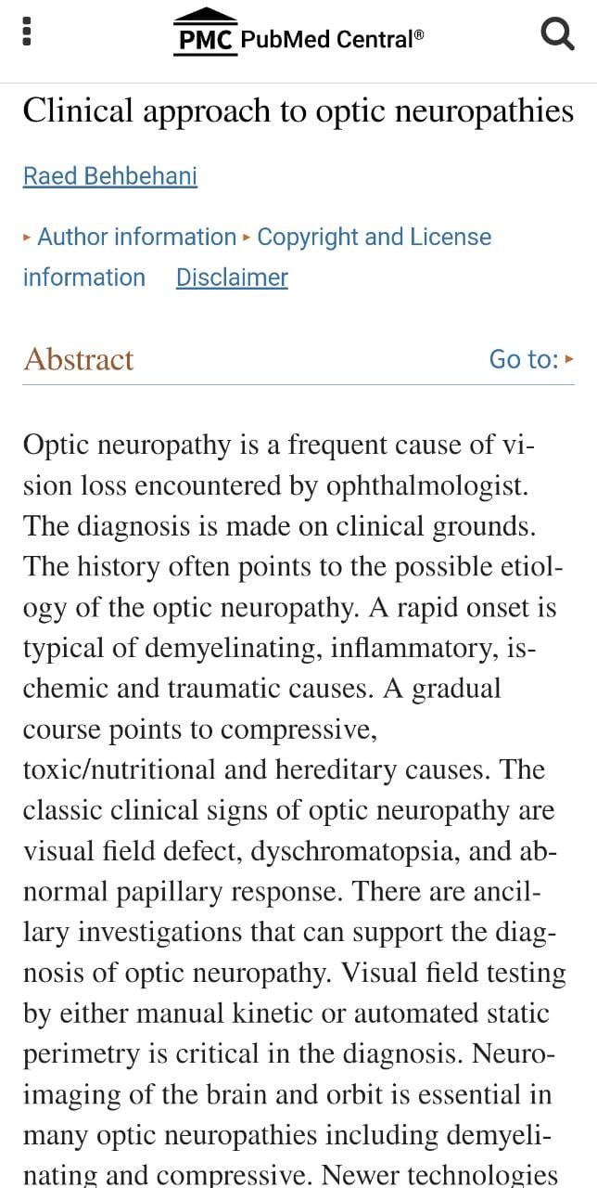
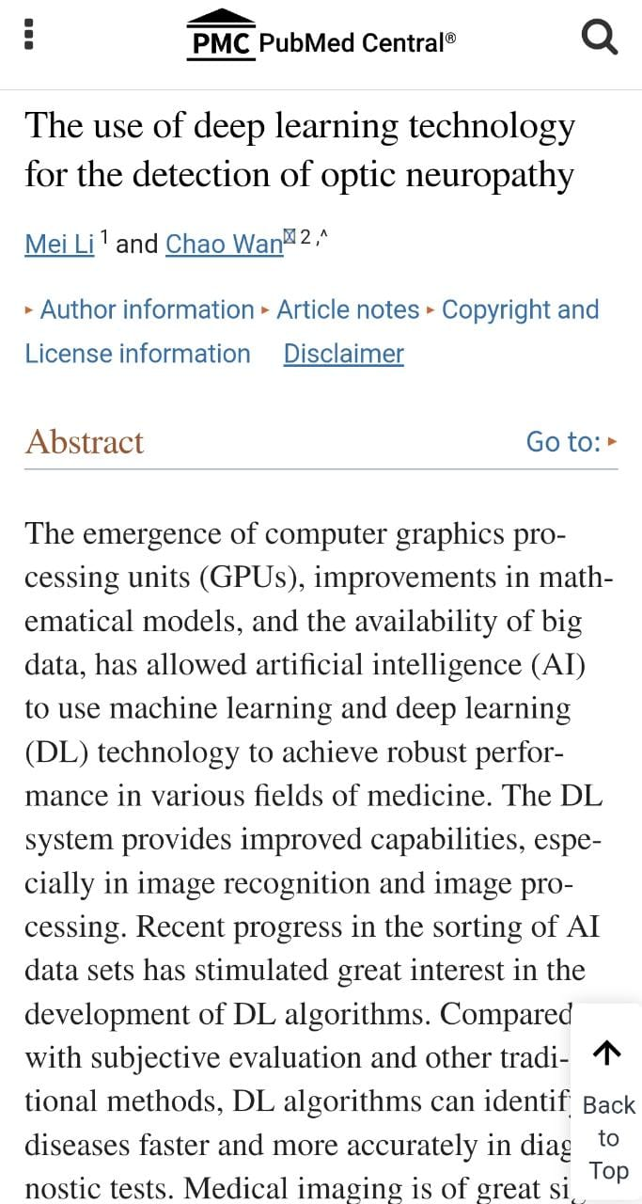
Ethics and research
Artificial intelligence
https://www.ncbi.nlm.nih.gov/pmc/articles/PMC2701125/
https://www.ncbi.nlm.nih.gov/pmc/articles/PMC8899937/

Slide 45
References
AAO, NEURO-OPHTHALMOLOGY, BCSC 2016-2017
OPHTHALMOLOGY AT A GLANCE 2015
KANSKI’S CLINICAL OPHTHALMOLOGY 9TH EDITION

