Slide 1
Lacrimal system
Dr AMBREEN GUL (MBBS, FCPS, CHPE, CHR)
MEMBER ESCRS, APSCRS, EuRETINA
Assistant Professor
Ophthalmology Department, BBH, RMU
Sources:
Kanskis-Clinical-Ophthalmology-Systematic-Approach
Oxford Handbook of Ophthalmology Book by Philip I. Murray

Slide 2
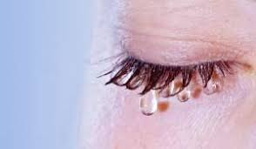

Slide 3
Learning objectives
At the end of one hour large group interactive session (LGIS) using the PowerPoint , fourth year medical student should be able to
Describe anatomy of lacrimal system and tears
Describe clinical features along with treatment options of congenital and acquired nasolacrimal duct obstruction
Differentiate between acute and chronic dacryocystitis

Slide 4
Sequence of lecture:
Core Subject
Spiral Integration
Horizontal Integration
Vertical integration
EOLA(End of lecture assessment)
Digital Library References
( Research, Bioethics, Artificial Intelligence)

Slide 5
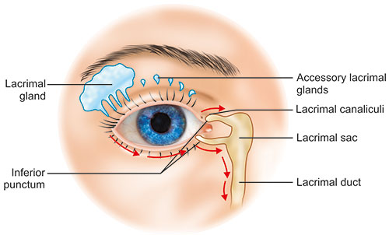
Anatomy of lacrimal system
vertical integration

Slide 6
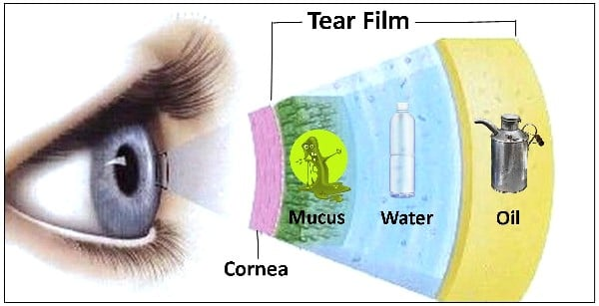
Tear film anatomy
vertical integration

Slide 7
physiology
vertical integration

Slide 8
pathology
Horizontal integration

Slide 9
Causes of epiphora
Core subject
Punctal occlusion (congenital absence, atresia, stenosis , occlusion due to foreign body)
Congenital delayed canalization of nasolacrimal duct
Chronic dacryocystitis with nasolacrimal duct obstruction
Inferior meatus growth or inflammation
Ectropion , Bell’s palsy

Slide 10
COMMUNITY MEDICINE
Horizontal integration
Congenital nasolacrimal duct (NLD) obstruction (dacryostenosis) occurs in approximately 6 percent of newborns and is the most common cause of persistent tearing and ocular discharge in infants and young children.
Acquired dacryocystitis is more common in females than in males and is most common in patients older than 40 years, with a peak in patients aged 60-70 years

Slide 11
Congenital nasolacrimal duct obstruction
Core Subject

Slide 12
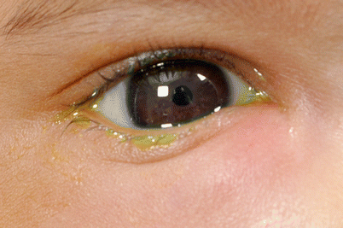
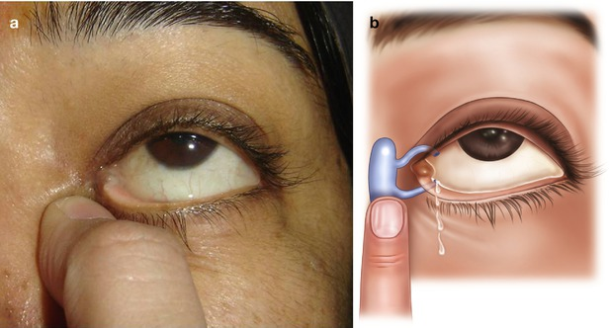
Congenital nld obstruction
Persistent epiphora or mucopurulent discharge
Positive regurgitation test
Core Subject

Slide 13
etiology
Core Subject

Slide 14
treatment
Core Subject
Conservative
Massage over lacrimal sac
Antibiotic drops

Slide 15
Treatment
Core Subject
Surgical
Probing and syringing of nasolacrimal duct
Primary intubation with silicone tube
Dacryocystorhinostomy (DCR)

Slide 16
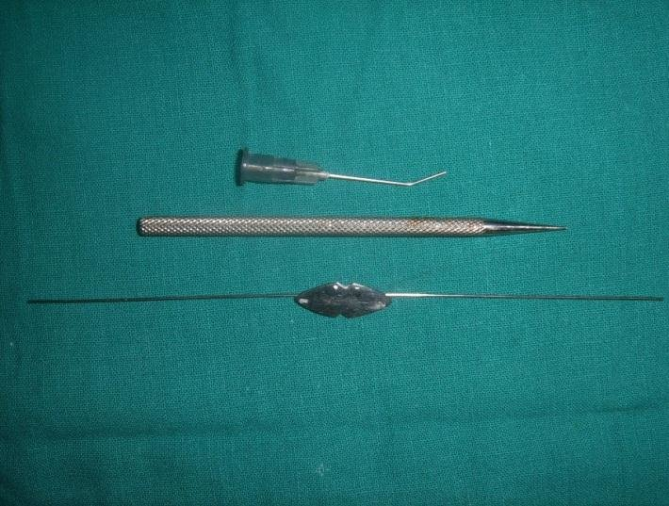
PROBING AND SYRINGING
Core Subject

Slide 17
Dacryocystorhinostomy (DCR)
vertical integration

Slide 18
ACUTE DACRYOCYSTITIS
Core Subject

Slide 19
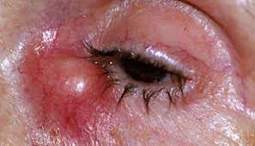
Clinical features
Core Subject
Acute suppurative inflammation of lacrimal sac
Pathogens staphylococcus, streptococcus, pneumococcus
Swelling , redness , tenderness over lacrimal sac area
Lacrimal sac abscess
Lacrimal fistula ( An epithelialized tract from lacrimal
system to the skin)

Slide 20
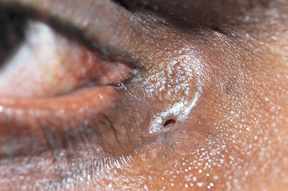
Lacrimal fistula
Core Subject

Slide 21
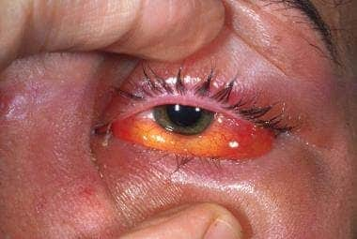
complications
Core Subject
Orbital cellulitis
Cavernous sinus thrombosis
Osteomyelitis of lacrimal bone

Slide 22
treatment
Core Subject
Medical
Systemic antibiotics, analgesics, anti-inflammatory agents
Hot fomentation
Surgical
Incision and drainage of lacrimal sac abscess
Fistulectomy (Excision of fistula tract and suturing)

Slide 23
CHRONIC DACRYOCYSTITIS WITH NASOLACRIMAL DUCT OBSTRUCTION
Core Subject

Slide 24
INTRODUCTION & ETIOLOGY
Core Subject
Chronic suppurative inflammation of the lacrimal sac resulting from obstruction of nasolacrimal duct
Etiology
Inferior turbinate hypertrophy
Nasal polyp pressure
Nasal septum deviation
Inflammation of nasal mucosa

Slide 25
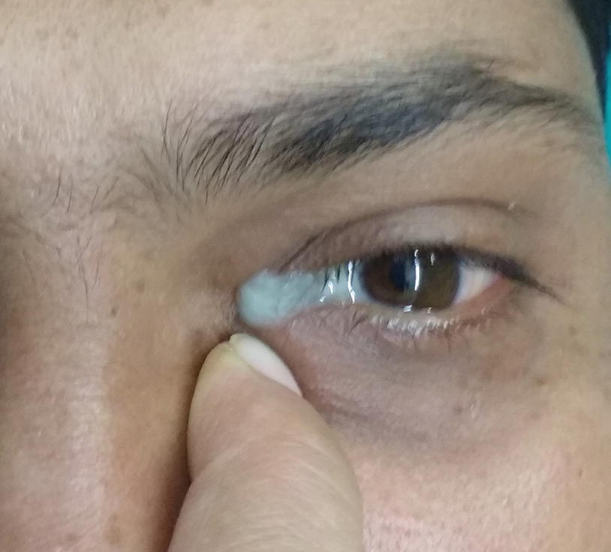
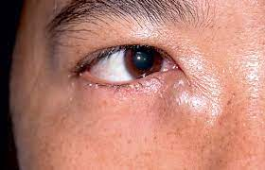
CLINICAL FEATURES
Core Subject
Constant epiphora
Pain, swelling or redness in case of infection
Positive regurgitation test (mucopurulent discharge)
Mucocele formation (Swelling at lacrimal sac area)

Slide 26
COMPLICATIONS
Core Subject
Lacrimal sac abscess
Lacrimal sac fistula
Non healing corneal ulcers
Pan ophthalmitis if any ocular surgery planned

Slide 27
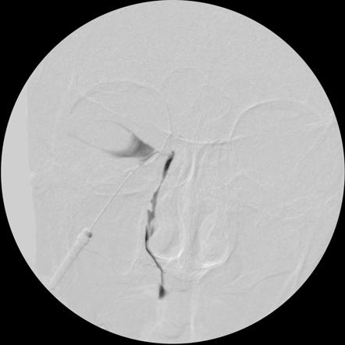
Investigations
Core Subject
Nasal examination to rule out turbinate hypertrophy and Deviated Nasal Septum
Dacryocystography using urografin and x-ray
to find out site of obstruction
Subtraction macrodacryocystography

Slide 28
TREATMENT
Core Subject
Conservative in fresh cases
Repeated syringing of nasolacrimal duct and antibiotic drops
For diagnostic and therapeutic purposes
Surgical in long standing resistant cases
Dacryocystectomy
Dacryocystorhinostomy
Insertion of special tubes lester jones tubes

Slide 29
DACRYOCYSTORHINOSTOMY
Core Subject
Surgical procedure to restore the flow of tears from the lacrimal sac into the nasal cavity to bypass the route of nasolacrimal duct
External DCR
Endoscopic DCR
Complications
Hemorrhage into nasal cavity
Failed DCR
SUMP syndrome

Slide 30
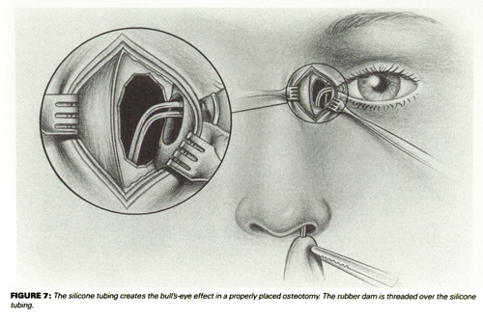
STEPS
vertical integration

Slide 31
EOLA( End Of Lecture Assessment)
A 30 years old female presented to ophthalmic clinic with complaints of watering right eye since 3 years and redness ,swelling along with purulent discharge of right eye from last 2 days. Examination reveals swelling over lacrimal sac area along with signs of inflammation. What is your provisional diagnosis for this patient? How will you treat this patient?

Slide 32
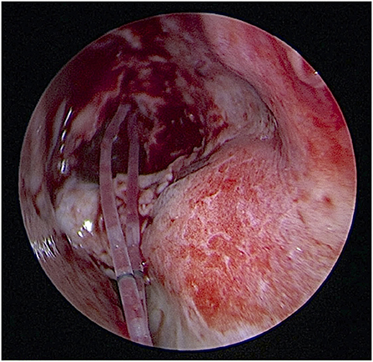
RECENT ADVANCES IN DCR- Endoscopic DCR ( sutureless surgery)
A light pipe inserted from the upper canaliculus into the sac. The illumination of sac located in front of the middle turbinate.
The pushed-type bicanalicular silicone stent (Nunchaku®) was pushed through the lower and upper puncta into the nasal cavity.
No knots or suture needed for fixation

Slide 33
BIOETHICS
Success rates of both external DCR and endo-dcr should be properly explained to the patient before going to surgery.

Slide 34
Role of AI IN LACRIMAL APPARATUS
Park et al. developed machine and deep learning algorithms using Lacrimal Scintigraphy images to classify lacrimal duct pathology in patients with epiphora. The system showed accuracy comparable to a trained oculoplastic specialist.
5 models were developed using machine learning tools, Python-based TensorFlow, R, and Microsoft Azure Machine Learning Studio (MAMLS)pp

