Slide 1
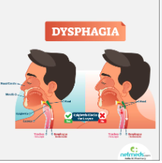

Slide 3
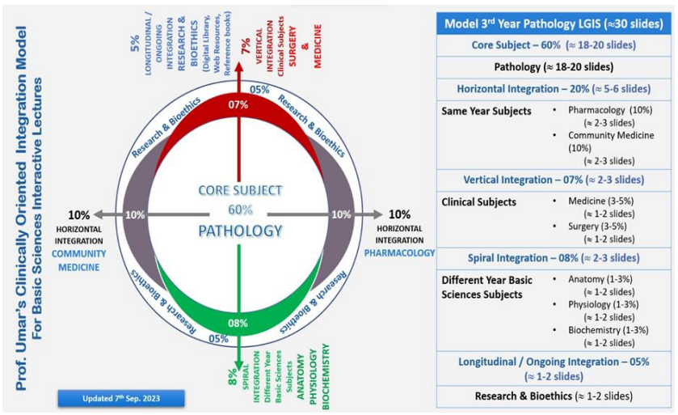

Slide 4
LEARNING OBJECTIVES:
Types of dysphagia
How to approach patient of dysphagia
Management of dysphagia
Recent advances regarding management of dysphagia.

Slide 5
“A 50 year old male presented in surgical OPD with complaints of progressive difficulty in swallowing solids & semi-solids for last 3 months.
He has a history of GERD ,has been on a PPI for many
years.
Recently he has been feeling fatigued and has
lost 7 Kg.
His physical examination does not reveal any abnormalities”

Slide 6
GRADES OF DYSPHAGIA:
mild dysphagia: only solid things can't be
swallowed
moderate dysphagia: solid & semi solid
thing can't be
swallowed
severe dysphagia: even liquids can't pass
DYSPHAGIA:
Difficulty in swallowing
Odynophagia:
Painful swallowing
Globus:
Constant sensation of a lump in throat …no organic defect
Notes:
6

Slide 7
Grade | Definition | Incidence at Diagnosis (%)
I | Eating normally | 11
II | Requires liquids with meals | 21
III | Able to take semisolids but unable to take any solid food | 30
IV | Able to take liquids only | 40
V | Unable to take liquids , but able to swallow saliva | 7
VI | Unable to swallow saliva | 12

Slide 10
Anatomy

Slide 11
Approach to dysphagia patient
Do Solids, & liquids both elicit dysphagia?
Solids mechanical :intrinsic/extrinsic
Both liquid/solid-very onset:motility disorders
What is the course of dysphagia?
Acute: food impaction,ulcer
Sudden: CVA
Progressive/long duration :strictures/malignancy
Non progressive /intermittent:rings
What is the duration of the dysphagia?
Short progressive history-malignancy

Slide 12
Whether can localise the site?
Accurately locate oropharyngeal cause
Oeso cannot localise
Some can point it at xyphoid

Slide 13
Whether has additional symptoms?
Heartburn,regurgitation,aspiration,weight loss,chest/abdominal pain
Chronic heartburn: erosive esophagitis/stricture
Cough/wheeze/sleep disruption
GERD or Achalasia-if also has chest pain

Slide 14
Whether has additional symptoms?
food sticking at throat/inability to chew/choking-neurological disease
Pain during swallowing:
malignancy/infection/inflammation from corrosive agents
Weight loss . Malignancy/achalasia

Slide 15
Does patient have any comorbidies?
Scleroderma/SLE
What medication does the patient take ?
Chronic immunosuppresives
Infection oesophagitis
NSAIDS

Slide 16
COMMON CAUSES OF DYSPHAGIA:
CONGENITAL
ACQUIRED
Notes:
16

Slide 17
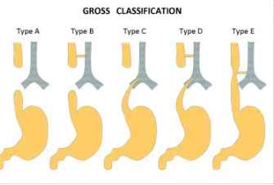
Congenital causes: Esophageal Atresia

Slide 18
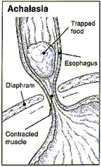
Achalasia of the Cardia
WWW.MD4A.NET
Notes:
18

Slide 19
1) Absence of peristalsis,
2) Elevated pressure of the LES,
3) Failure of the LES to relax during swallowing,
Causing functional obstruction at the gastroesophageal junction.
Notes:
19

Slide 20
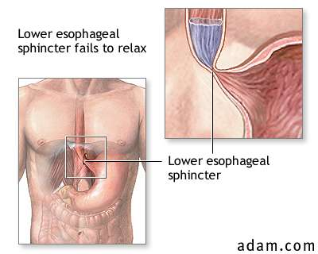
Notes:
20

Slide 21
History
Dysphagia (most common)
Regurgitation
Chest pain
Heartburn
Weight loss
Physical examination is noncontributory.
Notes:
21

Slide 22
Imaging Studies
UGI: Bird’s Beak.
EGD: Normal or dilated esophagus.
Manometry
Notes:
22

Slide 23
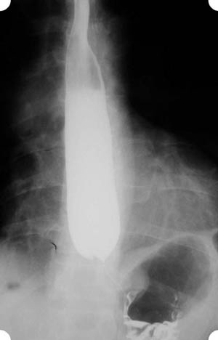
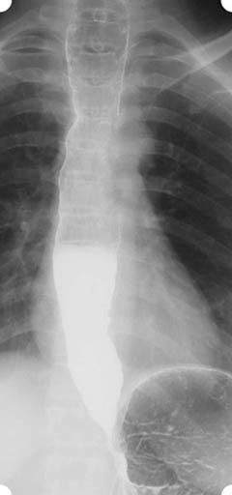
Notes:
23

Slide 24
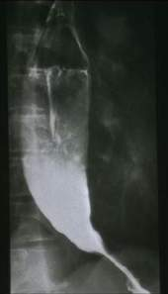
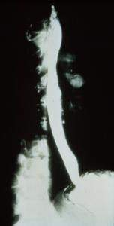
Bird’s Beak
Birds beak xray
Normal Barium Swallow
Notes:
24

Slide 25
Goal of therapy is:
Relieve symptoms by eliminating the
resistance caused by the hypertensive & nonrelaxing LES.
Medical Management
Surgical Management
Notes:
25

Slide 26
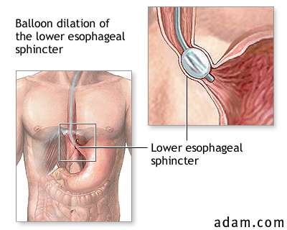
Pneumatic dilatation:
Notes:
26

Slide 27
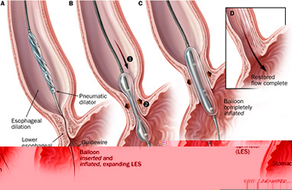
Notes:
27

Slide 28
Heller’S myotomy:
Cardiomyotomy and dividing the muscle of the lower end of the esophagus and the upper stomach down the mucosa.
The laparoscopic approach appears to be most appropriate.
Notes:
28

Slide 29
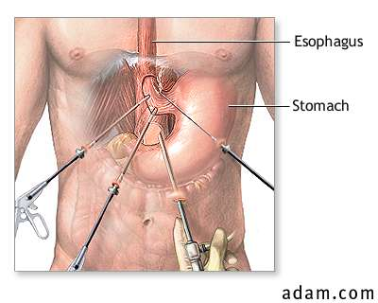
Notes:
29

Slide 30
Notes:
30

Slide 31
Esophageal cancer:
6th most common cancer worldwide
Peak incidence: 50 to 70 years
Male: female = 5:1
Two common histologic types:
Squamous cell carcinoma (upper 2/3rd)
Adenocarcinoma (lower 1/3rd)

Slide 32
Symptoms Caused by Local Tumor Effects
Dysphagia
Regurgitation
Vomiting
Odynophagia
Chest pain unrelated to eating
heartburn
Weight loss (>20%)
Upper gastrointestinal bleeding

Slide 33
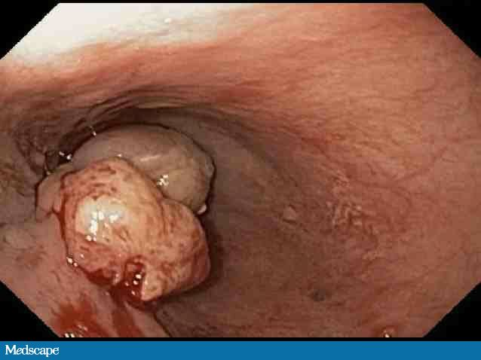
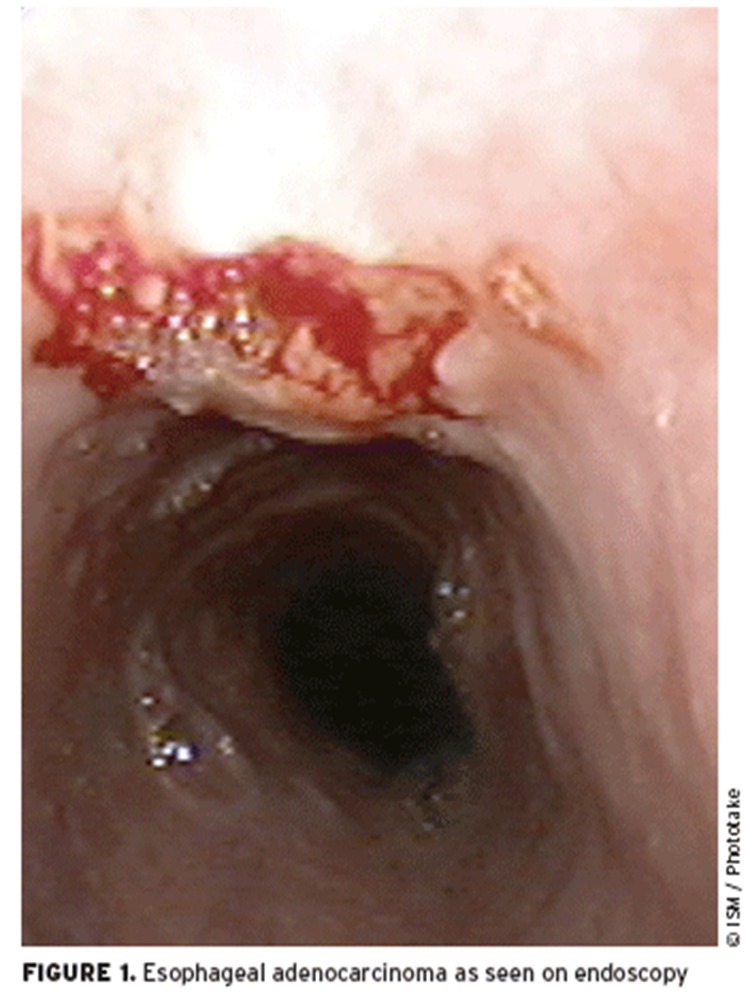
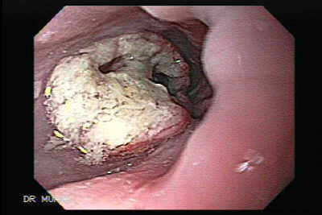
Patterns of Growth:
Fungating
Ulcerating
Infiltrating

Slide 34
Endoscopy

Slide 35
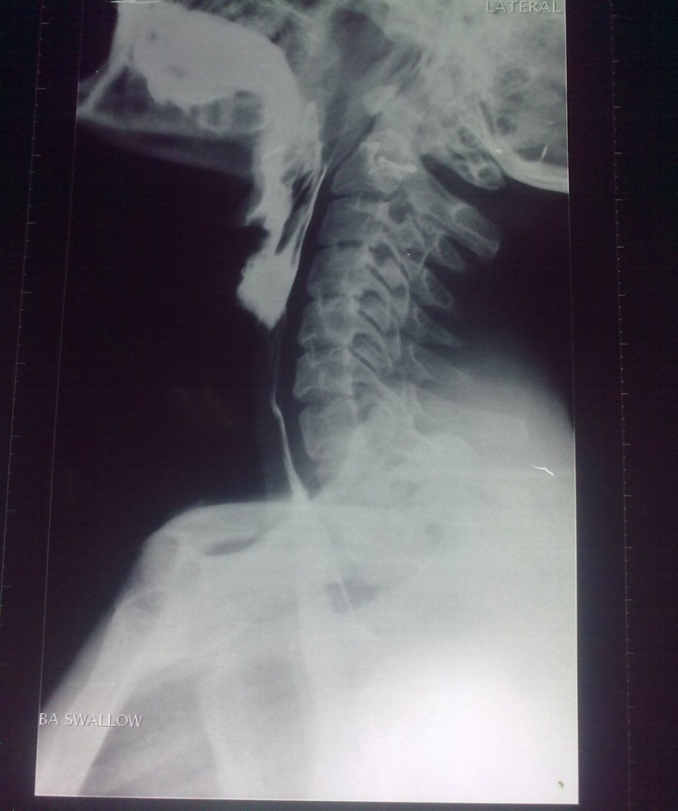

Slide 36
Apple core
WWW.MD4A.NET
Notes:
36

Slide 37
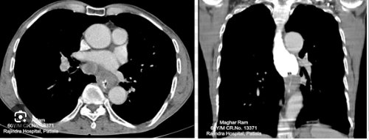

Slide 38
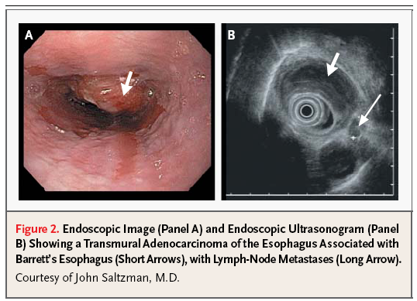

Slide 40
Management options

Slide 41
Surgery
Radiation
Preoperative radiation
Postoperative radiation
Chemotherapy
Combined Chemoradiation

Slide 42
Laparoscopic
Open

Slide 43
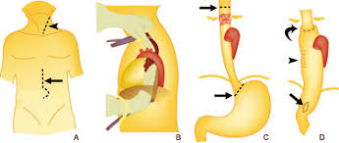

Slide 44
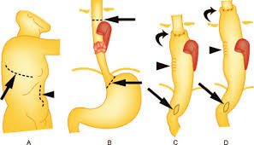

Slide 45
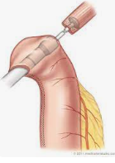
Laparoscopic esophagectomy:

Slide 46
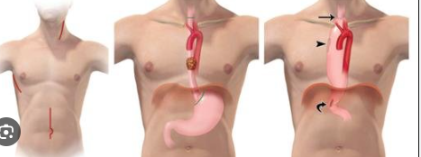

Slide 47
Neoadjuvant therapy:
Downstage the tumor and make it resectable.

Slide 48
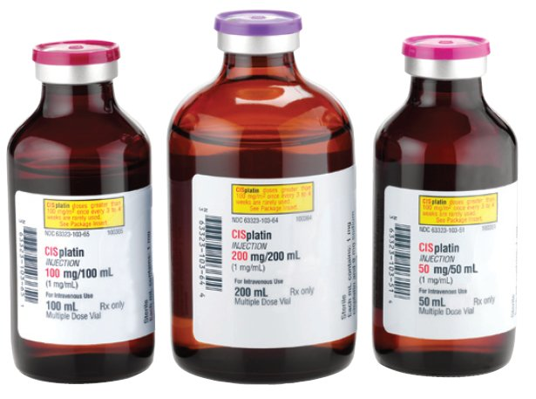
Partial response,
systemic micro metastasis
Improved survival of pts receiving systemic therapy
Single-agent chemotherapy
Combination chemotherapy

Slide 49
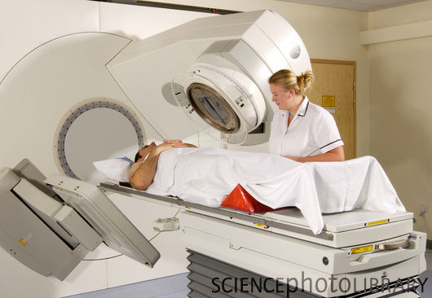
Squamous cell Ca is radiosensitive
Has three objectives:
Palliation
Cure
Adjunct to esophagectomy

Slide 50
Overall survival rate for esophageal cancer is less than 20%.
Stage | 5 year survival rate (%)
I | 60
II | 40
III | 15
IV | <5

Slide 51
Self expanding metallic stents
Endoscopic laser
Brachytherapy:

Slide 52
Recent advances:

Slide 53
Laser Ablation:

Slide 54
Take home message

