Slide 1
THE ABDOMINAL WALL
Professor Jahangir Sarwar Khan
HOD SU-1
Holy Family Hospital

Slide 4
Soft tissue swellings of the abdominal wall

Slide 5
A 45 year male construction worker presents to the emergency department with 2 days history of increasing abdominal wall swelling and pain.
He reports a recent history of heavy lifting and denies any trauma or previous abdominal surgery.
Medical History: Hypertension, Osteoarthritis
Current Medication: Lisinopril, Ibuprofen

Slide 6
Examination
Inspection: swelling in the right lower quadrant of the abdomen, which is more pronounced when the patient stands.
Palpation: A firm, non reducible tender mass distinct from the surrounding tissue. No rebound tenderness or guarding noted.
Percussion: Dullness over the mass area.
Auscultation: Normal bowel sounds.

Slide 7
Ultrasound: shows a large fluid collection in the rectus sheath

Slide 8
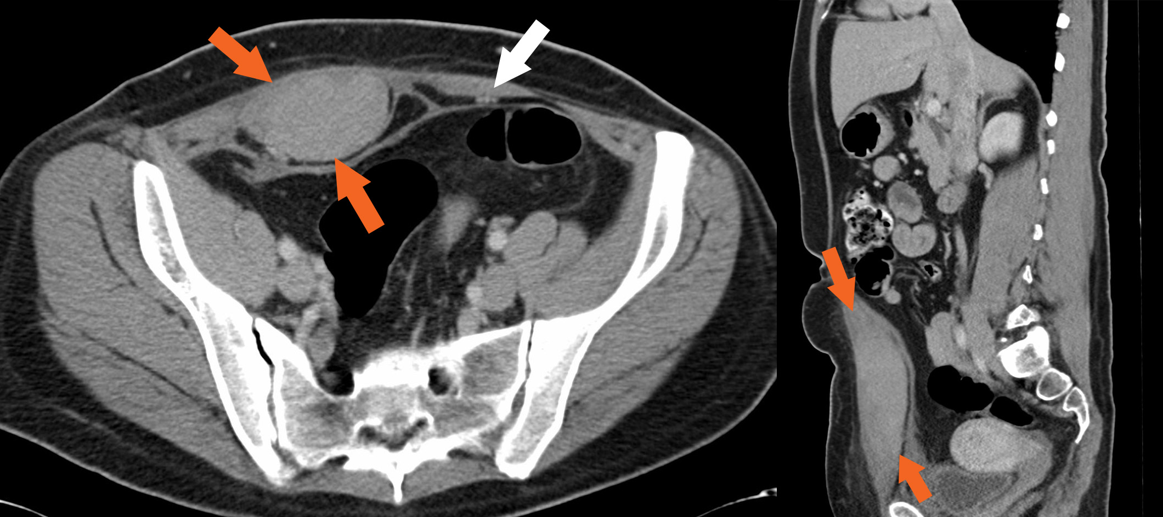

Slide 9
Learning objectives:
1. Define soft tissue swelling of the abdominal wall and explain its causes.
2. Describe the clinical features and signs of soft tissue swelling of the abdominal wall.
3. Understand the diagnostic approach, including imaging studies and laboratory tests.
4. Explain the management principles.

Slide 10
WHAT IS “THE ABDOMINAL WALL”?

Slide 15
BENIGN SOFT TISSUE SWELLINGS

Slide 16
Clinical presentation

Slide 17
Lump in the abdominal wall.
May vary from soft to hard.
Painless or painful.
Can be differentiated from intra abdominal masses by Carnett’s sign.

Slide 19
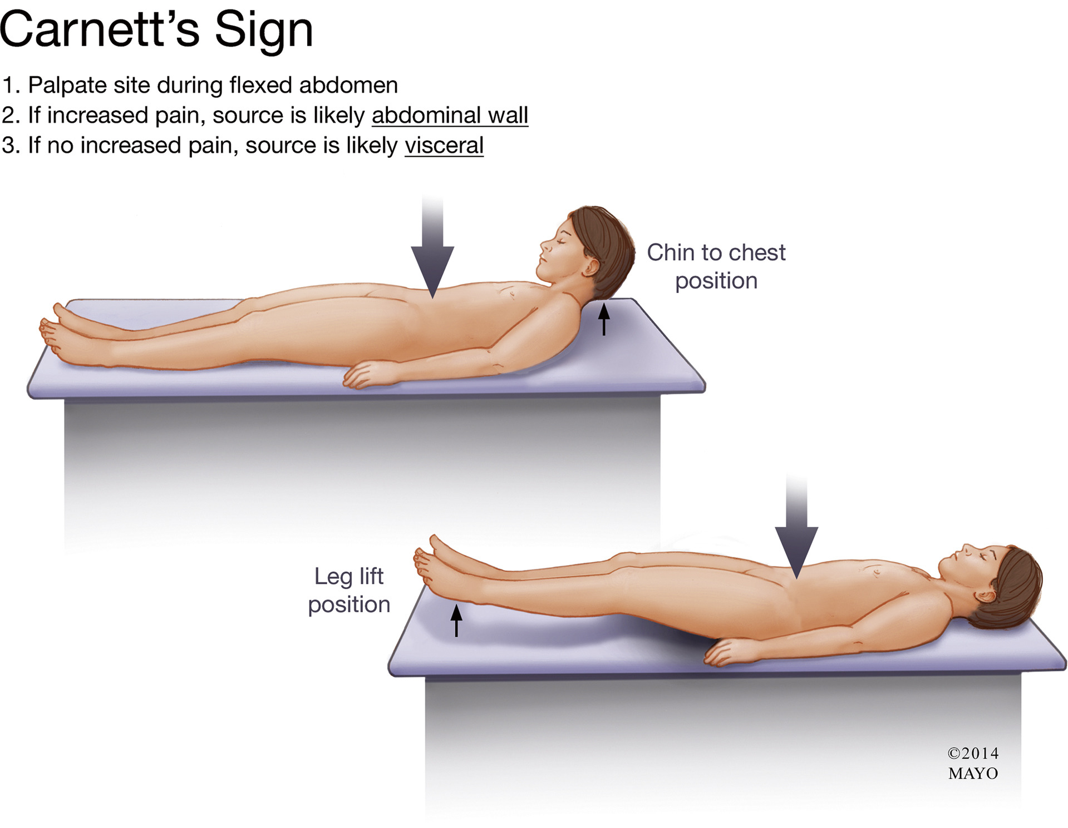

Slide 20
Types of Abdominal Wall Swellings:

Slide 21
Traumatic swellings: Caused by direct blows to the abdominal wall, leading to hematomas or seromas.
Infectious swellings: Resulting from infections like cellulitis, abscesses, or necrotizing fasciitis.
Inflammatory swellings: Associated with conditions like appendicitis, diverticulitis, or inflammatory bowel disease.
Neoplastic swellings: benign or malignant tumors as lipomas, sarcomas, or desmoid tumors.
Vascular swellings: vascular malformations, aneurysms, or deep vein thrombosis

Slide 22
Rectus sheath hematoma
History of trauma may or may not be present.
Can result from severe coughing, sneezing or vigorous physical activity.
Elderly with anticoagulants
May not be associated with skin bruising.
Tender mass in abdomen.
Carnett’s positive.

Slide 24
Ultrasound abdomen

Slide 25
CT scan abdomen

Slide 26
Management:
Small hematomas regress spontaneously.
Large may require hospitalization and transfusions of blood products and coagulation factors.
Rarely, Expanding hematomas may require angio-embolization.

Slide 28
LIPOMAS and NEUROFIBROMAS

Slide 29
Most common benign disorders of the abdominal wall
May be a part of “DERCUM’s Disease” (generalized disorder of disseminated lipomas).
Local excision indicated only for symptomatic lesions.

Slide 30
Border line: THE DESMOID TUMOR

Slide 32
THE DESMOID TUMOR
Borderline tumor.
Arises from MUSCULO-APONEUROTIC part of abdominal wall.
Female predominance.
Also known as aggressive fibrosis.

Slide 34
Why Borderline?

Slide 35
It has both malignant and benign characteristics
Malignant character:
Aggressive and fast growing.
Locally infiltrative.
Recurrence rate as high as 80% if margins involved.
Benign character:
No metastatic potential
No characteristics of anaplasia on histopathology

Slide 36
Excision of desmoid tumor with composite mesh reconstruction

Slide 38
Chemotherapy with doxorubicin and dacarbazine produce remissions in 50% pts.
Radiation therapy also has good results in adjuvant and palliative roles.
Prognosis is excellent if margin free excision is done
Poor with FAP and advanced disease with 5-year mortality of 50%.

Slide 39
Miscellaneous soft tissue swellings

Slide 40
Endometrioma of abdominal wall
This rare form of endometriosis occur in post C-section scars.
Cyclical pain with menstruation.
In advanced cases, pain association with menstrual cycle may not be there.

Slide 42
Treatment of choice is surgical excision.
Hormonal therapy is not as effective as in other forms of endometriosis.

Slide 43
Malignant soft tissue swellings.
Primary soft tissue tumors of the abdominal wall are exceedingly rare.
FIBROSARCOMAS
LEIOMYOSARCOMAS
Dermatofibrosarcoma protuberans.
Melonoma.
Surgical excision with myocutaneous flap reconstruction is treatment of choice.

Slide 44
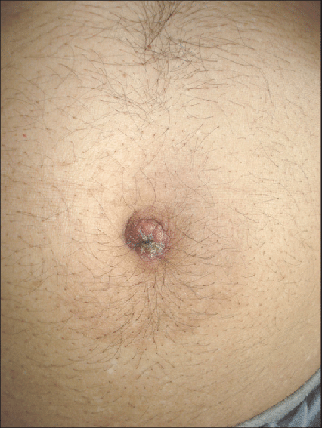
Metastatic tumors.
Sister mary joseph nodule most common example from stomach ca.
Other tumors may also Involve abdominal wall.

Slide 45
Recent advances

Slide 46
ROBOTIC ABDOMINAL WALL RECONSTRUCTION

Slide 47
Take home message.
Abdominal wall soft tissue swellings may vary greatly from benign harmless tumors to frank malignant lesions.
Have to be investigated if clinically suspicious.
Curative resections with abdominal wall reconstruction is treatment of choice for borderline and malignant lesions.

