Slide 1


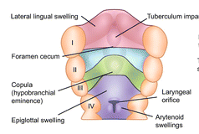
Gastrointestinal Tract (GIT) Module - I
2nd Year MBBS(LGIS)
Development of Tongue
Presenter: Prof. Dr. XYZ Date: 00-00-25

Slide 2
Prof. Umar’s Model of Teaching Strategy
Self Directed Learning Assessment Program
Objectives :To cultivate critical thinking, analytical reasoning, and problem-solving competencies.
To instill a culture of self-directed learning, fostering lifelong learning habits and autonomy.
First Ten Minutes
How to Assess?
Ten randomly selected students will be evaluated within the first 10 minutes of the lecture through 10 multiple-choice questions (MCQs) based on the PowerPoint presentation shared on Students Official WhatsApp group, one day before the teaching session.
The number of MCQs from the components of the lecture will follow the guidelines outlined in the Prof. Umar model of Integrated Lecture.
Component of LGIS | Core Knowledge | Horizontal Integration | Vertical Integration | Spiral Integration
No of MCQs | 6-7 | 1-2 | 1 | 1

Slide 3
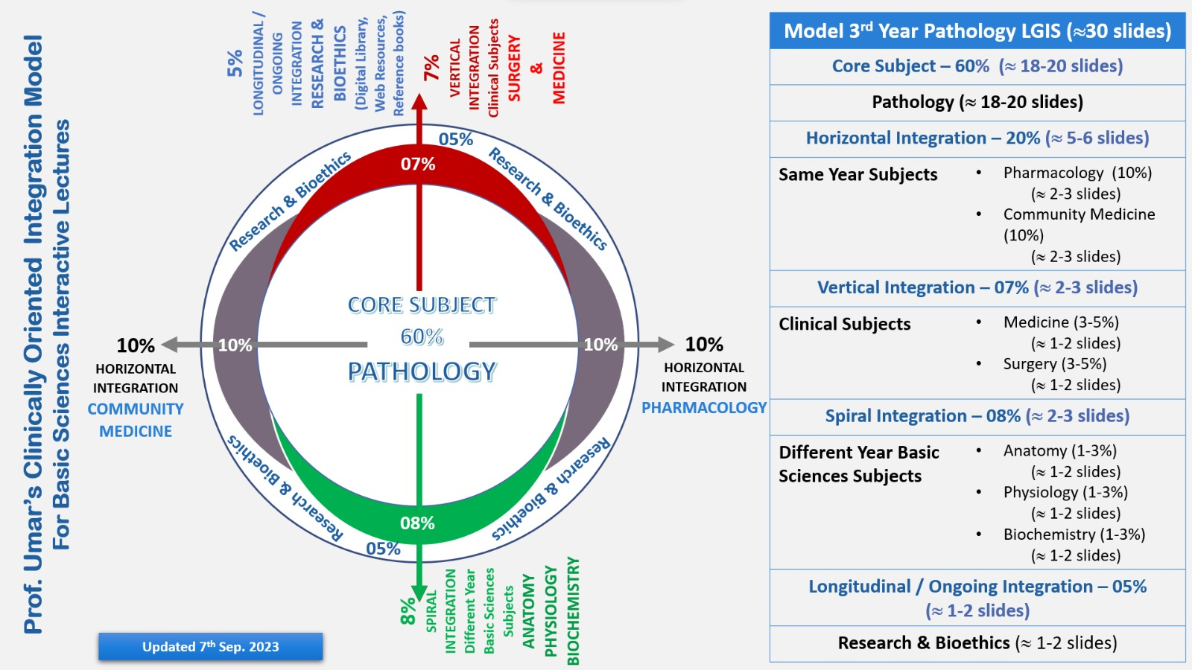
Professor Umar Model of Integrated Lecture

Slide 4
Motto, Vision, Dream
To impart evidence-based research oriented medical education
To provide best possible patient care
To inculcate the values of mutual respect and ethical practice of medicine
Wisdom
Truth
Service

Slide 5
Sequence of LGIS
Learning Objectives
Clinical Scenario
Development of tongue (Core concept=70%)
Related Physiology and Biochemistry
(Horizontal Integration-15%)
Related clinical/congenital abnormalities
(Vertical integration- 7%)
Spiral Integration- 8%
Research (4%)
Family Medicine(2%)
Ethics (2%)

Slide 6
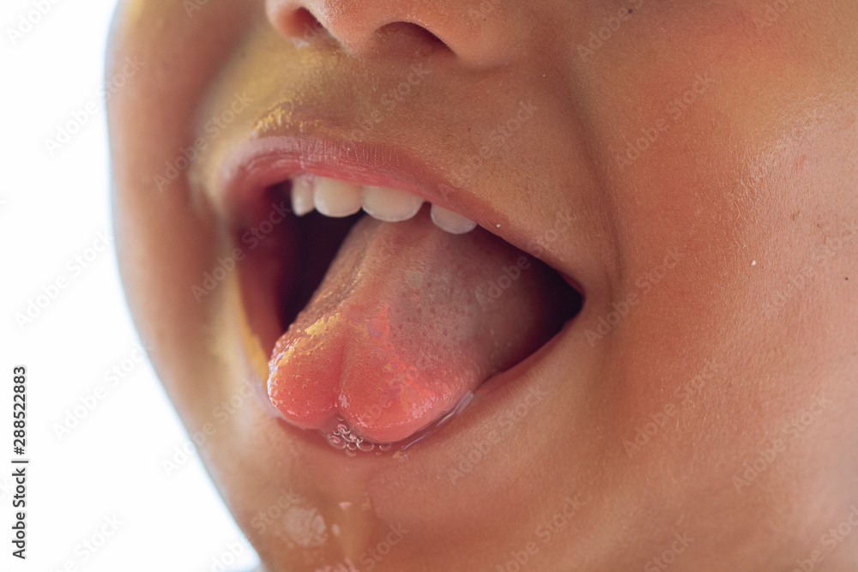
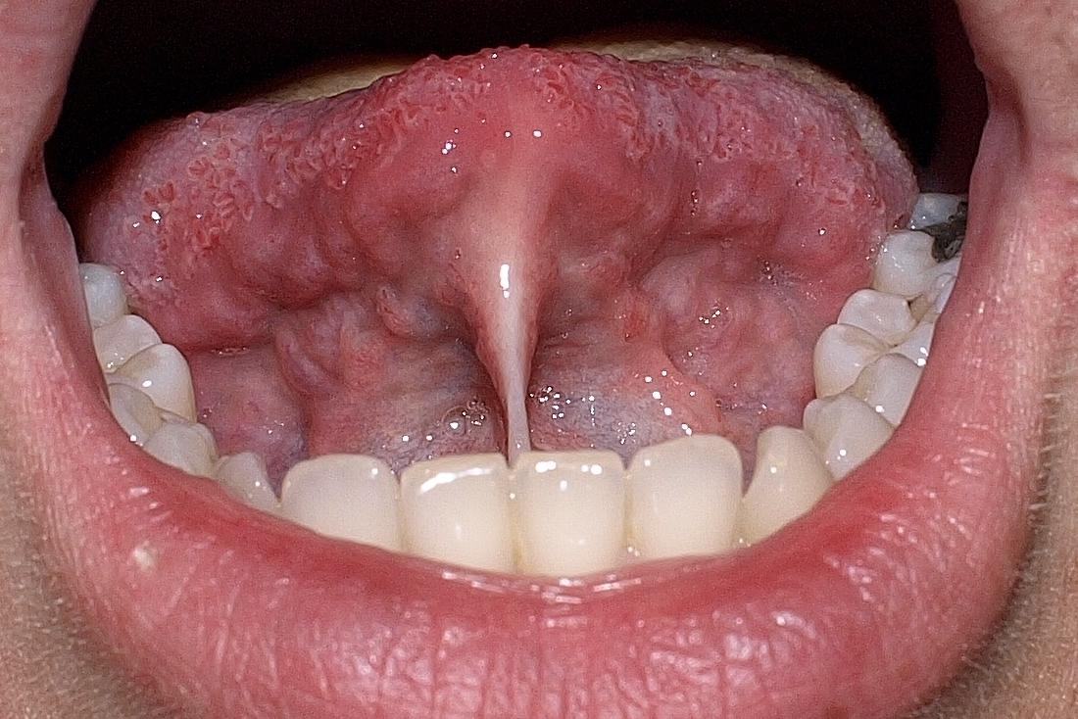
Clinical Scenario
A female patient aged 14 years was referred to oral surgery consultation for management of bifid tongue.
On initial interaction, the patient was found to be mildly mentally deficient and gave history of a previous surgery for correction of ankyloglossia
Interactive Session

Slide 7
Learning Objectives
At the end of the lecture, students will be able to
Describe role of pharyngeal apparatus in embryogenesis of tongue
Describe development of tongue
Integrate physiological and biochemical aspects of tongue with its developmental anatomy
Explain associated congenital abnormalities
Correlate and build core knowledge on the basis of latest research
Approach to a patient of bifid tongue

Slide 8
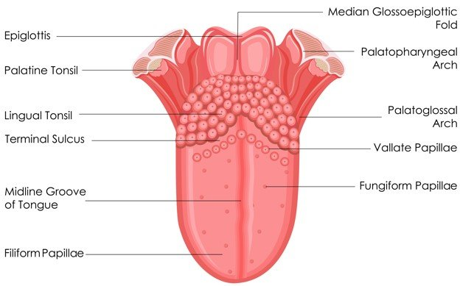

Gross Anatomy
The tongue is a unique organ located in the oral cavity that not only
facilitates perception of gustatory stimuli but
also plays important roles in mastication and swallowing
integral component of the speech pathway

Slide 9
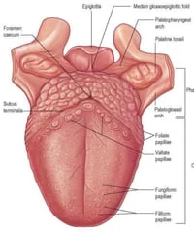
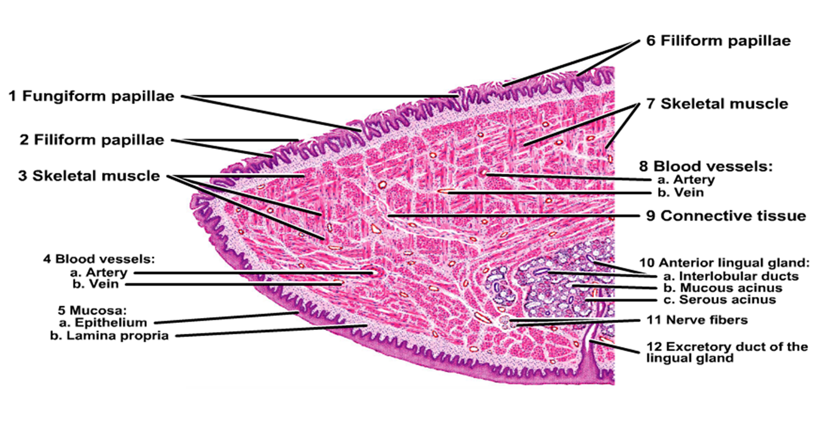
The tip or apex of the tongue is the most anterior, and most mobile aspect of the organ.
The tip is followed by the body of the tongue.
rough dorsal (superior) is populated with taste buds and lingual papillae,
and a smooth ventral (inferior) surface attached to the floor of the oral cavity by the lingual frenulum.

Slide 10
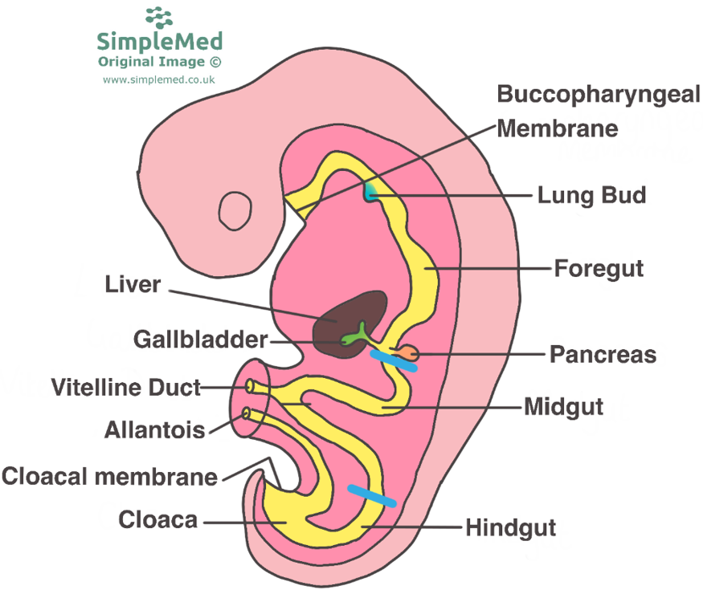
Recall

Slide 11
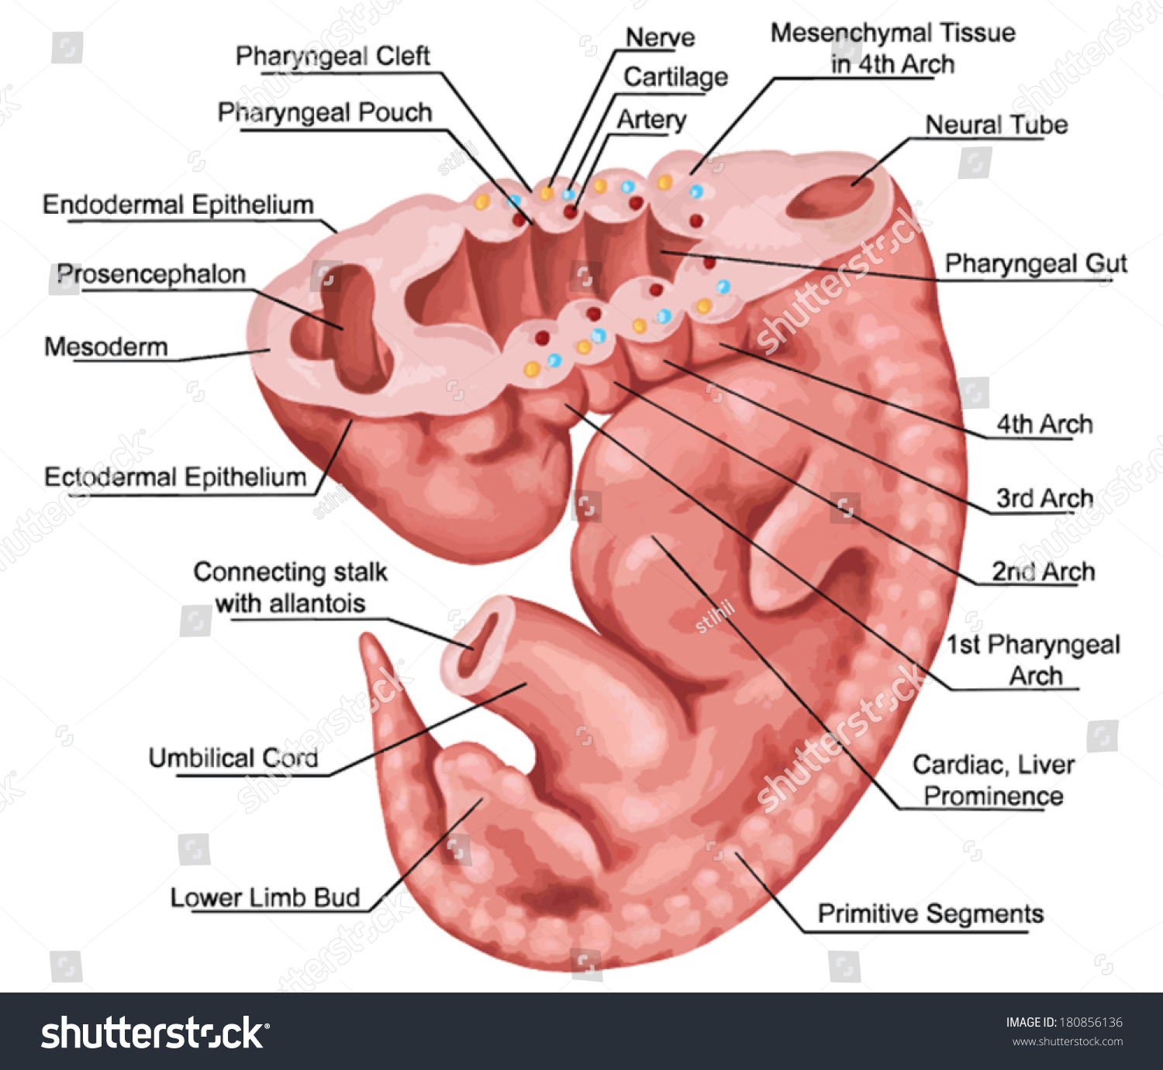
Introduction
Pharyngeal arches appear in the 4th and 5th weeks of development.
Initially they consist of bars of mesenchymal tissue
Separated by deep clefts known as pharyngeal or branchial clefts.

Slide 12
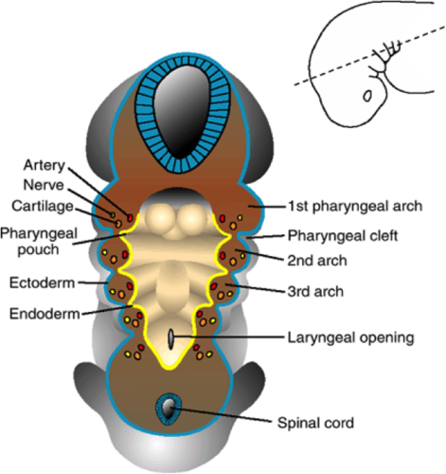
Simultaneously, a number of outpocketings, the pharyngeal pouches, appear along the lateral walls of the pharyngeal gut
but do not establish an open communication with the external clefts.

Slide 13
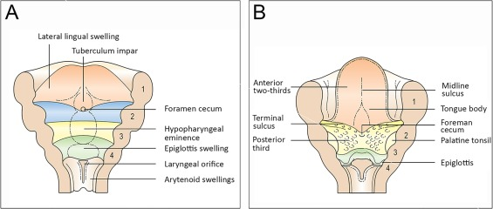
Development of tongue
Near the end of the fourth week, a median triangular elevation appears in the floor of the primordial pharynx, just rostral to the foramen cecum This swelling-
The median lingual swelling (tongue bud) (Latin, tuberculum impar)-is the first indication of tongue development.
Soon, two oval lateral lingual swellings (distal tongue buds) develop on each side of the median tongue bud.
Cause of swelling

Slide 14
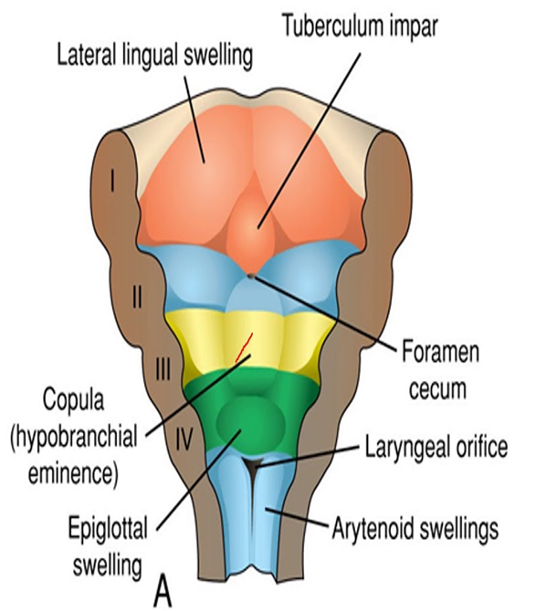
Formation of the posterior third (pharyngeal part) of the tongue is indicated in the fetus by two elevations that develop caudal to the foramen cecum
The copula (Latin, bond, tie) forms by fusion of the ventromedial parts of the second pair of pharyngeal arches.
The hypopharyngeal eminence develops caudal to the copula from mesenchyme in the ventromedial parts of the third and fourth pairs of arches.

Slide 15
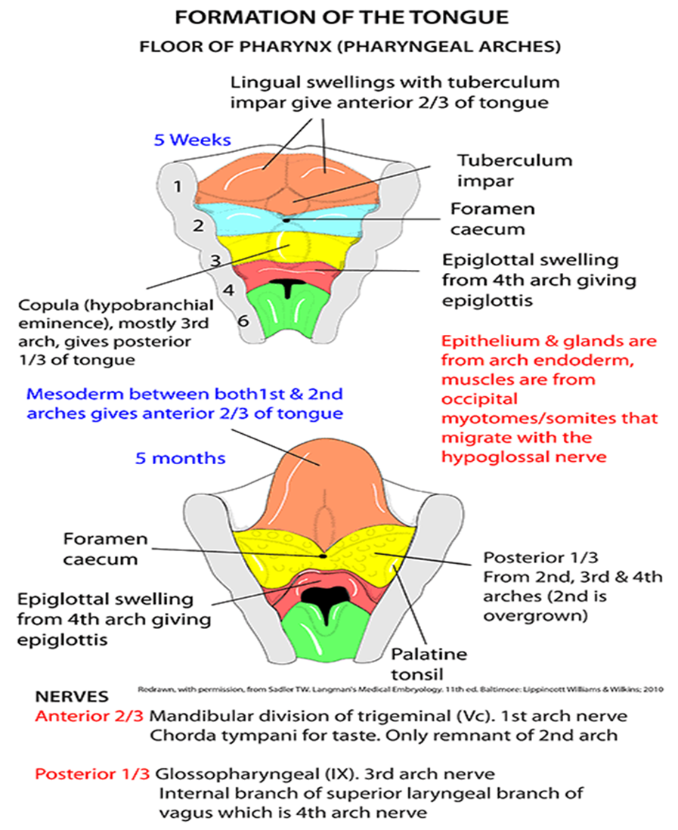
As the tongue develops, the copula is gradually overgrown by the hypopharyngeal eminence and disappears
As a result, the posterior third of the tongue develops from the rostral part of the hypopharyngeal eminence.

Slide 16
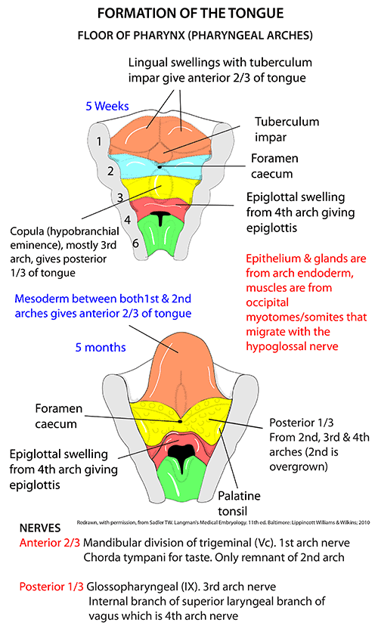

Slide 17
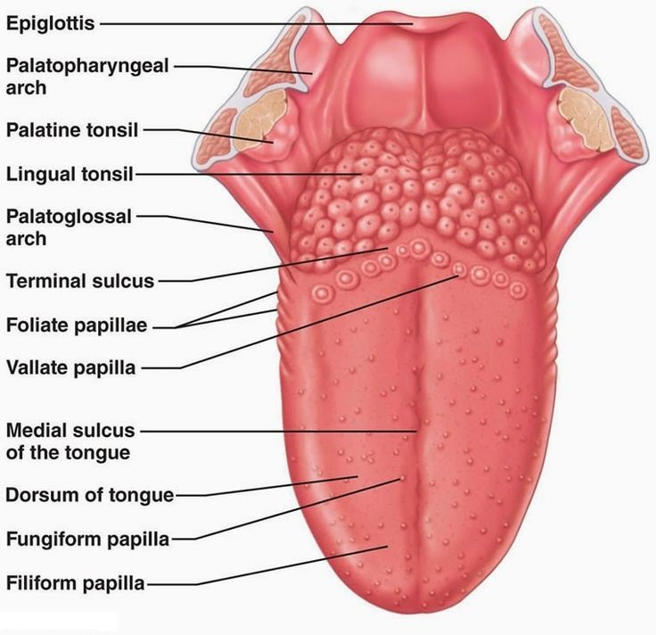
The line of fusion of the anterior and posterior parts of the tongue is roughly indicated by a V-shaped groove-the terminal sulcus
Pharyngeal arch mesenchyme forms the connective tissue and vasculature of the tongue.
Most of the tongue muscles are derived from myoblasts that migrate from the occipital myotomes
The hypoglossal nerve (CN XII) accompanies the myoblasts during their migration and innervates the tongue muscles.

Slide 18
Position of tongue
Both the anterior and posterior portions of the tongue are located within the oral cavity at birth
Posterior third descends into the oropharynx by 4 years of age.

Slide 19
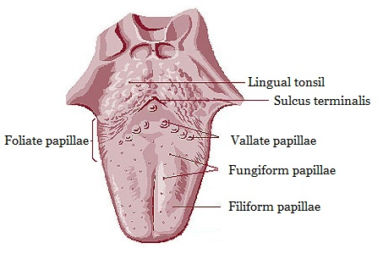
Development of papillae and taste buds
Lingual papillae appear toward the end of the eighth week.
The vallate and foliate papillae appear first, close to terminal branches of the glossopharyngeal nerve (CN IX).
The fungiform papillae appear later near terminations of the chorda tympani branch of the facial nerve (CN VII).

Slide 20
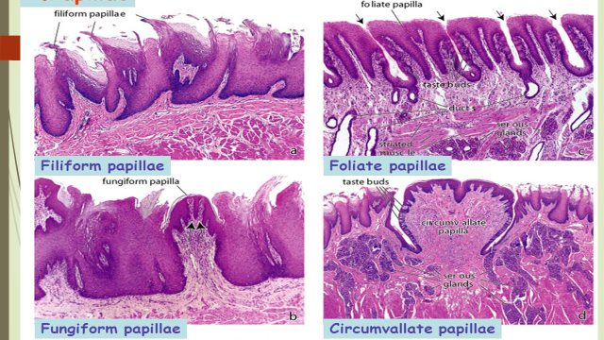
The most common lingual papillae, known as filiform papillae because of their threadlike shape, develop during the early fetal period (10-11 weeks).
They contain afferent nerve endings that are sensitive to touch.

Slide 21
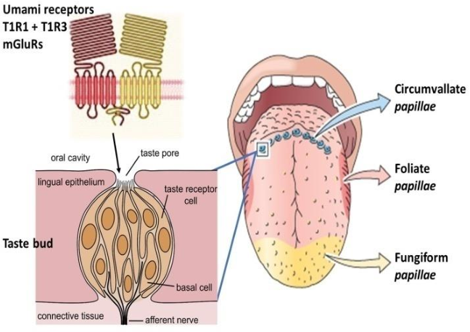
Taste buds
Develop during weeks 11 to 13 by inductive interaction between the epithelial cells of the tongue and invading gustatory nerve cells from the chorda tympani, glossopharyngeal, and vagus nerves.
Most taste buds form on the dorsal surface of the tongue,

Slide 22

Video Recap

Slide 23
Biochemical Aspect
Development of tongue is due to the complex interactions between genes Pax3 and Pax7
These are responsible for expansion and survival of muscles as well as patterning information in tongue myogenesis
Some studies show role of TGF in proliferation of myogenic cells during tongue morphogenesis
Horizontal integration

Slide 24
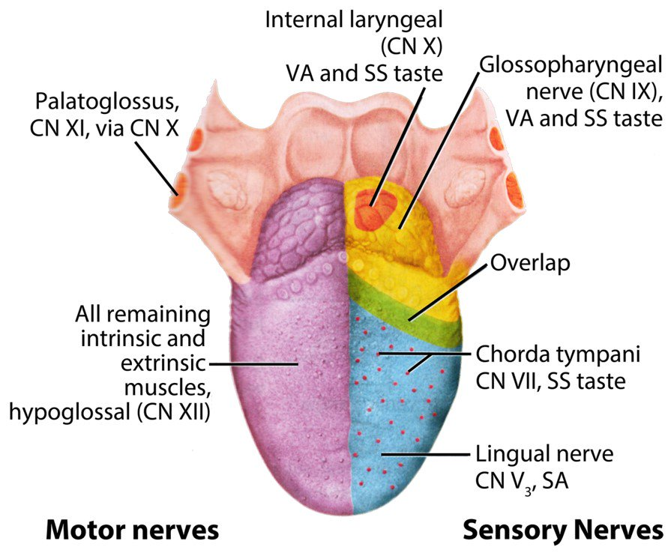

Slide 25
Taste Receptors
A very large number of molecules elicit taste sensations through a rather small number of taste receptors. Furthermore, it appears that individual taste receptor cells bear receptors for one type of taste. In other words, within a taste bud, some taste receptor cells sense sweet, while others have receptors for bitter, sour, salty and umami tastes.
HORIZONTAL INTEGRATION

Slide 26
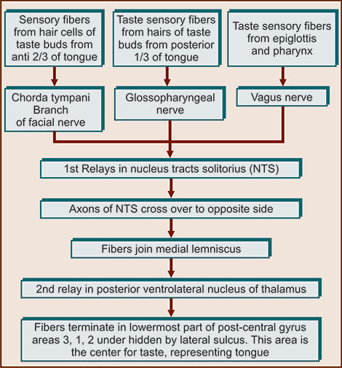
Taste Pathway
Horizontal Integration

Slide 27
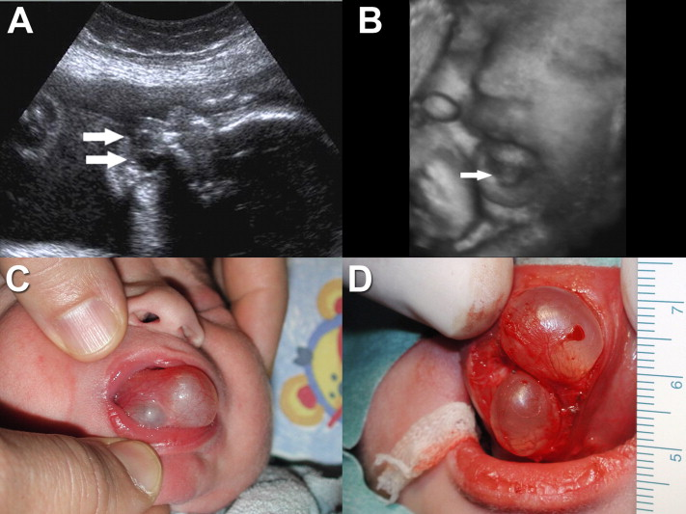
Congenital Lingual Cysts and Fistulas
Cysts in the tongue may be derived from remnants of the thyroglossal duct They may enlarge and produce symptoms of pharyngeal discomfort and/or dysphagia (difficulty in swallowing). Fistulas are also derived from persistence of lingual parts of the thyroglossal duct; they open through the foramen cecum into the oral cavity.
Vertical integration

Slide 28
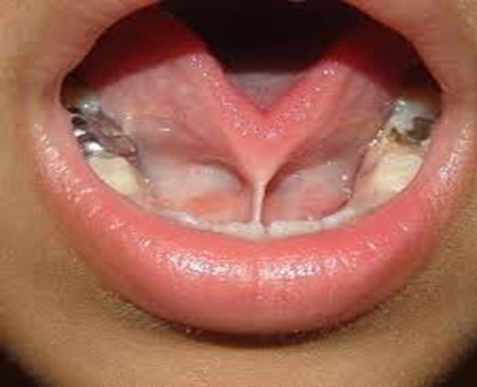
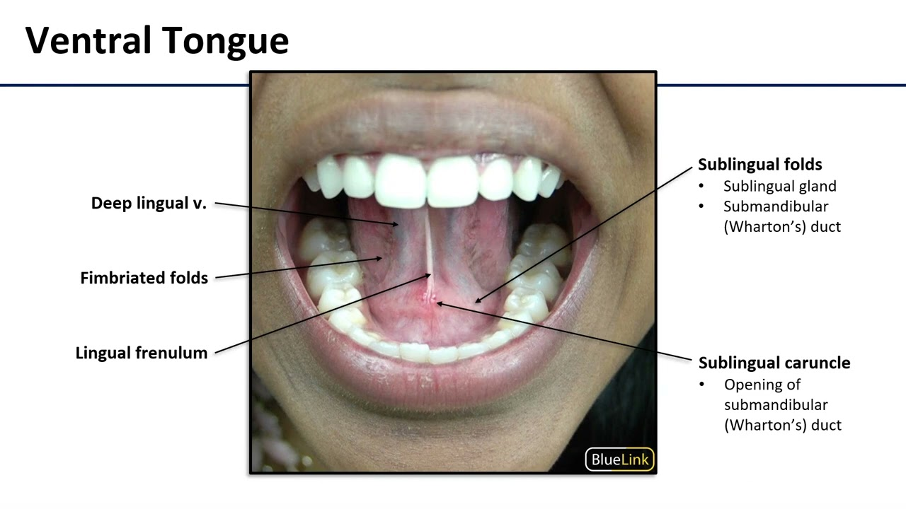
Ankyloglossia
The lingual frenulum normally connects the inferior surface of the tongue to the floor of the mouth. Sometimes the frenulum is short and extends to the tip of the tongue This interferes with its free protrusion and may make feeding difficult. A short frenulum usually stretches with time, making surgical correction of the anomaly unnecessary.
Vertical integration

Slide 29
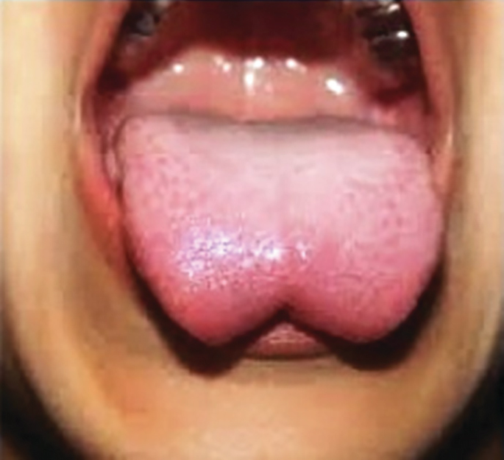
Bifid or Cleft Tongue (Glossoschisis)
Incomplete fusion of the lateral lingual swellings results in a deep midline groove in the tongue; usually this cleft does not extend to the tip of the tongue. This is a very uncommon anomaly.
Vertical integration

Slide 30
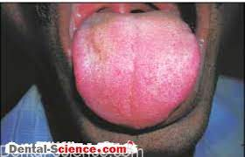
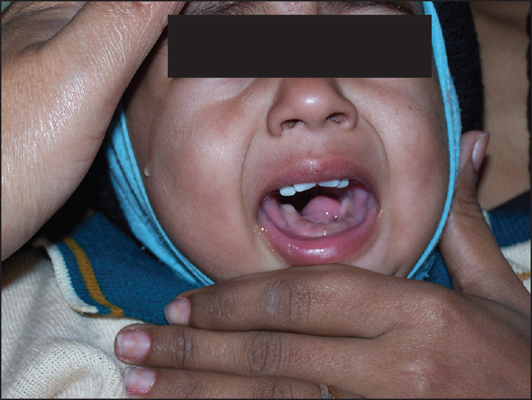
Congenital Abnormalities
Macroglossia
An excessively large tongue is not common. It results from generalized hypertrophy of the developing tongue, usually resulting from lymphangioma (a lymph tumor) or muscular hypertrophy.
Microglossia
An abnormally small tongue is extremely rare and is usually associated with micrognathia (underdeveloped mandible and recession of the chin) and limb defects (Hanhart's syndrome).

Slide 31
Gene profiling in dorso-ventral patterning of mouse tongue development
Objective: To reveal the signalling molecules involved in the formation of the dorsal and ventral parts of the tongue through microarray analysis.
Tae-Young Kim1 · Hyun-Geuk Jung1 · Elina Pokharel1 · Ji-Youn Kim2 · Jung-Hong Ha3 · Seo-Young An4 Genes & Genomics (2022) 44:1181–1189 https://doi.org/10.1007/s13258-022-01282-5
What is doi?
A DOI, or Digital Object Identifier, is a string of numbers, letters and symbols used to uniquely identify an article or document, and to provide it with a permanent web address (URL).
Spiral integration
Research

Slide 32
Approach towards patient of Tongue tie
Tongue-tie, also called ankyloglossia, is a congenital condition caused by an abnormally short lingual frenulum that limits tongue protrusion.
In the past, it was thought that tongue-tie rarely caused feeding problems. However, the increasing popularity of breastfeeding, which requires more oral work by the infant than bottle feeding, brought this idea into question
Several randomized trials have shown that in infants with tongue-tie and breastfeeding problems, frenulectomy is superior to education and lactation support alone.
Spiral integration
Family Medicine

Slide 33
Bioethical concerns in management of tongue tie
Tongue-tie has provoked controversy because it pits varieties of medicine that emphasize surgical intervention against those that emphasize care and support, and because it raises questions about the basis of clinicians’ authority to diagnose (by sight or palpation).
Frenotomy also raises a contentious bioethical question regarding the grounds on which it is justified to inflict pain on an infant.
How much confidence should we have in the benefits of a procedure in order to justify both the immediate pain of surgery and the risks associated with it?
Reference: Medical Anthropology Volume 41, 2022 - Issue 4
Controversy Over Tongue-Tie: Divisions in the Community of Healthcare Professionals
Maria Larrain ORCID Icon &Edward G.J. Stevenson ORCID Icon
Pages 446-459 | Published online: 08 Apr 2022
https://doi.org/10.1080/01459740.2022.2056843
BIOETHICS
Spiral integration

Slide 34
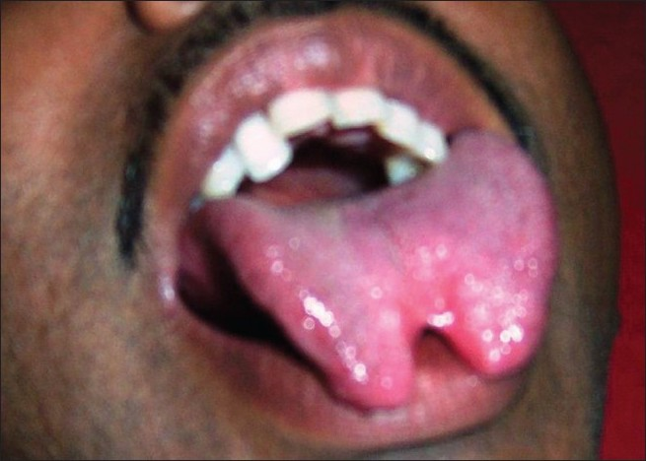
Home Assignment
A female patient aged 14 years was referred to oral surgery consultation for management of bifid tongue.
On initial interaction, the patient was found to be mildly mentally deficient and gave history of a previous surgery for correction of ankyloglossia
Give embryological basis of bifid tongue?
Describe nerve supply of tongue on the basis of development
Will be discussed in next lecture prior to discussion on new topic
Interactive Session

Slide 35


