Slide 1
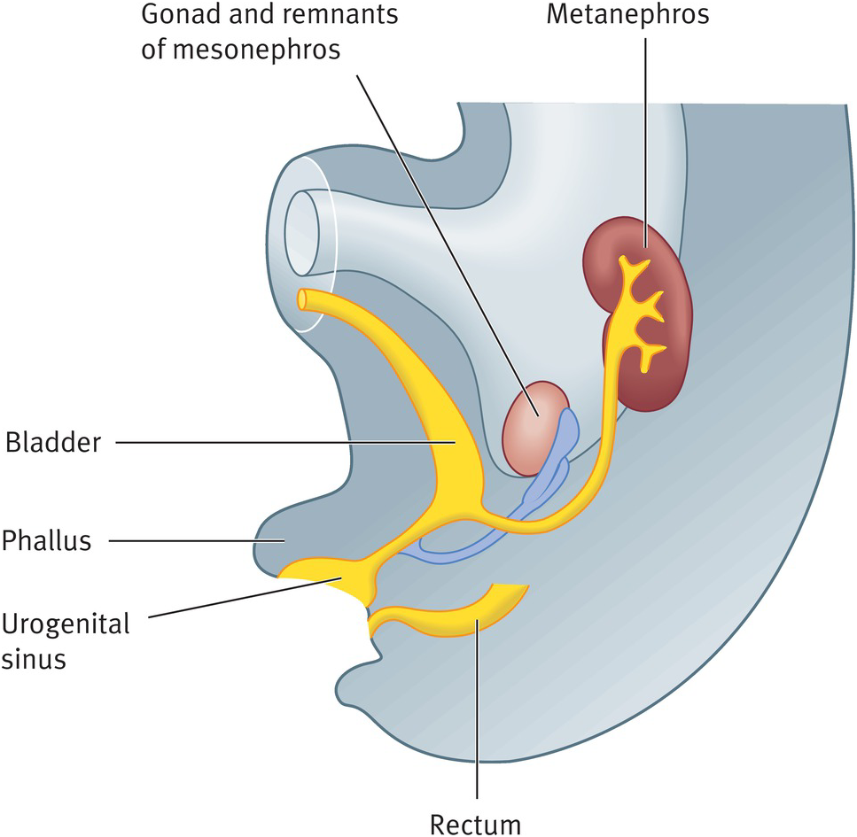
Renal Module 2nd Year MBBS(LGIS) Development of Urinary Bladder
Presenter: Prof.Dr. Ifra Saeed Date: 00-04-25

Slide 3
Prof. Umar’s Model of Teaching Strategy Self Directed Learning Assessment Program Objectives :To cultivate critical thinking, analytical reasoning, and problem-solving competencies. To instill a culture of self-directed learning, fostering lifelong learning habits and autonomy.
First Ten Minutes
How to Assess?
Ten randomly selected students will be evaluated within the first 10 minutes of the lecture through 10 multiple-choice questions (MCQs) based on the PowerPoint presentation shared on Students Official WhatsApp group, one day before the teaching session.
The number of MCQs from the components of the lecture will follow the guidelines outlined in the Prof. Umar model of Integrated Lecture.
Component of LGIS | Core Knowledge | Horizontal Integration | Vertical Integration | Spiral Integration
No of MCQs | 6-7 | 1-2 | 1 | 1

Slide 4
Professor Umar Model of Integrated Lecture

Slide 5
Learning Objectives
At the end of the lecture, students will be able to
Describe development of urinary bladder
Discuss physiological and biochemical aspects of Urinary Bladder & Vertically integrate pathology of urinary bladder
Discuss congenital abnormalities of ureter and bladder
Correlate and build core knowledge on the basis of latest research, Bioethics and family medicine Discuss role of Artificial Intelligence

Slide 6
Gross Anatomy

Slide 7
Histology of urinary Bladder

Slide 8
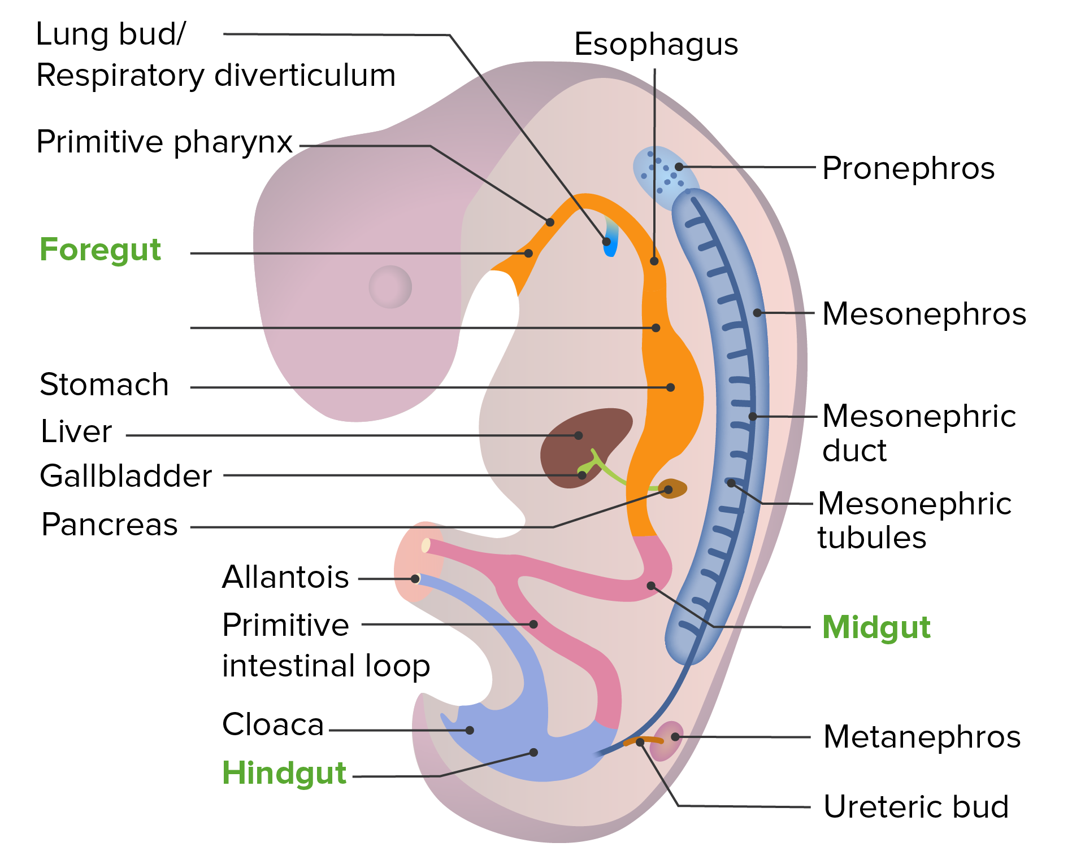
Development Of Urinary Bladder
Role of Urorectal septum

Slide 9
Role of Urorectal septum

Slide 10
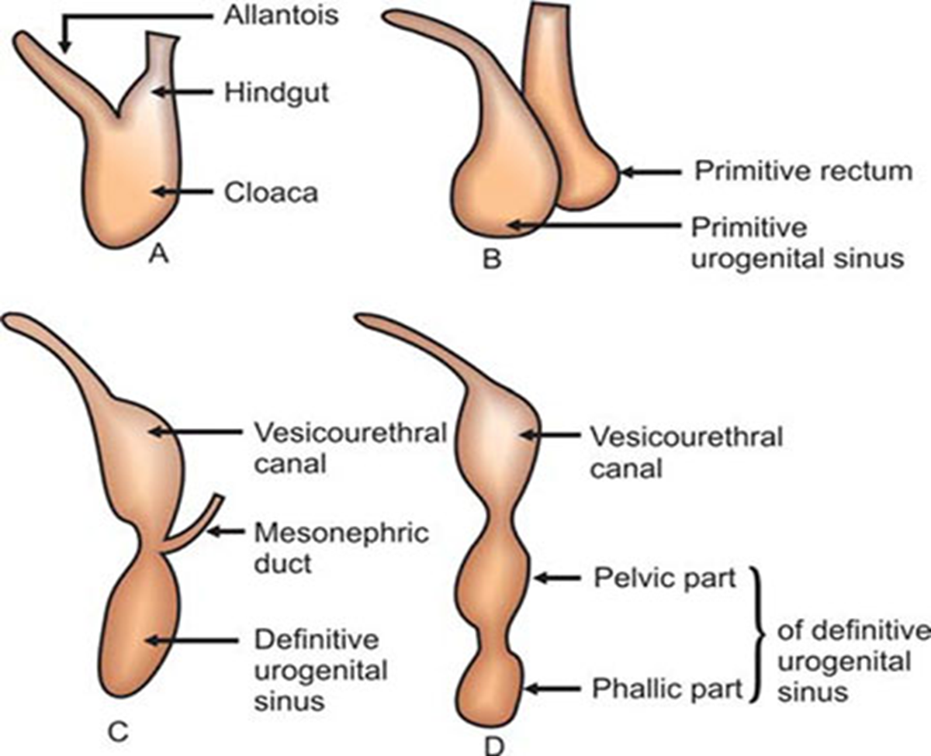
The urogenital sinus
is divided into three parts
A cranial vesical part that forms most of the bladder and is continuous with the allantois
A middle pelvic part that becomes the urethra in the bladder neck, the prostatic part of the urethra in males, and the entire urethra in females
A caudal phallic part that grows toward the genital tubercle (primordium of the penis or clitoris)

Slide 11
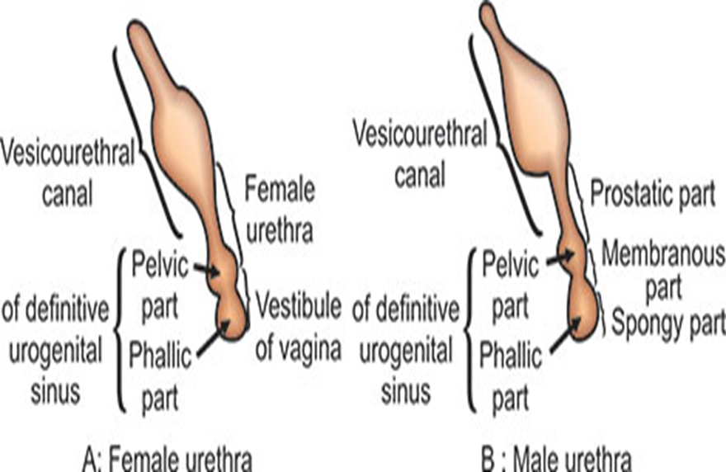
Parts of urogenital Sinus

Slide 12
Summary
The bladder develops mainly from the vesical part of the urogenital sinus, but its trigone region is derived from the caudal ends of the mesonephric ducts
The entire epithelium of the bladder is derived from the endoderm of the vesical part.
The other layers of its wall develop from adjacent splanchnic mesenchyme.

Slide 13
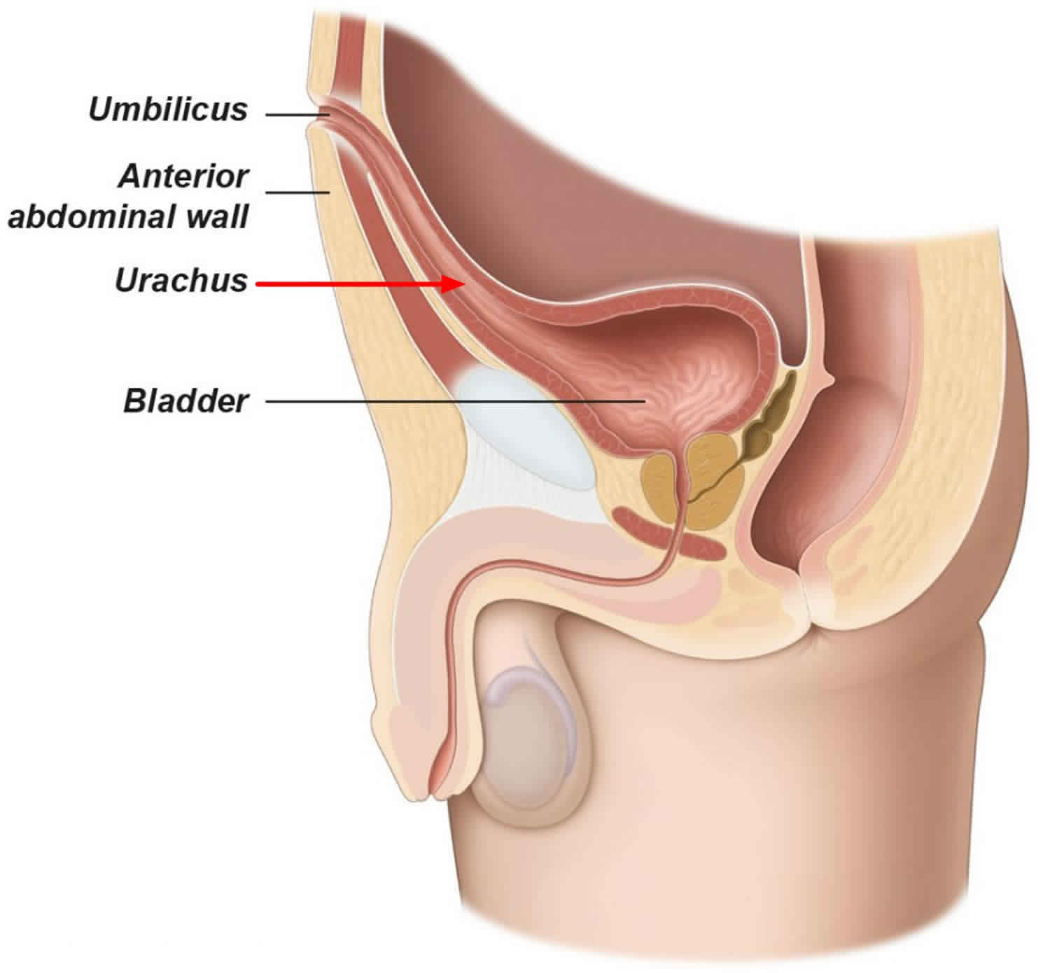
Urachus
Initially the bladder is continuous with the allantois,
The allantois soon constricts and becomes a thick fibrous cord, the urachus. It extends from the apex of the bladder to the umbilicus
In the adult, the urachus is represented by the median umbilical ligament.

Slide 14
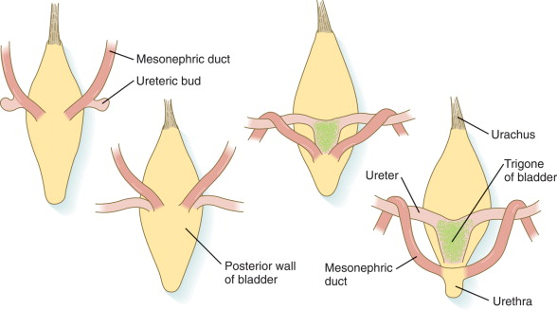
As the bladder enlarges, distal parts of the mesonephric ducts are incorporated into its dorsal wall These ducts contribute to the formation of the connective tissue in the trigone of the bladder.
As the mesonephric ducts are absorbed, the ureters come to open separately into the urinary bladder

Slide 15
Final Position of Ureters
Traction exerted by the kidneys during their positional change causes the orifices of the ureters move superolaterally and the ureters enter obliquely through the base of the bladder.
The orifices of the mesonephric ducts move close together and enter the prostatic part of the urethra as the caudal ends of these ducts develop into the ejaculatory ducts.
In females, the distal ends of the mesonephric ducts degenerate.

Slide 16
Final Developmental Changes

Slide 17
Micturition Reflex
Horizontal Integration

Slide 18
Micturition reflex
The micturition reflex is an autonomic spinal cord reflex, but it can be inhibited or facilitated by centers in the brain.
These centers include the following:
(1) strong facilitative and inhibitory centers in the brain stem, located mainly in the pons; and
(2) several centers located in the cerebral cortex that are mainly inhibitory but can become excitatory.
Horizontal Integration

Slide 19
Role of higher centers
The higher centers keep the micturition reflex partially inhibited, except when micturition is desired.
The higher centers can prevent micturition, even if the micturition reflex occurs, by tonic contraction of the external bladder sphincter until a convenient time presents itself.
When it is time to urinate, the cortical centers can facilitate the sacral micturition centers to help initiate a micturition reflex and, at the same time, inhibit the external urinary sphincter so that urination can occur.

Slide 20
Voluntary urination
First, a person voluntarily contracts the abdominal muscles,
which increases pressure in the bladder and allows extra urine to enter the bladder neck and posterior urethra under pressure, thus stretching their walls.
This action stimulates the stretch receptors, which excites the micturition reflex and simultaneously inhibits the external urethral sphincter.
Ordinarily, all the urine will be emptied, with rarely more than 5 to 10 milliliters left in the bladder.

Slide 21
Urachal Anomalies
In infants, a remnant of the lumen may persist in the inferior part of the urachus. In approximately 50% of cases, the lumen is continuous with the cavity of the bladder. Remnants of the epithelial lining of the urachus may give rise to urachal cysts, which are not usually detected except during a postmortem unless they become infected and enlarge. The patent inferior end of the urachus may dilate to form a urachal sinus that opens into the bladder. The lumen in the superior part of the urachus may also remain patent and form a urachal sinus that opens at the umbilicus Very rarely the entire urachus remains patent and forms a urachal fistula that allows urine to escape from its umbilical orifice
Vertical Integration

Slide 23
Exstrophy of Bladder
Exstrophy of the bladder is caused by incomplete median closure of the inferior part of the anterior abdominal wall
The defect involves both the anterior abdominal wall and the anterior wall of the urinary bladder and results from failure of mesenchymal cells to migrate between the ectoderm and endoderm of the abdominal wall
As a result, the inferior parts of the rectus muscles are absent, and the external and internal oblique and the transverse abdominal muscles are deficient. No muscle and connective tissue form in the anterior abdominal wall over the urinary bladder..

Slide 24
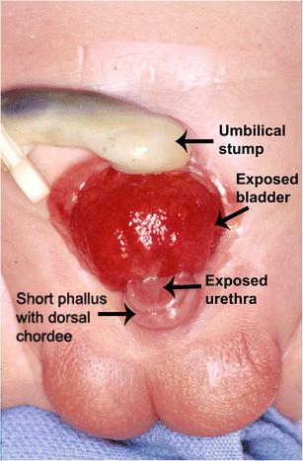

Slide 25
A Rare Case of Urinary Bladder Exstrophy Presenting With Signet Ring Cell Adenocarcinoma in an Adult DOI: 10.7759/cureus.34308 Received 01/05/2023 Review began 01/13/2023 Review ended 01/21/2023 Published 01/28/2023
An adult presenting with bladder exstrophy is quite uncommon. We present a 32-year-old man with a bladder mass that existed since birth. He complained of an unpleasant discharge from the mass upon presentation, and on examination, a mass was seen on the urinary bladder's exposed surface, ,a deformed scrotum, and undersized bilateral testicles. Ultrasonography of the kidneys, ureters and urinary bladder (USG KUB), contrast-enhanced computed tomography (CECT) of the abdomen and pelvis, and mass biopsy were all used to investigate the patient.
The patient was found to have signet ring adenocarcinoma of the urinary bladder. A radical cystectomy with an anterolateral thigh flap was performed. The clinical and radiological characteristics, treatments, and results of this uncommon presentation are discussed in this case report.
Research Article

Slide 26
Approach to a patient of CKD
Most patients with CKD can be managed in primary care. Serial follow-up is essential to identify patients at high risk of progression to advanced stages of CKD, including end-stage renal disease. Primary care providers must continue to work together with local nephrologists to improve the lives of those living with CKD.
Reference: Grill AK, Brimble S. Approach to the detection and management of chronic kidney disease: What primary care providers need to know. Can Fam Physician. 2018 Oct;64(10):728-735. PMID: 30315015; PMCID: PMC6184972
Family Medicine

Slide 27
Artificial intelligence: a new field of knowledge for nephrologists?
Reference Leonor Fayos De Arizón, Elizabeth R Viera, Melissa Pilco, Alexandre Perera, Gabriel De Maeztu, Anna Nicolau, Monica Furlano, Roser Torra, Artificial intelligence: a new field of knowledge for nephrologists?, Clinical Kidney Journal, Volume 16, Issue 12, December 2023, Pages 2314–2326, https://doi.org/10.1093/ckj/sfad182
Abstract: The potential of AI in the field of nephrology is vast, particularly in the areas of diagnosis, treatment and prediction. One of the most significant advantages of AI is the ability to improve diagnostic accuracy. Machine learning algorithms can be trained to recognize patterns in patient data, including lab results, imaging and medical history, in order to identify early signs of kidney disease and thereby allow timely diagnoses and prompt initiation of treatment plans that can improve outcomes for patients. In short, AI holds the promise of advancing personalized medicine to new levels. While AI has tremendous potential, there are also significant challenges to its implementation, including data access and quality, data privacy and security, bias, trustworthiness, computing power, AI integration and legal issues
Artificial Intelligence

Slide 28
International Continence Society white paper on ethical considerations in older adults with urinary incontinence
Reference Neurourol Urodyn.2022 Jan;41(1):14-3010.1002/nau.24795. Epub 2021 Sep 23
Abstract:
Urinary incontinence is a common problem among older adults that is often complicated by many nuanced ethical considerations. Unfortunately, there is a lack of guidance for healthcare professionals on how to navigate such concerns. This International Continence Society white paper aims to provide healthcare professionals with an ethical framework to promote best care practices in the care of older adults with urinary incontinence.
Bioethics

Slide 29
Learning Resources
KLM Embryology Developing Human 11th Edition Clinically oriented embryology by Keith Moore, T. V. N. Persaud, Mark Torchia
Langman's Medical Embryology 15th Edition
by Dr. T.W. Sadler PhD
Google scholar
Google images

