Slide 1


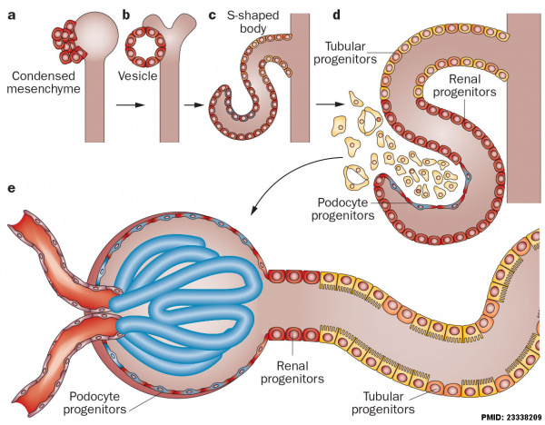
Renal Module
2nd Year MBBS (LGIS)
Development of Kidney
Presenter: Prof. Dr. Ifra Saeed Date: 00-04-25

Slide 2
Prof. Umar’s Model of Teaching Strategy
Self Directed Learning Assessment Program
Objectives :To cultivate critical thinking, analytical reasoning, and problem-solving competencies.
To instill a culture of self-directed learning, fostering lifelong learning habits and autonomy.
First Ten Minutes
How to Assess?
Ten randomly selected students will be evaluated within the first 10 minutes of the lecture through 10 multiple-choice questions (MCQs) based on the PowerPoint presentation shared on Students Official WhatsApp group, one day before the teaching session.
The number of MCQs from the components of the lecture will follow the guidelines outlined in the Prof. Umar model of Integrated Lecture.
Component of LGIS | Core Knowledge | Horizontal Integration | Vertical Integration | Spiral Integration
No of MCQs | 6-7 | 1-2 | 1 | 1

Slide 3
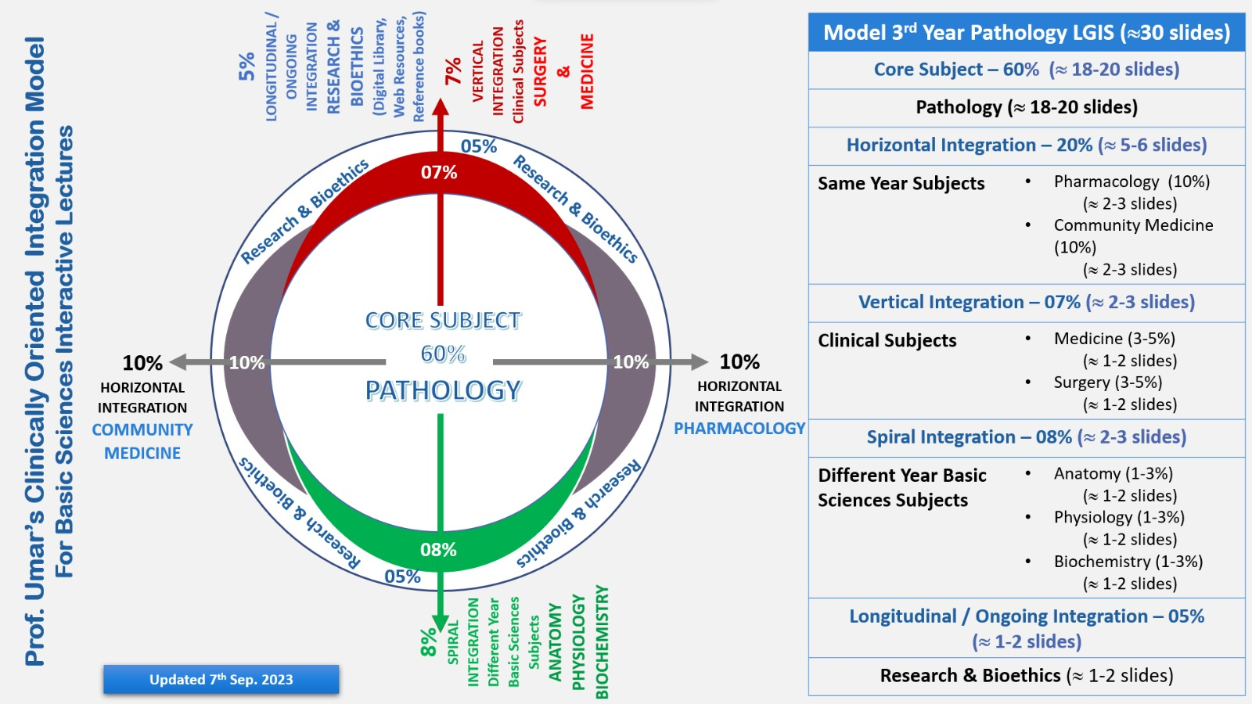
Professor Umar Model of Integrated Lecture

Slide 4
Learning Objectives
At the end of the session, student will be able to
Describe development of different kidney systems during embryonic life
Relate physiology and biochemistry with development of urinary system
Discuss congenital abnormalities of Kidneys
Correlate and build core knowledge on the basis of latest research
Role of Artificial Intelligence and Family Medicine related to renal diseases
Bioethics related to kidney disorders

Slide 5
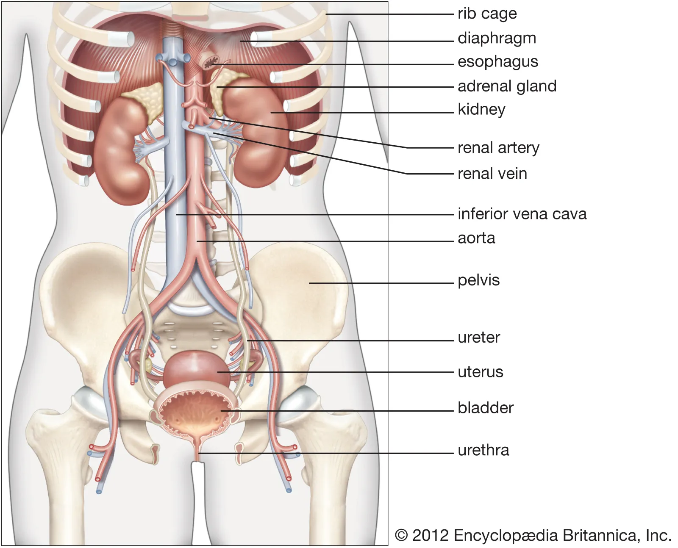
Gross Anatomy
Each of the two bean-shaped organs weighs about 125 to 175 grams and 115 to 155 grams in males and females respectively.
The kidney typically measures approximately 11 to 14 centimeters in length, 6 centimeters in width and is about 4 centimeters thick.
The kidneys lie retroperitoneally (behind the peritoneum) in the abdomen, either side of the vertebral column. They typically extend from T12 to L3,
Core Concept

Slide 6
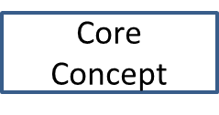
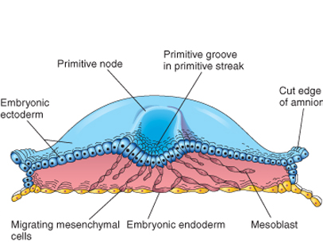
Formation Of Three Germ Layers

Slide 7
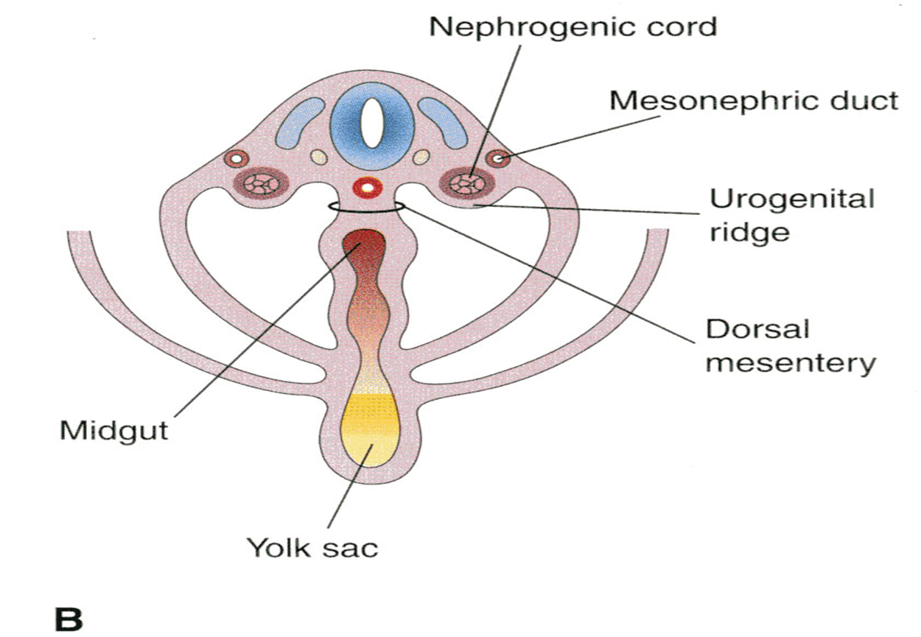
Development Urogenital system
Intermediate mesoderm loses its somites connection. Urogenital ridge which gives rise to
a. Nephrogenic cord
Give rise to the urinary system
b. Gonadal ridge.
Give rise to the genital system

Slide 8
Development of the Kidneys
Three sets of kidneys develop in human embryos.
The first set-the Pronephroi-is rudimentary, and the structures are never functional.
The second set-the Mesonephroi-is well developed and functions briefly.
The third set-the Metanephroi-becomes the permanent kidneys.

Slide 9
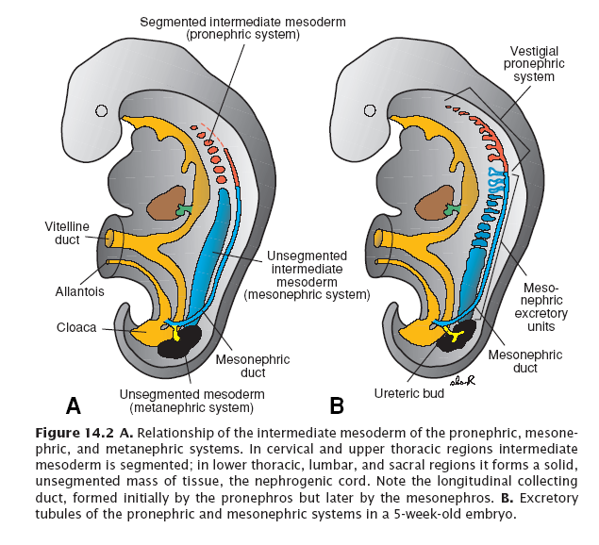
Development of the kidneys

Slide 10
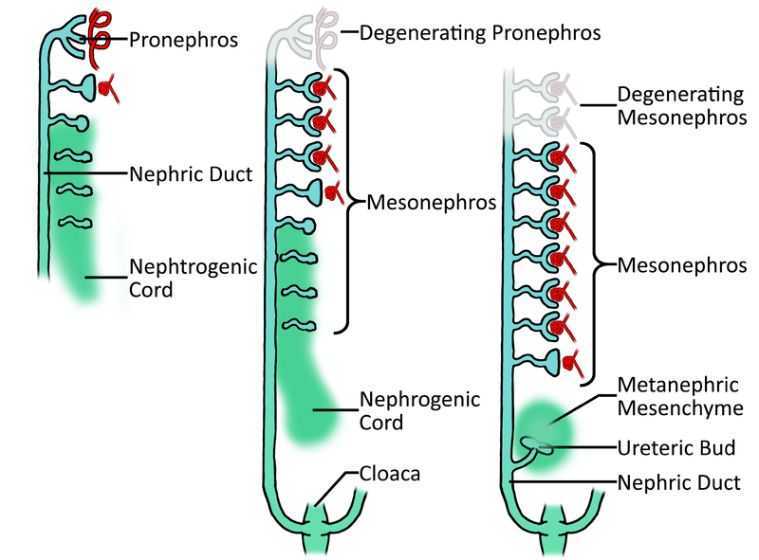
1. Pronephros (Transitory)
, At the beginning of 4th wk, it is represented by 7 to 10 solid cell groups in cervical region
Forms vestigial excretory units, NEPHROTOMES
Regress before more caudal ones are formed
Disappears completely at 4th week of development
Nonfunctional
Tubules open into cloaca.
Utilized by mesonephros

Slide 11
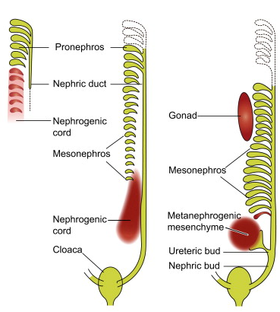
Mesonephric kidneys
These large, elongated excretory organs appear late in the fourth week, caudal to the rudimentary pronephroi
Function as interim kidneys for four weeks a. Glomeruli and mesonephric tubules.
b. Tubules open into the cloaca.
c. Degenerate, their tubules
become efferent ductules of
the testes .

Slide 12
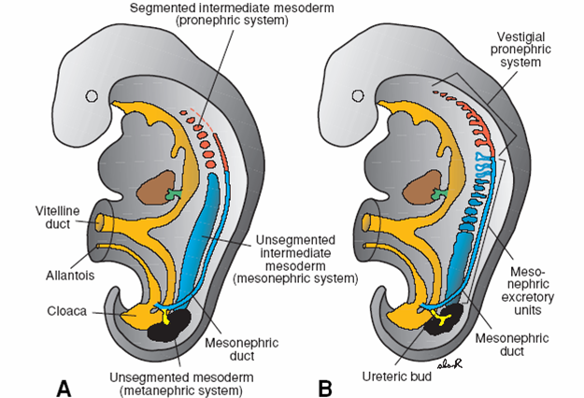
Mesonephros
  Mesonephros & mesonephric ducts are derived from intermediate mesoderm from upper thoracic to upper lumbar (L3 segments)

Slide 13
Mesonephric Tubules
The mesonephric kidneys consist of glomeruli and tubules The mesonephric tubules open into bilateral mesonephric ducts, which were originally the pronephric ducts.

Slide 14
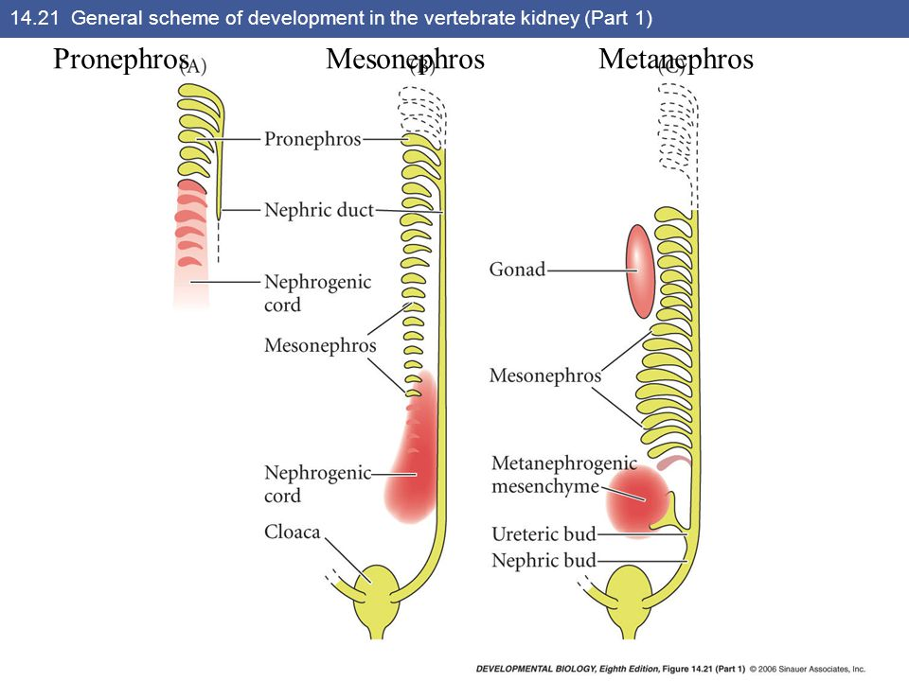
Mesonephric ducts
The mesonephric ducts open into the cloaca.
The mesonephroi degenerate toward the end of the first trimester; however, their tubules become the efferent ductules of the testes.

Slide 15
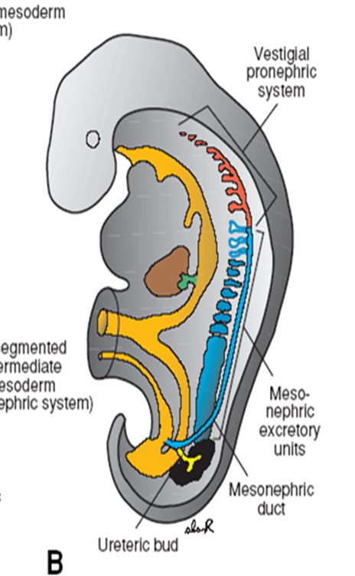
Metanephroi
The primordia of permanent kidneys-begin to develop early in the fifth week and start to function approximately 4 weeks later.
The metanephric diverticulum (ureteric bud)
The metanephrogenic blastema or metanephric mass of mesenchyme

Slide 16
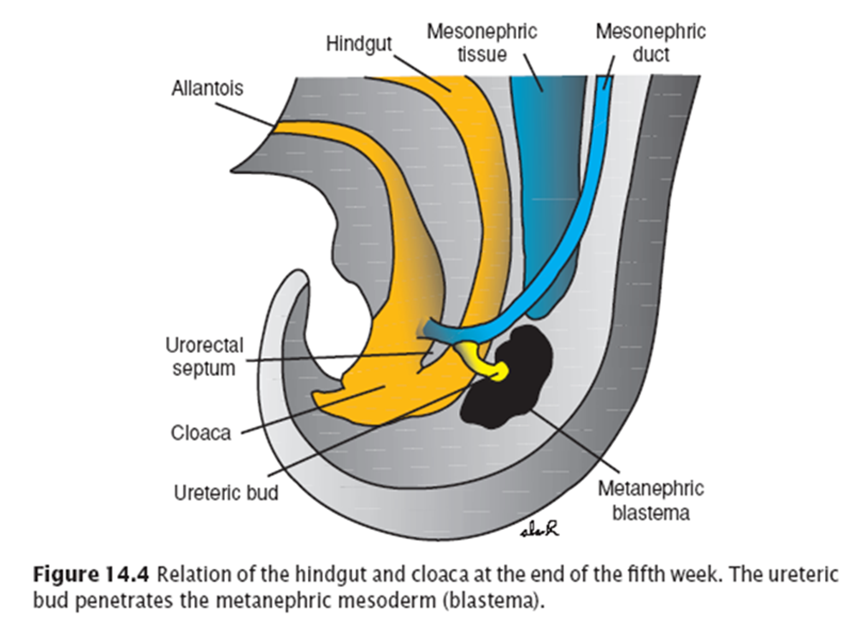
Metanephric Diverticulum
The metanephric diverticulum is an outgrowth from the mesonephric duct near its entrance into the cloaca, and the metanephrogenic blastema is derived from the caudal part of the nephrogenic cord

Slide 17
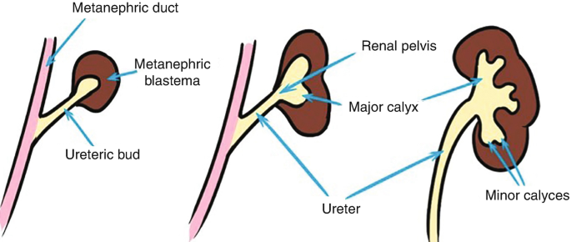
As it elongates, the metanephric diverticulum penetrates the metanephrogenic blastema-a mass of mesenchyme
The stalk of the metanephric diverticulum becomes the ureter, and the cranial portion of the diverticulum undergoes repetitive branching which differentiate into the collecting tubules of the metanephros

Slide 18
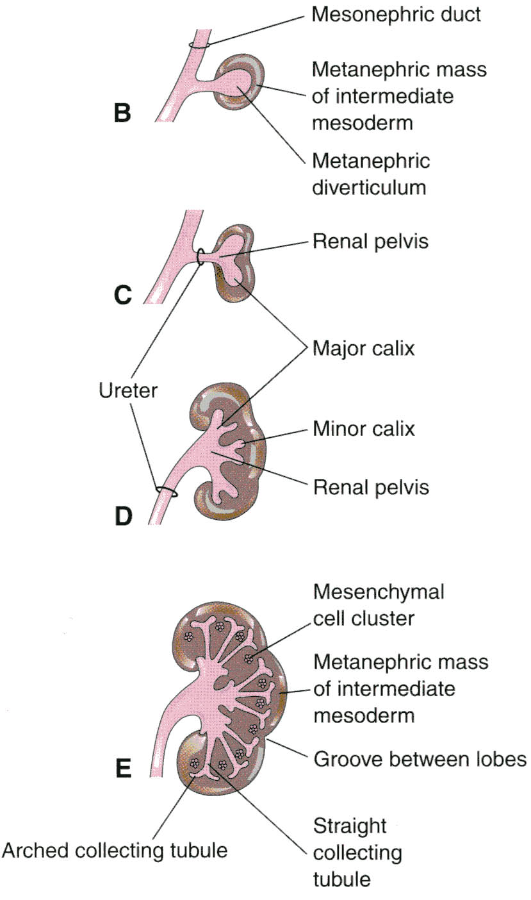

Slide 19
Development of major/ minor calyces
The first four generations = major calices
and the second four generations minor calices.
The end of each arched collecting tubule induces clusters of mesenchymal cells in the metanephrogenic blastema to form small metanephric vesicles
These vesicles elongate and become metanephric tubules
The proximal ends of these tubules are invaginated by glomeruli. The tubules differentiate into proximal and distal convoluted tubules, and the nephron loop (Henle loop), together with the glomerulus and its capsule, constitute a nephron.

Slide 20
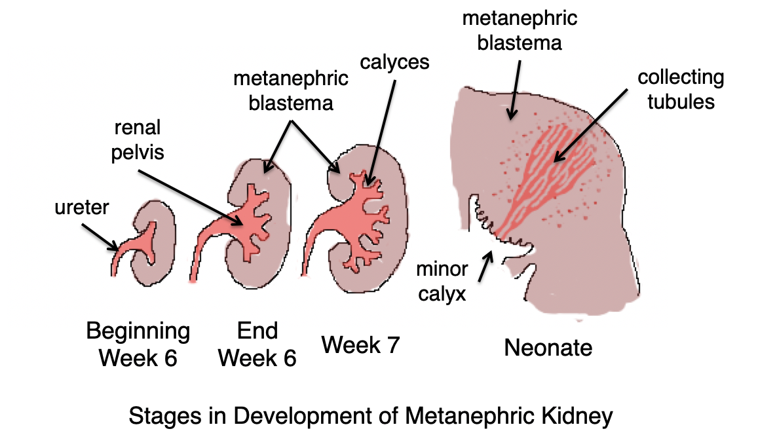
Collecting system

Slide 21
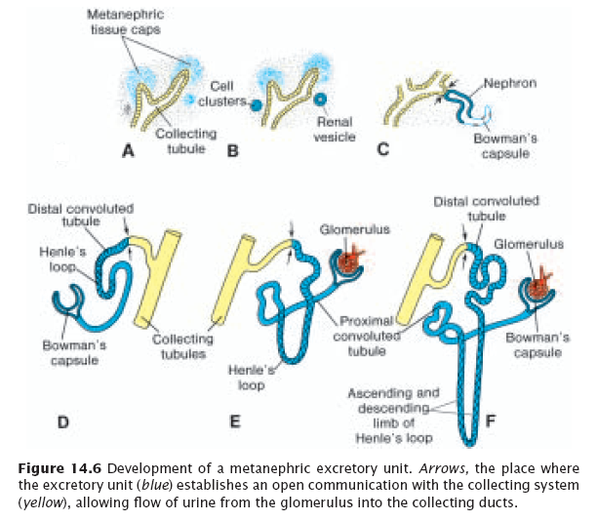

Excretory System

Slide 22
Excretory System
During the 10th and 18th weeks of gestation, the number of glomeruli increases rapidly until the 32nd week
The fetal kidneys are subdivided into lobes that usually disappears during infancy
At term each kidney contains 400,000 to 20, 00,000 nephrons.
The increase in kidney size after birth results from
the elongation of the proximal convoluted tubules as well as an increase of interstitial tissue.

Slide 23
Parts of unifererous tubules
A uriniferous tubule consists of two embryologically different parts
A nephron derived from the metanephrogenic blastema
A collecting tubule derived from the metanephric diverticulum (ureteric bud)

Slide 24
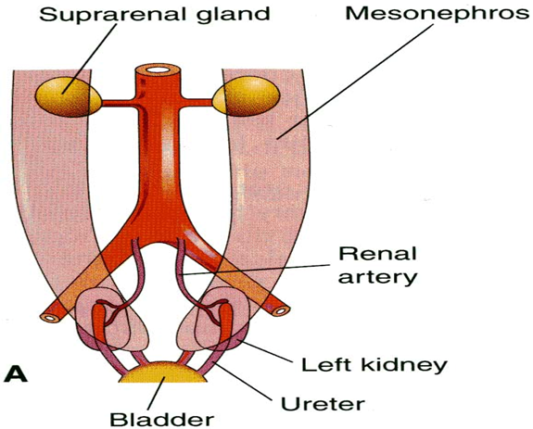
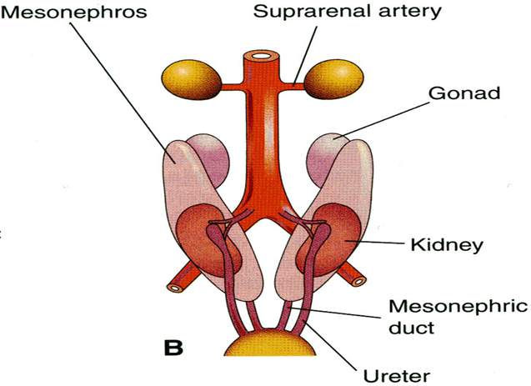
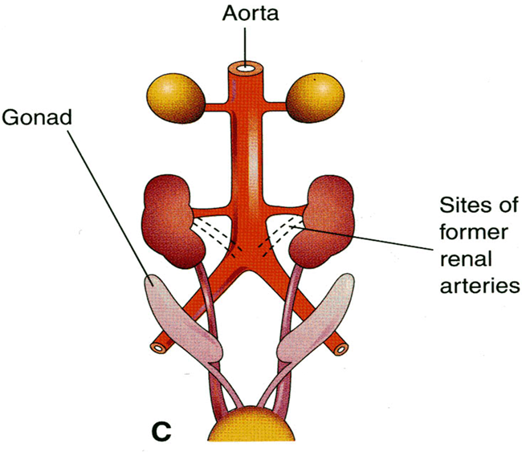
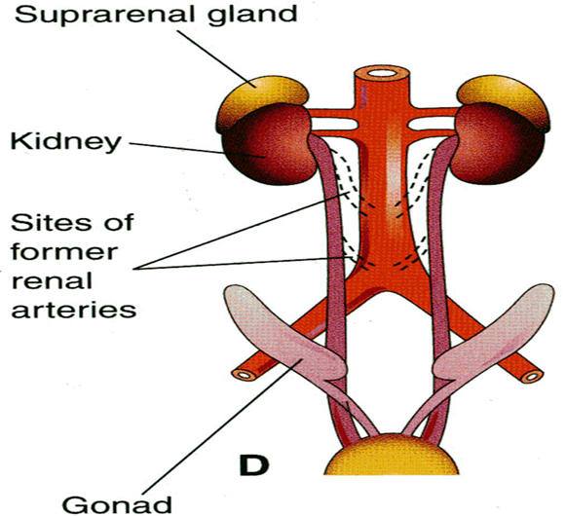
Positional Changes
Initially the metanephric kidneys lie close to each other in the pelvis, ventral to the sacrum
As the abdomen and pelvis grow, the kidneys gradually come to lie in the abdomen and move farther apart
They attain their adult position by the ninth week
This relative ascent results mainly from the growth of the embryo's body caudal to the kidneys.

Slide 25
Rotation of Kidneys
Initially the hilum of the kidney, where vessels and nerves enter and leave, faces ventrally; however, as the kidney relocates (ascends), it rotates medially almost 90 degrees. By the ninth week, the hilum is directed anteromedially
Eventually the kidneys become retroperitoneal (external to the peritoneum) on the posterior abdominal wall.

Slide 26
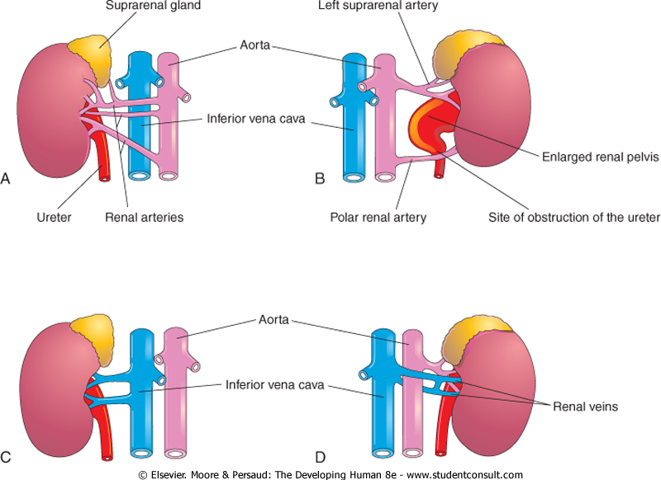

Accessory Renal Vessels

Slide 27
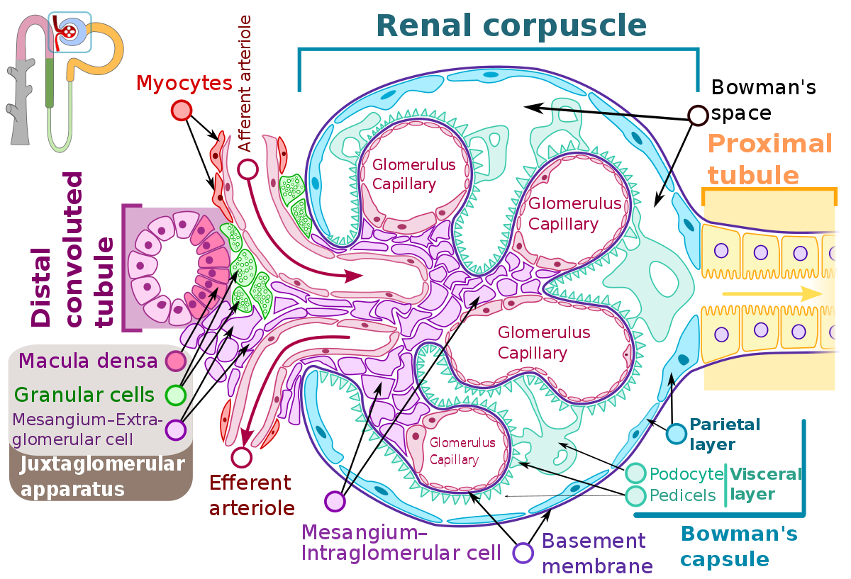

Biochemical aspects

Slide 28
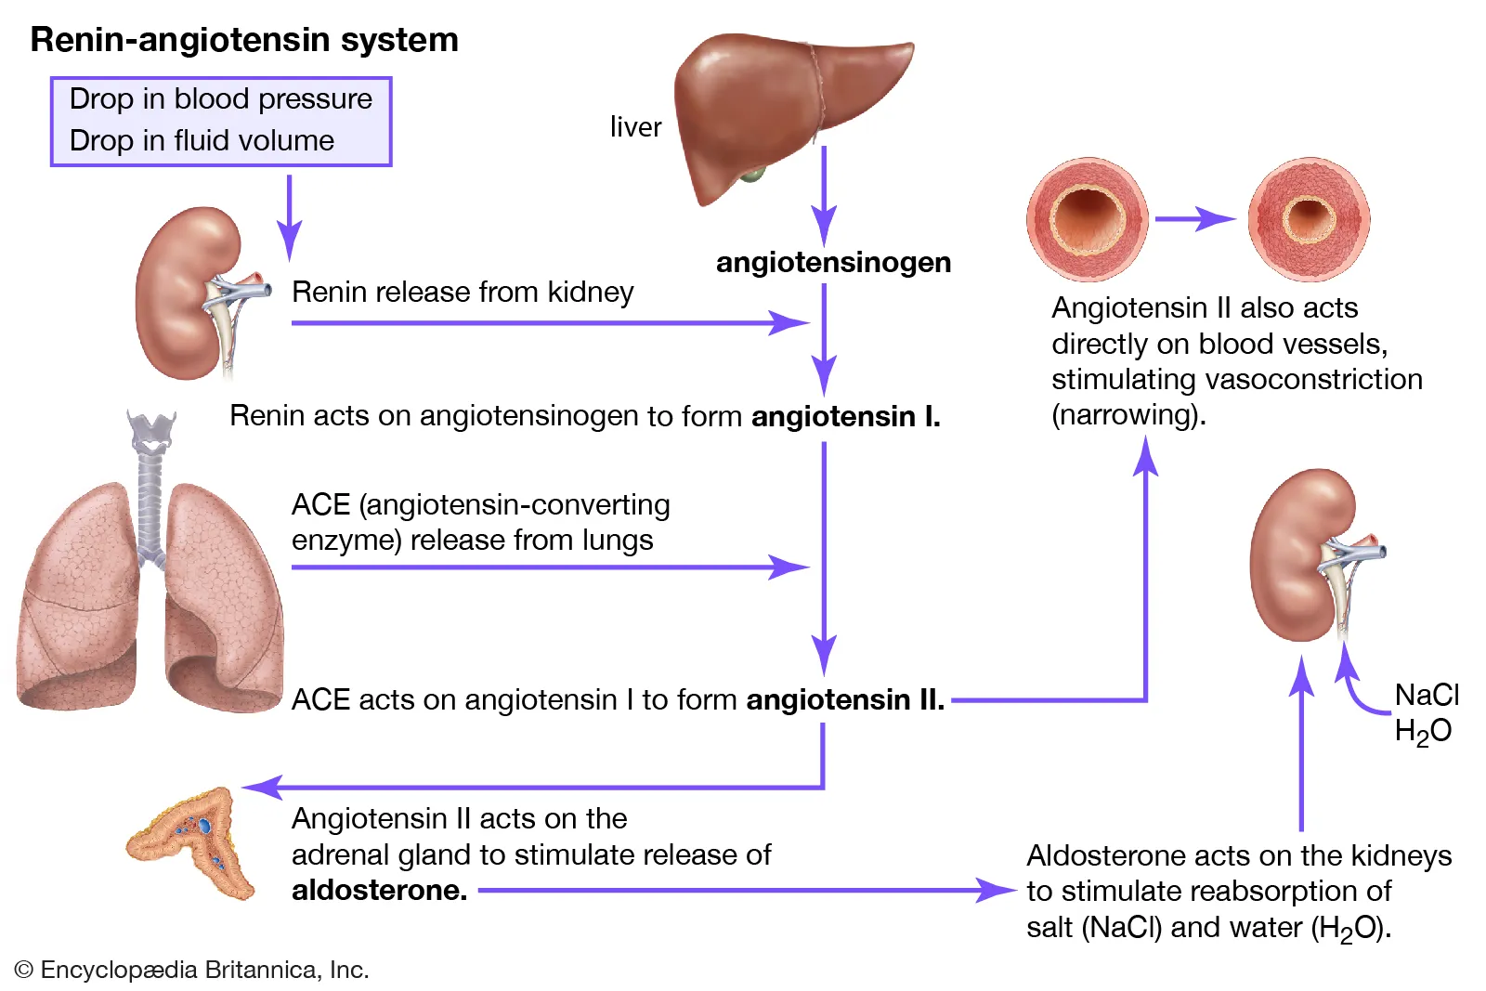

Slide 29
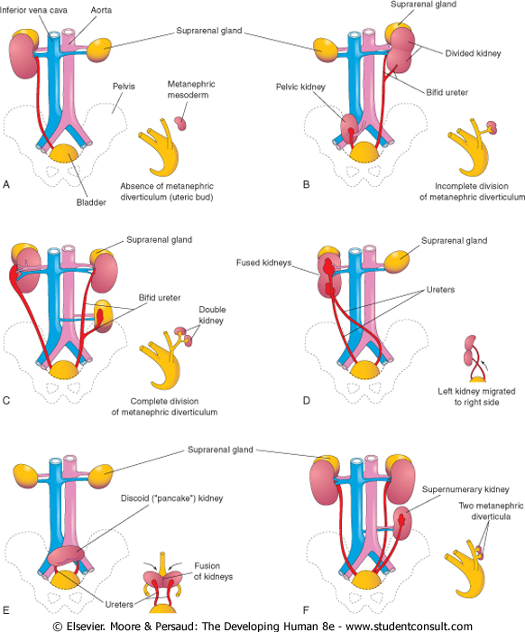
Congenital Abnormalities
Vertical integration

Slide 30
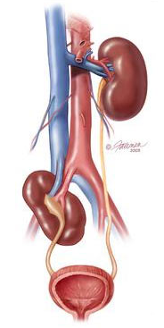
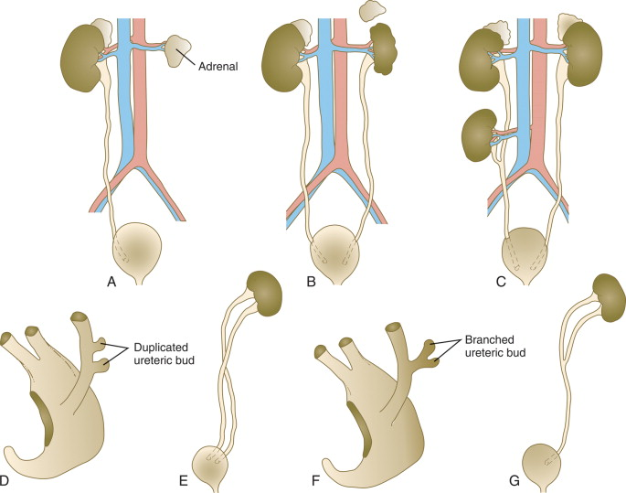
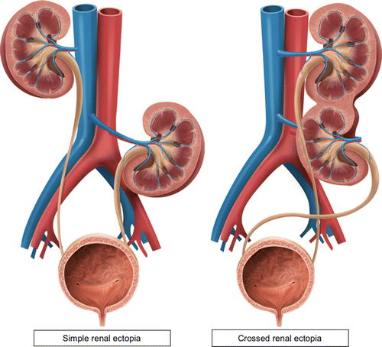
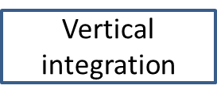
Congenital Abnormalities
Bilateral renal agenesis
Ectopic kidneys
Mal rotated Kidneys

Slide 31
Bilateral pelvic kidneys with upper pole fusion and malrotation: a case report and review of the literature
Journal of Medical Case Reports Khougali et al. J Med Case Reports (2021) 15:181 https://doi.org/10.1186/s13256-021-02761-1
Abstract
We present the case of a 36-year-old Sudanese female patient who presented with a long history of recurrent urinary tract infections unresponsive to antibiotics. Ultrasound scan revealed bilateral pelvic kidneys. Computed tomography (CT) urography confrmed bilateral ectopic fused kidneys, with the left kidney mal-rotated (renal pelvis facing upwards and laterally). Kidney infection secondary to vesicoureteral refux was diagnosed. Antibiotics were prescribed according to culture and sensitivity. The patient responded well to ciprofoxacin.
Conclusion: A history of recurrent urinary tract infections without an apparent cause is highly suggestive of renal anomaly and should be investigated expediently. Ultrasonography or CT imaging may be utilized to aid in diagnosis.
Early recognition may help prevent the high risk of end-stage renal failure associated with anomalies.
Spiral Integration
Research

Slide 32
Bioethics Related to Chronic Renal Failure
Chronic kidney failure is the gradual loss of kidney function. It can progress to end-stage kidney failure, which is fatal without artificial filtering (dialysis) or a kidney transplant.
The care of patients with kidney failure involves diverse ethical challenges. For example, many patients with chronic kidney failure need to decide whether to begin or stop dialysis therapy.
Dialysis may offer considerable benefits (e.g., be life sustaining), but also entails major burdens (e.g., is very restrictive and time consuming). Balancing these benefits and side-effects for different stages of the disease involve complex value judgments.
Further ethical issues might come with heterogeneities of referral criteria for transplantation or financial conflicts of interest that could intervene in a sound inter-professional management of patients with chronic kidney failure.
Spiral integration
Bioethics

Slide 33
Family Medicine
The Kidney Wise clinical tool kit, created by the Ontario Renal Network and available at www.kidneywise.ca, provides evidence-informed, practical guidance to primary care providers on the diagnosis and management of CKD.
A component of this tool is an algorithm that offers a step-by-step approach to diagnosing and managing CKD. This resource will help empower providers to identify those at high risk of this condition, order appropriate diagnostic tests, help prevent further disease progression, and reduce comorbid cardiovascular risk in patients with CKD.
Reference Grill AK, Brimble S. Approach to the detection and management of chronic kidney disease: What primary care providers need to know. Can Fam Physician. 2018 Oct;64(10):728-735. PMID: 30315015; PMCID: PMC6184972.
Spiral Integration
Family Medicine

Slide 34
Artificial Intelligence
Application of artificial intelligence in the management of patients with renal dysfunction
In recent years, the field has witnessed remarkable progress in machine learning (ML) and artificial intelligence (AI), leading to profound impacts across various industries. Particularly in the medical domain, ML and AI have undergone significant development, emerging as powerful tools
These advancements have opened up new avenues for exploring both the diagnosis and treatment of renal dysfunction . Recognizing the transformative potential of ML and AI in addressing the complexities of renal dysfunction, we have curated this special issue to delve into the applications of machine learning and artificial intelligence in the context of patients with renal dysfunction.
Reference
Zhang B, Jiang X, Yang J, Huang J, Hu C, Hong Y, Ni H, Zhang Z. Application of artificial intelligence in the management of patients with renal dysfunction. Renal Failure. 2024 Dec 31;46(1):2337289.ts with renal dysfunction
Spiral Integration
Artificial Intelligence

Slide 35
Learning Resources
KLM Embryology Developing Human 11th Edition Clinically oriented embryology by Keith Moore, T. V. N. Persaud, Mark Torchia
Langman's Medical Embryology 15th Edition
by Dr. T.W. Sadler PhD
Google scholar
Google images

Slide 36


