Slide 1
DANGEROUS DRUG ACT 1930 THE DRUGS ACT, 1976
Dr Filza ali & Dr Gulzaib
Forensic medicine and toxicology

Slide 3
🞂​To impart evidence based research oriented medical education
🞂​ To provide best possible patient care
🞂​ To inculcate the values of mutual respect and
ethical practice of medicine

Slide 4
SEQUENCE OF LGIS
Learning Objectives
Core concept 70 %
Horizontal integration related to Pathology and Pharmacology 15 %
Relevant clinical concepts and medico legal application of core knowledge / Vertical integration 10%
Research article relevant to the topic 3%
Ethics and family medicine 2%

Slide 5
Learning Objectives
By the end of the lecture students will be able to
Define drug, drug dependence, drug abuse and drugs addiction.
State the WHO criteria for drug addiction/ dependence.
Enlist the strategic measures to prevent abuse of dangerous drugs.
Briefly describe the different sections/ rules of dangerous drug act 1930.

Slide 6
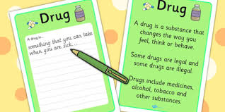
Core Concept
Drug
is a substance used in the diagnosis, treatment/ prevention of disease or as a component of medication.

Slide 7
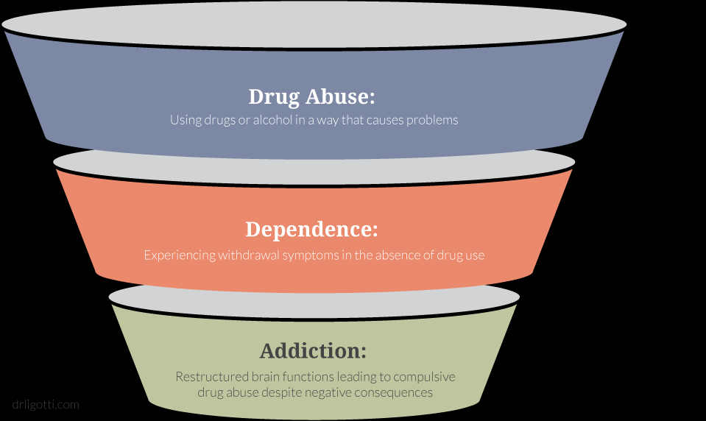
Core Concept
Drug Abuse: it is use of drugs to affect the mind and body for non medical reasons or using substances or chemicals which are illegal.
Drug Dependence: is a compulsion to take a drug to produce a desire effect or to prevent unpleasant effects when the drug is withheld.
Drugs of Addiction: Drugs which are used to treat the patient properly and prolong life but become dangerous if person gets addicted.
When drugs are taken apart from its medicinal use.

Slide 8
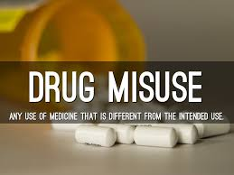
DRUGS HAVING POTENTIAL FOR MISUSE
Core Concept
These are ones which alter mood, thought or perception
Repeated use of such drugs even on medical grounds may adversely affect an individual depending upon different factors such as;
Physical dependence
Tolerance
Withdrawal symptoms
Social behavior
Physiological dependence

Slide 9
COCAINE
Core Concept

Slide 10
HEROIN
Core Concept

Slide 11
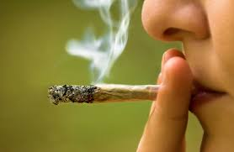
CANNABIS (Hashish, Bhang, Charas)
Core Concept

Slide 12
WHO CRITERIA FOR DRUG ADDICTION/ DEPENDENCE
Core Concept
An individual may become compelled to continue taking drugs (craving)
Amount needed for the intended initial effect may have to be increased (tolerance)
Discontinuation of the drug may lead to complex sequence of symptoms (withdrawal symptoms)
Physical and psychological dependence may occur (dependence)
Social deterioration of the personality of the drug user may occur (deterioration)

Slide 13
Core Concept
An individual may become compelled to continue taking drugs (craving)
Amount needed for the intended initial effect may have to be increased (tolerance)
Discontinuation of the drug may lead to complex sequence of symptoms (withdrawal symptoms)
Physical and psychological dependence may occur (dependence)
Social deterioration of the personality of the drug user may occur (deterioration)

Slide 14
STRATEGIC MEASURES TO PREVENT ABUSE OF DANGEROUS DRUGS
Core Concept
Punishing severely those who indulge in illegal transportation of such drugs
Providing treatment centers
Restricting availability of such drugs to those who are predisposed to their abuse

Slide 15
Core Concept
DANGEROUS DRUG ACT 1930 THE DRUGS ACT, 1976
An Act to regulate the
Import
Export
Manufacture
Storage
Distribution
Sale of the drug

Slide 16
DANGEROUS DRUG ACT 1976
Core Concept
Dangerous Drug Act 1930 was established to prevent misuse of drugs having potential for abuse.
It was amended in 1976 earlier and then in 2012
Sections/ rule of dangerous drug act 1976:
There are 4 important sections/rules of dangerous drug act 8, 13, 14, 17

Slide 17
1.DANGEROUS DRUG RULE 8
Deals with mode of sale and supply of the drugs
2.DANGEROUS DRUG RULE 13
Rule prescribe limitation about the quantity of the dangerous drugs
3.DANGEROUS DRUG RULE 14
maintenance of record of dangerous drugs
4.DANGEROUS DRUG RULE 17
Every person who causes any dangerous drug to be subjected to any process which would alter its nature/ willfully opens/ breaks any package containing a dangerous drug in transit except under the instruction of the commissioner and in such a manner as he may direct shall be guilty of an offence against this act.
Core Concept

Slide 18
DANGEROUS DRUG RULE 8
Core Concept
Deals with mode of sale and supply of the drugs
A licensed chemist may sell opium alkaloid or coca derivatives to a medical practitioner known to him subject to the following conditions:
If the drugs are to be obtained by post, shall be sent by registered post
In case of real emergency the drugs may be supplied on oral message, provided the chemist is satisfied about the genuineness of

Slide 19
Core Concept
the order & medical practitioner assures to provide written signed order within 24 hrs
The drug may also be supplied to any person having a prescription subject to the following conditions:
RMP should sign the register in person/ send a written signed order stating his name, registration no. address and the name and quantity of the drugs required
Licensee chemist shall satisfy himself about the genuineness of the signatures and qualification of the Medical practitioner

Slide 20
Core Concept
Opium alkaloids/ coca derivatives shall be sold in such quantity only as may be specified in the prescription
If the prescription does not bear a superscription the dangerous drugs shall be sold once only and the prescription shall be retained
If the prescription bears a superscription the chemist shall make entries about the amount of drug supplied, date of sale and shall sign and seal in the prescription before returning it to the holder of the prescription

Slide 21
Core Concept
If it appears that dangerous drug has already been sold on prescription 5 – 6 times or such a number of times as the prescription is required to be repeated then the chemist will retain the prescription
The licensee shall maintain a written record of such sales in a manner as directed by commissioner

Slide 22
DANGEROUS DRUG RULE 13
Core Concept
Rule prescribe limitation about the quantity of the dangerous drugs, which a RMP may possess for use in his practice at any one time.
Medicinal hemp (cannabis indica) --------- 3 ounces
Medicinal opium ------------------------------- 3 ounces
Opium alkaloid derivatives
(excluding prepared opium) ----------------- 60 grains
Coca derivatives -------------------------------- 60 grains

Slide 23
SYNTHETIC OPIODS
Core Concept
Methadone
Tramadol

Slide 24
DANGEROUS DRUG RULE 14
Core Concept
Is about maintenance of record of dangerous drugs in separate registers for each drug or in separate parts of the same register assigned to each of the following classes of drugs and preparations:
Cocaine & preparation containing it
Medicinal opium
Morphine and preparations containing it
Morphine derivatives and preparations containing them
Extract/ tinctures of Indian hemp

Slide 25
Core Concept
Entries in the register shall be made on the day on which a drug is received / dispensed.
Where a medical practitioner practices at more than one place a separate account shall be maintained
Every entry required to be made and every correction of such an entry shall be made in ink
No cancellation, obliteration/ alteration shall be made of any entry in the register if correction needed shall be made by way of foot note and entry shall specify the date on which the correction is made

Slide 26
Core Concept
The record of dangerous drugs in the possession of a medical practioner are open for inspection by any officer from health department not below the rank of DHO/ EXCISE OFFICER not below the rank of inspector
Medical practitioner should submit such an information relating to the transactions in dangerous drugs as may be demanded from him
All records including registers and day books retained for two years from the date of last entry

Slide 27
Core Concept
RMP should keep the dangerous drugs under lock and key.
While carrying drugs to the house of patient the Medical practitioner should take full precautions for their safe custody, should report theft/ loss of dangerous drug to the nearest police station/ excise/ public health officer immediately.

Slide 28
DANGEROUS DRUG RULE 17
Core Concept
Every person who causes any dangerous drug to be subjected to any process which would alter its nature/ willfully opens/ breaks any package containing a dangerous drug in transit except under the instruction of the commissioner and in such a manner as he may direct shall be guilty of an offence against this act.

Slide 29
TOBACCO
Core Concept

Slide 30
ALCOHOL
Core Concept

Slide 31
Research
🞂​https://www.dra.gov.pk/wp-content/uploads/2022/10/Drugs-Act-1976.pdf
🞂​https://www.dra.gov.pk/about-us/legislation/acts/
https://www.google.com/search?sca_esv=7ee9948db661f286&sxsrf=AHTn8zotLWTtVZLwHzxbTOB79KVOFH5EpQ:1739192699369&q=dangerous+drug+act+pakistan&source=lnms&fbs=ABzOT_CWdhQLP1FcmU5B0fn3xuWpAdk4wpBWOGsoR7DG5zJBnsX62dbVmWR6QCQ5QEtPRrGFxp3K3tehynY_7YR4ChVqWd-ksvFY5xaocTN3d1NT6KV3LkmlgptSW0IeeMYFFY9HKjVYJjMZIIICqScbgoMEvLyFEvILRnd_hb0vHjhQwup0&sa=X&ved=2ahUKEwjxvKrYlbmLAxWcnf0HHdGYAB4Q0pQJegQIExAB&biw=1200&bih=665&dpr=2.5
🞂​

Slide 32
ETHICS
Biomedical ethics in a Dangerous Drug Act refers to the ethical considerations healthcare professionals must navigate when prescribing or administering controlled substances, including the need to balance patient autonomy with the potential for harm, ensuring proper informed consent, and upholding principles like non-maleficence (avoiding harm) and beneficence (doing good) within the legal boundaries set by the act.

Slide 33
Family Medicine
🞂​Initial management should be focused on acute stabilization and supportive care till the correct substance is identified
🞂​Plan of management is to provide supportive care, prevention of poison absorption, use of antidote wherever is indicated, and enhancement of elimination techniques.
🞂​The most commonly used include activated charcoal, acetylcysteine, naloxone, sodium bicarbonate, atropine, flumazenil, therapeutic antibodies and various vitamins

Slide 34
How To Access Digital Library
Steps to Access HEC Digital Library
Go to the website of HEC National Digital Library.
On Home Page, click on the INSTITUTES.
A page will appear showing the universities from Public and Private Sector and other Institutes which have access to HEC National Digital Library HNDL.
Select your desired Institute.
5.A page will appear showing the resources of the institution
6. Journals and Researches will appear
7. You can find a Journal by clicking on JOURNALS AND DATABASE and enter a keyword to search for your desired journal.

Slide 35
Learning Resources
Basics of Forensic Medicine and Toxicology, 2nd edition by Syed Muhammad Ali Aijaz
Review of Forensic Medicine and Toxicology , 5th edition by Gautam
Biswas

