Slide 1
corneal ectasia & keratoplasty Dr. Ambreen gul mbbs, fcps, chpe, chr, scholar mhpe assistant professor Ophthalmology dept. BBH, RMU

Slide 2
Sources
Kanski-Clinical-Ophthalmology-Systematic-Approach
Oxford Handbook of Ophthalmology Book by Philip I. Murray
The Wills Eye Manual: Office and Emergency Room Diagnosis and Treatment of Eye Disease

Slide 3
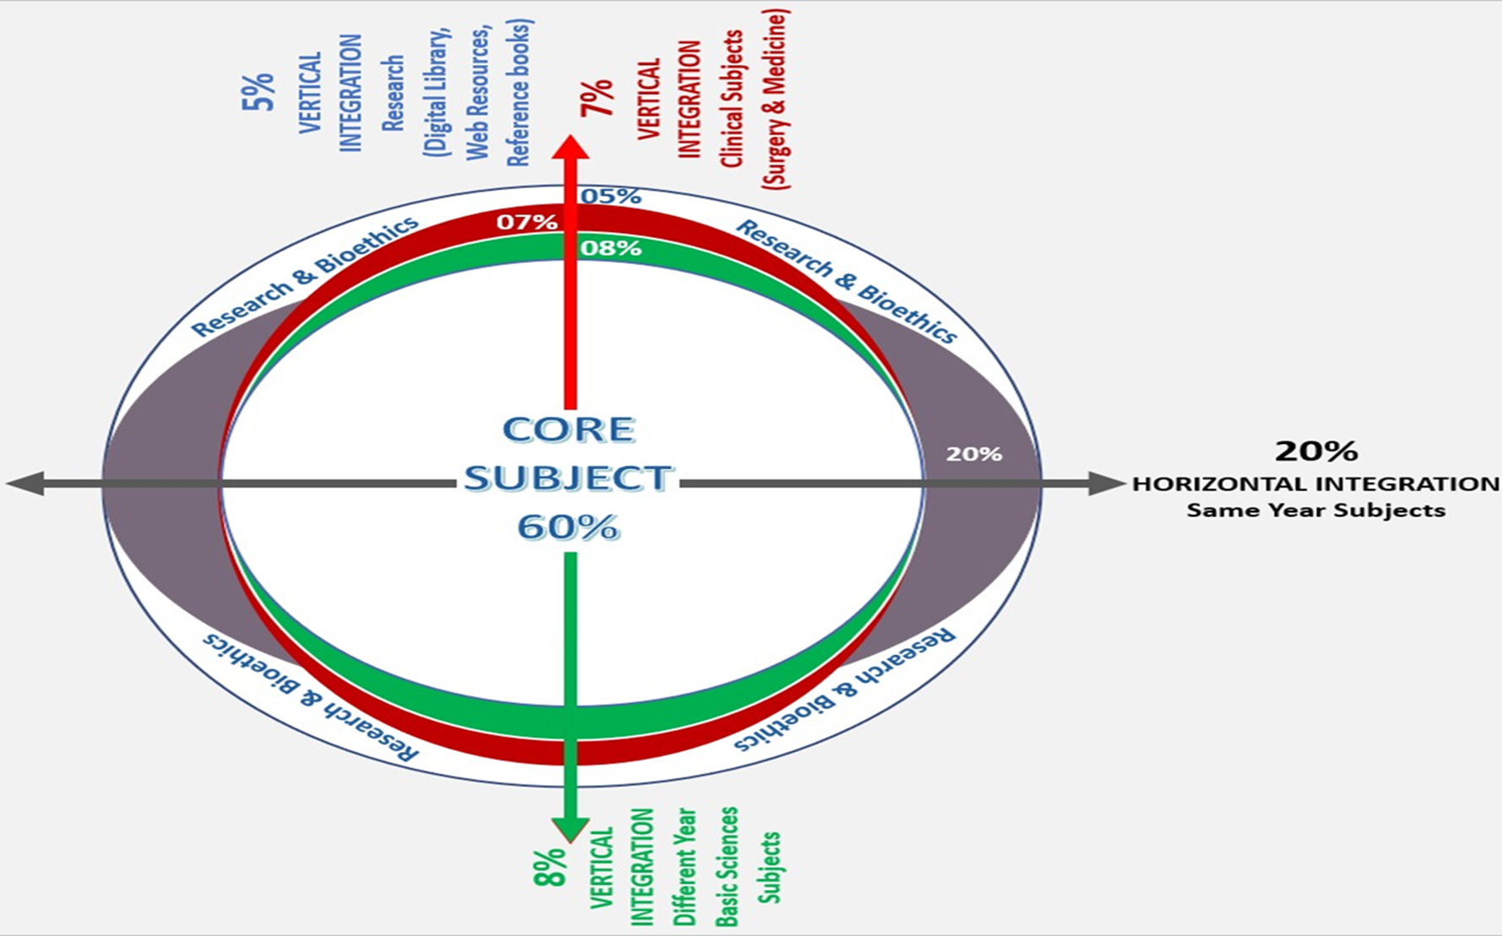
Sequence Of Lecture
Core Subject
Spiral Integration
Horizontal Integration
Vertical integration
EOLA(End of lecture assessment)
Digital Library References
( Research, Bioethics, Artificial Intelligence)

Slide 4
Learning Objectives
At the end of one hour large group interactive session (LGIS) using the PowerPoint , fourth year medical student should be able to
Describe anatomy and function of cornea
Describe the pathogenesis of keratoconus
Describe signs, symptoms, grading, diagnosis, and management of keratoconus
Describe indications, procedure and post-op management of keratoplasty

Slide 6
Anatomy Of Cornea
Vertical integration
Core Subject

Slide 7
Physiology
Vertical integration
Core Subject

Slide 8
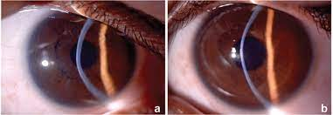
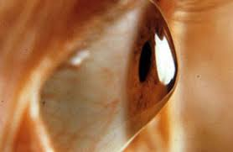
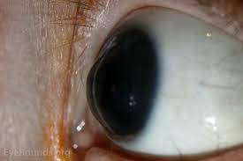
Introduction
Core Subject
A progressive disorder central or para central corneal stromal thinning occurs apical protrusion and irregular astigmatism
Graded by the highest axis of corneal power on keratometry as
Mild(<48 D)
Moderate(48D-54 D)
Severe (>54D)

Slide 9
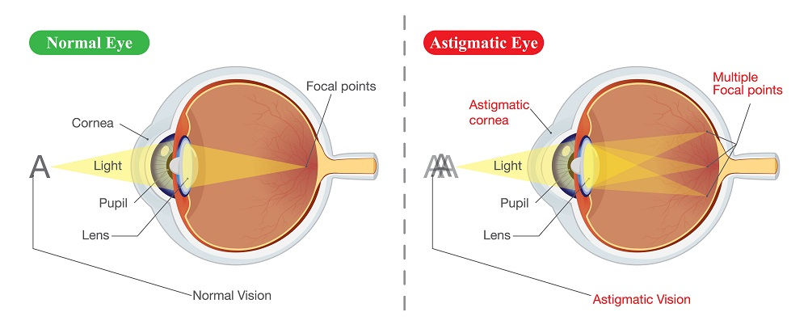
Core Subject

Slide 10
Pathogenesis Of Keratoconus
Horizontal integration

Slide 11
Horizontal integration

Slide 12
Associations Of Keratoconus
Core Subject
Systemic associations
Down syndrome
Ehlers–Danlos
Marfan syndromes
Osteogenesis imperfecta
Ocular associations
Vernal keratoconjunctivitis
Aniridia
Leber congenital amaurosis
Retinitis pigmentosa
Persistent eye rubbing

Slide 13
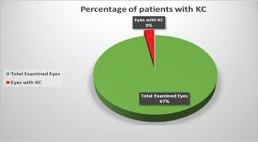
Community Medicine
Horizontal integration
Keratoconus is a worldwide disorder
Prevalence is different among different ethnic groups in the same geographical part of the world
Incidence : 1 in 400 individuals

Slide 14
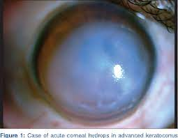
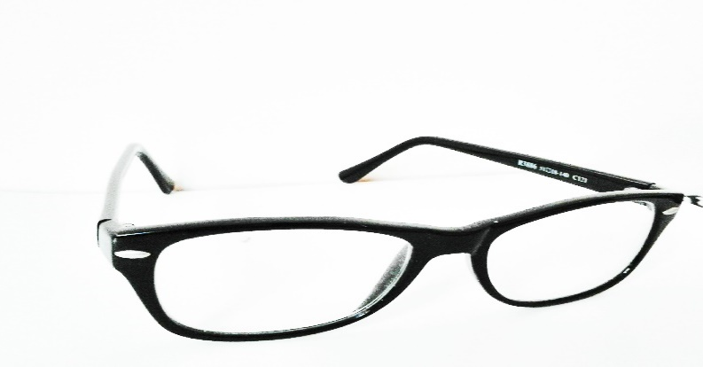
Clinical Presentation
Core Subject
Unilateral or bilateral gradual impairment of vision
Progressive myopia and astigmatism
Frequent change in glasses
Sudden loss of vision due to acute hydrops

Slide 15
Core Subject

Slide 16
Core Subject

Slide 17
Core Subject

Slide 18
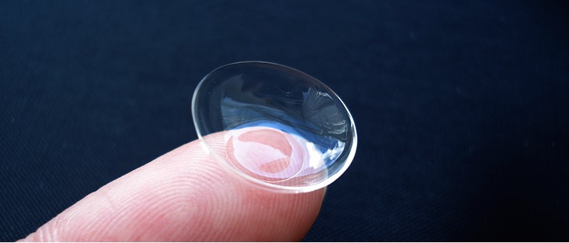
Treatment
Core Subject
LASIK is contraindicated
Eye rubbing should be avoided
Spectacles or soft contact lenses
Rigid contact lenses

Slide 19
Core Subject
Corneal collagen cross-linking (CXL)
Intracranial ring segment implantation
Keratoplasty

Slide 20
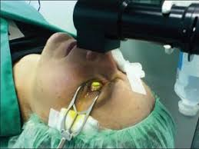
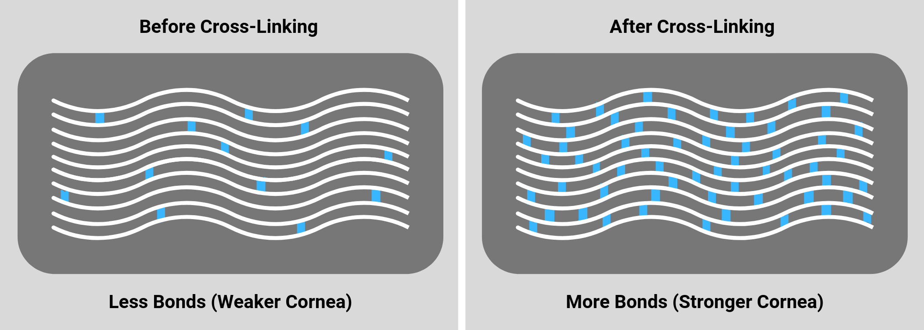
Collagen Cross Linking
Core Subject

Slide 21
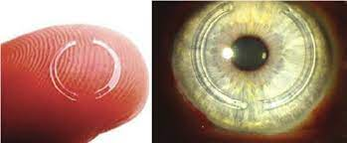
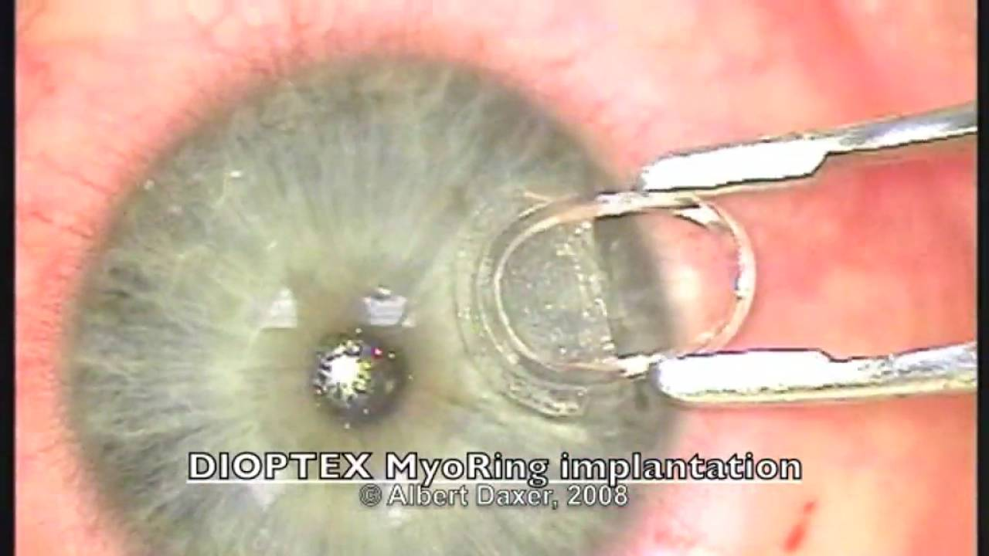
Intracorneal Ring Segment Implantation
Core Subject

Slide 22
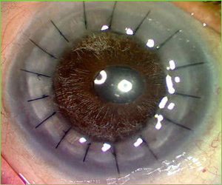
Keratoplasty
Core Subject

Slide 23
Core Subject
KERATOPLASTY

Slide 24
Introduction
Core Subject
Also known as corneal grafting or corneal transplant
A surgical procedure where a damaged or diseased cornea is replaced by donated corneal tissue
When the entire cornea is replaced it is known as penetrating keratoplasty
When only part of the cornea is replaced it is known as lamellar keratoplasty

Slide 25
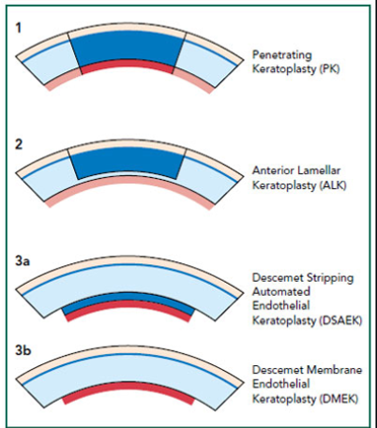
Penetrating versus lamellar keratoplasty
Core Subject

Slide 26
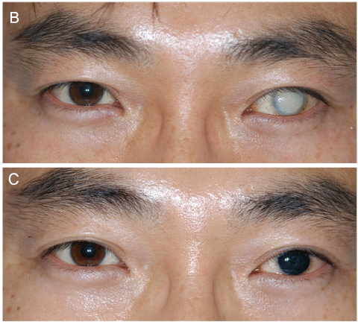
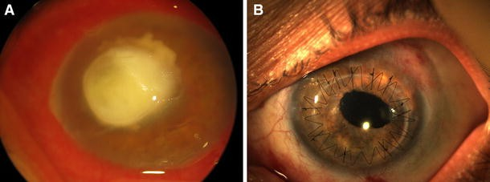
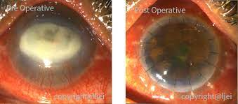
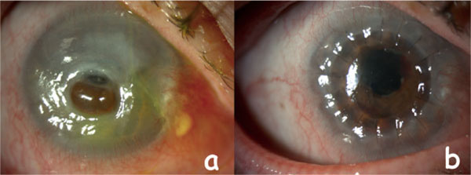
General Indications
Core Subject
Optical keratoplasty
Tectonic keratoplasty
Therapeutic keratoplasty
Cosmetic keratoplasty

Slide 27
Core Subject

Slide 28
Core Subject

Slide 29
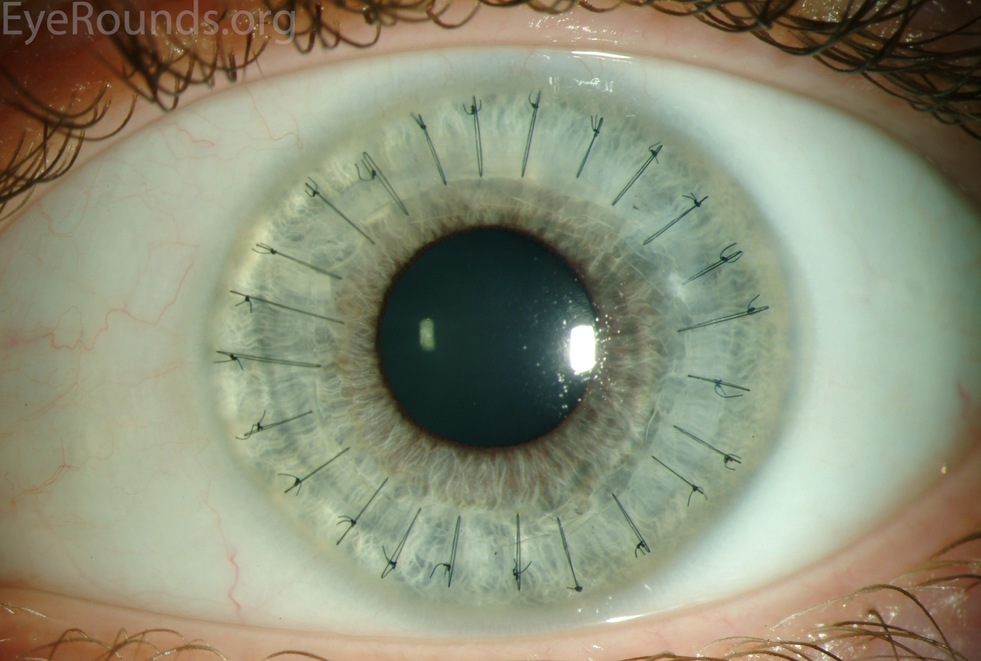
Core Subject

Slide 30
Core Subject

Slide 31
Postoperative Management
Core Subject
Topical steroids (e.g. prednisolone acetate 1%, dexamethasone phosphate 0.1%) to decrease risk of immunological graft rejection
Other immunosuppressant such as oral azathioprine and topical and systemic cyclosporine for high-risk patients.
Cycloplegics
Oral acyclovir in context of pre-existing herpes simplex keratitis to minimize the risk of recurrence
Monitoring of IOP

Slide 32
Core Subject

Slide 33
Management Of Graft Rejection
Core Subject
Intraocular pressure monitoring is critical
Preservative-free topical steroids hourly for 24 hours are the mainstay of therapy. The frequency is reduced gradually over several weeks
Topical cycloplegics
Systemic steroids.
Subconjunctival steroid injection
Other systemic immunosuppressants such as ciclosporin, tacrolimus or azathioprine

Slide 34
Core Subject

Slide 35
EOLA( End Of Lecture Assessment)
Core Subject
A 32-year-old male who complained of a progressive decrease in visual acuity greater in the right eye than the left. The patient’s Visual acuity was : (RE) 6/18 with -0.5 (-4 x 70 °) and (LE) 6/6 with -1 (-0.5 x 175 °). Patient has a history of rubbing his eyes when he awakes in the morning. He used to have frequent eye rubbing during childhood. Clinical examination with the slit lamp suggested a thin and irregular right cornea with a Fleischer ring. Oil droplet sign was present on retinoscopy.
What is the diagnosis?
How is the disease graded?
What are the treatment options in the management of this patient?

Slide 36
EOLA( End Of Lecture Assessment)
Core Subject
KERATOCONUS
Graded by the highest axis of corneal power on keratometry as
Mild(<48 D)
Moderate(48D-54 D)
Severe (>54D)
Management
Eye rubbing should be avoided.
Spectacles or soft contact lenses
Rigid contact lenses
Corneal collagen cross-linking (CXL)
Intracranial ring segment implantation
Keratoplasty

Slide 37
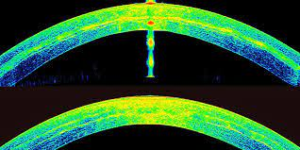
Research And Recent Advances
Research and advances
Intrastromal Implantation of Autologous ADASCs.
The use of advanced therapies with stem cells to reconstruct the complex tissue of corneal stroma has gained interest in recent years
The published evidence shows that the implantation of autologous adipose-derived adult stem cells (ADASCs) in corneal stromal pocket in cases with advanced keratoconus to be potentially effective for the treatment of advanced keratoconus

Slide 38
Bioethics
Bioethics
If the patient presents with severe keratoconus it is ethically important to tell him that collagen cross linking will not do him any good
It would be ethically wrong to go for CXL in such patients

Slide 39
Artificial Intelligence
Artificial intelligence
Tan et al. proposed a diagnostic model for keratoconus based on the 5-FNN neural network model.
Kamiya et al. developed a diagnostic classification model based on ResNet-18 to assist in the diagnosis and classification of keratoconus.
Dos Santos et al. designed an AI model that can diagnose keratoconus based on U-Net.
The high accuracy and excellent performance of the above AI models demonstrate that AI technology can be used extensively in the clinical diagnosis and treatment of keratoconus, thereby greatly reducing the work stress of clinicians.

Slide 40
Study Guide Resources
Core Subject
Kanskis-Clinical-Ophthalmology-Systematic-Approach
Oxford Handbook of Ophthalmology Book by Philip I. Murray
The Wills Eye Manual: Office and Emergency Room Diagnosis and Treatment of Eye Disease
Kuo MT, Hsu BW, Lin YS, Fang PC, Yu HJ, Chen A, Yu MS, Tseng VS. Comparisons of deep learning algorithms for diagnosing bacterial keratitis via external eye photographs. Scientific reports. 2021 Dec 20;11(1):24227.
Gu H, Guo Y, Gu L, Wei A, Xie S, Ye Z, Xu J, Zhou X, Lu Y, Liu X, Hong J. Deep learning for identifying corneal diseases from ocular surface slit-lamp photographs. Scientific reports. 2020 Oct 20;10(1):17851.

