Slide 1
CORNEAL disorders Dr. Ambreen gul mbbs, fcps, chpe, chr, SCHOLAR MHPE assistant professor Ophthalmology dept. BBH, RMU

Slide 2
Sources
Kanski-Clinical-Ophthalmology-Systematic-Approach
Oxford Handbook of Ophthalmology Book by Philip I. Murray
The Wills Eye Manual: Office and Emergency Room Diagnosis and Treatment of Eye Disease

Slide 4
Sequence Of Lecture
Core Subject
Spiral Integration
Horizontal Integration
Vertical integration
EOLA(End of lecture assessment)
Digital Library References
( Research, Bioethics, Artificial Intelligence)

Slide 5
Learning Objectives
At the end of one hour large group interactive session (LGIS) using the PowerPoint , fourth year medical student should be able to
Describe anatomy and function of cornea
Describe the pathogenesis of keratitis
Describe etiology, diagnosis, and treatment of different types of keratitis
Evaluate and manage keratitis patients

Slide 6
Anatomy Of Cornea
Vertical integration
Core Subject

Slide 7
Physiology
Vertical integration
Core Subject

Slide 8
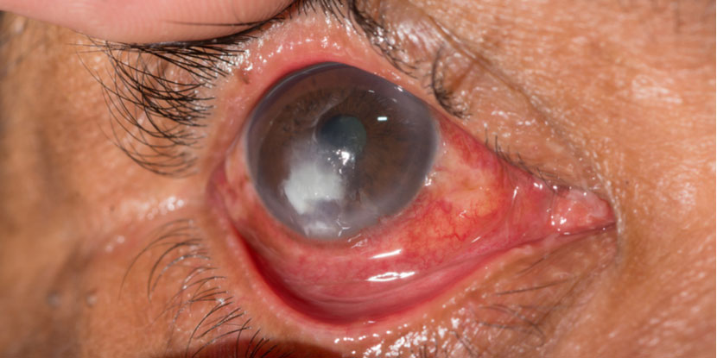
Keratitis
Core Subject
Inflammation of the cornea
Characterized by corneal edema, infiltration of inflammatory cells, and ciliary congestion
Types
Bacterial Keratitis
Viral Keratitis
Fungal Keratitis
Protozoan Keratitis

Slide 9
Pathology
Horizontal integration

Slide 10
Community Medicine
Horizontal integration
Among all etiologies such as infection, trauma, inflammation, degeneration and nutritional deficiency,
The leading cause of corneal blindness in both developed and developing countries is the Infectious Keratitis
An estimated incidence ranging from 2.5 to 799 per 100,000 population-year

Slide 11
Core Subject
BACTERIAL KERATITIS

Slide 12
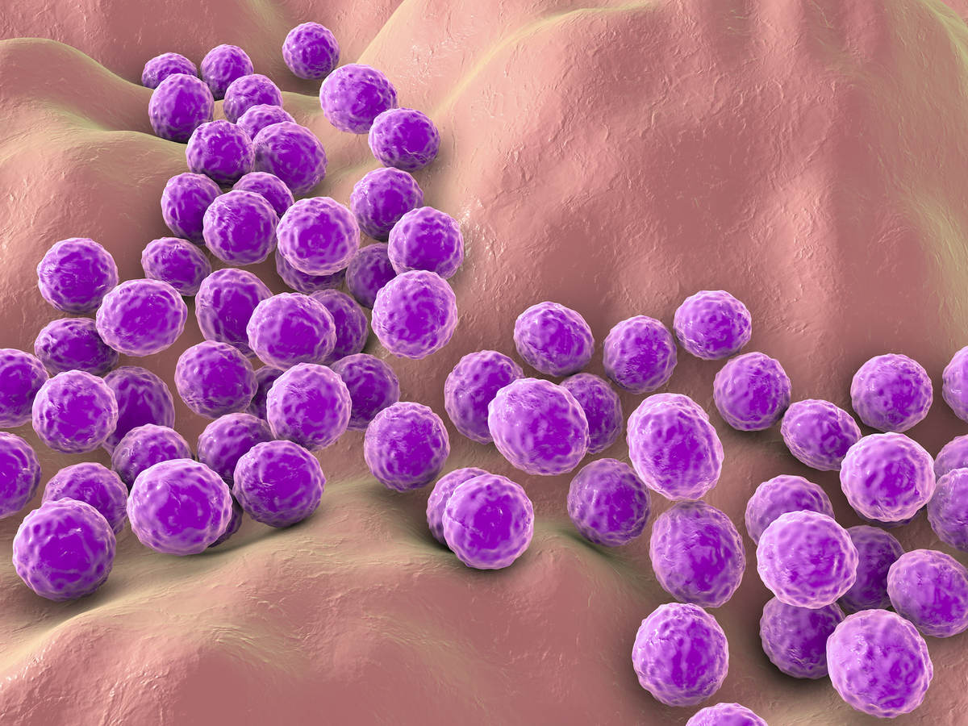
Pathogens
Core Subject
Commonly Occurring Pathogens
Pseudomonas aeruginosa
Staphylococcus aureus
Streptococci
Pathogens penetrating healthy cornea
Neisseria gonorrhoeae
Neisseria meningitides
Corynebacterium diphtheriae
Haemophilus influenzae

Slide 13
Normal Cornea
Core Subject

Slide 14
Stages Of Keratitis
Core Subject

Slide 15
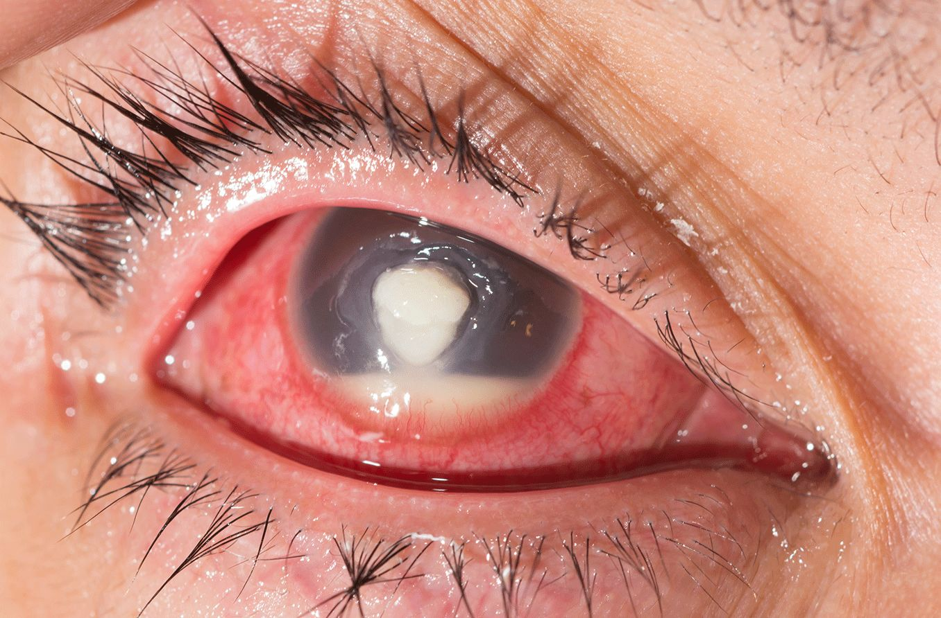
Clinical Features
Core Subject
Presentation
Pain, redness, Photophobia, Blurred vision and Mucopurulent or purulent discharge.
Signs
Epithelial defect with infiltrate
Circum corneal injection
Stromal edema, folds in Descemet membrane and anterior uveitis, commonly with a hypopyon and posterior synechiae

Slide 16
Pathogenesis
Core Subject
Horizontal integration

Slide 17
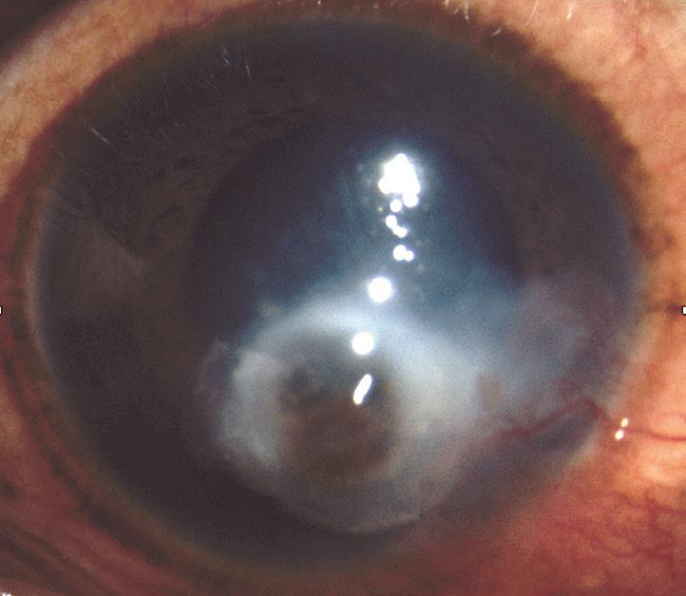
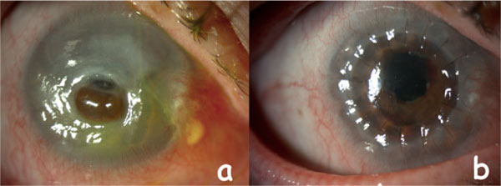
Complications Of Keratitis
Core Subject
Severe ulceration may lead to descemetocele formation and perforation
Particularly in pseudomonas infection

Slide 18
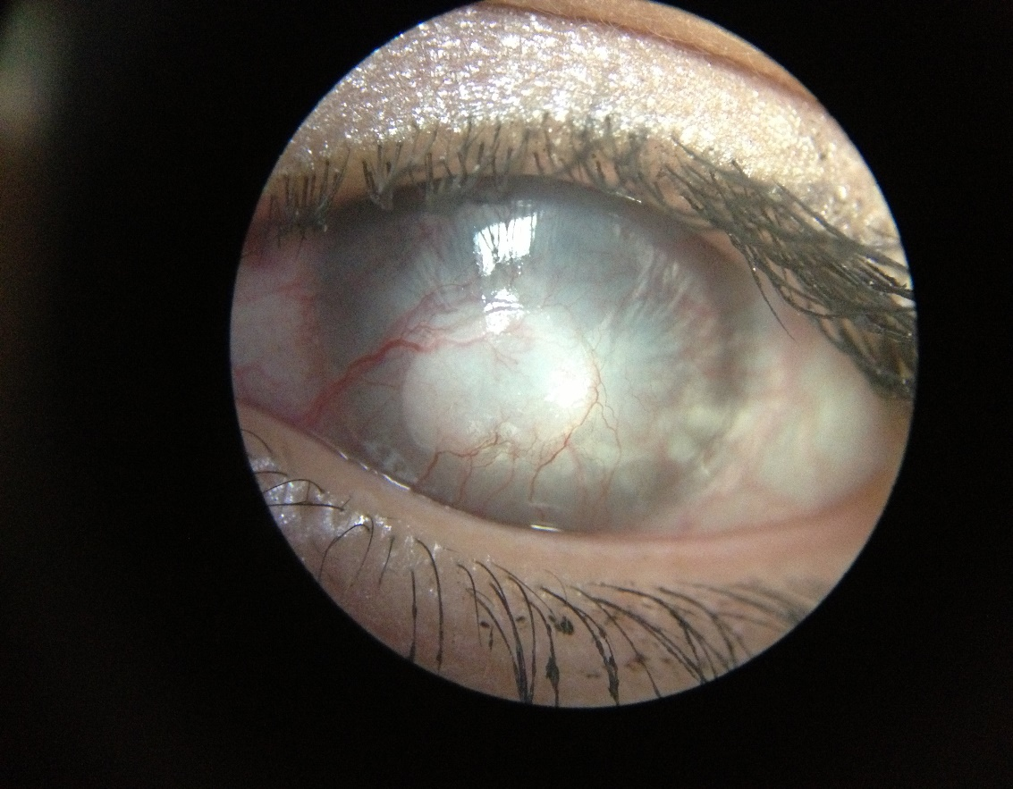
Complications Of Keratitis
Core Subject
Subsequent scarring may be severe, including vascularization
Corneal Opacification
Irregular astigmatism may limit vision
Reduced corneal sensations in Neurotrophic Keratopathy

Slide 19
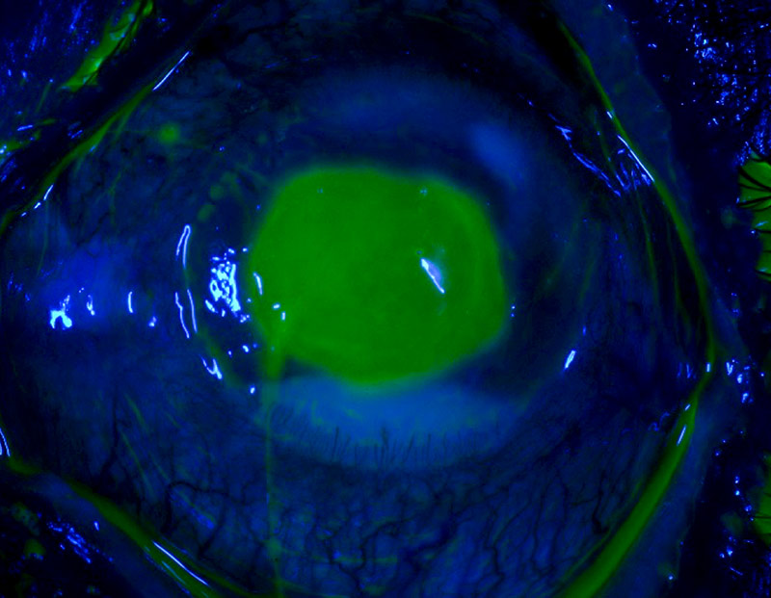
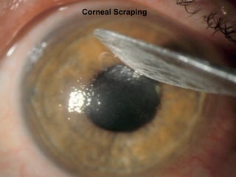
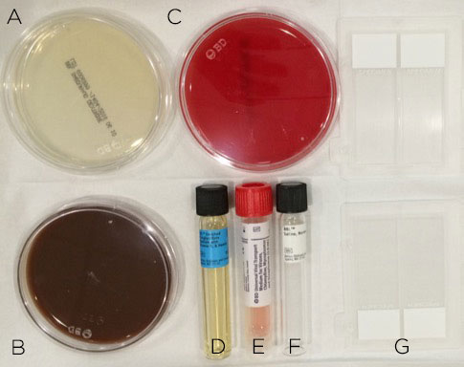
Investigations
Core Subject
Fluorescein staining
Conjunctival swabs
Corneal scrapes for gram staining and Culture sensitivity
Biopsy for histopathology

Slide 20
Aim of Treatment
Core Subject
Control of infection and inflammation
Promotion of epithelial healing

Slide 21
Management
Core Subject
Discontinuation of contact lens wear is mandatory.
A clear plastic eye shield
Topical therapy broad-spectrum antibiotic, Monotherapy (fluoroquinolone)or Duo therapy
Cycloplegics for pain relief (cyclopentolate 1%, homatropine 2% or atropine 1%)

Slide 22
Topical Antibiotics
Horizontal integration

Slide 23
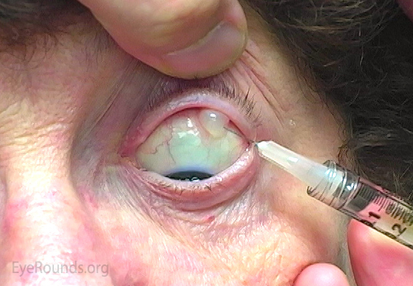
Other Routes Of Antibiotics
Horizontal integration
Subconjunctival antibiotics
Systemic antibiotics
Potential for systemic involvement
Severe corneal thinning with threatened or actual perforation
○ Ciprofloxacin for its antibacterial activity.
○ A tetracycline (e.g. doxycycline 100 mg BD) for its anti collagenase effect
Scleral involvement
Steroids to control inflammation in refractory cases

Slide 24
Core Subject
FUNGAL KERATITIS

Slide 25
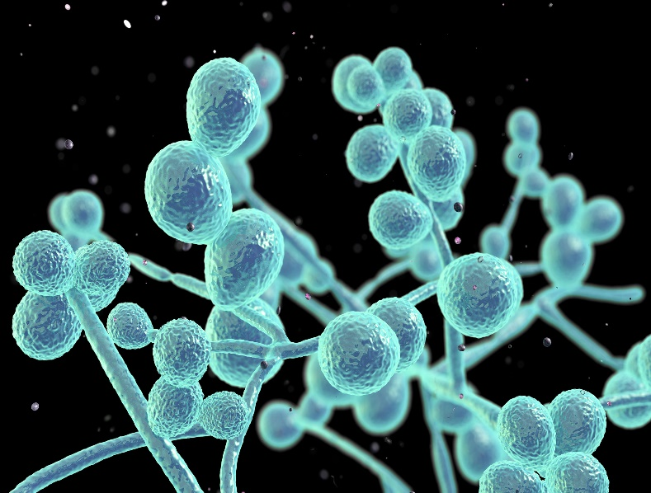
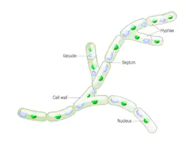
Core Subject
Introduction
Is a major cause of visual loss in tropical and developing countries
Severe inflammatory response – corneal perforation is common, and the outlook for vision is frequently poor
Yeasts (e.g. genus Candida)
Filamentous fungi

Slide 26
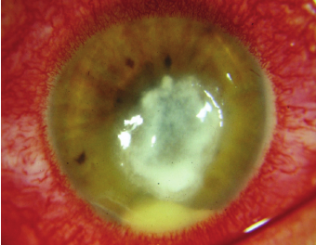
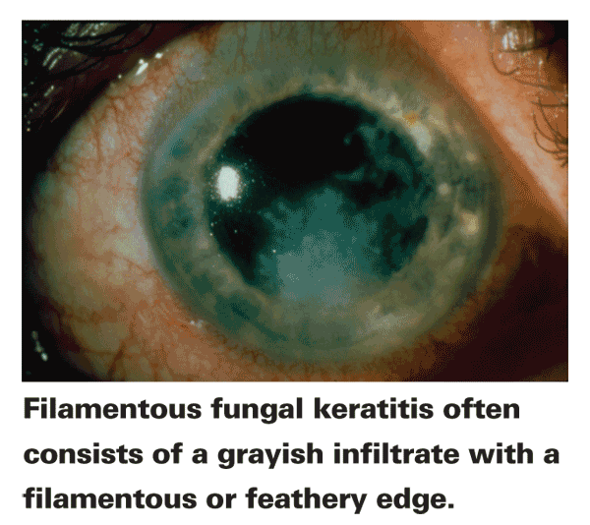
Presentation
Core Subject
Symptoms
Gradual onset of pain, grittiness, photophobia, blurred vision and watery or muco purulent discharge.
Candida keratitis: Yellow–white densely suppurative infiltrate
Filamentous keratitis: Grey or yellow–white stromal infiltrate with indistinct fluffy margins

Slide 27
Clinical Features
Horizontal integration
Progressive infiltration, often with satellite lesions
Feathery branch-like extensions or a ring-shaped infiltrate
Rapid progression with necrosis and thinning can occur
Penetration of an intact Descemet membrane may occur
Anterior uveitis, hypopyon with endothelial plaque
Sterile or infective endophthalmitis

Slide 28
Core Subject

Slide 29
Treatment
Horizontal integration
Debridement
Topical antifungals : Initially hourly for 48 hours continued for at least 12 weeks
Candida infection amphotericin B 0.15% ; alternatives include natamycin 5%, fluconazole 2%, voriconazole 1 or 2%.
Filamentous infection natamycin 5% ; alternatives are amphotericin B 0.15%, miconazole 1% and voriconazole 1 or 2%.
A broad-spectrum antibiotic to prevent bacterial co-infection.
Cycloplegics
Subconjunctival fluconazole may be used in severe cases

Slide 30
Horizontal integration
Systemic antifungals may be given in severe cases, for lesions near the limbus, and for suspected endophthalmitis.
Voriconazole 400 mg twice daily for one day then 200 mg twice daily, itraconazole or fluconazole
Tetracycline (e.g. doxycycline 100 mg twice daily) anticollagenase effect
Therapeutic keratoplasty (penetrating or deep anterior lamellar) when medical therapy is ineffective or following perforation.
Anterior chamber washout with intracameral antifungal injection

Slide 31
Core Subject
VIRAL KERATITIS

Slide 32
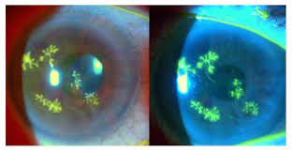
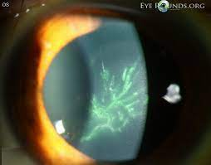
Herpes Simplex Keratitis And Herpes Zoster Keratitis
Core Subject
Reduced corneal sensations in both

Slide 33
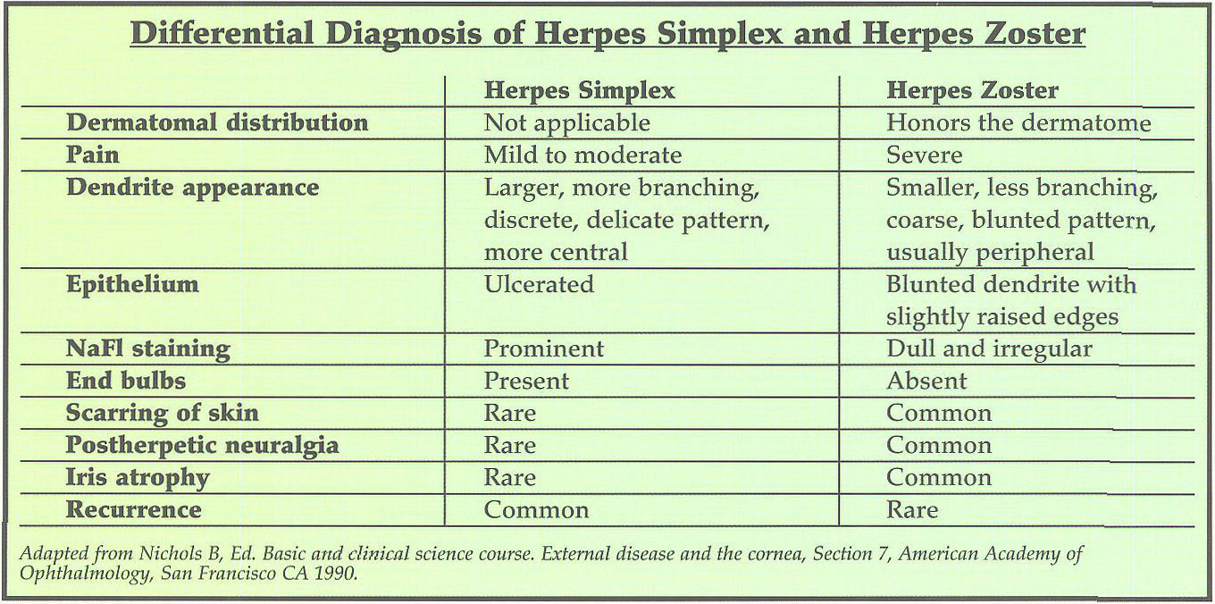
Horizontal integration

Slide 34
Core Subject
Herpes Simplex Keratitis

Slide 35
Disciform Keratitis
Core Subject

Slide 36
Treatment
Core Subject
Topical acyclovir 3% ointment and ganciclovir 0.15% gel, five times daily
Debridement may be used for resistant cases
Oral antiviral therapy (e.g. acyclovir 200–400 mg five times a day for 5–10 days, famciclovir or valaciclovir) for Skin lesions
Cycloplegics
Topical antibiotic to prevent bacterial infection
IOP control and Topical steroids only for significant disciform keratitis

Slide 37
Core Subject
PROTOZOAN KERATITIS

Slide 38
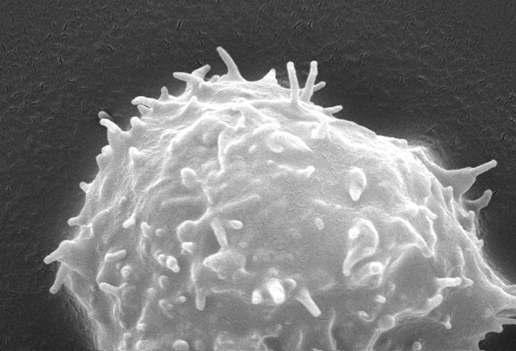
Introduction
Core Subject
Acanthamoeba spp. are ubiquitous free-living protozoa
Commonly found in soil, fresh or brackish water and the upper respiratory tract
Contact lens wear, especially if tap water is used for rinsing

Slide 39
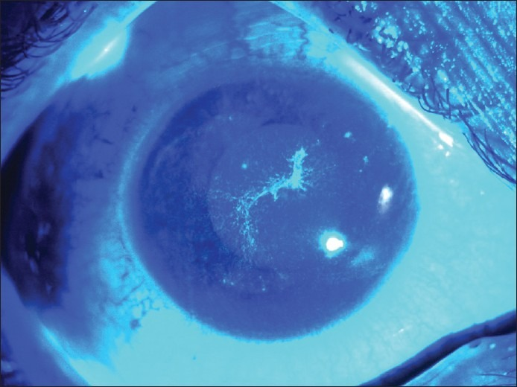
Clinical Features
Core Subject
Symptoms
Blurred vision and discomfort
Pain is often severe and characteristically disproportionate to the clinical signs.
Signs
Epithelial pseudo dendrites resembling herpetic lesions
Diffuse or focal anterior stromal infiltrates

Slide 40
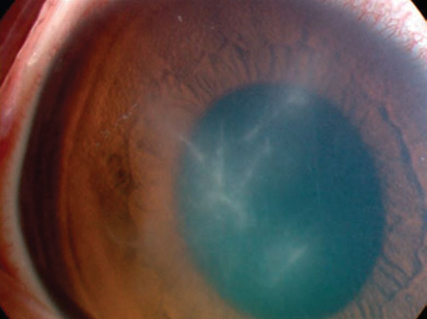
Clinical Features
Core Subject
Perineural infiltrates (radial keratoneuritis) are virtually pathognomonic
Coalescence of infiltrates form a ring abscess
Stromal opacification and vascularization
Corneal melting occurs at any stage

Slide 41
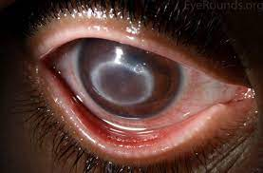
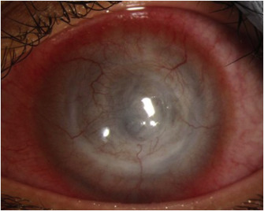
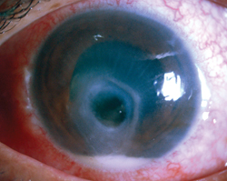
Clinical Features
Core Subject

Slide 42
Advanced Acanthamoeba keratitis
Core Subject

Slide 43
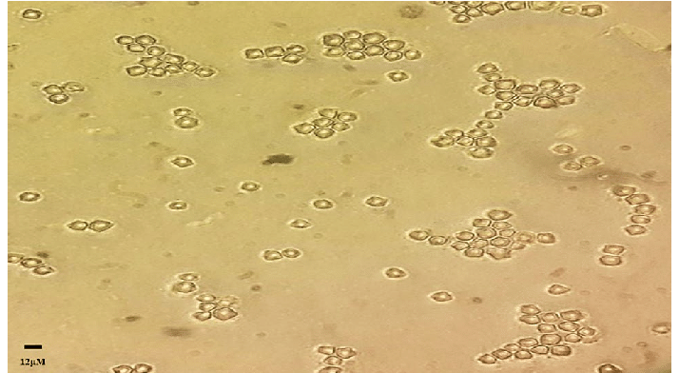
Investigations
Core Subject
Staining of corneal scrapings using periodic acid–Schiff or calcofluor white
Gram and giemsa stains may also demonstrate cysts
Culture : Non-nutrient agar seeded with dead E. Coli
Immunohistochemistry, PCR
Corneal biopsy

Slide 44
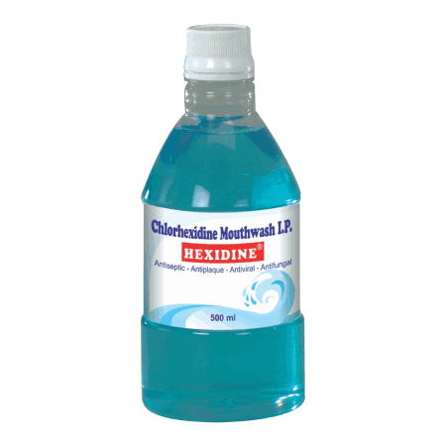
Treatment
Core Subject
Debridement
Topical amebicides polyhexamethylene biguanide (PHMB) 0.02% and chlorhexidine
Hexamidine or propamidine (brolene); the former has greater activity
Instillation is hourly at first, and gradually reduced; a clear response may take 2 weeks
Antibacterial and cycloplegics
It is necessary to continue treatment for many months
Horizontal Integration

Slide 45
EOLA( End Of Lecture Assessment)
Core Subject
A young man aged 30 years, green grocer by profession, presents with difficulty in vision in the left eye for the last 10 days. He gives history of trauma to his left eye with vegetative matter 10–15 days back. On examination, there is an ulcerative lesion in the cornea, whose base has raised soft creamy infiltrate. Ulcer margin is feathery. There are a few satellite lesions.
What is the diagnosis?
What are the treatment options in the management of this patient?

Slide 46
EOLA( End Of Lecture Assessment)
Core Subject
FUNGAL KERATITIS
Management
Debridement
Topical antifungals
Broad-spectrum antibiotic
Cycloplegic
Subconjunctival fluconazole
Systemic antifungals
Tetracycline
Therapeutic keratoplasty (penetrating or deep anterior lamellar)
Anterior chamber washout with intracameral antifungal injection

Slide 47
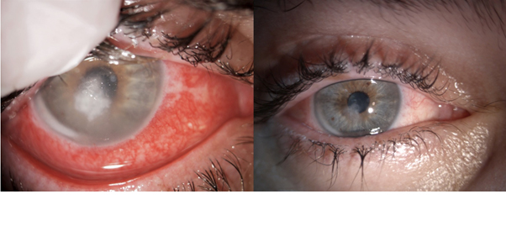
Research And Recent Advances
Research and advances
Collagen Cross-Linking for Bacterial and Fungal Keratitis
Collagen cross-linking (CXL) is a treatment in which photochemically activated riboflavin promotes the formation of covalent bonds between collagen molecules in the cornea. Collagen cross-linking helps strengthen corneal tissue and is currently used to treat keratoconus and other corneal ectatic disorders. Collagen cross-linking may be beneficial in the treatment of infectious ulcers because of its direct antimicrobial effects and its potential to improve the cornea’s resistance to enzymatic degradation.

Slide 48
Research And Recent Advances
Core Subject
Collagen Cross-Linking for Bacterial and Fungal Keratitis
Garg P, Das S, Roy A. Collagen cross-linking for microbial keratitis. Middle East African journal of ophthalmology. 2017 Jan;24(1):18.
Hafezi F, Hosny M, Shetty R, Knyazer B, Chen S, Wang Q, Hashemi H, Torres-Netto EA. PACK-CXL vs. antimicrobial therapy for bacterial, fungal, and mixed infectious keratitis: a prospective randomized phase 3 trial. Eye and Vision. 2022 Jan 7;9(1):2.

Slide 49
Bioethics
Bioethics
Amongst the treatable cause of blindness among young people, keratitis ranks high
In low-resource settings, inappropriate corticosteroid eye drops, ineffective antibacterial therapy, diagnostic delay or no diagnosis all contribute to poor ocular outcomes with blindness (unilateral or bilateral) common
One should prompt the education of community health workers, in addition to ophthalmologists, on the early signs and symptoms of keratitis and its treatment

Slide 50
Artificial Intelligence
Artificial intelligence
Applying AI technology to assist in keratitis diagnosis can aid the treatment of keratitis and reduce the blindness rate.
Kuo et al. constructed a model for the diagnosis of bacterial keratitis based on several DL algorithms (ResNet-50, ResNeXt-50, DenseNet-121, SE-ResNet50, EfficientNet B0, EfficientNet B1, EfficientNet B2, and EfficientNet B3).
Gu et al. proposed a method to distinguish infectious and non-infectious keratitis based on the Inception v3 algorithm.

Slide 51
Study Guide Resources
Core Subject
Kanskis-Clinical-Ophthalmology-Systematic-Approach
Oxford Handbook of Ophthalmology Book by Philip I. Murray
The Wills Eye Manual: Office and Emergency Room Diagnosis and Treatment of Eye Disease
Kuo MT, Hsu BW, Lin YS, Fang PC, Yu HJ, Chen A, Yu MS, Tseng VS. Comparisons of deep learning algorithms for diagnosing bacterial keratitis via external eye photographs. Scientific reports. 2021 Dec 20;11(1):24227.
Gu H, Guo Y, Gu L, Wei A, Xie S, Ye Z, Xu J, Zhou X, Lu Y, Liu X, Hong J. Deep learning for identifying corneal diseases from ocular surface slit-lamp photographs. Scientific reports. 2020 Oct 20;10(1):17851.

