Slide 2
DR. TANVEER HUSSAIN
MBBS FCPS (Med), FRCP,
FCPS (Gastro), CHPE
Associate Professor & HOD
Gastroenterology, RMU

Slide 3

University Motto, Vision, Values & Goals
Mission Statement To impart evidence-based research-oriented health professional education Best possible patient care Mutual respect, ethical practice of healthcare and social accountability. Vision and Values Highly recognized and accredited center of excellence in Medical Education, using evidence-based training techniques for development of highly competent health professionals, who are lifelong experiential learner and are socially accountable. Goals The Undergraduate Integrated Learning Program is geared to provide you with quality medical education in an environment designed to:

Slide 4
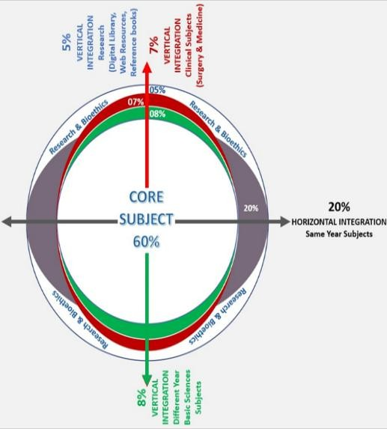
RMU Integrated Lecture Model

Slide 5
Los
At the end of lecture, students will be able to understand
Etiopathogenesis & clinical features of the disease
Specific investigations of the disease
Treatment plan of the disease
Complication of the disease

Slide 6
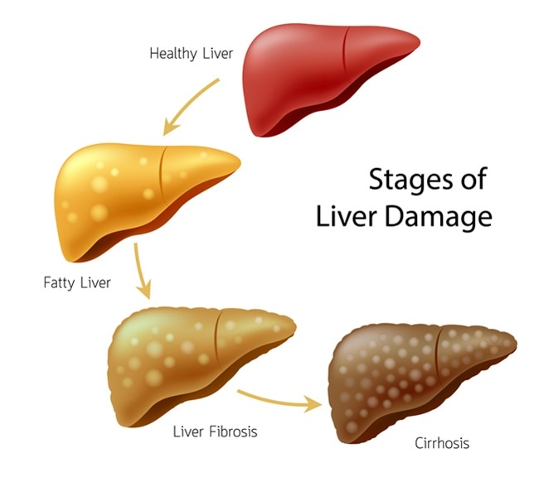

Slide 7
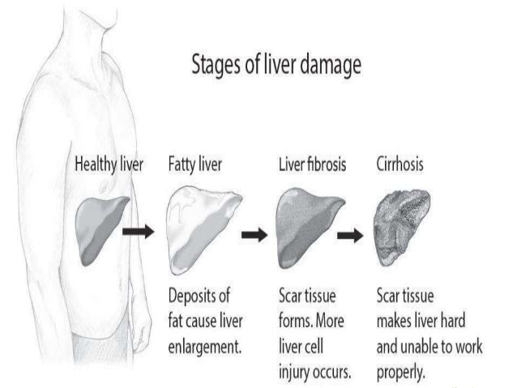

Slide 8
Liver Cirrhosis
A chronic progressive disease of the liver
  Extensive parenchymal cell degeneration
  Destruction of parenchymal cells.
Liver cells attempt to regenerate.
  Regenerative process is disorganized.
    Abnormal blood vessel and bile duct formation
    New fibrous connective tissue distorts liver’s normal structure, impedes blood flow.
    Poor cellular nutrition and hypoxia result.
Notes:
{See next slide for figure.}

Slide 9
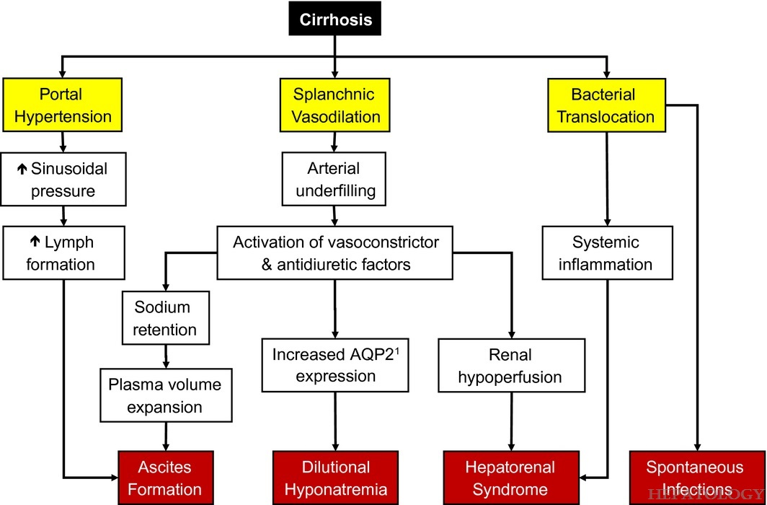

Slide 10
Multi-stage model for the clinical course of cirrhosis
Transition from compensated cirrhosis to DC occurs at a rate of ~5–7% per year
DC is a systemic disease, with multi-organ/system dysfunction
Compensated
Stage 0: no varices, mild PH LSM >15 and <20 or HVPG >5 and <10 mmHg
Stage 1: no varices, CSPH LSM ≥20 or HVPG ≥10 mmHg
Stage 2: varices (=CSPH)
Decompensated
Stage 3: Bleeding
Stage 4: First non-bleeding decompensation
Stage 5: Second decompensating event
End stage
Stage 6: late decompensation: Refractory ascites, persistent PSE or jaundice, infections, renal and other organ dysfunction
ACLF
Death
D’Amico G, et al. J Hepatol 2018;68:563−76;
EASL CPG decompensated cirrhosis. J Hepatol 2018;doi: 10.1016/j.jhep.2018.03.024
Notes:
ACLF, acute-on-chronic liver failure; CSPH, clinically signiﬁcant portal hypertension; DC, decompensated cirrhosis; HVPG, hepatic venous pressure gradient; LSM, liver stiffness measurement; PSE, portosystemic encephalopathy

Slide 11
Multi-stage model for the clinical course of cirrhosis
Transition from compensated cirrhosis to DC occurs at a rate of ~5–7% per year
DC is a systemic disease, with multi-organ/system dysfunction
Symptomatic
Median survival: 2 years
Asymptomatic
Median survival: 12 years
Decompensated
Stage 3: Bleeding
Stage 4: First non-bleeding decompensation
Stage 5: Second decompensating event
Compensated
Stage 0: no varices, mild PH LSM >15 and <20 or HVPG >5 and <10 mmHg
Stage 1: no varices, CSPH LSM ≥20 or HVPG ≥10 mmHg
Stage 2: varices (=CSPH)
End stage
Stage 6: late decompensation: Refractory ascites, persistent PSE or jaundice, infections, renal and other organ dysfunction
ACLF
Death
D’Amico G, et al. J Hepatol 2018;68:563−76;
EASL CPG decompensated cirrhosis. J Hepatol 2018;doi: 10.1016/j.jhep.2018.03.024
Notes:
ACLF, acute-on-chronic liver failure; CSPH, clinically signiﬁcant portal hypertension; DC, decompensated cirrhosis; HVPG, hepatic venous pressure gradient; LSM, liver stiffness measurement; PSE, portosystemic encephalopathy

Slide 12
Pathophysiology of DC
Cirrhosis
Portal hypertension
Liver injury
Bacterial translocation/PAMPs
Damaged cells/DAMPs
Other potential mechanisms
Activation of innate pattern recognition receptors
Release of pro-inflammatory molecules (ROS/RNS)
Splanchnic arteriolar vasodilation and cardiovascular dysfunction
++
Adrenal dysfunction
HE
Kidney dysfunction
HPS
Bernardi M, et al. J. Hepatol 2015;63:1272–84;
EASL CPG decompensated cirrhosis. J Hepatol 2018;doi: 10.1016/j.jhep.2018.03.024
Notes:
DAMP, damage-associated molecular pattern; DC, decompensated cirrhosis; HE, hepatic encephalopathy; HPS, hepatopulmonary syndrome; PAMP, pathogen-associated molecular pattern; RNS, reactive nitrogen species; ROS, reactive oxygen species

Slide 13
Signs & Symptoms
Bleeding gums
Clubbing
Leukonychia
Palmer erythema
Dupetryns contracture
Asterexis
Gynecomastia
Scratch marks
ascites

Slide 14
Signs & Symptoms
Encephalopathy
Jaundice
Pallor
KF ring
Xanthelasma
Parotid swelling
Fetor hepaticus

Slide 15
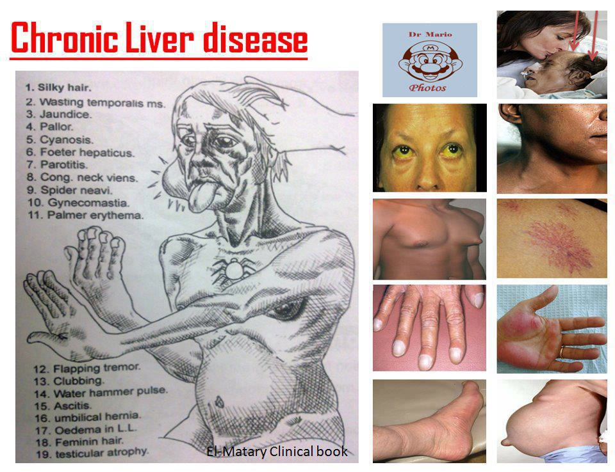
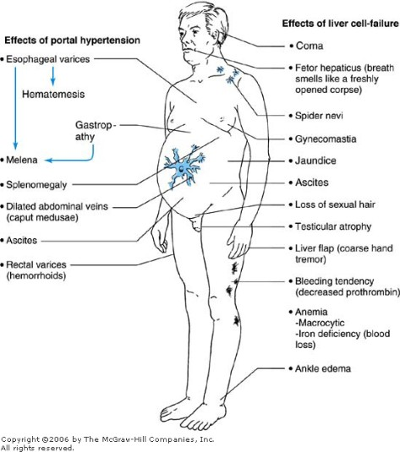
Signs of CLD

Slide 16
Etiology
Infection
Alcohol
Autoimmune
Cholestatic
Infiltrative
Metabolic
Vascular
Drugs

Slide 17
How would you investigate
Bedside
Observations, BM, fluid balance, weight
Blood tests
LFTs (pre/post) (including albumin), INR
FBC, U&Es, CRP
Liver screen: autoantibodies, alpha-1 antitrypsin, caeruloplasmin, serum copper, ferritin, viral hepatitis serology
Imaging
US abdomen + portal vein doppler
CXR, CT, MRI,
Special tests
Ascitic tap, OGD (oesophageal varices), liver biopsy

Slide 18
Management strategies for DC
Management of DC aims to improve outcomes of complications
Uncomplicated
Ascites
Hepatic
hydrothorax
Renal impairment
Refractory
AKI
CKD
Hyponatremia
Complications of DC
Bacterial infections
ACLF
RAI
GI bleeding
Cardiopulmonary
CCM
HPS
PPHT
Increased understanding of DC pathophysiology permits the development
of more comprehensive therapeutic and prophylactic approaches
to prevent or delay disease progression
EASL CPG decompensated cirrhosis. J Hepatol 2018;doi: 10.1016/j.jhep.2018.03.024
Notes:
ACLF, acute-on-chronic liver failure; AKI, acute liver injury; CCM, cirrhotic cardiac myopathy; CKD, chronic kidney disease; DC, decompensated cirrhosis; GI, gastrointestinal; HPS, hepatopulmonary syndrome; PPHT, portopulmonary hypertension; RAI, relative adrenal insufficiency

Slide 19
Overall management of DC
  Suppression of aetiological factor(s)
  Treatment of key pathogenic factors
Management of specific complications of DC
  Ascites
  Refractory ascites
  Hepatic hydrothorax
  Hyponatremia
  Gastrointestinal bleeding
  Bacterial infections
  Renal impairment
  Acute-on-chronic liver failure
  Relative adrenal insufficiency
  Cardiopulmonary complications
EASL CPG decompensated cirrhosis. J Hepatol 2018;doi: 10.1016/j.jhep.2018.03.024
Notes:
DC, decompensated cirrhosis

Slide 20
What is your management plan?
Conservative
Alcohol abstinence, optimise nutrition, low salt diet, fluid restriction
Medical
Vitamin B supplementation (IV/PO), chlordiazepoxide
Diuretics
Paracentesis (give albumin)
NG feeding
Antibiotics (? SBP)
Steroids + albumin (N.B. avoid NaCl)
Lactulose (in hepatic encephalopathy)
Surgical
TIPSS
Liver transplantation

Slide 21
Complications of Cirrhosis Result from Portal Hypertension or Liver Insufficiency
Variceal hemorrhage
Portal hypertension
Spontaneous bacterial peritonitis
Ascites
Cirrhosis
Hepatorenal syndrome
Encephalopathy
Liver insufficiency
Jaundice
Notes:
Slide 17
COMPLICATIONS OF CIRRHOSIS
Cirrhosis leads to two clinical syndromes: portal hypertension and liver insufficiency. Development of variceal hemorrhage and ascites are the direct consequence of portal hypertension, while jaundice occurs as a result of a compromised liver function. Encephalopathy is the result of both portal hypertension (portosystemic shunting) and liver dysfunction (decreased ammonia metabolism). Ascites in turn can become complicated by infection (spontaneous bacterial peritonitis) and by the development of a functional renal failure (hepatorenal syndrome).

Slide 22
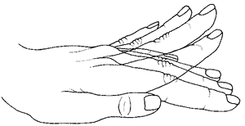
Hepatic Encephalopathy
Stage 1: shorted attention span, reversal of sleep-wake cycle, subtle personality changes (anxiety, irritability)
Stage 2: lethargy, personality change, disorientation. Asterixis.
Stage 3: stupor but responsive, severe confusion and disorientation, abnormal behaviour, incomprehensible speech
Stage 4: coma

Slide 23

STAGES OF HEPATIC ENCEPHALOPATHY
Stages of Hepatic Encephalopathy
Confusion
Drowsiness
Somnolence
Coma
1
2
3
4
Stage
Notes:
Slide 353
STAGES OF HEPATIC ENCEPHALOPATHY
Mental stages progress from confusion through drowsiness and somnolence to coma.

Slide 24
Treatment of Hepatic Encephalopathy
Identify and treat precipitating factor
  Infection
  GI hemorrhage
  Prerenal azotemia
  Sedatives
  Constipation
Lactulose (adjust to 2-3 bowel movements/day)
Protein restriction, short-term (if at all)
Notes:
Slide 361
TREATMENT OF HEPATIC ENCEPHALOPATHY
Treatment of hepatic encephalopathy involves 1) identifying and treating the precipitating factor, and 2) using lactulose adjusted to produce 2-3 bowel movements per day. Protein restriction is carried out typically when patients have stage 4 hepatic encephalopathy, but may not be necessary. Long-term protein restriction is not required. A vegetable protein diet is better tolerated than an animal protein diet.

Slide 25
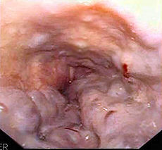
Acute GI Bleed
ABC
- Protect airway
- High flow O2
- Haemodynamically stable?
- Bloods (Hb, Urea, Cross match ), ABG
- Fluid resuscitation – anything, blood is best
Correct clotting abnormalities (vitamin K, FFP)
Emergency endoscopy: banding
Terlipressin
IV omeprazole, antibiotics

Slide 26
Variceal Hemorrhage
No varices
Varices
No hemorrhage
Management depends on the size of varices
Variceal
hemorrhage
Recurrent
hemorrhage
Notes:
Slide 120
MANAGEMENT OF PATIENTS WITH VARICES WHO HAVE NEVER BLED
Management of cirrhotic patients with varices that have not bled depends on the size of varices.

Slide 27
Treatment of Varices / Variceal Hemorrhage
No varices
Small varices
No hemorrhage
1) β-blockers (propranolol, nadolol) indefinitely
2) Endoscopic Variceal Ligation in patients intolerant to β-blockers
Medium/ large varices
No hemorrhage
Variceal
hemorrhage
Recurrent
hemorrhage
Notes:
Slide 121
MANAGEMENT OF PATIENTS WITH MEDIUM/LARGE VARICES WITHOUT PRIOR HEMORRHAGE
In patients with medium/large varices who have never bled, non-selective beta-blockers (propranolol, nadolol) should be considered first line therapy in the prevention of first variceal hemorrhage. Endoscopic band ligation can be considered in patients intolerant to beta-blockers or who have contraindications to beta-blockers.

Slide 28
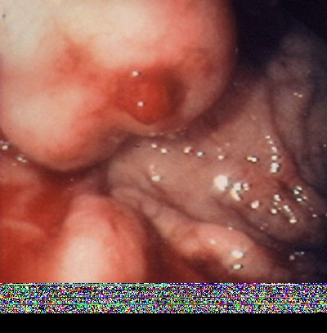
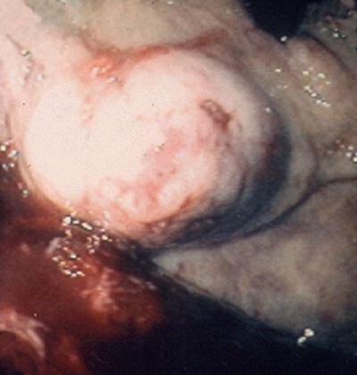
Gastric Varices
Pretreatment cyanoacrylate
Post-treatment cyanoacrylate
Notes:
Slide 189
ENDOSCOPIC IMAGES OF GASTRIC VARICES
The arrow on the panel on the left shows an actively bleeding gastric varix. The panel on the right shows the varix after treatment with cyanoacrylate.

Slide 29
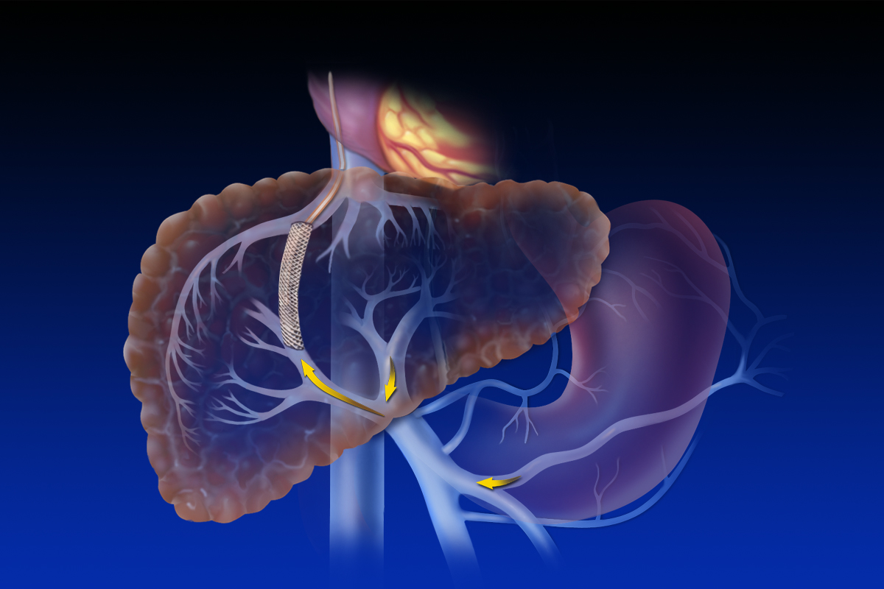
Transjugular Intrahepatic Porto systemic Shunt
Hepatic
vein
TIPS
Splenic
vein
Portal vein
Superior mesenteric vein
Notes:
Slide 147
THE TRANSJUGULAR INTRAHEPATIC PORTOSYSTEMIC SHUNT
Portal hypertension can be corrected by creating a communication between the hypertensive portal system and low-pressure systemic veins, bypassing the liver, i.e., the site of increased resistance. This communication can be created surgically or by the transjugular placement of an intrahepatic stent that connects a branch of the portal vein with a branch of an hepatic vein, a procedure designated transjugular intrahepatic porto-systemic shunt (TIPS). TIPS is performed by advancing a catheter introduced through the jugular vein into a hepatic vein and into a main branch of the portal vein. An expandable stent is then introduced connecting hepatic and portal systems, and blood from the hypertensive portal vein and sinusoidal bed is shunted to the hepatic vein. The procedure is highly effective in correcting portal hypertension but can be associated with complications related to diversion of blood flow away from the liver, namely portal-systemic encephalopathy and liver failure.

Slide 30
Prevalence and implications of malnutrition and sarcopenia in cirrhosis
Malnutrition is a frequent burden in liver cirrhosis; reported in 20% of patients with compensated cirrhosis and in more than 50% of patients with decompensated liver disease
The progression of malnutrition is associated with the progression of liver failure, and while malnutrition may be less evident in compensated cirrhosis, it is easily recognizable in decompensated patients
Both adipose tissue and muscle tissue can be depleted; female patients more frequently develop a depletion in fat deposits while males more rapidly lose muscle tissue

Slide 31
Spontaneous Bacterial Peritonitis (SBP) Complicates Ascites and Can Lead to Renal Dysfunction
Portal Hypertension
No Ascites
HVPG <10 mmHg
Mild Vasodilation
Uncomplicated
Ascites
HVPG >10 mmHg
Moderate Vasodilation
Refractory
Ascites
HVPG >10 mmHg
Severe Vasodilation
SBP
HVPG >10 mmHg
Extreme Vasodilation
Hepatorenal
Syndrome
Notes:
Slide 261
SPONTANEOUS BACTERIAL PERITONITIS (SBP) COMPLICATES ASCITES AND CAN LEAD TO RENAL DYSFUNCTION
Spontaneous bacterial peritonitis (SBP) is an infection of ascitic fluid that occurs in the absence of a hollow viscus perforation and in the absence of an intra-abdominal inflammatory focus such as an abscess, acute pancreatitis or cholecystitis. Any cirrhotic patient with ascites (uncomplicated or refractory) is at risk of developing SBP, a potential precipitating factor of the hepatorenal syndrome.

Slide 32
Hepatorenal Syndrome
Renal failure in patients with cirrhosis, advanced liver failure and severe sinusoidal portal hypertension
Absence of significant histological changes in the kidney (“functional” renal failure)
Marked arteriolar vasodilation in the extra-renal circulation
Marked renal vasoconstriction leading to reduced glomerular filtration rate
Notes:
Slide 310
CHARACTERISTICS OF HEPATORENAL SYNDROME (HRS)
The hepatorenal syndrome (HRS) occurs in patients with advanced cirrhosis. It is a functional renal failure, that is, the kidneys of these patients have no significant histological abnormalities. Renal failure occurs as a result of renal vasoconstriction that in turn occurs as a result of extreme peripheral vasodilatation.

Slide 33
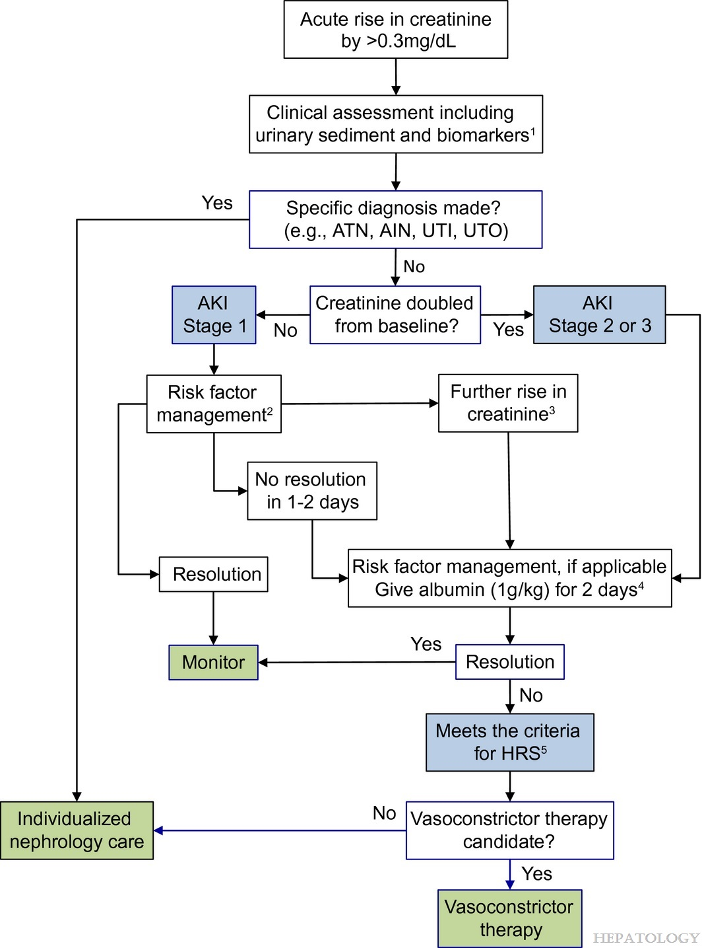

Slide 34
Management of Hepatorenal Syndrome
Proven efficacy
  Liver transplantation
Under investigation
  Vasoconstrictor + albumin
  Transjugular intrahepatic portosystemic shunt (TIPS)
  Vasoconstrictor + TIPS
  Extracorporeal albumin dialysis (ECAD)
Ineffective
  Renal vasodilators (prostaglandin, dopamine)
  Hemodialysis
Notes:
Slide 330
MANAGEMENT OF HEPATORENAL SYNDROME
The only definitive treatment of HRS is liver transplantation. Other therapies are under investigation, such as vasoconstrictors + albumin (most investigated, but mostly uncontrolled trials), TIPS (only small uncontrolled trials), vasoconstrictors + TIPS (small uncontrolled trial) and extracorporeal albumin dialysis (small controlled trial) and require further investigation. Treatments shown to be ineffective in HRS are renal vasodilators such as dopamine and prostaglandins.

Slide 35
Liver transplant
All patients with end stage liver disease should be assessed for liver transplant when ever is proven to significantly prolong survival and improve quality of life in a coast effective manner over natural history of the liver disease and other medical and non transplant surgical intervention.

Slide 36
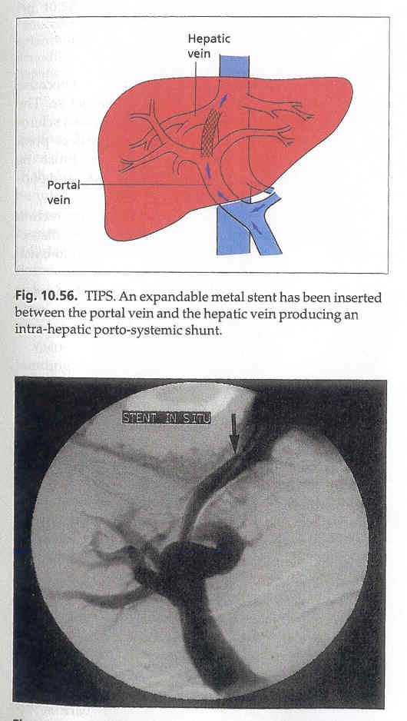
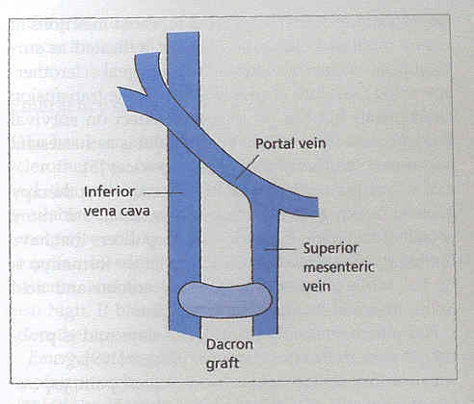
Types of Shunts
Surgical shunt
TIPS (Transjugular intrahepatic portosystemic shunt)

Slide 37
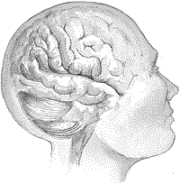
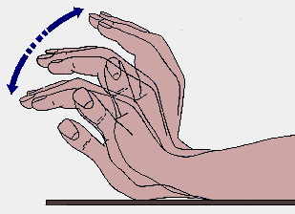

Slide 39
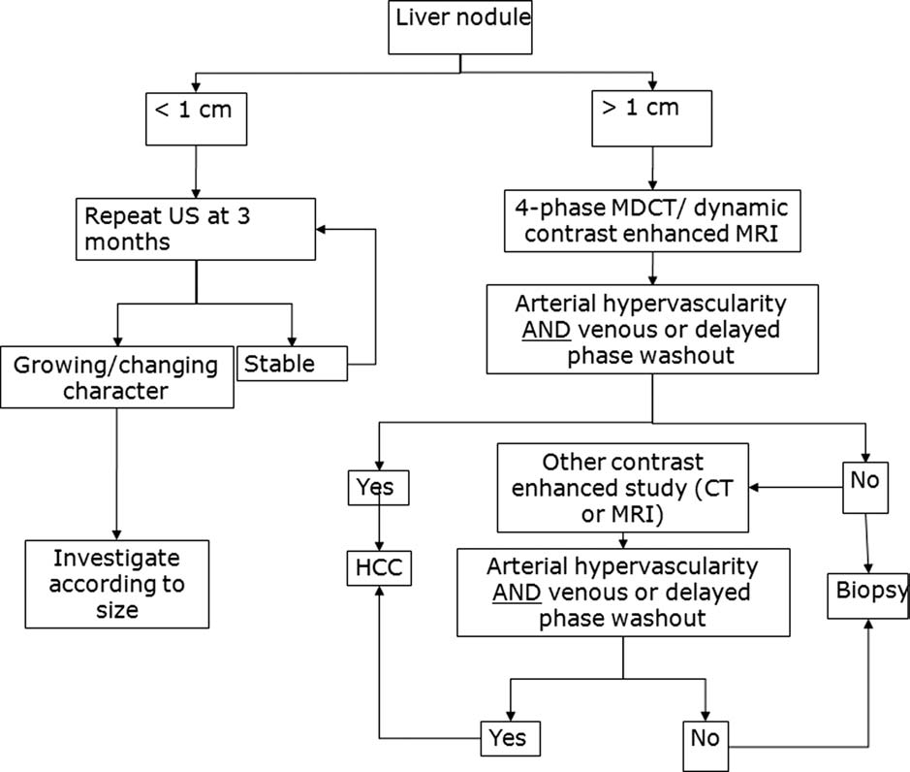
HCC

Slide 40
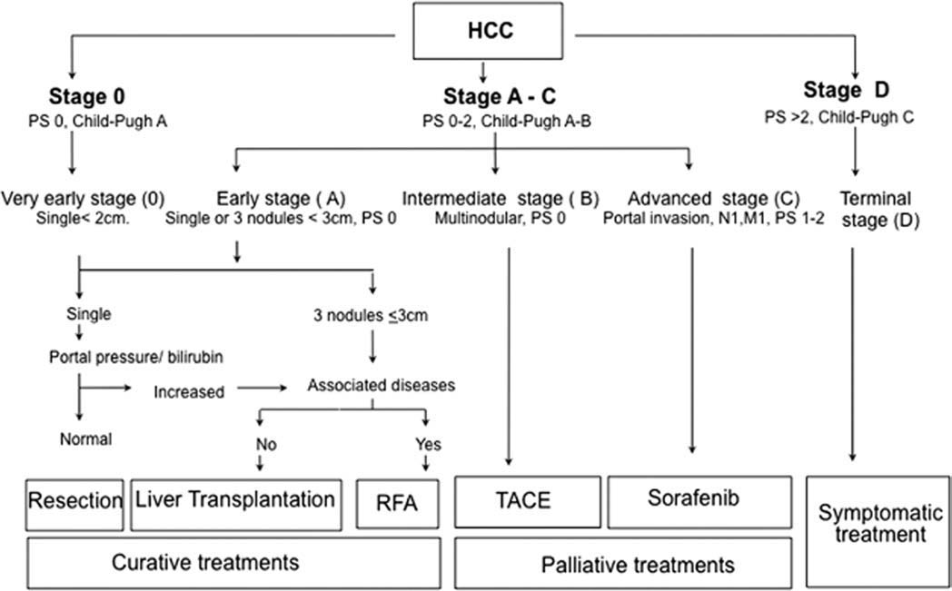
HCC

Slide 41
Ascites
Most common complication of decompensated cirrhosis
  Develops in 5–10% of patients with compensated cirrhosis per year
Significant impact on patients
  Impairs patient working and social life
  Frequently leads to hospitalization
  Requires chronic treatment
  Direct cause of further complications
  Poor prognosis (5-year survival, ~30%)
Ascites can be uncomplicated or refractory
  Ascites is uncomplicated when not infected, refractory or associated with impairment of renal function
EASL CPG decompensated cirrhosis. J Hepatol 2018;doi: 10.1016/j.jhep.2018.03.024

Slide 42
Uncomplicated ascites: evaluation and diagnosis
Cirrhosis is responsible for 80% of cases of ascites
Initial patient evaluation:
  History
  Physical examination
  Abdominal ultrasound
  Laboratory assessment
    Liver and renal function, serum and urine electrolytes, analysis of ascitic fluid
Ascites is graded based on amount of fluid in the abdominal cavity
Grading of ascites
Grade 1 | Mild ascites: only detectable by ultrasound examination
Grade 2 | Moderate ascites: manifest by moderate symmetrical distension of abdomen
Grade 3 | Large or gross ascites: provokes marked abdominal distension

Slide 43
Uncomplicated ascites: evaluation and diagnosis
Diagnostic paracentesis is indicated in:
  All patients with new-onset grade 2 or 3 ascites
  Patients hospitalized for worsening ascites or any complication of cirrhosis
Recommendation
Neutrophil count and culture of ascitic fluid culture† should be performed to exclude bacterial peritonitis Neutrophil count >250 cells/µl denotes SBP | II-2 | 1
Ascitic total protein concentration should be performed to identify patients at higher risk of developing SBP‡ | II-2 | 1
The SAAG should be calculated when the cause of ascites is not immediately evident, and/or when conditions other than cirrhosis are suspected§ | II-2 | 1
Cytology should be performed to differentiate malignancy-related from non-malignant ascites | II-2 | 1
Notes:
SAAG, serum ascites albumin gradient; SBP, spontaneous bacterial peritonitis

Slide 44
Prognosis
Ascites in patients with cirrhosis is associated with a poor prognosis
  1-year mortality: 40%
  2-year mortality: 50%
Patients with ascites should be considered for referral for LT
Patients may not receive adequate priority in transplant lists
  Most commonly used prognostic scores can underestimate mortality risk
Improved methods to assess prognosis in these patients are needed
Grade of evidence
Grade of recommendation
Recommendation
Grade 2 or 3 ascites in patients with cirrhosis is associated with reduced survival. LT should be considered as a potential treatment option | II-2 | 1
Notes:
LT, liver transplantation

Slide 45
Management
Grade 1 or mild ascites
  No data on evolution and not known if treatment modifies natural history
Grade 2 or moderate ascites
  Hospitalization not required
  Correct sodium imbalance:
    Dietary restriction and increased renal excretion with diuretics
Recommendation
Moderate restriction of sodium intake (80–120 mmol/day, corresponding to 4.6–6.9 g of salt) is recommended | I | 1
Generally equivalent to a no added salt diet with avoidance of pre-prepared meals. | II-2 | 1
Very low sodium diets (<40 mmol/day) should be avoided | II-2 | 1
Prolonged bed rest cannot be recommended | III | 1
Grade of evidence
Grade of recommendation

Slide 46
Management of Grade 3 ascites
Grade 3 or large ascites
  LVP, under strict sterile conditions, is the treatment of choice
    Ascites should be completely removed in a single session
  Contraindications to LVP include:
    Uncooperative patient, abdominal skin infection at puncture sites, pregnancy, severe coagulopathy, severe bowel distention
Recommendation
LVP should be followed with plasma volume expansion | I | 1
Plasma volume expansion should be performed by albumin infusion (8 g/L ascites) For >5 L of ascites: more effective than other plasma expanders For <5 L of ascites (low risk of PPCD): treat with albumin due to concerns about use of alternative plasma expanders | I III | 1 1
After LVP, patients should receive the minimum dose of diuretics necessary to prevent re-accumulation of ascites | I | 1
When needed, LVP should be performed in patients with AKI or SBP | III | 1
Notes:
AKI, acute kidney injury; LVP, large-volume paracentesis; PPCD, post-paracentesis circulatory dysfunction; SBP, spontaneous bacterial peritonitis

Slide 47
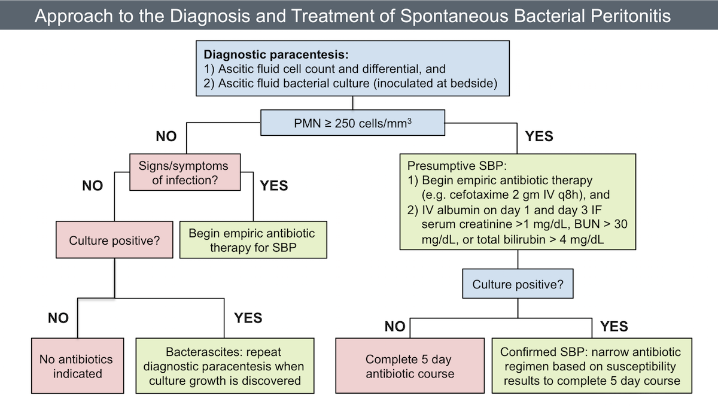

Slide 48

Refractory ascites: definition
International Ascites Club:
  “Ascites that cannot be mobilized or early recurrence of which (after LVP) cannot be satisfactorily prevented by medical therapy
Refractory ascites
Diuretic resistant
Diuretic intractable
Ascites that cannot be mobilized
or early recurrence of which
cannot be prevented because of a
lack of response to sodium
restriction and diuretic treatment
Ascites that cannot be mobilized
or early recurrence of which
cannot be prevented because of the
development of diuretic-induced
complications that preclude the
use of an effective diuretic dosage
Notes:
LVP, large-volume paracentesis

Slide 49
Diagnostic criteria
Diagnostic criteria
Treatment duration | Patients must be on intensive diuretic therapy for at least 1 week and on a salt-restricted diet of less than 90 mmol/day
Lack of response | Mean weight loss of <0.8 kg over 4 days and urinary sodium output less than the sodium intake
Early ascites recurrence | Reappearance of grade 2 or 3 ascites within 4 weeks of initial mobilization
Diuretic-induced complications | HE: development of encephalopathy in the absence of any other precipitating factor Renal impairment: increase of serum creatinine by >100% to a value >2 mg/dl (177 µmol/L) in patients with ascites responding to treatment Hyponatraemia: a decrease of serum sodium by >10 mmol/L to a serum sodium of <125 mmol/L Hypo- or hyperkalaemia: a change in serum potassium to <3 mmol/L or >6 mmol/L despite appropriate measures Incapacitating muscle cramps
Notes:
HE, hepatic encephalopathy

Slide 50

The principles in Medical Ethics

Slide 51
What are Ethical Principles

Slide 52
The Principles in Medical Ethics:
The Principle of Non-Maleficence
The Principle of Beneficence
The Principle of Autonomy
The Principle of Veracity
The Principle of Confidentiality(or Fidelity)
The Principle of Social Responsibility and Justice

Slide 53
The Principle of Non Maleficence:
A procedure does not harm the patient involved or others in society.
Concern about:
First do no harm
Sanctity of life
Be aware double effect doctrine, where a treatment intended for good unintentionally causes harm.

Slide 54
The Principle of Beneficence:
The procedure be provided with the intent of doing good for the patient involved.
Health care providers develop and maintain skills and knowledge, continually update training, consider individual circumstances of all patients, and strive for net benefit.
Patient’s welfare as the first consideration
All healthcare providers must strive to improve their patient’s health, to do the most good for the patient in every situation.
What is good for one patient may not be good for another, so each situation should be considered individually.

Slide 55
Research:
Davidson's Principles and Practice of Medicine
24th Edition - March 1, 2022
EASL CPG decompensated cirrhosis. J Hepatol 2018;doi: 10.1016/j.jhep.2018.03.024
J Gastroenterol. 2021; 56(7): 593–619. Published online 2021 Jul7. doi: 10.1007/s00535-021-01788-x

Slide 56


