Slide 1
Malignant neoplasms of Lungs
Muhammad Waqas Raza
FCPS FRSC MHPE

Slide 2
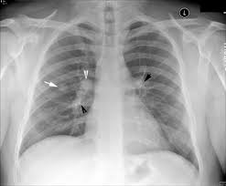
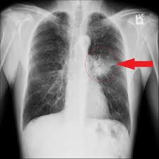
Diagnosis/Differential diagnosis

Slide 3
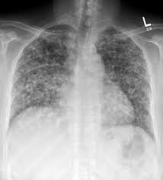
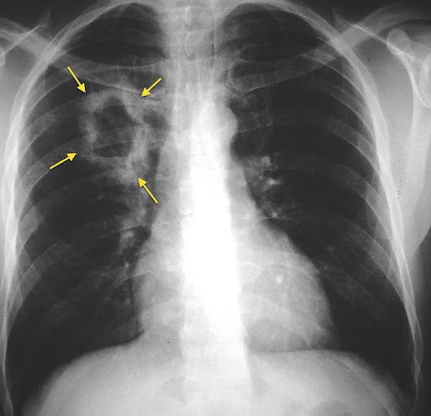

Slide 4
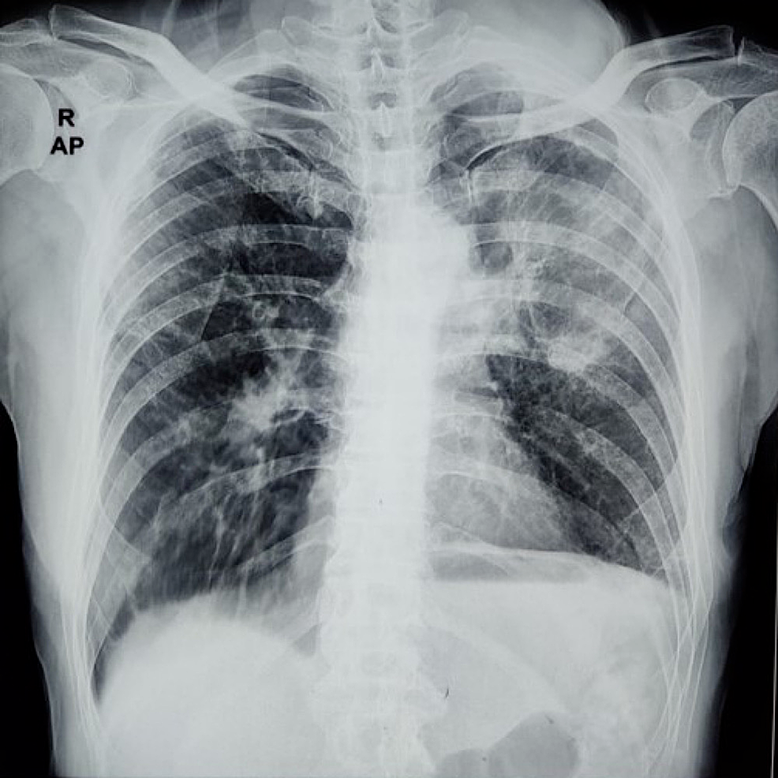
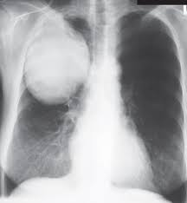

Slide 5
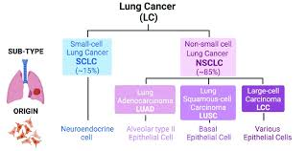

Slide 6
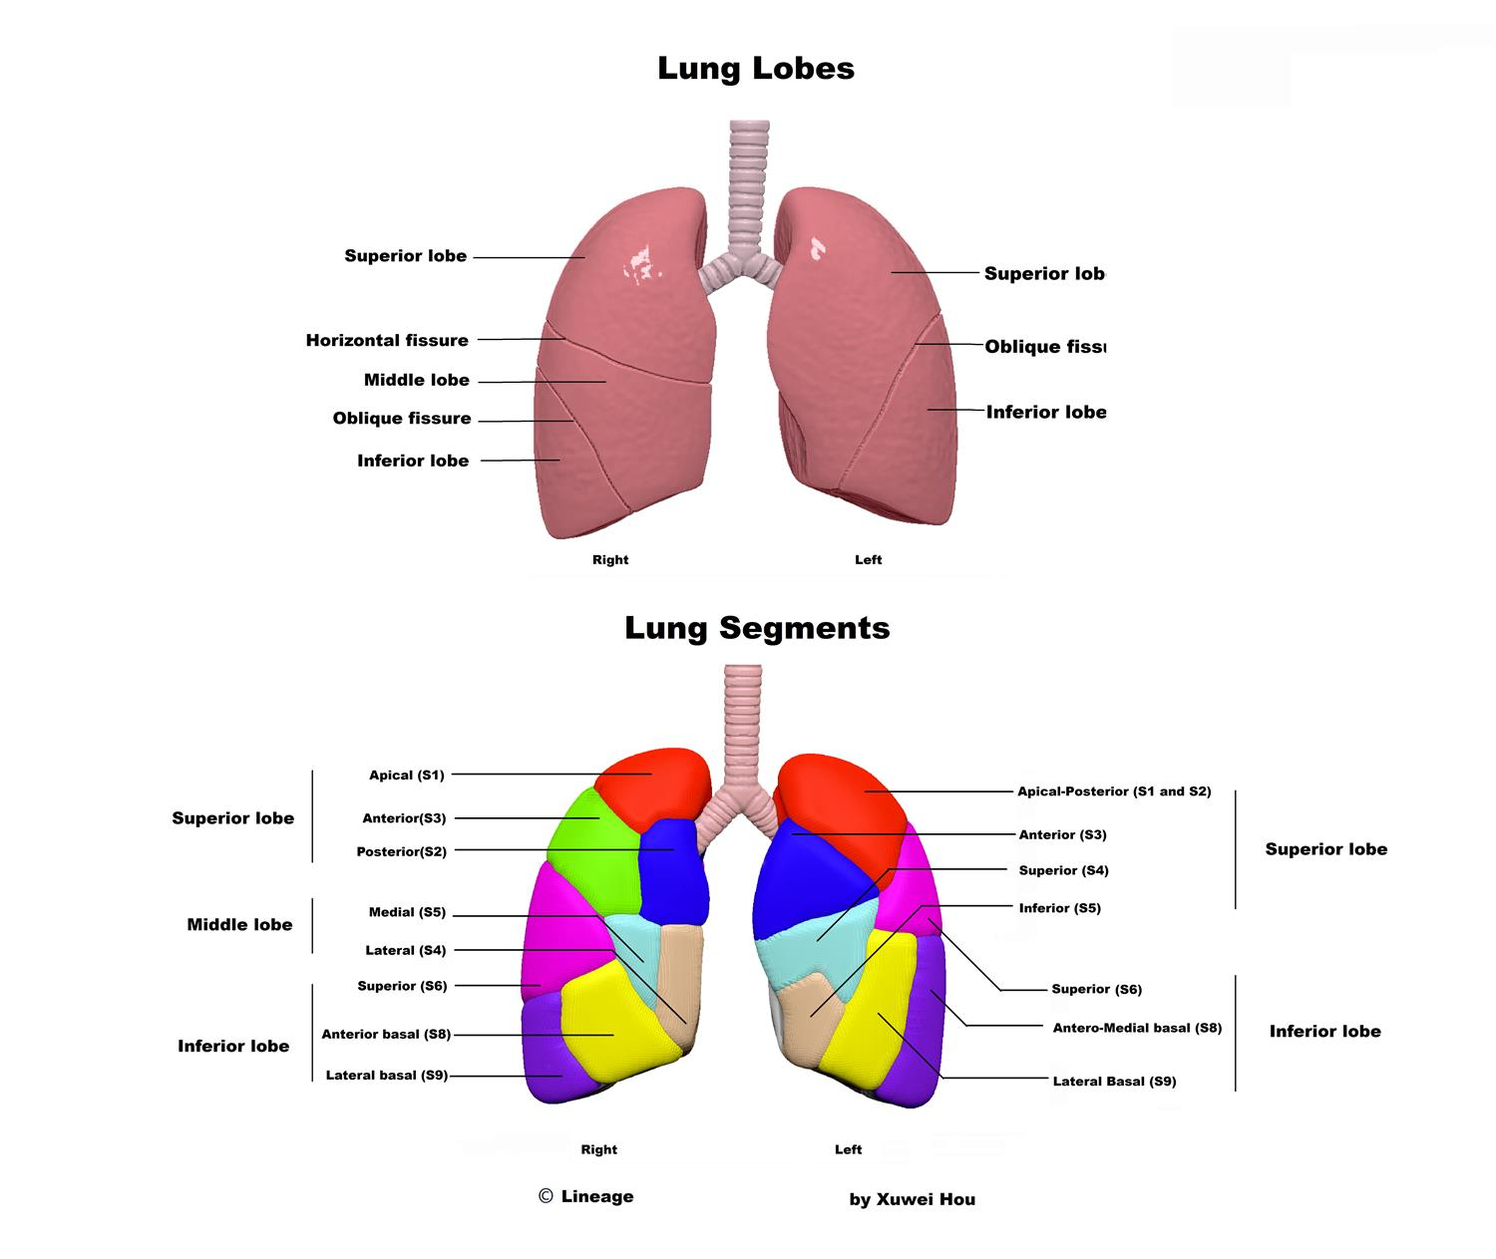

Slide 7
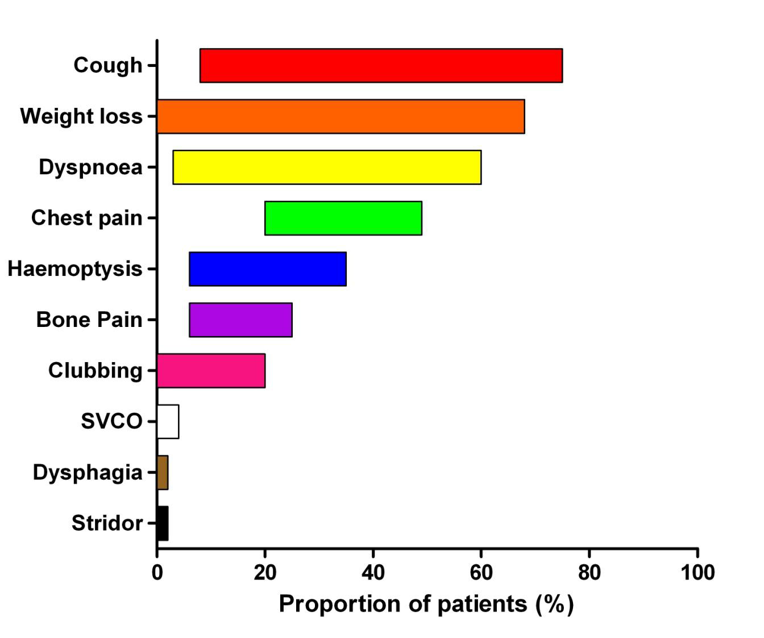
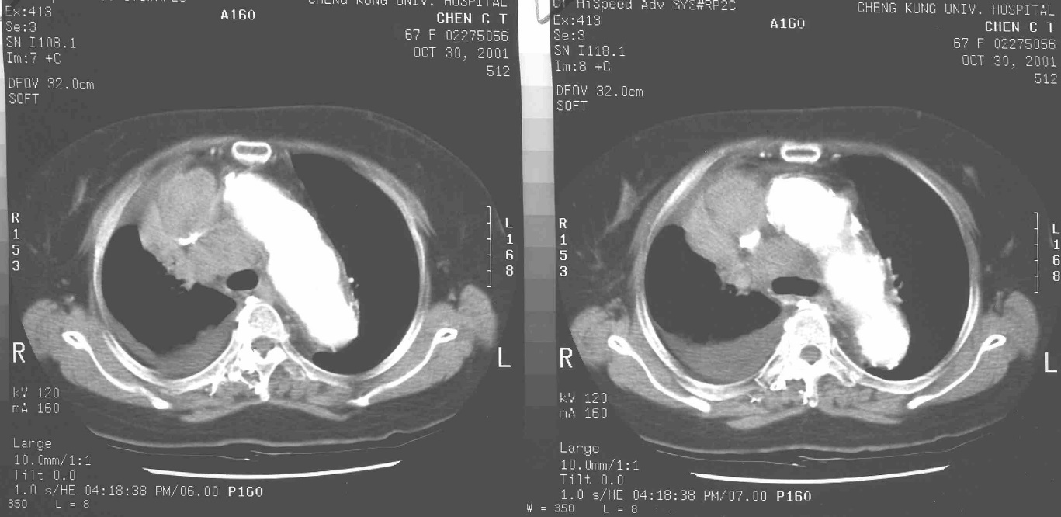
Symptoms in patients who turn out to have lung cancer

Slide 8
Red flags are not always reliable but……NICE says
Any haemoptysis
Three weeks of unexplained clubbing or…..
Cough
Breathlessness
Chest or shoulder pain
Weight loss
Hoarseness
Chest signs
Or just because smokes and tired? Unclear. But probably.
Don’t wait for antibiotics to work

Slide 9
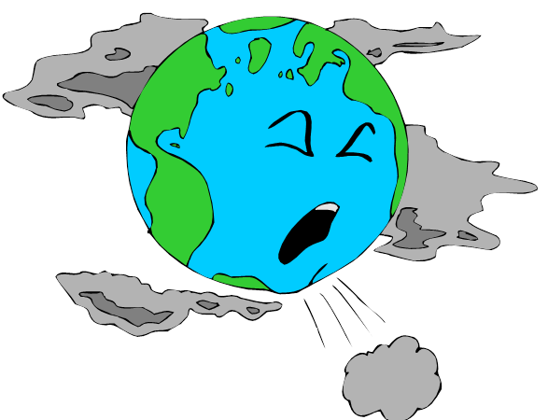
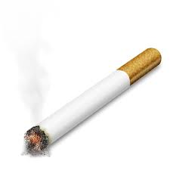
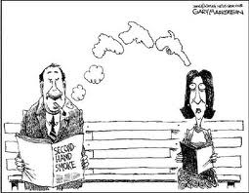
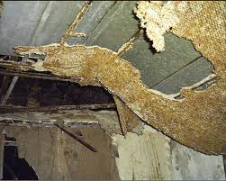
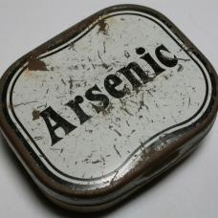
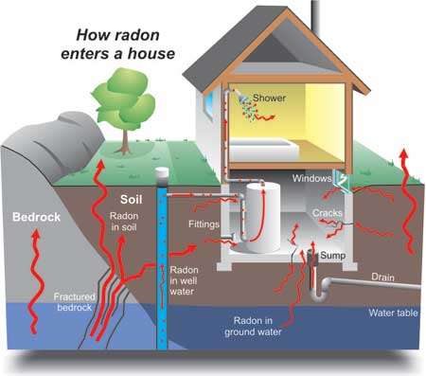
Causes and Risk factors of Lung Cancer
Notes:
Risk factors may increase a person’s chance of developing lung cancer. The factors that increase the risk of developing lung cancer include:
smoking tobacco- is the predominant cause of Lung Ca and accounts for 80% of all new cases in women and 90% in men. Lung cancer is 10 times more likely to occur in smokers than non-smokers.
second-hand smoke- studies have shown that people who are exposed to tobacco smoke in a closed environment (car, house, building) are at inc’d risk of developing lung Ca than those who are not exposed.
Asbestos-Asbestos refers to a group of naturally occurring minerals that are used in some industries. Asbestos fibers have a tendency to easily shatter into small bits that can be suspended in the air and adhere to clothes. In the event that these asbestos particles are inhaled, they can enter into the lungs, damaging cells, escalating the risk for lung cancer development. Studies have revealed that workers exposed to great amount of asbestos are 3 to 4 times more at risk of developing lung cancer than those who work in asbestos free environment.
Arsenic - Arsenic can be found in both surface water and groundwater sources, with levels generally higher in groundwater and is known to be a human carcinogenic (Health Canada, 2008, http://www.hc-sc.gc.ca/ewh-semt/pubs/water-eau/arsenic/rationale-justification-eng.php)
Radon- Radon is gas that is undetectable, fragrance-free, and tasteless radioactive gas that occurs naturally in soil and rocks. It naturally occurs in can cause damage to the lungs that may lead to lung cancer. People who work in mines may be exposed to radon and, in some parts of the country, radon is found in houses. Smoking increases the risk of lung cancer even more for those already at risk because of exposure to radon. A kit available at most hardware stores allows homeowners to measure radon levels in their homes. The home radon test is relatively easy to use and inexpensive. Once a radon problem is corrected, the hazard is gone for good.
There are also various carcinogens identified in the atmosphere from vehicle emissions and pollutants from refineries and manufacturing plants. Evidence suggests that the incidence of lung cancer is greater in urban areas as a result of the buildup of these pollutants (Day et. al, 2010, p. 630).
Information from: http://info.cancer.ca/cce-ecc/default.aspx?Lang=E&toc=26
Some other risk factors are:
Marijuana
Pollution
Industry work
Lung Disease
Personal History
Diet
Lung Diseases. Certain lung ailments, such as tuberculosis (TB), add to a person's likelihood of developing lung cancer. Lung cancer tends to grow in the regions of the lung that are scarred from TB. Other diseases such as tuberculosis (TB) and some types of pneumonia often leave scars on the lung. This scarring can increase the risk of developing lung cancer. People with diseases from breathing in certain minerals also have a higher risk of lung cancer.
Personal History. A person who has a history of having lung cancer lung cancer is more prone to develop lung cancer again compared with someone who has never had lung cancer. Smoking cessation following a diagnosis of lung cancer may stop the development subsequent lung cancer.
Additionally, People who have had prior experiences with radiation therapy on the chest at higher risk for lung cancer, especially if they smoke.
Diet: Some reports propose that a diet low in fruits and vegetables may amplify the risk of lung cancer in people who are exposed to environmental tobacco smoke.
It is believed that fruits and vegetables help protect against lung cancer.
We already know greatest way to avoid developing lung cancer. Stop smoking or never start. The sooner you quit the better, it’s never too late to give up smoking.

Slide 10
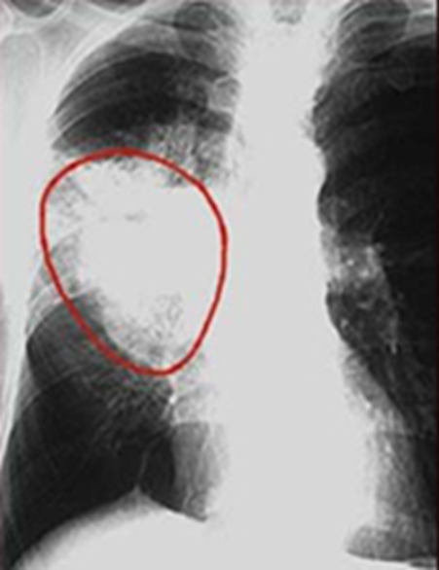
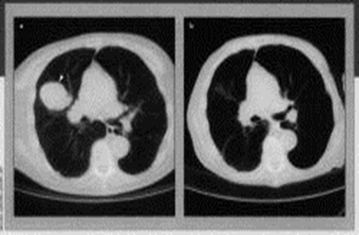
Diagnostic Tests
CXR
CT Scans
MRI
Sputum cytology
Fibreoptic bronchoscopy
Transthoracic fine needle aspiration
Notes:
**As a nurse working with a client, what would be some things you could tell him or her about what to expect for each test?
A chest x-ray is preformed to search for:
pulmonary density, a solidary peripheral nodule (coin lesion) (a mass in the lung or airway)
Atelectasis (collapsed lung)
Infection
fluid in the lung
enlarged lymph nodes in the chest
“A chest x ray is a painless, noninvasive test that creates pictures of the structures inside your chest, such as your heart, lungs, and blood vessels. "Noninvasive" means that no surgery is done and no instruments are inserted into your body
Your ribs and spine are bony and absorb radiation well. They normally appear light on a chest x ray. Your lungs, which are filled with air, normally appear dark. A disease in the chest that changes how radiation is absorbed also will appear on a chest x ray”. (http://www.nhlbi.nih.gov/health/health-topics/topics/cxray/)
Chest x rays have few risks. The amount of radiation used in a chest x ray is very small. A lead apron may be used to protect certain parts of your body from the radiation.
CT scans
shows the size, shape, and position of your lungs and other structures in your chest.
Follow up on abnormal findings from standard chest x rays.
Find the cause of lung symptoms, such as shortness of breath or chest pain.
Find out whether you have a lung problem, such as a tumor, excess fluid around the lungs, or a pulmonary embolism.
Most places will provide the patient with a gown. He/she will need to undress, usually down to their underwear, and put the gown on. If the place does not provide a gown the patient should wear loose-fitting clothes.
Any woman who suspects she may be pregnant should tell her doctor beforehand.
Doctors may ask the patient to fast (eat nothing) and even refrain from consuming liquids for a specific period before the scan.
The patient will be asked to lie down on a motorized examination table, which then goes into the giant doughnut-like machine. The couch with the patient goes into the doughnut hole.
MRI is like a CT only it uses magnetism instead of xrays,
remove all metallic objects, fill out a screening form, asked to lie down on a comfortably padded table that gently glides you into the scanner.
earplugs or headphones to protect your hearing because, when certain scanners operate, they may produce loud noises. These loud noises are normal and should not worry you.
Nurse may inject a contrast agent called "gadolinium" in vein to help obtain a clearer picture of the area being examined.
A saline solution will drip through IV to prevent clotting until the contrast material is injected at some point during the exam.
The most important thing for the patient to do is to relax and lie still. Most MRI exams take between 15 to 45 minutes to complete depending on the body part imaged and how many images are needed.
You will be asked to remain perfectly still during the time the imaging takes place, but between sequences some minor movement may be allowed. You will be guided.
may breathe normally, however, for certain examinations it may be necessary for you to hold your breath for a short period of time.
During your MRI examination, the MR system operator will be able to speak to you, hear you, and observe you at all times. Consult the scanner operator if you have any questions or feel anything unusual.
When the MRI procedure is over, you may be asked to wait until the images are examined to determine if more images are needed. After the scan, you have no restrictions and can go about your normal activities.
Sputum cytology is rarely used to make a dx of lung Ca;
medical test in which a sample of sputum (mucus) is examined under a microscope to determine whether abnormal cells are present.
A sample may be obtained either by the person coughing up mucus at home or in the doctor’s office or during a bronchoscopy.
Remove dentures if you wear them.
• Rinse your mouth with water.
• Take about four deep breaths followed by a few short coughs, then inhale deeply and cough forcefully into the container. Make sure to get a sample from deep in your airway.
(http://www.lung-cancer.com/sputum.html)
however fibreoptic bronchoscopy is more commonly used and provides a detailed study of the tracheobronchial tree and allows for brushings, washings, and biopsies of suspicious areas.
Test to see inside the airways of your lungs, or to get samples of mucus or tissue from the lungs.
Bronchoscopy involves placing a thin tube-like instrument called a bronchoscope through the nose or mouth and down into the airways of the lungs. The tube has a mini-camera at its tip, and is able to carry pictures back to a video screen or camera.
not to eat after midnight the night before (or about 8 hours before) the procedure. You will also receive instructions about taking your regular medicines, smoking and removing any dentures before the procedure.
Before beginning the procedure, you will inhale an aerosol spray of a medicine like Novocain, which numbs the nose and throat area and helps to prevent coughing and gagging during the procedure. After that you will be given a sedative by vein. The sedative will help you to relax, and may make you feel sleepy. The sedative may also help you to forget any unpleasant sensations felt during the test.
After the procedure, do not drink for 1⁄2 to 1 hour or until the numbness completely wears off.
Do not drive home by yourself after the procedure; arrange for a family member or friend to take you home.
Contact your doctor immediately if you have shortness of breath or chest pain, or you cough up more than a few tablespoons of blood at home.
(http://patients.thoracic.org/information-series/en/resources/fiberoptic-bronchoscopy.pdf)
A transthoracic fine needle aspiration
A fine needle aspiration biopsy is a test done to see if a tumor is benign (non-cancerous) or malignant (cancerous.)
Fine needle aspiration (FNA) is done by inserting a thin needle into a tumor and removing cells that can be evaluated under the microscope. A pathologist looks at the cells to see if the suspicious tumor is cancer, and if it is cancer, what type of cancer.
With lung cancer, the needle is inserted into the chest through the skin. Doctors can make sure the needle goes to the right part of the lung by watching it through ultrasound or a CT scanner.
Given cough suppressant, CT scan or help find target of biopsy, skin cleaned just above ribs, sedative and local anesthetic for area, <30mins, small incising in skin, hold breathe stay still, insert needle thru skin and chest wall, feel pressure and pain when reach surface of lung, pain when reach area for tissue extraction. CXR done to see no collapse, short recovery time and home the same day unless a complication. (http://www.youtube.com/watch?v=abvYaB2VcmI)
http://lungcancer.about.com/od/glossary/g/FNA.htm

Slide 11
Laboratory Tests
Blood Tests
*CBC-to check red/white blood cell & platelets
-to check bone marrow and organ function
*Blood Chemistry Test-to assess how organs
are functioning such as liver and kidney
Biopsy-to determine if the tumor is cancer or not
-to determine the type of cancer
-to determine the grade of cancer (slow
or fast)

Slide 12
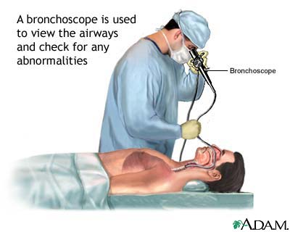
Biopsy
Notes:
A lung biopsy removes a small piece of lung tissue which can be analyzed at under a microscope
to determine if the tumor is cancer or not
to determine the type of cancer
to determine the grade of cancer (slow or fast)

Slide 13
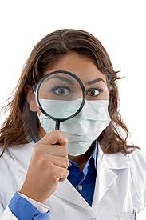
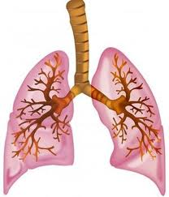
Endoscopy
Bronchoscopy
Mediastinoscopy
VATS (video assisted thoracoscopic surgery)
Notes:
There are three methods that I’ll discuss on how biopsies may be preformed and how surgeons can prove or disprove suspicions of lung cancer.
These are Bronchoscopy, Mediastinoscopy and video assisted thoracoscopic surgery. After I explain each one I will talk about some nursing management that should be done post-op.

Slide 14
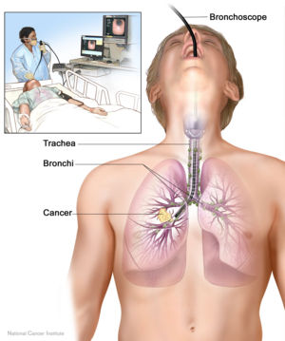
Bronchoscopy
Notes:
This type of biopsy uses a lighted instrument (bronchoscope) inserted through the mouth or nose and into the airway to remove a lung tissue sample. (Web MD, 2012, http://www.webmd.com/lung/lung-biopsy).
Bronchoscopies are used:
To visually examine airways for tumors, obstructions, secretions or foreign bodies.
To diagnose disease processes such as interstitial pulmonary diseases.
To therapeutically remove foreign bodies, mucous plugs or excessive secretions.
To locate the site and cause of hemoptysis.
To treat malignant airway obstruction
(http://www.endonurse.com/articles/2002/05/bronchoscopy-for-the-new-endoscopy-nurse.aspx)

Slide 15
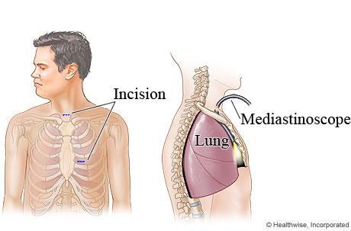
Mediastinoscopy
Notes:
This procedure determines whether the cancer has spread the lymph nodes. Patients are usually given a general anesthesia. A small incision is made in the neck and a thin tube is inserted. Fluid samples and biopsies are then collected from the lymph nodes near the throat and lungs. The samples are tested for cancerous cells (http://www.lung.ca/diseases-maladies/cancer-cancer/signs-signes/diagnosis-diagnostique_e.php)

Slide 16
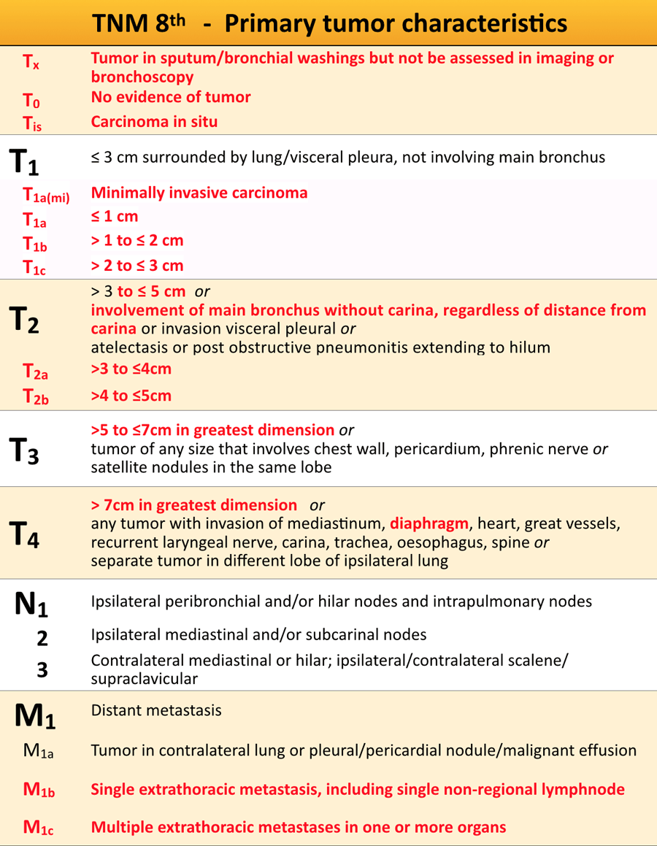

Slide 17
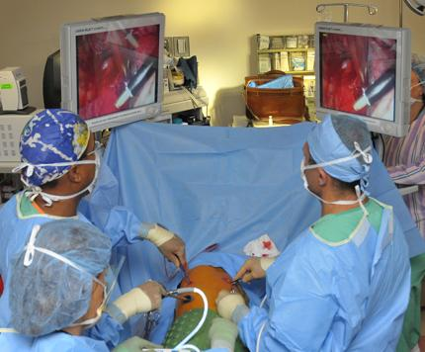
VATS (video assisted thoracoscopic surgery)
Notes:
Video-assisted thoracic surgery (VATS)
is a recently developed type of surgery that enables doctors to view the inside of the chest cavity after making only very small incisions. It allows surgeons to take a biopsy close to the outside edges of the lung and to test them for cancer.
It is also useful for diagnosing certain pneumonia infections, pneumothorax, infection, cysts and other thoracic disorders.
(http://www.health.harvard.edu/diagnostic-tests/video-assisted-thoracic-surgery.htm)
http://ca.video.search.yahoo.com/video/play;_ylt=A2KLqIqSYDZQuDsAakQWFQx.;_ylu=X3oDMTBrc3VyamVwBHNlYwNzcgRzbGsDdmlkBHZ0aWQD?p=lobectomy&vid=D81124D6FD06CA7C2ED6D81124D6FD06CA7C2ED6&l=2%3A00&turl=http%3A%2F%2Fts2.mm.bing.net%2Fvideos%2Fthumbnail.aspx%3Fq%3D4505773586186253%26id%3Daab7a3e98a6ab74f3a799026b5e8853d%26bid%3D1i58ygb91iQR2A%26bn%3DLargeThumb%26url%3Dhttp%253a%252f%252fwww.youtube.com%252fwatch%253fv%253detSe9915ZS4&rurl=http%3A%2F%2Fwww.youtube.com%2Fwatch%3Fv%3DetSe9915ZS4&tit=VATS+Lobectomy+for+Lung+Cancer&c=8&sigr=11auu2s71&fr=yfp-t-715

Slide 18
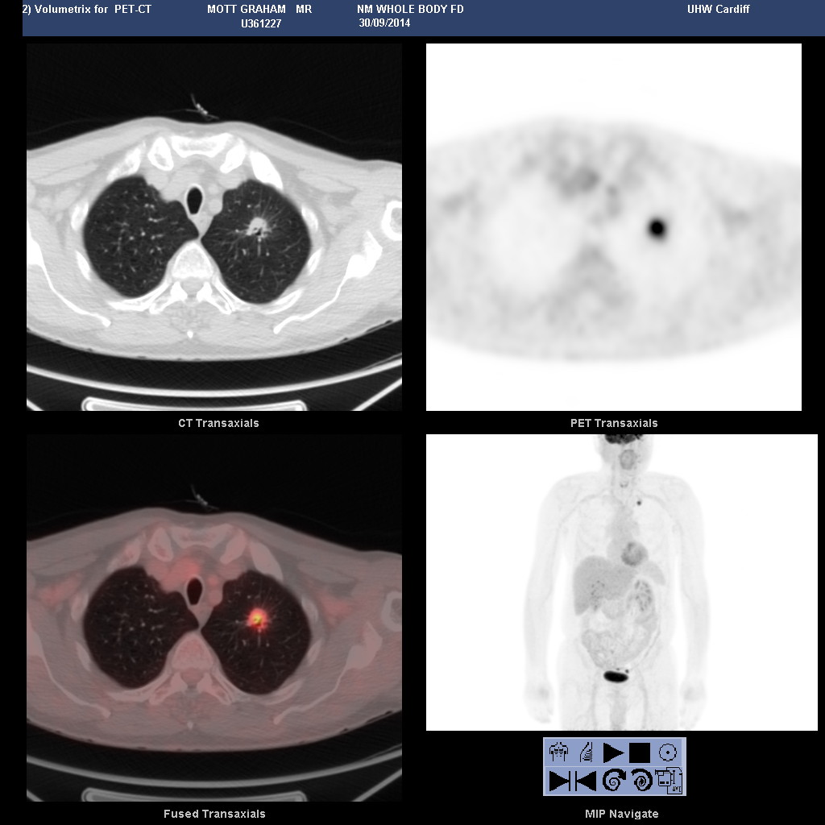

Slide 19
DIAGNOSTIC WORKUP
History: metastasis symptoms
PE: H & N lymph nodes
Chest X-ray
CT: the most valuable radiologic study for evaluation,
staging, and therapeutic planning of lung cancer
MRI: mediastninum or paravetebral region
Bone scans: stage III before curative therapy

Slide 20
PET influenced radiation delivery in 65% for definitive radiotherapy (Kalff et al.).
Brain CT scan: small cell carcinoma.
Pulmonary function tests: ability to undergo surgical resection or withstand irradiation

Slide 21
Pathology
Sputum cytology: 20% to 30% sensitivity
Bronchoscopic examination: 90% positive
CT-guided Bx: 95% positive
Bx: Primary tumor lesion, scalene node

Slide 22
Incidence
 | Taiwan (TCOG) | USA
NSCLC | 85-88 % | 80 %
SCLA | 12-15 % | 20 %

Slide 23
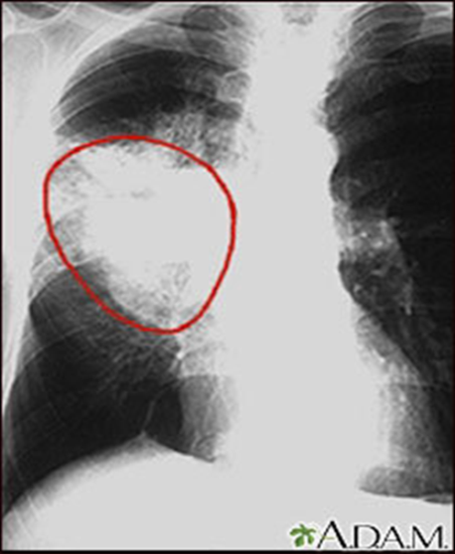
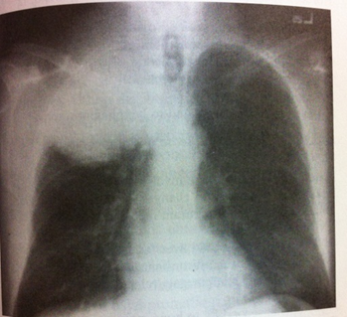
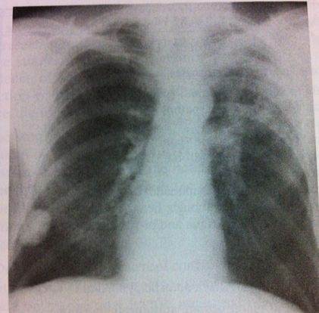
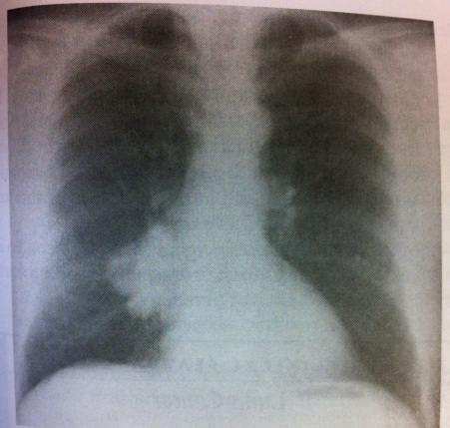
Lung Cancer Re-cap
Small Cell Lung Cancer
Non-Small-Cell Lung Cancer
Squamous cell
Adenocarinoma

Slide 24

Squamous cell carcinoma
Moderate to poor differentiation
makes up 30-40% of all lung cancers
more common in males
most occur centrally in the large bronchi
Uncommon metastasis that is slow effects the liver, adrenal glands and lymph nodes.
Associated with smoking
Not easily visualized on xray (may delay dx)
Most likely presents as a Pancoasts tumor
Notes:
“Squamous cell is the most likely lung cancer to present as a Pancoast’s tumor, which is high in the lung apex with extension to the chest wall, causing shoulder pain that radiates down the ulnar nerve” (Otto, 2001, p. 384)
also known as epidermoid carcinoma. Squamous cell cancers are also known as epidermoid cancer that makes up 30-40% of all lung cancers
This type of cancer is characterized by having cells that are moderate to poor in differentiation ( lacking in distinguishing features)
This cancer is more common in males
most originate in the central portion of the lungs such as in the large bronchi. It Is hard to detect by x-ray. For this reason, diagnoses will often be delayed.
slow growing
Uncommon metastasis that is slow, The cancer would eventually effects the liver, adrenal glands and lymph nodes.
Associated with smoking

Slide 25
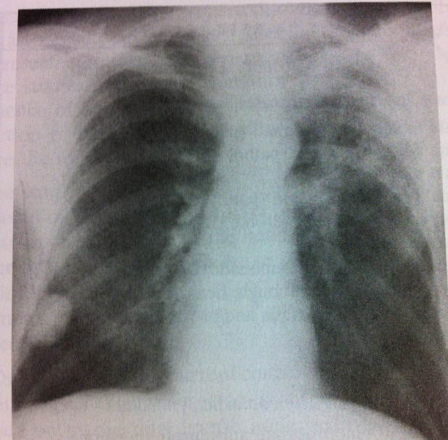
Adenocacinoma
Increasing in frequency. Most common type of Lung cancer (40-50% of all lung cancers).
Clearly defined peripheral lesions (RLL lesion)
Glandular appearance under a microscope
Easily seen on a CXR
Can occur in non-smokers
Highly metastatic in nature
  Pts present with or develop brain, liver,
  adrenal or bone metastasis
Notes:
most common type of lung cancer
makes up 40-50% of all lung cancers
most of these cancers originate at the peripheral areas of the lung, like the bronchial mucosa
can also begin in scars caused by fibrosis, easily seen on x-rays
can occur in non-smokers
more common in women, strongly linked to smoking
Slow metastasis can occur throughout the lung or other body organs

Slide 26
Large cell carcinomas
makes up 15-20% of all lung cancers
Poorly differentiated cells
Tends to occur in the outer part (periphery) of lung, invading sub-segmental bronchi or larger airways
Metastasis is slow BUT
Early metastasis occurs to the kidney, liver organs as well as the adrenal glands
Notes:
http://www.youtube.com/watch?v=3wzjqbhbesI*** (NOT THAT GREAT)
makes up 15-20%of all lung cancers and also has poorly differentiated cells
tends to occur in the outer part (periphery) of lung, invading sub-segmental bronchi or larger airways
Metastasis is slow BUT
Early metastasis occurs to the kidney, liver organs as well as the adrenal glands

Slide 27
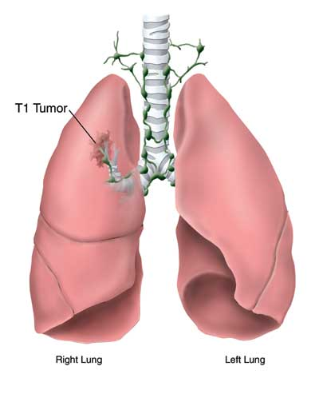
TMN Staging system for Lung Cancer
T= Tumors : tumor size, (local invasion)
N= Node : node involvement (size and type)
M= Metastasis : general involvement in organs and tissues
Notes:
The TNM staging system is based on 3 parts – T for tumor, N for nodes, and M for Metastases.
T: indicates the size of the primary tumour and its degree of spread into nearby tissues (local invasion)
N: indicates whether or not nearby lymph nodes are involved, the size of the involved nodes and/or how many contain cancer
M: indicates whether or not cancer has spread (metastasized) to distant organs
Additional letters or numbers may be placed after "T", "N" and "M" to provide more specific details.

Slide 28
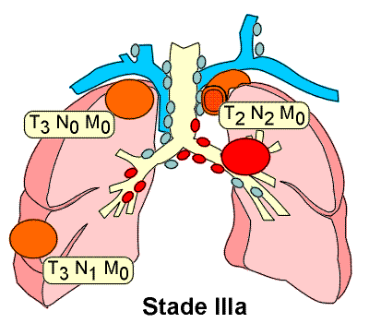
Lung Cancer Staging Continued
T: Tx, T0, Tis, T1-T4 (T3-tumors greater than 7cm, T4 is a tumor of any size)
N: N0, N1, N2, N3
M: M0, M1a, M1b
Notes:
Tx – The tumor size is unknown, or cancer cells are only found in sputum.
T0 – There is no evidence of a primary tumor.
Tis – Tumor in situ – The tumor is present only in the cells lining the airway and has not spread to nearby tissues.
T1 – Tumors less than or equal to 3 cm (1 ½ inches).
T3 – Tumors greater than 7 cm
T4 – A tumor of any size. It is a tumor that invades structures in the chest such as the heart, major blood vessels near the heart, the trachea, the esophagus.
N0 – No nodes are involved.
N1 – The tumor has spread to nearby nodes on the same side of the body.
N2 – The tumor has spread to nodes farther away, but on the same side of the chest.
N3 – The tumor has spread to lymph nodes on the other side of the chest from the original tumor, or has spread to nodes near the collarbone or neck muscles.
M – Metastasis (Spread) to Other Regions
M0 - The tumor has not spread to distant regions.
M1:
M1a – The tumor has spread to the opposite lung, to the lung lining
M1b – The tumor has spread to distant regions of the body, such as the brain or bones.

Slide 29
Stage grouping (AJCC 2002)
T1 T2 T3 T4
N0 IA IB IIB IIIB
N1 IIA IIB IIIA IIIB
N2 IIIA IIIA IIIA IIIB
N3 IIIB IIIB IIIB IIIB

Slide 30
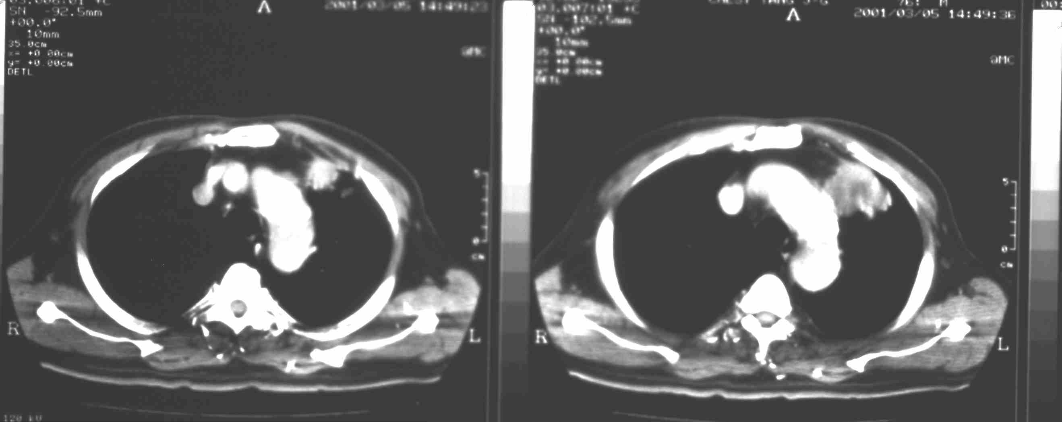
Man, age: 76, cough and BWL

Slide 31
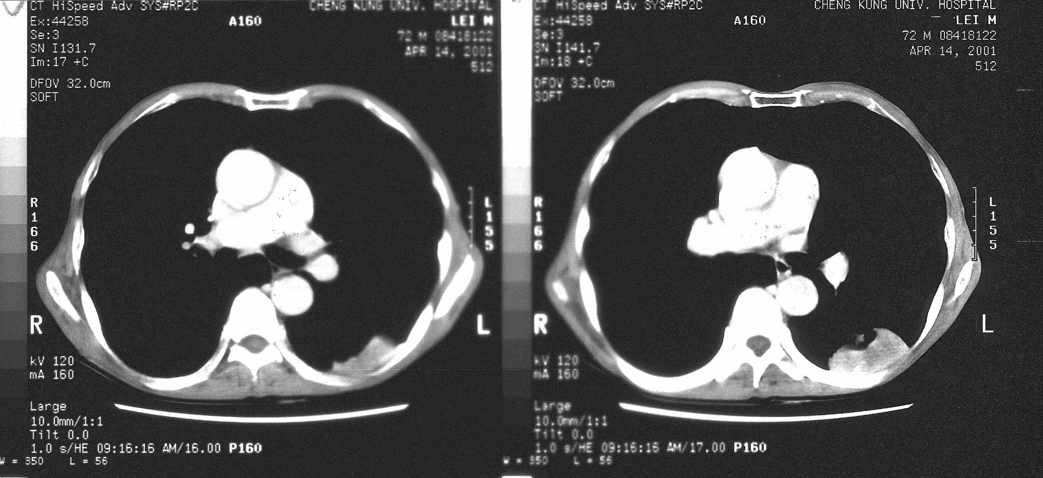
Man, age: 72, LLL

Slide 32
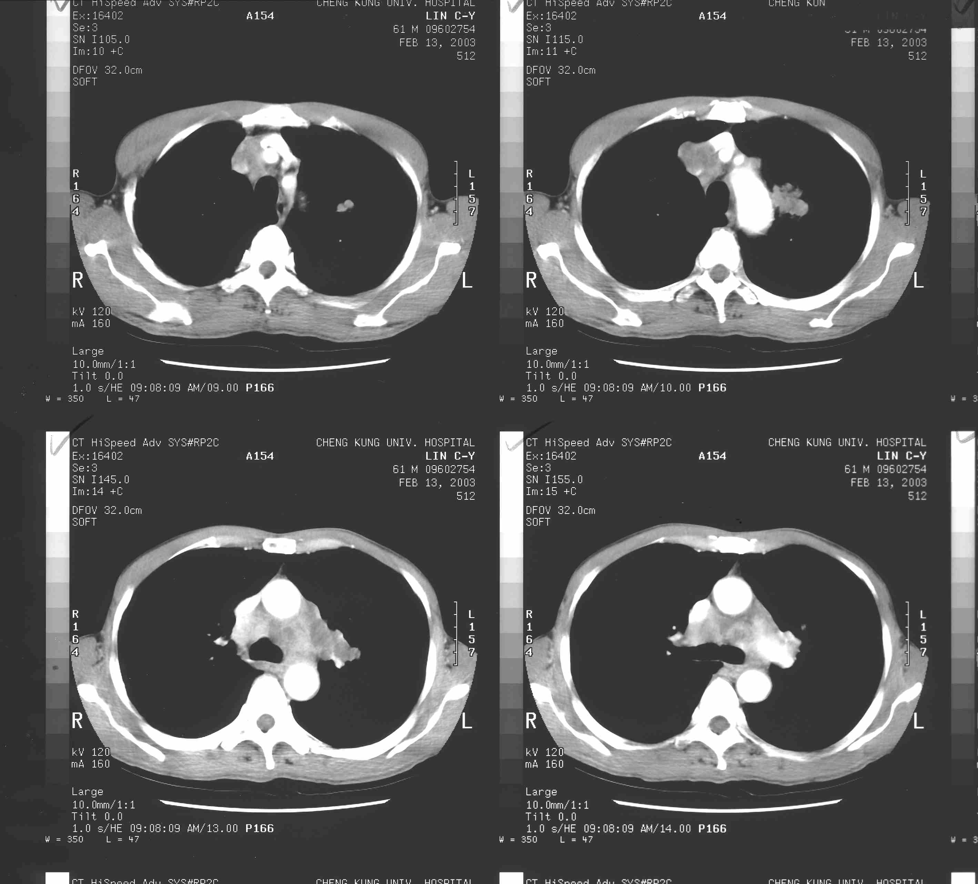
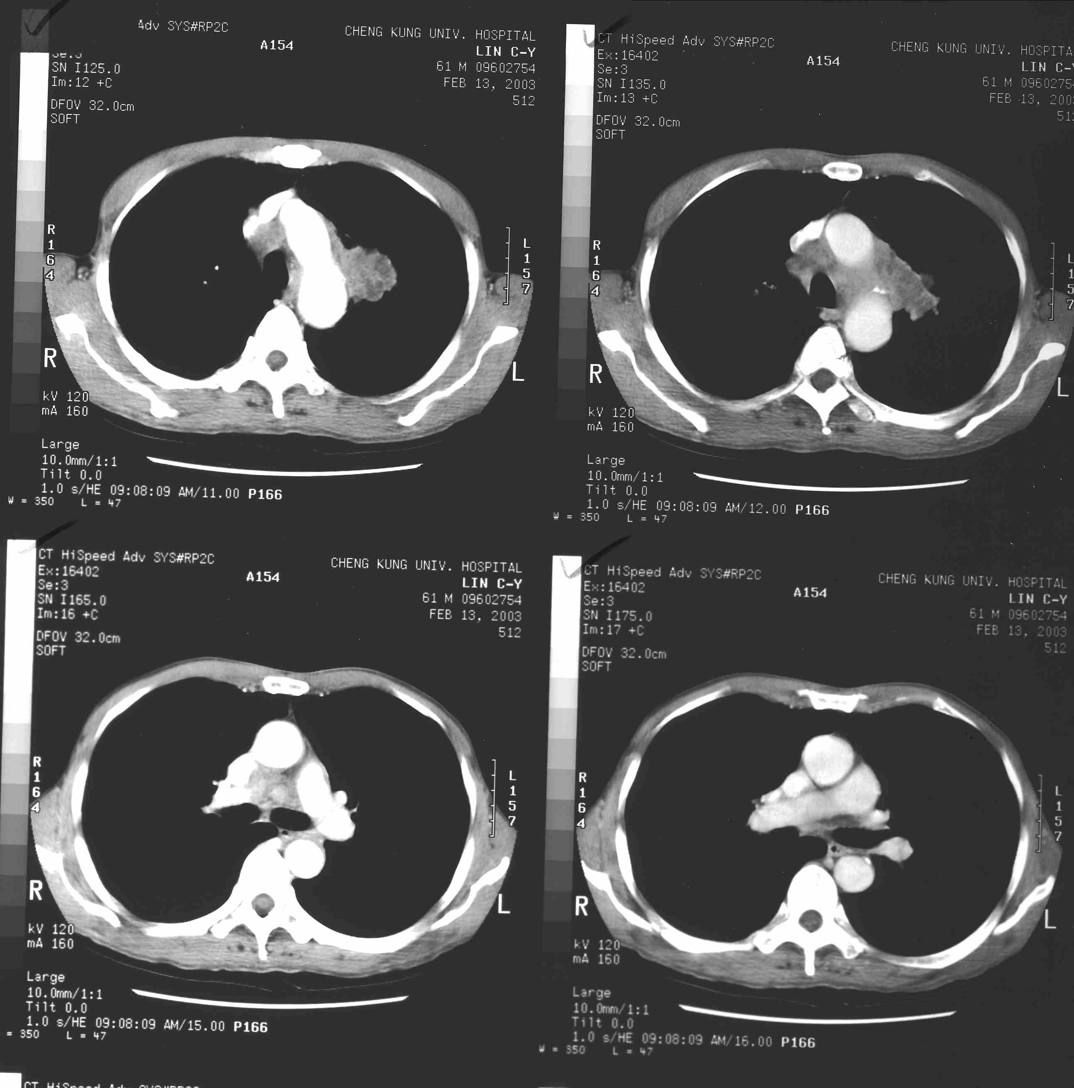
Small cell lung Ca
Limited stage

Slide 33

Woman, age: 68
SVC syndrome

Slide 34
Treatment
Surgery is preferred radical option
‘Resectable’ versus ‘operable’
Radical RT (or SBRT) should be considered even if patient not fit for surgery (‘operable’)
Performance status at diagnosis is crucial:
Grade | Explanation of activity
0 | Fully active, able to carry on all pre-disease performance without restriction
1 | Restricted in physically strenuous activity but ambulatory and able to carry out work of a light or sedentary nature, e.g., light house work, office work
2 | Ambulatory and capable of all selfcare but unable to carry out any work activities. Up and about more than 50% of waking hours
3 | Capable of only limited selfcare, confined to bed or chair more than 50% of waking hours
4 | Completely disabled. Cannot carry on any selfcare. Totally confined to bed or chair
5 | Dead

Slide 35
Medical Management
The three main cancer treatments are:
*surgery (lung resections)
*radiation therapy
*chemotherapy
Other types of treatment that are used to treat certain cancers are hormonal therapy, biological therapy, Immunotherapy, targeted chemotherapy or stem cell transplant.

Slide 36
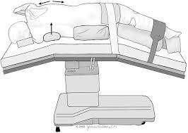
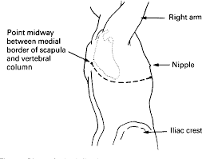
Posterolateral thoracotomy

Slide 37
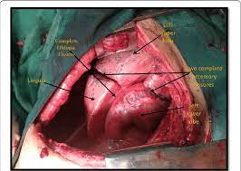
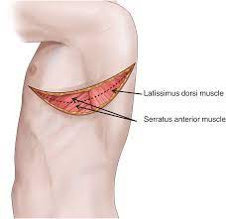

Slide 38
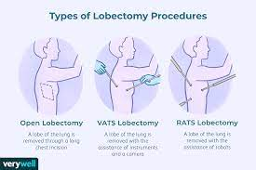
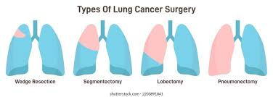

Slide 39
Prognostic Factors
The best estimate on how a patient will do based on:
*type of cancer cells
*grade of the cancer
*size or location of the tumor
*stage of the cancer at the time of diagnosis
*age of the person
*gender
*results of blood or other tests
*a persons specific response to treatment
*overall health and physical condition

