Slide 2
Bladder/Urothelial Carcinoma
Dr Zeeshan Qadeer
Associate Professor
Department of Urology
Rawalpindi Medical University

Slide 3
University Motto, Vision, Values & Goals
Mission Statement
To impart evidence-based research-oriented health professional education
Best possible patient care
Mutual respect, ethical practice of healthcare and social accountability.
Vision and Values
Highly recognized and accredited centre of excellence in
Medical Education, using evidence-based training techniques for development of highly competent health
professionals, who are lifelong experiential learner and are socially accountable.
Goals
The Undergraduate Integrated Learning Program is geared to provide you with quality medical education in an environment designed to:

Slide 4
SEQUENCE OF LGIS
Learning objectives
Core Subject (70%)
Vertical Integration (10%)
Horizontal Integration (15%)
Research (3%)
Biomedical Ethics (2%)

Slide 5
PROF UMER MODEL OF INTEGRATED LECTURE

Slide 6
Learning objectives
Presentation of bladder tumor
Investigate bladder tumor
Staging & grading
Types of bladder tumor
Plan to individualize treatment according to it’s stage

Slide 7
CORE SUBJECT

Slide 8
INCIDENCE
Most common urogenital CA
Male female ratio is 3.8 : 1
Average age is after 60 years
75% of tumor are localized while 25% are metastasized at time of presentation

Slide 9
RISK FACTORS
Cigarette smoking 50%
Occupational exposure 15 % to 35%
Radiotherapy
Bladder schistosomiasis
Synchronous upper tract tumors

Slide 10
SYMPTOMS
Visual painless hematuria with clots
Frequency, urgency
Dysuria
Suprapubic pain
Voiding LUTS
Obstructive uropathy

Slide 11
SIGNS
Anemia
Palpable bladder
Palpable kidneys
On Bimanual examination mass may be palpable in advanced tumors

Slide 12
INVESTIGATIONS
Urine R/E
Urine cytology
USG KUB
Flexible Cystoscopy
CT Scan KUB with contrast
IVU

Slide 13
Diagnosis
Cytology
cytology of urinary sediment is to detect malignant cells.
sensitive in high grade tumors
false negative in 20 % cases

Slide 14
Cystoscopy
Gold Standard procedure for diagnosis.
Tumor mapping is done.
All visible tumor removed and muscle under it resected plus multiple biopsies taken of suspicious sites.

Slide 15
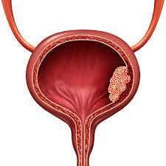

Slide 16
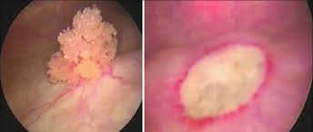
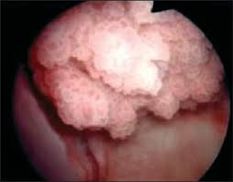

Slide 17
VERTICAL INTEGRATION WITH RADIOLOGY

Slide 18
Radiology
Excretory urography:
It was a conventional method to diagnose bladder tumor but now replaced by CT Scan

Slide 20
CT scans: Tumor extent, nodal metastasis and distant spread
MRI: Same resolution & sensitivity
Pregnant lady
Renal impairment
Findings of CT Scan are equivocal

Slide 21
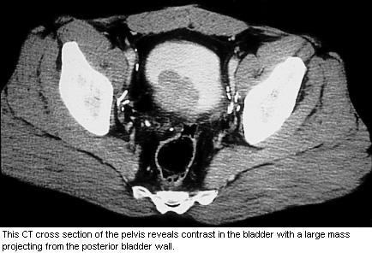

Slide 22
HORIZONTAL INTEGRATION WITH PATHOLOGY, HISTOPATHOLOGY

Slide 23
Pathological types
92% are transitional cell carcinoma
6% as squamous cell carcinoma
2% are adenocarcinomas

Slide 24
Histopathological Grading:
Grade 1:(Well differentiated tumors):
Thin fibro-vascular core, thickened urothelium
More than seven cell layers,
Slight anaplasia, pleomorphism with rare mitotic figures.
Often recur after endoscopic resection

Slide 25
Grade II (Moderately differentiated tumors):
Wide fibro- vascular core with disturbance of base to surface cell maturation
loss of cell polarity
nuclear pleomorphism and frequent mitotic figures
Grade III (Poorly differentiated):
no differentiation of cells
marked nuclear pleomorphism, higher N:C ratio

Slide 26
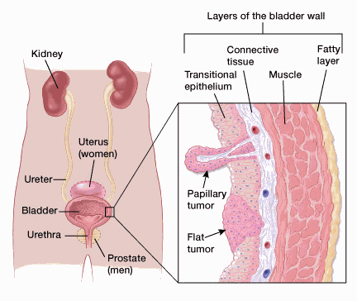

Slide 27
STAGING OF BLADDER TUMOUR (TNM STAGING)

Slide 28
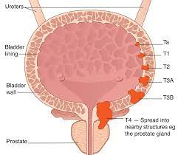

Slide 30
TABLE 1: 2009 TNM CLASSIFICATION OF URINARY BLADDER CANCER
T - Primary Tumour
TX | Primary tumour cannot be assessed
T0 | No evidence of primary tumour
Ta | Non-invasive papillary carcinoma,involving epithelium only
Tis | Carcinoma in situ: ‘flat tumour’
T1 | Tumour invades subepithelial connective tissue
T2 | Tumour invades muscle T2a Tumour invades superficial muscle (inner half) T2b Tumour invades deep muscle (outer half)
T3 | Tumour invades perivesical tissue T3a Microscopically T3b Macroscopically (extravesical mass)
T4 | Tumour invades any of the following: prostate stroma, seminal vesicles, ureterus, vagina, pelvic wall, abdominal wall T4a Tumour invades prostate stroma, seminal vesicles, uterus or vagina T4b Tumour invades pelvic wall or abdominal wall

Slide 31
N - Lymph nodes
NX | Regional lymph nodes cannot be assessed
N0 | No regional lymph-node metastasis
N1 | Metastasis in a single lymph node in the true pelvis (hypogastric, obturator, external iliac or presacral)
N2 | Metastasis in multiple lymph nodes in the true pelvis (hypogastric, obturator, external iliac or presacral)
N3 | Metastasis in a common iliac lymph node(s)
M - Distant Metastasis
M0 M1 | No distant metastasis Distant metastasis

Slide 32
Treatment
For the purpose of treatment, bladder cancer can be grouped in to three major groups:
Superficial / Non Muscle Invasive disease
Muscle Invasive
Metastatic

Slide 33
Non Muscle Invasive Disease
80% of all bladder cancers
Aims of treatment:
To eradicate the primary lesion
To prevent superficial relapse
To prevent progression to muscle invasive and less curable form of disease

Slide 34
Initial management is complete transurethral resection (TURBT)
Depending upon cystoscopic and pathological findings, superficial bladder cancers can be further sub divided in low risk and high risk groups

Slide 35
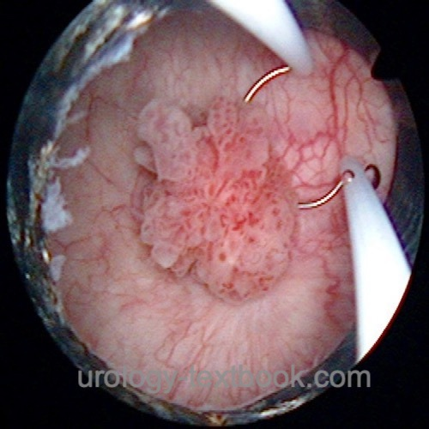

Slide 36
Commonly used intravesical agents:
Drug
Type of risk
Induction Scheme
Toxicity
Mitomycin C
Low risk
Weekly 6-8 wks
Chemical cystitis, skin reactions
BCG
High risk
Weekly x 6 wks
Cystitis, haematuria

Slide 37
Muscle Invasive Disease

Slide 38
Muscle Invasive Disease
Stages T2-T3
Radical Cystectomy + ileal conduit
Radical Cystectomy + Neo-Bladder reconstruction
Radical Cystectomy + ureterosigmoidostomy

Slide 39
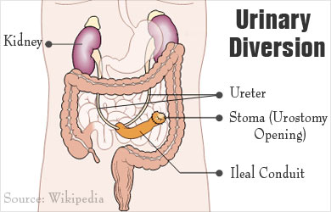

Slide 43
Stage T4 & Metastatic disease
Multimodality treatmentI
It combines TURBT, EBRT and chemotherapy
comparable results to radical cystectomy
Bladder should continuously monitored .
High level of compliance required

Slide 44
Spiral Integration with Family Medicine
Early detection and risk assessment in primary care, especially in high-risk groups (smokers, industrial workers).
Screening strategies and timely referral for patients presenting with hematuria or persistent LUTS.

Slide 45
Biomedical Ethics
Ethical concerns in managing incidental bladder tumors, including patient counseling and decision-making.
Informed consent and quality-of-life considerations for radical cystectomy and bladder reconstruction.

Slide 46
Research
Emerging imaging and molecular diagnostic techniques, such as PET scans and liquid biopsy for bladder cancer.
Advancements in targeted therapies and immunotherapy, including checkpoint inhibitors for metastatic disease.
https://pmc.ncbi.nlm.nih.gov/articles/PMC10886494/

Slide 47
REFERENCES
Campbells urology 12th edition
Smith and Tanaghos urology 9th edition
EAU 2024 guidelines

Slide 48
THANK YOU ☺

