Slide 1
Bladder carcinoma
Renal Module
4th Year MBBS
Dr Kiran Fatima
Pathology Department
Rawalpindi Medical University

Slide 2

MOTTO OF RMU
Wisdom
Truth
Service

Slide 3
VISION OF RMU
THE DREAM/ TOMORROW
To impart evidence based research oriented medical education
To provide best possible patient care
To inculcate the values of mutual respect and ethical practice of medicine

Slide 4
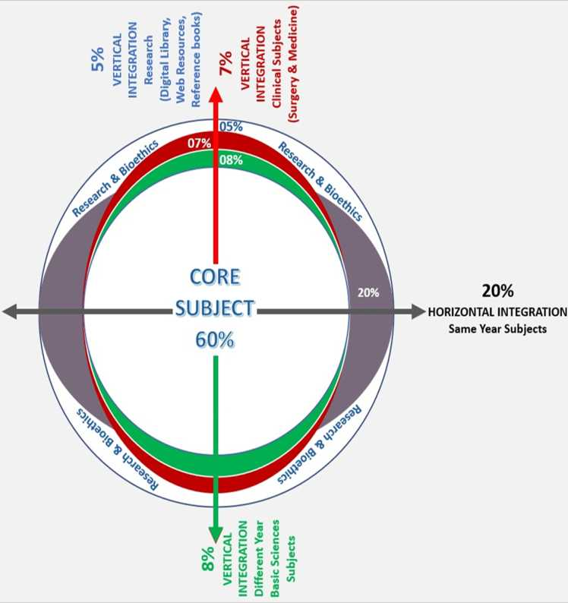

Slide 5
How to use HEC Digital Library
Steps to Access HEC Digital Library
Go to the website of HEC National Digital Library.
On Home Page, click on the INSTITUTES.
A page will appear showing the universities from Public and Private Sector and other Institutes which have access to HEC National Digital Library (HNDL).

Slide 6
4. Select your desired Institute.
5. A page will appear showing the resources of the institution
6. Journals and Researches will appear
7. You can find a Journal by clicking on JOURNALS AND DATABASE and enter a keyword to search for your desired journal.

Slide 7
Learning outcomes
  Classify bladder tumors (urothelial carcinoma, etc.).
  Describe tumor grades & stages.
  Explain risk factors for bladder cancer.
  Outline the molecular mechanisms involved.
  List common signs & symptoms.
  Describe diagnostic methods (cystoscopy, imaging).
  Interpret diagnostic results.
  Outline treatment options (TURBT, cystectomy, etc.).
  Discuss treatment strategies for different stages.

Slide 8
Incidence
Core Content
Second most common cancer of genitourinary tract.
Male female ratio is 3.8;1:0
Women present commonly with muscle invasive
Average age of presentation is 65 years
75% are localized while 25% have spread to regional lymph nodes or metastatised at the time of presentation

Slide 9
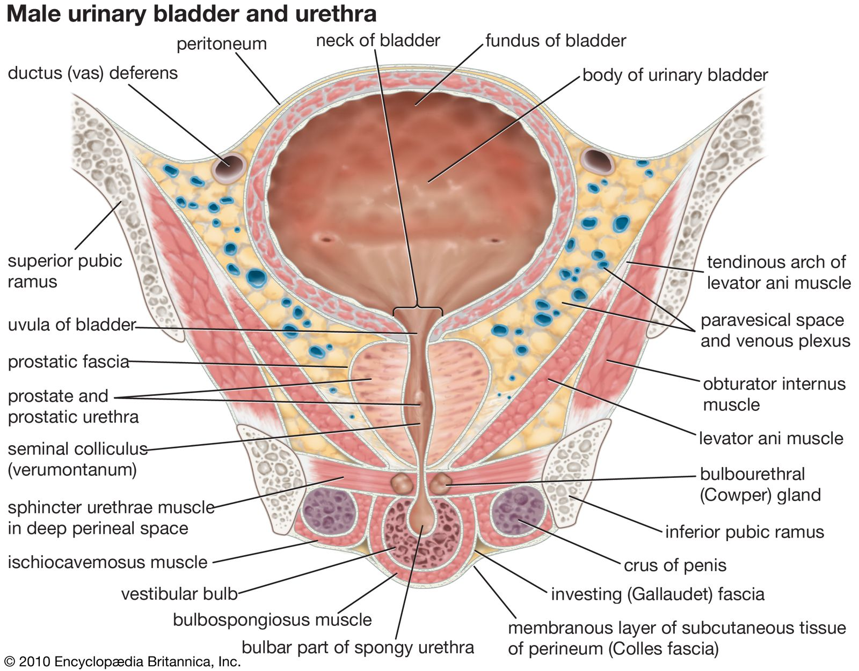
Spiral

Slide 10
Risk factors
Integration Vertical
Cigarette smoking 50%
Occupational exposure 15 % to 35%
Radiotherapy
Bladder schistosomiasis
Synchronous upper tract tumors
Hereditary factoors

Slide 11
Symptoms
Integration Vertical
Early stage
    Asymtomatic
Locally advanced disease
    Obstructive / irritative voiding
    Retention of urine
    Hematuria
    Renal failure
    Pelvic pain

Slide 12
Symptoms
Integration Vertical
Visual painless hematuria with clots
Frequency
Urgency
Dysuria
Suprapubic pain
Pelvic pain
Obstructive uropathy

Slide 13
Signs
Integration Vertical
Anemia
Palpable bladder
Palpable kidneys
On Bimanual examination mass may be palpable in advanced tumors, especially when examined under anaesthesia

Slide 14
Investigations
Integration Vertical
Urine R/E
Urine cytology
USG KUB
Flexible cystoscopy
Excretory phase CT urography
IVU

Slide 15
Pathology
Core Content
92% are transitional cell carcinoma, 6% as squamous cell carcinoma and 2% are adenocarcinomas
Carcinogens:
    Annilinedyes
    Aromatic Amines
    Alfa and Beta naphthylamines (Cigarette Smoke)
Beta-naphthylamines in cigarrete smoke
Radiotherapy
Schistosomiasis

Slide 16
Grading
Integration Vertical
Grade 0 (Papillary lesion):
  Fine fibro- vascular core,
  Covered by normal bladder mucosa and
  Never recurs after endoscopic resection
Grade 1:(Well differentiated tumors):
  Thin fibro- vascular core, thickened urothelium
  More than seven cell layers,
  Slight anaplasia, pleomorphism with rare mitotic figures.
  Often recur after endoscopic resection

Slide 17
Grading-cont
Integration Vertical
Grade II (Moderately differentiated tumors):
  Wide fibro- vascular core with disturbance of base to surface cell maturation
  loss of cell polarity
  nuclear pleomorphism and frequent mitotic figures
Grade III (Poorly differentiated):
  no differentiation of cells
  marked nuclear pleomorphism, higher N:C ratio & frequent mitotic figures

Slide 18
Diagnosis
Integration Vertical
Cytology:
Microscopic cytology of urinary sediment or saline bladder to detect malignant cells. (saline bladder washes more accurate)
Microscopic cytology is more sensitive in high grade tumours or carcinoma in situ but can be falsely negative in 20% of cases.

Slide 19
Cystoscopy
Integration Vertical
Gold Standard procedure for diagnosis and staging - cystosocpy and bimanual examination under anesthesia (EUA) before and after resection.
Tumour mapping done first
All visible tumour removed and muscle under it resected plus multiple biopsies taken of suspicious sites.

Slide 20
Cystoscopy-cont
Integration Vertical
Random biopsies from normal areas of bladder to detect field change are controversial
Except in patients with a positive urine cytology with no obvious tumour.
Tumour encroaching the ureteral orifice: resection without fulguration with D-J stent.
Tumor in diverticulum: Biopsy only - high risk of perforation.

Slide 21
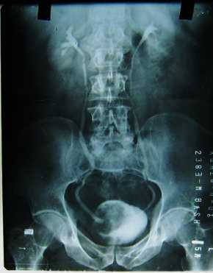

Slide 22
Radiology
Integration Vertical
Excretory urography: In every case, to examine the upper urinary tracts for associated urothelial tumours, to rule out ureteral obstruction and other upper tract abnormalities that may affect management decisions.

Slide 23
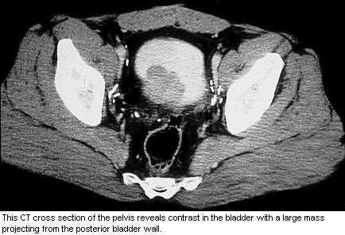

Slide 24
Integration Vertical
CT scans: Tumour extent, nodal metastasis and distant spread (Accuracy in nodal mets- 40-70%)
MRI: Same resolution, better sensitivity
CT and MRI are the imaging techniques used
Extant of local tumor invasion
Tumor spread to lymph nodes
Tumor spread to the upper tract and distant spread(lung,liver,bones ,peritoneum,pleura and adrenals)
Chest X-Ray: Routine
Bone scan: in symptomatic patients

Slide 25
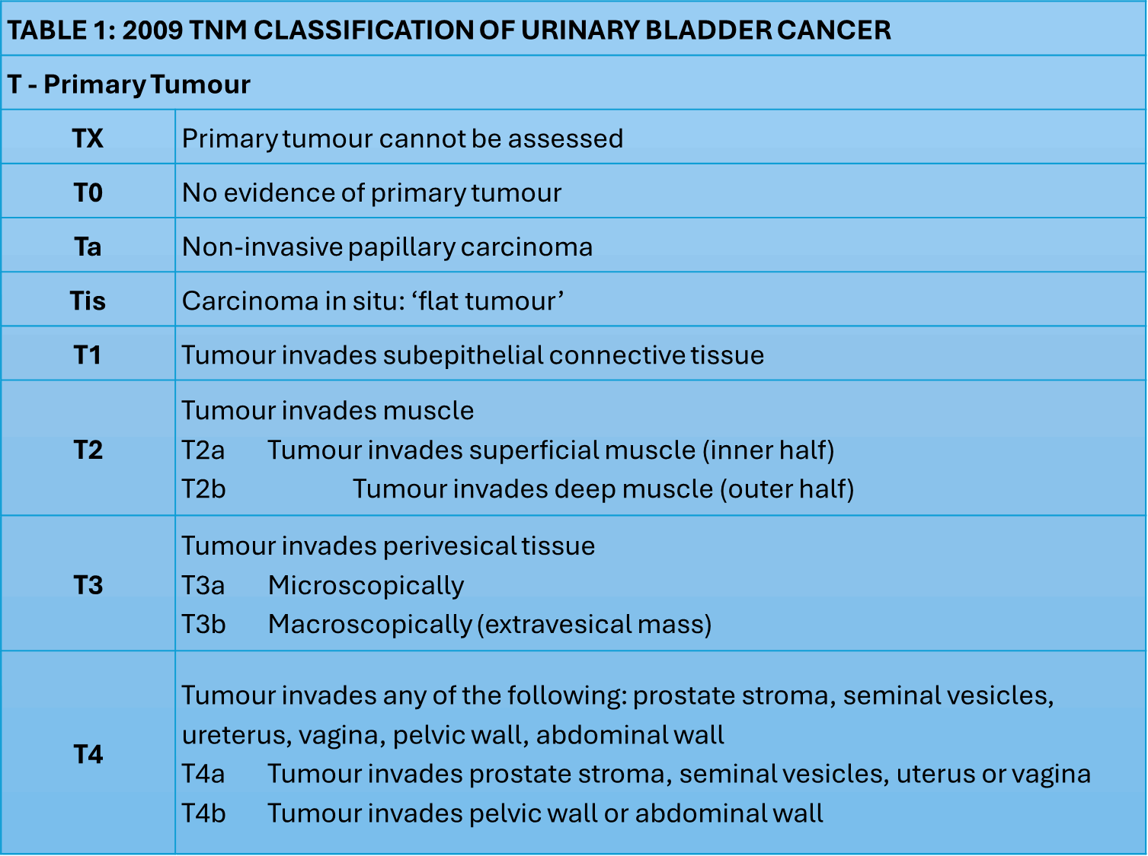

Slide 26
TABLE 1: 2009 TNM CLASSIFICATION OF URINARY BLADDER CANCER
T - Primary Tumour
TX | Primary tumour cannot be assessed
T0 | No evidence of primary tumour
Ta | Non-invasive papillary carcinoma
Tis | Carcinoma in situ: ‘flat tumour’
T1 | Tumour invades subepithelial connective tissue
T2 | Tumour invades muscle T2a Tumour invades superficial muscle (inner half) T2b Tumour invades deep muscle (outer half)
T3 | Tumour invades perivesical tissue T3a Microscopically T3b Macroscopically (extravesical mass)
T4 | Tumour invades any of the following: prostate stroma, seminal vesicles, ureterus, vagina, pelvic wall, abdominal wall T4a Tumour invades prostate stroma, seminal vesicles, uterus or vagina T4b Tumour invades pelvic wall or abdominal wall
Integration Vertical

Slide 27
N - Lymph nodes
NX | Regional lymph nodes cannot be assessed
N0 | No regional lymph-node metastasis
N1 | Metastasis in a single lymph node in the true pelvis (hypogastric, obturator, external iliac or presacral)
N2 | Metastasis in multiple lymph nodes in the true pelvis (hypogastric, obturator, external iliac or presacral)
N3 | Metastasis in a common iliac lymph node(s)
M - Distant Metastasis
M0 M1 | No distant metastasis Distant metastasis
Integration Vertical

Slide 28
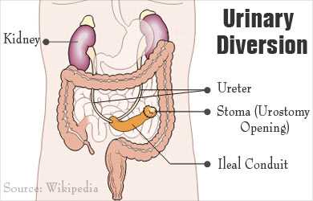

Slide 29
Treatment
Integration Horizontal
For the purpose of treatment, bladder cancer can be grouped in to three major groups:
Superficial / Non Muscle Invasive disease
Muscle Invasive
Metastatic

Slide 30
Non muscle invasive disease
Core Content
80% of all bladder cancers
Aims of treatment:
To eradicate the primary lesion
To prevent superficial relapse
To prevent progression to muscle invasive and less curable form of disease
Initial management is complete transurethral resection
Depending upon cystoscopic and pathological findings, superficial bladder cancers can be further sub divided in low risk group and high risk group

Slide 31
Integration Vertical
Commonly used intravesical agents:
Drug
Dose
Induction Scheme
Toxicity
Mitomycin C
20-60 mg
Weekly 6-8 wks
Chemical cystitis, skin reactions
BCG
80 mg
Weekly x 6 wks
Cystitis, haematuria

Slide 32
Muscle invasive bladder cancer
Integration Vertical
Stages T2-T3
Radical Cystectomy + ileal conduit
Radical Cystectomy + Neo-Bladder reconstruction
Radical Cystectomy + ureterosigmoidostomy
Radiotherapy (alone) does not cure locally invasive disease

Slide 33
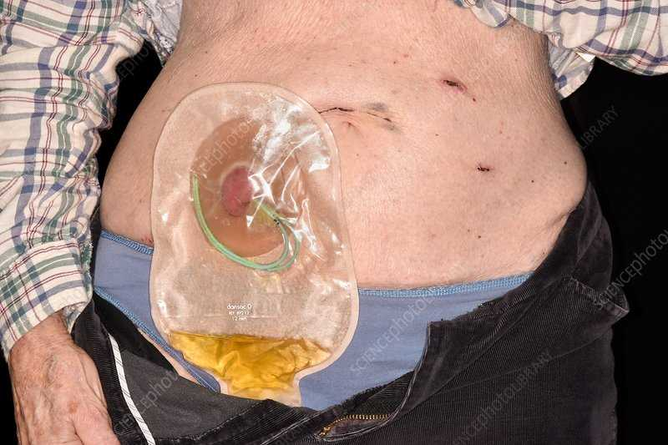

Slide 34
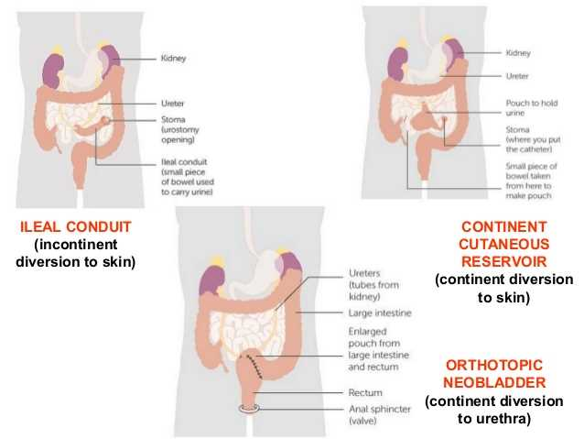

Slide 35
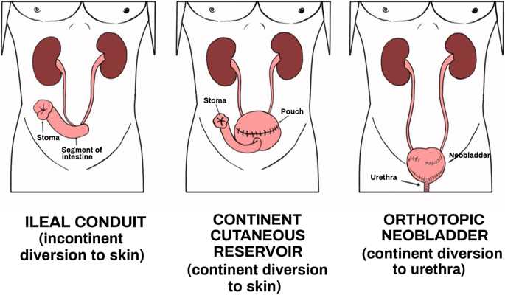

Slide 36
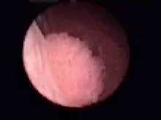

Slide 37
Muscle invasive bladder cancer
Core Content
Stages T4 and metastatic disease
Chemotherapy; responses to single drugs short-lived and incomplete
Greater success with combination of drugs e.g. M-VAC
Treatment is toxic but selected patients have shown long-term and complete responses
Notes:
Recent advances in chemotherapy have resulted in complete or partial responses in 50-70% of patients. Combination regimens result in 10-15% enjoying long-term disease-free survival.
M-VAC (Methotrexate, vinblastine, doxorubicin, and cisplatin) - Complete response in 36% of pts. Median survival for CR’s approx 38 months cf 8/12 for non-responders (FRCS 8)

Slide 38
Core Content
First line treatment for fit patients
Cisplatin based chemotherapy CG (cisplatin and gemcitabine)
PCG(paclitaxel,cisplatin,gemcitabine)
MVAC(methotrexate,vinblastine,adriamycineand cisplatin)

Slide 39
Role of pre and postop radiotherapy
Core Content
CONCLUSIONS
No data exist to support that pre-operative radiotherapy for operable MIBC increases survival. | 2a
Pre-operative radiotherapy for operable MIBC, using a dose of 45-50 Gy in fractions of 1.8-2 Gy, results in down-staging after 4-6 weeks. | 2
Limited high-quality evidence supports the use of pre-operative radiotherapy to decrease local recurrence of MIBC after radical cystectomy | 3

Slide 40
Multimodality treatment
Integration horizontal
It combines TURB,EBRT and chemotherapy
It has got compareable results to the radical cystectomy
Bladder should continuously monitored .
High level of patient compliance is required

Slide 41
Research
https://www.cancer.gov/types/bladder/research/articles
Bladder Cancer Trial Finds Extended Lymph Node Surgery Doesn’t Improve Survival
Posted: November 6, 2024
A randomized clinical trial comparing two types of surgery in people with localized muscle-invasive bladder cancer found that more extensive surgery removing a larger group of lymph nodes did not improve survival, compared with standard lymph node surgery.
Immunotherapy after surgery helps people with high-risk bladder cancer live cancer-free longerPosted: September 16, 2024
An NCI trial shows that giving patients pembrolizumab after surgery for high-risk muscle invasive bladder cancer doubles the median length of time that they remain cancer free, compared with observation alone after surgery.
Groundbreaking Trial Results Expand Treatment Options for Some People with Bladder CancerPosted: November 30, 2023
For the first time in decades, people with advanced bladder cancer have more effective treatment options. New clinical trial results mark a pivotal moment following years of little progress, bladder cancer experts believe.

Slide 42
Family medicine
A 65-year-old male smoker presents with painless hematuria (blood in the urine). He has a history of recurrent urinary tract infections. Which of the following is the MOST likely diagnosis?
Renal cell carcinoma
b) Benign prostatic hyperplasia (BPH)
c) Bladder cancer
d) Kidney stones

Slide 43
Take home message
Bladder cancer most often affects older adults, with smoking being a major risk factor.
Painless hematuria is the most common presenting symptom.
Diagnosis often involves cystoscopy and biopsy.
Treatment varies depending on the stage and grade of the tumor, and can include surgery, chemotherapy, and radiation.

Slide 44
THANK YOU

