Slide 1


Slide 2


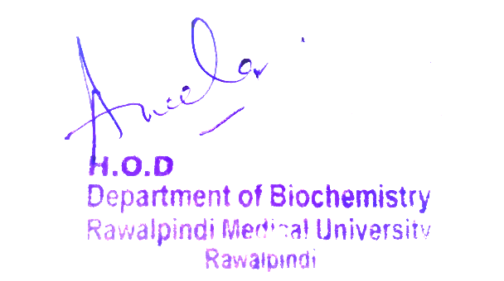
Blood and Immunity Module
1st Year MBBS(LGIS)
Acute phase proteins, Ceruloplasmin
Presenter: Dr Uzma Zafar Date: 01-02-25
Dept of Biochemistry
RMU

Slide 3
Motto, Vision, Dream
To impart evidence based research oriented medical education
To provide best possible patient care
To inculcate the values of mutual respect and ethical practice of medicine
Wisdom
Truth
Service

Slide 4
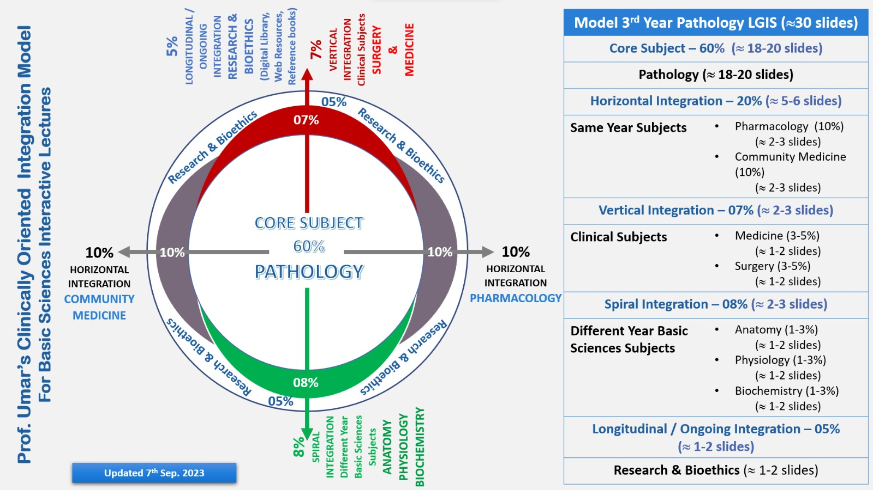
Professor Umar Model of Integrated Lecture

Slide 5
Learning Objectives
At the end of this session students should be able to
Discuss different acute phase proteins
Discuss role of ceruloplasmin in iron transport
Integrate anatomical and physiological aspects

Slide 6
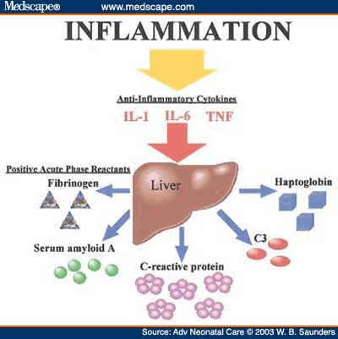
Core Knowledge
Acute phase proteins
Proteins which level increase in plasma, in response to acute inflammatory states, or secondary to tissue damage
These are
C- reactive protein (CRP)
Alpha-1 antitrypsin
Haptoglobin
Fibrinogen
Their levels rise to a variable extent 50% to 1000 fold (CRP) in chronic inflammatory states in cancer

Slide 7
Core Knowledge
Alpha-1 antitrypsin can neutralize proteases released due to acute inflammation
C- reactive proteins (CRP) can stimulate classic complement pathway
C reactive protein (CRP) is used as biomarker of
Tissue injury
Infection
Inflammation
Cancer
People have high risk of heart attack

Slide 8
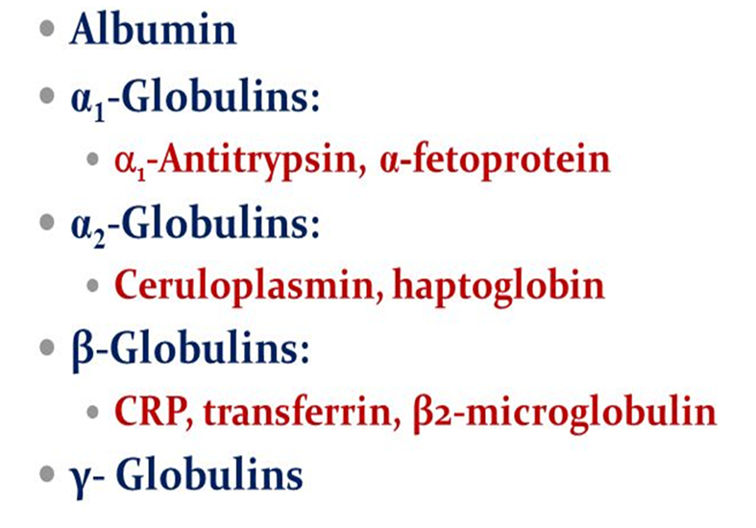
Core Knowledge
Types
of plasma
globulin

Slide 9
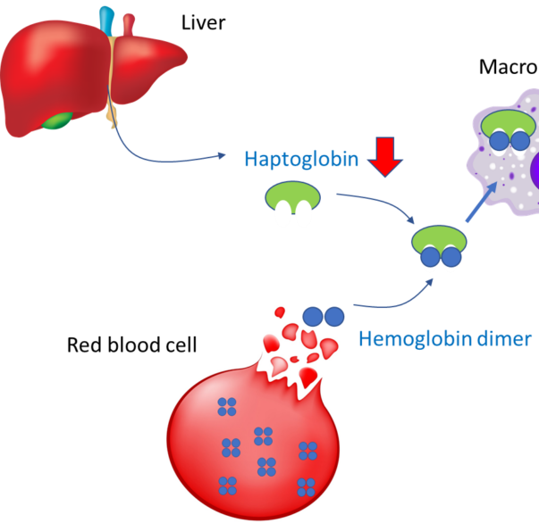
Core Knowledge
Haptoglobin
Haptoglobin (Hp) is a plasma alpha2 globulin that binds extracorpuscular hemoglobin (Hb) in a tight noncovalent complex (Hb-Hp), preventing free hemoglobin from entering the kidney

Slide 10
Core Knowledge
Approximately 10% of the hemoglobin that is degraded each day is released into the circulation and is thus extracorpuscular
The other 90% is present in old, damaged red blood cells, which are degraded by cells of the MPS

Slide 11


Core Knowledge
Hemoglobin
Hb
10%
Release in circulation
Extracorpuscular
90%
Degraded by MPS
Bind with haptoglobin
HP
Hb-Hp

Slide 12
Core Knowledge
Following intravascular haemolysis
Haemoglobin (Hb) is bound by haptoglobin and taken up by MPS
When haptoglobin stores are depleted
Heme is released from Hb and is bound by hemopexin
The heme-hemopexin complex is cleared by macrophages and hepatocytes
If haemolysis overwhelms the capacity of both haptoglobin and hemopexin, then heme remains within the circulation

Slide 13
Core Knowledge
Hemopexin (HPX) is the plasma protein with the highest binding affinity to heme among known proteins. It is mainly expressed in liver, and belongs to acute phase reactants, the synthesis of which is induced after inflammation

Slide 14

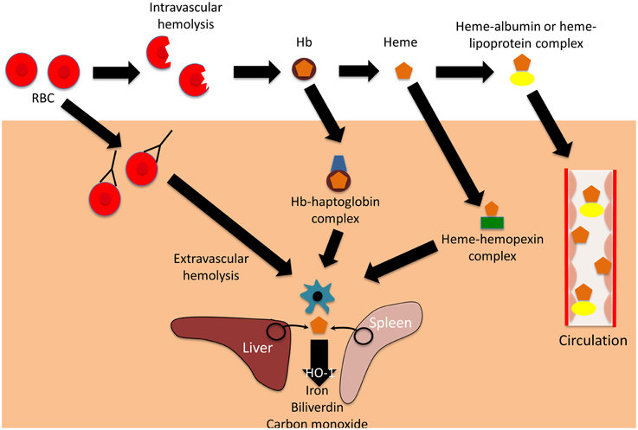
Core Knowledge
Steps
following
intravascular
hemolysis

Slide 15
Core Knowledge
Different fates of free hemoglobin and of the hemoglobin-haptoglobin complex
The levels of haptoglobin in human plasma vary and are of some diagnostic use
Low levels of haptoglobin are found in patients with haemolytic anaemia
This is explained by the fact that, in contrast to haptoglobin, which has a half-life of around 5 days, the Hb-Hp complex has a half-life of roughly 90 minutes due to the complex's quick removal from plasma by hepatocytes

Slide 16
Core Knowledge
Thus, when haptoglobin is bound to hemoglobin, it is cleared from the plasma about 80 times faster than normally
Accordingly, the level of haptoglobin falls rapidly in situations where hemoglobin is constantly being released from red blood cells, such as occurs in hemolytic anemias
Haptoglobin is an acute phase protein, and its plasma level is elevated in a variety of inflammatory states

Slide 17
Core Knowledge
Molecular mass of Hb- Hp 155000
Free Hb can pass the glomerulus of kidney and can precipitate in tubule or pass in urine, but Hb- Hp complex can prevent loss of Hb and therefore iron is not lost
Haptoglobin exist in three polymorphic forms
Hp- 1-1
Hp- 2-1
Hp 2-2
These can be separated by electrophoresis

Slide 18
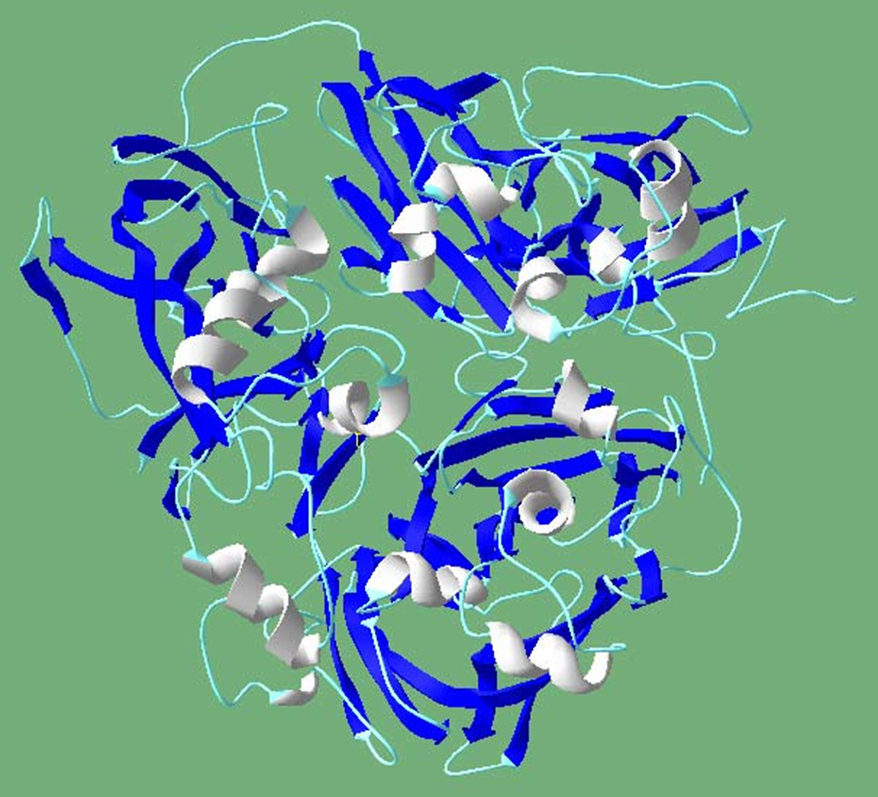
Core Knowledge
Ceruloplasmin
alpha2- globulin, blue colored due to excessive copper, one molecule binds 6 copper atoms
Ceruloplasmin binds 90% copper tightly which is not readily exchangeable, 10% of copper binds to albumin loosely which is readily exchangeable
So albumin is more important in copper transport

Slide 19
Core Knowledge
Ceruloplasmin is a plasma protein synthesized in liver
It stores and carries the mineral copper around your body
Copper is vital to many processes in your body
Ceruloplasmin also posses copper dependent oxidase activity which is involved in oxidation of iron Fe++ to Fe+++
Normal level 20-60 mg/dl
Ceruloplasmin level decreases in Wilson's disease
Excessive copper is dangerous

Slide 20

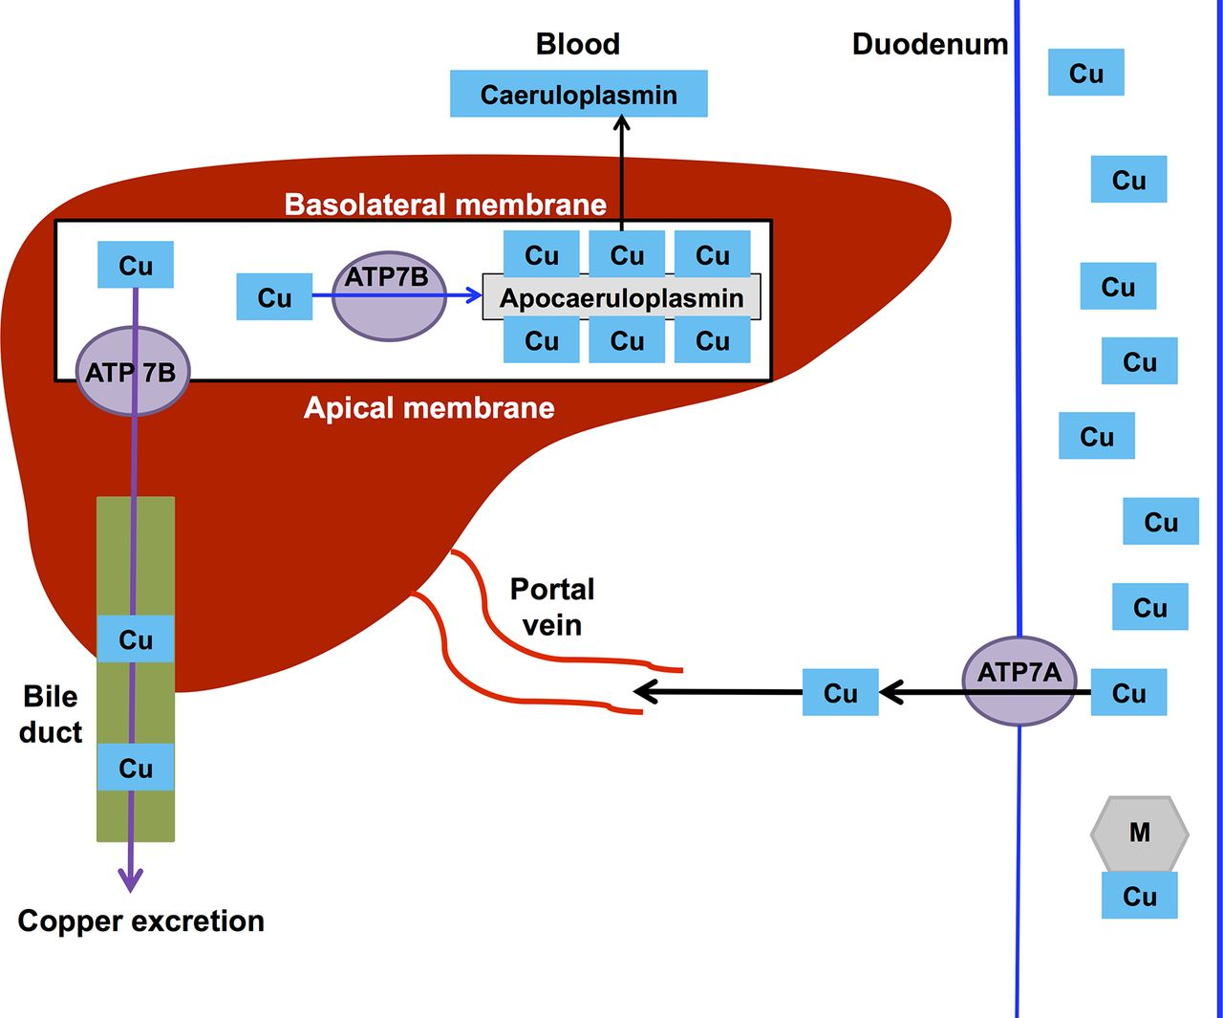
Core Knowledge
Copper metabolism
Copper is carried to liver by albumin and part of it is excreted in bile
Copper leaves liver bound with aceruloplasmin which is synthesized in liver

Slide 21
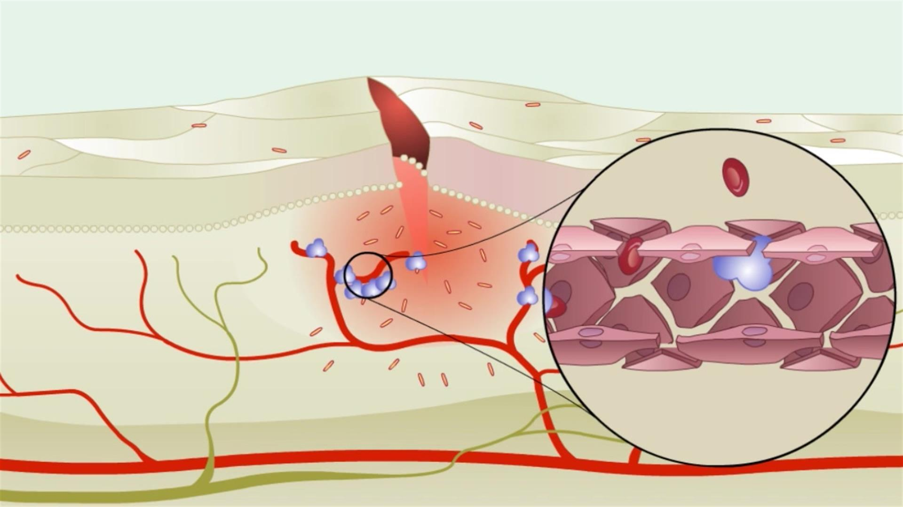
Horizontal Integration

Slide 22
Vertical Integration
Menkes Disease

Slide 23
Spiral Integration
Family Medicine
Family Medicine plays important role in following manner:
Diagnosis
Education & Counselling
Dietary Guidance
Monitoring
Refer to Specialists

Slide 24
Spiral Integration
Bioethics
Ethical Considerations
From an ethical standpoint, the scenario raises considerations regarding patient autonomy, informed consent, and confidentiality
The physician must ensure that patient fully understands her diagnosis, treatment options, and potential implications
Discuss the necessity of a healthy lifestyle & treatment plan. This requires clear communication and understanding of risks and benefits.
Additionally, the physician must respect patient’s privacy and confidentiality throughout the diagnostic and treatment process

Slide 25
Spiral Integration
Artificial Intelligence
Role of AI in Management
AI can potentially aid in enhancing diagnostic accuracy and efficiency.
AI-powered decision support systems can also help clinicians in selecting appropriate treatment modalities
AI-driven predictive models may help anticipate the risk of complications of the Disease in susceptible populations

Slide 26
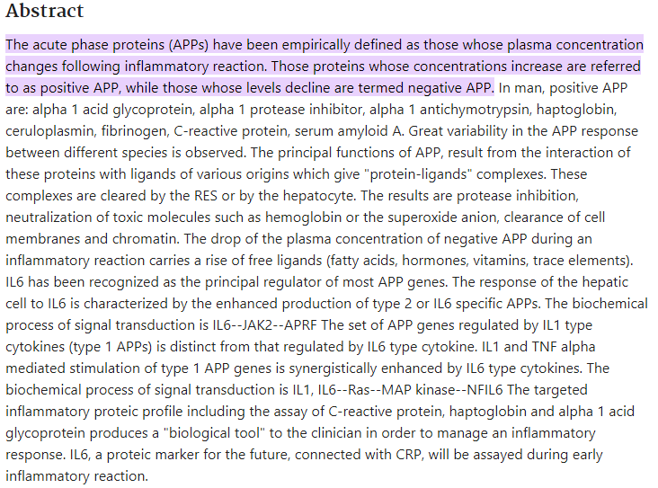
Spiral Integration
Research Article

Slide 27
How To Access Digital Library
Steps to Access HEC Digital Library
Go to the website of HEC National Digital Library
On Home Page, click on the INSTITUTES
A page will appear showing the universities from Public and Private Sector and other Institutes which have access to HEC National Digital Library HNDL
Select your desired Institute
A page will appear showing the resources of the institution
Journals and Researches will appear
You can find a Journal by clicking on JOURNALS AND DATABASE and enter a keyword to search for your desired journal

Slide 28
Learning Resources
Harper's Illustrated Biochemistry,
(Edition 30, chapter 52,
Pages 630- 332, 634)
Related articles
Google images

Slide 29
THANK YOU

