Slide 1


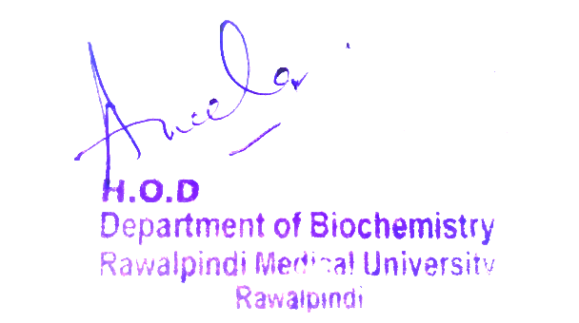
Respiratory Module
1st Year MBBS(LGIS)
Xenobiotics
Presenter: Dr Uzma Zafar Date: 01-02-25
Dept of Biochemistry
RMU

Slide 2
Motto, Vision, Dream
To impart evidence based research oriented medical education
To provide best possible patient care
To inculcate the values of mutual respect and ethical practice of medicine
Wisdom
Truth
Service

Slide 3
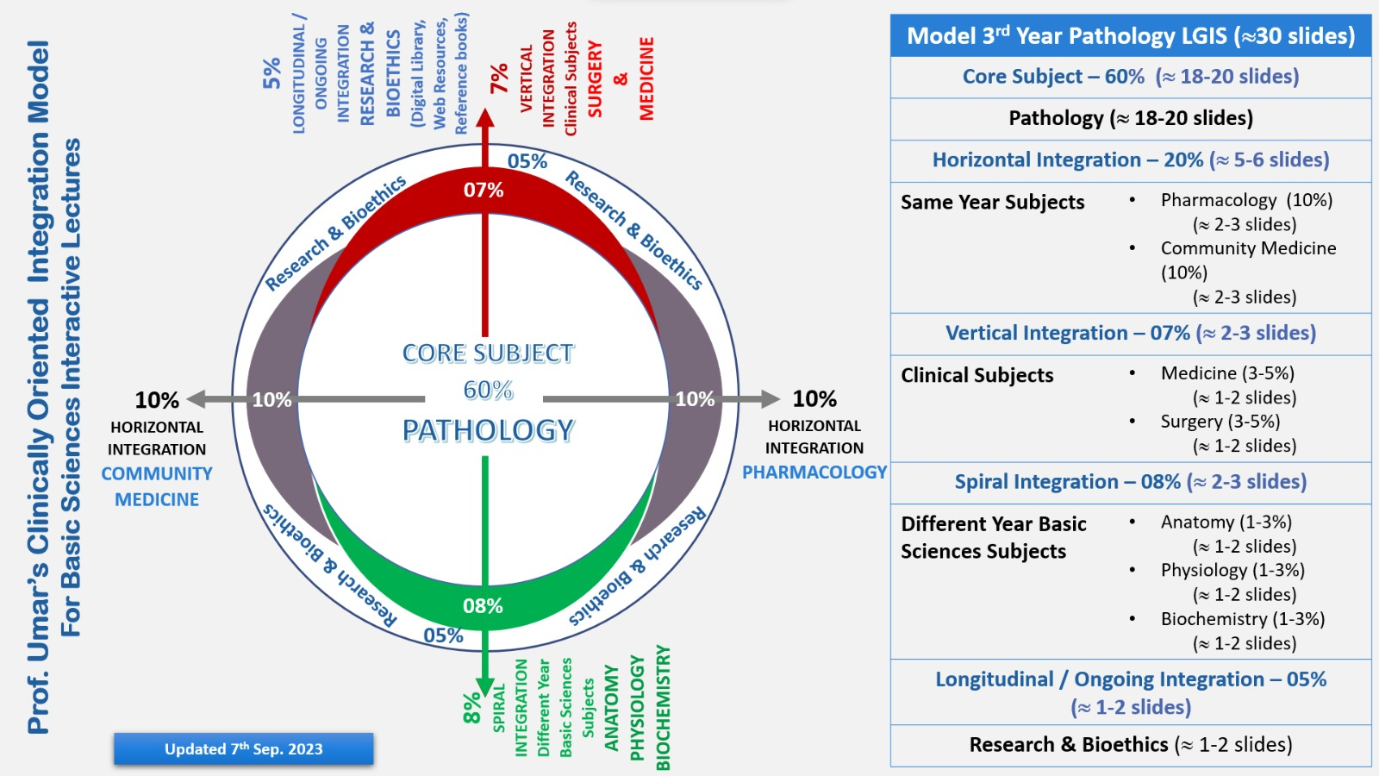
Professor Umar Model of Integrated Lecture

Slide 4
Learning Objectives
At the end of this session students should be able to
Define & describe the metabolism of xenobiotics
Describe the metabolism of xenobiotics Understand the mechanisms of detoxification.
Identify the types of enzymes involved in xenobiotic metabolism

Slide 5
Core Knowledge
Xenobiotics
Xenobiotics can be-
Exogenous- Foreign molecules which enter in the Human body via dietary food or in form of certain medications used for a therapeutic cause or even inhaled via environment Examples- Drugs, food additives, Environmental pollutants, pesticides, chemical carcinogens
Endogenous – Though they are not foreign substances but having effects similar to exogenous xenobiotics. These are synthesized in our body or produced as metabolites of various processes in the body. Examples-Bilirubin, Bile acids, Steroids, Eicosanoids and certain fatty acids

Slide 6
Metabolism of Xenobiotics
Core Knowledge
Metabolism of xenobiotics occurs in two phases
Phase 1, Major Reaction is Hydroxylation,catalyzed by Hepatic mono-oxygenase or cytochrome p450
Oxidation
Reduction…….Other types of Phase-1 reactions
Phase 1 Reactions result in Metabolic Activation of that Xenobiotic, resulting in formation of less toxic compounds known as Detoxification OR toxicity of Xenobiotics is sometimes even further enhanced known as Entoxication

Slide 7
Core Knowledge
Metabolism of Xenobiotics
Conjugation Reactions Phase- 2
The Hydroxylated compounds of Phase- 1 reactions Conjugate with a conjugating agent producing Phase-2 Reactions Catalysed by specific enzymes which convert them into water soluble form and are then excreted.
Major Phase-2 reactions include
SULFATION
ACETYLATION
GLUCURONIDATION
METHYLATION

Slide 8
Core Knowledge
Biotransformation/
Detoxifification Reactions
All the biochemical reactions involved in the conversion of foreign, toxic and water insoluble molecules into LESS toxic, water soluble are called Detoxification / Biotransformation reactions
Overall purpose of Phase-1 and Phase-2 reactions of Xenobiotics metabolism is to increase their water solubility to facilitate their excretion However, In certain situations , this Biotransformation may even Enhances the toxicity of a foreign compound , known as, Entoxication reaction

Slide 9
Core Knowledge
Role of Liver
Liver is the major organ involved along with kidney
Hepatocytes contain wide variety of enzymes to process xenobiotics
Enzymes are present in Hepatic cytosol, Endoplasmic reticulum and in its other cell organelles too
Large number of therapeutic compounds used as Drugs undergo the process of Hydrolysis in Liver usually

Slide 10
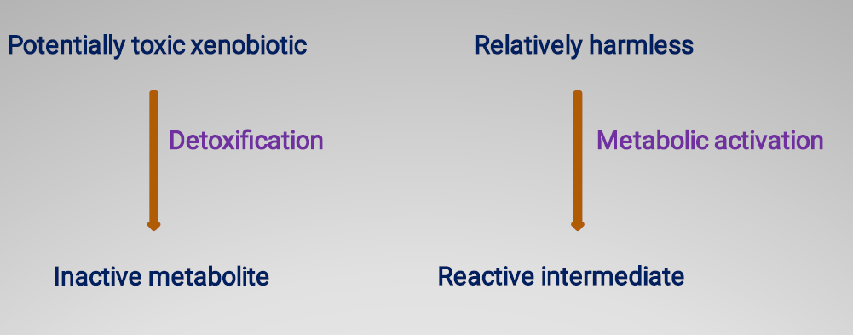
Core Knowledge
Biotransformation

Slide 11
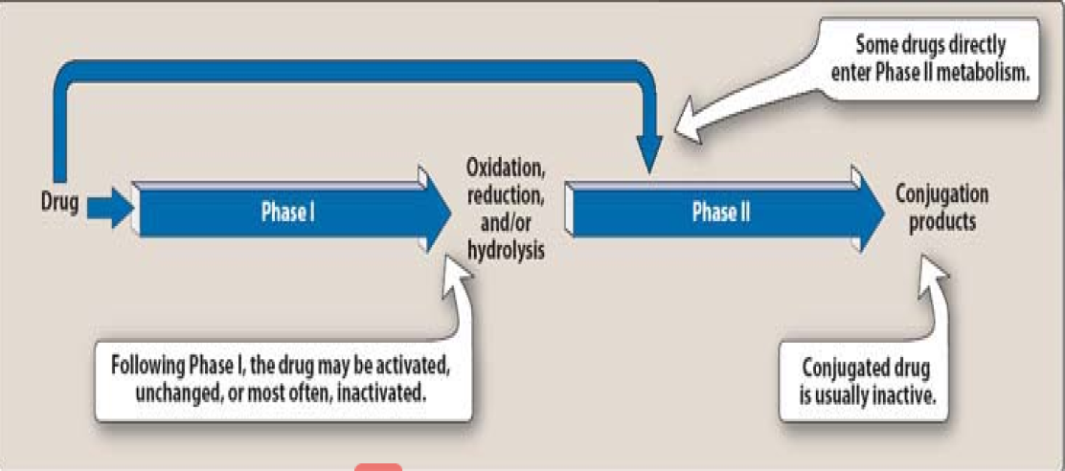
Overview of Detoxification
Reactions
Core Knowledge

Slide 12
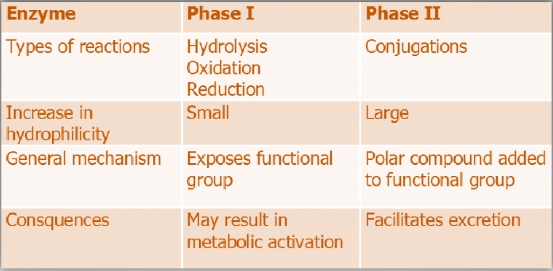
Core Knowledge
Comparing Phase I & Phase II

Slide 13
Phase 1 reactions- Overview
Core Knowledge
Oxidation
Reduction
Hydrolysis/Hydroxylation reactions
A functional group (-0H) is exposed that serves as the active center/base for sequential conjugation in a phase II reaction
Hydroxylation is the major reaction of phase-1, catalyzed by
Mono-Oxygenase/ Cytochrome P 450 species of enzymes

Slide 14
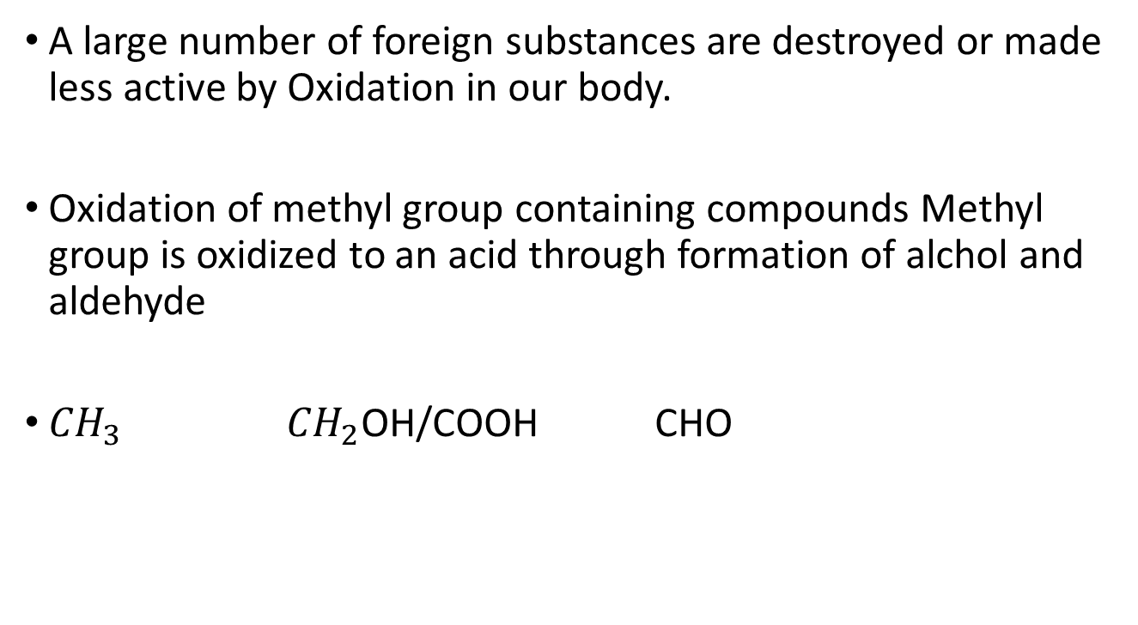
A) Oxidation
Core Knowledge
A large number of foreign substances are destroyed or made less active by Oxidation in our body.
Oxidation of methyl group containing compounds Methyl group is oxidized to an acid through formation of alchol and aldehyde
${CH}_{3}$ ${CH}_{2}$OH/COOH CHO

Slide 15
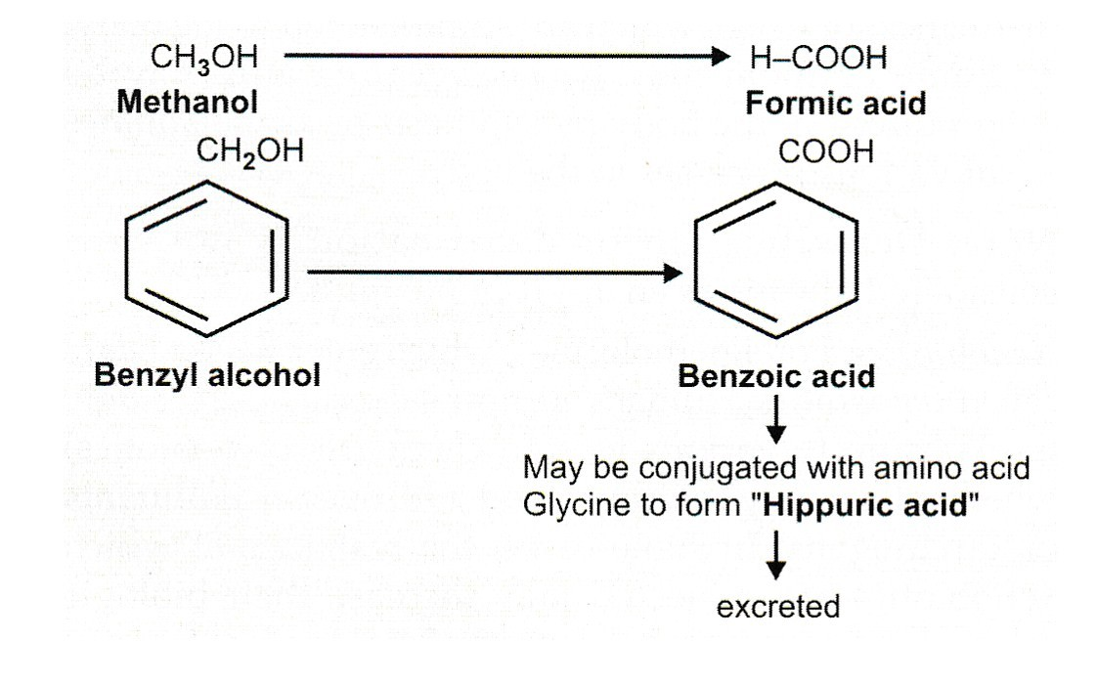

Core Knowledge

Slide 16
B) Reduction
Core Knowledge
Reduction of Nitro compounds into Amines occurs.
P-nitro benzene is an organic compound used in industry such as Rubber
Reduced metabolites may also become more toxic
P-nitro p-Amino benzene
P-nitro phenol p-Amino phenol

Slide 17
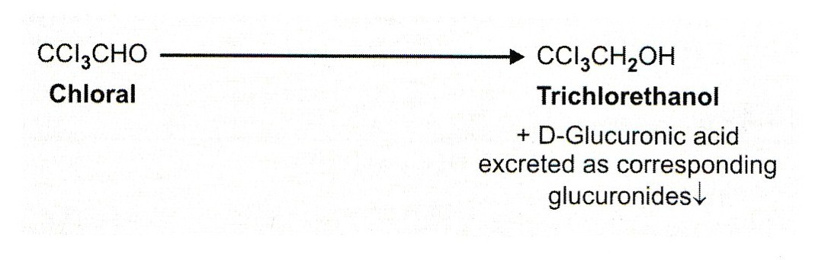
Core Knowledge

Slide 18
C) Hydrolysis
Core Knowledge
Most of the drugs (more than 50%) are detoxicated by Hydrolysis in liver.
Examples:
Acetyl Salicylic A H2o Acetic acid + Salicylic acid
ASPIRIN (Acetyl Salicylic Acid) is a classic example of Hydrolysis.
Aspirin most widely used drug in clinical practice having analgesic, antipyretic and anti-atherogenic effects.

Slide 19
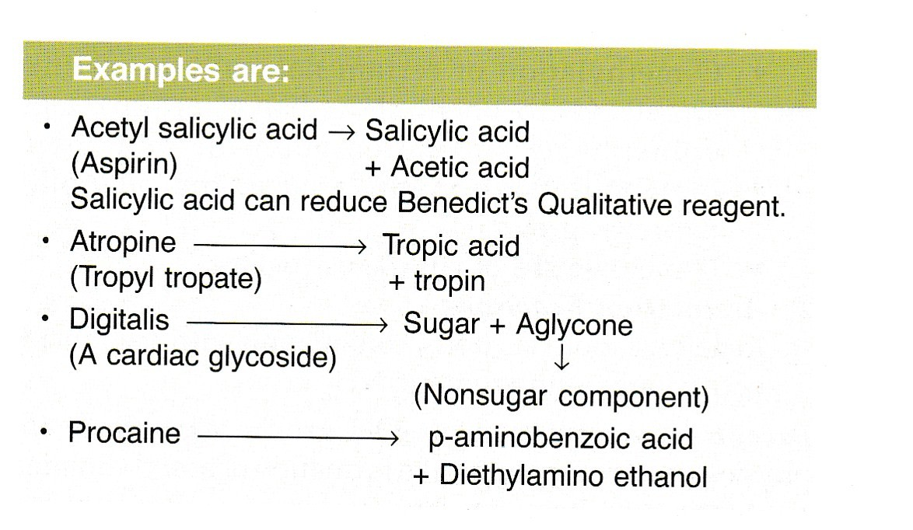
Core Knowledge

Slide 20
Phase 2 - Conjugation
Core Knowledge
Conjugation is a process by which Xenobiotics are coupled with a conjugating agent and are converted to water soluble, non toxic derivatives which are easily excreted in urine can occur independently or can follow phase 1 reactions.
Conjugation takes place primarily in liver and in kidney too.
Conjugation agent is a substance produced or synthesized in the body.
Eight different conjugating agents have been identified in the body.

Slide 21
Types of Phase 2 Reactions
Core Knowledge
Glucuronidation
Sulfation
Acetylation
Methylation
Conjugation with Amino Acids
Conjugation with G-SH

Slide 22
Conjugating Agents
Core Knowledge
Glucuronic Acid
Glycine
Cysteine (of glutathione)
Glutamine
Methyl group
Sulfate
Acetic acid

Slide 23
1) Glucuronidation
Core Knowledge
Glucuronidation is the most important and commonest conjugation reaction.
UDP-glucuronic acid forms as an active D-Glucoronic acid in uronic acid pathway of Glucose metabolism via oxidation of glucose (Non energy yielding pathway)
Enzyme UDP – Glucuronyl Transderase plays a key role in the Glucuronidation.
Compounds conjugate with Glucuronic acid and excreted as Glucuronides such as Bilirubin
Glucuronic acid forms two types of linkages during the conjugation process, an Ether (Glycosidic) linkage and an Ester linkage

Slide 24
2) Sulfation
Core Knowledge
The sulfate donor is adenosine 3’-phosphate-5’-phosphosulfate (PAPS). This compound act as “active sulfate”.
The catalyzing enzyme is Sulfo-Transferase.
Various toxic Aliphatic and Aromatic compounds are conjugated with sulfate (PAPS) include:
Phenols
Cresols
Indole
Steroids
These are formed in the gut by the action of intestinal bactaria and then transported to liver where these conjugate with sulfate to form Ethereal sulfates which are excreted in urine, being less toxic

Slide 25
3) Acetylation
Core Knowledge
Acetylation is represented by
X + Acetyl – CoA -→ Acetyl – X + CoA
Where X represent a xenobiotic.
Acetyl-CoA (active acetate) is the acetyl
These reactions are catalyzed.
Slow acetylators People are more subjected to certain toxic effects of drugs because the drugs persists for longer duration in these individuals.

Slide 26
4) Methylation
Core Knowledge
Methylation is limited in the body though important.
Some Xenobiotics employ S-Adenosyl Methionine (Active Methionine) as an active Methyl group donor.
Reactions are called Transmethylation reactions.
Enzymes catalyzing the reactions are Methyl Transderases.
Methylation reactions also result in Entoxication like Methylation of mercury which makes it more Lipophilic, enhancing its permeability resulting in increased neurotoxicity of the metal.

Slide 27
5) Conjugation with Glutathione
Core Knowledge
Glutathione is a repeptide consisting of (Glutamic Cysteine Glycine acid.
Glutathione is commonly abbreviated GSH (because of the sulfhydryl group of its cysteine, which is the business part of the molecule. Glutathione is important in phase 2 reactions. It is an important intracellular Anti oxidant agent.
A number of potentially toxic xenobiotics ( such as certain carcinogens) are conjugated with the GSH in reactions follows:
R + GSH --→ R-S-G
Where R = xenobiotics.

Slide 28
Physiological aspects of Xenobiotics
Horizontal Integration
Detoxification
Therapeutic Action (Drugs)
Hormonal Disruption
Induction of Enzymes
Generation of Reactive Metabolites
Toxin Elimination

Slide 29
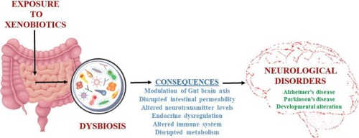
Vertical Integration

Slide 30
Spiral Integration
Family Medicine
Management
Lifestyle: Maintain a low-salt diet, manage weight and abstain from alcohol.
Medications: Diuretics for ascites, beta-blockers for variceal bleeding, lactulose for hepatic encephalopathy.
Surveillance: Regular screening for varices, liver function, and hepatocellular carcinoma.
Complications: Manage ascites (paracentesis), SBP (antibiotics), and consider liver transplant.
Patient Education: Inform about complication signs and the importance of adherence to treatment.

Slide 31
Spiral Integration
Bioethics
Ethical Considerations
From an ethical standpoint, the scenario raises considerations regarding patient autonomy, informed consent, and confidentiality
The physician must ensure that patient fully understands her diagnosis, treatment options, and potential implications
Discuss the necessity of a healthy lifestyle & treatment plan. This requires clear communication and understanding of risks and benefits.
Additionally, the physician must respect patient’s privacy and confidentiality throughout the diagnostic and treatment process

Slide 32
Spiral Integration
Artificial Intelligence
Role of AI in Management
AI can potentially aid in enhancing diagnostic accuracy and efficiency.
AI-powered decision support systems can also help clinicians in selecting appropriate treatment modalities
AI-driven predictive models may help anticipate the risk of complications of the Disease in susceptible populations

Slide 33
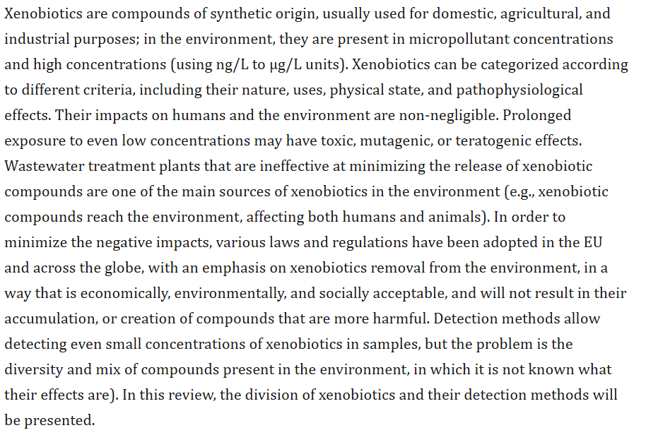
Suggested Research Article
Spiral Integration
Research Article
Link:
https://pmc.ncbi.nlm.nih.gov/articles/PMC8628977/

Slide 34
How To Access Digital Library
Steps to Access HEC Digital Library
Go to the website of HEC National Digital Library
On Home Page, click on the INSTITUTES
A page will appear showing the universities from Public and Private Sector and other Institutes which have access to HEC National Digital Library HNDL
Select your desired Institute
A page will appear showing the resources of the institution
Journals and Researches will appear
You can find a Journal by clicking on JOURNALS AND DATABASE and enter a keyword to search for your desired journal

Slide 35
Learning Resources
Lippincott Illustrated Reviews 8th Edition,
Harper’s Illustrated Biochemistry 32nd Edition
Google images

