Slide 1
Uveitis
Dr AMBREEN GUL
Assistant Professor
Ophthalmology Department, BBH, RMU
Sources:
Kanski-Clinical-Ophthalmology-Systematic-Approach
Oxford Handbook of Ophthalmology Book by Philip I. Murray
The Wills Eye Manual: Office and Emergency Room Diagnosis and Treatment of Eye Disease

Slide 2
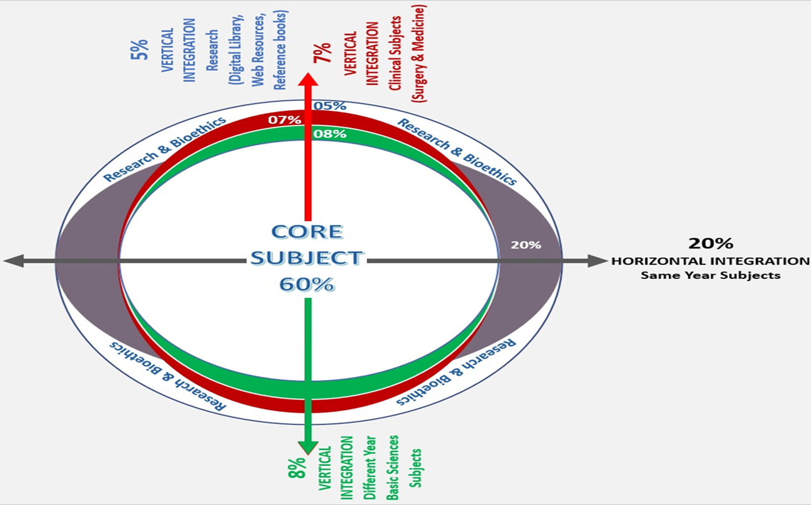
Sequence Of Lecture
Core Subject
Spiral Integration
Horizontal Integration
Vertical integration
EOLA(End of lecture
assessment)
Digital Library References
( Research, Bioethics, Artificial Intelligence)

Slide 3
Learning Objectives
At the end of one hour large group interactive session (LGIS) using the PowerPoint , fourth year medical student should be able to
Describe anatomy and physiology of uveal tract
Describe etiology, pathophysiology and classification of uveitis
Discuss clinical presentation, diagnosis, and treatment of intermediate and posterior uveitis

Slide 4
Anatomy
VERTICAL INTEGERATION- WITH ANATOMY
Notes:
Anterior ciliary arteries, short and long posterior ciliary arteries, venous drainage in vortex veins

Slide 5
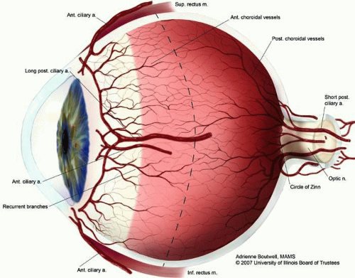
Physiology of Uveal Tract
Source of blood flow to the ocular tissues
Source of aqueous humor (fluid that fills the inside of the eye) and maintenance of intraocular pressure
Constitutes the blood-aqueous barrier
Prevents undesired blood products from reaching
the eye
Vertical integration- with physiology

Slide 6
Blood Aqueous Barrier
Blood-aqueous barrier is formed by an epithelial barrier located in the nonpigmented layer of the ciliary epithelium and in the posterior iridial epithelium, and by the endothelium of the iridial vessels.
VERTICAL INTEGERATION- WITH PHYSIOLOGY
Notes:
uveal tract frequently cause a breakdown of this barrier, which leads to exudation of excessive amounts of proteins or cells into the aqueous humor, vitreous, or subretinal space.

Slide 7
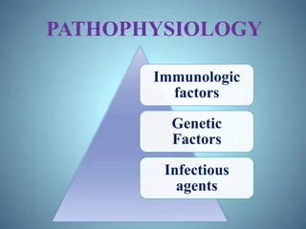
Pathophysiology of Uveitis
Inflammatory response chemical mediators result in vasodilation
Increased vascular permeability, chemotaxis of inflammatory cells in eye
Infectious, neoplastic, traumatic, autoimmune or idiopathic
Horizontal integration-with pathology

Slide 8
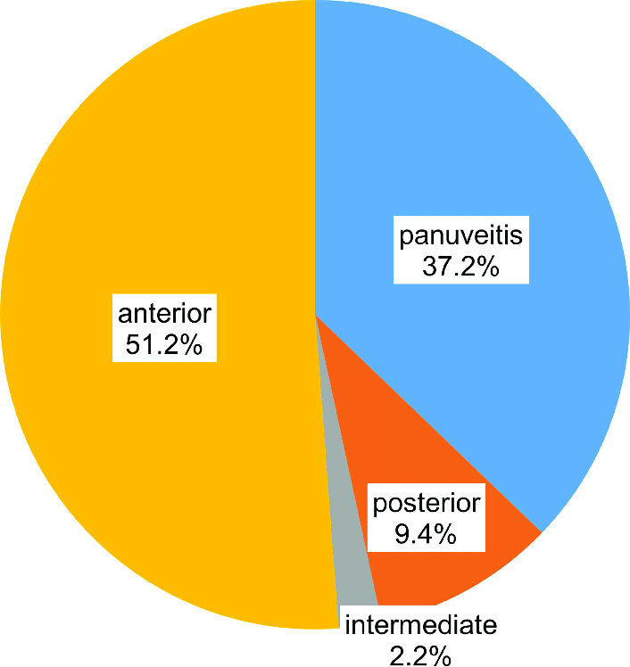
Epidemiology
The annual incidence of uveitis is between 17 and 52 per 100,000 population, and the prevalence is 38 to 714 cases per 100,000 population.
HORIZONTAL INTEGRATION-WITH COMMUNITY MEDICINE

Slide 9
Anatomical Classification of Uveitis
Type | Primary site of inflammation | Includes
Anterior uveitis | Anterior chamber | Iritis , iridocyclitis, anterior cyclitis
Intermediate uveitis | Vitreous | Pars planitis, posterior cyclitis, hyalitis
Posterior uveitis | Retina or choroid | Focal, multifocal, diffuse choroiditis, chorioretinitis, retinochoroiditis, retinitis, neuro retinitis
Pan uveitis | Anterior chamber, Vitreous and Retina or choroid
CORE SUBJECT

Slide 10
Anatomic Types
CORE SUBJECT

Slide 11
Clinical/Etiological Classification Of Uveitis
Group | Subgroup
Infectious | Bacterial, viral, fungal, parasitic
Noninfectious | Known systemic association No known systemic association
Masquerade | Neoplastic Non neoplastic
CORE SUBJECT

Slide 12
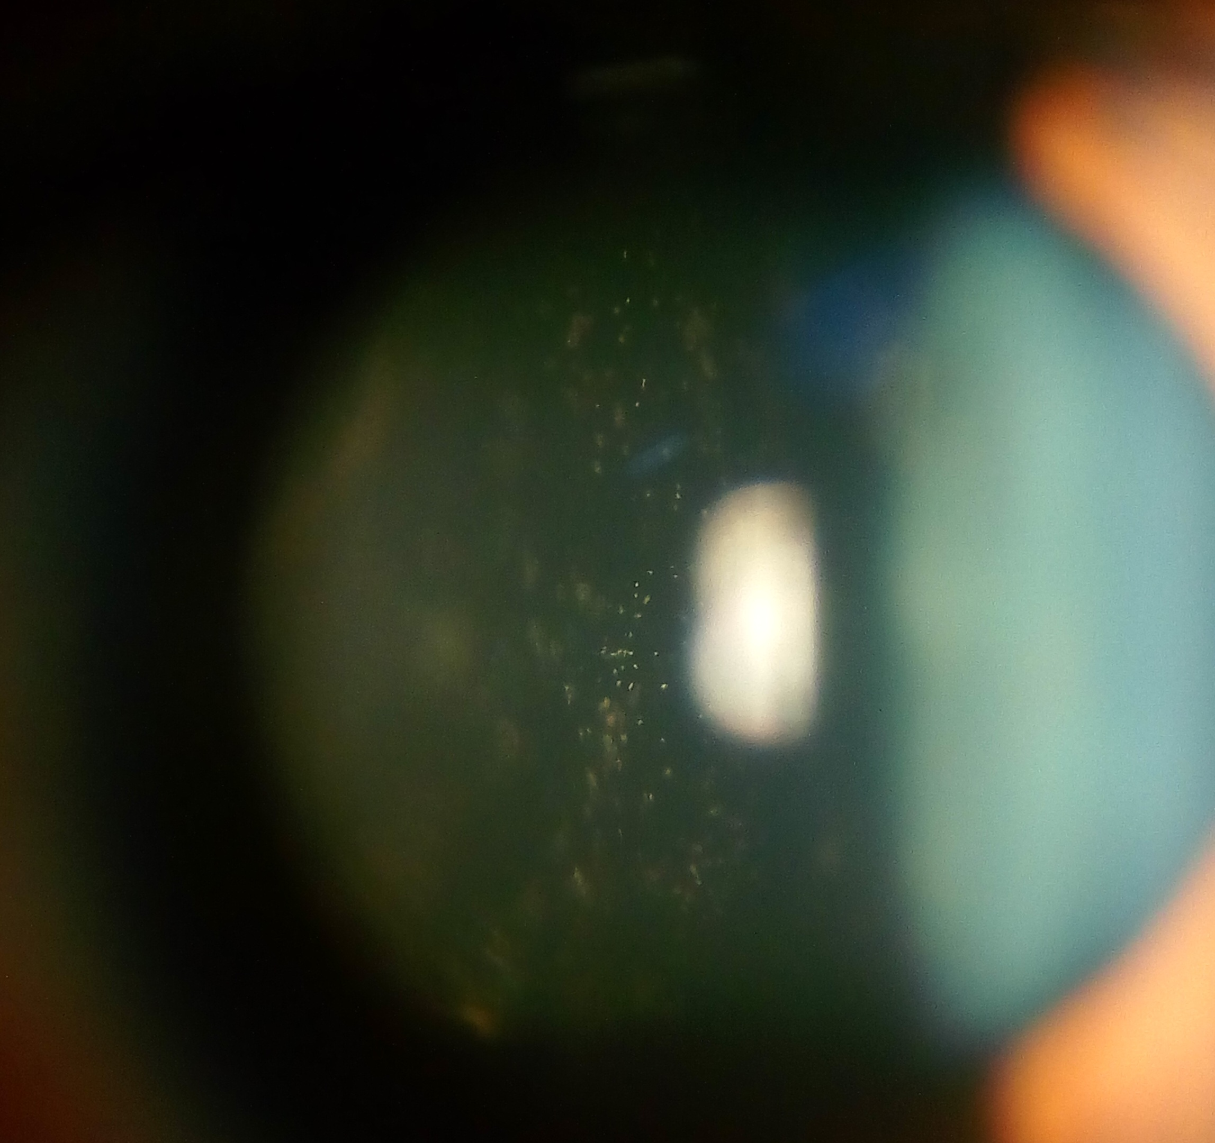
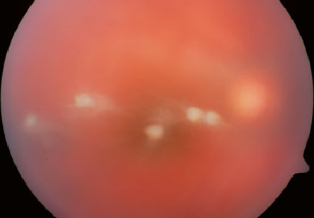
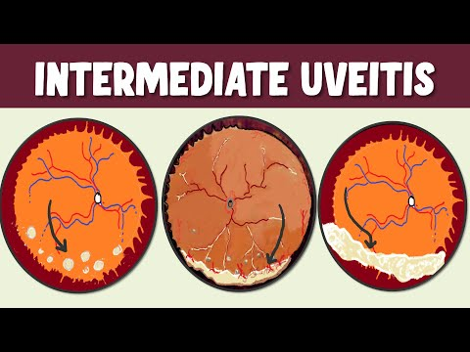
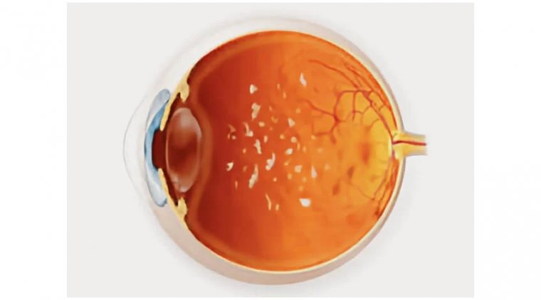
Intermediate Uveitis
CLINICAL FEATURES
CORE SUBJECT

Slide 13
Clinical Features
CORE SUBJECT

Slide 14
Etiology Of Intermediate Uveitis
Idiopathic/
Pars planitis
Multiple sclerosis
Tuberculosis
Sarcoidosis
Syphilis
Lyme disease
CORE SUBJECT

Slide 15
Complications
Cystoid macular edema and epiretinal membrane formation
CORE SUBJECT

Slide 16
Intermediate Uveitis Treatment
CORE SUBJECT

Slide 17
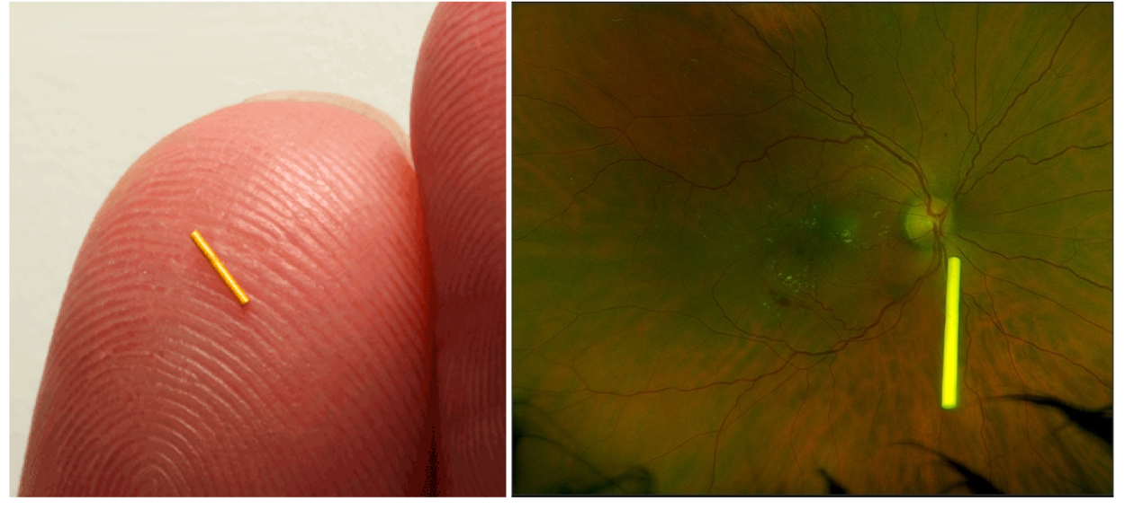
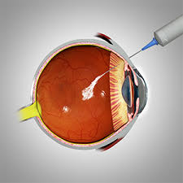
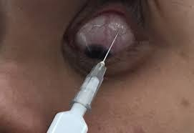
Treatment Options
Medical
Topical steroids or NSAIDS
Regional (sub tenon)
Intraocular steroids slow release implants or intravitreal injections
Systemic steroids, immunosuppressives, antimetabolites, biopharmacologicals
Surgical
Pars plana vitrectomy for vitreous hemorrhage, tractional retinal detachment, cystoid macular edema
CORE SUBJECT

Slide 18
Posterior Uveitis
Reduced vision, floaters
CORE SUBJECT

Slide 19
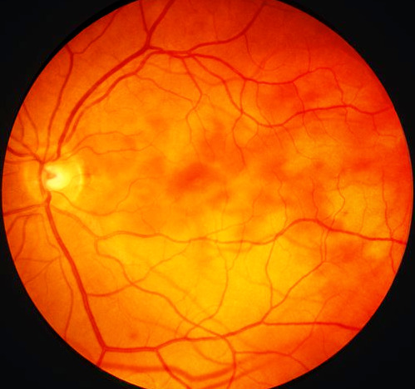
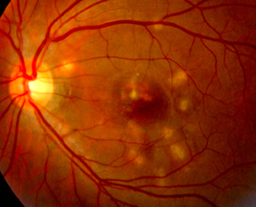
Retinitis Versus Choroiditis
CORE SUBJECT

Slide 20
Etiology Of Posterior Uveitis
Posterior uveitis
Vitritis
Retinitis
Choroiditis
Idiopathic
Toxoplasmosis
Lymphoma
Endophthalmitis
Focal
Toxoplasmosis
Multifocal
Syphilis
Sarcoidosis
Focal
Tuberculosis
Multifocal
Lymphoma
Sarcoidosis
TB
CORE SUBJECT

Slide 21
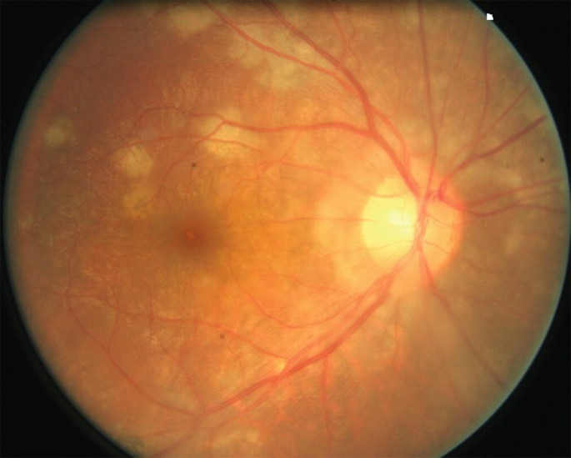
Focal Versus Multifocal
CORE SUBJECT

Slide 22
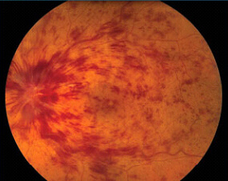
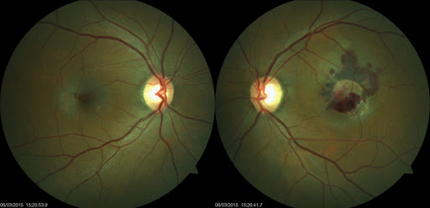
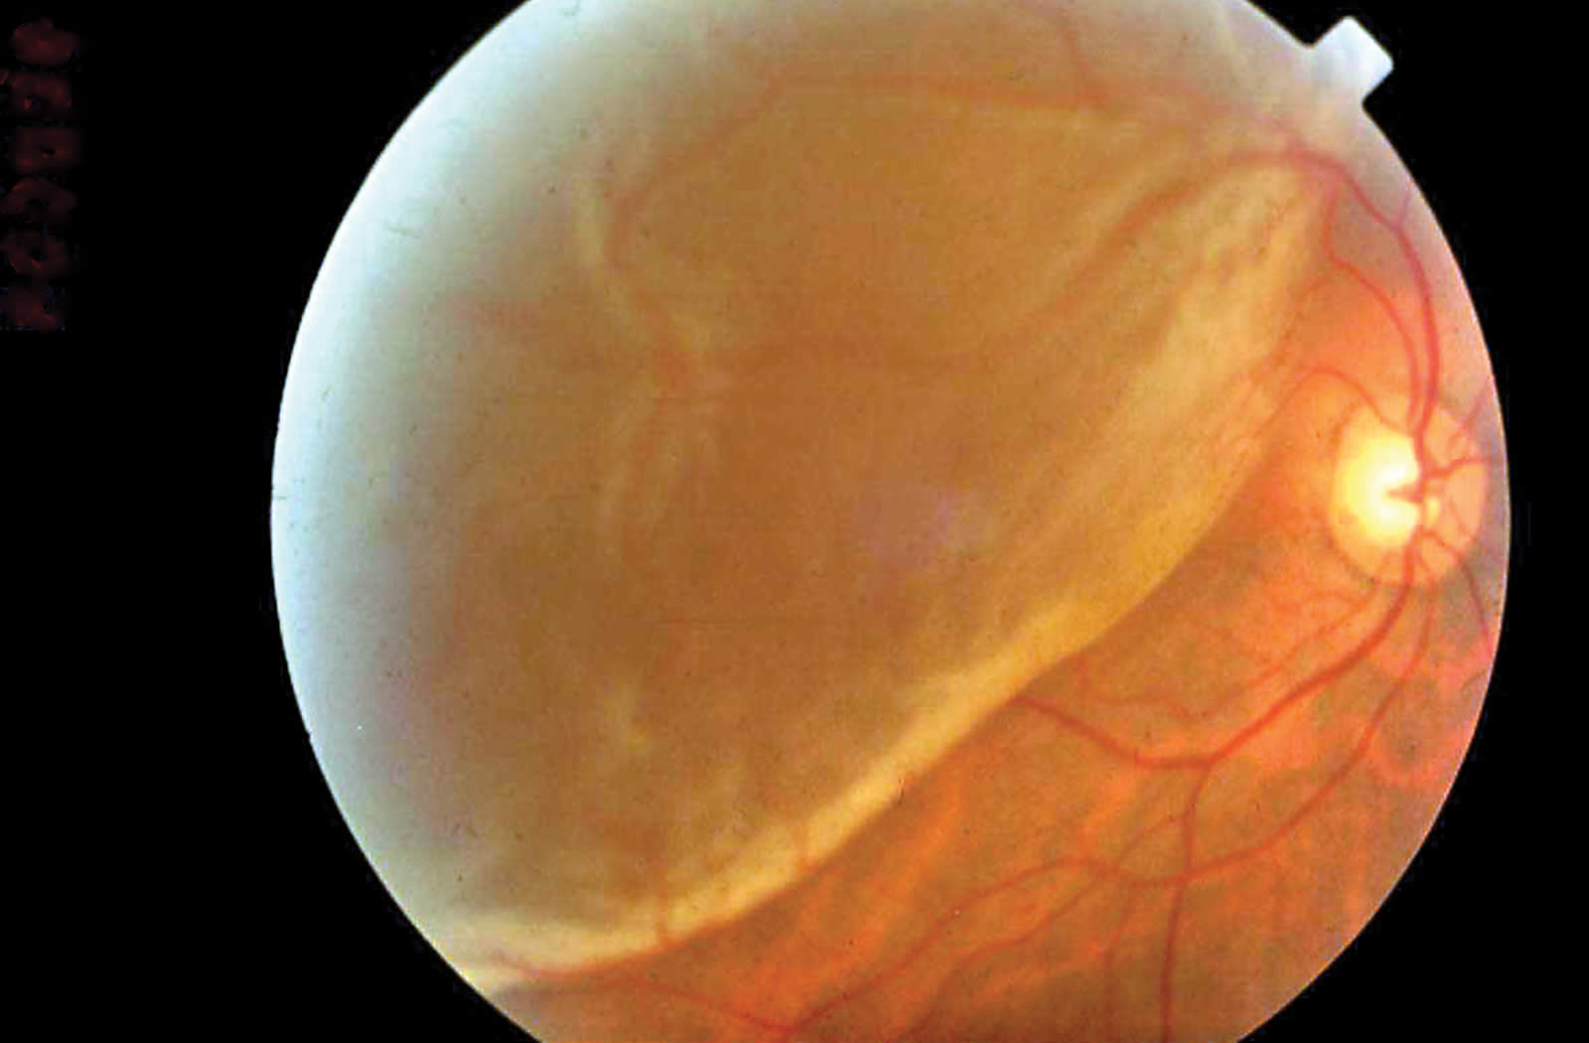
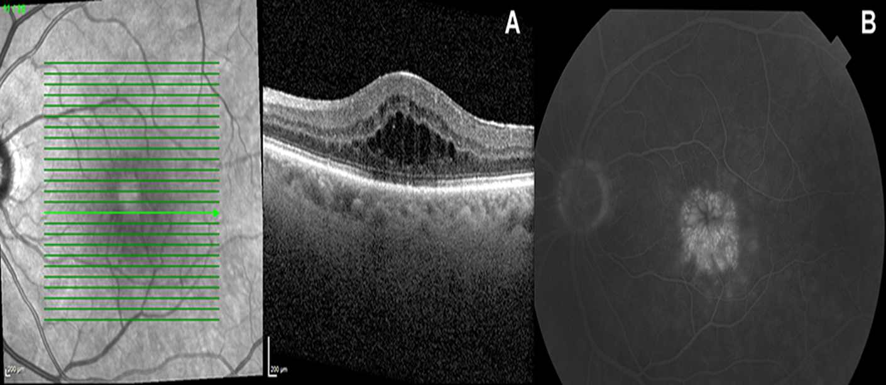
Complications Of Posterior Uveitis
CORE SUBJECT

Slide 23
Investigations
CORE SUBJECT

Slide 24
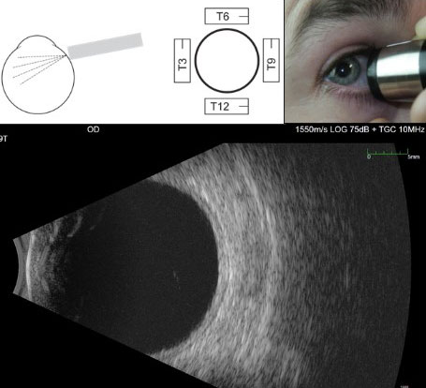
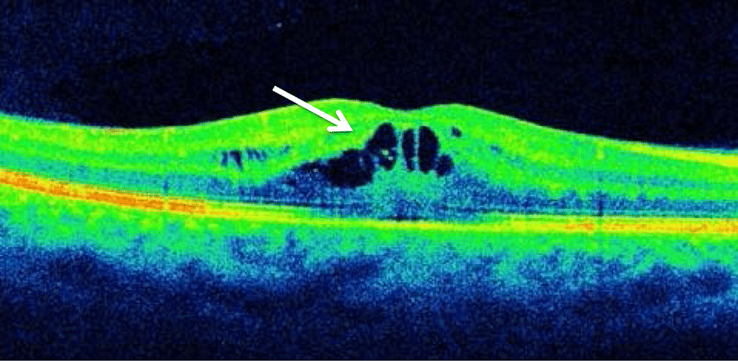
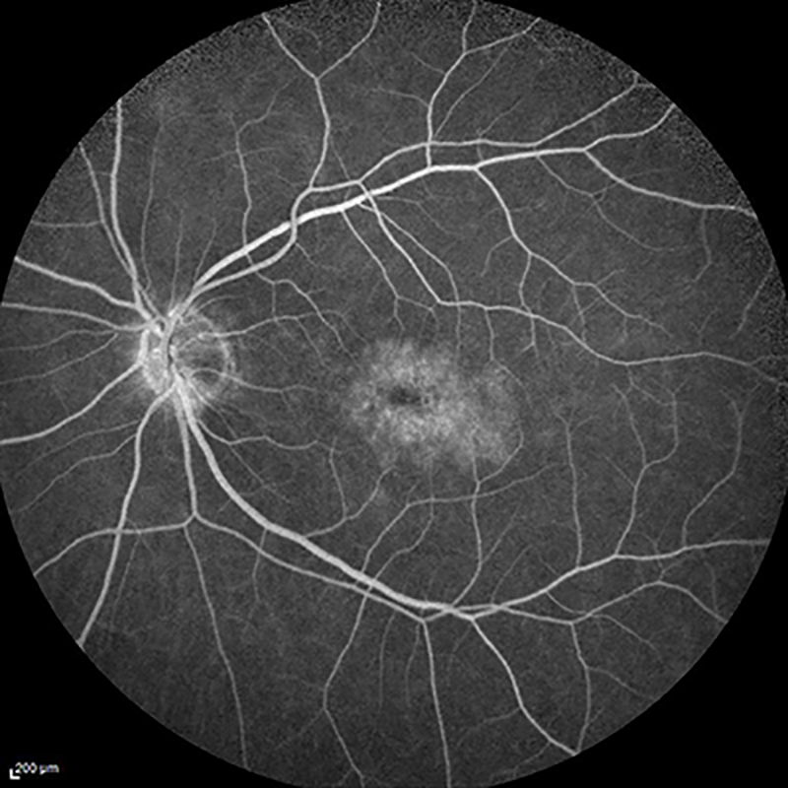
Imaging
OCT (optical coherence tomography)
FFA (fundus fluorescein angiography)
B-SCAN (ultrasound)
CORE SUBJECT

Slide 25
Posterior Uveitis Treatment
Posterior Uveitis
Rule Out Infectious Etiology And Masquerade Syndrome
Ocular only
Steroids intraocular and periocular if U/L
If B/L oral steroids
If no response immune modulators
Ocular and systemic
Multidisciplinary approach
Iv high dose or oral steroids
Immune modulators
Treat infection along with inflammation
Establish Diagnosis Both Ocular And Systemic & Severity
CORE SUBJECT

Slide 26
Therapeutic Agents
CORE SUBJECT

Slide 27
EOLA( End Of Lecture Assessment)
A 30-year-old man, presents with vision loss and floaters in right eye. He reports recent exposure to cats. Examination shows hazy fundal view due to dense vitritis. Fundus shows focal retinitis. What is the likely infectious cause of his posterior uveitis?
Toxoplasmosis
Tuberculosis
Sarcoidosis
Multiple sclerosis
Syphilis
EOLA( End Of Lecture Assessment)

Slide 28
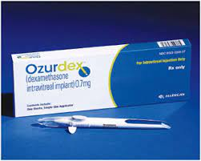
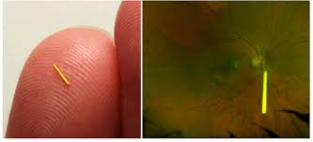
Research And Recent Advances
Enhanced depth imaging–optical coherence tomography (EDI-OCT)… a promising novel technique for imaging the choroid
Ultra-wide-field fluorescein angiography
Newer steroid implants.. dexamethasone implant (Ozurdex®) and fluocinolone implant (Iluvien®) and Retisert
RESEARCH AND RECENT ADVANCES

Slide 29
Research And Recent Advances
RESEARCH AND RECENT ADVANCES

Slide 30
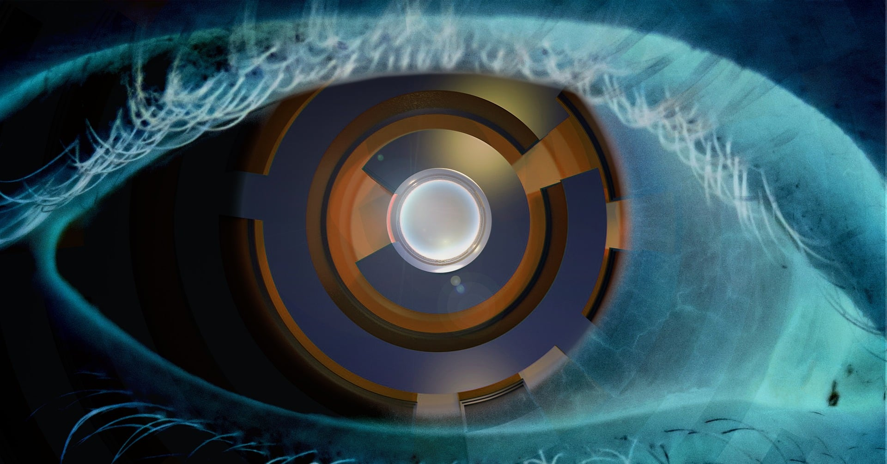
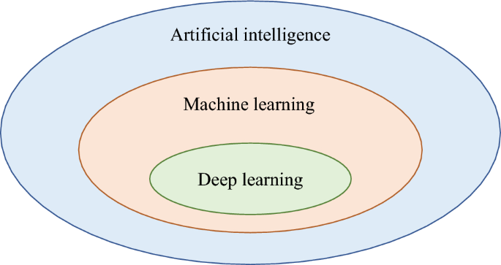
Artificial Intelligence
AI holds great promise to assist with the diagnosis and detection of ocular findings of uveitis
1. https://www.linkedin.com/pulse/artificial-intelligence-based-differential-diagnosis-uveitis?utm_source=share&utm_medium=guest_desktop&utm_campaign=copy
Artificial Intelligence

Slide 31
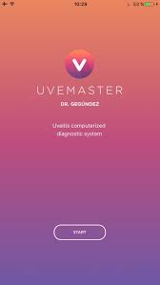
UVEMASTER : An App designed to detect uveitis
An app called Uvemaster, contains a large database of knowledge including 88 uveitis syndromes each with 76 clinical items, both ocular and systemic (total 6688) and their respective prevalences, and displays a differential diagnoses list (DDL) ordered by sensitivity, specificity, or positive predictive value (PPV).
A study was conducted to assess the diagnostic accuracy of uvemaster, which revealed that the diagnostic accuracy of the app was 96.6%. ²
Artificial Intelligence

Slide 32
Bioethics
A 32 years old non diabetic, non hypertensive, underweight male, who has been living in Thailand for the past 6 years, comes to the OPD with complains of blurring of vision and floaters for the past 3 months. As a part of routine ocular exam, you do his fundoscopy and find features suggestive of CMV retinitis. You immediately order ELISA for HIV-AIDS, which comes out to be positive. You disclose the news to the patient after which he asks you not to discuss this with his family as he was about to get married in a month’s time. What would you do?
BIOETHICS

Slide 33
Study Guide Resources
Kasnki’s Clinical Ophthalmology – Systematic Approach
Oxford Handbook of Ophthalmology – Phillip I. Murray
Yeh S, Huang Y, Thomas J. Innovations in the diagnosis and management of uveitis: promising research to address unmet patient needs. Ann Eye Sci
Gegundez-Fernandez JA, Fernandez-Vigo JI, Diaz-Valle D, Mendez-Fernandez R, Cuiña-Sardiña R, Santos-Bueso E, Benitez-Del-Castillo JM. Uvemaster: A Mobile App-Based Decision Support System for the Differential Diagnosis of Uveitis. Invest Ophthalmol Vis Sci. 2017 Aug 1;58(10):3931-3939. doi: 10.1167/iovs.17-21493. PMID: 28772309

