Slide 1
Urinary Incontinence
                Dr. M. Ali Shahiman
                Senior Registrar
                Department of Urology
                RMU and Allied Hospitals

Slide 2
University Vision And Mission
Vision
To impart evidence-based research oriented health professional education in order to provide best possible patient care and inculcate the values of mutual respect, ethical practice of healthcare and social accountability.
Mission
Highly recognized and accredited center of excellence in Medical Education, using evidence-based training techniques for development of highly competent health professionals, who are lifelong experiential learner and are socially accountable.

Slide 3
Sequence of LGIS
Learning objectives
Vertical integration with anatomy and physiology
Horizontal integration with pathology
Clinical aspect as core subject
Ethics

Slide 4
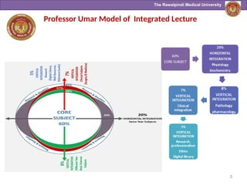

Slide 5
Vertical Integration with Anatomy

Slide 6
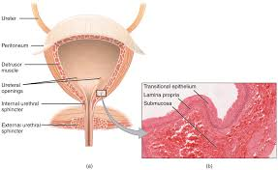
Anatomy Of Urethral Sphincters

Slide 7
Horizontal Integration with Pathology

Slide 8
Pathophysiology :
Age related Lower Urinary Tract changes
Bladder contractility decreases
Uninhibited bladder contractions increase
Diurnal urine output occurse later in day
Bladder capacity decreases
Sphincteric striated muscle attenuates
PVR increases

Slide 9
Prevalence
Increases with age
Affects women more than men (2:1) until age 80
15-30% in age 65 and older
60-70% in older adults age 65 and older in long term care
Significantly impairs quality of life

Slide 10
Risk Factors
Obesity
Functional impairment
Dementia
Medications
Notes:
medications: estrogen blockers; alpha blockers; cholinesterase inhibitors

Slide 11
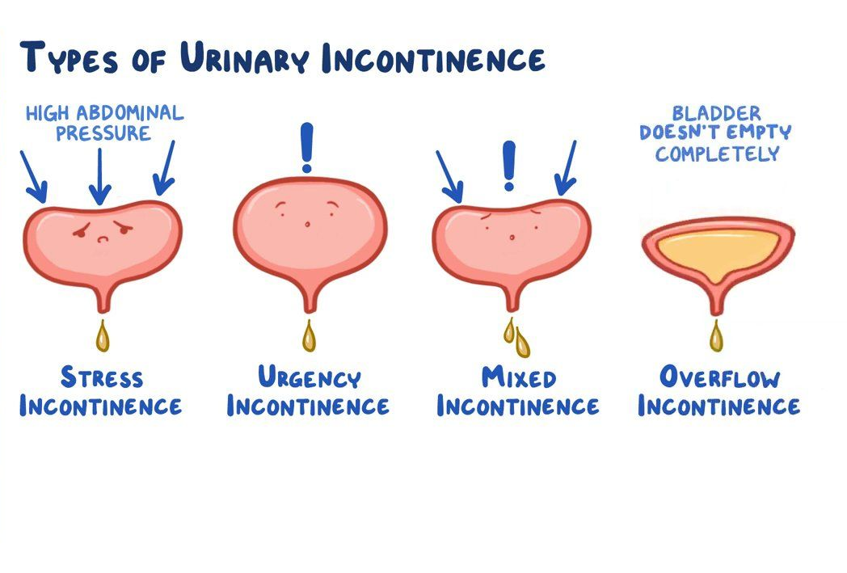

Slide 12
Age related Lower Urinary Tract changes- Women
In addition to the physiologic changes already discussed:
  Urethral closure pressure decreases
  Vaginal mucosal atrophy

Slide 13
Age related Lower Urinary Tract changes- Men
In addition to the physiologic changes already discussed:
  Benign prostatic hyperplasia
  Prostate hypertrophy

Slide 14
Urge Urinary Incontinence
Urge Urinary incontinence with detrusor overactivity (uninhibited bladder contractions)
40% on urodynamic testing
Suggest detrusor overactivity PLUS impaired compensatory mechanisms.
Idiopathic, age-related, secondary to lesions in cerebral and spinal pathways.
Due to bladder outlet obstruction or bladder irritation (infection, stones, tumor)
Notes:
Research emphasizes the role of afferent stimulation from the bladder urothelium and impaired CNS control of urgency in DO and overactive bladder.
Occurs with urgency, a compelling and often sudden need to void; most common in both men and women.

Slide 15
Stress Urinary Incontinence
Etiology
  Damage to the pelvic floor supports
  Sphincter failure
Leakage associated with coughing, sneezing, laughing, physical activity
Second most common form in women
Seen in men after prostectomy
Notes:
Damage to pelvic floor supports (levator ani, CT) which compress the urethra when intrabdominal pressure increases.
Sphincter failure- surgical damage, severe atrophy, or (rare) subsacral SCI.

Slide 16
Mixed Urinary Incontinence with both detrusor overactivity and impaired sphincter support
Leakage occurs with both urgency and activity
Seen in women

Slide 17
Medications Associated with Urinary Incontinence
Alcohol
Alpha-adrenergic agonists
Alpha-adrenergic blockers
ACE Inhibitors
Anticholinergic
Antipsychotics
CCB
Cholinesterase inhibitors
Estrogen
Gabapentin
Loop diuretics
Narcotics
NSAIDs
Sedative hypnotics
Thiazolidinediones
TCA

Slide 18
Physical Examination
Rectal Exam
  Masses, fecal loading, prostate nodules or firmness
Neuro Exam
  Sacral cord integrity (sensory)
  Anal tone and contraction (motor)
Pelvic Exam
  Labial and vaginal lesions
  Pelvic organ prolapse
Psychological Exam
  Association between depression and Urinary incontinence

Slide 19
Diagnostic Testing
Urinalysis
  Hematuria, glycosuria
Bladder diaries (time, volume & Urinary incontinence episode in 48 hr)
Urodynamics
  Only in uncertain diagnosis

Slide 20
Urinary Incontinence Treatment and Management
Lifestyle Management
  Weight loss
  Extreme fluid intake
  Limit caffinated beverages
  Limit evening fluid intake
  Quit smoking

Slide 21
Urinary Incontinence Treatment and Management
Behavioral Therapies
  A. Bladder training and pelvic muscle exercises
  B. Prompt timed voiding

Slide 22
Medications :
Anti Muscarinics
Mechanism of Action :
  Increase bladder capacity by decreasing basal excretion of Ach from urothelium
Contraindicated
  Narrow angle glaucoma
  Impaired gastric emptying
  Known urinary retention
  Patient taking cholinesterase inhibitor
Drugs
  Oxybutynin
  Tolterodine
  Fesoterodine
  Trospium
  Darifenacin
  Solifenacin

Slide 23
Medications
Urinary Incontinence and Overactive Bladder
Mechanism of Action
  Stimulation of beta 3 receptors in the detrusor mediates bladder relaxation:
  Mirabegron 25-50mg QD
Adverse Effects :
  Increase blood pressure
  Prescribe carefully in patient with renal and hepatic impairment

Slide 24
Other Treatments
Intravesical injection of botulinum toxin
Sacral nerve neuromodulation

Slide 25
Surgical Treatment
Surgery (stress urinary incontinence)
  Colposuspension (Burch Operation)
  Slings (synthetic mesh, autologus or cadaveric fascia)

Slide 26
Biomedical Ethics
Before doing any medical and surgical treatment informed consent must be taken
Prognosis should be explained to the patient and attendants

Slide 27
Thank You

