Slide 1
Upper Urinary Tract Stone Diesease
Dr. Zeeshan Qadeer
Associate Professor Urology,RMU

Slide 2
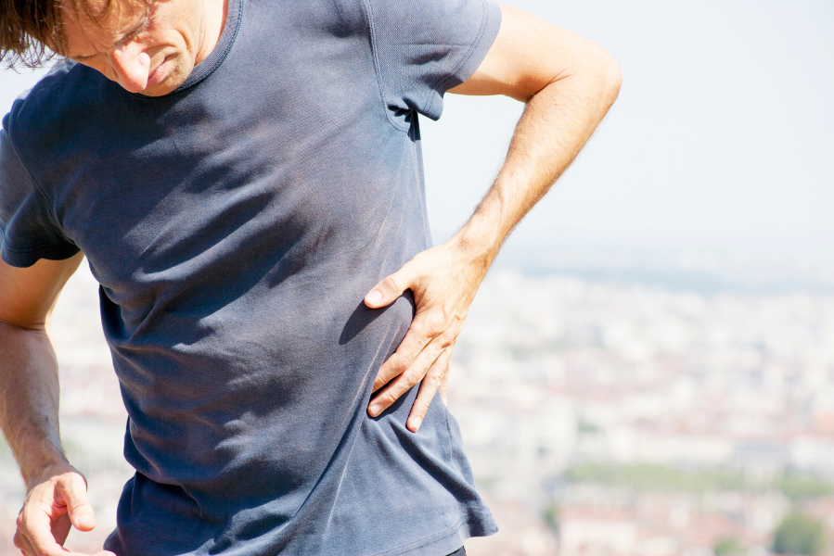

Slide 3
University Motto, Vision, Values & Goals
Mission Statement
To impart evidence-based research-oriented health professional education
Best possible patient care
Mutual respect, ethical practice of healthcare and social accountability.
Vision and Values
Highly recognized and accredited centre of excellence in
Medical Education, using evidence-based training techniques for development of highly competent health
professionals, who are lifelong experiential learner and are socially accountable.
Goals
The Undergraduate Integrated Learning Program is geared to provide you with quality medical education in an environment designed to:

Slide 4
SEQUENCE OF LGIS
Learning objectives
Core Subject (70%)
Vertical Integration (10%)
Horizontal Integration (15%)
Research (3%)
Biomedical Ethics (2%)

Slide 5
PROF UMER MODEL OF INTEGRATED LECTURE

Slide 6
Learning Objectives
Understand the clinical presentation of ureteric stones, including pain patterns, hematuria, dysuria, and complications like obstructive uropathy.
Identify appropriate diagnostic modalities for ureteric stones, including urine R/E, ultrasound KUB, and non-contrast CT KUB (gold standard).
Differentiate between conservative and surgical management, based on stone size, location, degree of obstruction, and kidney function.
Recognize indications for urgent intervention, such as intractable pain, hydronephrosis, renal function deterioration, or solitary kidney obstruction.
Explore recent advancements in ureteric stone management, including ureterorenoscopy (URS), retrograde intrarenal surgery (RIRS), and PCNL.
Understand the complications of untreated ureteric stones, including complete renal obstruction, kidney damage, and renal failure.

Slide 7
CORE SUBJECT

Slide 8
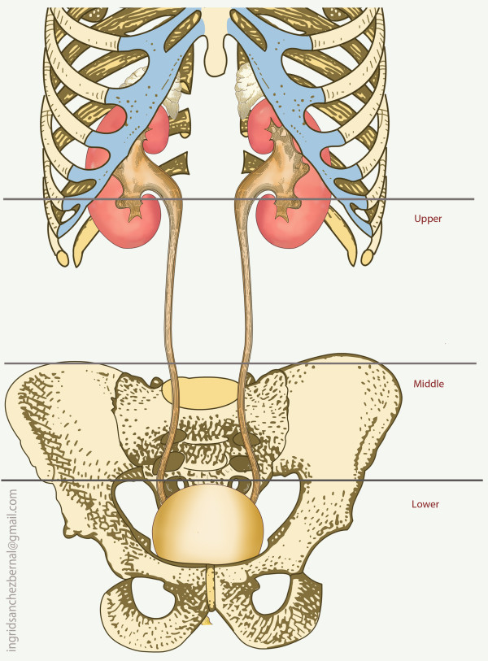

Slide 9
URETERIC CALCULUS
A stone in the ureter usually comes from the kidney.
Most are single small stones that are passed spontaneously.

Slide 10
Clinical features
Intermittent episodes of pain.
Loin pain is typically radiates to groin, external genitalia
If stone is in intramural part, then pain radiates to glans penis/Clitoris.
Nausea/Vomiting
Dysuria , frequency
Hematuria

Slide 11
Obstructive Uropathy
If complete obstruction persists for 3-4 weeks, it may lead to damage to the renal parenchyma.
Can lead to severe deterioration of renal functions - if calculi causing bilateral ureteric obstruction - Stone in solitary functioning kidney

Slide 12
Abdominal examination
Tenderness and some rigidity over some part of the course of the ureter.
On the right side is to distinguish from ??
The presence of hematuria does not rule out appendicitis, because an inflamed appendix can give rise to a local ureteritis.

Slide 13
Investigations
Urine R/E
Ultrasonography (KUB)
CT scan KUB without contrast (Gold Standard)
Renal function tests

Slide 14
VERTICAL INTEGRATION WITH RADIOLOGY

Slide 15
CT Scan KUB (Plain)

Slide 16
Conservative Management
Appropriate Analgesia
Alpha blockers
Restrict fluid intake
Antibiotics in case of UTI

Slide 17
Intervention
Intractable pain.
Stone causing obstruction (Hydro-nephrosis).
Derangement of kidney functions.
Solitary functioning kidney.

Slide 18
Surgical Management
Goal is to achieve maximal stone clearance with minimal morbidity.
Minimally invasive treatment modalities: Ureterorenoscopy (URS)
Retrograde intra-renal sugery (RIRS).
Recent advancements in endoscopic techniques dramatically reduced the need for open surgical procedures.

Slide 20
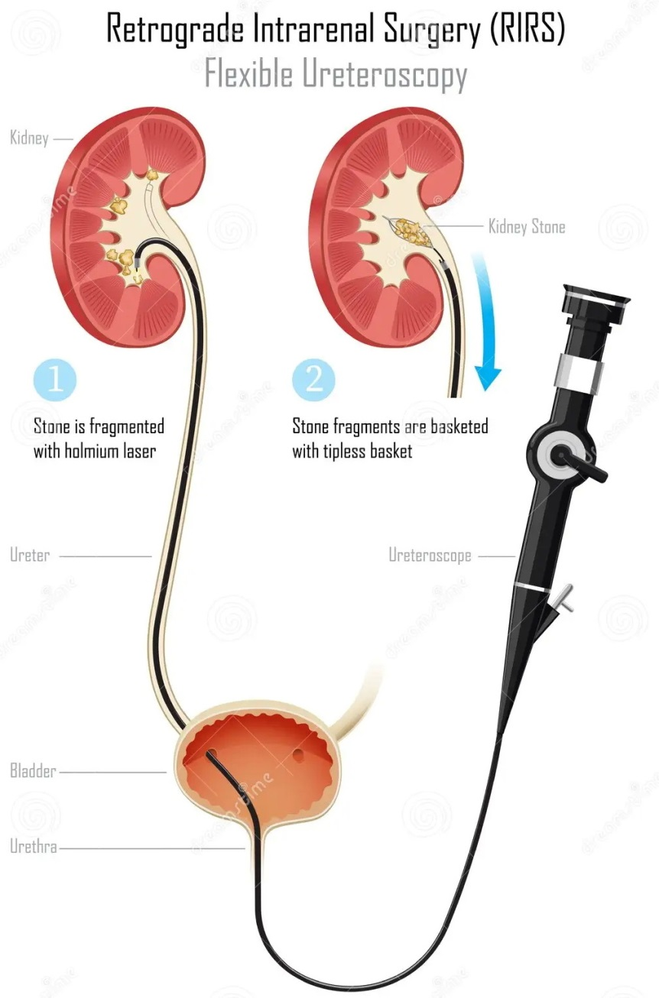
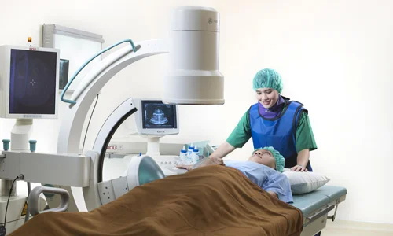

Slide 22
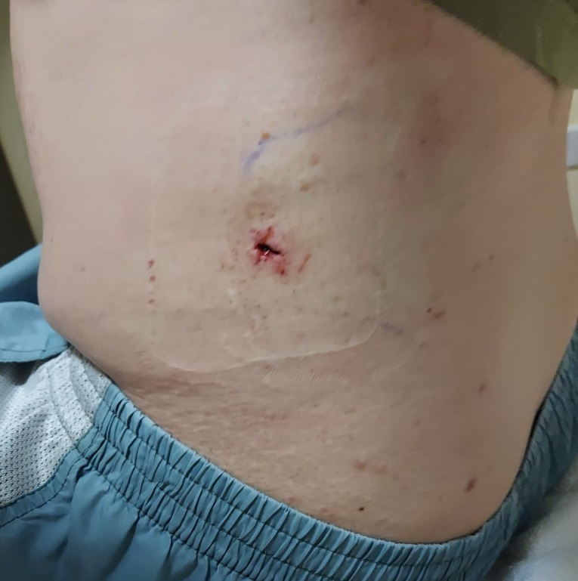
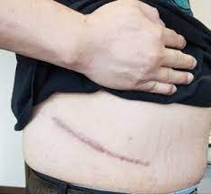
Recent advancement in surgery
PCNL
Conventional Surgery

Slide 23
HORIZONTAL INTEGRATION WITH PATHOLOGY

Slide 24
Pathology
Stone Composition: Calcium oxalate (most common), uric acid, struvite, cystine, and xanthine stones.
Pathogenesis: Supersaturation, crystallization, and stone formation in different metabolic conditions

Slide 26
Dissolution therapy for kidney stones.
Fluid intake.
Role of diet for prevention.

Slide 27
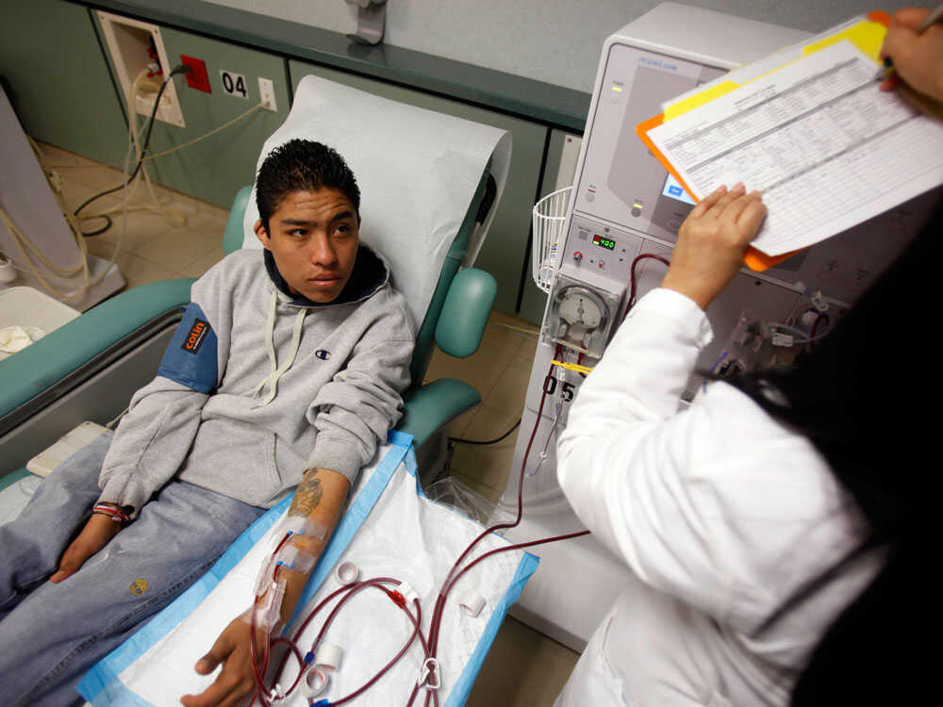
Dreadful Complication
Complete unilateral kidney damage.
Renal failure.

Slide 28
Spiral Integration with Family Medicine
Early recognition of ureteric colic symptoms and referral criteria for intervention.
Preventive strategies, including dietary modifications, hydration, and metabolic evaluation for recurrent stone formers.

Slide 29
Biomedical Ethics
Informed consent for surgical interventions like URS, RIRS, and PCNL, including risks and benefits.
Patient autonomy in conservative vs. surgical treatment decisions, especially in asymptomatic cases.

Slide 30
Research
Emerging technologies in ureteric stone management, such as laser lithotripsy and micro-PCNL.
Ongoing studies on pharmacological stone dissolution therapy and metabolic stone prevention.
https://pubmed.ncbi.nlm.nih.gov/35749787/

Slide 31
REFERENCES
Campbells urology 12th edition
Smith and Tanaghos urology 9th edition
EAU 2024 guidelines

Slide 32
Questions ???

Slide 33
Thank You

