Slide 1
UVEITIS
DR. WAJEEHA RASOOL
SR, EYE DEPT. BBH
SOURCES:
Kanskis-Clinical-Ophthalmology-Systematic-Approach
Oxford Handbook of Ophthalmology Book by Philip I. Murray

Slide 2
Components Of Lecture
Core Subject
Spiral Integration
Horizontal Integration
Vertical integration
EOLA(End of lecture assessment)
Digital Library References
( Research, Bioethics, Artificial Intelligence)

Slide 3
Learning objectives
At the end of one hour large group interactive session (LGIS) using the PowerPoint , fourth year medical student should be able to
Describe anatomy and physiology of uveal tract
Describe etiology, pathophysiology, classification, diagnosis, and treatment of uveitis

Slide 4
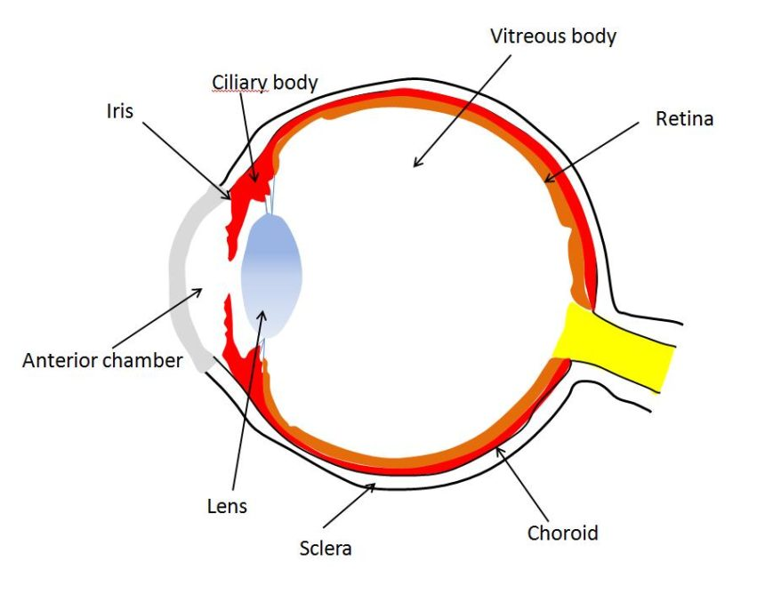
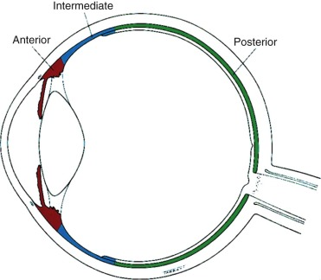
ANATOMY
VERTICAL INTEGERATION- WITH ANATOMY

Slide 5
Functions of Uveal Tract
Vertical integration
source of blood flow to the ocular tissues.
source of aqueous humour (fluid that fills the inside of the eye) and maintenance of intraocular pressure.
constitutes the blood-aqueous barrier and prevents undesired blood products from reaching the eye.

Slide 6
IMMUNE PRIVILEGE
Vertical integration

Slide 7
Pathophysiology of Uveitis
Horizontal integration

Slide 8
EPIDEMIOLOGY
Horizontal integration
The annual incidence of uveitis is between 17 and 52 per 100,000 population, and the prevalence is 38 to 714 cases per 100,000 population.

Slide 9
4 Qs
Core subject

Slide 10
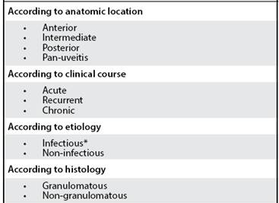
CLASSIFICATION
Core subject

Slide 11
ANATOMIC TYPES
Core subject

Slide 12
DETAILED CLASSIFICATION
Core subject
TINU, SLE

Slide 13
ANTERIOR UVEITIS
Core subject

Slide 14
ANTERIOR UVEITIS
Core subject

Slide 15
ANTERIOR UVEITIS
Core subject

Slide 16
ANTERIOR UVETIS
Core subject

Slide 17
ANTERIOR UVETIS
Core subject

Slide 18
ANTERIOR UVETIS
Core subject

Slide 19
ANTERIOR UVETIS
Core subject

Slide 20
GOALS OF TREATMENT
Core subject

Slide 21
TREATMENT PLAN IN ANTERIOR UVEITIS
Core subject
top. Cyclosporin
NSAIDS
Ant.periocular steroid
,mydricaine, tPA

Slide 22
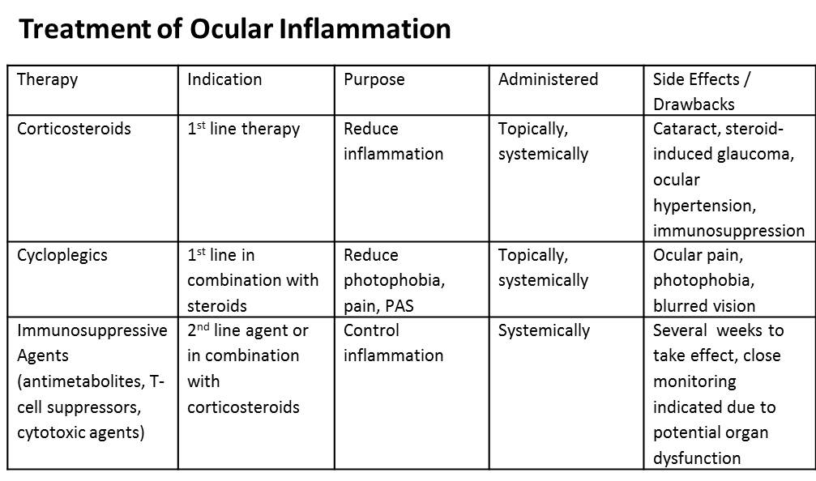
Core subject

Slide 23
INTERMEDIATE UVEITIS
Core subject
FEATURES

Slide 24
INTERMEDIATE UVEITIS
Core subject

Slide 25
POSTERIOR UVEITIS
Core subject
Reduced vision, floaters

Slide 26
POSTERIOR UVEITIS
Core subject

Slide 27
COMPLICATIONS
Core subject
epiretinal
band keratopathy

Slide 28
INVESTIGATIONS
Core subject

Slide 29
IMAGING
Core subject
OCT (optical coherence tomography)
FFA (fundus fluorescein angiography)
B-SCAN (ultrasound)

Slide 30
THERAPUTIC AGENTS
Core subject

Slide 31
TOPICAL STROIDS
Horizontal integeration
difluprednate

Slide 32
TOPICAL MYDRIATICS AND CYCLOPLEGICS
Horizontal integeration

Slide 33
PERI/ INTRA OCULAR STEROIDS (triamcinolone)
Horizontal integeration
Intraocular steroids for CMO

Slide 34
SYSTEMIC STEROIDS
Horizontal integeration
TAB PREDNISOLONE 5mg
1mg/kg bw
TAB DEXAMETHASONE 5mg
IV METHYL PREDNISOLONE 1000 mg
OD 3 days
once every alt day, 3 days

Slide 35
IMMUNE MODULATORS
Horizontal integeration
ANTIMETABOLITES
AZATHIOPRINE
METHOTREXATE
MYCOPHENOLATE
CALCINEURINE INHIBITORS
CYCLOSPORIN
TACROLIMUS
SIROLIMUS
VOCLOSPORIN
ALKYLATING AGENTS
CYCLOPHOSPHAMIDE
CHLORAMBUCIL
BIOPHARMACOLOGICALS (anti TNF monoclonal Ab)
INFLIXIMAB
RITIXUMAB
ADALIMUMAB
ETANERCEPT
GOLIMUMAB
CERTOLIZUMAB

Slide 36
Name the sign. It is observed in which type of ant. uveitis? Commonest causative infectious disease.
EOLA( End Of Lecture Assessment)
A 38 year old male patient presented to eye OPD with painful red Right eye for 3 days. It was associated with photophobia, watering and reduced vision. On examination VA was 6/12 in right eye and 6/6 in left eye.

Slide 37
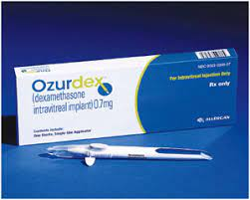
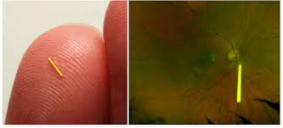
Research and recent advances
Enhanced depth imaging–optical coherence tomography (EDI-OCT)… a promising novel technique for imaging the choroid
Ultra-wide-field fluorescein angiography
Newer steroid implants.. dexamethasone implant (Ozurdex®) and fluocinolone implant (Iluvien®)

Slide 38
UVEMASTER : An App designed to detect uveitis
Artificial Intelligence
An app called Uvemaster, contains a large database of knowledge including 88 uveitis syndromes each with 76 clinical items, both ocular and systemic (total 6688) and their respective prevalences, and displays a differential diagnoses list (DDL) ordered by sensitivity, specificity, or positive predictive value (PPV).
A study was conducted to assess the diagnostic accuracy of uvemaster, which revealed that the diagnostic accuracy of the app was 96.6%. ²
2. Gegundez-Fernandez JA, Fernandez-Vigo JI, Diaz-Valle D, Mendez-Fernandez R, Cuiña-Sardiña R, Santos-Bueso E, Benitez-Del-Castillo JM. Uvemaster: A Mobile App-Based Decision Support System for the Differential Diagnosis of Uveitis. Invest Ophthalmol Vis Sci. 2017 Aug 1;58(10):3931-3939. doi: 10.1167/iovs.17-21493. PMID: 28772309.

Slide 39
Bioethics
A 32 years old non diabetic, non hypertensive, underweight male, who has been living in Thailand for the past 6 years, comes to the OPD with complains of blurring of vision and floaters for the past 3 months. As a part of routine ocular exam, you do his fundoscopy and find features suggestive of CMV retinitis. You immediately order ELISA for HIV-AIDS, which comes out to be positive. You disclose the news to the patient after which he asks you not to discuss this with his family as he was about to get married in a month’s time. What would you do?

Slide 40
REFERENCES
Kasnki’s Clinical Ophthalmology – Systematic Approach
Oxford Handbook of Ophthalmology – Phillip I. Murray
Yeh S, Huang Y, Thomas J. Innovations in the diagnosis and management of uveitis: promising research to address unmet patient needs. Ann Eye Sci
Gegundez-Fernandez JA, Fernandez-Vigo JI, Diaz-Valle D, Mendez-Fernandez R, Cuiña-Sardiña R, Santos-Bueso E, Benitez-Del-Castillo JM. Uvemaster: A Mobile App-Based Decision Support System for the Differential Diagnosis of Uveitis. Invest Ophthalmol Vis Sci. 2017 Aug 1;58(10):3931-3939. doi: 10.1167/iovs.17-21493. PMID: 28772309

