Slide 1
URINARY TRACT
INFECTION
Dr Saadat Ali Shah Hashmi
Chief Consultant Urologist,
Department of Urology,
RMU & Allied Hospitals

Slide 2
University Motto , Vision, Values & Goals
Vision & Values
To impart evidence-based research oriented health professional education in order to provide best possible patient care and inculcate the values of mutual respect, ethical practice of healthcare and social accountability.
Mission Statment
Highly recognized and accredited center of excellence in Medical Education, using evidence-based training techniques for development of highly competent health professionals, who are lifelong experiential learner and are socially accountable.

Slide 3
Sequence of LGIS
Learning objectives
Vertical integration with anatomy
Horizontal integration with pathology
Clinical aspect of urinary tract infections as core subject
Ethics

Slide 5
Learning Objectives
Introduction of urinary tract infection
Identify Causative organisms
Presenting sign and symptoms
Diagnosis
Managment

Slide 6
Vertical Integration with anatomy

Slide 7
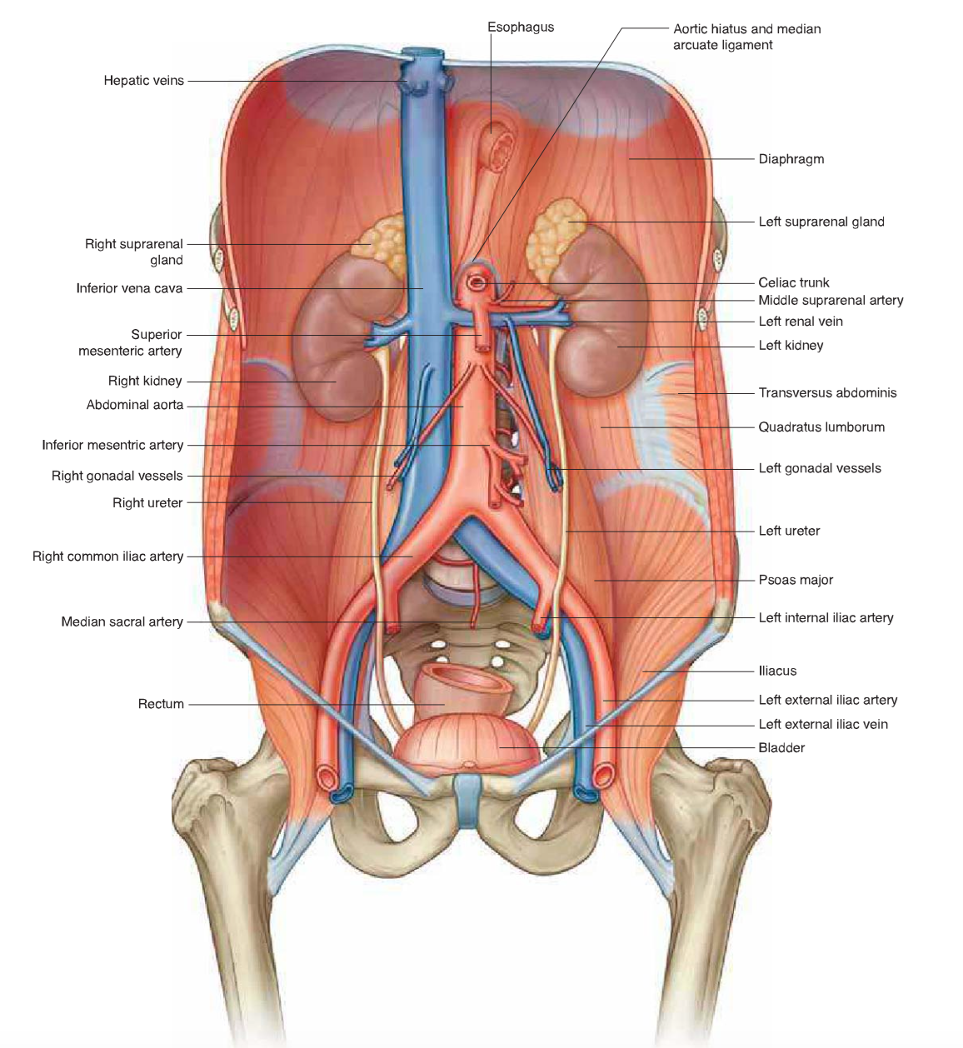

Slide 8
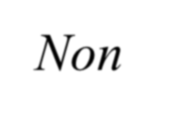
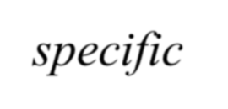
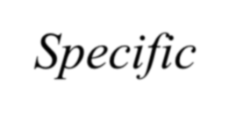
Urinary Tract Infections
Non specific
Specific

Slide 9
DIFFERENCE BETWEEN SPECIFIC AND
NON-SPECIFIC INFECTIONS
STAMEY CLASSIFICAITON OF INFECTION
Isolated infections
Recurrent infections
Persistent infections
Un-resolved infections
Re- infections

Slide 10
Types of Special infection
Tuberculosis
Schistosomiases
Candidasis
Filariasis
Actinomycosis

Slide 11
Horizontal integration with pathology

Slide 12
Causative Organisms
Gram –ve rods
Escherichia coli
Enterobacter sp.
Gardnerella Vaginalis
Klebsiella sp.
Proteus sp.
Pseudomonas aeruginosa
Serratia sp.

Slide 13
Gram +ve cocci
Staph. Aureus
Staph. Epidermidis
Staph. Saprophyticus
Steptococcus group-D
S-faecalis (enterococci)
S-bovis
Gram Negative cooci
Neisseria Gonorrhoeae
Other Pathogens
Chlamydiae
Micoplasmas, Ura Plasmas
Obligate Anaerobes

Slide 14
Modes of Entry of Organisms
Ascending infections
Hematogenous
Lymphatogenous
Direct extension

Slide 15
Spectrum of conditions comprising UTI
Nonspecific Infections in adults
Asympotmatic bacteriuria
Acute uncomplicated cystitis
Recurrent Cystitis
Acute Uncomplicated pyelonephritis
Chronic pyelonephritis
Epididymitis
Prostatitis

Slide 16
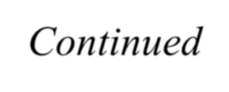
Continued…….
Specific Infections
Genitourinary T.B.
Fungal, Parasitic & Viral Infections
Infections In special situations
In Children
In Pregnancy
In the elderly
Catheter associated infection

Slide 17
Acute Pyelonephritis
Inflammation of parenchyma & pelvis of Kidney
Bacteriology
E. Coli 80%
Klebsiela
Proteus, pseudomonas
Enterobacter, Staph

Slide 18
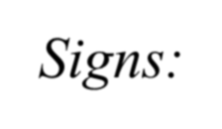
Clinical Features
Abrupt onset of fever
Chills, flank pain
LUTS – Frequency, Urgency, Dysuria
Nausea, Vomiting, Malaise
Signs:
Tachycardia, temperature 101 - 104 Fº Renal angle tenderness, Abdominal signs.

Slide 19
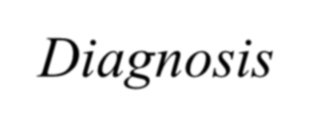
Diagnosis
Blood. C/P
Leukocytosis-Neutrophils
Urinalysis
Pyuria, Bactiuria, Hematuria
Urine C/S
100,000 CFU/ml
Blood culture
Bacteraemia / Septicemia
Doppler USG
CT Scan
Isotope Scan

Slide 20
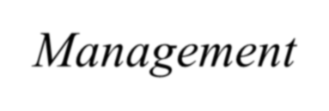
Management
Antibiotics
Antipyretics
I/V fluids
Correction of anatomical anomalies

Slide 21
Perinephric abscess
Pus between kidney & gerota's fascia Etiology
Rupture of renal abscess
Ascending infection in urinary stasis,
Obstruction, Calculi, neurogenic bladder, diabetes.
Clinical features
Fever, flank pain, LUTS, Tender flank mass, skin erythema, anaemia

Slide 22
Diagnosis
Blood C/P
Urinalysis
Urine C/S
Blood. C/S
P/C aspiration
IVU & CT scan
Management
Antibiotics
P/C aspiration
Open drainage

Slide 23
Acute Cystitis
More common in women
Men are protected due to prostatic secretions
Ascending route – faecal to perineum to Urethra
E. Coli – 80%

Slide 24
Clinical Features
Irritative voiding symptoms
Low back pain & S.P. pain
Cloudy foul smelling urine, hematuria
Constitutional symptomic – rare
Diagnosis
Urine R/E
Urine C/S

Slide 25
Management
Antibiotics
Analgesics

Slide 26
Bio Medical Ethics
Before doing any medical and surgical treatment informed consent must be taken
Prognosis should be explained to the patient and attendants

Slide 27
THANK YOU

