Slide 1
Traumatology
Firearm - I
Dr Filza ali & Dr Gulzaib Forensic Medicine & Toxicology

Slide 2
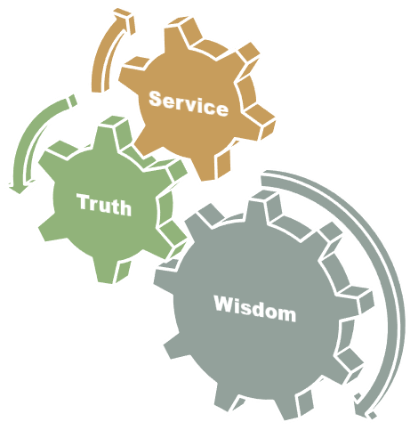
Motto of RMU

Slide 3
Vision of RMU
The Dream/ Tomorrow
To impart evidence based research oriented medical education
To provide best possible patient care
To inculcate the values of mutual respect and ethical practice of medicine

Slide 4
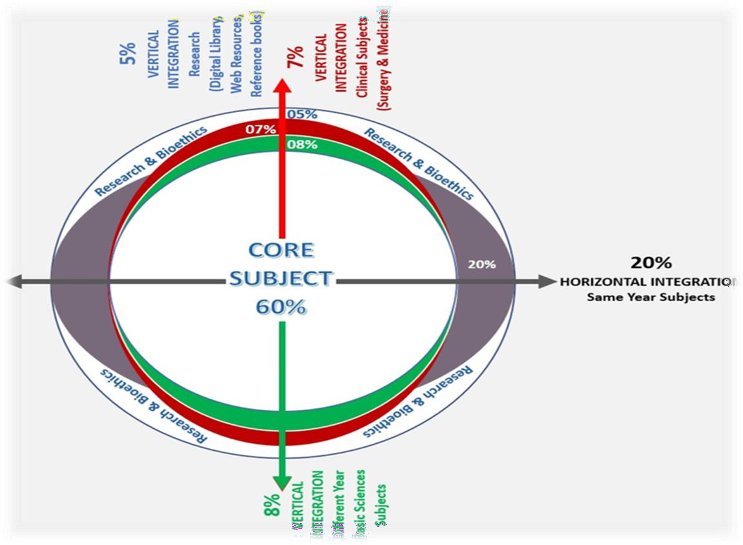
Prof Umar’s LGIS model

Slide 5
SEQUENCE OF LGIS
Learning Objectives
Core concept 70 %
Horizontal integration related to Pathology and Pharmacology 15 %(if applicable)
Relevant clinical concepts and medico legal application of core knowledge / Vertical integration 10%
Research article relevant to the topic 3%
Ethics and family medicine 2%

Slide 6
Learning objectives
Define firearm injuries and describe the classification of firearms and ballistics.
Describe the structure of a ammunition of a firearm/bullet.
Briefly describe the structure of a firearm along with its mechanism of action

Slide 7
BALLISTICS
Core Concept
It is the science of motion of projectile.
Firearm is a device used to propel a projectile by force of gases.
Projectile is an object projected into space by the exertion of force and passes through a medium, it has no source of energy of its own.

Slide 8
Types of Ballistics
Core Concept
Internal ballistics
External ballistics
Terminal ballistics

Slide 9
INTERNAL BALLISTICS or INTERIOR BALLISTICS:
Core Concept
The science of motion of a projectile, when it is moving inside the barrel of the fire arm weapon.

Slide 10
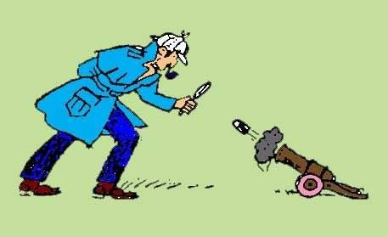
EXTERNAL BALLISTICS or EXTERIOR BALLISTICS
Core Concept
The science of motion of a projectile, after it comes out of the barrel.
barrel ------air-------- target
Forces of medium – air resistance,
gravity.

Slide 11
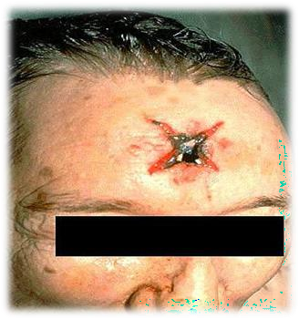
TERMINAL BALLISTICS
Core Concept
It is the study of the effect of a bullet/shots on the target till it comes to rest, resulting in wound formation.
Wound ballistics
Target ballistics
Firearm wound complex

Slide 12
Core Concept

Slide 13
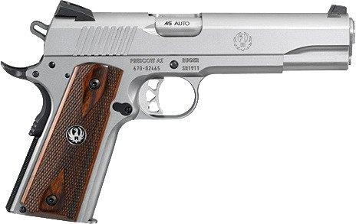
CLASSIFICATION OF FIREARM
Core Concept
RIFLED FIRE ARMS
Rifles…………………high velocity
Revolvers……..…..medium velocity
Pistols……………….low velocity
SMOOTH BORE FIRE ARMS
Shot guns
Muskets

Slide 14
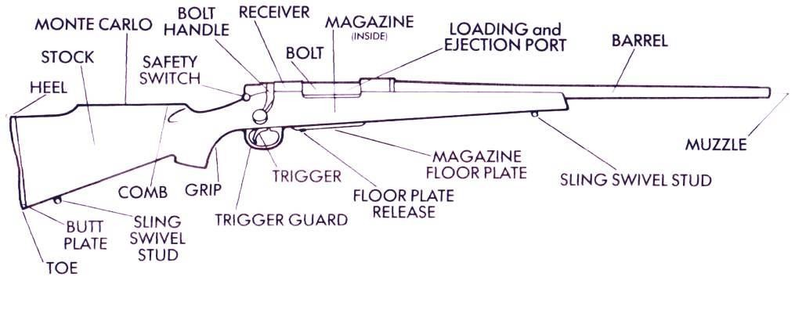
VARIOUS PARTS OF A FIREARM
Core Concept
Barrel
Firing pin
Hammer
Trigger
Butt
Magazine

Slide 15
BARREL
Core Concept
It consists of a cylindrical steel tube, which is closed at its proximal end known as BREECH END.
Distal end which is always open known as MUZZLE END.
Breech end contains a chamber for accommodating cartridge and may carry an extractor to remove the cartridge case after firing.

Slide 16
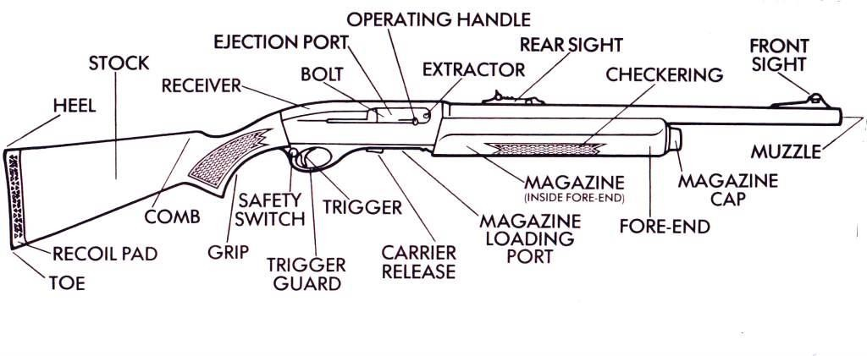
HAMMER & FIRING PIN
Core Concept
A firing pin is present incorporated with hammer and on loading, it is held in cocked position, on pulling the trigger it hits the sensitive primer at the base of cartridge and firing occurs.

Slide 17
TRIGGER
Core Concept
It is a lever situated in front of butt or hand grip.
As the weapon is cocked and trigger is pressed it releases firing pin or hammer resulting in the detonation of the primer in the percussion cap of a cartridge.

Slide 18
BUTT OR GRIP
Core Concept
Is part of fire arm gripped in hand in small barreled fire arms such as pistols, revolvers etc.
While the butt is long and shaped to fit the shoulder in cases of shot gun and rifles.

Slide 19
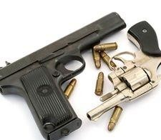
MAGAZINE
Core Concept
It is a spring loaded box or container carrying a number of cartridges.
It may be separated or attached.

Slide 20
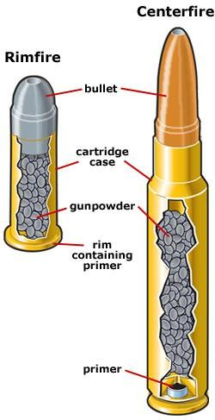
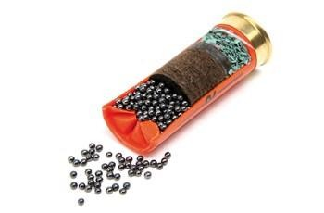
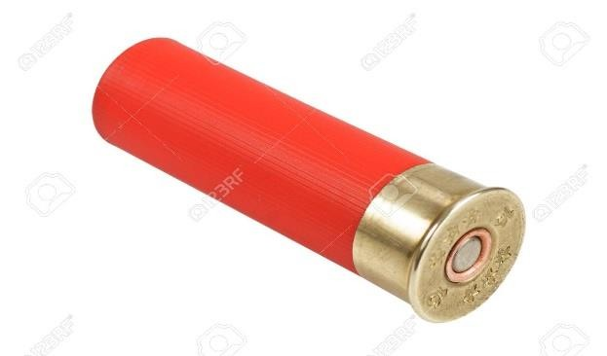
CARTRIDGE
Core Concept
Cartridge case with percussion cap containing the primer at the base.
Propellant charge
Projectile(bullet, shot/pellets)
Wads

Slide 21
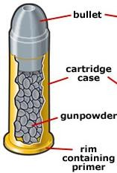
1. Cartridge case
Core Concept
Outer covering made of
Brass(bullet)
Plastic/cardboard(shotgun cartridge)
USE:
Keeps all components of cartridge together
Water proof
Preservation
Percussion cap at the base contains primer
Whole cartridge is combustible

Slide 22
Primer
Core Concept
The percussion cap at the base contains a small amount of sensitive detonating composition known as the primer.
Primer ignites the propellant through the flash
hole.
The primer composition may contain,
Potassium chlorate
Antimony sulphide
lead styphnate,
Barium nitrate
21

Slide 23
2. Propellant charge
Core Concept
It propels the missile forwards.
It is composed of:
Black powder or gun powder
Smokeless powder
It lies between the primer & projectile.
Its ignition results in rapid formation of expanding hot gases under
pressure.
Chamber pressure(pressure inside the chamber)
Revolver -------- 4 tons
Pistol ----------- 6 tons
Rifle ------------ 20 tons
22

Slide 24
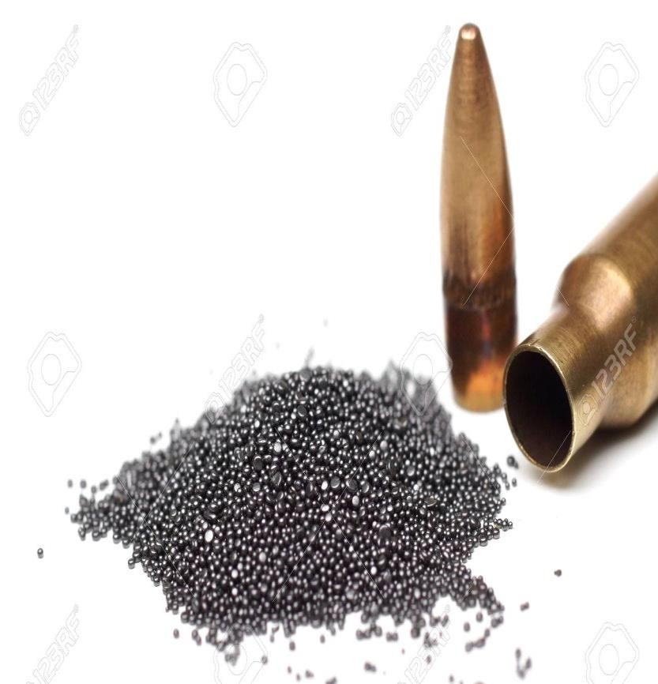
Types of Propellant:
Core Concept
Black powder
Smokeless powder
Black powder Contains:
Charcoal 15%,
Sulphur 10%
Potassium Nitrate 75% When ignited, it produces
Smoke
Powder partly burnt
Powder not burnt
More blackening and tattooing seen around
injury
23

Slide 25
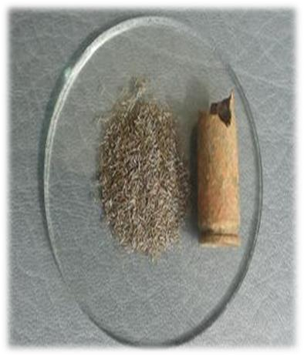
2. SMOKELESS POWDER
Core Concept
Contains:
Nitrocellulose – single base
Nitroglycerine --------- double base
It is more effective than black powder as it burns more efficiently.
When it ignites, it produces
Much less or no smoke.
Less blackening and tattooing
24
around the injury.

Slide 26
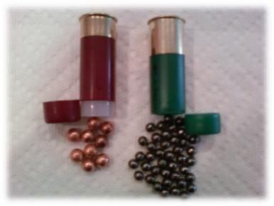
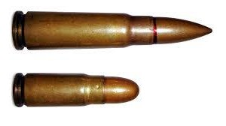
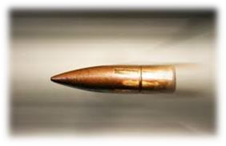
3. PROJECTILE
Core Concept
Any object being capable of projecting with great force from a fire arm weapon is known as projectile
Pellets in shot guns.
Bullet in rifled fire arms.
25

Slide 27
Bullet
Core Concept
A bullet is made of lead.
Since lead is a soft material and easily deformable, the bullet is jacketed either fully or partly with cupronickel and copper.
26

Slide 28
Core Concept
Tip of the bullet is known as the nose.
A rifle bullet is elongated with a pointed nose.
The revolver and pistol bullets are shorter with a rounded nose.

Slide 29
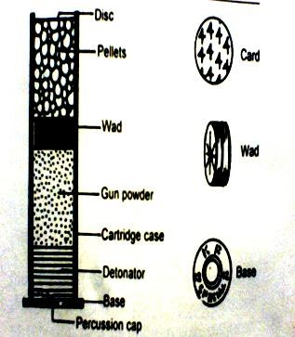
4. WAD
Core Concept
It is a circular disc used in the shotgun cartridge. One or more wads maybe present.
Made up of felt, cardboard, plastic, stout paper. Functions;
Separates the projectile from propellant.
Seals the bore effectively.
Prevents the gases from escape.
Allows optimum pressure to be developed.

Slide 30
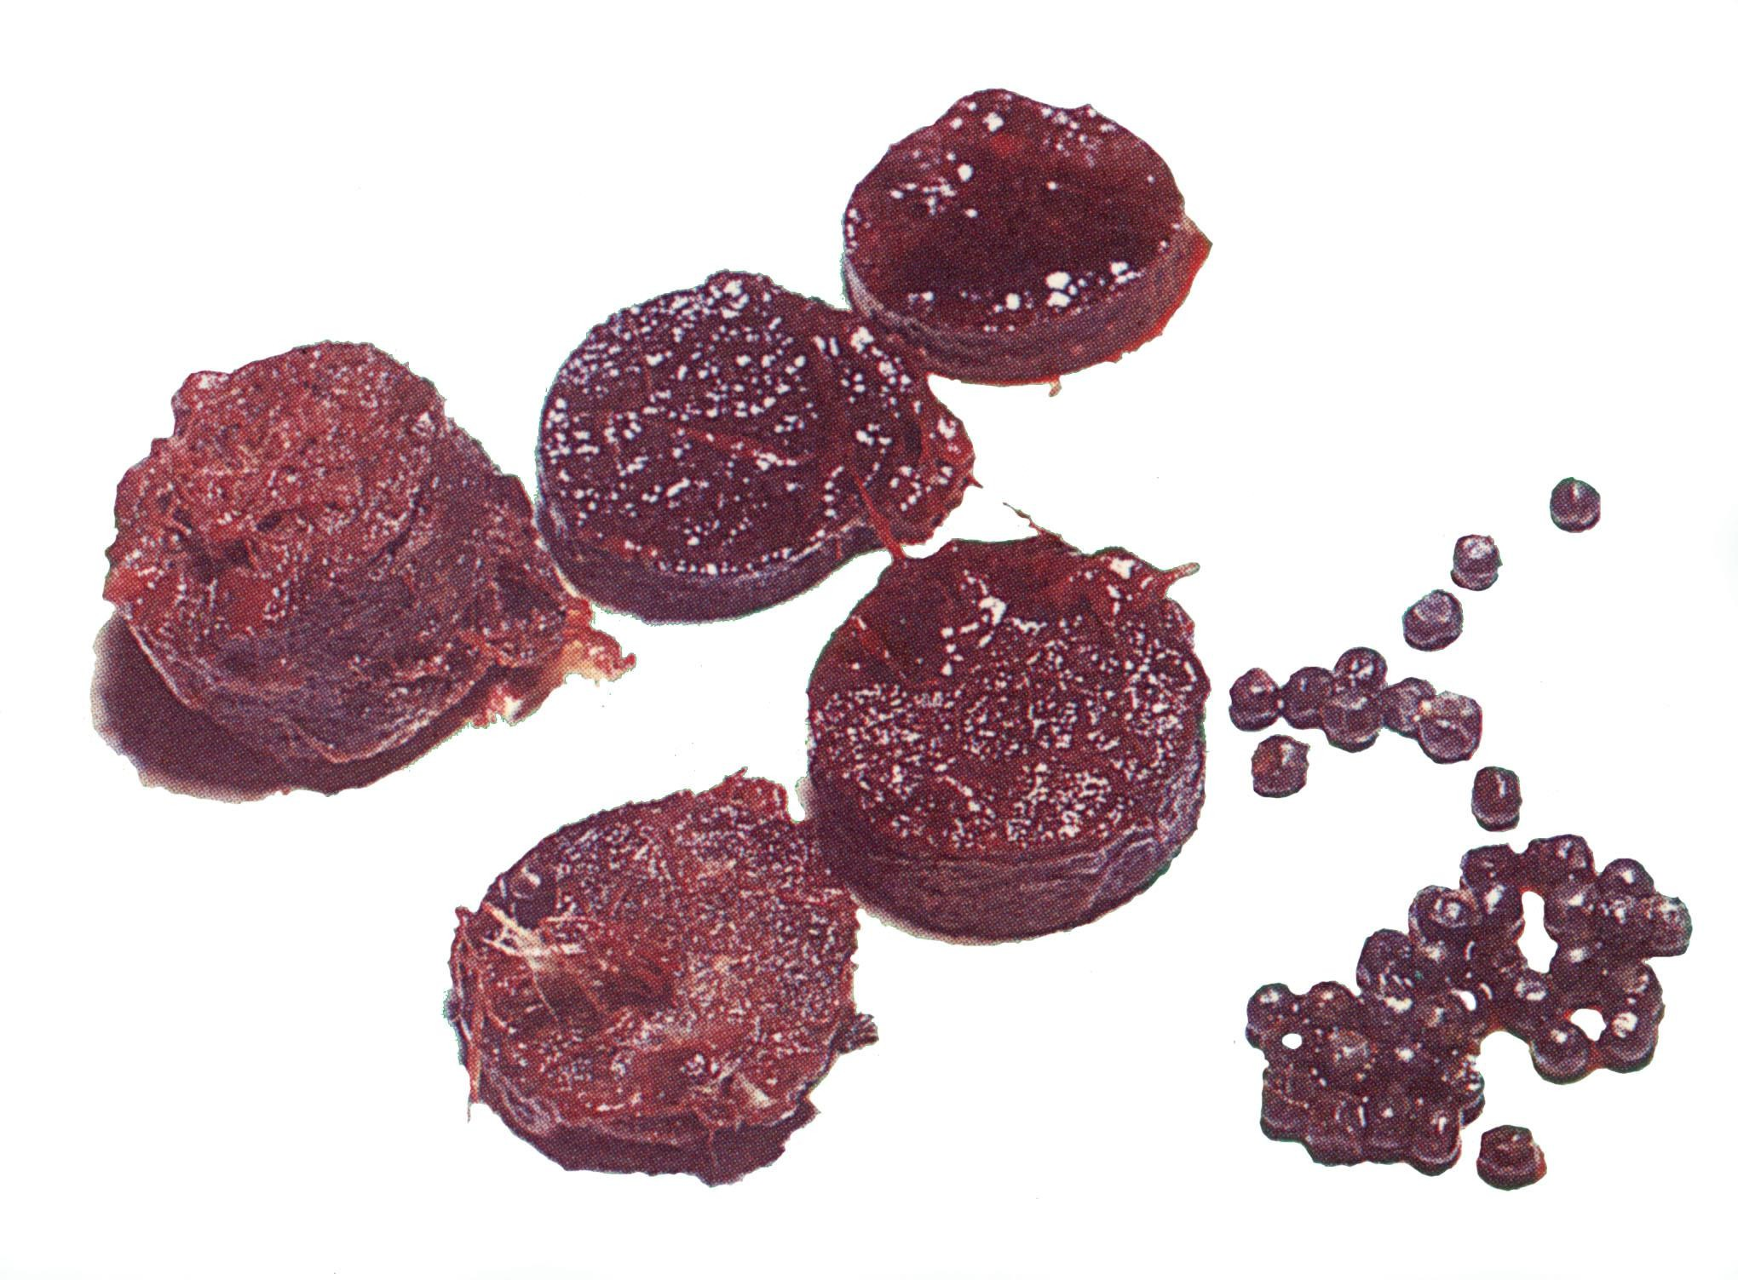
Wads & shots
Core Concept
Recovered on post-mortem examination

Slide 31
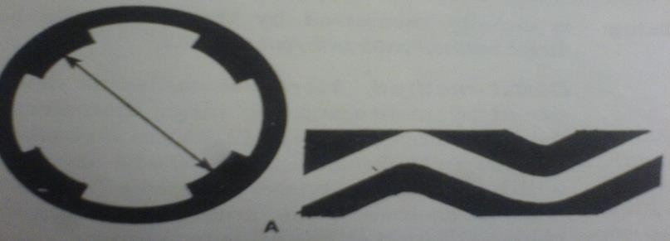
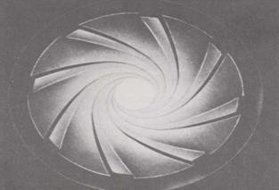
RIFLING
The inside of the bore is rifled i.e, it is cut lsongitudinally with a number of spiral grooves (usually 4 – 7) which run parallel to each other from chamber end to muzzle end and the missile spins on their long axis.
Core Concept

Slide 32
The function of grooves is to impart a spin movement to the bullet while passing through the barrel.
Core Concept
Advantages of Rifling:
It gives spinning(gyroscopic) movement to bullet.
Prevents from wobbling.(stabilizes the bullet)
Increases the power of penetration.
Gives greater accuracy and longer range. (forward movement)
31

Slide 33
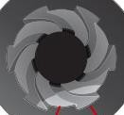
BORE/CALIBER/GAUGE
Core Concept
It is the diameter of the interior of the barrel expressed in
inches or millimeter.
In case of smooth bore weapon the number of lead balls of equal size made from 1 pound of lead, which completely fit into the barrel is the bore.
eg.12 bore shot gun, we take 1lb of lead and make 12 rounded balls of equal weight and each ball fits exactly the internal diameter of the barrel .As the bore increases the internal diameter of the barrel decreases.
12 bore ------------------- 20 bore.
In case of rifled firearm it is the distance between two
opposite lands, in 1/100th of an inch.
22 caliber pistol means 22/100th inch = 0.22”
It mean the weapon is a pistol with a caliber of 0.22
inches
32

Slide 34
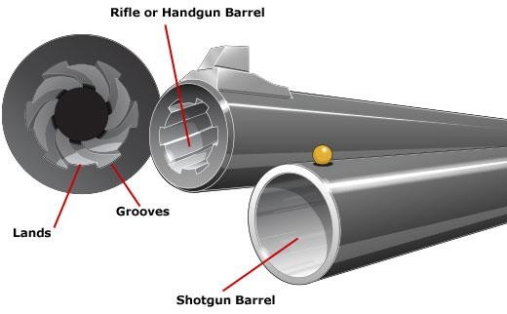
Core Concept

Slide 35
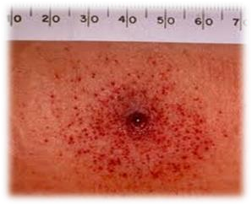
Tattooing
Core Concept
Gun powder consists of particles which are embedded
under the skin through the force of their impact.
It is seen only when the weapon is near enough for
the powder grains to strike with force.
STIPPLING
When the range increases to the point that the powder particles do not embed themselves but still leave a visible mark, it is called stippling.

Slide 36
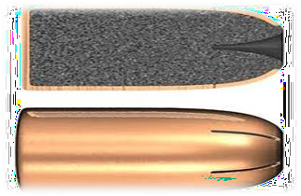
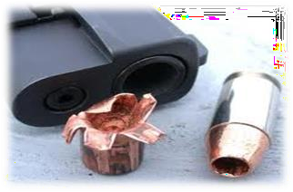
Types Of Bullet
Core Concept
Dum Dum bullets: are jacketed bullets with its nose cut off to expose the core.
They mushroom up into pieces when they strike the body; they are very destructive and produce extensive lacerated wounds

Slide 37
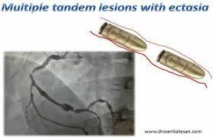
Tandem Bullets / Piggy Back Phenomenon:
bullets ejected one after other, when the first bullet, having been struck in the barrel, fails to leave the barrel, and is ejected by the subsequent fired bullet. When weapon is old or rusty and faulty.
Core Concept

Slide 38
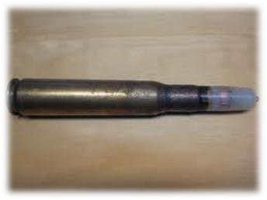
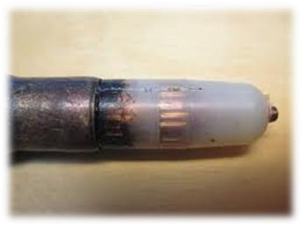
Duplex rounds:
This contains two projectiles by design. They enter the target at different points
Core Concept

Slide 39
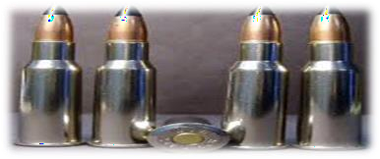
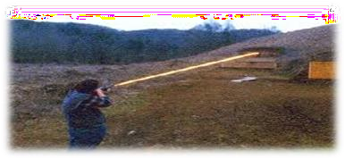
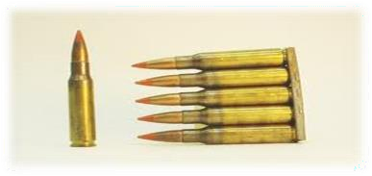
Core Concept
Tracer Bullets:
These bullets have Barium per oxide and magnesium enclosed in their base.
These bullets emit light as they pass, usually used for signaling purposes.

Slide 40
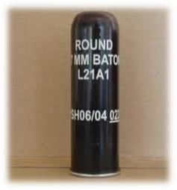
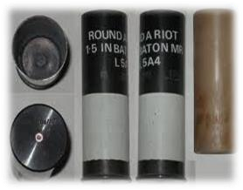
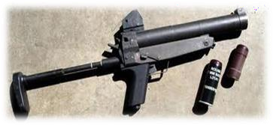
Core Concept
Baton Cartridge:
Rubber bullets or plastic bullets.
Used by police.

Slide 41
RESEARCH
RESEARCH
https://www.ncbi.nlm.nih.gov/pmc/articles/PMC5801608/
https://www.nature.com/articles/d41586-022-03044-5
https://www.rand.org/research/gun-policy/key-findings/what- science-tells-us-about-the-effects-of-gun-policies.html

Slide 42
BIOMEDICAL ETHICS
ETHICS
The 4 basic ethical principles of
Beneficence
Non-Maleficence
Respect for autonomy
Justice
https://journals.sagepub.com/doi/abs/10.1177/10731105209 79415
This piece aims to utilize the fundamental principles of medical ethics to present a framework for physician involvement in firearm violence.

Slide 43
FAMILY MEDICINE
FAMILY MEDICINE
Firearm-related deaths are on the rise in Pakistan and western world, especially among our youth.
https://www.ncbi.nlm.nih.gov/pmc/articles/PMC7213995/
The 4 universal rules of gun safety are:
Treat all guns as if they are always loaded.
Never let the muzzle point at anything that you are not willing to destroy.
Keep your finger off the trigger.
Be sure of your target and what is behind it.

Slide 44
How To Access Digital Library
1. Go to the website of HEC National Digital Library.
2. On Home Page, click on the INSTITUTES.
3. A page will appear showing the universities from Public and Private Sector and other Institutes which have access to HEC National Digital Library HNDL.
4. Select your desired Institute.
5. A page will appear showing the resources of the institution
6. Journals and Researches will appear
7. You can find a Journal by clicking on JOURNALS AND DATABASE and enter a keyword to search for your desired journal.

Slide 45
TEXT BOOKS & PRACTICAL NOTEBOOK:
Principles & Practice of Forensic Medicine.
by Nasib R. Awan
Parikh’s Textbook of Medical Jurisprudence,
Forensic Medicine & Toxicology.
Practical Manual Of Forensic Medicine
& Toxicology

Slide 46
THANK YOU

