Slide 1
TRACE EVIDENCE
Dr Sharukh & Dr Shahida
Forensic Medicine & Toxicology

Slide 2
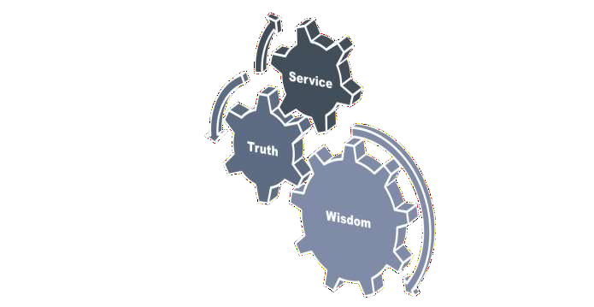
Motto of RMU

Slide 3
Vision of RMU The Dream/ Tomorrow
To impart evidence based research oriented medical education
To provide best possible patient care
To inculcate the values of mutual respect and ethical practice of medicine

Slide 4
Motto of RMU

Slide 5
Motto of RMU

Slide 6
Motto of RMU

Slide 7
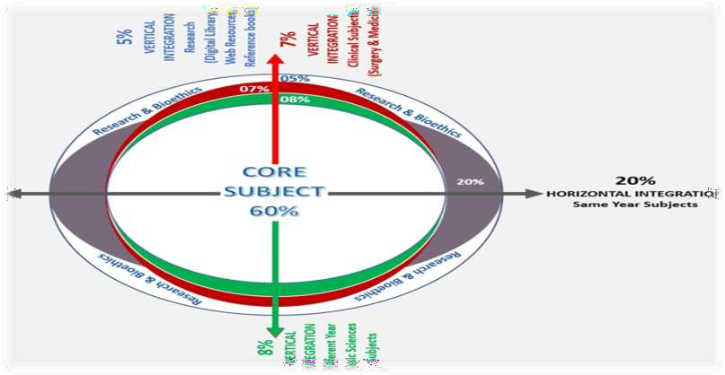
Prof Umar’s LGIS model

Slide 8
Motto of RMU

Slide 9
SEQUENCE OF LGIS
Learning Objectives
Core concept 70 %
Horizontal integration related to Pathology and Pharmacology 15 %(if applicable)
Relevant clinical concepts and medico legal application of core knowledge / Vertical integration 10%
Research article relevant to the topic 3%
Ethics and family medicine 2%

Slide 10
Motto of RMU

Slide 11
Learning Objectives
Define trace evidence and Locard’s principle of exchange.
Briefly explain the different types of trace evidence.
State the medicolegal importance of Chain of custody.
Briefly explain the method to collect, preserve, dispatch various human body specimens.

Slide 12
Trace Evidence
Core Concept
Trace Evidence is defined as “the material left on the scene of crime or on the body of a victim or assailant which helps in identification of the source from where it has originated”. For example, trace evidence may be a stain of the body fluid such as saliva, blood, semen etc. or some other material such as a fiber from carpet
or clothing, hair, smoked cigarette butt, grit, paint or
glass piece or teeth or fingerprint etc.

Slide 13
Trace Evidence
Core Concept
Locard's principle of exchange says: "Every contact leaves its trace".
Edmond Locard introduced the concept of use of the trace evidence as means of
personal identification on scientific lines.

Slide 14
Locard’s Exchange principle states that:
Core Concept
Every contact leaves a trace.
Exchange of trace may be and often is a two way process. Comparing it with a control taken from the source from where it is suspected to have come will confirm the character of such a trace. An example of such an exchange is noted in cases of rape (zina), in which transfer of biological material such as semen and blood occurs both from assailant and victim to each other and also to the scene and similarly non – biological material is transferred from the scene to both assailant and victim.

Slide 15
Types of Trace Evidence
Core Concept
The trace evidence can be classified according to the groups to which it belongs:
Biological groups: originated from a human being or a animal.
Non–biological groups: originated from belongings of a person and environment.

Slide 16
Biological group includes body fluids and tissue such as hair or nails etc.
Core Concept
The body fluids include blood, saliva, semen, cerebrospinal fluid, urine, vomit, stomach wash and excreta.
Such fluids may be found in the form of stains at the scene or stains on the clothes, skin and body orifices such as urethra, vagina and rectum etc. of the victim or assailant.
Other examples of the biological materials are human hair from the head, eyebrows and pubis or the hair or body fluids of an animal origin
Scraping from the under surface of nails which contains epithelium of skin of victim or assailant deposited during physical or sexual assault.

Slide 17
Non–biological group includes the items of personal use and other materials found in the environment.
Core Concept
The list of items of personal use consists of clothes
and other possession such as spectacles, wrist watch,
purse or any other thing in the pockets.
Environmental materials are fibers of wool from carpet, vegetation from the garden like pieces of leaves, grass ,seeds , their stems and grit particles from the roads.
This groups may also include implements such as bottles, tablets, bullets or pellets , weapon of offence or any other thing used concerning the crime.

Slide 18
Method For The Collection, Preservation And Despatch Of Specimen To Analytical Laboratory
Core Concept
Source of Specimen
Source of specimen should be above suspicion and that is why the handling is limited to the medical profession, It is generally believed that technical people do not interfere in the form of addition it is necessary to stress that this belief must be maintained at all costs.

Slide 19
Core Concept
Collection:
It must be collected in suitable containers, from contamination. Collection calls for special knowledge to decide the number, choice of specimen, also from where to be collected.
Labelling:
After collection in suitable container, it must be
labelled mentioning clearly the time of collection with date, name of the person from whom taken, the site from where obtained. It should also have the name, designation and address of the Medical Officer.
Sealing:
All these specimens must be carefully sealed. A good way of sealing is to strap the top with paper-adhesive tape around the joint, In practice special seals are available, and the impression of the seal is sent ) the analyst on the forwarding letter for identification

Slide 20
Core Concept
Numbering of the specimens:
When more than one specimen is taken, as in cases of poisoning or sexual assault, it is advisable to identify each specimen with number or a letter and schedule of the specimens with their numbers should be prepared, and sent to the analyst.
Transportation:
Usually the specimens are handed over to police during transit if the sending medical officer and the analyst laboratory are situated on the same station, it is advisable that the specimens should be sent by hand on the same day and receipt obtained from the analyst.
In practice, signature of the police official are obtained over
the medico-legal report at the time of handing over.
If they are sent by post, packages should be such that no damage "takes place during transit and they should be sent by registered post.

Slide 21
Chain of Custody:
Core Concept
In medico legal cases the chain of custody of the body must be
documented by a record in which each person in charge is identified
including when the body came into his custody and when the period
of custody ended.
Care must be taken that no one tampers with the body without properly recorded authorization. If possible a lock should be put on the refrigerator or on the room in which the body is kept.
There also must be a record of chain of custody for other physical
evidence such as toxicological material or bullets.

Slide 22
Core Concept
Such material should be saved in sealed containers, each
labelled with all significant data and numbered with the
corresponding descriptions in the protocol, e.g. to indicate the
exact site from which the foreign body had been removed.
v Confusion is avoided if each specimen is bottled, labelled and sealed in same manner right after it is removed, if sealing wax is used, the doctor should imprint his stamp on the seal while it is warm.
All identifying features must be entered into the autopsy
protocol for finger printing. If the skin of pulp of fingers
are shrivelled, inject air into the subcutaneous tissues of finger
tips.

Slide 23
Core Concept
Safety storage:
Once they are collected, and preserved, they should be sent to
laboratory as early as possible.
For the period of time, they remain with the medical officer, they should be stored in freezer under lock and key.
The analyst should make sure that the seals are intact and they have not been tempered with on their way, after confirming, he should store them in freezer under lock and key, for their turn.

Slide 24
Manner of collection and preservation:
Core Concept
Manner of collection and preservation differ with the type of
specimen, the usual specimen are body fluid i.e.
Blood.
Vomitus.
Stomach wash.
Semen.
Urine.
Excreta.
Other specimens are article of clothing, metallic
Bullets/pellets.

Slide 25
Vomitus, stomach wash, excreta
Core Concept
It is a material of choice in all cases of poisoning by oral
route, also in morphine poison even when taken by injection.
Entire quantity or at least 150 cc is preserved in chemically clean and clear glass bottle with screw cap. No preservative is used.
Blood
It is the most frequently collected body fluid for the detection/estimation of alcohol/drug or poisons.
It is collected with disposable syringe, normally from a vein, Site should not be cleaned with spirit ,in cases of alcohol poisoning.
Quantity taken should be 10 cc. After collection, specimen is transferred into a chemically clean glass container containing 1% sodium fluoride.

Slide 26
Core Concept
The fluoride inactivates the enzymes present in the
blood prevents fermentation and thus acts as a
preservative it is also anticoagulant.
Urine
Collection of the urine is the easiest of all the specimens, taken for detection/estimation of certain poisons and alcohol.
Entire quantity is taken in a chemically clean glass container with screw cap. Normally no preservative is used.

Slide 27
Article & Clothing
Core Concept
Usually taken by the police but when removed by
medical officer in cases of criminal violence at the time
of examination.
They should be placed in hangers to dry them off, and finally packed in clean cellophane bags. Clothes should be signed with a copying pencil.
If they have corresponding injuries mark, they should be
encircled and dated.

Slide 28
Bullets:
Core Concept
When present, X-Ray picture AP/ lateral view must
be taken to show the place of their lying.
At operation table, while removing they should be
handed very carefully to avoid scratching.
They are picked with rubber toothed forceps to avoid scratching and damaging the distinguishing mark present on the bullet.
After removal they should be placed in glass bottle of
suitable size, with cotton placed above and below.
An empty bottle of streptomycin may be suitable container.

Slide 29
Core Concept
Semen:
It is an important specimen in all cases of sexual offences, it is usually present on the body or clothes in the form of stains, when present on the clothes, they are sent as such and when on the body, it is preserved in the form of swabs slides.
Vulval sample:
Sterile swab, external and internal before further
examination. Perianal swab should also be taken.
Vaginal swab:
Pipette sample and sterile swab before
further examination, insert non-lubricated speculum to visualize vaginal walls and cervix.

Slide 30
ROUTINE VISCERAS SENT TO CHEMICAL EXAMINATION
Core Concept
Stomach
Stomach should be tied off or clamped above the diaphragm and across the duodenum before being removed from the body, it must be removed intact and its contents measured and collected into a large chemically clean jar. The contents and stomach itself must be retained.
Intestines
Proximal part of small intestine at least 2 to 3 feet and its
contents.

Slide 31
Core Concept
Liver, spleen and kidney
16 Ounces of Liver, half spleen and one kidney.
Finger-Nail Scrapings
Place in individual containers such as test-tubes or envelopes.
Samples of Pubic Hairs
Combed or plucked from live or dead body sellotape may be used to pick-up loose hairs.
Sample of head hairs
Combed or plucked.

Slide 32
Method of collection & dispatch of viscera to chemical examiner
Core Concept
If the patient is alive the following material should be preserved, preferably in the quantity mentioned:
1. | Vomit 300 ml | It less available, the whole quantity
2. | Stomach washout 500 ml | If less available, the whole quantity
3. | Blood and urine As mentioned below

Slide 33
Core Concept
Material | Quantity
Stomach | Whole
Stomach contents | 300 ml. If less available, whole quantity
Small intestine | 100 cms in adults, 200 cms in children, and whole in infants, preferably tied at short lengths
Small intestine contents | 100 ml. If less available, the whole quantity
Liver, preferably the portion containing gall bladder and its contents | 500 gms or 5 cms thick slice of liver in adults, and whole in children and infants
Spleen | Half in adults, and whole in children

Slide 34
Core Concept
Kidneys | Half from each kidney in adults and both kidneys in children
Urine | 100-200 ml If less available, the whole quantity
Blood | 10 ml, preferably more, 100 ml As much as can be withdrawn
Vitreous

Slide 35
Stomach
Core Concept
Bottle no.1
Tie both ends by double ligature and remove it. Place in a clean plate and open it along the lesser curvature contents of stomach and put in bottle No. 1 preservative is added then it is sealed and labeled. On the bottle it is written:
No. of postmortem.
Date of postmortem examination.
Name of the deceased.
Signature of the Doctor.

Slide 36
Bottle no.2
Core Concept
16 ounces of liver.
One kidney.
Spleen.
Which is sealed and labeled.
Bottle no.3
A portion of small intestine, upper part at least 2-3 feet and its content.
Bottle no.4
Sample of preservative added.
Best preservative is saturated saline, other is rectified sprit;/ quantity of preservative should be equal to the viscera in bulk. Bottle should be of such a size to leave about one third of the bottle empty after addition of preservative to prevent bursting of bottle by gases of decomposition.

Slide 37
Core Concept
Stopper should be greased and covered with a piece of cloth which is
tied with a thread and sealed.
A label bearing the name of deceased and no. of bottle and contents is pasted on the bottle.
The bottles are packed in wooden box.
A duplicate copy of rewarding letters is also enclosed in the box. This means a sample of seal used.
The box is then covered with a cloth which is sewn and sealed.
This is then dispatched to the chemical examiner.

Slide 38
Research
Research
https://scholarlycommons.law.northwestern.edu/cgi/vie wcontent.cgi?referer=&httpsredir=1&article=4721&conte xt=jclc
https://nij.ojp.gov/topics/articles/improving-analysis-and-
collection-trace-evidence-samples
https://www.researchgate.net/publication/259271974_Tra
ce_Evidence_Overview
https://nij.ojp.gov/topics/forensics/trace-evidence

Slide 39
Biomedical Ethics
Ethics
Bioethics in healthcare brings understanding and knowledge
among healthcare professionals about medical practice.
Stressing upon the ethical aspects of bioethics, medical professionals are capable oftagging along ethical codes while practicing especially while dealing with issues.
https://www.ncbi.nlm.nih.gov/pmc/articles/PMC7219182/
https://www.nuffieldbioethics.org/wp-content/uploads/The- forensic-use-of-bioinformation-ethical-issues.pdf

Slide 40
Family Medicine
Family Medicine
https://www.ncbi.nlm.nih.gov/books/NBK441852/
Crime scene investigators document the crime scene. They take photographs and physical measurements of the scene, identify and collect forensic evidence, and maintain the proper chain of custody of that evidence.
The Seven S'S of Crime-Scene Investigation
Securing the Scene.
Separating the Witnesses.
Scanning the Scene.
Seeing the Scene.
Sketching the Scene.
Searching for Evidence.
Securing and Collecting Evidence.

Slide 41
How To Access Digital Library
Go to the website of HEC National Digital Library.
On Home Page, click on the INSTITUTES.
A page will appear showing the universities from Public and Private Sector and other Institutes which have access to HEC National Digital Library HNDL.
Select your desired Institute.
A page will appear showing the resources of the institution
Journals and Researches will appear
You can find a Journal by clicking on JOURNALS AND DATABASE and enter a keyword to search for your desired journal.

Slide 42
Learning Resources
Principles & Practice of Forensic Medicine by Nasib R. Awan
Parikh’s Textbook of Medical Jurisprudence, Forensic Medicine & Toxicology.

Slide 43
THANK YOU

