Slide 1
THANATOLOGY-II
Livor Mortis & Rigor Mortis
Dr Shahida & Dr Gulzaib
Forensic Medicine & Toxicology

Slide 2
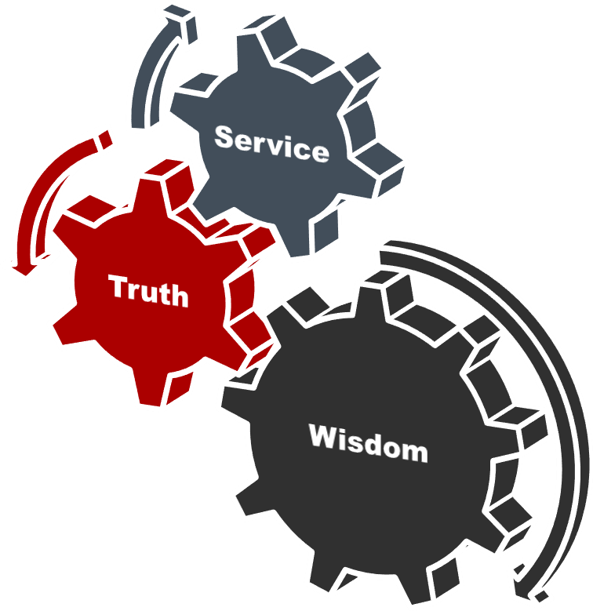

Slide 3
Vision of Rawalpindi Medical University The Dream/ Tomorrow
To impart evidence based research oriented medical education
To provide best possible patient care
To inculcate the values of mutual respect and ethical practice of medicine

Slide 4
Prof Umar’s LGIS Model

Slide 5
SEQUENCE OF LGIS
Learning Objectives
Core concept 70 %
Horizontal integration related to Pathology and Pharmacology 15 %
Relevant clinical concepts and medico legal application of core knowledge / Vertical integration 10%
Research article relevant to the topic 3%
Ethics and family medicine 2%

Slide 6
Learning Outcomes:
Students will be able to:
Define Livor mortis and state its medico legal importance.
Differentiate between Livor mortis and bruise.
State the mechanism of Rigor Mortis in the body after death and its medico legal importance?
Enumerate the factors which modify the onset & duration of rigor mortis?
Enlist the conditions simulating rigor mortis and differentiate them

Slide 7
Livor Mortis
Core Concept
Livor Mortis
Postmortem lividity
Postmortem staining
Hypostasis
Vibices
It is discoloration of the body (skin & organs) due to accumulation of fluid blood in toneless capillaries and small veins of dependant parts of the body.

Slide 8
Livor Mortis
Core Concept
Time require for its development
Reddish purple discoloration
Appreciable within about ½ hr of death
1-3 hrs……a series of mottled patches
3-6 hrs……increase in size and join together.
6-8hrs…….fully developed and fixed.
Fixation of PM lividity is due to packing and complete stagnation of blood in the distended toneless capillaries and small veins.
Fixation of PM lividity is not due to coagulation of blood.
If you change the position of the body there is no change in the position of livor mortis/Hypostasis/PM lividity when it is fixed.

Slide 9
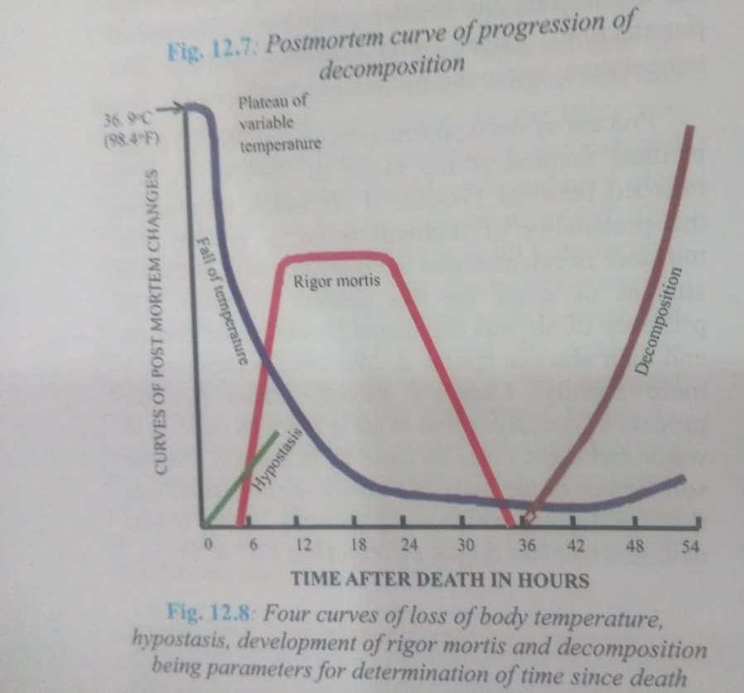
Livor Mortis
Core Concept

Slide 10
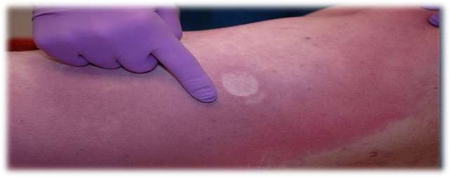
Livor Mortis
Core Concept
How to check fixation?
If thumb pressure blanches the area ------ lividity is not fixed
------ time since death less then 8hrs.
If thumb pressure doesn’t blanch ------ lividity is fixed ------- time since death is more then 6hrs.
This is called Blanching effect of PM lividity

Slide 11
Livor Mortis
Core Concept
Contact Flattening
These are the areas of body which are in actual contact with the surface on which the body is lying.
Post mortem lividity is not developed over such areas because the toneless capillaries are compressed by the weight and pressure of the body. E.g.
If a person is lying on his back at the time of death, the post mortem lividity is not seen on the back of his shoulder blades, buttocks and back of the calves.

Slide 12
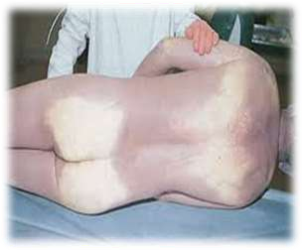
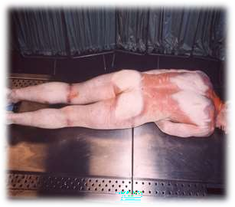
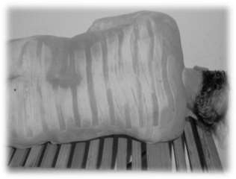
Livor Mortis
Core Concept
Hypostasis & Contact Flattening

Slide 13
Livor Mortis
Core Concept
Examples:
Person lying on his back on a flat surface.
Person lying on crumpled blanket.
Hanging.
Drowning in moving water.
Drowning in still water.
Color and Intensity of lividity:
Depend on:-
Color of blood
Mode of death
Example:-
Normally ------------------ blue-pink later blue-purple
Corbonmonoxide poisoning ----------- bright cherry red
Opium poisoning ---------------- black

Slide 14
Livor Mortis
Core Concept
Cherry red……………CO poisoning
Pink……………………..Cyanide
Chocolate brown…..Chlorates
Dark brown…………..Phosphorus
Reddish brown……….Nitrites
Green……………………..Hydrogen sulphide
Black……………………….Opiates
Grayish brown………..Septic abortion caused by Clostridium
perfringens.

Slide 15
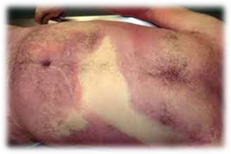
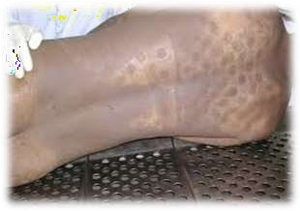
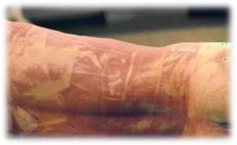
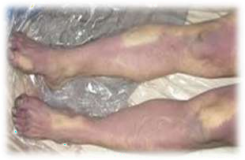
Livor Mortis
Core Concept
Post Mortem Lividity in different situations

Slide 16
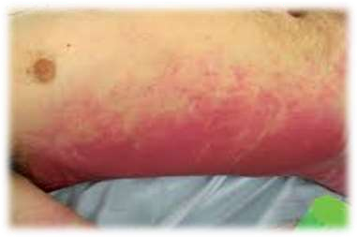
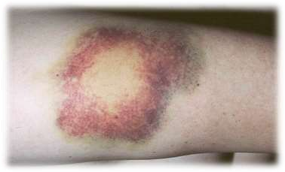
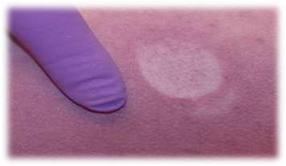
Livor Mortis
Core Concept
Cherry Red Post Mortem lividity in CO Poisoning
Bruise
Blanching effect of PM lividity

Slide 17
Livor Mortis
Core Concept
Medico Legal Importance:
Time since death
Position of the body at the time of death
Cause of death
Anemia…….very faint PM lividity
Asphxia……Intense, purple lividity
Lobar pneumomia……less obvious.
Poisoning…..vary.
Suggest the circumstances at the time of death
e.g. hanging,

Slide 18
Difference between PM Staining and Bruise
Core Concept
Features | Post Mortem Staining | Bruise
Causes | Due to dilation of blood vessels in dermis | Due to rupture of blood vessels
Site | Seen on dependant parts of body | Anywhere on the body
Appearance | No elevation of the involved area | Swollen
Epidermis | Not abraded | May be abraded
Margins | Clearly defined | Merge with the surrounding area
Colors | Uniform bluish purple | Color changes with the age of the injury
On incision | Blood in blood vessels, which can be easily washed away | Extravasated blood ,which cannot be washed away
Effect of pressure | Absent | Little lighter over the area of pressure

Slide 19
Rigor Mortis
Core Concept
Muscle tissue after death pass through 3 stages.
Primary relaxation or flaccidity
Rigor mortis or cadaveric rigidity
Secondary relaxation
Primary flaccidity -----------> Rigor Mortis---------->secondary flaccidity
Primary Relaxation:
Relaxation of muscle tone immediately after death results in
Relaxation of sphincters resulting in incontinence of urine and faeces.
Dilatation of pupils.
Drooping of lower jaw.
Flexibility of joints.
Muscles still react to external stimuli like mechanical , chemical, electrical.
WHY??? Because Tissues are still alkaline

Slide 20
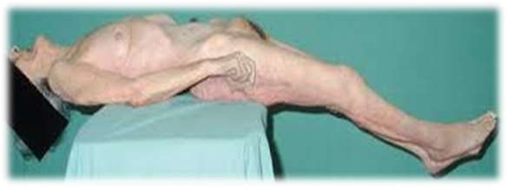
Rigor Mortis
Core Concept
Rigor = Rigidity Mortis = of death
Rigor mortis is that state of the muscles in a dead body when they become stiff or rigid with some degree of shortening.
The phase of primary relaxation of the muscles continues for about an hour which is followed by stiffening or rigidity. It indicates molecular death of the concerned muscles

Slide 21
Rigor Mortis
Core Concept
During life:
Production and utilization of ATP is balanced
After death:
ATP is resynthesized -------------glycogen(locally available)
ATP cannot be resynthesized ---------- glycogen (used)
Fusion of myosin and actin filaments into a dehydrated stiff gel. This
condition is Rigor Mortis.
Muscle reaction changes from alkaline to acidic due to local formation of lactic acid.
Breaking of the Rigor Mortis:
Rigor mortis can be broken by mechanical force. But it doesn’t
appear again when once broken.
No rigor mortis --------- in less than 2 hours and more than 36 hours

Slide 22
Rigor Mortis
Core Concept
Mechanism & Sequence:
Appears first in involuntary muscles e.g. Heart within an hour
after death.
In voluntary muscles:
Eyelids …………………………..3-4 hours
Face……………………………… 4-5 hours
Neck and trunk ……………..5-7 hours
Upper extremities …………7-9 hours
Lower extremities ………….9-11 hours
Finger and toes……………….11-12 hours
Rigidity passes off in the same order due to autolysis of
muscles protein.
Rigor mortis of erector pilae muscles -------granular puckered appearance ------ Goose skin or Cutis anserina

Slide 23
Rigor Mortis
Core Concept

Slide 24
Rigor Mortis
Core Concept
Average Duration of RM Development
Rigor mortis starts in 2 -3 hours after death.
Develops in 12 hours after death ---------- Developing stage/phase
Persists for 12 hours after death --------- Static stage
Passes off in 12 hours after death --------- Passing off phase
Also known as March of Rigor Mortis or Rule of 12
Stage of development:
Developing stage/phase
Static stage
Passing off phase

Slide 25
Rigor Mortis
Core Concept
Progression of Rigor Mortis
Eyelid 3-4 hrs
Face 4-5 hrs
Neck & Trunk 5-7 hrs
Upper Limb 7-9 hrs
Lower Limb 9-11 hrs
Small Muscles of fingers & toes 11-12 hrs
Static phase 13-24 hrs
Passing off phase 25-48 hrs

Slide 26
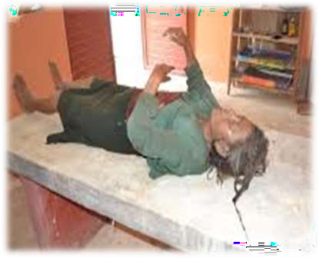
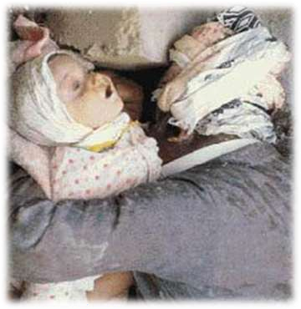
Rigor Mortis
Core Concept

Slide 27
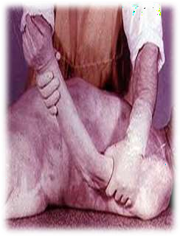
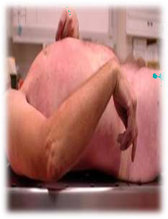
Rigor Mortis
Core Concept
Testing of Rigor Mortis
Attempting to open eyelid
Depressing the jaw
Flexing neck and other joints
Factors effecting Rigor Mortis
Temperature
Age
Body structure
Nutritional status
Muscular activity
Mode of death

Slide 28
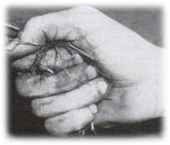
Rigor Mortis
Core Concept
Secondary Relaxation
Synchronous with onset of putrefaction
Muscles become soft and flaccid.
Do not respond to mechanical and electrical stimuli.
Tissues are alkaline.
Medico Legal Importance
Diagnosis of death.
Determining postmortem interval.
Determining manner of death.
Position of body at the time of death
Conditions simulating Rigor Mortis
Heat stiffening
Cold stiffening
Cadaveric spasm

Slide 29
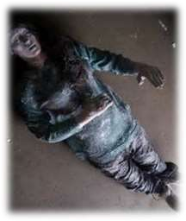
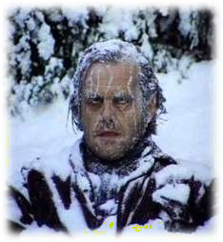
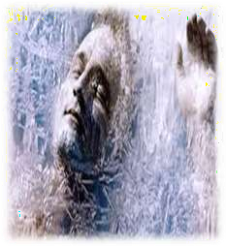
Conditions simulating Rigor Mortis
Core Concept
1. Freezing or Cold Stiffening
Bodies undergo cold stiffening due to solidification of body fat
when exposed to freezing temperature.
Stiffening disappears ------ Rigor ------------removed from freezing temp
Rigor comes rapidly ------- lasts less time ----- less intensity

Slide 30
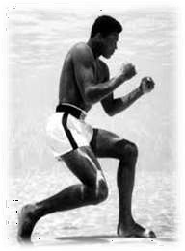
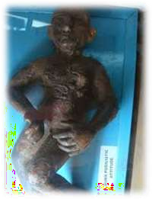
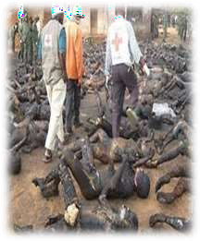
Conditions simulating Rigor Mortis
Core Concept
Heat coagulation or heat stiffening
Seen in bodies subjected to heat more then 70 C e.g. burning, high voltage electrocution and boiling fluids.
Heat coagulate the proteins and causes stiffening/ contraction
Pugilistic attitude, boxer’s attitude and fencing posture
Rigor doesn’t develop -------------------- decomposition

Slide 31
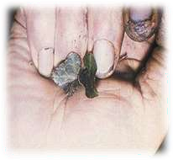
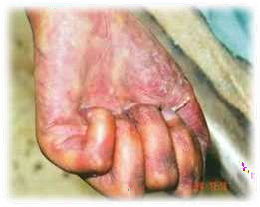
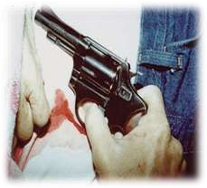
Conditions simulating Rigor Mortis
Core Concept
Cadaveric spasm
Also known as Instantaneous Rigor or Instantaneous rigidity
“Stiffening of muscles immediately after death without the stage of primary relaxation.”
It is seen in
Extreme physical activity at the time of death
Great emotional tension at the time of death
Somatic death occurs in extreme rapidity

Slide 32
Conditions simulating Rigor Mortis
Core Concept
Cadaveric spasm
It is a conclusive proof that the object was
gripped at the time of death.
It is impossible to simulate cadaveric spasm.
In rigor mortis ---------- moderate force required to break it .
In cadaveric spasm -------- very great force is required.
Group of muscles are involved e.g. muscles of forearms and hands.
Light weight objects may be firmly grasped in the hand after death.
Knife/ Pistol ------------------ Suicide
Grass/ weeds ------- Drowning
Hair ------------------- Homicidal scuffle

Slide 33
Difference Between Rigor Mortis &Cadaveric Spasm
Core Concept
Rigor Mortis | Cadaveric Spasm
Postmortem | Antemortem
Involves both voluntary as well as involuntary muscles | Involves only voluntary muscles.
Muscles of whole body are affected | Only a group of muscles is effected.
Has a specific pattern of development | Develops instantaneously, being associated with last action before death
Occurs in all deaths | Occurs in sudden death and emotional stress.
Moderate force is required to break the rigidity | Very hard to break
Has no relation to establishment of manner of death | Helps to establish manner of death

Slide 34
RESEARCH
Research
https://pubmed.ncbi.nlm.nih.gov/9651006/
https://www.wjpmr.com/download/article/33032018/15224 79038.pdf
https://www.nature.com/articles/s41418-017-0012-4
https://www.ncbi.nlm.nih.gov/pmc/articles/PMC5749053/
http://howmed.net/forensic/concept-of-death-cause-mode-
manner-and-stages/

Slide 35
BIOMEDICAL ETHICS
ETHICS
Death is often considered in terms of medical, legal, ethical, philosophical, societal, cultural, and religious rationales.
The biomedical definition of death is primarily a scientific issue supported by the best available evidence.
Time of death is important because of survivorship clauses in wills.
A medical practitioner has certain ethical and legal responsibilities regarding death, such as:
Effort for prevention of death
Determination of death
Determination of time/moment of death
Declaration of death
Issuing the certificate
If needed, autopsy or organ removal for transplantation.
https://www.ncbi.nlm.nih.gov/pmc/articles/PMC80882/

Slide 36
How to Approach a dead body
Family Medicine
Family Medicine participation will likely lead to improve
quality of life and death in patients
Prompt and accurate certification of death is essential as it serves a number of functions
When a patient dies it is the statutory duty of the doctor who
has attended in the last illness to issue the death certificate.
A medical certificate of cause of death enables the deceased’s family to register the death.
https://www.ncbi.nlm.nih.gov/pmc/articles/PMC5084539/

Slide 37
How to use HEC Digital Library
Go to the website of HEC National Digital Library
http://www.digitallibrary.edu.pk
On Home Page, click on the INSTITUTES.
A page will appear showing the universities from Public and Private Sector and other Institutes which have access to HEC National Digital Library (HNDL).
Select your desired Institute.
A page will appear showing the resources of the institution
Journals and Researches will appear
You can find a Journal by clicking on JOURNALS AND DATABASE and enter a keyword to search for your desired journal

Slide 38
Learning Resources
Principles & Practice of Forensic Medicine by Nasib R. Awan
Parikh’s Textbook of Medical Jurisprudence,Forensic Medicine & Toxicology.

Slide 39
Thank you

