Slide 1
THANATOLOGY-I
Introduction ,Types Immediate & Early signs of death
Dr Urooj & Dr Naila
Forensic Medicine &Toxicology

Slide 3
Vision of Rawalpindi Medical University The Dream/ Tomorrow
To impart evidence based research oriented medical education
To provide best possible patient care
To inculcate the values of mutual respect and ethical practice of medicine

Slide 4
Prof Umar’s LGIS Model

Slide 6
SEQUENCE OF LGIS
Learning Objectives
Core concept 70 %
Horizontal integration related to Pathology and Pharmacology 15 %
Relevant clinical concepts and medico legal application of core knowledge / Vertical integration 10%
Research article relevant to the topic 3%
Ethics and family medicine 2%

Slide 7
Learning Outcomes:
By the end of class students will be able to
Define Death , sudden death and suspended animation.
Differentiate between somatic and molecular death
Briefly explain mode , manner , mechanism and cause of death
Enumerate different immediate and early signs of death.
Define Algor mortis and state its medicolegal importance.

Slide 8
Thanatology
Core Concept
Thanatos
meaning death
Logos meaning science.
Forensic thanatology is the medicolegal study of death.
Life depends upon Three vital systems
Respiratory system………………………………….Asphyxia
Circulatory system……………………...............Syncope
Central nervous system…………………………..Coma
This is called the TRIPOD OF LIFE

Slide 9
Death/Thanatology
Core Concept
Cessation of all physiological processes or complete and permanent cessation of circulation and respiration is called Death

Slide 10
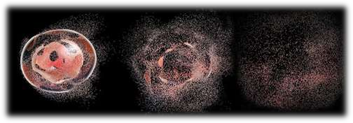
Levels of death
Core Concept
Somatic:
Cessation of vital functions of human body.
Cellular/Molecular:
Individual death of cells of tissues.

Slide 11
Somatic death clinical criteria
Core Concept
Cessation of heart beating :
Absence of pulse (central i.e. carotid )
Absence of heart sound on repeated prolonged auscultation.
A flat electrocardiogram (ECG).
Cessation of breathing:
Absence of respiratory movement
Absence of breath sound on thorough auscultation of chest. (Central)
Cessation of brain activity:
Generalized flaccidity with generalized anesthesia.
Dilated fixed pupils, not responding to light.
Absence of motor responses within the cranial nerve distribution on painful stimuli.
Absence of corneal reflexes

Slide 12
Cellular/Molecular death
Core Concept
It is the death of individual tissues and cells depending upon their oxygen requirement.
Biologically death of organs is spread over a period of time. It is generally completed within 3 to 4 hours of somatic death.
i. Nervous tissue | ------- | 5 minutes
ii. Liver | ------- | 15 minutes
iii. Kidney | ------- | 45 minutes
iv. Heart | ------- | 1 hour
v. Cornea | ------- | 6 hours
vi. Muscle tissue | ------- | 3 to 6 hours

Slide 13
Cellular/Molecular death
Core Concept
Somatic death is followed by progressive disintegration of
body tissues and is called as cellular or molecular death.
In absence of circulation and respiration different cells die at different times.
Brain Death:
Brain death means irreversible loss of cerebral function.
Brain death means that the patient is dead whether or not the function of some other organ such as heart beat is maintained by artificial means and all the function of the brain must have permanently and irreversibly ceased

Slide 14
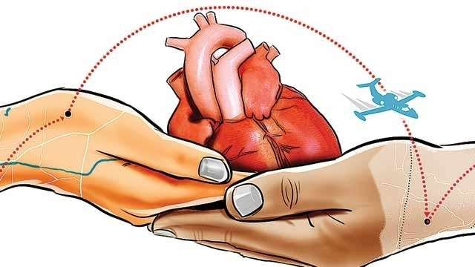
Medicolegal Importance
VERTICAL INTEGERATION
Why it is important to differentiate between somatic death and molecular death?
Disposal of body
Organ transplantation

Slide 15
WHO clinical brain death criteria
Core Concept
Coma or unresponsivness…..No cerebral motor response to pain in all extremities
Absence of brainstem reflexes
Pupils
Absent pupillary response to light Mid position , dilated and fixed
Ocular movements
No oculocephalic reflex
Absent oculovestibular reflex
Facial sensation & motor response No jaw reflex ,No corneal reflex
No grimacing to deep pressure on nail bed , supraorbital ridge
Pharyngeal and tracheal reflexes No gag reflex
No cough response to bronchial suction.

Slide 16
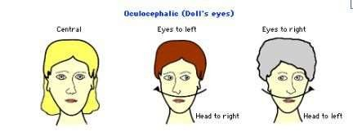
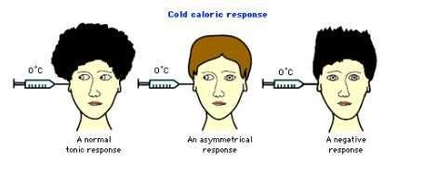
III.
Apnea test:
It is based on the fact that loss of brainstem function
Core Concept
definitively results in loss of centrally controlled breathing with resultant apnea.

Slide 17
Difference between Somatic and Molecular death
Core Concept
Features | Somatic death | Molecular death
Definition | Complete and irreversible cessation of brain , circulation &respiration | Progressive disintegration and death of individual tissues
Onset | Precedes molecular death | Succeeds somatic death
Tissues and cells of body | Alive and functioning | Dead and non-functioning
Response to external stimuli | Muscle responds to thermal , electrical or chemical stimulus | Does not respond
Confirmation | Flat ECG & EEG Absent breath sounds | Algor mortis, Rigor mortis , Livor mortis
Resemblance | Suspended animation , coma , hypothermia | Does not resemble any condition

Slide 18
Suspended Animation/Apparent Death
Core Concept
It is a condition , wherein the vital functions of body (heart beat and respiration) are maintained at a low pitch reduced to a minimum for sometime, that they could not be detected by routine methods of clinical examination.
The function of circulatory , respiratory or nervous system may not be perceived by conventional method though the person is still alive.
The function of these system may return after sometime by proper resuscitation. Such a death like state is known as suspended animation.

Slide 19
Causes of Suspended Animation:
Core Concept
Voluntary
Yoga practicing.
Involuntary
Newborn infants
Drowning
Electrocution
Thunder injury
Sever diarrhea/Cholera
Poisoning
Anesthesia
Shock
Sun-stroke
Epilepsy

Slide 20
Medico legal importance of Suspended Animation
Vertical Integration
It can lead error if precautions are not taken.
Confusion may lead to issue of a dead certificate for a live person
An alive person may be sent to mortuary.
Premature burial / funeral.
May create professional problems for doctor.
May create social/public agitation/problems.

Slide 21
Sudden Death:
Core Concept
Sudden death may be defined as a death which occur suddenly or unexpectedly when a person not known to have been suffering from any dangerous disease, injury or poisoning is found dead or dies within 24hours after the onset of terminal illness.
Causes Of Sudden Death:
Cardiovascular 40-50%
Coronary artery disease , Valvular heart disease Congenital heart disease , Cardiac temponade Hypertensive heart disease , Aortic aneurysm
Respiratory 15-23%
Pulmonary embolism , Air embolism Lobar/Bronchopneumonia Obstruction by foreign body

Slide 22
Core Concept
Central nervous system 10-18%
Intracranial/ Subdural hemorrhage
Meningitis , Embolism , Tumor , Cerebral thrombosis
Gastrointestinal 6-8% Hemorrhage from peptic ulcer Ruptured abdominal aneurysm
Genitourinary 3-5%
Chronic nephritis , Nephrolithiasis , Tumors of kidney/bladder
Reproductive
Rupture of Ectopic pregnancy
Miscellaneous Anaphylaxis Anesthesia
Mismatched blood transfusion

Slide 23
Medico-legal Significance of sudden Death
Vertical integration
In cases of sudden death, it is usually not possible to certify the cause of death from an external examination of the body.
In all such cases, an autopsy is necessary to obviate the possibility of unnatural death.
A doctor who issues a death certificate in such a case runs the risk of being accused as an accessory to a crime and obstructing the course of justice, should the death be found eventually due to foul play.

Slide 24
Different aspects of death:
Vertical integration
Manner of death
Mode of death
Cause of death
Mechanism of death
Manner of death
It is the way by which cause of death was produced.
Natural
Unnatural– Suicidal, homicidal, accidental
Undetermined/unexplained

Slide 25
Modes of death
Vertical integration
Mode of death refers to an abnormal physiological state that pertained at the time of death e.g. cardiorespiratory failure , coma , pulmonary edema.
Coma:
Cessation of function of brain
Asphyxia:
Cessation of function of lungs
Syncope:
Cessation of function of heart

Slide 26
Cause & Mechanism of death
Core Concept
Cause:
The reason of someone's death is basically its cause .It can be
Immediate cause
Contributory cause
Mechanism:
It is the physiological derangement produced by the cause of death that results in death e.g. Hemorrhage , septicemia , Metabolic acidosis etc.
A cause of death e.g. gunshot wound of the abdomen can result in many possible mechanisms of death like hemorrhage or peritonitis leading to septicemia.

Slide 27
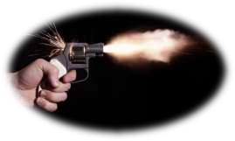
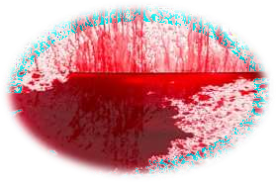
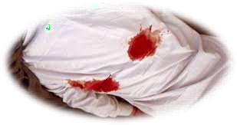
Example:
Core Concept
Cause of death…. Gunshot wound
Mechanism of death…..Hemorrhage
Mode of death……Syncope
Manner of death……Homicide

Slide 28
Signs of Death
Core Concept
Immediate signs:
Irreversible cessation of
Functions of Brain , Circulation , Respiration
Early signs (Early hours postmortem changes) (12-24 hours)
Loss of elasticity of the skin and facial pallor
Primary relaxation of the muscles
Changes in the eyes
Algor Mortis/ Cooling of the body

Slide 29
Core Concept
Livor Mortis/ Postmortem staining/Hypostasis
Rigor Mortis/ Stiffness of the body
Late signs (Late postmortem changes) (after 24 hours)
Putrefaction
Adipocere formation
Mummification

Slide 30
Early Signs
Core Concept
Changes in the eye and skin
Primary flaccidity/relaxation
Cooling of the body (Algormortis)
Postmortem lividity (livormortis )
Stiffening of the body (Rigormortis)
Secondary flaccidity/relaxation

Slide 31
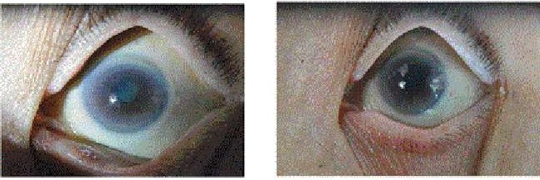
Changes in eye and skin
Core Concept
SKIN
Skin becomes pale, ashy white.
Loses elasticity
Lips darken due to drying.
EYES
Soon after death, glistening appearance of the eye is lost.
Corneal reflex loss.
Cornea becomes dry, cloudy and opaque.

Slide 32
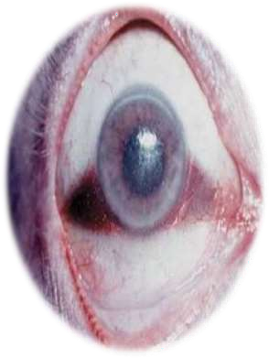
Changes in eye and skin
Core Concept
Tache noir
If the eyelids remain open for 3–4 h after death, there is formation of two yellow triangles
The base of these triangles is on the limbus, apex at the lateral or medial canthus and sides are formed by the margins of the upper and lower eyelids) on the sclera at each side of the iris, which become brown and then black.
Cause: Drying/desiccation, and deposition of cellular debris, mucus and dust on the exposed conjunctiva and the sclera underneath.

Slide 33
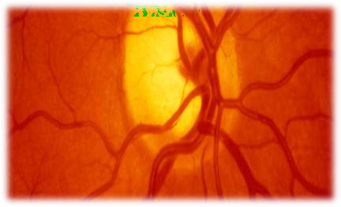
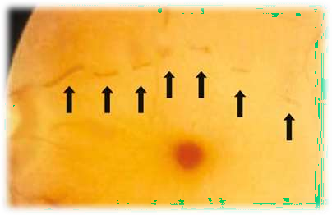
2. Loss of intraocular tension: Intraocular tension falls rapidly after death. It becomes zero in 4–8 h from 10–22 mmHg during life. The eyeballs look sunken in the orbit. „
Core Concept
3. Changes in the retina: The blood in retinal vessels appears fragmented or segmented (cattle trucking or shunting ) within seconds to minutes after death, and persists for about an hour ( Kevorkian sign ).
This occurs all over the body due to loss of blood pressure, but it can be seen only in retina by an ophthalmoscope
Normal retinal vessels Segmented retinal vessels

Slide 34
Algor Mortis
Core Concept
Cooling of the body
Also known as algor mortis.
Algor--------------- coldness
Mortis------------ of death
•
During life there is a balance between heat production and heat
loss
Heat lost= Heat Gain
After death heat production stops. Body loses heat by conduction,
convection and radiation, till it reaches equilibrium with the temperature
of the surroundings.
•
*Most reliable site to record the temperature of the body is its inner core.

Slide 35
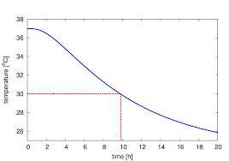
Algor Mortis
Core Concept
Temperature Recording
Temperature is recorded by a chemical thermometer known as thanatometer, 25cm long with a range from 0 to 50degreeC. Inserted 8 to 10cm(4inch) in rectum. It is left their for 2 to 3 mins.
4 readings each,at interval of half hour should be taken.
Sites for recording temperature
Rectum
A small slit in the abdomen under the liver
Auditory meatus in homosexuals
Nostrils
There is no fall in rectal temperature for about 45mins after death.
This phase is known as isothermic phase or postmortem plateau.

Slide 36
Postmortem Caloricity
Core Concept
Post = After.
Mortem = Death.
Calor = Heat
•
In certain conditions the heat may be retained or even increased in the first 2 hrs of death, after which the body begins to cool. This phenomena is known as post mortem caloricity.
Examples
Sunstroke, pontine haemorrhage
Tetanus and strychnine poisoning
Acute bacterial and viral infections such as typhoid, and encephalitis.

Slide 37
RESEARCH
Research
https://pubmed.ncbi.nlm.nih.gov/9651006/
https://www.wjpmr.com/download/article/33032018/15224 79038.pdf
https://www.nature.com/articles/s41418-017-0012-4
https://www.ncbi.nlm.nih.gov/pmc/articles/PMC5749053/
http://howmed.net/forensic/concept-of-death-cause-mode-
manner-and-stages/

Slide 38
BIOMEDICAL ETHICS
Ethics
Death is often considered in terms of medical, legal, ethical, philosophical, societal, cultural, and religious rationales.
The biomedical definition of death is primarily a scientific issue supported by the best available evidence.
Time of death is important because of survivorship clauses in wills.
A medical practitioner has certain ethical and legal responsibilities regarding death, such as:
Effort for prevention of death
Determination of death
Determination of time/moment of death
Declaration of death
Issuing the certificate
If needed, autopsy or organ removal for transplantation.
https://www.ncbi.nlm.nih.gov/pmc/articles/PMC80882/

Slide 39
FAMILY MEDICINE
FAMILY MEDICINE
Family Medicine participation will likely lead to improve
quality of life and death in patients
Prompt and accurate certification of death is essential as it serves a number of functions
When a patient dies it is the statutory duty of the doctor who
has attended in the last illness to issue the death certificate.
A medical certificate of cause of death enables the deceased’s family to register the death.
https://www.ncbi.nlm.nih.gov/pmc/articles/PMC5084539/

Slide 40
How To Access Digital Library
Go to the website of HEC National Digital Library.
On Home Page, click on the INSTITUTES.
A page will appear showing the universities from Public and Private Sector and other Institutes which have access to HEC National Digital Library HNDL.
Select your desired Institute.
A page will appear showing the resources of the institution
Journals and Researches will appear
You can find a Journal by clicking on JOURNALS AND DATABASE and enter a keyword to search for your desired journal.

Slide 41
Learning Resources
Principles & Practice of Forensic Medicine by Nasib R. Awan
Parikh’s Textbook of Medical Jurisprudence,Forensic Medicine & Toxicology.

Slide 42
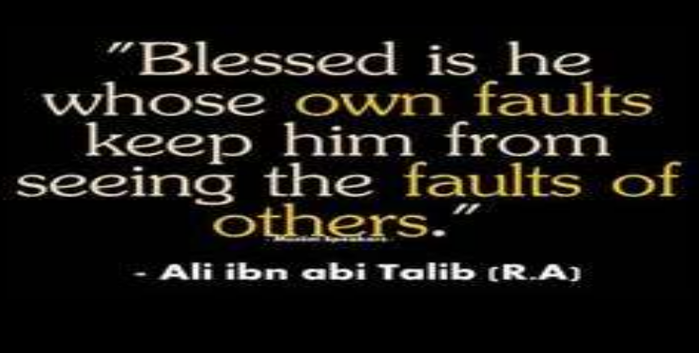
Thank you

