Slide 3
UNIVERSITY MOTTO, VISION, VALUES & GOALS
MISSION STATEMENT
To impart evidence-based research-oriented health professional education
Best possible patient care
Mutual respect, ethical practice of healthcare and social accountability.
VISION AND VALUES
Highly recognized and accredited centre of excellence in Medical Education, Using evidence-based training techniques for development of highly Competent health professionals, who are lifelong experiential learner and are Socially accountable.

Slide 4
GOALS
The Undergraduate Integrated Learning Program is geared to Provide you with quality medical education.
Provide thorough grounding in the basic theoretical concepts underpinning the practice of medicine.
Develop and polish the skills required for providing medical
services at all levels of the Health care delivery system.
Help you attain and maintain the highest possible levels of
ethical and professional conduct in your future life.
Kindle a spirit of inquiry and acquisition of knowledge to help
you attain personal and professional growth & excellence.

Slide 5
SEQUENCE OF LGIS
Learning objectives
Definition
Integration with pathophysiology
Types of Tuberculosis
Related Clinical Features
Complications
Investigations
Management and Vaccination
MDR Tuberculosis
Research articles related to topic
Ethics

Slide 6
LEARNING OBJECTIVES
AT THE END OF THIS LECTURE STUDENTS SHALL BE ABLE TO LEARN:
Definition Tuberculosis
Types of Tuberculosis
Pathophysiology of Tuberculosis
Signs and symptoms of Tuberculosis
Investigations
Medical management of Tuberculosis
MDR Tuberculosis and Traetment
Recent advances
Ethics

Slide 8
DEFINATION
·
Tuberculosis is an infectious bacterial
disease characterized by growth of
nodules(tubercles) in the tissue,
especially in lungs.

Slide 9
TYPES
Primary Tuberculosis :
This is when a person is infected by M. tuberculosis
for the first time.
Secondary Tuberculosis :
➢
The dormant bacteria gets reactivated mostly in
people who are immune compromised leading to
secondary TB. E.g. AIDS

Slide 10
CAUSITIVE ORGANISM (the culprit)
· M. tuberculosis is a slender, straight
or slightly curved, aerobic acid fast
bacilli.
·
These bacilli cannot be seen properly in
gram staining so the Ziehl- Neelsen
staining is done.
(The tuberculosis bacilli, it stains red in Ziehl- Neelsen staining)

Slide 11
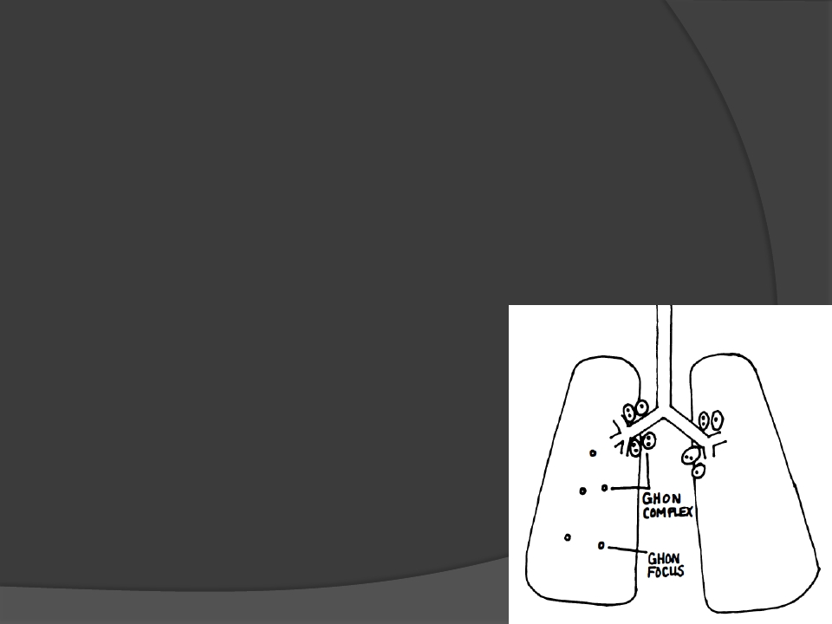
CLINICAL MANIFESTATION
Asymptomatic primary infection:
Once the granuloma is formed the foci of the bacteria is
trapped in the caseous necrosis.
These granulomas then heal by scar formation which is
followed by calcification and fibrosis and form tiny tubercles.
Ghon’s focus: Calcified tubercles
1.
·
·
·
in the upper or middle lobes of the
lung.
·
Ghon’s complex: Ghon’s focus
accompanied by perihilar lymph node
calcified granuloma.

Slide 12
2. Secondary or reactivation tuberculosis:
•
•
•
➢
•
•
•
The already trapped foci of the bacteria can be reactivated
later in life
This happens mostly in immune compromised individuals.
The organ system involved in tuberculosis:
Pulmonary Tuberculosis – Lungs are the most common
site form of tuberculosis.
It normally reactivates at the upper part of the lower lobe and
lower part of the upper lobe due to the rich oxygen as M.
tuberculosis is a aerobic organism.
Slowly these areas of infection grow, caseate, liquify and
cavitate.
Clinically patients present with chronic low grade fever, night
sweats, weight loss, and productive cough that may have
blood in it.

Slide 13
Liquid fluid cavities in the lungs
In pulmonary TB

Slide 14
➢
➢
➢
➢
➢
➢
Lymph node infection : this is the most common form of extra
pulmonary tuberculosis. The cervical lymph nodes are mostly
affected . They become swollen and mat together and drain.
Lymph node tuberculosis is called scrofula.
Pleural and pericardial infection: Infection in the spaces
results in infected fluid collection around the lungs or the
heart respectively.
Kidney: Patients may have red and white blood cells but no
bacteria is seen in gram stain (frequency ,hematuria,dysuria)
Skeletal: This involves thoracic and lumber spines.(backache)
Joints: there is chronic arthritis of joint.(knee and hip pain)
Central nervous system: Tuberculosis causes sub acute
meningitis and forms granulomas in the brain.

Slide 15
Miliary Tuberculosis :
·
·
·
Tiny millet sized tubercles(granulomas) are
disseminated all over the body like shotgun blast.
lungs, liver and kidney and other organs are riddled
with tubercles.
this disease normally occurs in children and elderly.

Slide 16
Diagnosis
●
Tuberculosis is diagnosed definitively by
identifying the causative organism in a
clinical sample.
● ► When this is not possible , a probable
diagnosis may be made using imaging
(X-rays or scans) or a tuberculin skin test.
● ► Currently, infection is diagnosed in a
non-immunized person by recent
techniques as PCR.

Slide 17
Types of specimens:
❖ Sputum.
❖ Urine
❖ Pleural
fluid
❖ Peritoneal fluid
CSF
Biopsy of tissue (granuloma/caseous necrosis)

Slide 18
Diagnosis
1.Bacteriological test/Microscopy:
a.
Zeihl-Neelsen stain
b. Auramine stain(fluorescence microscopy)
2. Sputum culture test:
a.
Lowenstein – Jensen(LJ) solid medium: 4-18 weeks
b. Liquid medium : 8-14 days
c.
Agar medium : 7 to 14 days

Slide 19
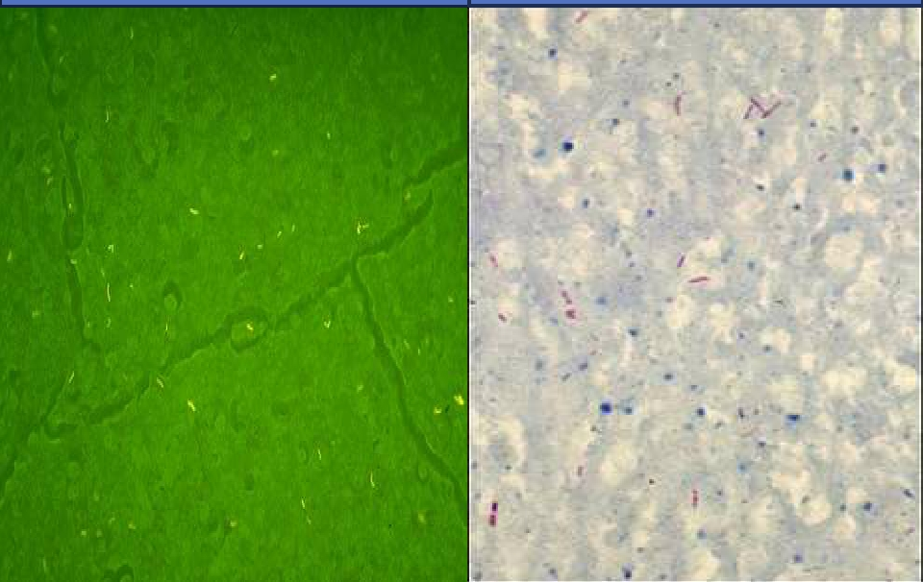
Acid fast Bacilli seen as in
Florescent Microscope
Acid Fast Bacilli seen in a
Sputum

Slide 20
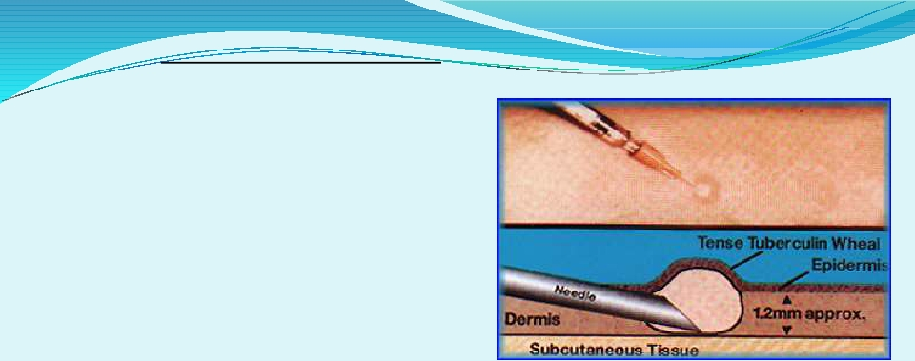
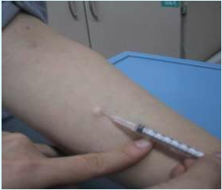
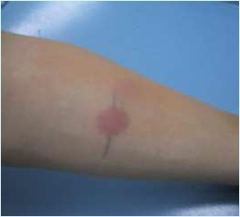
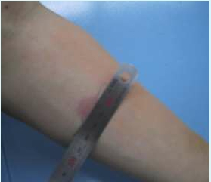
Tuberculin skin test (PPD)
➢
➢
➢
Injection of fluid into
the skin of the lower
arm.
48-72 hours later –
checked for a reaction.
Diagnosis is based on
the size of the wheal.
1 dose = 0.1 ml contains 0.04µg
Tuberculin PPD.

Slide 21
Uses:
➢ To measure prevalence of infection in a community.
➢ To diagnose active infection in young children.
➢ It is used as an indicator of successful BCG vaccination.

Slide 22
Other biological examinations
Protein and ADA levels – Ascites, pleural
effusion and meningitis
.Molecular methods: PCRPolymerase chain reaction/Gene Xpert/RIF is a rapid method in diagnosis of tuberculosis. It is based on DNA amplification and has been used to detect M. tuberculosis in clinical specimens.
Polymerase chain reaction (PCR) is a rapid method in
diagnosis of tuberculosis. It is based on DNA amplification
and has been used to detect M. tuberculosis in clinical
specimens.

Slide 23
Radiography

Slide 24
Preventive measures
1) Mask
2) BCG vaccine
3) Regular medical follow up
4) Isolation of Patient
5) Ventilation
6) Natural sunlight
7) UV germicidal irradiation

Slide 26
BCG vaccine
 Bacille Calmette Guerin (BCG).
 First used in 1921.
 Only vaccine available today for protection against tuberculosis.
 It is most effective in protecting children from the disease.
 Given 0.1 ml intradermally.
 Duration of Protection 15 to 20 years
 Efficacy 0 to 80%.
 Should be given to all healthy infants as soon as possible after birth
unless the child presented with symptomatic HIV infection.

Slide 27
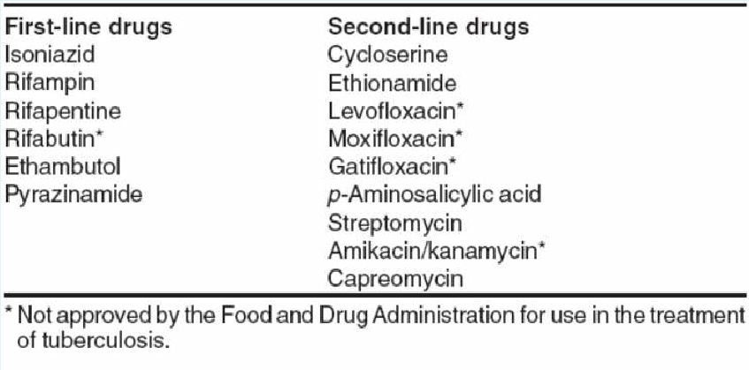
Management

Slide 28
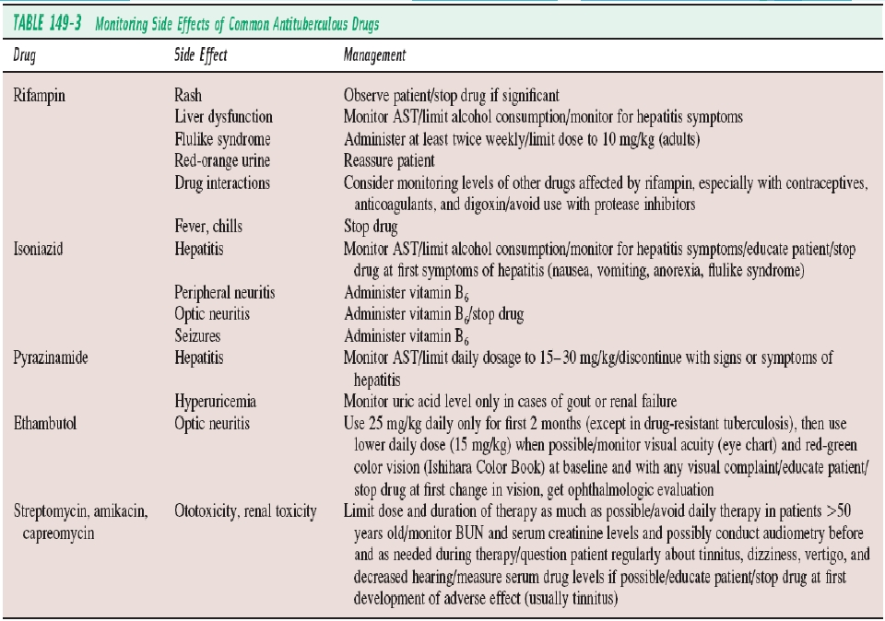
ADRs and its Management

Slide 29
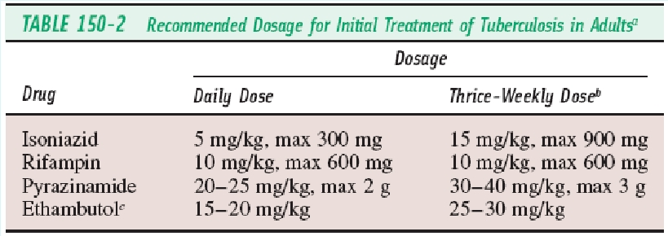
Dosage regimen
□ Intensive phase + continuation phase
□ HREZ (2 months) + HRE/HR (4 to 6 months)

Slide 30
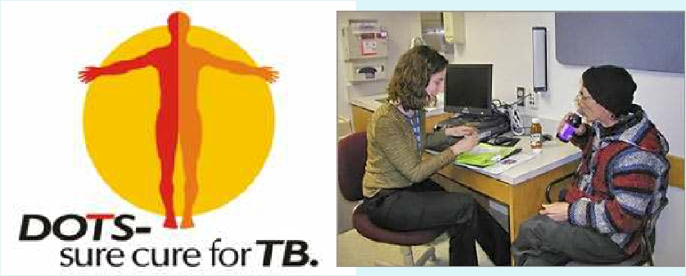
DOTS
DOTS - Directly observed treatment, short-course
 DOT means that a trained health care worker or other designated
individual provides the prescribed TB drugs and watches the patient
swallow every dose.

Slide 31
Multi-Drug Resistance TB
➢ TB caused by strains of Mycobacterium
tuberculosis that are resistant to at least isoniazid
and rifampicin, the most effective anti- TB drug.
➢ Globally, 3.6% are estimated to have MDR-TB.
➢ Almost 50% of MDR-TB cases worldwide are
estimated to occur in China and India.

Slide 32
Extensively drug resistance TB
 Extensively drug-resistant TB (XDR-TB) is a form of TB
caused by bacteria that are resistant to isoniazid and
rifampicin (i.e. MDR-TB) as well as any fluoroquinolone
and any of the second-line anti-TB injectable drugs
(amikacin, kanamycin or capreomycin).

Slide 33
RESEARCH
Natarajan A, Beena PM, Devnikar AV, Mali S. A systemic review on tuberculosis. Indian Journal of Tuberculosis. 2020 Jul 1;67(3):295-311.

Slide 34
ETHICS
Before doing any medical or surgical treatment, informed consent must be taken
Prognosis should be explained to patients
and attendants

Slide 35
thanks

