Slide 1
GENERAL TOXICOLOGY-III
Dr Filza Ali
Dr Shahida
Forensic Medicine & Toxicology

Slide 3
Vision of Rawalpindi Medical University The Dream/ Tomorrow
To impart evidence based research oriented medical education
To provide best possible patient care
To inculcate the values of mutual respect and ethical practice of medicine

Slide 4
Prof Umar’s LGIS Model

Slide 5
SEQUENCE OF LGIS
Learning Objectives
Core concept 70 %
Horizontal integration related to Pathology and Pharmacology 15 %
Relevant clinical concepts and medico legal application of core knowledge / Vertical integration 10%
Research article relevant to the topic 3%
Ethics and family medicine 2%

Slide 6
Learning objectives
students will be able to
Enlist the steps of management of a case of poisoning
Describe the role of elimination of unabsorbed poison
Briefly describe the procedure of gastric lavage along with its indications, contraindications and complications
State the role of elimination of absorbed poison with special emphasis on forced diueresis and exchange transfusion
Briefly describe the duties of medical practitioner in a case of suspected poisoning

Slide 7
Poisoning in the Living
Core Concept
core subject
There is no single symptom and no definite group of symptoms which are absolutely characteristic of poisoning.
Following should arouse suspicion of poisoning
Symptoms appear immediately or within a short period after food or drink.
Symptoms are uniform in character and increase rapidly in severity.
When several persons eat or drink from the same source of food or drink at the same time, all suffer from similar symptoms at or about the same time.

Slide 8
Core Concept
iv Discovery of poison in food taken, in the vomitus or in the excreta is strong proof of poisoning.
Symptoms Suggestive of Poisoning
Sudden onset of abdominal pain, nausea, vomiting, diarrhea and collapse.
Sudden onset of coma with constriction of pupils.
Unexplained coma, especially in children.
Coma in an adult, known to have a depressive illness. V⁵Neurological symptoms

Slide 9
Features indicative of Chronic poisoning
Core Concept
Features indicative of Chronic poisoning
Symptoms are exaggerated after the administration of suspected food, fluid or medicine. ii. Malaise, cachexia, depression, and gradual deterioration of general condition of the patient. iii. Repeated attacks of diarrhea and vomiting. Removal of patient from his usual surroundings causes the symptoms to disappear. v.Traces of poison found in the urine, blood, stool or vomit.

Slide 10
Core Concept
Diagnosis of Poisoning in Dead
Evidence of poisoning will depend on postmortem examination, chemical analysis, experiments on suitable animals and circumstantial evidence

Slide 11
Postmortem Examination
External Findings | Internal Findings
The color changes in skin and mucous membrane | The skull should be opened first to detect unusual odors in the brain, since the opening of the body masks such odors.
iii.Smell present about the mouth and nose. The natural orifices, e.g. mouth, nostrils, rectum and vagina may show presence of poisonous material | Mouth and throat: Examine for any evidence of inflammation, erosion or staining.
Injection marks should be looked for with care. | Respiratory system: Corrosives may cause edema of glottis, and congestion and desquamation of mucous membrane.
Skin should be examined for lesions | Stomach: Hyperemia of mucous membrane Color changes of mucous membrane of stomach seen in different poisoning . Softening & ulceration of mucous membrane seen in corrosives.
Jaundice may occur in chronic poisoning | Kidneys (nephrotoxic poisons).degenerative changes are seen.
Core Concept
Diagnosis of Pois
oning in Dead

Slide 12
History and Symptoms
Core Concept
Sudden onset of vomiting/diarrhea/pain in abdomen
Onset of symptoms who had taken food together.
History of consumption of poison or suspicious material

Slide 13
Core Concept
Persistent vomiting and diarrhea with or without dehydration
Pain in abdomen
Drowsiness/unconsciousness/coma
Breathlessness, constriction in chest, choking sensation
Convulsions
Palpitations, arrhythmias, chest pain
Hypothermia
Paralysis

Slide 14
Principles of management
Core Concept
Stabilization and evaluation, maintainance of vitals
Decontamination
Poison elimination
Antidote administration
Nursing care
Psychiatric care
Pain killers, assisted ventilation, cardiac stimulants

Slide 15
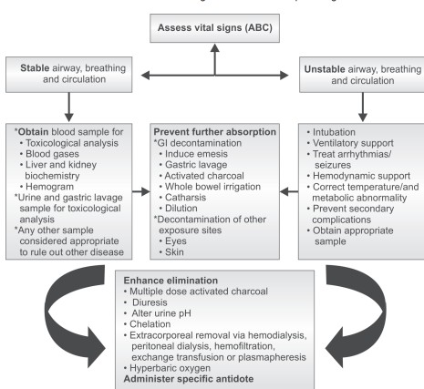
Core Concept

Slide 16
Removal of Unabsorbed Poison | Elimination of the absorbed poison
Inhaled poisons: take into fresh air artificial respiration O2 (6-8 l/min) Air passages should be kept free from mucus by postural drainage or by suction | Urine by forced diuresis
 | Haemodialysis
Injected poisons tourniquet Immersion of the extremity in water at 10°C or below | Use of catharsis
 | Haemoperfusion
Contact poisons copious flushing with water Saline A triple wash | Peritoneal dialysis
 | Exchange transfusion (only feasible with small children)
Ingested Poisons Gastric lavage Forced emesis | Whole bowel irrigatuion
Core Concept

Slide 17
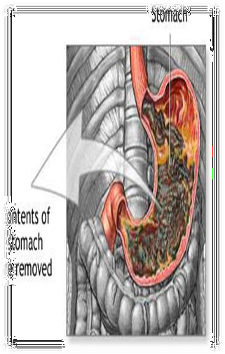
PROCEDURE OF GASTRIC ASPIRATION AND LAVAGE
Core Concept
Apparatus.
Position of the patient.
Passing of the gastric tube.
Siphoning off the gastric contents.
Injecting the fluid into the stomach.
Taking out gastric tube.

Slide 18
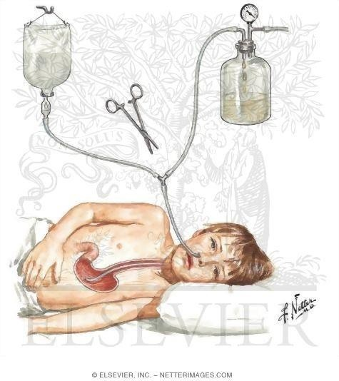
Position in gastric lavage
Core Concept
Left lateral position for gastric lavage

Slide 19
Complications of gastric lavage:
Core Concept
Aspiration.
Entering of gastric content in small intestine.
Vasovagal reflex.
Eosophageal rupture/ perforation & Haemorrhage.
Profuse bleeding if blood vessels are weak
Vasovagal reflex.
Hypothermia

Slide 20
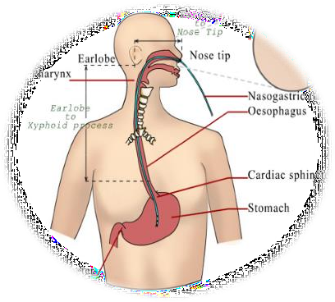
Contraindications of gastric lavage:
Core Concept
Unconscious patient.
Convulsive patient.
Petroleum and pine distillates.
Corrosives/alkalis.
Children below 6 months.
Severe cardiovascular disease.
Aneurysm.
Sever emphysema.
Weak blood pressure.
It should be remembered that sufficient bulk should be present in
stomach.

Slide 21
Management
Core Concept
1. A- maintenance of airway
B- maintenance of breath
C- maintenance of circulation (monitoring of BP, pulse and tissue perfusion, urinary output, skin signs and arterial blood pH), continuous ECG monitoring.
D- disability (neurologic status)management:- Assess level of consciousness.

Slide 22
Core Concept
Whole gut lavage.
Activated charcoal.
Antidotes.
Mechanical or physical.
Chemical.
Physiological or pharmacological.
Universal antidote
If the poison is known, specific treatment must be started.
If the poison is unknown, treatment is given on general lines.
19

Slide 23
Core Concept

Slide 24
Core Concept
These duties are divided into categories
Medical care
Legal duties
Medical care
Care and treatment to save the life of the patient.
Legal duties
Assist the police to determine the manner of poisoning.
21

Slide 25
Core Concept
In any case of poisoning, the doctor must record
the preliminary particulars
Full name with parentage
Age
Sex
Occupation
Home address
Date and time of arrival
Brought by whom
History,
Assess whether dying declaration is necessary or not.
Identification marks.
22

Slide 26
Private practice
Core Concept
He is bound information to
to furnish the the police or
magistrate if he doesn't fulfill the his legal duty and some how the case is registered then he may be summoned by the investigating police officer or magistrate for such information, he should do so and maintain the record.

Slide 27
In accidental poisoning
Core Concept
If there is any indication of danger to spread to the general public, e. g in a case food poisoning from a eating house or contamination of public drinking water, the doctor must notify to the health authorities at once to prevent its spread.

Slide 28
Suspected homicidal poisoning
Core Concept
Collect sample of vomitus, stomach wash, urine and blood samples in separate container in his presence and handover to police for analysis from FSL with a receipt.
Any suspicious article, such as:-
Utensils used for preparing the poison.
Bottles or containers of solid or liquid medicine found at the scene.

Slide 29
Core Concept
Food or drink lying near the patient
Clothes or bed sheet soiled by vomit, urine or faeces, should be preserved for possible future examination
Consult in strict confidence to a senior practitioner and keep him informed about the case.
Refer the patient to the hospital.
If the patient refuses, the doctor should engage nurses of his confidence who should administer the medicine and food and allow no one to be with the patient alone.

Slide 30
Core Concept
7 . Doctor should take every precaution to prevent the possibility of further administration of the poison to other so he should inform to local police to take needful action
6.If the patient is serious, arrangement for taking a dying declaration should also be made.

Slide 31
7.In the event of death, a death certificate should not be issued but the fact of death must be communicated to the nearest police officer for necessary investigation.
Core Concept
any opinion about the nature of poison can be given only after report from the forensic Science laboratory.

Slide 32
Doctor of Govt. Hospital.
Core Concept
The doctor in charge of a government or public sector Hospital must report to police all cases of poisoning, either suicidal, homicidal or accidental, admitted to his institution.

Slide 33
Take home message for future
Core Concept

Slide 34
Research, Artificial Intelligence
RESEARCH
https://www.msdmanuals.com/professional/injuries- poisoning/poisoning/general-principles-of-poisoning
https://www.mcgill.ca/criticalcare/education/teaching/teach ing-files/toxicology-series/general-management-principles https://www.ncbi.nlm.nih.gov/pmc/articles/PMC5570727/

Slide 35
Biomedical Ethics
Ethics
Emergency physicians shall evaluate and treat all patients to the best of their ability regardless of a patient's ability to pay.
Physicians must work to conserve life, alleviate suffering, promote health, do no harm, and encourage the quality and equal availability of emergency medical care.
To maintain professional competence, striving always for clinical excellence in the delivery of patient care as well as maintaining secrecy.

Slide 36
Family Medicine
Family Medicine
ongoing treatment of unstable patients with toxic medication ingestions should focus on correcting hypoxia and acidosis while maintaining adequate circulation.
. Disposition of a person who has been poisoned warrants careful consideration of multiple factors, and those exhibiting signs or symptoms of toxicity must be monitored longer.
Poisoning is a worldwide problem that consumes substantial health care resources and causes many premature deaths.
Prevention is the key to reducing unintentional poisoning deaths.

Slide 37
How To Access Digital Library
1. Go to the website of HEC National Digital Library.
2. On Home Page, click on the INSTITUTES.
3. A page will appear showing the universities from Public and Private Sector and other Institutes which have access to HEC National Digital Library HNDL.
4. Select your desired Institute.
5. A page will appear showing the resources of the institution
6. Journals and Researches will appear
7. You can find a Journal by clicking on JOURNALS AND DATABASE and enter a keyword to search for your desired journal.

Slide 38
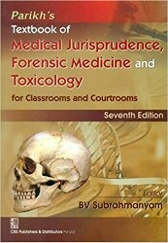
Learning Resources
Principles & Practice of Forensic Medicine.
by Nasib R. Awan
Parikh’s Textbook of Medical Jurisprudence,
Forensic Medicine & Toxicology.

Slide 39
Thanks

