Slide 2
THROMBOTIC DISORDERS IN PREGNANCY
DR MUHAMMAD ARIF
ASSOCIATE PROFESSOR
MEDICINE DEPARTMENT
RAWALPINDI MEDICAL UNIVERSITY

Slide 3
University Motto, Vision, Values & Goals
Mission Statement
To impart evidence-based research-oriented health professional education Best possible patient care Mutual respect, ethical practice of healthcare and social accountability.
Vision and Values
Highly recognized and accredited centre of excellence in Medical Education, using evidence-based training techniques for development of highly competent health professionals, who are lifelong experiential learner and are socially accountable.
Goals
The Undergraduate Integrated Learning Program is geared to provide you with quality medical education in an environment designed to:

Slide 5
LEARNING OBJECTIVES
CORE CONCEPT
Etiologies and risk factors for common thrombotic disoders in pregnancy
Clinical features and investigations to confirm thrombotic disorders in pregnancy and post partum period
Appropriate anticoagulation therapy in pregnancy and breastfeeding

Slide 6
INTRODUCTION
CORE CONCEPT
Pregnancy and the purperium (postpartum period) are well-established risk
factors for venous thromboembolism (VTE).
Prevalence is 1 in 1600.
The overlap with symptoms of pregnancy may impair clinical suspicion making diagnosis of VTE more challenging.
VTE can manifest during pregnancy as an isolated lower extremity deep vein thrombosis (DVT) or as pulmonary embolus (PE).
PE is the seventh leading cause of maternal mortality, responsible for 9 percent of maternal deaths.
Thus, the detection of DVT during pregnancy is critical to preventing deaths from PE.

Slide 7
RISK FACTORS:
CORE CONCEPT
Incidence is 4 to 50 times higher compared to non pregnant women.
Increased risk for VTE is highest in the postpartum period, with a higher than usual prevalence of clot in the left lower extremity and pelvis.
In addition, risk is augmented further in women with inherited thrombophilias.

Slide 8
TIMING DURING PREGNANCY
CORE CONCEPT
Antepartum – Most studies report equal distribution of VTE across the trimesters of pregnancy. Factors that increase the risk of VTE antepartum are less well described but include the following:
Multiple births
Varicose veins
Inflammatory bowel disease
Urinary tract infection
Diabetes
Hospitalization for non-delivery reasons (particularly those >3 days)
Body mass index (BMI) ≥30 kg/m2
Increased maternal age ≥35 years

Slide 9
POSTPARTUM
CORE CONCEPT
Compared with the antepartum period VTE is two to five times more common postpartum. The risk is highest in the first six weeks postpartum and declines to rates that approximate that of the general population by about 13 to 18 weeks .
Cesarean section (CS), especially emergent CS.
Medical comorbidities (e.g., varicose veins, cardiac disease, inflammatory bowel disease)
BMI ≥25 kg/m2
Young gestational age (preterm delivery <36 weeks)
Obstetric hemorrhage
Stillbirth
Increased maternal age ≥35 years
Hypertension
Smoking
Eclampsia or preeclampsia
Postpartum infection
Transfusion
Thrombophilias

Slide 10
INHERITED THROMBOPHILIAS DURING PREGNANCY:
HORIZONTAL INTEGRATION
The risk of VTE is further magnified in pregnant women who have inherited thrombophilia (e.g., such as factor V Leiden; anti thrombin III, protein S, or protein C deficiency; or anti phospholipid syndrome).
FACTOR FIVE LEIDEN
Compared to the general population, the thrombotic risk is three times higher for pregnant women with factor V Leiden .
Further augmenting that risk in pregnant patients with factor V Leiden deficiency and G20210A prothrombin-gene mutation is a history of prior VTE in the patient or an affected first-degree relative (up to 50-fold).

Slide 11
CONT.
CORE CONCEPT
When compared with pregnant women without a known thrombophilia, pregnant women with an inheritable deficiency of antithrombin III, protein S, protein C had an eight-fold increased risk of venous thrombosis in the antepartum and postpartum periods combined.
Among women with known antiphospholipid syndrome, one prospective study described a 5 percent risk of thrombosis during pregnancy.

Slide 12
PATHOGENESIS:
HORIZONTAL INTEGRATION
Pregnancy and the postpartum period are marked by the presence of all three components of Virchow's triad: venous stasis, endothelial injury, and a hypercoagulable state. All features likely contribute to the increased risk of venous thromboembolism (VTE) in pregnancy.
Stasis – Venous stasis of the lower extremities occurs during pregnancy because of two factors: pregnancy-associated changes in venous capacitance and compression of large veins by the gravid uterus.
Endothelial injury – Delivery is associated with vascular injury and changes at the uteroplacental surface. Forceps, vacuum extraction, or surgical delivery can exaggerate vascular intimal injury and amplify this phenomenon.

Slide 13
CONT.
HORIZONTAL INTEGRATION
Hypercoagulability – Pregnancy is a hypercoagulable state associated with progressive increases in several coagulation factors, including factors I, II, VII, VIII, IX, and X, along with a decrease in protein S.
A progressive increase in resistance to activated protein C is normally observed in the second and third trimesters.
Activity of the fibrinolytic inhibitors PAI-1 and PAI-2 is increased during pregnancy, although total fibrinolytic activity may not be impaired.

Slide 14
CLINICAL PRESENTATION
HORIZONTAL INTEGRATION
Signs and symptoms:
Other than the higher propensity to develop left-sided DVT and iliac vein thrombosis, the clinical presentation of DVT during pregnancy is identical to that in nonpregnant women.
Signs and symptoms suggestive of proximal vein thrombosis are diffuse pain and swelling that may or may not be associated with erythema, warmth and tenderness of the lower extremity.
Symptoms of iliac vein thrombosis include swelling of the entire leg with or without flank, lower abdomen, buttock, or back pain.

Slide 15
DEEP VEIN THROMBOSIS:
CORE CONCEPT
(DVT) — The majority of lower extremity DVTs during pregnancy are left-sided. In addition, the incidence of pelvic vein thrombosis is significantly higher during pregnancy and the puerperium, although DVT remains most often found in the proximal veins (e.g. femoral vein). No studies describe an increased incidence of upper extremity DVT during pregnancy or the puerperium.
Left lower extremity DVT
Pelvic vein DVT

Slide 16
DIAGNOSIS
VERTICAL INTEGRATION
The diagnosis of deep vein thrombosis (DVT) in pregnancy is made by demonstrating a lack of compressibility of the proximal veins on compressive ultrasound (femoral vein thrombosis) or poor flow on Doppler imaging of the femoral-iliac vein (iliac vein thrombosis).
The diagnosis is rarely made by the demonstration of a filling defect on contrast or magnetic resonance venography. D-dimer levels and clinical exam cannot be used alone to diagnose DVT.
A diagnostic approach for suspected DVT in pregnancy is discussed in detail below (algorithm 1). (See 'Diagnostic algorithm’

Slide 17
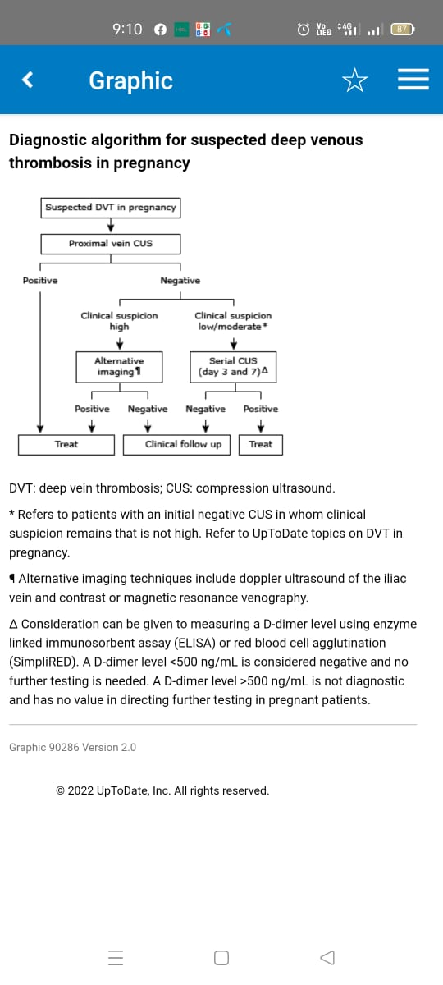
VERTICAL INTEGRATION

Slide 18
TREATMENT
VERTICAL INTEGRATION
Initial management of suspected venous thromboembolism (VTE) depends upon the degree of clinical suspicion for acute pulmonary embolism (PE), whether there are contraindications to anticoagulation, and whether PE, deep vein thrombosis (DVT), or both are suspected:
●When there is a high clinical suspicion for acute PE, empiric anticoagulant therapy is indicated prior to the diagnostic evaluation. Anticoagulant therapy is discontinued if VTE is excluded.
●When there is low or moderate clinical suspicion for PE, empiric anticoagulant therapy prior to diagnostic evaluation is determined on a case-by-case basis.

Slide 19
CONT.
VERTICAL INTEGRATION
● For those patients in whom PE is suspected but anticoagulant therapy is contraindicated, diagnostic evaluation should be expedited. Anticoagulation-independent therapy (e.g., inferior vena cava filter) is indicated if VTE is confirmed.
● When there is suspicion for DVT alone (no clinical evidence or suspicion of acute PE), anticoagulant therapy is generally withheld until VTE is confirmed, assuming that diagnostic evaluation can be performed in a timely fashion.

Slide 20
ANTICOAGULATION
VERTICAL INTEGRATION
The following approach is generally consistent with the guidelines on management of VTE in pregnancy published by the American College of Chest Physicians (ACCP) (2012), the American College of Obstetricians and Gynecologists (ACOG) (2018), the European Society of Cardiology/European Respiratory Society (2018 and 2019), and the American Society of Hematology (2018).
Once it is determined that anticoagulation is indicated, it should be initiated using subcutaneous low molecular weight heparin (LMWH), intravenous unfractionated heparin (IV UFH), or subcutaneous UFH.
Agent selection — Subcutaneous LMWH is preferred over IV UFH or subcutaneous UFH in most patients because it is easier to use, appears to be more efficacious, and has a better safety profile

Slide 21
CONT
VERTICAL INTEGRATION
In contrast, IV UFH is preferred in patients who have an elevated risk of bleeding or persistent hypotension due to pulmonary embolism (PE). This preference is based on clinical experience. The rationale is that its short half-life and near complete reversal with protamine are desirable if the anticoagulant effect needs to be stopped due to bleeding or to perform a procedure.
UFH (either IV or subcutaneous) is preferred over subcutaneous LMWH in patients who have severe renal failure.
Direct oral anticoagulants are avoided since little is known about their safety in pregnancy.

Slide 22
DOSING
VERTICAL INTEGRATION
Little information exists about the appropriate dosing of anticoagulants during pregnancy, though weight-adjusted dosing is recommended. Anticoagulant activity should be monitored with either intravenous or subcutaneous unfractionated heparin, but it is controversial when low molecular weight heparin is being used.
LMWH — Reasonable initial doses of subcutaneous LMWH include dalteparin 200 units/kg once daily or 100 units/kg every 12 hours, tinzaparin 175 units/kg once daily, or enoxaparin 1 mg/kg every 12 hours.

Slide 23
CONT.
VERTICAL INTEGRATION
IV UFH — Initial dosing of IV UFH consists of an IV UFH bolus of 80 units/kg, followed by a continuous infusion of 18 units/kg per hour. The infusion is titrated every six hours to achieve a therapeutic activated partial thromboplastin time (aPTT), defined as the aPTT that corresponds to an anti-Xa level of 0.3 to 0.7
Subcutaneous UFH — A reasonable initial dose of subcutaneous UFH is 17,500 units every 12 hours. The dose is then titrated to achieve a therapeutic aPTT.
The first aPTT is generally measured six hours after the second dose.

Slide 24
LABOR AND DELIVERY
VERTICAL INTEGRATION
Treatment with subcutaneous LMWH should be discontinued at least 24 hours prior to delivery if the delivery time is predictable (e.g., induction of labor, planned cesarean section). This allows the effect of heparin to resolve.
A period of 24 to 36 hours without anticoagulant therapy may be undesirable in pregnant females who are at high risk for recurrent VTE (e.g., those with an acute PE or proximal DVT that developed within the past month). Such patients may benefit from having their subcutaneous LMWH or subcutaneous UFH switched to IV UFH, which can be discontinued 4 to 6 hours prior to delivery.

Slide 25
CONT.
VERTICAL INTEGRATION
In cases in which preterm delivery is anticipated (e.g. triplets, preterm rupture of membranes, significant cervical dilation, preeclampsia, growth restriction), it is common to discontinue subcutaneous LMWH or subcutaneous UFH at 36 weeks of gestation. IV UFH is then used instead.

Slide 26
AFTER DELIVERY
VERTICAL INTEGRATION
A heparin regimen (subcutaneous LMWH, IV UFH, or subcutaneous UFH) should be restarted 12 hours after a cesarean delivery or six hours after a vaginal birth, assuming that significant bleeding has not occurred.
Options for long-term anticoagulant therapy include subcutaneous LMWH, subcutaneous UFH, or an oral vitamin K antagonist (eg, warfarin).

Slide 27
LENGTH OF THERAPY
VERTICAL INTEGRATION
The optimal duration of anticoagulation is unknown and should be individualized.
The total duration of anticoagulant therapy (pregnancy plus the postpartum period) should be at least three to six months for females whose only risk factors for VTE were transient (e.g. pregnancy, cesarean section).
Anticoagulant therapy generally continues for at least six weeks postpartum.
Patients with persistent risk factors for VTE may require a longer duration of therapy.

Slide 28
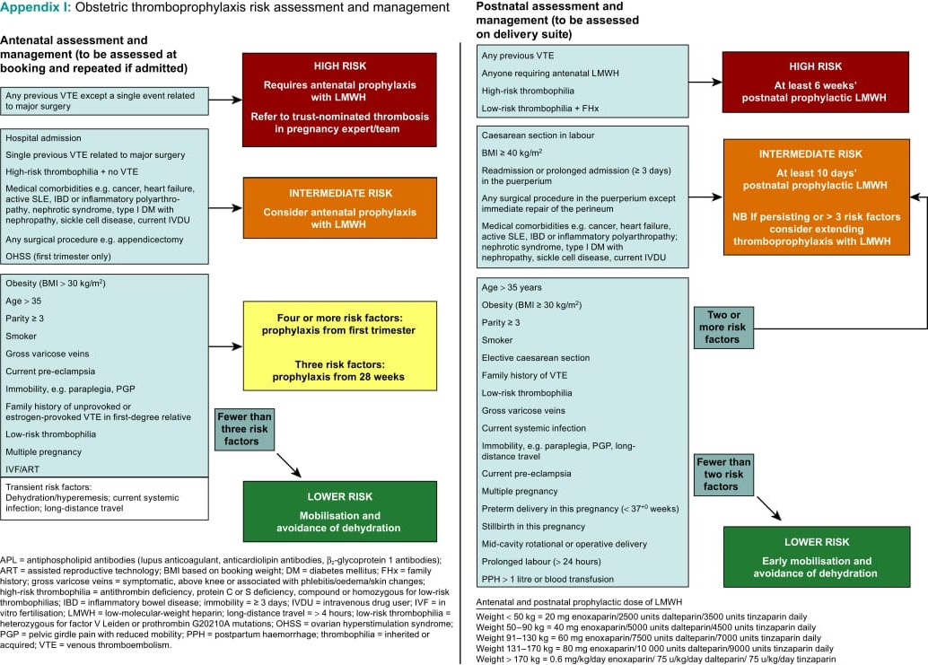

Slide 29
CEREBRAL VENOUS THROMBOSIS
CORE CONCEPT
Epidemiology of CVT — Cerebral venous thrombosis (CVT), also known as cerebral venous sinus thrombosis, is rare in the general population but occurs more commonly in association with pregnancy.
It presents most often in the third trimester of pregnancy and the puerperium.

Slide 30
CLINICAL MANIFESTATIONS
VERTICAL INTEGRATION
Clinical manifestations of CVT consist of :
Headache, vomiting, focal or generalized seizure, confusion, blurred vision, focal neurologic deficits, and/or altered consciousness.
The headache frequently precedes other symptoms, is diffuse, and is often severe.
The severity of symptoms correlates with the degree of thrombosis and the vessel involved

Slide 31
DIAGNOSIS
VERTICAL INTEGRATION
The combination of an abnormal signal in a venous sinus on brain MRI and the corresponding absence of flow on MR venography confirms the diagnosis of CVT. However, these findings are not always evident, and the diagnosis may rest on imaging features showing only absence of flow in a venous sinus or cortical vein.
Other than neuroimaging, there is no simple confirmatory laboratory test that can confidently rule out CVT in the acute phase of the disease.

Slide 32
NEUROIMAGING FEATURES
VERTICAL INTEGRATION
Parenchymal brain lesions, including brain swelling, edema, venous infarction, or hemorrhagic venous infarction, may occur secondary to venous occlusion.
Head CT scan is normal in up to 30 percent of CVT cases, and most of the findings with CVT are nonspecific. However, in about one-third of patients, CT demonstrates direct signs of CVT, which include the cord sign, the dense triangle sign, and the empty delta sign.

Slide 33
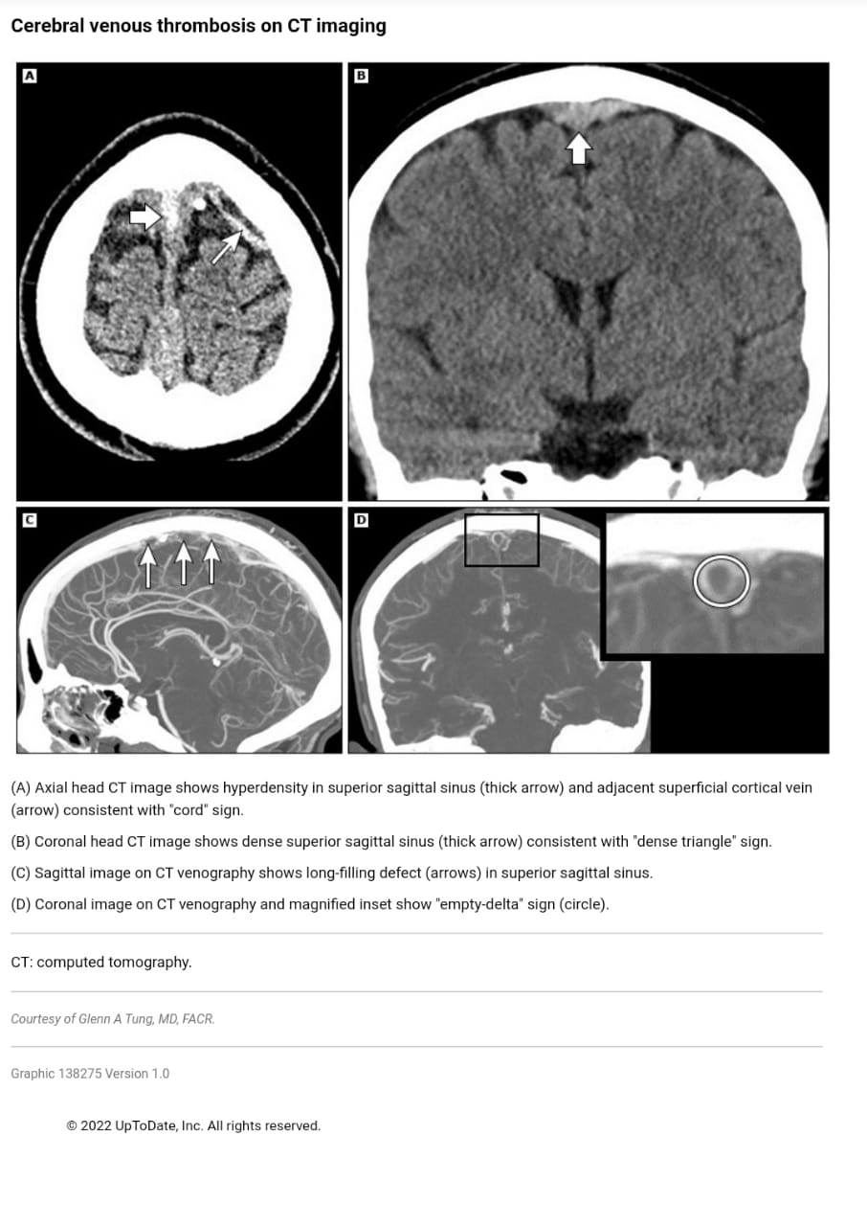

Slide 34
CONT.
VERTICAL INTEGRATION
Brain MRI along with MR venography is the most informative technique for demonstrating the presence of dural thrombus, cortical vein thrombosis, and the extent of brain injury
CT venography may demonstrate filling defects, sinus wall enhancement, and increased collateral venous drainage and is an alternative to magnetic resonance (MR) venography.

Slide 35
ANTICOAGULATION
VERTICAL INTEGRATION
The mainstay for the treatment of symptomatic CVT, with or without hemorrhagic venous infarction, is anticoagulation therapy with intravenous heparin or subcutaneous low molecular weight heparin
For women with CVT during pregnancy, guidelines from the AHA/ASA conclude that low molecular weight heparin in full anticoagulant doses should be continued throughout pregnancy.
Low molecular weight heparin or a vitamin K antagonist with a target international normalized ratio (INR) of 2 to 3 should be continued for at least six weeks postpartum for a total minimum duration of therapy of six months.
Symptomatic management issues include control of seizures and intracranial hypertension.

Slide 36
LONGITUDINAL INTEGRATION

Slide 37
THANK YOU!!

