Slide 1
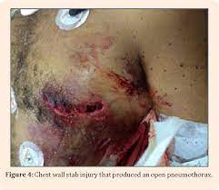
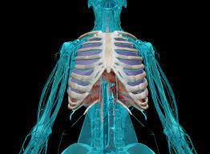
THORACIC TRAUMA

Slide 2
Introduction:
Second leading cause of trauma deaths
RTA is common aetiology 65-70 %
25% of trauma deaths are a direct result of chest injury
50% of patients who die from multiple trauma have significant chest injury

Slide 3
Death:
Death :
can be immediate (within seconds to minutes),
early (minutes to hours), or
late (days to weeks) after injury.

Slide 4
Immediate deaths:
– disruption of the heart or great vessel injury.
Early deaths :
airway obstruction, tension pneumothorax, pulmonary contusion, or cardiac tamponade.
Late deaths:
pulmonary complications, sepsis, and missed injuries

Slide 5
Trimodal Distribution of Death:

Slide 6
Mechanism of Chest injury:
Body acceleration and deceleration ( organ inertia lags behind skeletal acceleration or deceleration ) eg. RTA
Body compression ( force > the strength of skeleton ) eg. Crush injury and falls
Penetrating wounds ( open pneumothorax and organ injury ) eg. assaults

Slide 7
Penetrating Injury:

Slide 8
Types of Chest injury:
Blunt Chest injury ( closed chest injury )
Eg. RTA, Fall, Crush injury
Associated with multiple injuries such as head, limb, abdomen
Penetrating Chest injury ( open chest injury)
Mostly by assault
Associated with chest wall damage, open pneumothorax, and organ injury

Slide 9
Pathophysiology in Chest Injury:

Slide 10
Pathophysiology in Chest Injury:

Slide 11
Initial assessment and management:
Primary survey by ATLS guideline
Resuscitation of vital functions
Detailed secondary survey
Definitive care

Slide 12
ATLS:

Slide 13
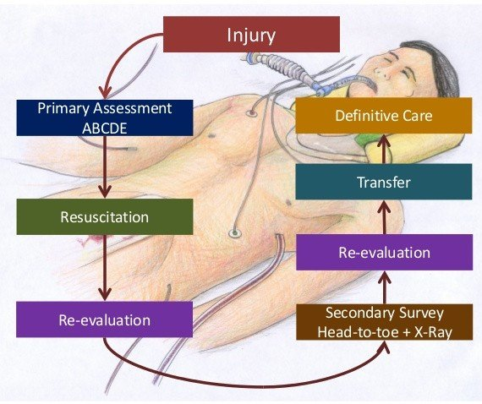

Slide 14
Resuscitation:
As per trauma ATLS guidelines
Maintain double IV line
Fluid resuscitation
Blood ideal fluid
Assessment and maintaince of airway
Vital monitoring

Slide 15
Investigations:
Examination
FAST scan
CXR
Ct scan chest with IV contrast

Slide 16
Classification:
Immediate Life Threatening injuries (Lethal Six)
Potential Life Threatening injuries( Hidden Six)

Slide 17
Immediate Life Threatening injuries(Lethal Six)
Fatal if they are not recognized and treated immediately:
Airway Obstruction
Tension pneumothorax
Open pneumothorax “sucking chest wound”
Massive hemothorax
Flail chest
Cardiac tamponade

Slide 18
Potential Life Threatening injuries( Hidden Six):
Primary or secondary survey may reveal one of eight potentially life-threatening thoracic injuries
Cardiac contusion
Aortic disruption
Diaphragmatic rupture
Oesophageal injury
Pulmonary contusion
Tracheo-bronchial injuries

Slide 20
Airway obstruction:
Airway obstruction – Control of the airway is foremost in trauma resuscitation.
Protect the cervical spine as the airway is being managed

Slide 21
Causes :
The tongue is the most common cause
Dentures, avulsed teeth, tissue, secretions, and blood
Bilateral mandibular fracture
Expanding neck hematomas
Laryngeal trauma
Tracheal tear or transection

Slide 22
Sign and Symptoms:
Stridor
hoarseness of voice
subcutaneous emphysema
altered mental status,
accessory muscle working apnea,
and cyanosis (sign of pre-terminal hypoxemia).
if any suspicion of airway obstruction or inability to exchange air adequately mandates early intubation.

Slide 23
Management:
Intubate using a controlled rapid sequence when in doubt of obstruction
Provide inline cervical spine immobilization during intubation.
Early intubate in cases of neck hematoma or possible airway edema
Emergency cricothyroidotomy should perform if endotracheal intubation fails.

Slide 24
Tension Pneumothorax:
Air enters pleural space and becomes trapped leads to pressure increase
Increased pressure which collapses lung and shifts mediastinum to unaffected side
Increased dyspnoea and compressed heart and great vessels leads to decreased cardiac output.
Leads to Cardiogenic Shock

Slide 25
Tension Pneumothorax:
Signs & Symptoms
Dyspnoea and Tachypnoea
Anxiety
Diminished breath sounds
Hypotension
Tachycardia
JVD
Narrowing pulse pressure
Tracheal Deviation – Late Sign
Shock

Slide 26
Tension Pneumothorax Treatment:
Needle Thoracostomy ( 12 or 14 gauge IV catheter in 2nd ICS & MCL or 5th ICS in AAL )
Chest tube placement
Possible thoracotomy or thoracoscopy

Slide 27
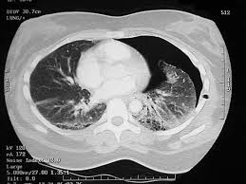
Pneumothorax:

Slide 28
Chest intubation:

Slide 29
Open Pneumothorax (Sucking Chest Wound):
Open chest wall injury
Stab wounds usually self-sealing
GSW more extensive damage
Air passes through opening into the pleural space and remains outside of lung
Large open defect in chest wall (>3 cm diameter) with equilibration between intrathoracic and atmospheric pressure

Slide 30
Signs & Symptoms:
Gurgling sound during respiration
Bubbling wound
Dyspnea
Tachypnea
Diminished breath sound

Slide 31
Treatment:
Oxygenation and possible intubations if in distress
Bandage may be applied over the wound and taped on 3 sides for cover the defect
Immediate CT insertion to affected side.
Urgent thoracotomy to evacuate blood clot and treat associated intrathoracic injuries. – Irrigate, debride, and close the chest wall defect in the OR.
Large defects may require flap closure.

Slide 32
3 way occlusive dressing:

Slide 33
Massive Hemothorax:
Blood in the pleural space
Each side of the chest can hold 2500-3000ml of blood
Possible Sources
– Intercostal vessels
– Internal mammary artery
– Pulmonary vessel
– Lung parenchyma
Can lead to tension pneumothorax

Slide 34
Hemothorax:

Slide 35
Sign and Symptoms:
Hemorrhagic shock
Absence or diminution of breath sound in affected side
Dullness on percussion in affected side
Flattened neck veins
CXR will show unilateral “white out” (opacification)

Slide 36
Management:
Chest Tube insertion first with available of blood transfusion
Thoracotomy indicated
if immediate drainage of 1000-1500mls of blood Or
200ml for 2 to 4 hours
Failure to completely drain hemothorax

Slide 38
Flail Chest:
When 3 or more adjacent ribs fractures in 2 or more places
Paradoxical movement of the flailed segment moves in opposite direction of the chest wall movement
Can also occur when the sternum is fractured loose form its attachments with the ribs

Slide 39
Sign & Symptoms:
Severe pain with chest wall movement
Decreased ventilatory volume
Underlying lung contusion
Potentially Pneumo/hemothorax
Potentially (flailed sternum)
– Cardiac Tamponade
– Traumatic Asphyxia

Slide 40
Treatment:
Is directed towards
Protected underling lung
Maintain ventilation
Prevent pneumonia
Analgesia is the main treatment
PCA and NSAID Epidural is the best option ( elderly )
Intubations and mechanical ventilation is rarely indicated
Operative Fixation by wires or plates was indicated in
Patient going for thoracotomy
Fixed thoracic impaction
Failure to wean from ventilator

Slide 41
Cardiac Tamponade:
Collection of blood between heart and pericardium
Source of blood can be coronary arteries or myocardium.
Pericardium may hold up to 200-300ml of blood before S&S develop

Slide 42
Cardiac Tamponade:

Slide 43
Signs & Symptoms:
Tachycardia
Paradoxical pulse
JVD
Narrowing pulse pressures
Muffled heart sounds
S&S of shock
Beck’s Triad

Slide 44
Beck’s Triad:
Muffled heart sounds
JVD
Hypotension

Slide 45
Management:
Assess the need for intubation, oxygenate, and start volume resuscitation.
Life saving Pericardiocentesis can be used to relieve tamponade before definitive repair
Ideal management is emergency left antero-lateral thoracotomy to relieve the tamponade

Slide 46
Diaphragm Rupture:
Rupture diaphragm may occur from:
Penetrating injuries
Crush injuries
Left hemi diaphragm Ruptured more frequently by blunt trauma ( 9:1)
Posterolaterally weakened due to gap for abdominal aorta & oesophageal hiatus
Right Hemidiaphragm – protected by liver

Slide 47
Left hemi diaphragm rupture
Herniation of stomach , spleen , left transverse colon/ omentum
Right Hemi diaphragm rupture
Herniation of liver
In penetrating injuries
herniation occurs rarely and slowly

Slide 48
The symptoms of diaphragmatic rupture are similar to pneumothrax as the lung is compressed and hypoxemia develops
Chest x-ray :
Loss of the diaphragmatic contour
Presence of bowel or NG tube in the chest
Elevation of the hemidiaphragm
Intubation / mechanical ventilation needed for adequate oxygenation.

Slide 49
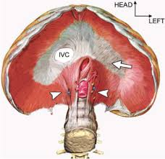
Diaphragm Rupture:

Slide 50
Management:
Intubation / mechanical ventilation needed for adequate oxygenation.
Operative repair indicated in all cases.
All penetrating diaphragmatic injuries repaired via abdomen and not chest, to rule out hollow viscus injury.

Slide 52
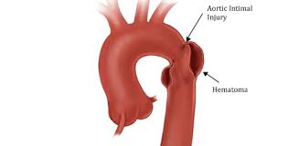
Aortic Tear:
Most common cause of immediate death
Motor-vehicle collisions or falls from heights
90% die immediately
The rupture is usually at the ligamentum arteriosum just distal to the left subclavian artery.
Clinical signs of traumatic aortic injury rarely present
Diagnosis based on high index of suspicion based on mechanism of injury, and imaging studies

Slide 53
Investigations:
Chest x-ray
CT scan
Aortography
Surgical Repair performed immediately due to fatal risk of haemorrhage

Slide 54
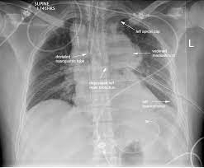
Findings on Chest Radiograph:
Suggestive of a Descending Thoracic Aortic Tear
1. Widened mediastinum
2. Loss of aortic contour
3. Tracheal shift to right
4. Nasogastric tube shift
5. Left apical cap
6. Depression of the left main bronchus
7. Elevation of right main stem bronchus.
8. Obliteration of the aorticopulmonary window
9.Left sided haemothorax Aortic Tear

Slide 55
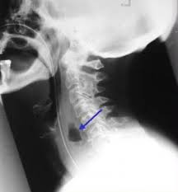
Oesophageal Rupture:
Most oesophageal injuries due to penetrating trauma
High index of suspicion necessary to diagnose

Slide 56
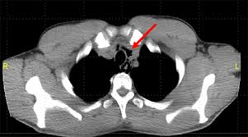
Odynophagia
Subcutaneous/Mediastinal emphysema
Pleural effusion
Air in retro-oesophageal sapce
Unexplained fever within 24hrs of injury

Slide 57
Management:
Mortality rate rises exponentially if treatment delayed for more than 12-24 hrs.
Chest xray
Oesophagogram & Oesophagoscopy confirm diagnosis
Treatment: Operative repair & Drainage

Slide 58
CXR:
Widened mediastinum
Bilateral airspace disease and pleural effusion
Left sided pleural effusion,
Subcutaneous emphysema
Pneumomediastinum
Left lower lobe atelectasis
Pulmonary edema

Slide 59
Complications of Chest injury:
Chest wall injury
Sucking wound & open pneumothorax
# ribs – pain, haemothorax,
flail chest, deformed chest, respiratory distress
Lung injury
Lung contusion, haemothorax, pneumothorax ( usually haemo- pneumothorax), empyema thoracis
Major air way injury
Surgical emphysema, massive pneumothorax

Slide 60
Complications of Chest injury:
Esophageal injury
Mediastinal sepsis, septicaemia, pneumothorax
Cardiac injury
Cardiac temponade, myocardial contusion/ laceration
Great vessel injury
Hypovolaemia, shock
Terminal complication
ARDS

Slide 61
Prognostic factors in chest injury:
Following features are associated with increased morbidity and mortality –
Extreme of age
Pre-existing pulmonary or cardiac disease
Previous chest surgery
Obesity
Deformity of the chest wall
Delay in managing hypoxia and hypotension
Overloading in fluid replacement

Slide 62
Conclusion:
Principal aims of treatment are control of hypoxia & hypotension
High degree of suspicion for avoid missing associated injuries
Simple measures if timely, and properly adopted will definitely save the life.
Knowledge of anatomy, respiratory physiology and
critical care gives vast account

Slide 63
MCQs:
Which injuries are considered life-threatening requiring immediate intervention?
a. Tension pneumothorax and pericardial tamponade
b. Cardiac contusion and rib fractures
c. Clavicle fracture and pulmonary contusion
d. Pneumomediastinum and subcutaneous emphysema

Slide 64
What is an early sign of tension pneumothorax?
a. Tracheal deviation
b. Respiratory distress
c. Increased cardiac output
d. Epistaxis

Slide 65
What is the immediate management of tension pneumothorax
a. Chest tube placement in 7th intercostal space
b. Place a three-sided dressing over chest tube site
c. Needle thoracentesis in 2nd intercostal space
d. ED thoracotomy

Slide 66
A nasogastric tube was inserted in a trauma patient. A follow-up chest radiograph shows abdominal contents in the chest cavity. The nurse should be suspicious of
a. Diaphragmatic rupture
b. Chylothorax
c. Pleural effusion
d. Tension pneumothorax

Slide 67
Thank you

