Slide 1
SYMPTOMATOLOGY OF MEDICINE
Dr Faran Maqbool
ASSISTANT PROFESSOR
Department of Medicine
RAWALPINDI TEACHING HOSPITAL

Slide 3
Learning Outcomes
Main symptoms and causes of following systems
Gastrointestinal system
Central nervous system
Endocrinology
Rheumatology

Slide 4
GASTROINTESTINAL SYSTEM
VERTICAL INTERGRATION
Abdominal pain
Jaundice
Heart burn/ acid regurgitation
Bleeding

Slide 5
ABDOMINAL PAIN

Slide 6
VERTICAL INTEGRATION
S ite
O nset
C haracter
R adiation
A lleviating factors
T iming
E xacerbating factors
S everity

Slide 7
Causes of abdominal pain
CORE CONCEPT

Slide 8
JAUNDICE

Slide 9
CORE CONCEPT
Duration
Dark urine / pale stools
Pruritis
Fever
Weight loss
Abdominal pain / change in bowel habits
Vomiting
I/V drug abuse / tattoos / alcohol intake / transfusion

Slide 10
Causes of jaundice
 | PRE HEPATIC | HEPATIC | POST HEPATIC
 | Due to excessive hemolysis | Impaired cellular uptake, defective conjugation or abnormal secretion of bilirubin by liver cell | Impaired excretion due to mechanical obstruction to bile flow
BILIRUBIN | Elevated unconjugated bilirubin | Elevated both conjugated and unconjugated bilirubin | Elevated conjugated bilirubin
URINE COLOR | normal | dark | dark
STOOL COLOR | normal | normal | pale
PRURITIS | no | no | yes
CAUSES | Hemolytic anemias ( spherocytosis, sickle cell anemia, G6PD deficiency) | Hepatitis A,B,C,E Alcoholic hepatitis Drug toxicity Autoimmune hepatitis | Primary biliary cirrhosis Primary sclerosing cholangitis Cholestatic hepatitis

Slide 11
HEART BURN / ACID REGURGITATION

Slide 12
VERTICAL INTEGRATION
Duration / frequency
Does it occur after meals or empty stomach ?
Pain relieved by antacids
Dysphagia

Slide 13
CAUSES
HORIZONTAL INTEGRATION
GERD
Fatty / spicy food
Smoking
Anxiety / stress
NSAIDS
Caffeine

Slide 14
BLEEDING
( hemetemesis, melena, hematochezia)

Slide 15
 | HEMETEMESIS | MELENA | HEMATOCHEZIA
DEFINITION | Passage of vomited material that contains frank blood or coffee ground vomitus | Passage of black , tarry stools | Passage of bright or dark red blood per rectum
LOCATION OF BLEEDING | Bleeding proximal to ligament of treitz | Bleeding distal to ligament of treitz | Colonic source
CAUSES | Peptic ulcer Esophageal varices Mallory weiss tear Esophageal carcinoma | Bleeding ulcers Esophageal varices Meckel’s diverticulum | Anal fissure Infectious colitis intussusception

Slide 16
EnDocrine system
HORIZENTAL INTEGRATION
Hyperthyroidism symptoms
Hypothyroidism symptoms
Diabetes mellitus

Slide 17
HYPERTHYROIDISM

Slide 18
HORIZONTAL INTEGRATION
Weight loss
Heat intolerance
Excessive sweating
Hand tremors
Nervousness
Diarrhea
Increased appetite

Slide 19
HYPOTHYROIDISM

Slide 20
CORE CONCEPT
Hair loss
Fatigue
Cold sensitivity
Constipation
Weight gain
Depression / mood swings
Poor memory

Slide 21
DIABETES MELLITUS

Slide 22
CORE CONCEPT
Polyuria
Polyphagia
Polydipsia
Weight loss or weight gain
Recurrent skin infections
Hypoglycemic episodes
Treatment and compliance
Complications ( eye , renal , neuropathy )

Slide 23
RHEUMATOLOGY

Slide 24
 | MONOARTHRITIS | OLIGO/PAUCI ARTHRITIS | POLYARTHRITIS
NO OF JOINTS INVOLVED | One joint involved | Less than 4 joints involved | ≥ 4 joints involved
EXAMPLES | Septic arthritis , Crystal induced arthritis | Septic arthritis, reactive arthritis, JRA | Rheumatoid arthritis, Osteoarthritis, ankylosing spondylitis

Slide 25
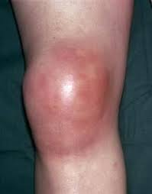
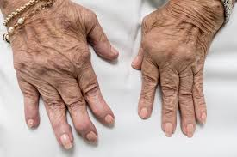
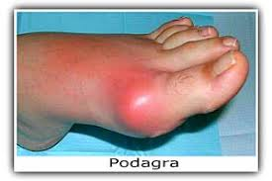
VERTICAL INTEGRATION

Slide 26
CNS
Headache
Fits
Weakness in limbs

Slide 27
HEADACHE

Slide 28
CAUSES
VERTICAL INTEGATIONR
Sinusitis
Migraine
Tension headache
Cluster headache

Slide 29
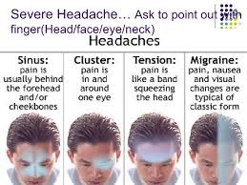
CORE CONCEPT

Slide 30
FITS

Slide 31
VERTICAL CONCEPT
How often have episodes occur
Any warning preceding fit ( aura )
Urinary incontinence
Tongue bite
Post ictal drowsiness

Slide 32
CAUSES
VERTICAL INTEGRATION
Epilepsy
Electrolyte imbalance
Post stroke epilepsy
Viral encephalitis
Brain tumors

Slide 33
WEAKNESS IN LIMBS ( PARALYSIS )

Slide 34
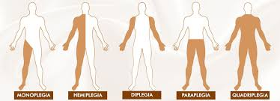
VERTICAL INTEGRATION
Hemiplegia ( half side of body )
Paraplegia ( both lower limbs )
Quadriplegia ( all 4 limbs )

Slide 35
CAUSES
CORE CONCEPT
Ischemic stroke
Hemorrhagic stroke
Cerebral venous sinus thrombosis
Cerebral palsy
Multiple sclerosis
Spinal cord injury

Slide 36
MCQs
SELF DIRECTED
1) Passage of vomited material that contains frank
blood or coffee ground vomitus is
a) hemoptysis
b) hemetemesis
c) melena
d) hematochezia
Key .b

Slide 37
2) Number of joints involved in oligiarthritis are
a) less than 2
b) less than 4
c) less than 6
d) less than 8
Key .b

Slide 38
3) Weakness involving both lower limbs is
a) hemiplegia
b) quadriplegia
c) paraplegia
d) diplegia
Key . c

Slide 39
4) A 35 year old woman presented with a 6 month history of amenorrhoea, diarrhoea, weight loss and palpitations. She had resting tachycardia and exophthalmos on examination. Likely diagnosis is ?
a) hypothyroidism
b) hyperthyroidism
c ) myxedema
d) anxiety
ANS .. b

Slide 40
5) Which of the following statements relating to abdominal pain are correct?
Movement tends to relieve the pain of perforation.
Renal colic has a relatively slow onset.
Peptic ulcer pain is characteristically exacerbated by vomiting.
Shock is a characteristic feature of gallstone colic.
Peritoneal inflammation may cause shoulder-tip pain.
ANS… e

Slide 41
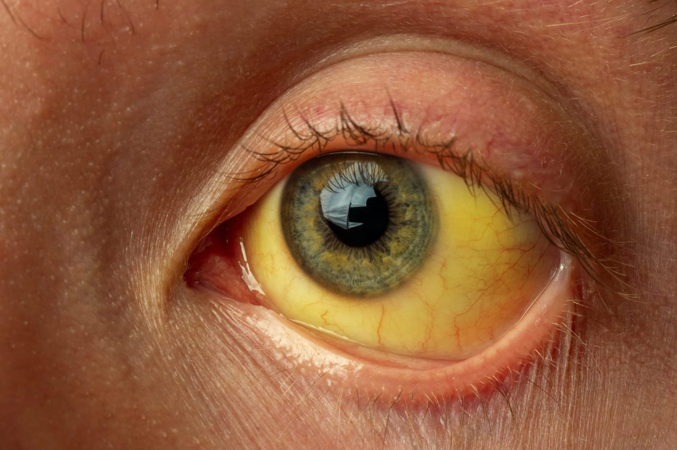
OSPE
A) what is the clinical finding in this picture ?
B) write down 2 causes of
this condition .
C) what other clinical
symptoms may be
associated with this
condition ?

Slide 42
Key
Ans : A) jaundice
B) acute viral hepatitis
Obstructive jaundice
C) dark colored urine
Pale stools
Nausea , vomiting , fever

Slide 43
SEQ
A 23 year old man presents with recurrent headaches. These typically occur 2 or 3 times a month and are characterized by severe, right sided headaches which are throbbing in nature and last around 8- 12 hours . When he gets the headaches he finds it hard to carry on working and tends to go and lie down in a dark room .
a) What is the likely diagnosis?
b) What points in the history of patient favors your diagnosis ?
c) Based on history how this type of headache can be differentiated from headache due to sinusitis?

Slide 44
THANK YOU

