Slide 2
Strabismus (squint)
Dr. Sidra Jabeen
MBBS, FCPS Ophthalmology,
FCPS Pediatric ophthalmology
Assistant Professor, HFH,RMU

Slide 3
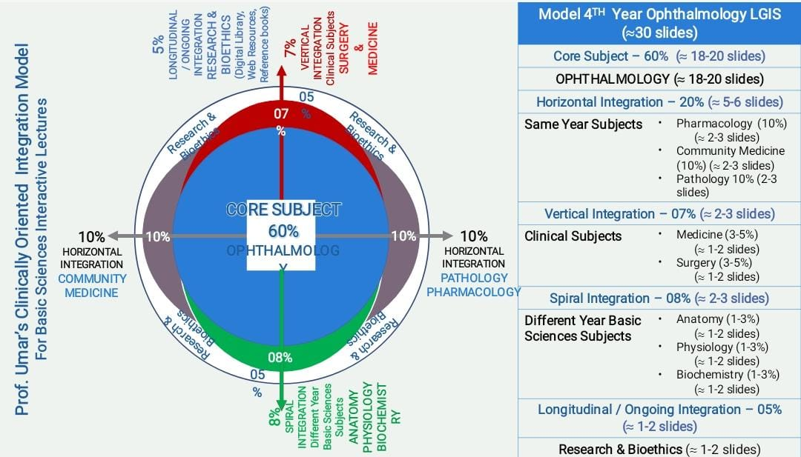
Contents:
Learning objectives
Anatomy, physiology and pathophysiology of orbit, muscles and strabismus
Strabismus evaluation and management
Recent research about strabismus
Artificial intelligence and squint
End of lecture assessment

Slide 4
Learning objective:
At the end of lecture students will be able to:
define strabismus
classify different types of strabismus
outline examination and investigation of strabismus
enlist various treatment options including surgical procedure

Slide 5
Content
Definition
Visual and orbital axes
Orthophoria
Types of strabismus
Psuedo strabismus
Heterophoria
Heterotropia
Paralytic squint

Slide 6
Strabismus
Core Subject
Definition
The misalignment of the visual axes of two eyes is called squint or strabismus

Slide 7
Binocular single vision
Core Subject
Definition
Ability to use both eyes simultaneously with bifoveal fixation to form single image

Slide 8
Binocular single vision
Core Subject
Grades
Grade 1- Simultaneous perception
Grade 2- Fusion
Unified single perception of an object in two dimensions(height and width)
Grade3- Stereopsis
Unified single perception of an object in three dimensions(height, width and depth)

Slide 9
Binocular single vision
Core Subject
Anamolies of BSV
When BSV breaks down ,following things occur:
1-Confusion
Appreciation of two dissimilar images, one on top of other
Caused by stimulation of corresponding retinal elements (usually fovea) by different object
2-Pathologic diplopia
Appreciation of a single object as two images
Caused by stimulation of non-corresponding retinal elements by same object

Slide 10
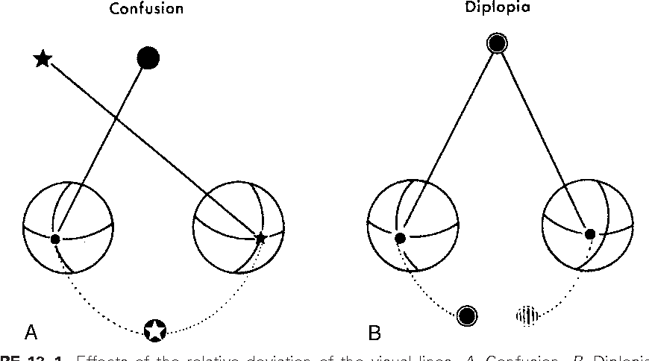

Slide 11
Binocular single vision
Core Subject
Sensory adaptations to strabismus
Suppression
Abnormal retinal correspondence
Motor adaptations to strabismus
Abnormal head posture

Slide 12
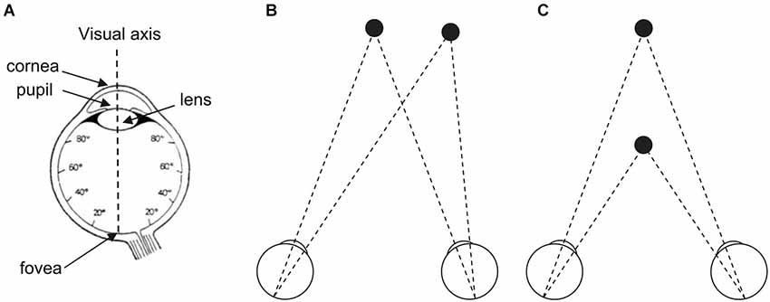
Core Subject
Visual axis
An imaginary line which joins fovea with the object of regard
In normal eyes, the visual axes of two eyes intersect at the point of fixation

Slide 13
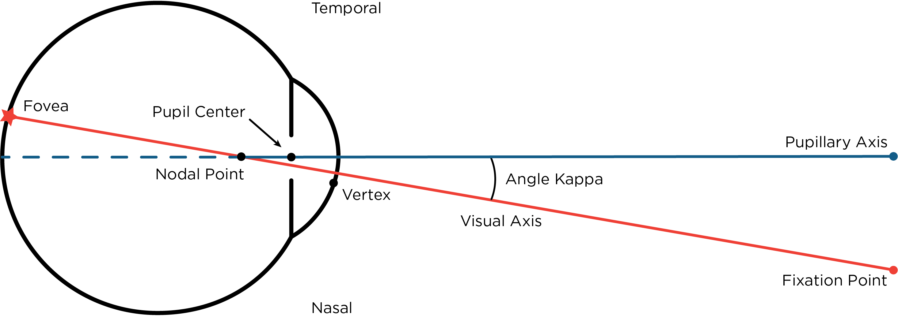
Optical axis

Slide 14
Corneal light reflex

Slide 15
Core Subject
Orbital axis
The lateral and medial walls of orbit make an angle of 45 degrees with each other, the orbital axis therefore forms an angle of 22.5 with both medial and lateral walls
Visual axis
Orbital axis

Slide 16
Assessment of strabismus
Core Subject
Hirschberg test
Cover/ uncover test
Alternate cover test
Prism cover test
Extraocular movements
Versions
ductions

Slide 17
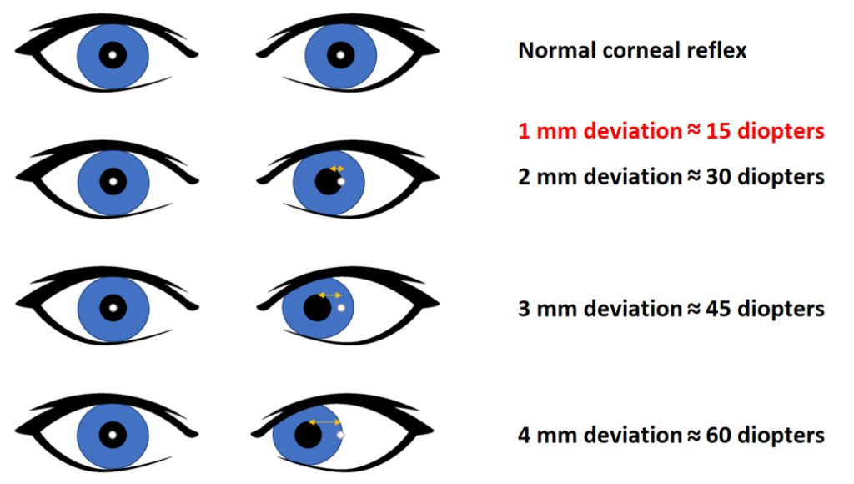
Hirschberg test
Core Subject

Slide 18
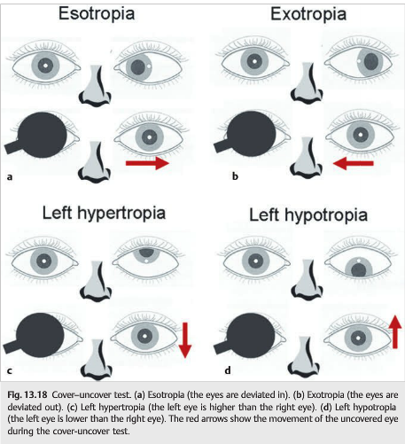
Cover/uncover test
Core Subject

Slide 19
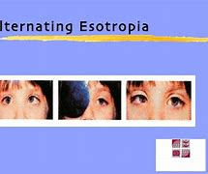

Slide 20
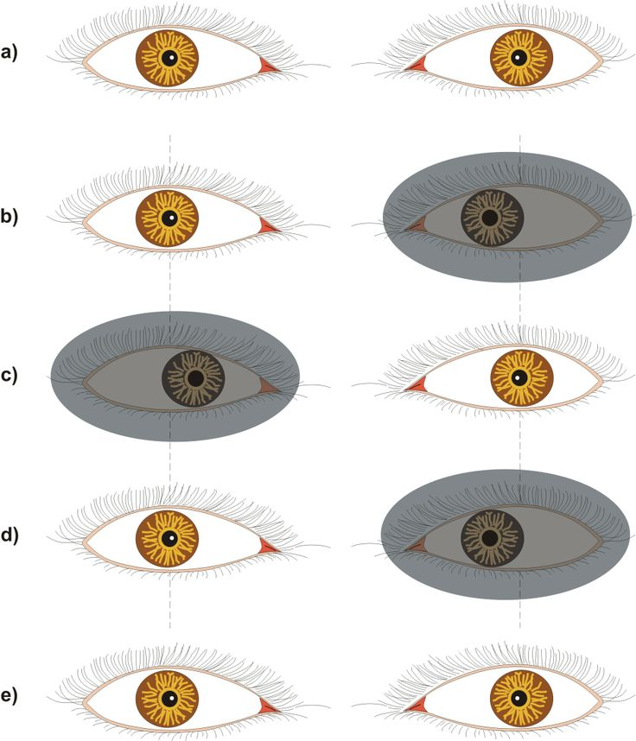
Alternate cover test
Core Subject

Slide 21
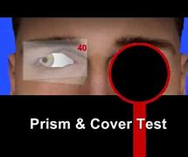
Prism cover test
Core Subject

Slide 22
Strabismus
Core Subject
Orthophoria
Perfect ocular alignment in the absence of any stimulus for fusion

Slide 23
Types of Strabismus
Core Subject
Heterophoria
Heterotropia
Psuedo-strabismus

Slide 24
Psuedo-strabismus
Core Subject
Definition
Clinical impression of ocular deviation when no squint is present
Examples :
1-Prominent epicanthic folds
2-Abnormal interpupillary distance

Slide 25
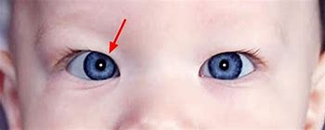
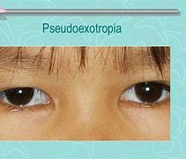
Core Subject

Slide 26
Heterophoria
Core Subject
Definition
Tendency of eyes to deviate, which is kept latent by fusion mechanism
Latent squint
Esophoria
Tendency for inward deviation
Hypermetropes
Exophoria
Tendency to deviate outwards
Myopes
Younger age group
Older age group
Types

Slide 27
Heterophoria
Core Subject
Diagnosis
Alternate cover test
Detects presence of phoria
Maddox rod test
Detects phoria for distance
Maddox wing test
Detects phoria for near

Slide 28
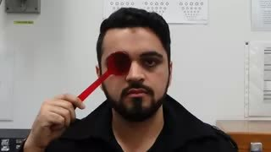
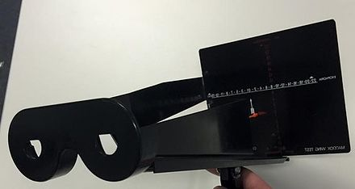
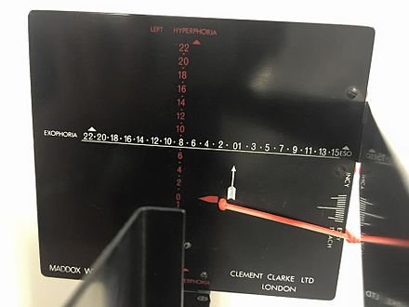
Heterophoria
Core Subject
Maddox rody
Maddox wing

Slide 29
Heterophoria
Core Subject
Treatment
Orthoptic exercises in case of convergence weakness
Incorporation of Fresnel prisms into spectacles
Surgery for larger deviations when phoria becomes decompensated
Correction of refractive error

Slide 30
Heterotropia
Core Subject
Definition
Manifest deviation in which visual axes don’t intersect at the point of deviation
Manifest squint

Slide 31
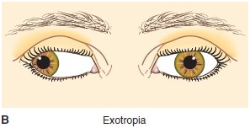
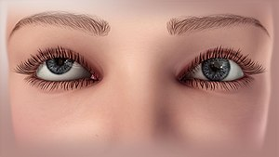
Heterotropia
Core Subject
Exotropia
Hypertropia
Esotropia

Slide 32
Heterotropia
Core Subject
Types
comitant
non- comitant
Infantile
Refractive errors
Paralytic
Nerve palsies
myopathies e.g; myasthenia gravis
restrictive
Thyroid eye disease

Slide 33
Core Subject
Comitant squint
angle of deviation of squinting eye remains same in all directions of gaze
no limitation of ocular movement.

Slide 34
Core Subject
Comitant squint
Esotropia
Exotropia
Vertical Squint
infantile esotropia
accomodative esotropia
refractive
non-refractive
Intermittent
Constant

Slide 35
Esotropia
Core Subject

Slide 36
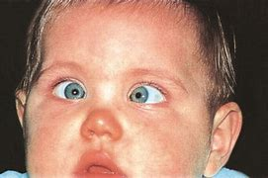
Infantile esotropia
Core Subject
Onset– 6months of life
Large angle
Alternate
Cross fixation
Minimal refractive error
DVD and IOOA

Slide 37
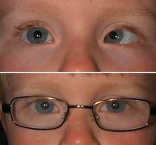
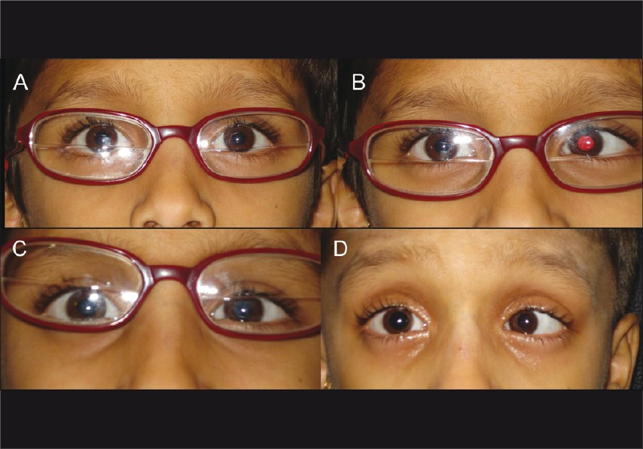
Accommodative esotropia
Core Subject
AC/A ratio– 3-5PD
Refractive
Rx– glasses
Non refractive
Rx–
bifocals
surgical

Slide 38
Exotropia
Core Subject

Slide 39
Types/Etiology of Exotropia
Core Subject
Intermitent Exotropia
Constant Exotropia
Consecutive Exotropia

Slide 40
Management of Squint
Core Subject
Refraction
Occlusion therapy for amblyopia
Surgery

Slide 41
Surgery
Core Subject
Muscle Strengthening Procedures
Muscle Weakening Procedures

Slide 42
Muscle Strengthening Procedures
Core Subject
Resection
Advancement
Tucking

Slide 43
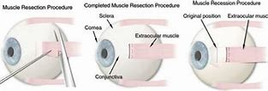
Core Subject

Slide 44
Muscle Weakening Procedures
Core Subject
Recession
Myectomy
Myotomy
Botox Injection
Posterior Fixation Suture

Slide 45
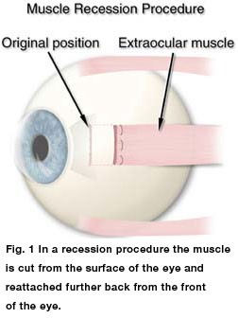
Core Subject

Slide 46
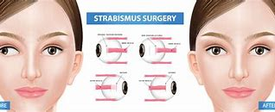
Core Subject

Slide 47
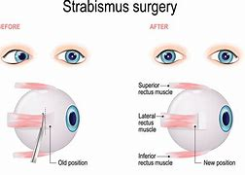
Core Subject

Slide 48
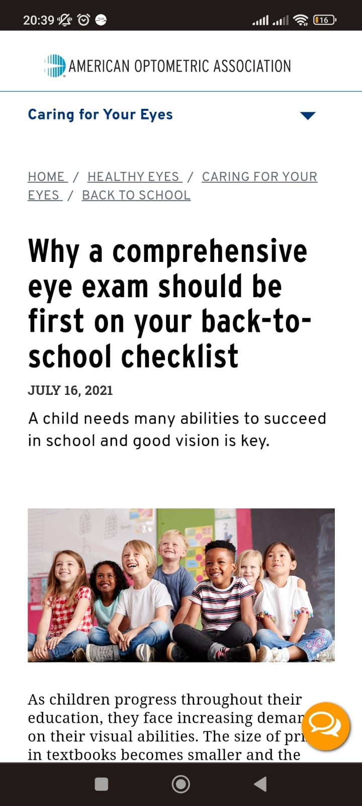
Eye Examination in Schools
Horizontal Integration
An early diagnosis of strabismus is important in order to rule out treatable organic causes in children.
It is advised that eye camps can be arranged at school levels to check for vision and deviation in eyes so that these children can be referred to an ophthalmologist early on for better treatment outcomes.
https://www.aoa.org/healthy-eyes/caring-for-your-eyes/back-to-school?sso=y

Slide 49
Recent research:
Core Subject
According to journal of AAPOS weekend atropine topical drops can improved visual acuity in amblyopic squinted eye in age group of 3-12 years
It can be a good alternative to patching and avoid compliance of patching.

Slide 50
Artificial intelligence and Squint:
Core Subject
A cross sectional study done at Zhongshan Ophthalmic Center of Sun Yat-sen University An AI platform consisting of three deep learning (DL) systems was used for strabismus diagnosis, angle evaluation, and operation plannings based on corneal light-reflection photo.
It was 99% accurate for diagnosis and 95% accurate for evaluation of degree of squint.
Hence AI is becoming a useful tool for screening of early squint cases.

Slide 51
EOLA( END OF LECTURE ASSESSMENT)
Core Subject
A 2 YEARS OLD CHILD WAS BROUGHT TO OPD BY HIS MOTHER WITH COMPLAINT OF INWARD DEVIATION OF HIS RIGHT SINCE 3 MONTHS OF HIS LIFE.ON EXAMINATION ANGLE OF DEVIATION WAS EQUAL IN EACH GAZE OF EYE.HIRSCHBERG WAS AT PUPILLARY MARGIN. DEFINE TYPE AND DEGREE OF SQUINT.

Slide 52
References:
Core Subject
Kanski clinical ophthalmology, strabismus, 728-771
Basic ophthalmology by Renu Jogi
Mao K, Yang Y, Guo C, Zhu Y, Chen C, Chen J, Liu L, Chen L, Mo Z, Lin B, Zhang X, Li S, Lin X, Lin H. An artificial intelligence platform for the diagnosis and surgical planning of strabismus using corneal light-reflection photos. Ann Transl Med. 2021 Mar;9(5):374. doi: 10.21037/atm-20-5442. PMID: 33842595; PMCID: PMC8033395.

