Slide 1
Strabismus
Dr Sidra Jabeen
MBBS,FCPS ophthalmology
FCPS Pediatric Ophthalmology & Strabismus
Assistant Professor Ophthalmology dept
Holy Family Hospital, RMU

Slide 2
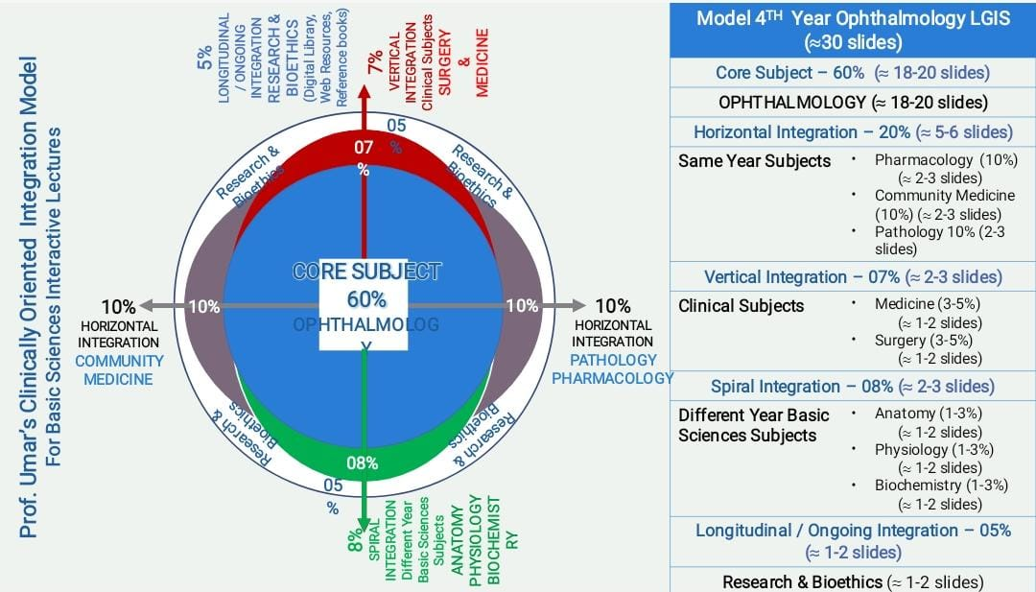
SEQUENCE OF LECTURE
VERTICAL INTEGRATION
HORIZONTAL INTEGRATION
CORE SUBJECT
EOLA (END OF LECTURE ASSESSMENT)
DIGITAL LIBRARY REFERENCES (RESEARCH, BIOETHICS, ARTIFICIAL INTELLIGENCE.)

Slide 3
Learning Objectives
At the end of this session, student will be able to
Recall the anatomy of eye and extraocular muscles
Describe the Ocular movements
Define the Laws of ocular motility
Describe Binocular single vision
Describe Amblyopia, its types, and treatment options.

Slide 4
Extraocular Muscles
Vertical Integration
6 extraocular muscles in each eye:
A pair of horizontal recti
Medial rectus
Lateral rectus
A pair of vertical recti
Superior rectus
Inferior rectus
A pair of oblique muscle
Superior oblique
Inferior oblique

Slide 5
Origin or rectii
Vertical Integration
Annulus of Zinn

Slide 6
Insertions of rectii
Vertical Integration
Spiral of tillaux

Slide 7
Horizontal Recti
Vertical Integration
Medial rectus
Origin: Annulus of zinn at the orbital axis
Insertion:5.5mm away from nasal limbus on sclera in front of equator
Lateral rectus
Origin : annulus of zinn at orbital axis
Insertion:6.9mm behind temporal limbus on sclera in front of equator

Slide 8
Vertical recti
Vertical Integration
Superior rectus
Origin: annulus of zinn
Insertion:7.7mm behind superior limbus on sclera in front of equator
Inferior rectus
Origin :annulus of zin
Insertion :6.5mm behind inferior limbus on sclera in front of equator

Slide 9
Oblique Muscles
Vertical Integration
Superior oblique
Origin : superomedial aspect of optic foramen, moves forward along medial wall of orbit to reach trochlea where its converted into tendon
Insertion :after passing thru trochlear pulley, moves lateral and backward to get inserted into superotemporal quadrant of sclera behind the equator
Inferior oblique
Origin: small depression just behind orbital rim lateral to lacrimal sac
Insertion: moves lateral and backward to get inserted into inferotemporal aspect of sclera behind equator

Slide 10
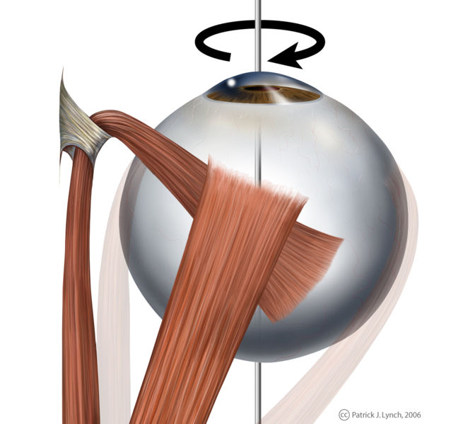
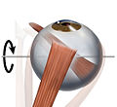
Vertical Integration
Oblique muscles

Slide 11
Innervation of extraocular muscles
Vertical Integration
Lateral rectus: 6th cranial nerve
Superior oblique: 4th cranial nerve
Other extraocular muscles along with levator palpebrae superioris , ciliary muscle and sphincter pupillae: 3rd cranial nerve (oculomotor nerve)

Slide 12
Actions of Extraocular Muscles
Core Subject
Primary action: main action of muscle when eye is in primary position
Subsidary action: additional effects which depend upon different eye positions
 | Main action | Subsidiary actions
Medial rectus | Adduction
Lateral rectus | Abduction
Superior rectus | Elevation | Intorsion | Adduction
Inferior rectus | Depression | Extorsion | Adduction
Superior oblique | Intorsion | Depression | Abduction
Inferior oblique | Extorsion | Elevation | Abduction

Slide 13
Ocular Movements
monocular
ductions
binocular
version
vergences

Slide 14
Ocular Movements
Core Subject
Ductions
Uniocular movements
Tested by occluding the fellow eye
Adduction | Gaze to nasal side
Abduction | Gaze to temporal side
Supraduction | Upgaze
Infraduction | Downgaze
Incycloduction (intorsion) | Sup. pole of cornea moves medially
Excycloduction (extorsion) | Sup. pole of cornea moves laterally

Slide 15
Ocular Movements
Core Subject
Versions
Binocular, simultaneous, conjugate movements-in the same direction so that angle between two eyes remains constant

Slide 16
Ocular Movements
Core Subject
Vergence
Binocular,simultaneous, disjugate movements-in opposite directions so that angle between two eyes changes
Convergence | simultaneous adduction of two eyes ; may be voluntary or reflex
Divergence | Outward movement from a convergent position

Slide 17
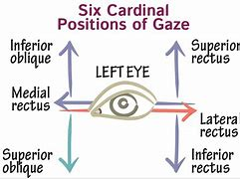
Positions of gaze
Core Subject
6 Cardinal positions of gaze

Slide 18
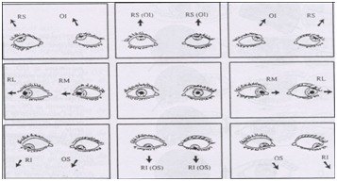
Positions of Gaze
Core Subject
9 diagnostic positions of gaze
Primary position, upgaze, downgaze and 6 cardinal positions

Slide 19
Ocular Motility
Core Subject
Agonist –antagonist
Muscles of same eye that move eye in opposite direction
The agonist is primary muscle moving eye in a given direction
The antagonist moves eyes in opposite direction to agonist
E.g right lateral rectus is antagonist to right medial rectus
Synergists
Muscles of same eye that move eyes in same direction
E.g right superior rectus and right inferior oblique synergistically elevate eye

Slide 20
Ocular Motility
Core Subject
Yolk muscles
Contralateral synergists
Pair of muscles ,one in each eye that produce conjugate ocular movements
E.g yolk muscle of left superior rectus is right inferior oblique and vice versa
E.g yolk muscle of left lateral rectus is right medial rectus and vice versa

Slide 21
Laws of ocular motility
Core Subject
Sherington law of reciprocal innervation
Increased innervation to an extraocular muscle is accompanied by decrease in innervation of its antagonist
Applies to both versions and vergences
E.g contraction of medial rectus leads to relaxation of lateral rectus
Hering law of equal innervation
During any conjugate movement, equal and simultaneous innervation flows to the yolk muscles

Slide 22
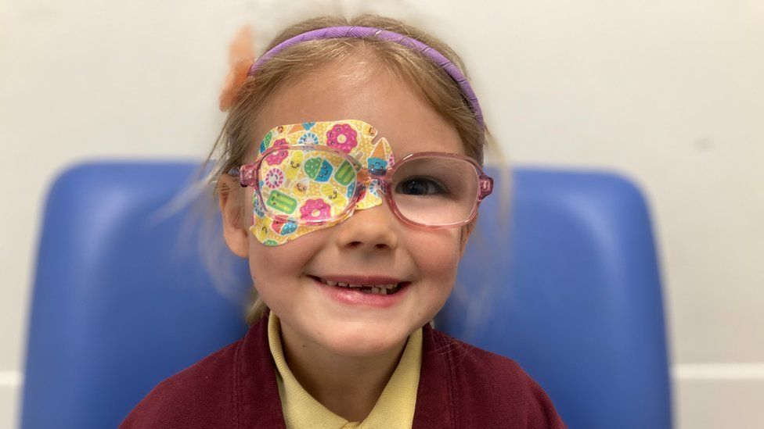
Amblyopia
Core Subject
Definition
It is unilateral or rarely bilateral decrease in best corrected visual acuity for which there is no identifiable organic cause in the eye or visual pathway
monocular: >2 snellens line difference between both eyes
binocular: binocular VA < 20/40

Slide 23
Clinical features
No organic ocular pathology
<BCVA
Pinhole test shows no improvement in vision
Crowding phenomenon: VA in amblyopes is better while reading single letters than letters

Slide 24
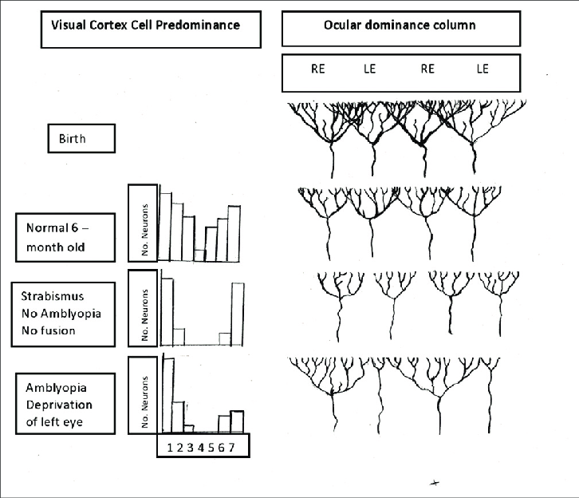
Pathophysiology of amblyopia

Slide 25
degrees of amblyopia
Mild: >20/40 VA
Moderate: 20/40-20/100
Severe: <20/100

Slide 26
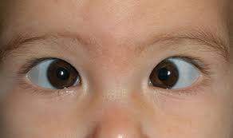
Types of amblyopia
Core Subject
Strabismic amblyopia
It occurs in unilateral squint when there is prolonged monocular suppression of deviating eye

Slide 27
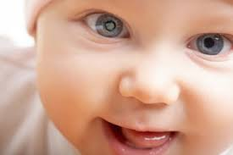
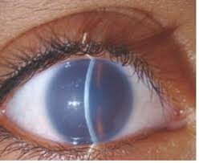
Types of Amblyopia
Stimulation deprivation amblyopia
Results from vision deprivation in early life
Unilateral or bilateral
Caused by opacities in media (e.g cataract) or complete ptosis or corneal opacity

Slide 28
Types of Amblyopia
Anisometropic amblyopia
Caused by difference in refractive errors between two eyes
the more ametropic eye receives a blurred image
Hypermetropia | +1D
Myopia | -3D
Astigmatism | ±1.5D

Slide 29
Types of Amblyopia
Core Subject
Bilateral ametropic amblyopia
Results from high symmetrical refractive error
Hypermetropia | >+5D
Myopia | >-10D
Astigmatism | ±2.5D

Slide 30
Types of Amblyopia
Astigmatism/meridional amblyopia
Results from image blur in one meridian
Caused by uncorrected astigmatism of more than 1 diopter persisting beyond period of emmetropization in early childhood
Unilateral or bilateral

Slide 31
Prognosis

Slide 32
Treatment of Amblyopia
Core Subject
1. Clear visual axis; e.g cataract extraction or ptosis surgery in cases of stimulus deprivation amblyopia
2. Correction of refractive error

Slide 33
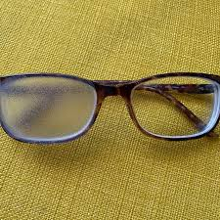
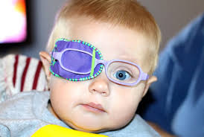
Treatment of Amblyopia
Core Subject
3. Correction of ocular dominance
patching
Penalization of normal eye

Slide 35
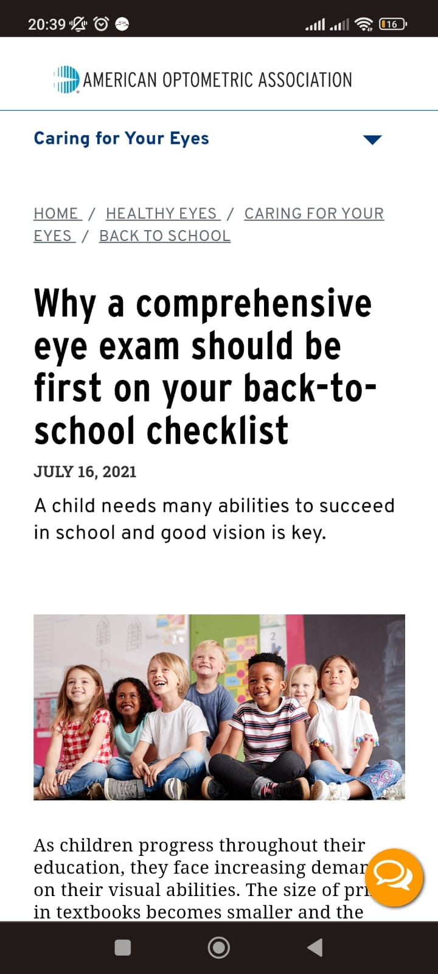
Eye Examination in Schools
Horizontal Integration
An early diagnosis of strabismus is important in order to rule out treatable organic causes in children.
It is advised that eye camps can be arranged at school levels to check for vision and deviation in eyes so that these children can be referred to an ophthalmologist early on for better treatment outcomes.
https://www.aoa.org/healthy-eyes/caring-for-your-eyes/back-to-school?sso=y

Slide 36
ETHICS AND RESEARCH
https://jduhs.com/index.php/jduhs/article/view/723/1757

Slide 37
ARTIFICIAL INTELLIGENCE
https://www.ncbi.nlm.nih.gov/pmc/articles/PMC8033395/

Slide 38
END OF LECTURE ASSESSMENT (EOLA)
A 5 years old child was brought to you by her mother with complaint of decreased vision as noticed by his teacher. On examination he has visual acuity of 6/6 in right eye and 6/60 in left eye. Left eye has esotropia of 30 degree. His both fundus are unremarkable on examination. What could be the possible cause of his decrease vision and what treatment would you advice?

Slide 39
REFERENCES
Kanski clinical ophthalmology, strabismus 728-771
Basic ophthalmology by Renu Jogi

